Slide 1
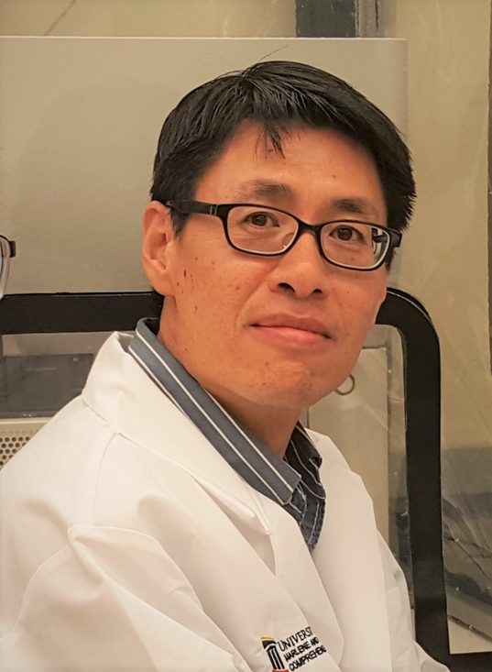
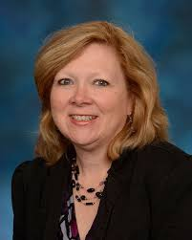


UMGCCC Flow Cytometry Shared Service
Xiaoxuan Fan, PhD
Director
XiaoxuanFan@som.umaryland.edu
Karen Underwood, MS
Kunderwood@som.umaryland.edu
Bryan Hahn, BS
BryanHahn@som.umaryland.edu
Lab: BRB 7-022, (410) 706-2173
Staff: flowcore@som.umaryland.edu
Link to Flow Lecture and Resources
Notes:
1

Slide 2
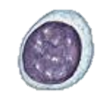


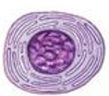

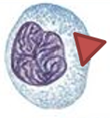
Markers & CDs : Specific proteins on cells that help identify their “lineage”
Rather than rely on “morphology”, use defined MOLECULAR features !!
Mixture of cells
Marker:
e.g. CD4
Anti-CD4 mAb
Dye
CD8
+
Anti-CD8 mAb
Dye
Notes:
Some important Lineage Markers :
T cells = TCR and CD4 or CD8, CD3
B cells = BCR (surface IgM or IgG) and CD19 o B220
NK cells = NK1.1, DX5
Dendritic cells = CD11c
There are different type of immune cells. To distinguish them, rather then just rely on morphology, we can use molecular features because each cell type express specific proteins. We use these markers to identify their lineage.
Let’s look at the T cells, some express CD4, CD8. They have similar morphology but different functions. To study them separately, we stain the cells with fluorescence tagged antibodies to CD4 or CD8. Then by reading the color, we can figure out CD4 CD8 T cells.
Flow cytometry is an important tool to identify different immune cell subsets.

Slide 3
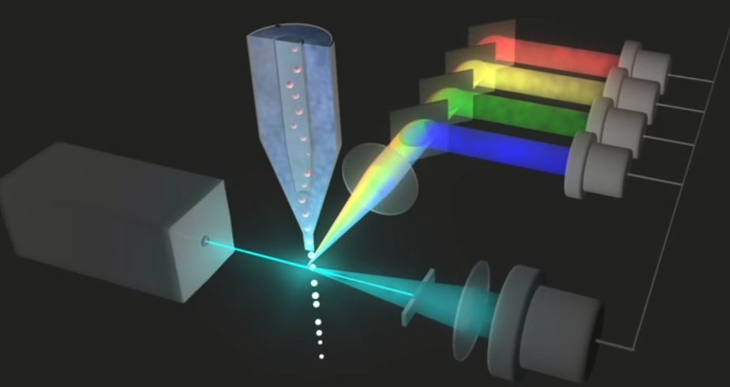
Flow Cytometry

Slide 4
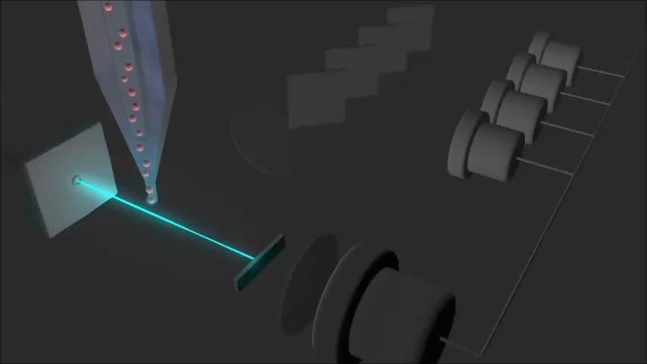

Slide 5
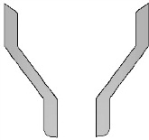
Fluidics Schematic
Sample
Pressure
(Variable)
Waste
Tank
Sheath
Tank
Sheath
Pressure
(Constant)
Vacuum
Line Pressure
Notes:
Next, let’s look the inside of the cytometer. The sheath fluid comes from sheath tank, go through flow cell, then collected in waste tank. The sheath fluid is under constant pressure. On top of this sheath pressure, additional pressure is applied to the sample, so that sample can flow into the flow cell. The sample differential pressure is adjustable, that is how we control the flow rate.

Slide 6
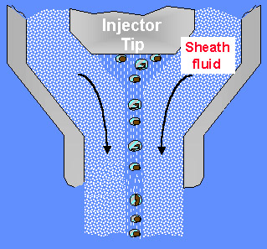
Flow Cell
Hydrodynamic
Focusing
Laser
From Purdue University Cytometry Laboratories
Notes:
To make accurate measurement, the cells must be measured one at a time, in other words, they must travel single-file in the stream. The method to achieve this is Hydrodynamic focusing. In the flow cell, a slow-moving sample stream is injected into the faster-moving sheath stream. By surface tension and laminar flow, the sample stream is brought into a narrow faster moving stream and travel single file.

Slide 7
High flow rate
Core Stream
Wide core stream
Faster sample rate
More coincident events
Increased abort rate
Cells are not all excited equally
LASER LIGHT

Slide 8
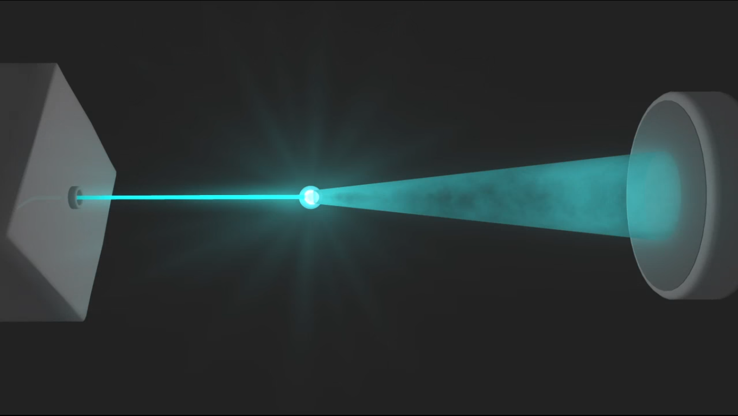
Forward Scatter (FSC)

Slide 9
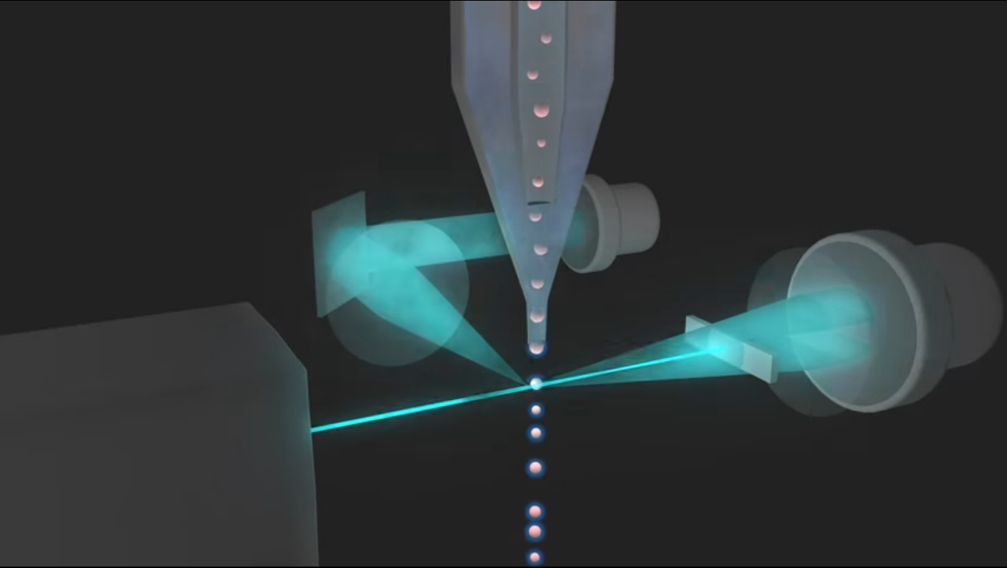
Side Scatter (SSC)

Slide 10
Side Scatter
refracted and reflected light
granularity and internal complexity
Forward Scatter
defracted light
cell size
Light Source

Slide 11

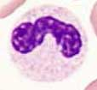

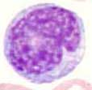

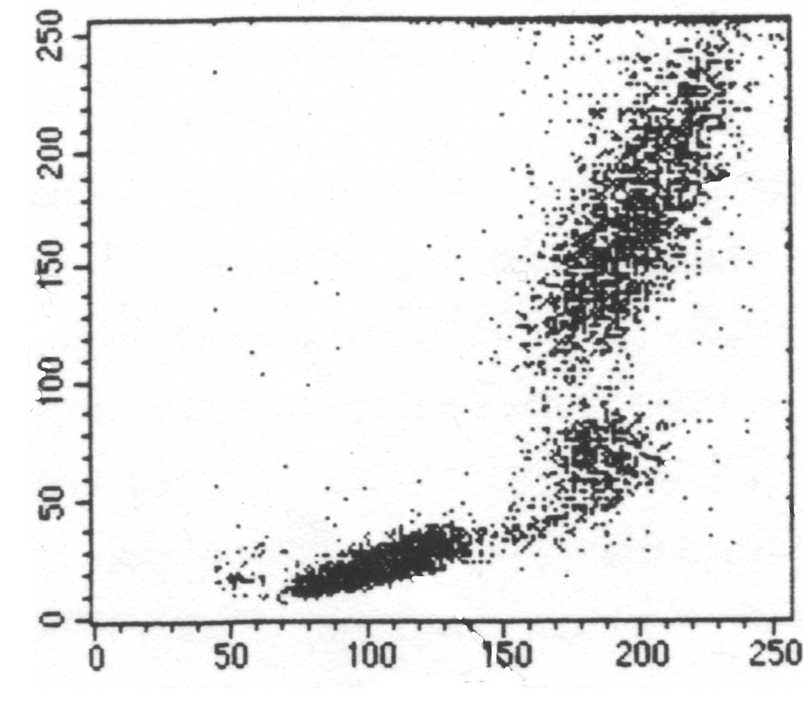

Scatter Plot
Granulocytes
Lymphocytes
SSC
Monocytes
RBCs
Debris
FSC
Notes:
Different type of cell has its unique scatter property. In this scatter plot, we can see several populations.
FSC is not a precise way to measure the size of the cell.

Slide 12
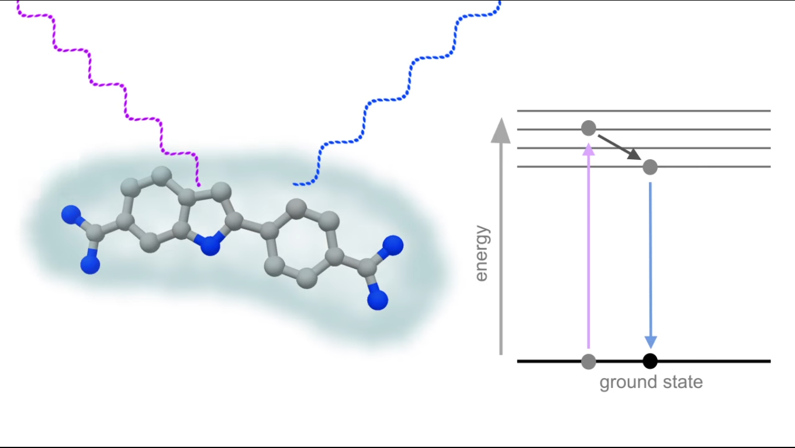
Fluorescence
excitation
emission
Ex.
Em.

Slide 13
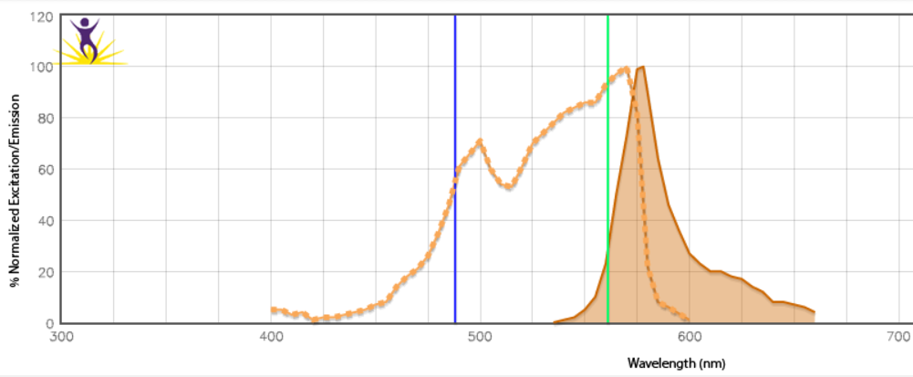
PE Spectra

Slide 14
Photons In ~ Voltage Out
PMT
Linear
Amplification
Current
Voltage
Voltage
Log
Amplification
Time
PMT Voltage Input
150V-999V
Notes:
The detectors collect light and convert them to current. The current go through lin or log amp and is transformed into vol. For each event, in the end, we get a vol pulse.
The current can be amplified by the voltage applied to the detector, so the detector is also called PMT.

Slide 15
Measurements of the Pulse
Height
Voltage Intensity
Width
Area
Time
Notes:
15

Slide 16
Histogram
Event # | Param 1 FSC | Param2 SSC | Param 3 FITC | Param 4 PE
1 | 100 | 500 | 10 | 650
2 | 110 | 505 | 700 | 700
3 | 90 | 480 | 720 | 670
4 | 95 | 490 | 15 | 720
Data Format: FCS files
Cell Counts
10⁰ 10¹ 10² 10³ 10⁴
FITC

Slide 17
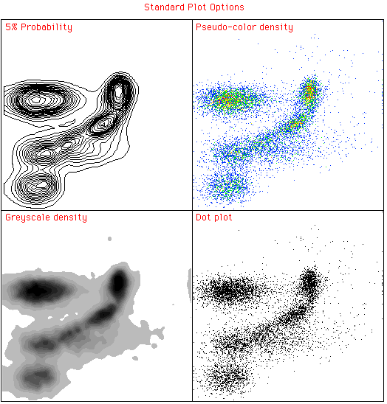
Plots
Contour Plot
Density Plot
Greyscale Density
Dot Plot

Slide 18
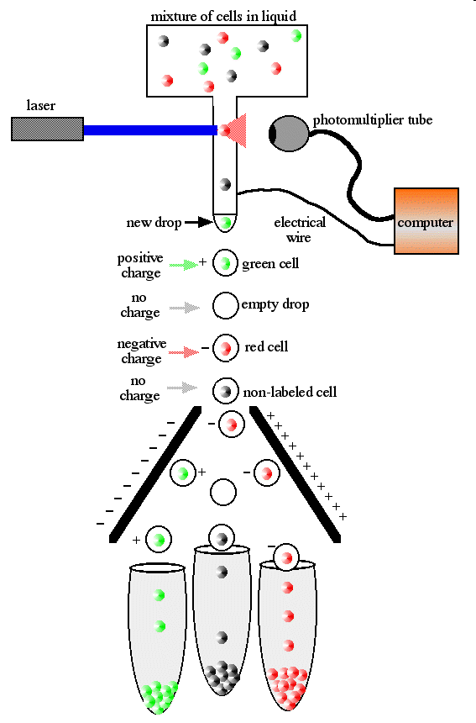
Cell Sorting
Notes:
This is a method to isolate HIGHLY PURE population of cells (or bacteria or particles) based on very specific combination of markers !

Slide 19
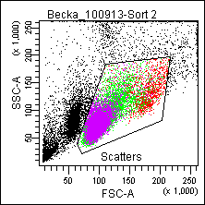
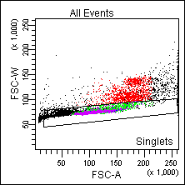
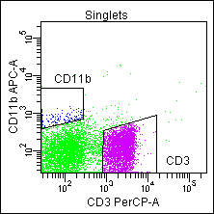
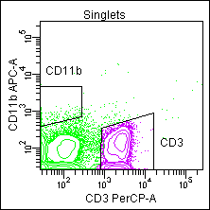
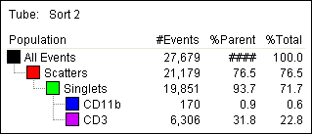
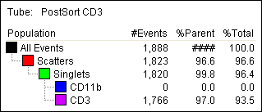
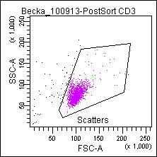
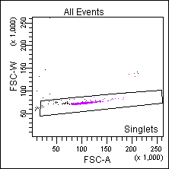
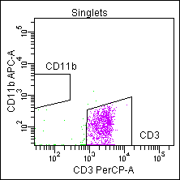
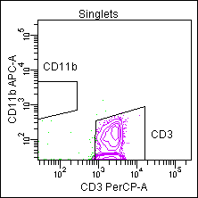
Mouse splenocytes sorted on Aria II
32%
97%
Notes:
Introduce gate

Slide 20
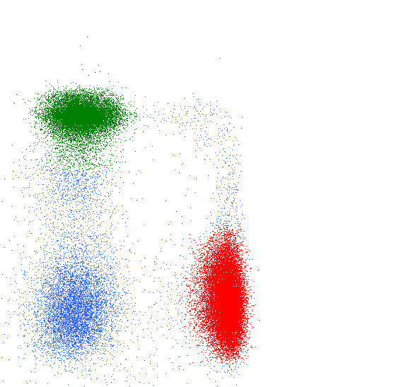
Data you get
% from parent
What is the relative abundance of the cells ?
MFI -- Median Fluorescence Intensity
Co-expression
(based on gating analysis)
How much marker is on the cell ?
Population median; but can be a surrogate for single cell expression
6
CD8
10
Double
5
10
CD8
4
10
3
10
CD4
3
-10
3
3
4
5
6
-10
0
10
10
10
10
CD4

Slide 21
Terminologies
FACS -- Fluorescence-activated cell sorting
Analyzer vs Cell sorter
Use fluorochrome name FITC, PE instead of green, red
Spillover and Compensation
Notes:
Explain spillover

Slide 22
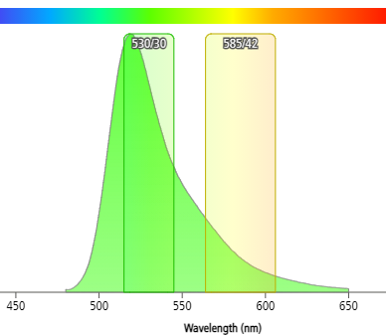
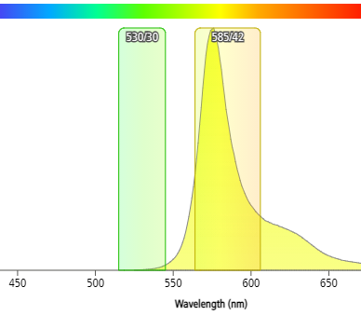
Spillover and Compensation
FITC
PE
FITC
PE
FITC
PE
FITC alone
PE should have no signal
Real PE= Measured-Spillover
PE alone
FITC should have no signal
Real FITC = Measured-Spillover
y% FITC
x% PE

Slide 23
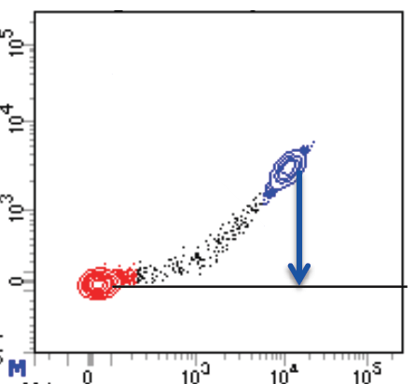
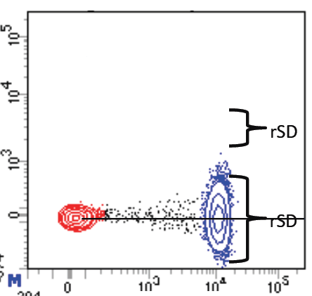
Compensation
No compensation
Compensated
PE
PE
FITC
FITC
Notes:
23
This is FITC single color staining. As you can see the fitc signal spills over PE channel. By adjusting comp, we can bring this population down, so that the median of the fitc pos population is the same as neg. After the comp, fitc pos population appears more spread in pe channel. This is because the measurement error occurs at the high log range. Comp makes it more apparent. This spread makes the detection of double pos population more difficult.

Slide 24
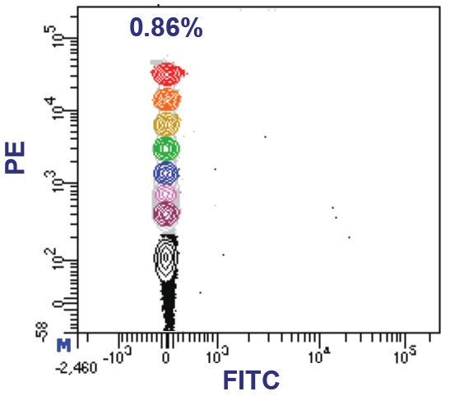
PE Spillover FITC very little
PE

Slide 25
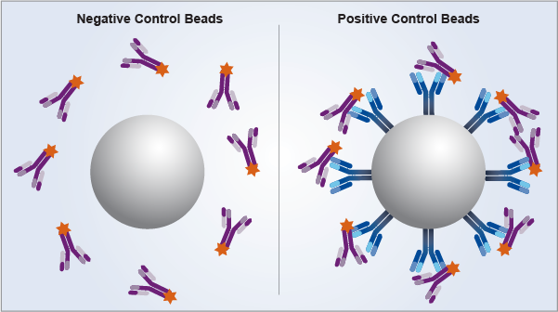
Compensation Beads
Antibody Capture Beads, save cells and get good positive staining
Not for viability dyes: PI, fixable viability dyes
Keep PMT settings same as cell samples
(exception: FSC/SSC, nothing to do with compensation)
Not for antibody titration
Not perfect, sometimes changes spectrum
Species specific
ThermoFisher Ultracomp eBeads
  Cat# 01-2222-42

Slide 26
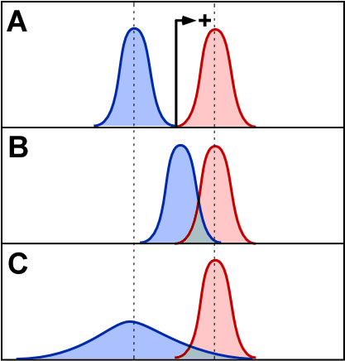
Positive vs. Background
“Negative”
Population
Positive
Population
Low
Non-specific staining
Autofluorescence
High
Spectral overlap
(compensation)
High CV
Notes:
26
With low bg, the positive population is well resolved.
The spread of the neg population can come from the compensation.
High bg decrease the resolution.
Hi bg can come from non-spe of the ab. So it is very important to titrate your ab. Use just enough amount to saturate the ag.

Slide 27
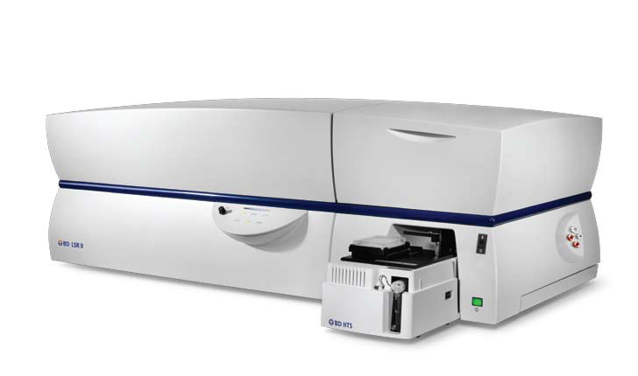
LSR II

Slide 28
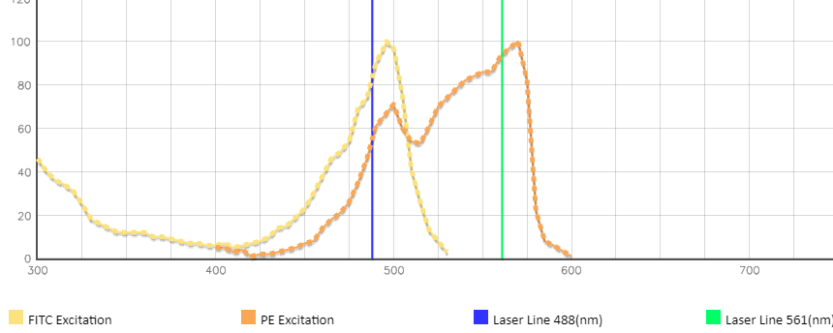
Sequential laser interrogation
FITC
PE
Laser path
Notes:
Laser beams are spatially separated. To assign the signals generated on different lasers to a particular cell, the variable called "laser delay" is used. Laser delay represents the time, which one particle spends on its way from primary laser to another laser.

Slide 29
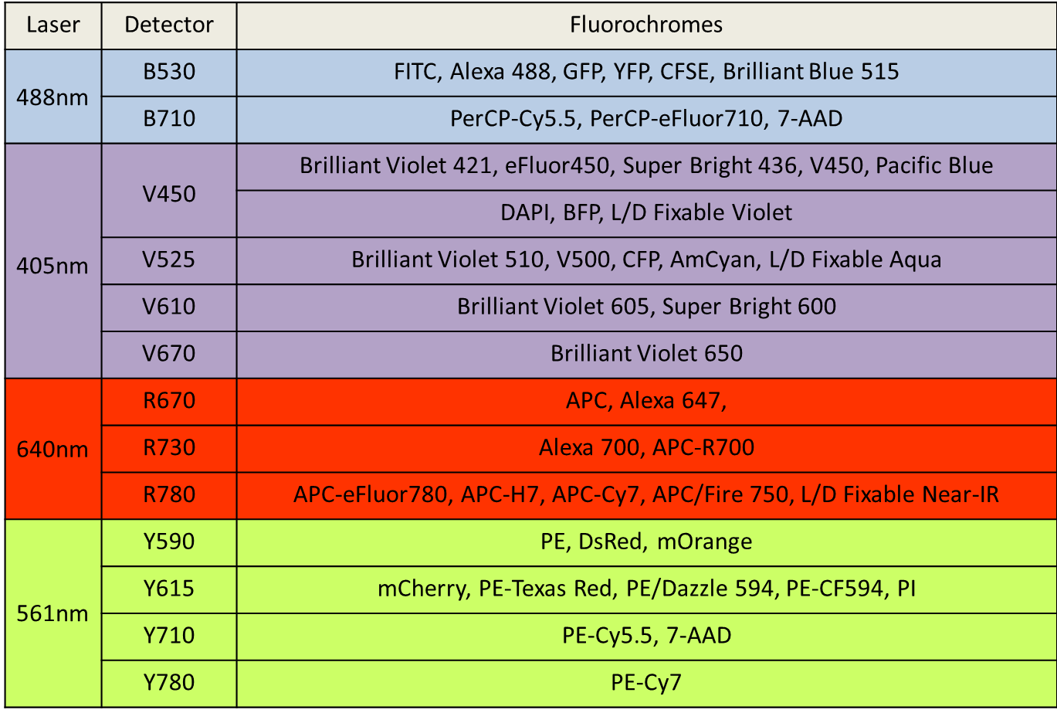
LSR II - 4 lasers, 13 colors

Slide 30
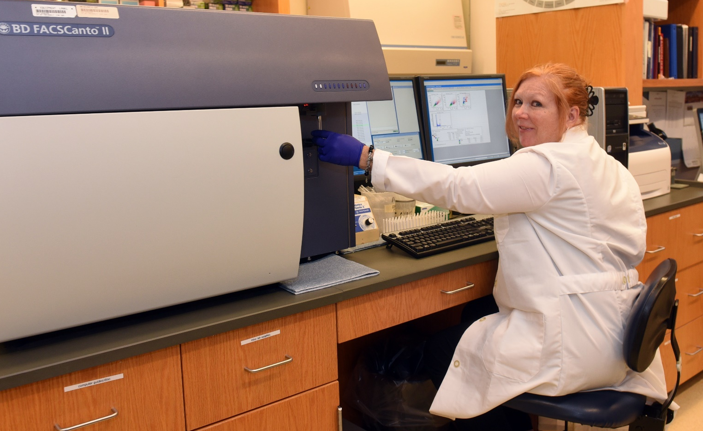
Canto II - 2 lasers, 6 colors

Slide 31
Canto II - 2 lasers, 6 colors
Laser
Detector
Alternative Fluorochromes
Blue 488 nm
FITC
Alexa 488, Brilliant Blue 515, GFP, YFP, CFSE
PE
PE, PI, RFP
PerCP-Cy5.5
PerCP-eFluor 710, PE-Cy5.5, PI, 7-AAD
PE-Cy7
Red
633 nm
APC
Alexa 647, TO-PRO-3
APC-Cy7
APC-H7, APC-eFluor 780, APC/Fire 750

Slide 32
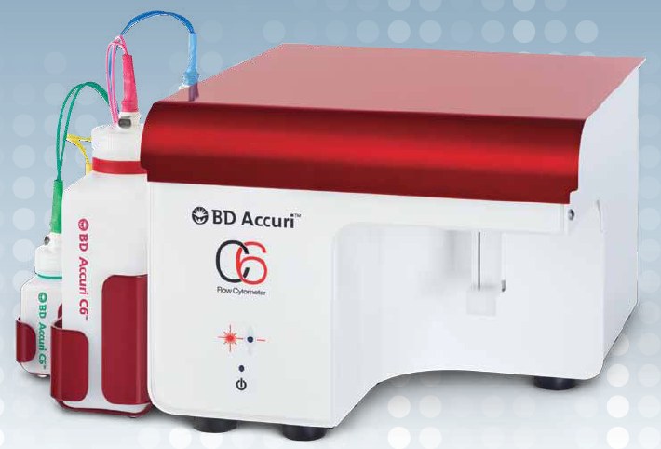
Accuri C6 - 2 lasers, 4 colors
Located at HSF II, S107, Dr. Civin lab.
Min Jung Kim, mjkim@som.umaryland.edu, 6-1218

Slide 33
Accuri C6 - 2 lasers, 4 colors
Laser
Detector
Alternative Fluorochromes
Blue 488 nm
FITC
Alexa 488, Brilliant Blue 515, GFP, YFP, CFSE
PE
PE, PI, RFP
PerCP-Cy5.5
PerCP-eFluor 710, PE-Cy5.5, PI, 7-AAD, PE-Cy7
Red
633 nm
APC
Alexa 647, TO-PRO-3

Slide 34
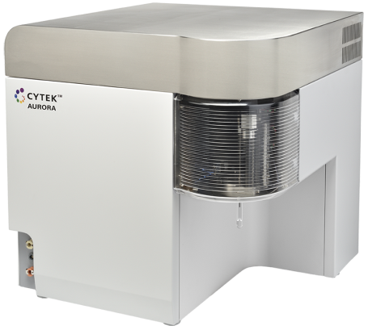
Cytek Aurora Spectral Cytometer
4 lasers
355, 488, 407, 640 nm
over 30 colors
violet laser blue laser red laser
Notes:
It is time to go Spectral. Cytek Aurora, it has only 3 laser, but can detect over 20C, including some overlapping colors. Compensation must be horrible, right?

Slide 35
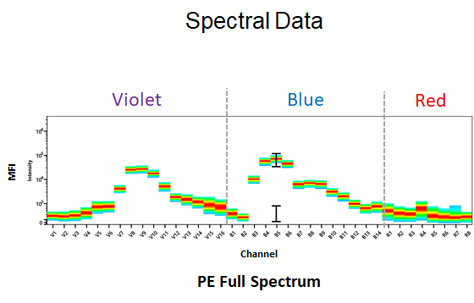

Slide 36
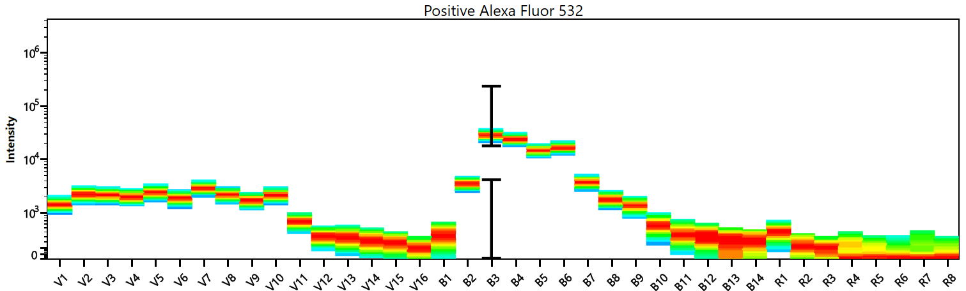
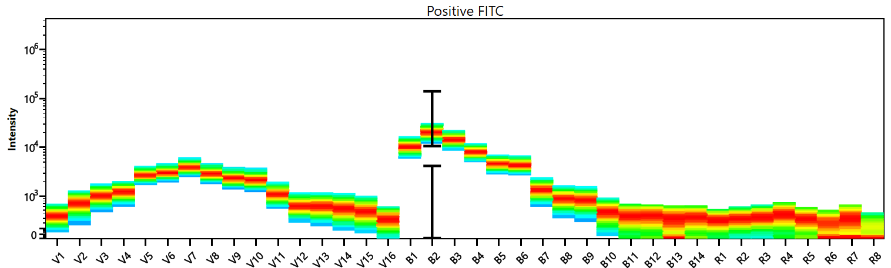
Alexa 532
FITC
Notes:
It actually uses a different approach. It uses 38 detectors to record the whole spectrum of each color. For each single color we record the spec, then use this signature to unmix them in multicolor. Yes, this is called unmixing, finally I can get away from the word compensation.
This is FITC and A532’s sepectrum, emission peak overlaps significantly, but their signature is different in other areas, we can use it to unmix.

Slide 37
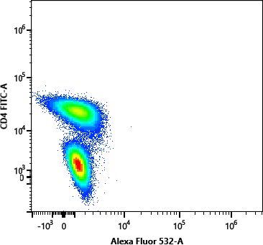
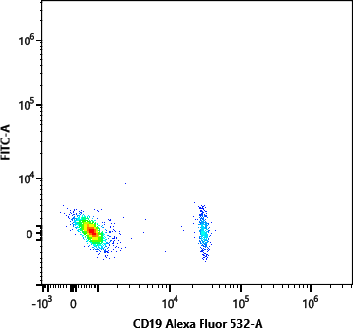
FITC and Alexa 532 unmixed
FITC
Alexa 532
Notes:
Do not expect magic here, population still spread out a little, but consider these two colors are not even possible to distinguish on LSR.
A532 is actually a very good color in spectral cytometer, does not interfere with other commonly used colors.

Slide 38
LSR II 13 color Spillover Spreading Matrix (SSM)
 | BV421 | BV510 | BV605 | BV650 | FITC | PE | PE-Dazzle | PE-Cy5 | PCP-Cy5.5 | PE-Cy7 | APC | AF700 | APC-Fire
BV421 | from\into | 0.5 | 0.6 | 0.5 | 0.3 | 0.3 | 0.1 | 0.5 | 0.6 | 0.5 | 0.3 | 0.3 | 0.1
BV510 | 0.8 |  | 5.2 | 4.8 | 1.3 | 1.3 | 0.6 | 1.0 | 0.9 | 0.8 | 1.3 | 1.2 | 1.2
BV605 | 0.5 | 0.3 |  | 6.9 | 0.5 | 2.3 | 3.1 | 1.3 | 1.9 | 1.6 | 0.6 | 0.5 | 0.8
BV650 | 0.7 | 0.0 | 2.1 |  | 0.2 | 0.3 | 0.5 | 0.7 | 1.0 | 1.0 | 0.7 | 1.4 | 0.8
FITC | 0.2 | 0.4 | 0.3 | 0.7 |  | 0.1 | 0.3 | 0.4 | 0.3 | 0.3 | 0.4 | 0.3 | 0.6
PE | 0.1 | 0.1 | 1.6 | 1.4 | 0.5 |  | 4.8 | 1.4 | 3.1 | 1.5 | 0.5 | 0.4 | 0.1
PE-Dazzle | 0.1 | 0.2 | 2.7 | 2.2 | 0.4 | 5.9 |  | 2.3 | 5.9 | 2.6 | 0.9 | 0.8 | 0.5
PE-Cy5 | 0.1 | 0.1 | 0.3 | 4.2 | 0.2 | 1.1 | 0.9 |  | 15.4 | 8.5 | 4.0 | 5.8 | 2.9
PCP-Cy5.5 | 0.4 | 0.3 | 0.8 | 3.0 | 0.7 | 0.2 | 0.3 | 2.2 |  | 3.5 | 1.2 | 3.4 | 2.1
PE-Cy7 | 0.1 | 0.1 | 0.2 | 0.3 | 0.1 | 0.3 | 0.2 | 0.3 | 0.7 |  | 0.0 | 0.2 | 1.2
APC | 0.4 | 0.4 | 0.9 | 4.2 | 0.5 | 0.3 | 0.3 | 1.9 | 3.7 | 4.3 |  | 7.8 | 3.9
AF 700 | 0.5 | 0.4 | 0.8 | 1.1 | 0.6 | 0.3 | 0.2 | 1.1 | 2.0 | 4.3 | 0.5 |  | 4.1
APC-Fire | 0.5 | 0.3 | 0.1 | 0.4 | 0.2 | 0.2 | 0.6 | 0.2 | 0.5 | 7.2 | 0.2 | 1.2
Showing spillover from y to x
Notes:
Reference: Nguyen, R., Perfetto, S., Mahnke, Y. D., Chattopadhyay, P., Roederer, M. 2013. Quantifying spillover spreading for comparing instrument performance and aiding in multicolor panel design. Cytometry A, 83(3): 306-315

Slide 39
Aurora 13 color SSM
 | BV421 | BV510 | BV605 | BV650 | FITC | PE | PE/Dazzle | PE-Cy5 | PCP-Cy5.5 | PE-Cy7 | APC | AF 700 | APC-Fire
BV421 | From\into | 1.1 | 0.5 | 0.5 | 1.1 | 0.5 | 0.8 | 0.4 | 0.4 | 0.1 | 0.1 | 0.3 | 0.3
BV510 | 0.4 |  | 3.2 | 2.1 | 1.9 | 1.6 | 0.9 | 1.0 | 1.1 | 0.2 | 0.3 | 0.2 | 0.2
BV605 | 0.6 | 0.4 |  | 3.6 | 0.9 | 1.2 | 1.4 | 1.5 | 1.5 | 0.5 | 0.6 | 0.3 | 0.2
BV650 | 1.1 | 0.2 | 1.9 |  | 0.8 | 0.5 | 0.3 | 1.6 | 2.0 | 0.4 | 1.2 | 0.8 | 0.7
FITC | 0.3 | 1.1 | 0.7 | 0.5 |  | 2.7 | 1.6 | 1.1 | 0.6 | 0.3 | 0.3 | 0.1 | 0.3
PE | 0.4 | 1.3 | 2.7 | 1.7 | 0.7 |  | 4.0 | 2.8 | 1.6 | 0.7 | 0.8 | 0.6 | 0.1
PE/Dazzle | 0.2 | 0.6 | 3.1 | 2.0 | 1.0 | 3.9 |  | 3.9 | 2.5 | 1.0 | 1.3 | 0.9 | 0.2
PE-Cy5 | 0.1 | 0.3 | 0.8 | 3.4 | 0.5 | 0.8 | 1.2 |  | 4.2 | 2.3 | 2.8 | 1.9 | 1.1
PCP-Cy5.5 | 0.9 | 1.5 | 0.6 | 2.8 | 0.7 | 0.2 | 0.8 | 4.1 |  | 3.1 | 1.3 | 2.1 | 1.8
PE-Cy7 | 0.3 | 0.3 | 0.2 | 0.3 | 0.5 | 0.6 | 0.3 | 0.8 | 1.0 |  | 0.2 | 0.4 | 2.4
APC | 0.5 | 0.8 | 0.3 | 2.0 | 0.9 | 0.4 | 0.1 | 1.2 | 0.9 | 0.3 |  | 2.1 | 1.6
AF 700 | 0.4 | 0.2 | 0.3 | 0.4 | 0.9 | 0.4 | 0.5 | 0.6 | 1.0 | 0.6 | 0.6 |  | 2.5
APC-Fire | 0.3 | 0.4 | 0.4 | 0.2 | 0.2 | 0.1 | 0.5 | 0.5 | 0.6 | 0.8 | 0.4 | 0.7

Slide 40
Aurora - 23 Color Panel
Spillover Spreading Matrix (SSM)
Live/dead: 7-AAD for fresh samples
Zombie NIR for fixation after stain

Slide 41
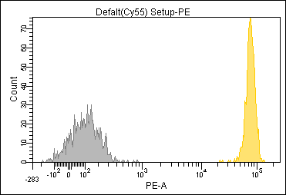
Stain Index:
The brightness is a function of the
  Reagent
    Antigen density, fluorochrome used.
  Instrument
    PMT gain setting, laser power
Brightness
Width of negative
The width of the negative is a function of
  Instrument performance
  Spillover (multi-color panels)
Notes:
Spread is measured by a metric called SI. It was developed by David Parks at Stanford University a number of years ago, and it takes into account these two concepts. First of all, you look at the MFI and what you’re looking at there is the difference between the brightness of these two populations. So, the difference is the positive versus the negative. And this difference can be due to a variety of factors. It can be due to the fluorochrome brightness, which we talked about in the first lecture. IT can be due to the antigen density, which we talked about in the second lecture. So you can see how these concepts all come together. It can also be due to factors with respect to the instrument…the pmt voltage.
The second part of the equation, the bottom half, is due to the spread of the negative population. And the spread of the negative population is due to a number of factors including those associated with the instrument that we’ll talk about greatly, and the second half of the talk will deal with fluorescence spillover because that’s the other major source of the spread.

Slide 43
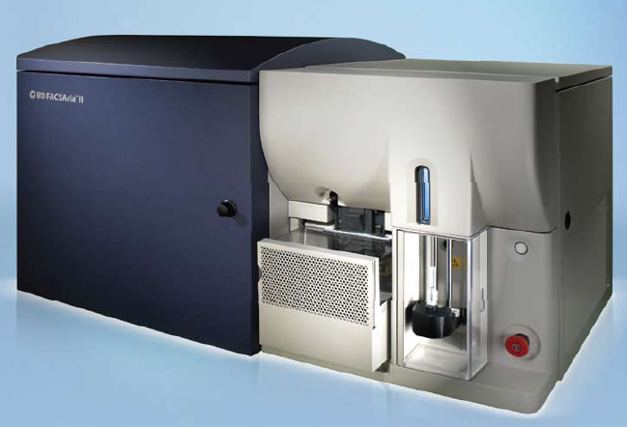
BD FACSAria II

Slide 44
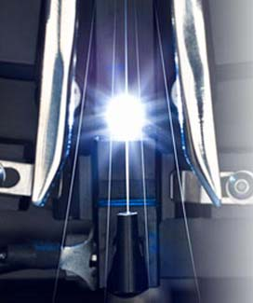

4 way sorting into tubes
Single cell sorting for cloning

Slide 45


10 d
The sorted single GFP positive cell grows into a colony. GFP is lost due to transient transfection.

Slide 46

Aria II

Slide 47


Slide 49
CD34: stem cells
Gamma-H2AX:
DNA double-strand breaks
20x Magnification
Resolution: 1 um/pixel
Notes:
human acute myeloblastic leukemia KASUMI-1 cell line

Slide 50

MACSQuant® Analyzer 10
Compliance with FDA 21 CFR Part 11, ready for clinical studies
Express Modes automate analysis of flow experiments via predefined experiment settings
QC for CAR T cell production in the F.A.C.T. lab, open to other labs too.
Staff run only
3 lasers, 8 colors
Notes:
Fannie Angelos Cellular Therapeutics Lab

Slide 51
Hourly Rates
 | Accuri | Canto | LSR | Aurora | Aurora UV | FlowSight | Aria | MACSQuant
Acad. | $30 | $40 | $60 | $60 | $75 | $60 | $100 * | 120 **
Industry | X | $70 | $90 | $90 | $105 | $90 | $150 * | 190 **
Staff assisted run, additional $60/h
* $50 set up fee for each sort

Slide 52


Data Analysis
FCS Express 7 site license
No charge to flow core users
Email Karen for instructions
FlowJo dongles
PC and Mac dongles can be borrowed at no charge.
Purchase site license through IHV flow core

Slide 53



Other Flow Cores
CVD
Marcelo Sztein
Mass Cytometry
2 Fluidigm CyTOF Helios mass cytometers
Simultaneous detection of 50 metal-labeled antibodies
IHV
Yutaka Tagaya
BSL-3 cell sorting
FlowJo Site License

Slide 54

iLab Online Booking
cibr.umaryland.edu

Slide 55


Slide 56



Slide 57
Biosafety
Sorting generates cell containing aerosols
Sort BSL-1 materials at BSL-2 facility
Sort BSL-2 materials at BSL-2 enhanced facility.
Bio-Bubble hood on Aria II sorter - BSL-2 enhanced practice.
Masks, lab coat, gloves required
Hands on training, one on one.
Aurora can share screen to other users.
After training, email Karen for card access.

Slide 58
Flow Cytometry Controls
Matching unstained cells
Single color cells
  compensation
  setting the gate
Fluorescent minus one (FMO)
Isotype controls
  CD14-PE, mouse anti-human, IgG1k
  Isotype control: IgG1k-PE
PE
FITC
Notes:
58

Slide 59

Detector configurations on our cytometers
Fluorochromes spectrum, brightness
Multicolor panel builder
Antibody search engine, database across over 20 vendors

Slide 60

Canto II Configuration

