Slide 1
Tools and Technologies for Pluripotent and Adult Stem Cells
Mark J. Powers, Ph.D.
Senior Director, R&D
Mohan C. Vemuri, Ph.D.
Director, R&D
Primary and Stem Cell Systems

Slide 2

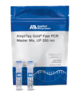
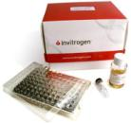
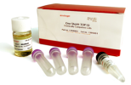
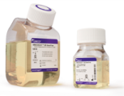

Profile of Life Technologies
(approximately)
1
Revenue
$3.6B
Products
50,000
Countries
160
Employees
9,000
Customers
75,000
Patents, licenses
3,900
Note: 1) LTM revenue as of Feb 3, 2011

Slide 3



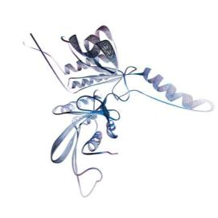
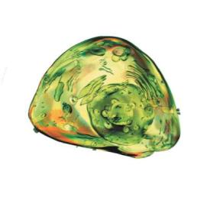
Offering the Broadest Product Portfolio
DNA & RNA
Sequence
Gene Function
Cells
Life Technologies offers products across the entire biological spectrum
Notes:
3

Slide 4

Primary Cells and Stem Cells
“Modeling Life… Enabling Cures”
Transform science
Key Disease Focus
Relevant Cell Types
Offer innovative, relevant cell systems that…
Better represent in vivo systems
Reduce effort and variability in cell culture
Enable safer, effective and personalized medicine
Developmental Biology
ESCs
iPSCs
Cosmetics/ Wound healing
Keratinocytes
Fibroblasts
Blood stem cells
Primary and Stem
Cell Systems
Metabolic Disease/ Obesity
Hepatocytes
Beta islets
Fat cells/ fat stem cells
Neuro-degenerative
Neurons
Neural Stem cells
Basic Research
Discovery & Development
Cell
Therapy
Glial Cells
ADME/ Tox
Liver Cells
Cardio-myocytes
Core Technology Platforms
MSCs
Age related wear & tear
Bone, muscle, cartilage
Corneal

Slide 5

Cell Systems Tools
Design tools to enhance the performance of primary and stem cell systems
Workflow:
make it easier
simplify
streamline
reduce time
de-mystify
consistent
modular
etc..
media/
reagents
Function:
make it better
relevance
authenticity
reliability
cell health
performance
etc.
cells
matrix/
substrate
assay

Slide 6
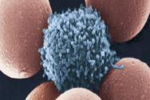
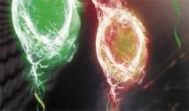
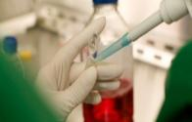
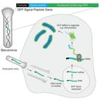


Tools: Workflow
1. Cell Health
Cell Biology Researcher Workflow
Isolate
Characterize
Expand
Engineer
Differentiate
Preserve

Slide 7
iPSC Workflow
Somatic Cells
Culture-Expand
Reprogram
Characterize
Isolate
Culture-Expand
Characterize
Differentiate
Cryopreserve
Characterize
Isolate
Culture-Expand
Engineer
Cryopreserve

Slide 8
Cell Systems Tools
Workflow:
make it easier
simplify
streamline
reduce time
de-mystify
consistent
modular
etc..
Function:
make it better
relevance
authenticity
reliability
cell health
performance
etc.

Slide 9
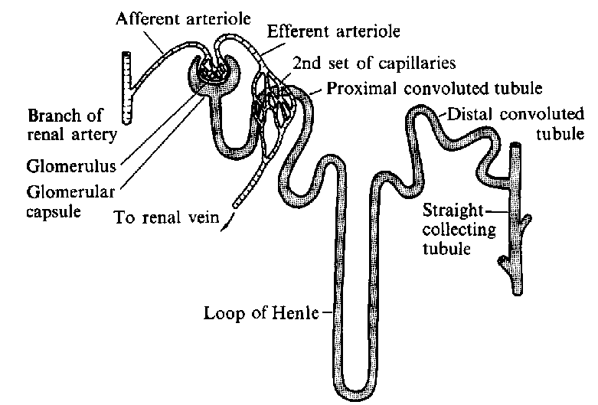
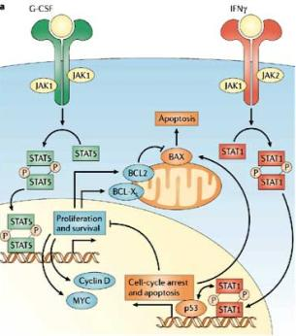
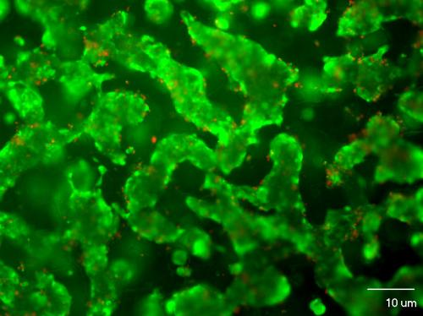
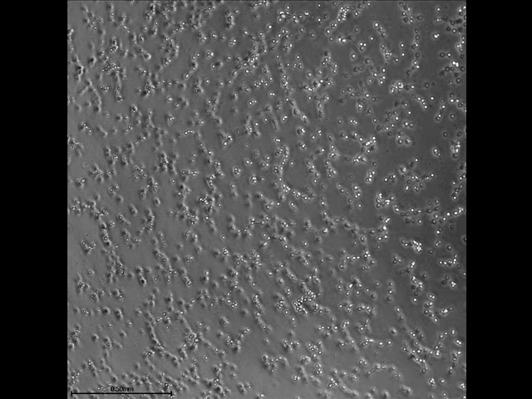
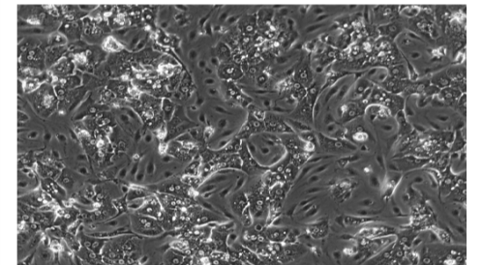
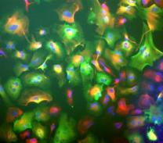
In Vitro Context: Driving Functionality
tubular epithelium
organotypic culture systems
organ
endothelial cell
angiogenesis models
tissue
basement membrane
co-culture systems
capillary
cellular
engineered disease models
molecular

Slide 10

pluripotent stem cell
culture systems
iPSC and ESC

Slide 11
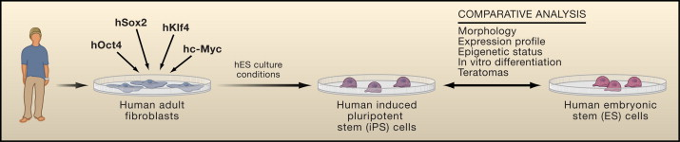
iPSC Experimental Workflow: Challenges and Solutions
Efficiency
<0.1%
Current bottleneck
Reprogram: Efficient Methods
Validate: Easy Detection
Reprogramming Technologies
  Integrating viral methods
  Non-integrating viral methods
  Non-integrating nonviral methods
Characterization Tools
  Alexa Fluor® surface antibodies
  Live Alkaline Phosphatase Dye for PSCs
  Molecular Tools

Slide 12

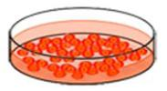
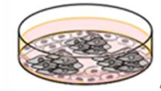

iPSC Line Derivation is Long and Tedious
1-6 rounds of infection
~3-4 weeks
Adult cells
Viral or Non Viral
Reprogramming
~50-150 colonies
Select
clones
~6 weeks
~6 weeks
Pick 3 clones/
parent line
Putative iPSC
ESC-like lines
Identify ESC-like lines
~10-30 clones
Grow, expand, bank:
~8-12 weeks
Test for pluripotency
Test for Differentiation
Differentiation
~5 weeks
Notes:
12

Slide 13
Current Methods for Reprogramming
Somatic Cell
Intermediate
iPSC Colony
miRNA
CytoTuneTM
(Sendai virus)
Retrovirus
RNA
Lentivirus
Excisable Lentivirus
EFFICIENCY
Transposon
Episomal Vector
Small Molecule
Adenovirus
Protein
SAFETY
(Modified from Gonzalez et al., 2011)
Notes:
We have focused on two — plasmid based vectors and RNA virus as the other methods did not give us significant advantage over any of the exisitng methods

Slide 14
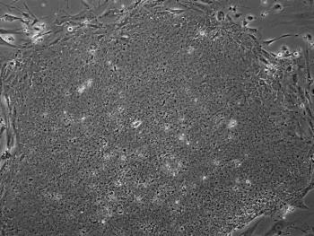
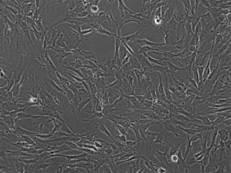
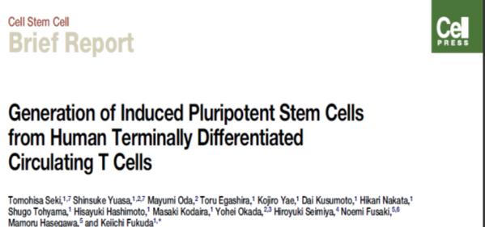
CytoTune™- iPS Sendai Reprogramming Kit Workflow
KLF
MYC
OCT
ALP
High efficiency
Low background
No integration
Easy to use
KLF
SOX
Day 1
Transduce Cells
overnight
4 weeks
Day 2
iPSCs
Change Medium
Colony formation
Notes:
Day 2, directly into KSR in some cases

Slide 15
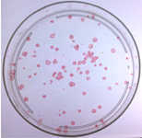
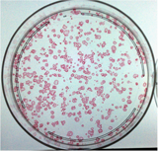
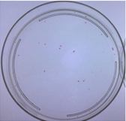
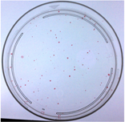
StemPro hESC SFM vs mTeSR1
Colony Count N=1
Condition | Cells Plated | Colony Count
GelTrex StemPro | 2x105 | ~5 (previous data)
GelTrex StemPro | 5x105 | ~89
GelTrex StemPro | 1x106 | ~430
MatriGel mTeSR1 | 2x105 | ~28
MatriGel mTeSR1 | 5x105 | ~72
5x10⁵ GT StemPro
1x10⁶ GT StemPro
2x10⁵ MG mTeSR1
5x10⁵ MG mTeSR1

Slide 16
Technical Analysis – Advantages of Sendai Virus
 | Sendai virus | Lentivirus/ Retrovirus | Adenovirus | Episomal/ Minicircle | Protein | Modified mRNAs
Efficiency | 0.01-1% | 0.001-0.01% | 0.0001% | 0.0001% | 0.00001% | >1%
Integration | No | Yes | No (DNA) | No (DNA) | No | No
Multiple Transductions | No | No | No | No/Yes | Yes | Yes
Up to 100-fold higher reprogramming efficiency than lentiviral methods
Sendai is a non integrating virus, and the number of non-iPS colonies are significantly reduced (low background)
Sendai virus can infect a wide variety of cell types
Only one round of transduction is required for most cell types

Slide 17
iPSC Experimental Workflow: Challenges and Solutions
Efficiency
<0.1%
Current bottleneck
Reprogram: Efficient Methods
Validate: Easy Detection
Reprogramming Technologies
  Integrating viral methods
  Non-integrating viral methods
  Non-integrating nonviral methods
Characterization Tools
  Alexa Fluor® surface antibodies
  Live Alkaline Phosphatase Dye for PSCs
  Molecular Tools

Slide 18
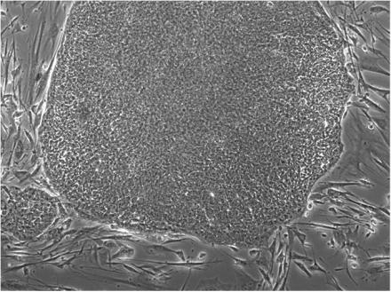
iPSC Identification and Characterization
Morphology
Antibody Staining
Differential Uptake Dyes
Advantages: Noninvasive
Disadvantage : User Expertise, Subjective, Time consuming
Advantages: Easy detection, 1 or 2 step method, diverse dyes for detection
Disadvantage: Antibody attached to cells, Sterility concerns, Expensive for HTS
Advantages: Ideal for HTS, Inexpensive
Disadvantage: Terminal, Cell integrity not preserved

Slide 19
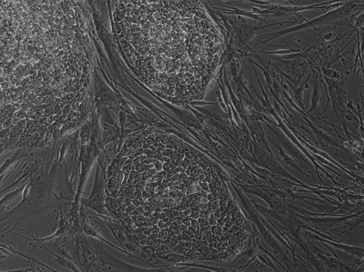
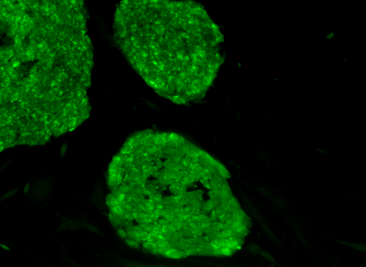
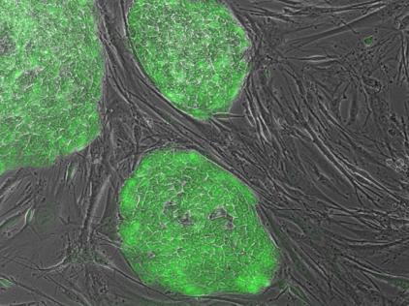
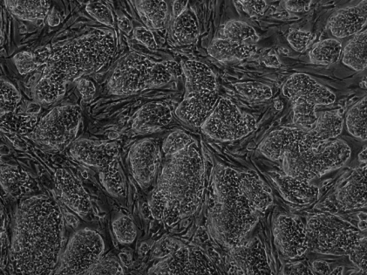
A Novel Alkaline Phosphatase (AP) Dye for Live Staining
H9 hESC
mESC
A novel live alkaline phosphatase substrate that specifically stains mouse and human pluripotent stem cells without compromising their integrity.

Slide 20

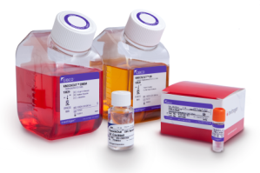
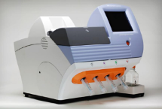
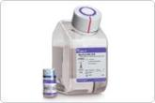


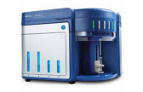
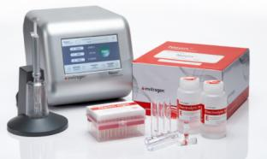
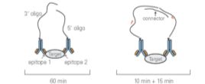
iPS Cell Research Tools at Life Technologies
Delivering innovative solutions at every step of the iPS Cell workflow
PGM™
KnockOut™ and
GIBCO® reagents
GIBCO® cells
and reagents
CytoTune™ -iPS Reprogramming
Attune™ Flow Cytometer
Neon™ Transfection System
GIBCO® CTS™
TaqMan® Arrays
& Assays

Slide 21
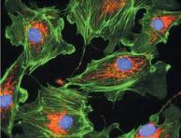
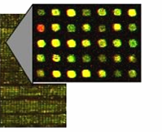
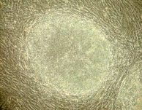
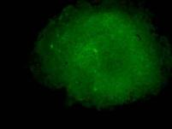
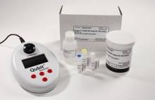

Areas of Particular Interest for Collaboration
Molecular Biology
Reprogramming
Cell based assays
Reporter Systems
Signaling Pathways
Cell Systems
Stem/Primary cell tools
Stem Cell Characterization
Differentiation
Novel Media Development
Applied Research Areas
Cell Therapy
Immunotherapy
Regenerative Medicine

Slide 22
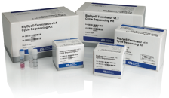


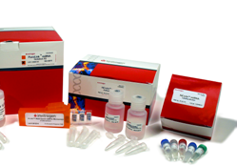
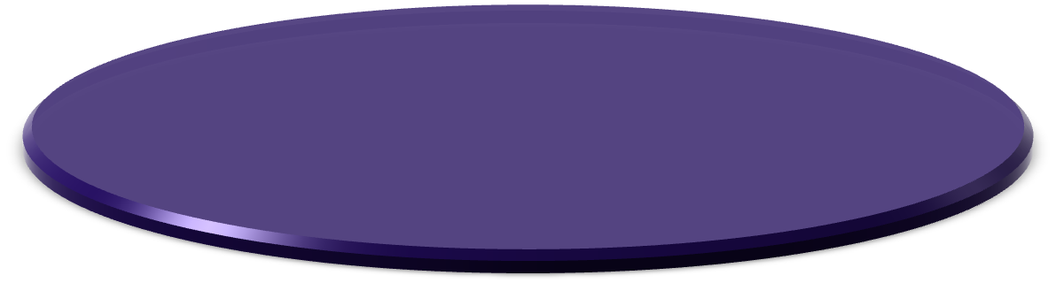

Partnering with LIFE
Broad Scale and Scope
Operational
Excellence
Experienced in
Partnering
Broad scientific areas
Wide geographic coverage
Basic research support
Enabling CTS
Front runners in iPSC
Efficient supply chain
Continuous interactions with researchers
TEDCO support/Grants
Technology source agnostic
Rapid commercialization
Sponsor enabling technologies

Slide 23
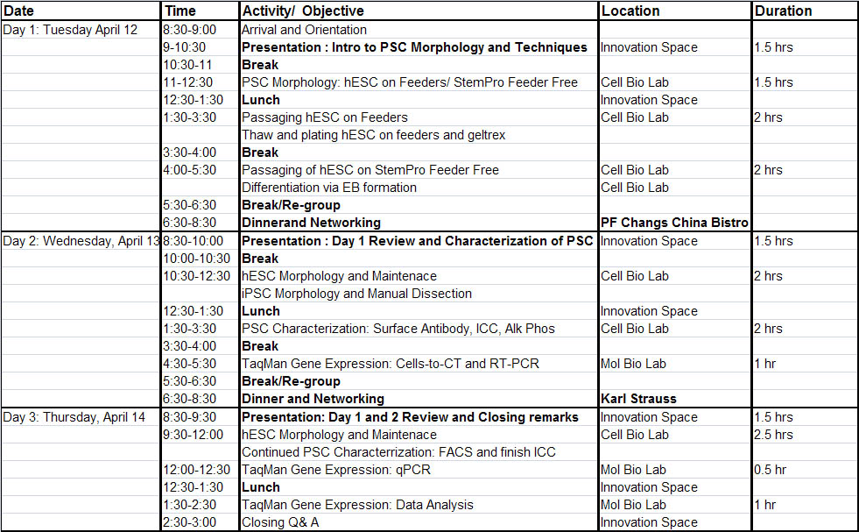
Workshop

