Slide 1
UMSOM Mini Medical School “Sarca-What?”
Wonder Puryear Drake, MD
University of Maryland School of Medicine
Professor of Medicine; Senior Associate Dean of Faculty Affairs
November 7, 2023

Slide 2
Introduction
Begin with how to pronounce it.
How is the diagnosis made?
What organs are affected?
Who gets it?
How do we treat it?
Is there any research studies available for me?

Slide 3
What’s that word again?
Sarcoidosis
Sar-rhymes with car
coid-rhymes with Lord
do-like dough, like in bread or money
sis-like a sibling

Slide 4
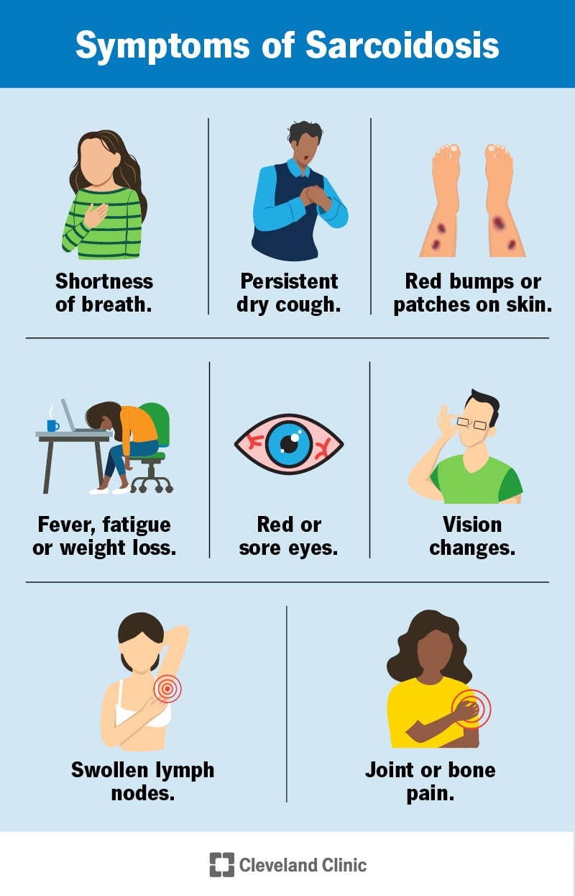

Slide 5
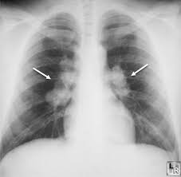
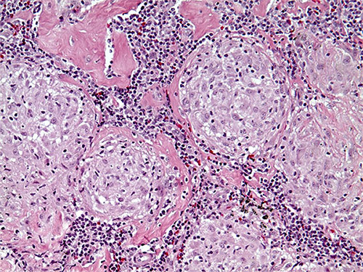
How is the diagnosis made?
Granuloma

Slide 6
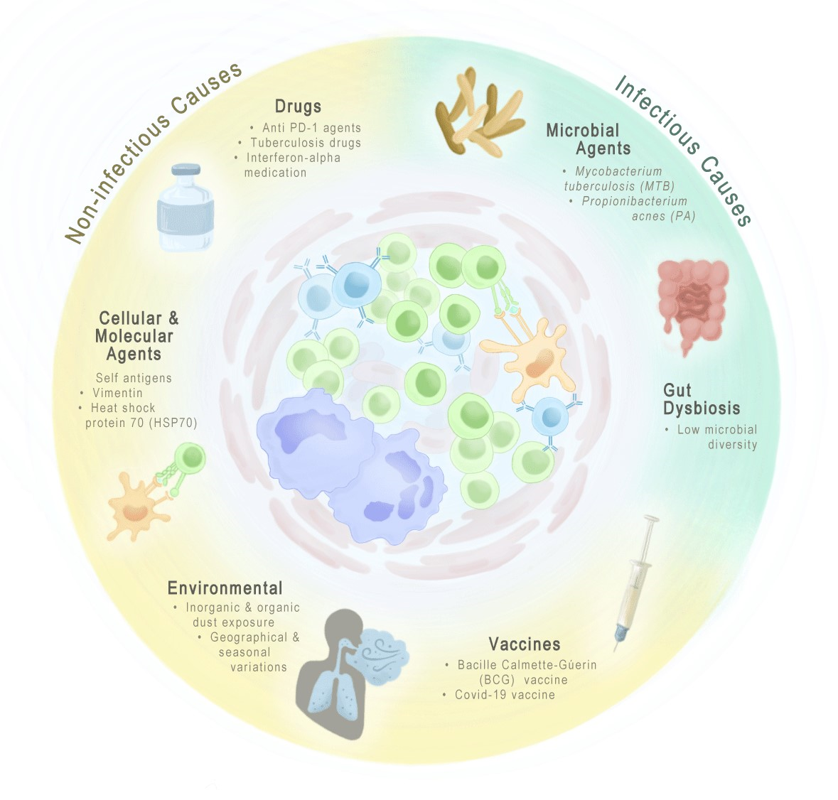
Causes of granulomas

Slide 7
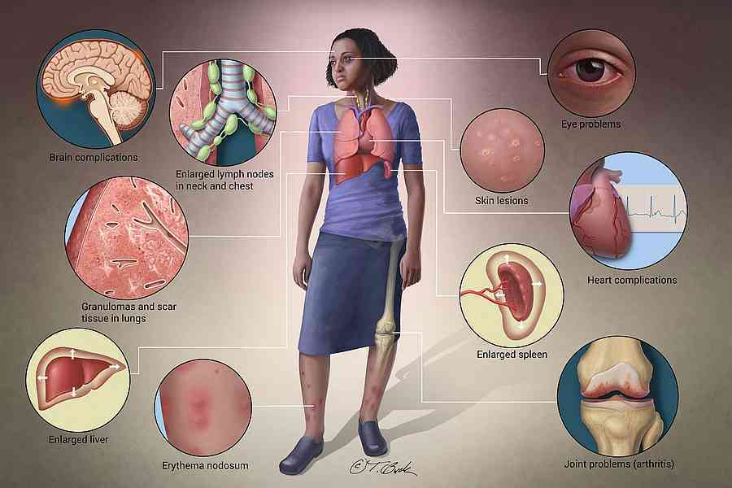
Which organs are involved?

Slide 8
Sarcoidosis prevalence worldwide
Arkema EV, et al. Curr Opin Pulm Med 2020;26(5):527-534

Slide 9
Sarcoidosis prevalence worldwide
Arkema EV, et al. Curr Opin Pulm Med 2020;26(5):527-534

Slide 10
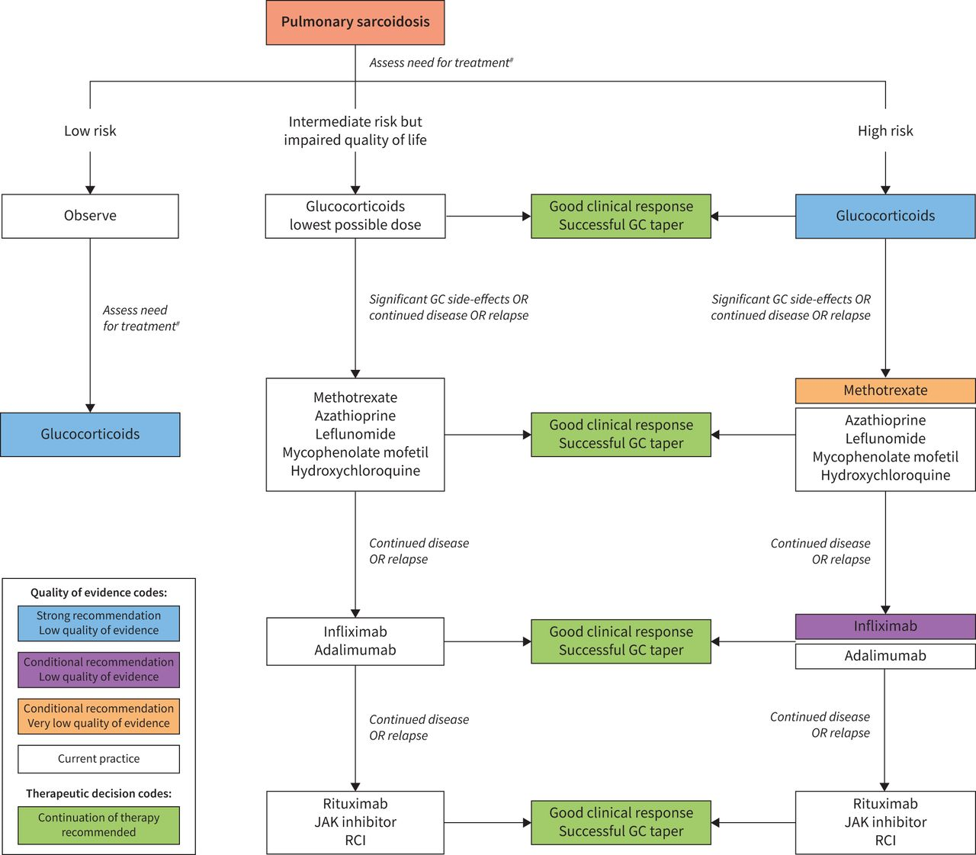
Medications for sarcoidsois
Baughman RP, et al. Eur Respir J. 2021;58(6):2004079.

Slide 11
Medications for sarcoidosis
Baughman RP, et al. Eur Respir J. 2021;58(6):2004079.

Slide 12
UMSOM Research Studies
1. Investigation of the strength of a sarcoidosis biomarker to predict clinical outcome
2. Investigation of the capacity of metformin to improve pulmonary sarcoidosis
Contact: Wdrake@som.umaryland.edu

Slide 13
Conclusions
Sarcoidosis is a world-wide disease that affects the lungs 90% of the time.
Women are more likely than men to get sarcoidosis.
Most of the medications for sarcoidosis suppress the immune system.
UMSOM has two sarcoidosis research projects.

