Slide 2
Everything You Need to Know to Protect Yourself Against the 2023 Respiratory Virus Season (RSV, COVID-19, Flu)
Dr. Matthew B. Laurens, MD, MPH, FAAP, FPIDS
November 7, 2023

Slide 3
Disclosures
My work is supported by grants and contracts to my institution from the NIH, the Bill & Melinda Gates Foundation, Howard Hughes Medical Institute, SEEK UK, BioNTech
I am a consultant to PATH and USAID Malaria Vaccine Development Program for combination CSP + bloodstage malaria vaccine development

Slide 4
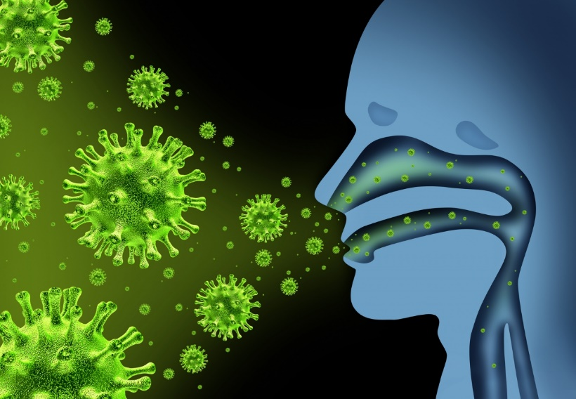
Outline
What is a respiratory virus?
Influenza
Respiratory Syncytial Virus (RSV)
COVID-19
Current status and outlook for the 2023-2024 season
How to protect yourself!

Slide 5
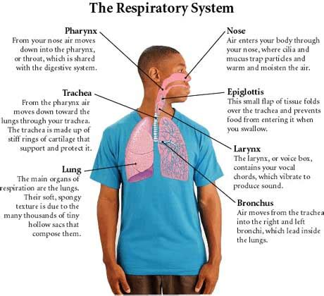
What is a Respiratory Virus?
Respiratory System: the group of tissues and organs that allows us to breathe, bringing in oxygen and exhaling carbon dioxide
Air enters through nose and mouth, travels through voice box
Then through windpipe, and into your lungs
A virus is the smallest germ or microorganisms that can cause disease or illness
Over 200 viruses can infect humans

Slide 6
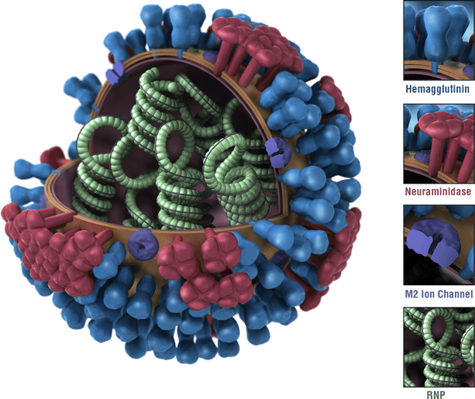
Influenza- what causes it?
Contagious respiratory illness
Caused by influenza viruses
Influenza A
Influenza B
Infect the nose, throat, and sometimes the lungs
Notes:
Four types of human influenza viruses: A, B, C, and D. Influenza A and B viruses cause seasonal epidemics of disease in people (known as flu season) almost every winter in the United States.
Influenza A viruses are further classified into subtypes, influenza B viruses are further classified into two lineages: B/Yamagata and B/Victoria.
Influenza A viruses are divided into subtypes based on two proteins on the surface of the virus: hemagglutinin (H) and neuraminidase (N). There are 18 different hemagglutinin subtypes and 11 different neuraminidase subtypes (H1 through H18 and N1 through N11, respectively).
RNP = ribonucleoprotein containing RNA-dependent RNA polymerase (RdRP) and multiple copies of nucleoprotein (NP). The RNP complex plays a crucial role in viral life cycle, supporting and regulating transcription and replication of viral genome in infected cells.

Slide 7
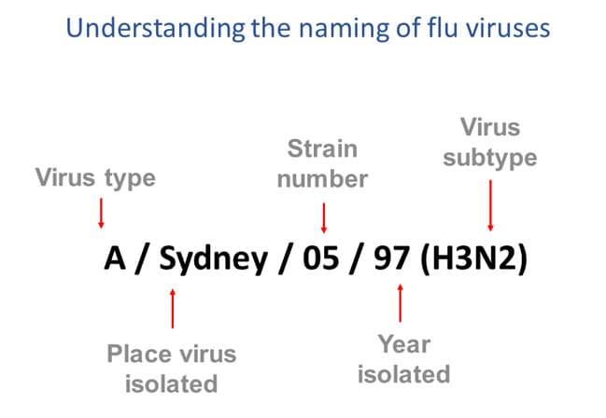
Notes:
The antigenic type (e.g., A, B, C, D)
The host of origin (e.g., swine, equine, chicken, etc.). For human-origin viruses, no host of origin designation is given. Note the following examples:
(Duck example): avian influenza A(H1N1), A/duck/Alberta/35/76
(Human example): seasonal influenza A(H3N2), A/Perth/16/2019
Geographical origin (e.g., Denver, Taiwan, etc.)
Strain number (e.g., 7, 15, etc.)
Year of collection (e.g., 57, 2009, etc.)
For influenza A viruses, the hemagglutinin and neuraminidase antigen description are provided in parentheses (e.g., influenza A(H1N1) virus, influenza A(H5N1) virus) which is the avian flu virus
The 2009 pandemic virus was assigned a distinct name: A(H1N1)pdm09 to distinguish it from the seasonal influenza A(H1N1) viruses that circulated prior to the pandemic.
When humans are infected with influenza viruses that normally circulate in swine (pigs), these viruses are call variant viruses and are designated with the letter “v” (e.g., an A(H3N2)v virus).
Major outbreaks of H1N1 strains in humans include the 1918 Spanish flu pandemic, the 1977 Russian flu pandemic and the 2009 swine flu pandemic.

Slide 8
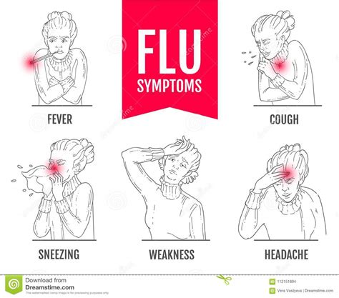
Influenza- what symptoms does it cause?
fever* or feeling feverish/chills
cough
sore throat
runny or stuffy nose
muscle or body aches
headaches
fatigue (tiredness)
some people may have vomiting and diarrhea, though this is more common in children than adults.
Not everyone with flu will have a fever.

Slide 9
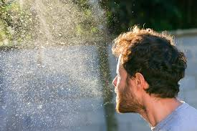
Influenza- Epidemiology
Tiny droplets made when people with flu cough, sneeze, or talk
Droplets can land in the mouths or noses of people who are nearby. Less often, a person might get flu by touching a surface or object that has flu virus on it and then touching their own mouth, nose or possibly their eyes.
8 percent of the U.S. population gets sick from flu each season

Slide 10
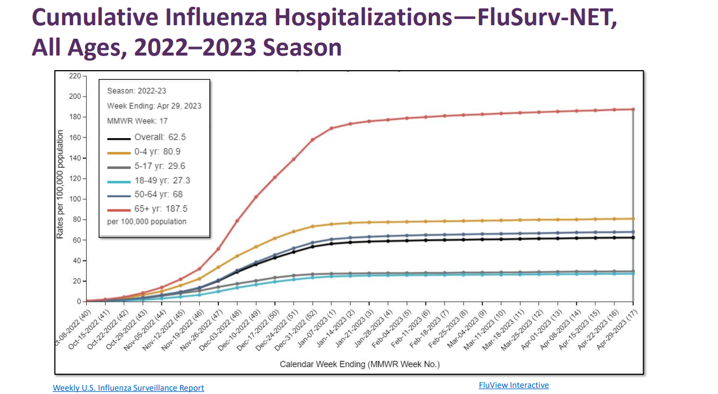
Notes:
Following is a list of all the health and age factors that are known to increase a person’s risk of getting serious flu complications:
Adults 65 years and older
Children younger than 2 years old¹
Asthma
Neurologic and neurodevelopment conditions
Blood disorders (such as sickle cell disease)
Chronic lung disease (such as chronic obstructive pulmonary disease [COPD] and cystic fibrosis)
Endocrine disorders (such as diabetes mellitus)
Heart disease (such as congenital heart disease, congestive heart failure and coronary artery disease)
Kidney diseases
Liver disorders
Metabolic disorders (such as inherited metabolic disorders and mitochondrial disorders)
People who are obese with a body mass index [BMI] of 40 or higher
People younger than 19 years old on long-term aspirin- or salicylate-containing medications.
People with a weakened immune system due to disease (such as people with HIV or AIDS, or some cancers such as leukemia) or medications (such as those receiving chemotherapy or radiation treatment for cancer, or persons with chronic conditions requiring chronic corticosteroids or other drugs that suppress the immune system)
People who have had a stroke

Slide 11
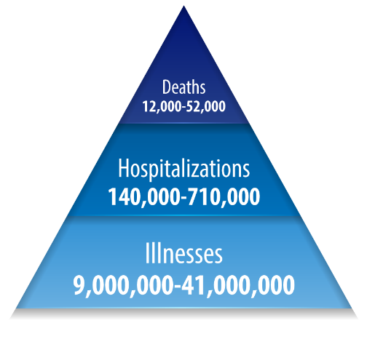
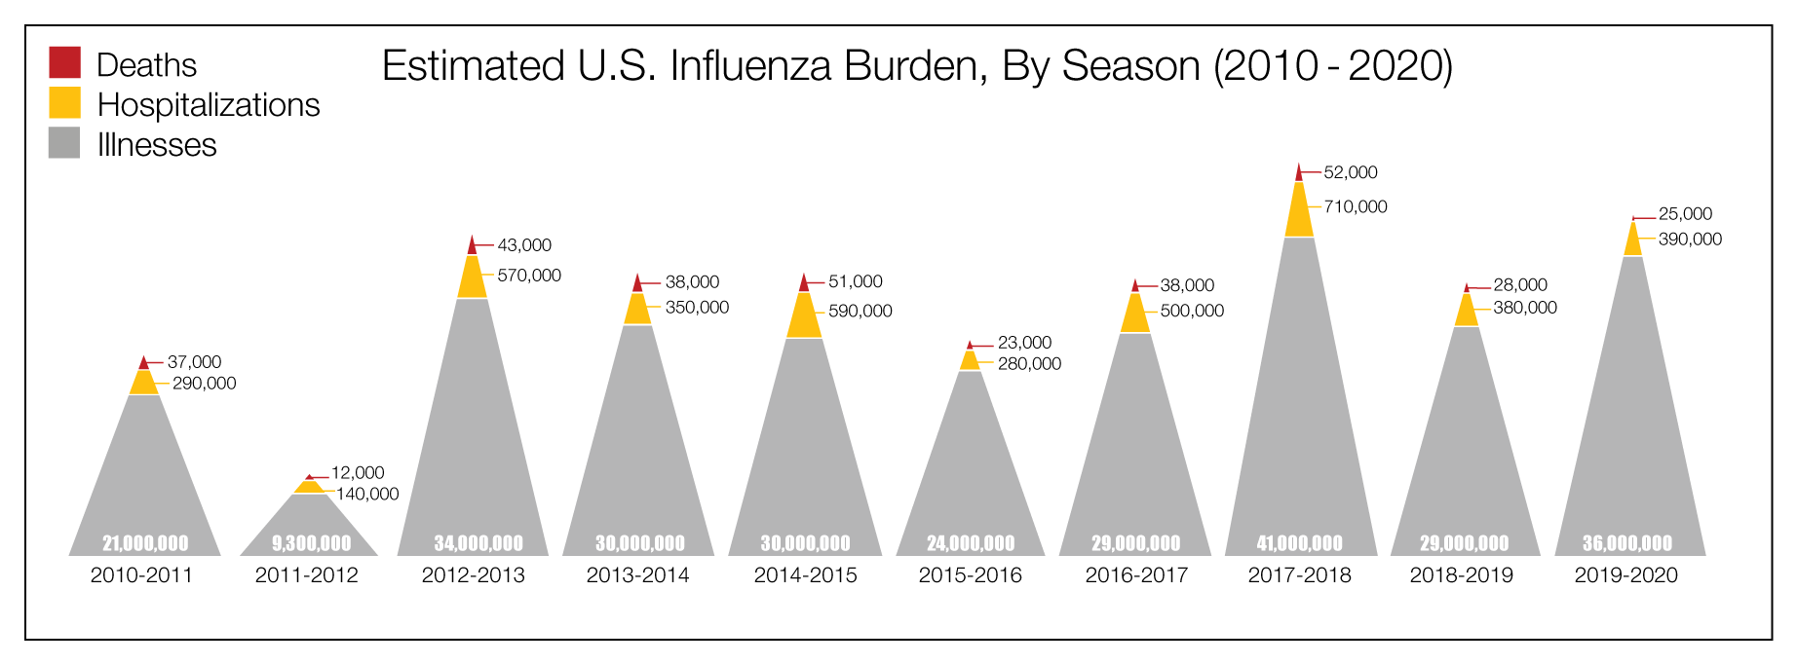
Influenza disease burden
Notes:
Annual influenza burden in USA (average from 2010-2020)

Slide 12
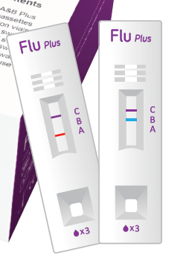
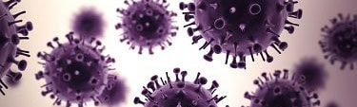
Influenza- how do we diagnose it?
Swab inside of nose or back of throat, then test:
Rapid Diagnostic Tests (RDTs) take 10-15 minutes
Rapid Molecular assays take 15-20 minutes, more accurate
PCR can take hours, even more accurate
Cannot tell the difference between RSV, flu and COVID-19 by symptoms alone because some of the symptoms are the same
Notes:
RDTs detect flu antigens that stimulate an immune response.
Rapid molecular assays detect genetic material.

Slide 13
Influenza- how do we treat it?
Antiviral drugs work best when started within the first 1-2 days
Oseltamivir phosphate
Zanamavir
Peramivir
Baloxavir marboxil
Can lessen symptoms and shorten the time you are sick by 1 or 2 days
Can prevent influenza complications such as pneumonia

Slide 14
*Quiz question*
You can spread flu to others even before symptoms appear.
True or False?

Slide 15
*Quiz question*
You can spread flu to others even before symptoms appear.
True or False?
True
You may be able to spread flu to someone else before you know you are sick, as well as while you are sick.

Slide 16
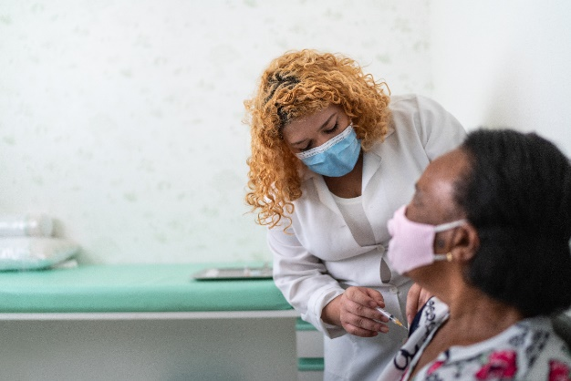
Influenza- how do we prevent it?
Influenza vaccination
Ages 6 months and older
Every year – annual vaccination
Avoid close contact with people who are sick.
If you are sick, limit contact with others.
Cover coughs and sneezes.
Wash your hands often with soap and water.
Avoid touching your eyes, nose, and mouth.

Slide 17
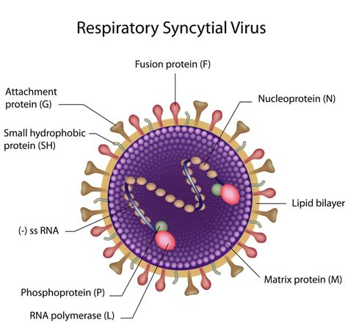
RSV- what causes it?
Respiratory Syncytial Virus = RSV
Common respiratory virus that usually causes mild, cold-like symptoms
Most people recover in a week or two
RSV can be serious. Infants and older adults are more likely to develop severe RSV and need hospitalization.

Slide 18
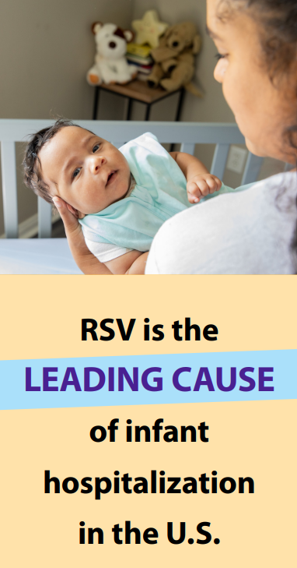
RSV- what symptoms does it cause?
People infected with RSV usually show symptoms within 4 to 6 days after getting infected. Symptoms of RSV infection usually include
Runny nose
Decrease in appetite
Coughing
Sneezing
Fever
Wheezing
In very young infants with RSV, the only symptoms may be irritability, decreased activity, and breathing difficulties.
Notes:
Almost all children will have had an RSV infection by their second birthday.

Slide 19
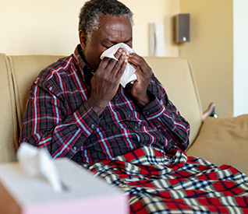
RSV- Who is at risk for severe disease?
Infants and young children
Older adults
Severe disease can include lower respiratory tract disease (pneumonia), worsening heart failure, or worsening COPD

Slide 20
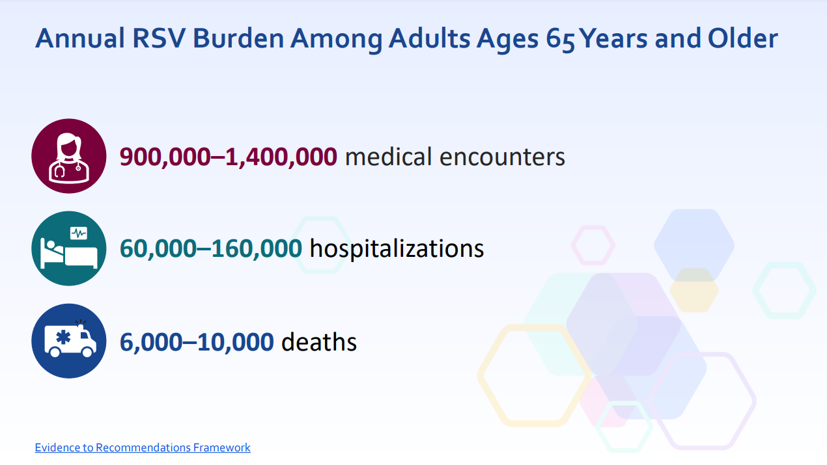

Slide 21
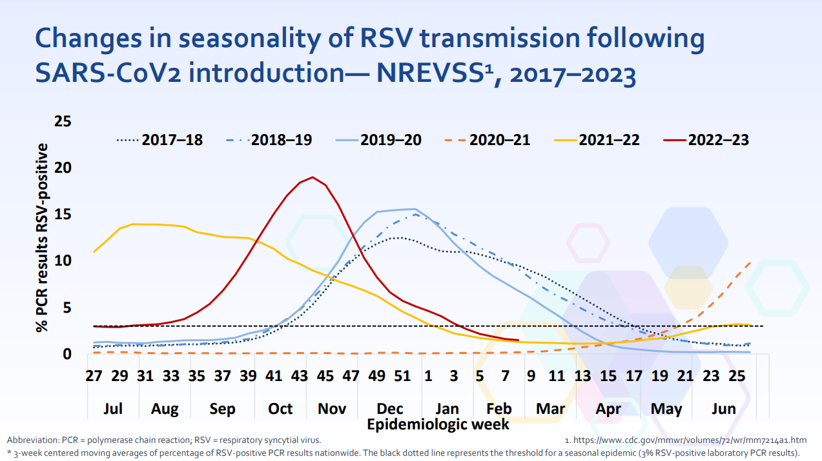

Slide 22
RSV- how does it spread?
RSV can spread when
An infected person coughs or sneezes
You get virus droplets from a cough or sneeze in your eyes, nose, or mouth
You have direct contact with the virus, like kissing the face of a child with RSV
You touch a surface that has the virus on it, like a doorknob, and then touch your face before washing your hands
Notes:
People infected with RSV are usually contagious for 3 to 8 days and may become contagious a day or two before they start showing signs of illness. However, some infants, and people with weakened immune systems, can continue to spread the virus even after they stop showing symptoms, for as long as 4 weeks.

Slide 23
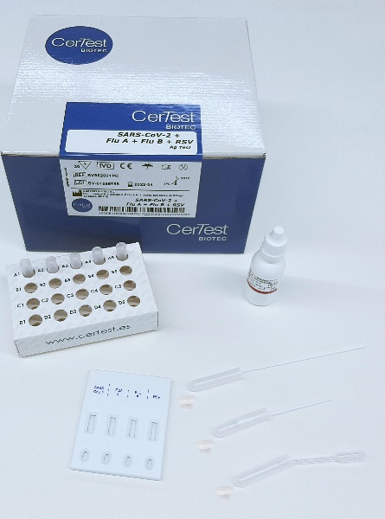
RSV- how do we diagnose it?
Swab inside of nose or back of throat, then test:
Rapid Diagnostic Tests (RDTs) take 10-15 minutes
Rapid Molecular assays take 15-20 minutes, more accurate
PCR can take hours, even more accurate
Cannot tell the difference between RSV, flu and COVID-19 by symptoms alone because some of the symptoms are the same

Slide 24
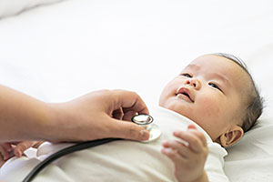
RSV- how do we treat it?
No antiviral medications exist
1-2 weeks until recovery
Supportive care: oxygen, mechanical ventilation, hydration, fever medications, pain medications
Complications: pneumonia

Slide 25
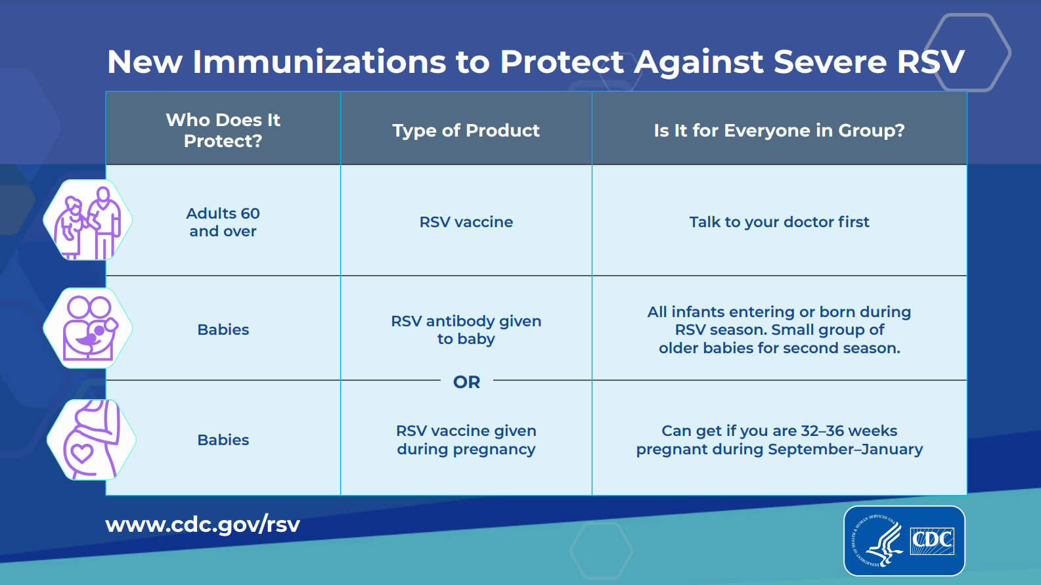
RSV- how do we prevent it?
Notes:
Avoid close contact with people who are sick.
If you are sick, limit contact with others.
Cover coughs and sneezes.
Wash your hands often with soap and water.
Avoid touching your eyes, nose, and mouth.

Slide 26
*Quiz question*
Everyone should get a vaccine to protect against RSV.
True or False?

Slide 27
*Quiz question*
Everyone should get a vaccine to protect against RSV.
True or False?
FALSE
Only infants, pregnant women, and elderly are eligible.

Slide 28
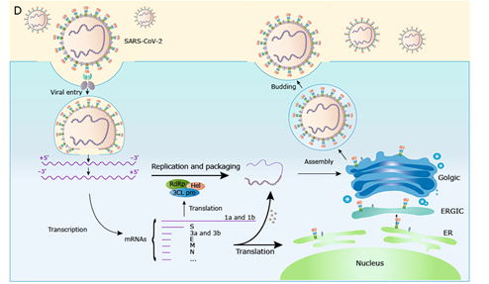
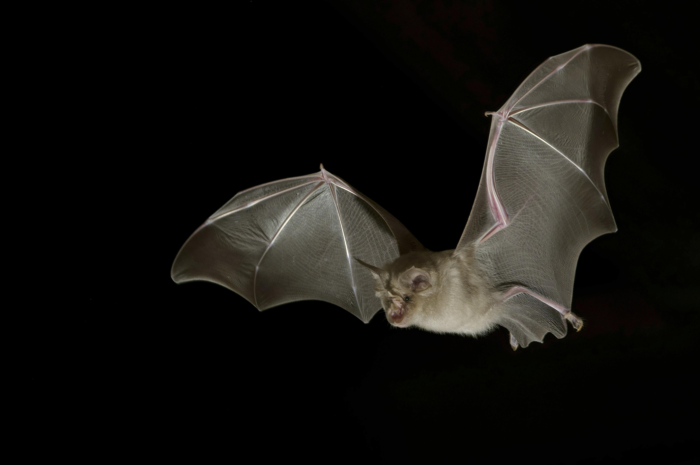
COVID-19: what causes it?
Coronavirus
RNA virus
Other coronaviruses
Receptor ACE2
Variants

Slide 29
COVID-19: how does it spread?
Transmission: droplets, households
Viral loads in nose -- similar to adults
Can transmit with or without symptoms
High-risk for complications:
Elderly
Persons with chronic health conditions
Pregnant women

Slide 30
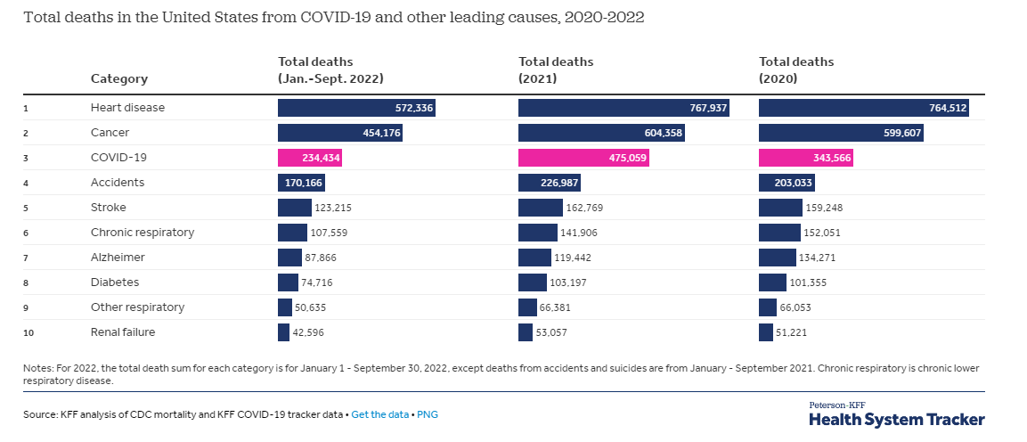
COVID-19 causes death

Slide 31
COVID-19- Epidemiology- Mortality

Slide 32
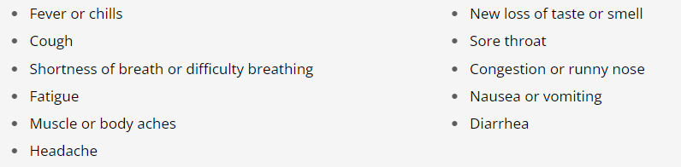
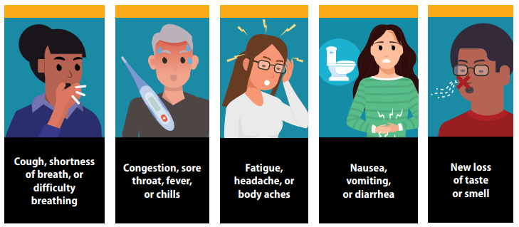
COVID-19: what symptoms does it cause?

Slide 33
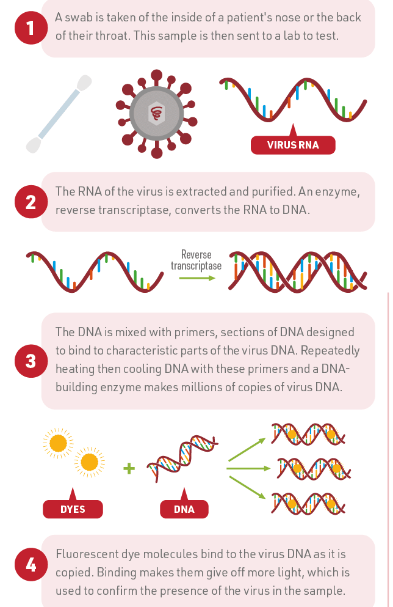
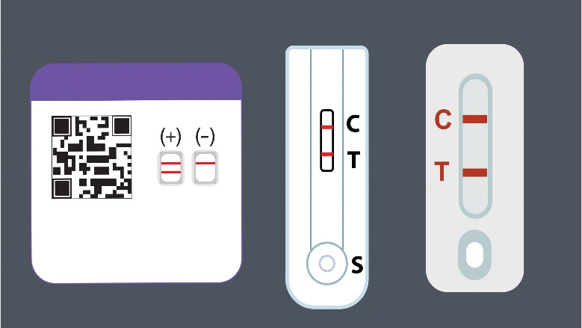
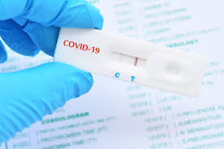
COVID-19: how do we diagnose it?
Swab inside of nose or back of throat, then test:
Rapid Diagnostic Tests (RDTs) take 10-15 minutes
PCR can take hours, even more accurate
Cannot tell the difference between RSV, flu and COVID-19 by symptoms alone because some of the symptoms are the same
Notes:
If you do not have symptoms but have been exposed to COVID-19, wait at least 5 full days after your exposure before taking a test.
If you are only going to take a single test, a PCR test will provide a more reliable negative test result.
If you use an antigen test, a positive result is reliable, but a negative test is not always accurate.
If your antigen test is negative, take another antigen test after 48 hours or take a PCR test as soon as you can.
If your second antigen test is also negative, wait another 48 hours and test a third time.

Slide 34
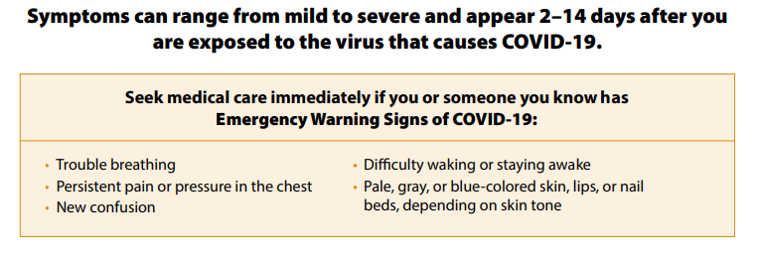

Slide 35
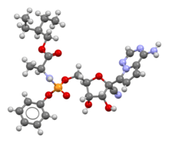

COVID-19: how do we treat it?
Most people with COVID-19 have mild illness and can recover at home. You can treat symptoms with over-the-counter medicines, such as acetaminophen or ibuprofen, to help feel better.
Treatment within 5-7 days
Older adults (50+), chronic conditions
Paxlovid (age 12+, oral, twice daily for 5 days)
Molnupiravir (age 18+, oral, twice daily for 5 days)
Remdesivir (1 month+, intravenous only)

Slide 36
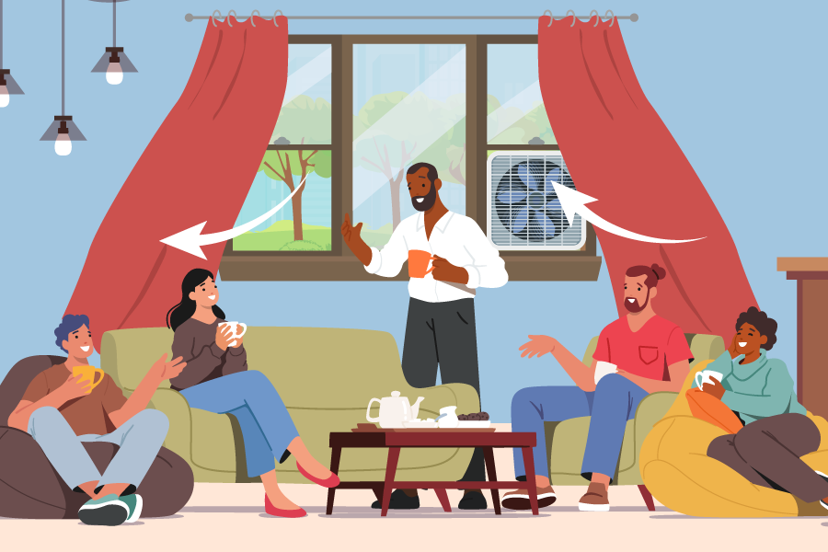
COVID-19: how do we prevent it?
Vaccination: stay up to date
Everyone aged 5 years and older should get 1 dose of an updated COVID-19 vaccine to protect against serious illness from COVID-19
Children 6 months – 4 years need multiple doses, including 1 updated dose
Immunocompromised may get additional doses
Improve ventilation
Get tested if you have symptoms
Isolate if you have been exposed
Stay home if you have COVID-19
Avoid people who have COVID-19

Slide 37
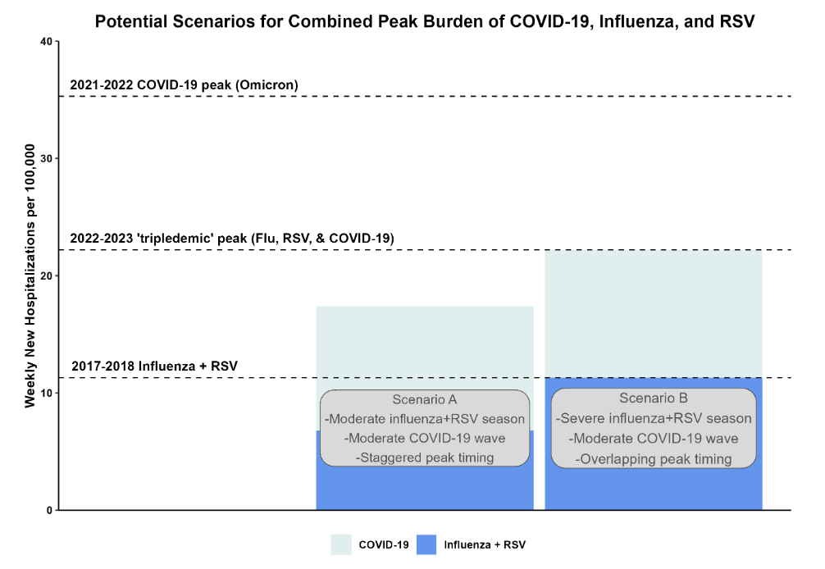
Notes:
CDC expects the upcoming fall and winter respiratory disease season will likely have a similar number of total hospitalizations compared to last year. As with last year, the number of hospitalizations is expected to be higher than that experienced prior to the COVID-19 pandemic, when severe disease was caused primarily by the influenza virus and the respiratory syncytial virus (RSV).
However, it remains possible that hospitalizations this season may be higher than last year, with more widespread illness and healthcare system strain. This increase could result from the emergence of a new COVID-19 variant with an increased ability to evade the body’s prior immunity, or from a severe influenza season combined with COVID-19 and RSV waves that are similar to last year, or, as we saw last year, an increase in RSV infections. A key factor is the timing of the peak number of hospitalizations associated with each disease and whether those peaks coincide.
https://www.cdc.gov/forecast-outbreak-analytics/about/season-outlook.html#scenarios
CDC developed two hypothetical scenarios for the peak hospital burden of COVID-19, influenza, and RSV.
These scenarios illustrate how the additional burden from COVID-19 during a moderate season for the three respiratory diseases may generate more hospital demand – potentially resulting in hospital strain – than a severe influenza and RSV season prior to the emergence of COVID-19 (Figure 1).

Slide 38
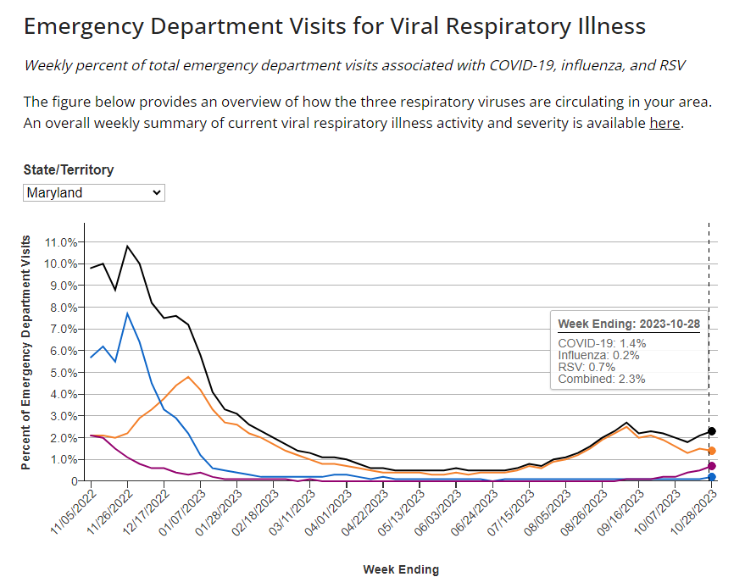
Current Respiratory Illnesses in Maryland

Slide 39
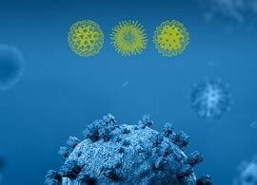
Take home messages
We have more tools than ever: This is the first fall and winter virus season where vaccines are available for the three viruses responsible for most hospitalizations – COVID-19, RSV, and flu.
Vaccines can be given together
The time is now: Cases of COVID-19 and RSV are rising – and flu season is on the horizon
Notes:
Vaccination remains the best way to protect yourself and your loved ones against serious outcomes of these diseases. Vaccination is especially important for people who are at higher risk of developing serious complications.
Modeling results indicate that a 20% relative increase in vaccine coverage across age-groups compared to recent seasons could avert around 9% of influenza-associated hospitalizations this season. Conversely, a 20% drop in relative vaccine coverage could increase influenza-associated hospitalizations at least 10%.

Slide 40


Thank you
Email
mlaurens@som.umaryland.edu

