Slide 1
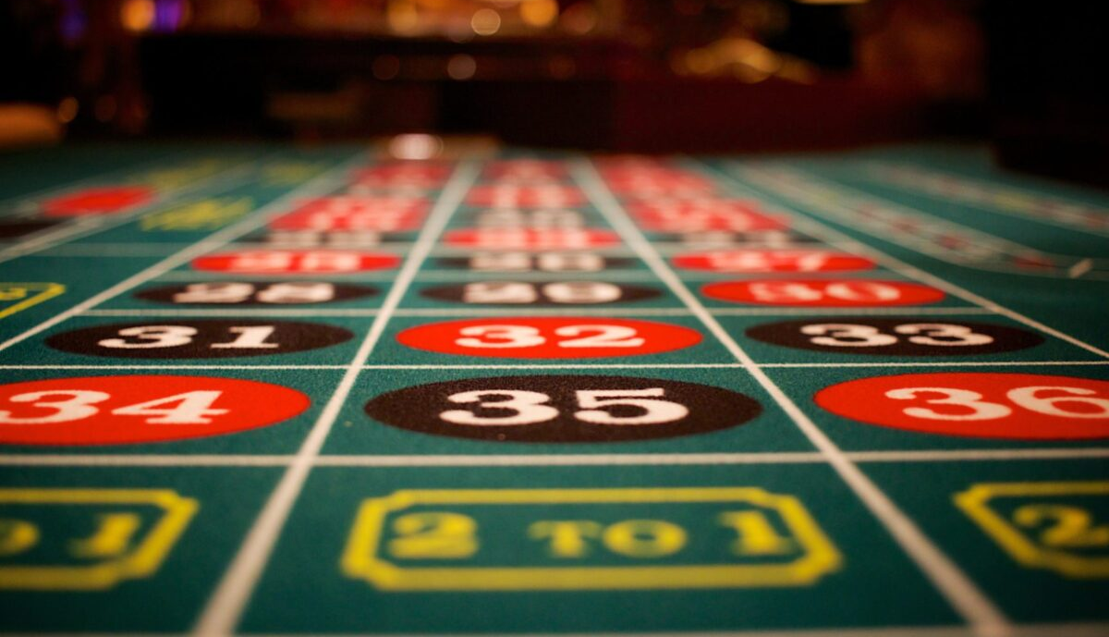


PATHOLOGICAL GAMBLING: A HIDDEN ADDICTION
Christopher Welsh M.D.
Associate Professor
Medical Director & Research Director
Maryland Center of Excellence on Problem Gambling
University of Maryland School of Medicine
Division of Addiction Research & Treatment
cwelsh@som.umaryland.edu

Slide 2

What Is Gambling?
Webster says:
“to wager or risk money or anything of value on the outcome of something involving chance with the intent of winning or gaining something of more value than was risked.”
“any matter or thing involving risk.”
Typically involves consideration, risk, & a prize.

Slide 3
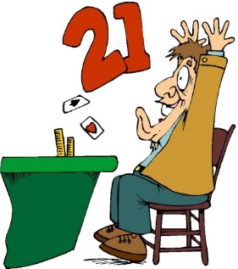
Types Of Gambling
“Games Of Skill”
Cards (Poker, Blackjack, etc)
Pool
Lottery
Mega Millions/Powerball
Instant Scratch Tickets
Daily Numbers
Lotto
Sports
Horse Racing At Tracks
Off Track Betting
On-line
Office Pools
Games Of Chance
Slot Machines
Roulette
BINGO
Dice
Raffles
Stock Market
Cryptocurrency

Slide 4
Types of Gambling
Action Gambling
Primarily at games of perceived “skill”
Believe they can “beat the house” or other individuals by developing a system
Preferred Games
Poker
Dice
Cards
Horse/Dog Racing
Sports Betting
Escape Gambling
Primarily as a way to escape “stress”
often in a hypnotic state while gambling
Does not gamble to beat the house or others
Preferred Games
Bingo
Slot Machines
Video Poker
Lottery

Slide 5
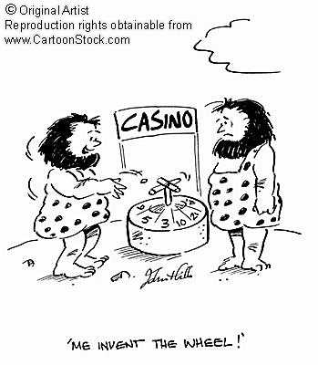
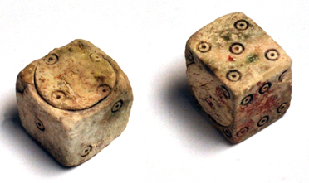
Gambling: History
Gambling likely the oldest “vice.”
older than alcohol
Gambling was a way early humans communicated with gods
an attempt to control/predict future events
Gambling games have been found in the Egyptian pyramids
The Bible has various references to gambling.
Tossing of lots were how decisions were made.
Dice were found in the ruins at Pompeii
loaded dice were found in Pompeii.

Slide 6
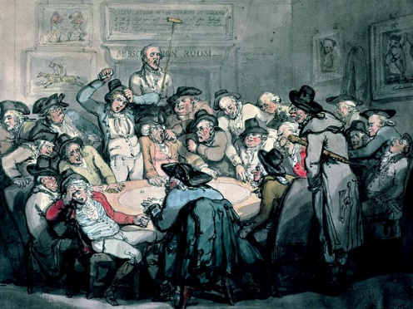
Gambling In The U.S.
First Wave: Colonial period
In 1612, the Virginia Company of Jamestown petitioned the King of England for permission to conduct a lottery
Lotteries funded public projects (even Ivy League Colleges)
Cheating at such drawings ended legality
Second Wave: Pre-Civil War
Wild West, gambling halls, riverboat casinos
More cheating and this, too, was banned.
Third Wave: 1930s-Present
Began in Las Vegas
Indian Gaming Act of 1988
Very strictly regulated-Cheating possible but very difficult.

Slide 7

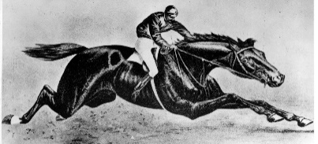
Gambling In Maryland
1791- Maryland first legalized gambling
“Lottery grants” to help fund projects
By 1830s, there were > 3,200 lotteries in Baltimore alone
1834- Maryland legislature voted to stop new lottery grants
1870- Inaugural running of the “Dinner Party Stakes”
renamed the Preakness Stakes in 1873
at the original Pimlico Race Course
Early 1900s- Illegal slot machines began to appear
1940s- Slot machines legalized in 4 Southern Md. Counties
Anne Arundel, Calvert, St. Mary’s, Charles
1950s & 60- nicknamed parts of Southern Maryland as “Little Vegas” & “Little Reno”
> 9000 slot machines in local taverns and roadhouses
Earned > $24 million
1952- Charitable BINGO legalized
1963- Legislation to prohibit new slot machines

Slide 8
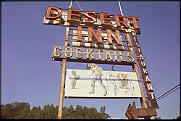

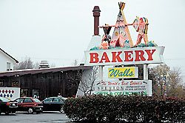
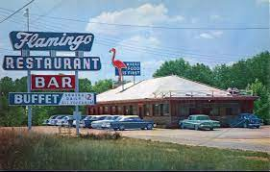
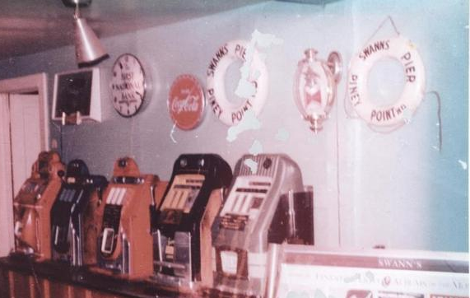
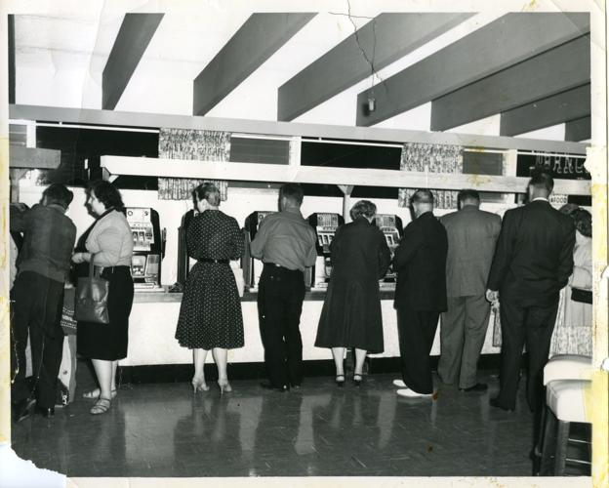
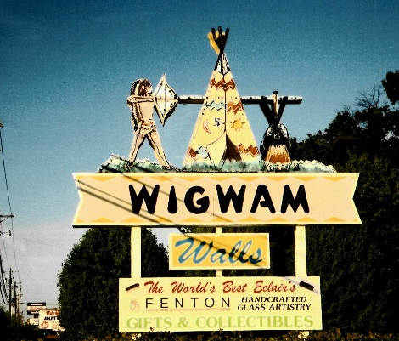
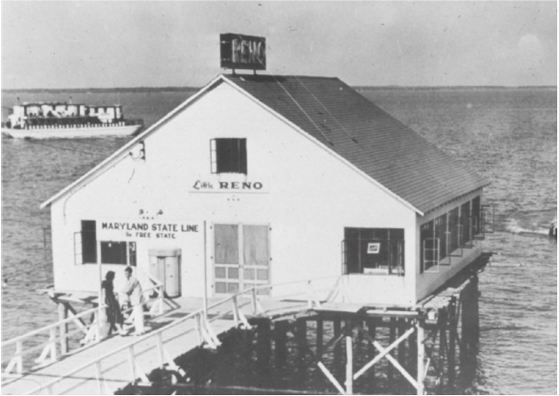
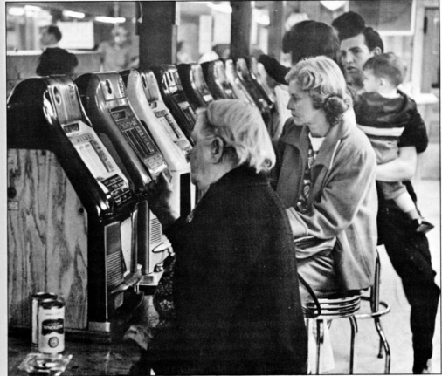
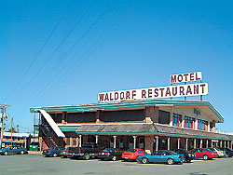
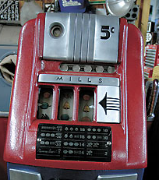
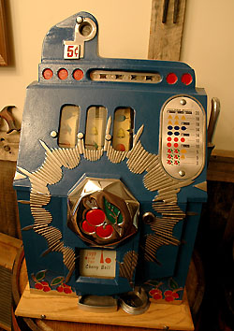
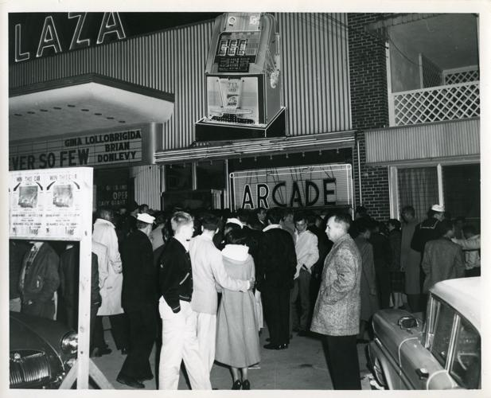

Slide 9
Gambling In Maryland
1973- establishment of the Maryland Lottery
1990s-discussions about slot machines begin
November, 2008- State referendum allowing video lottery terminals (slot machines) in 5 casinos
Mandated that money be placed in to “problem gambling fund.”
July 1, 2012 – Maryland Center of Excellence on Problem Gambling opens as part of The University of Maryland, School of Medicine, Department of Psychiatry
November, 2012- State referendum allowing a 6th casino in P.G. County, table games & 24-hour operation

Slide 10


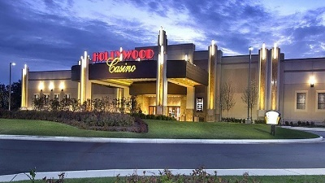
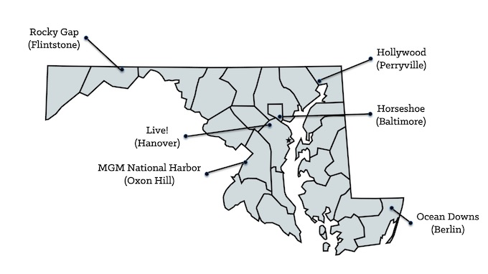



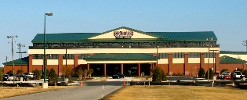
Maryland Casinos
(Opened 5/12/2013)
(Opened 9/17/2010)
(Opened 8/23/2014)
(Opened 6/6/2012)
(Opened 12/8/2016)
(Opened 1/4/2011)

Slide 11

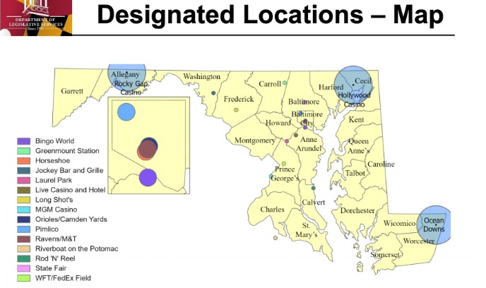
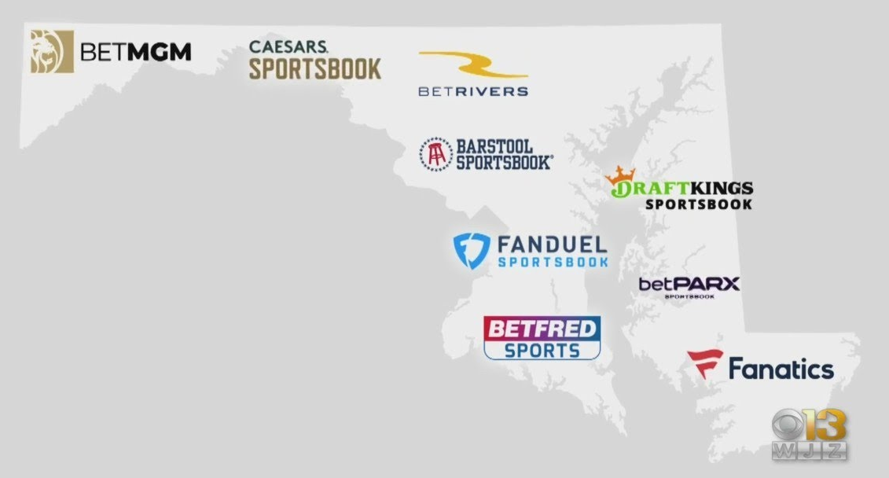
Sports Betting
May, 2018- the U.S. Supreme Court struck down a 1992 federal law that had effectively banned commercial sports betting in most states.
November, 2020- Maryland voters approved the establishment of sports betting in Maryland (signed into law May, 2021).
December, 2021- Retail sports betting launched at five casinos, race tracks & several other places in Maryland.
November, 2022- Online sports betting launched in Maryland.

Slide 12
Gambling: Some Numbers
About 85% of all adults in the US gamble at one time or another.
48 states have legalized gambling
Except Hawaii and Utah.
Gambling goes on in Hawaii and Utah via the stock market, internet gambling, cruise ship casinos, illegal gambling such as sports betting.
28 states (plus 2 territories) have casino gambling
30 states have casinos on Native American land
43 states have lotteries
6 states have river boats

Slide 13
Gambling In The U.S.: The Money
Legal gambling in the US is over a $100 Billion/yr profit-making industry.
Casinos gross > $60 billion/year
Direct state and local tax revenues of @ $10 billion/year
$65-70 million/month total revenue in Maryland
Lotteries have @ $70 billion/year in sales
@ $19 billion/year profit
Lottery is 3rd largest source of revenue in Md.
Behind sales tax and income tax
Used for various things in different states

Slide 14
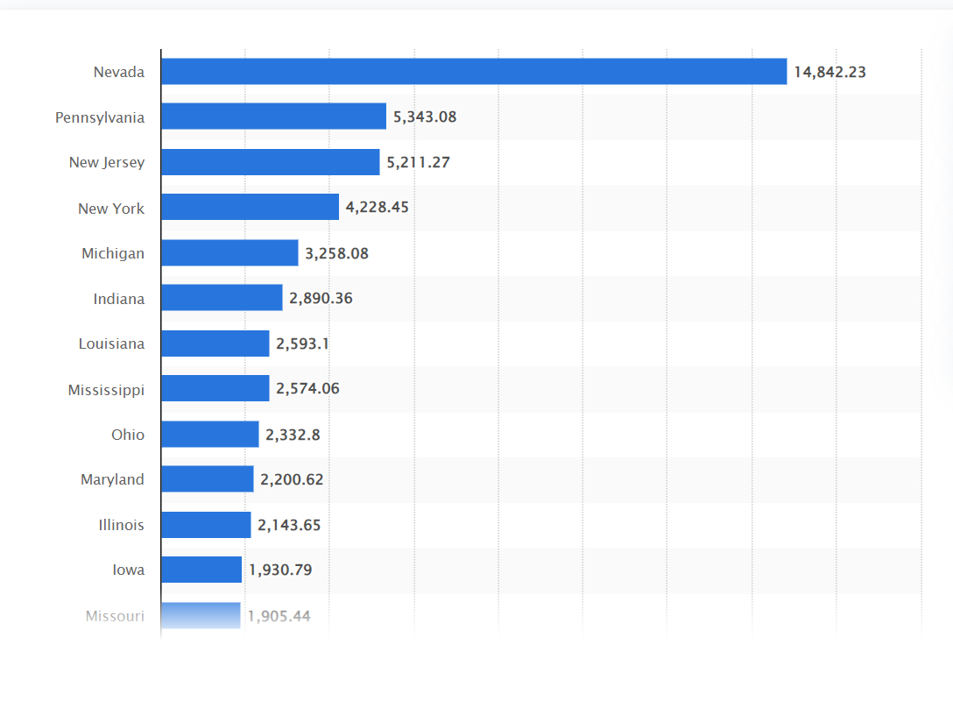
Gambling In The U.S.: Gross Revenue Casinos (2022)
in millions of dollars

Slide 15
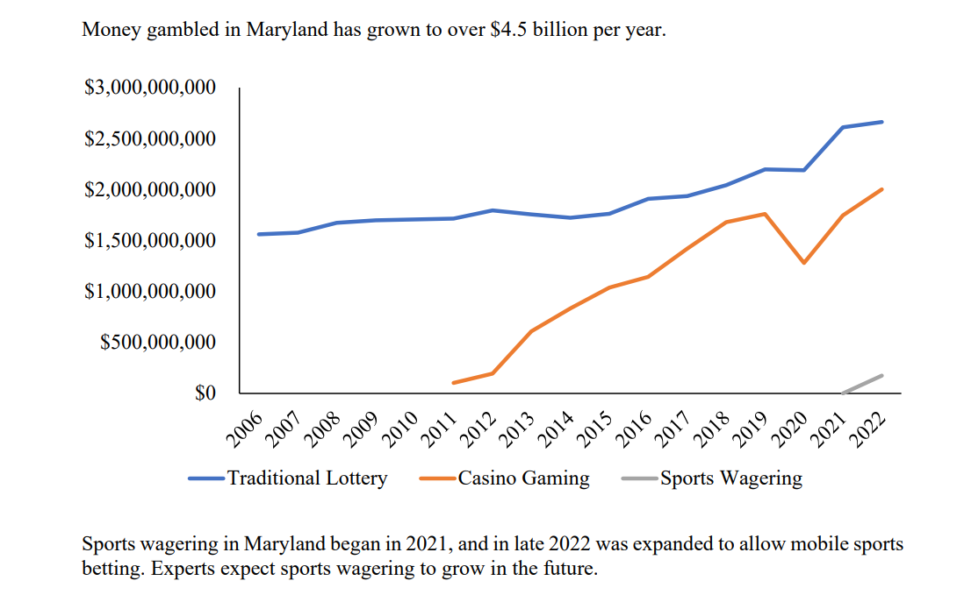
Money Gambled: Maryland

Slide 16
Legal Gambling Age
State-specific
Tribal casinos & overseas military casinos exempt
Casino 21yo
Sports 21yo
Poker Rooms 21yo
Lottery 18yo
Daily Fantasy 18yo
Horse Racing(pari-mutuel) 18yo
Bingo 18yo

Slide 17
Terminology
Problem (problematic)
Compulsive
At risk
Pathological
Disordered
Gambling vs Gaming
Also on-line gambling vs Social media “addiction”

Slide 18
Problem Gambling in the U.S.
Numbers vary depending on type of study
Adults
@ 1% (up to 3%)- Pathological (@ 2 million)
@ 2-3%- at risk or problematic (@ 4-6 million)
Adolescents
1-7%- Pathological
5-10%- at risk or problematic
College
3-11%-Pathological
5-15%- at risk or problematic

Slide 19
Problem Gambling: High Risk Groups
Growing numbers of gambling problems among:
Adolescents
Young adults
Older Adults
Women
People of Color
Lower Income populations
Less educated populations (high school or less)

Slide 20
Problem Gambling: Myths & Facts
Myth: You have to gamble every day to be a problem gambler.
Fact: A problem gambler may gamble frequently or infrequently. Gambling is a problem if it causes problems.
Myth: Problem gambling is not really a problem if the gambler can afford it.
Fact: Problems caused by excessive gambling are not just financial. Too much time spent on gambling can also lead to relationship and legal problems, job loss, mental health problems including depression, anxiety, and suicide.
Myth: Having a gambling problem is just a case of being weak-willed, irresponsible, or stupid.
Fact: Gambling problems affect people of all levels of intelligence and all backgrounds. Previously responsible and strong-willed people are just as likely to develop a gambling problem as anyone else.
Myth: Partners of problem gamblers often drive their loved ones to gamble.
Fact: Problem gamblers often try to rationalize their behavior. Blaming others is one way to avoid taking responsibility for their actions, including what is needed to overcome the problem.
Myth: If a problem gambler builds up a debt, you should help them take care of it.
Fact: Quick fix solutions may appear to be the right thing to do. However, bailing the gambler out of debt may actually make matters worse by enabling their gambling problems to continue.

Slide 21
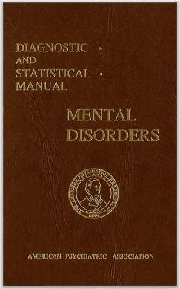
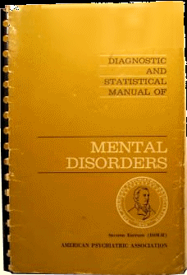
History of the Diagnosis
The Diagnostic & Statistical Manual of Mental Disorders (DSM)
DSM I (1952)
Disordered gambling not mentioned
Substance related disorders placed in “Personality Disorders- Sociopathic PD.”
DSM II (1968)
Disordered gambling not mentioned
Substance related disorders placed in “Personality Disorders and Certain Other Non-Psychotic Mental Disorders”

Slide 22
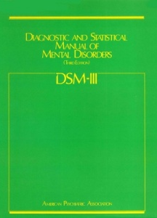
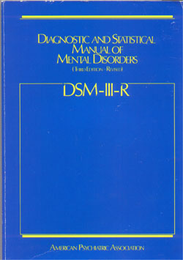
History of the Diagnosis
DSM III (1980)
1st time “Pathological Gambling” included
Placed in “Disorders of Impulse Control- NEC”(w Kleptomania, Pyromania)
Focus on finances and compromised, disrupted or damaged family, personal, & vocational pursuits
7 criterion (3 required for diagnosis)
DSM III-R (1987)
Remained “Pathological Gambling”
Remained in “Impulse Control Disorders NEC”
Basically, changed from focus on fraud and money to
adapting substance dependence criteria to gambling
Increased to 9 criterion (4 required for diagnosis)

Slide 23
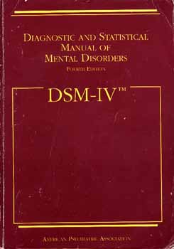
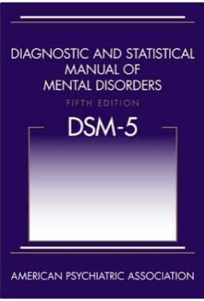
History of the Diagnosis
DSM IV (1994)
Remained “Pathological Gambling”
Remained in “Impulse-Control Disorders NEC”
New set of 10 criterion (5 required for diagnosis)
DSM-5 (2013)
Renamed: “Gambling Disorder”
Reclassified: in “Substance Related & Addictive Disorders”
Reduced to 9 criterion (Elimination of “illegal acts” criterion, as with SUDs)
Diagnostic cut-off lowered: 5 to 4 (different than SUDs)
Addition of Course Specifiers- Episodic or Persistent
Addition of Severity Specifiers- Mild(4-5), Moderate(6-7), Severe(8-9)
Addition of time frame: symptoms present within a 12-month period (as with SUDs)

Slide 24
DSM-5 Diagnostic Criteria
Persistent and recurrent problematic gambling behavior leading to clinically significant impairment or distress… 4 (or more) of the following in a 12-month period:
1. Needs to gamble with increasing amounts of money in order to achieve the desired excitement.
2. Is restless or irritable when attempting to cut down or stop.
3. Has made repeated unsuccessful efforts to control, cut back, stop gambling.
4. Is often preoccupied with gambling (e.g., having persistent thoughts of reliving.
5. Often gambles when feeling distressed (e.g. helpless, guilty, anxious, depressed).
6. After losing money gambling, often returns another day in order to get even (“chasing” one’s losses).
7. Lies to conceal the extent of involvement with gambling.
8. Has jeopardized or lost a significant relationship, job, or educational or career opportunity because of gambling.
9. Relies on others to provide money to relieve a desperate financial situation caused by gambling.

Slide 25
Other Non-Substance “Addictions”
Internet Gaming- in Section III (“Conditions for Further Study”)
Sex- dropped from Section III in final version
Eating- can be included in Feeding & Eating Disorders
Collecting- Hoarding Disorder added
Shopping- not included
Exercise- not included
Internet – not included

Slide 26
“Unique” Characteristics Of Pathological Gambling
The behavior is harder to define.
Gambling is a “hidden” addiction.
less physical consequences of use
overdose is not possible
Gambling is even less perceived of as a disorder than substance addiction.
No good objective tests for “use.”
The problem is more often perceived of as the solution.

Slide 27
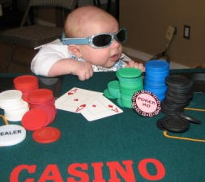
Genetics
Gambling addiction has a genetic component.
More in identical twins than non-identical
Like with other addictions, it is very complicated.
Only inherit an increased risk.
Associations with:
Dopamine receptor genes
Serotonin transporter genes
Monoamine Oxidase A Gene
Additionally, shared genetic association with other addictions (such as alcohol)

Slide 28
Early Exposure
@40-50% of children have been exposed to on-line gambling by adolescence
“Social” casino games
“Loot Boxes” in video games
Watching adults gamble
Holiday Lottery Tickets
School Bingo fund-raisers

Slide 29
Psychiatric Co-Morbidity
High correlation with mood and anxiety disorders
One study found 76% of pathological gamblers had a major depressive disorder with recurrent episodes in 28%
Suicide risk is high (17-24%)
Very high co-morbidity with alcohol and nicotine use disorders
if current alcohol dependence diagnosis, 16 times more likely to have current gambling problem
Less but significant co-morbidity with various other substance use disorders

Slide 30
Associated Medical Findings
2-6% of primary care patients meet the criteria of problem or pathological gambling
increased incidence of
insomnia
irritable bowel syndrome
peptic ulcer disease
hypertension
headaches/migraines

Slide 31
Neurochemistry
Norepinephrine Arousal
Dopamine Reward
Serotonin Compulsivity
Glutamate Craving; Cues
Opiate Reward Modulation

Slide 32
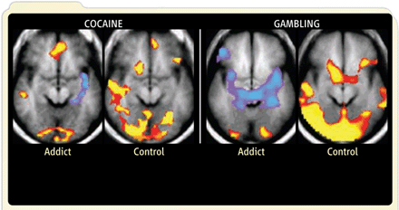
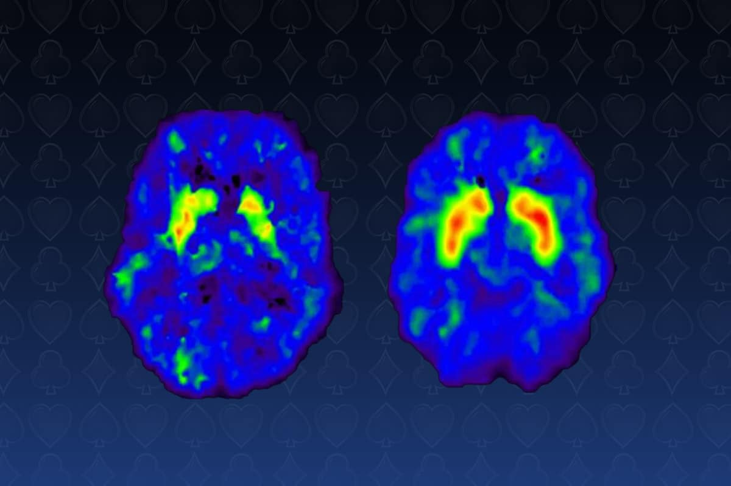
Neuroimaging
Ventromedial prefrontal cortex (vmPFC)
implicated in decision-making circuitry in risk-reward assessment
decreased activation in PG subjects during gambling cues
Also decreased activity in the basal ganglia and thalamus
Also impacts areas involved with dealing with stress
Addiction
Addiction

Slide 33
Thoughts & Behaviors
Tendency to increased Impulsivity.
A predisposition toward rapid, unplanned reactions to internal or external stimuli without regard to the negative consequences of these reactions to the individual or to others.
“Executive function” problems are greater in pathological gamblers compared to controls.
Planning
Cognitive flexibility
Categorization
Set-shifting
Response inhibition

Slide 34
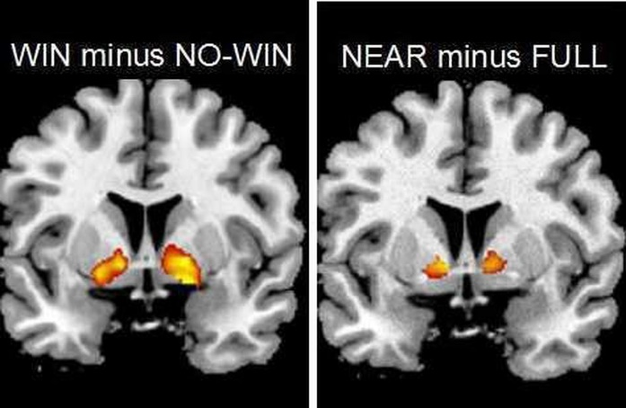
“Near Misses”
People with problematic gambling tend to interpret “near misses differently.
Near-misses were associated with significantly greater signal in the ventral striatum and anterior insula
Recruitment of win-related regions during near-miss outcomes underlies their ability to promote gambling behavior

Slide 35
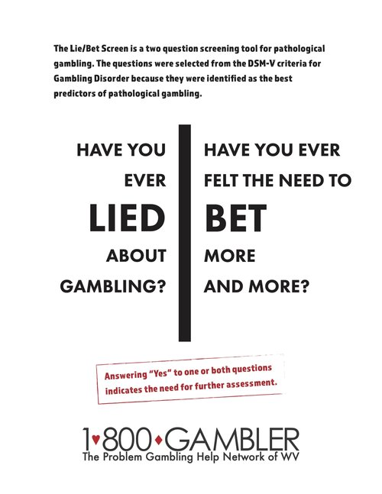
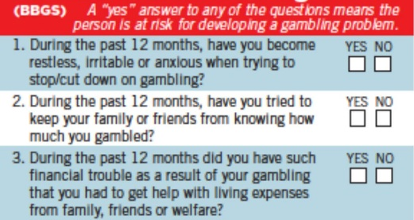
Problem Gambling Assessment Instruments & Screens
South Oaks Gambling Screen (SOGS)
National Opinion Research Center DSM Screen for Problem Gambling (NODS)
“Lie-Bet” 2 Question Brief Screen
CLiP
PERC
Brief Biosocial Gambling Screen
G.A.’s Twenty Questions
SOGS-R A- Adolescent Screen

Slide 36
Treatment
Medication
Psychotherapy
Mutual help

Slide 37
Medications
Various medications tested
SSRIs, Nefazadone, Buproprion, Clomipramine, Lithium, Valproate, Carbamazepine, Topiramate, Naltrexone, N-acetyl cysteine
Best evidence for naltrexone
None FDA approved for Gambling Disorder

Slide 38
Special Case
Pramipexole (Mirapex)
Dopamine agonist
Used to treat Parkinson’s Disease & Restless Leg Syndrome
Some patients have developed gambling problems
very small number (9 out of 529)
not sure of the connection

Slide 39

Gamblers Anonymous
Founded in 1957 by Jim W.
Open and closed meetings
not many open meetings secondary to legal concerns
Pressure Relief Group
not found in AA
gambler and spouse meet with GA members
bring in income and debt information
the group works out a budget to repay those owed money
12 steps
similar to AA

Slide 40
MD Prevalence Survey
Original phone survey conducted in 2010 (before casinos)
Repeat surveys in 2017, 2020, 2022 (now by mail)
Only adults
90% of adults in Maryland have gambled
Among adults gambling in Maryland
@ 22% gambled monthly in the past year (spend @ $190/month gambling)
@15% gambled weekly in the past year (spend @ $550/month gambling)
Found 1.6% have “probable pathological” gambling and 2.4% have “problem” gambling.
When combined, the prevalence rate of problem & pathological gambling is @ 4% (>150,000 adults).

Slide 41
Gambling in Maryland: Risk 2022 Survey of Maryland Adults (18+)

Slide 42
Gambling in Maryland: Sports 2022 Survey of Maryland Adults (18+)
Gender
Male: 34.6%
Female: 21.6%
Marital Status:
Married: 30.6%
Not married: 23.5%
Age (in years)*
18-24: 20.9% 25-34: 28.1% 35-44: 30.4% 45-54: 31.4% | 55-64: 27.3% 65-74: 24.2% 75+: 21.5%
Highest level of education:
High school diploma or less: 22.1%
Some school/vocational training beyond H.S.: 27.6%
Bachelor’s degree: 27.8%
Master’s degree or higher: 33.0%

Slide 43
Gambling in Maryland: Sports 2022 Survey of Maryland Adults (18+)
Of the Maryland residents who had gambled on sports:
50% had done so in the past 12 months
49% had wagered on yearly fantasy sports.
28% had wagered on daily fantasy sports.
Online sports gambling and fantasy sports were more commonly reported among younger age groups and amongst those who worked full-time.
At least 10% of sports gamblers were experiencing some disordered gambling.

Slide 44
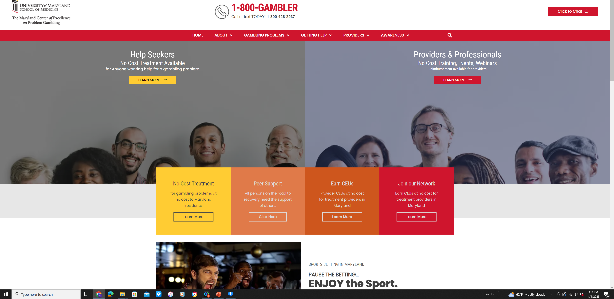
MCEPG

Slide 45
Funding of Problem Gambling Fund
Initially funded by slot machine (VLT) fees with additional sources added.
Video Lottery Terminal (VLT)- $425/machine/year
Table Game- $500/table game/year
Unclaimed Winnings from On-site Sports Wagers
Violations of the VEP
NOT Lottery, sports wagering, horse racing, Bingo

Slide 46
The Maryland Center of Excellence on Problem Gambling
24/7 Call Center/Referral Services
Peer Recovery Specialist Program
Training & Professional Education
Clinical Consultation & Supervision
Public Awareness
Prevention Programs
Policy Development
Research

Slide 47

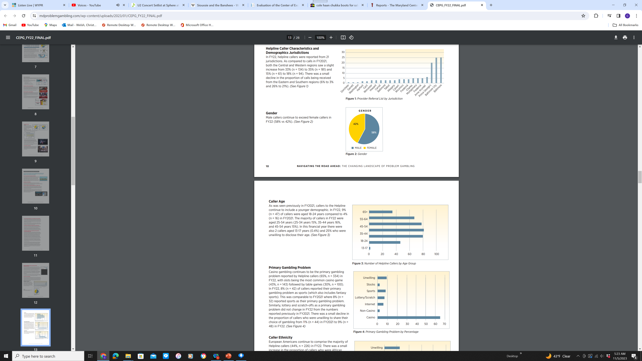
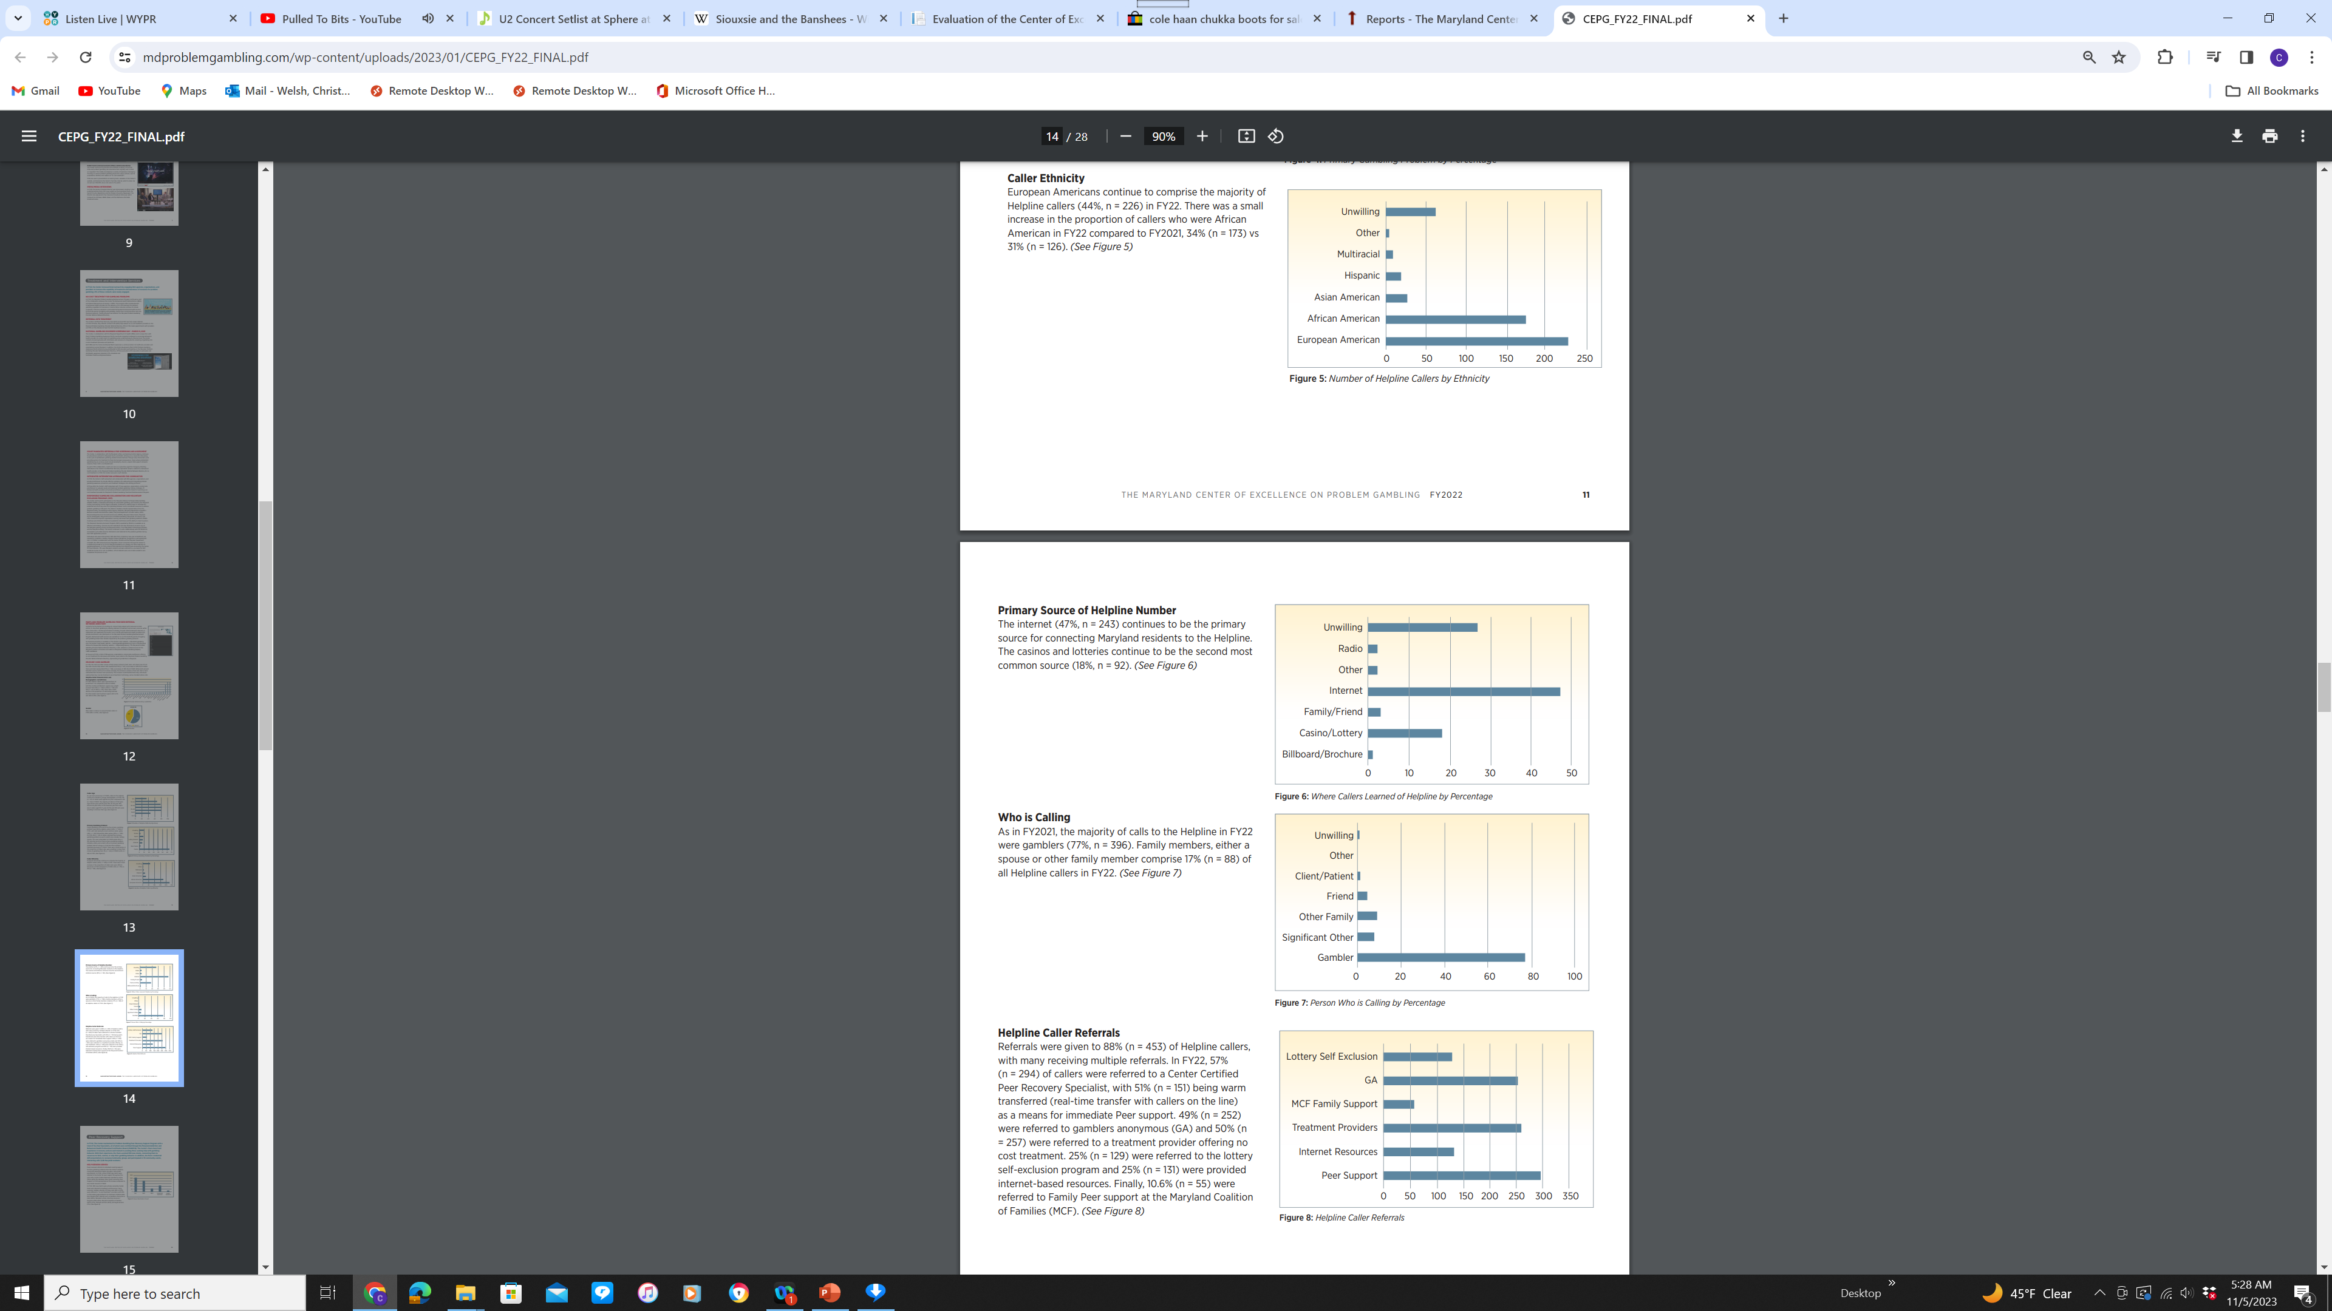
Help Line
24/7
Initially handled internally/locally
Now through a national # & call center in Louisiana
FY 2022 data

Slide 48
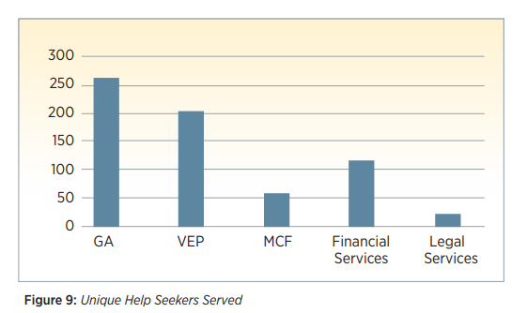
Help Line
FY 2022 data

Slide 49
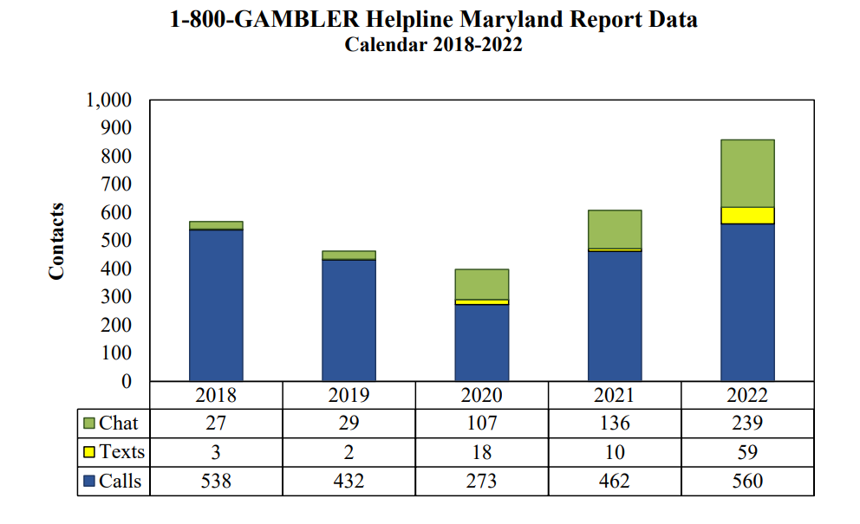
Help Line

Slide 50
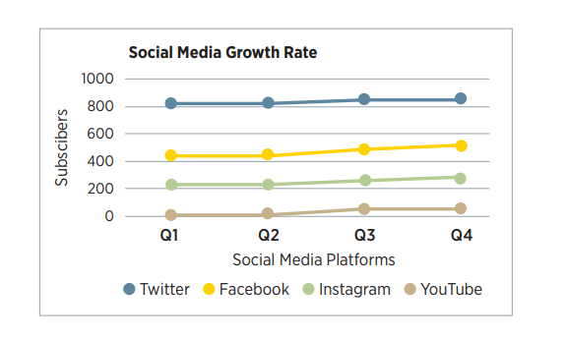
Social Media
> 400 social media public awareness messages posted to Twitter, Facebook, Instagram in FY 2022
> 17,000 subscribers reached

Slide 51
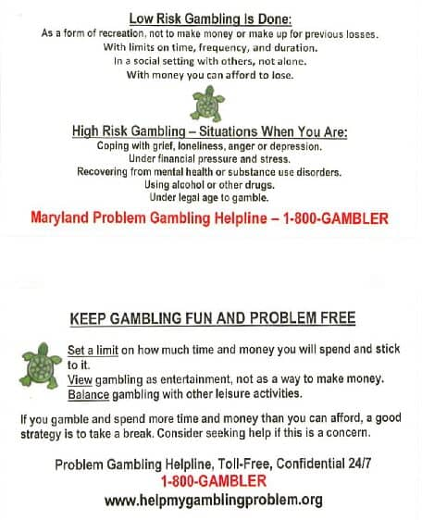
Safer Gambling

Slide 52
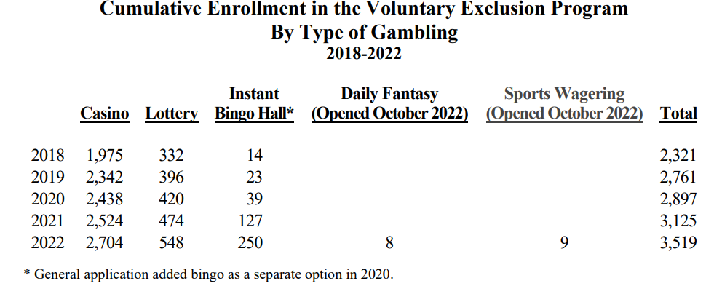
Voluntary Exclusion Program (VEP)
A self-limiting, exclusion tool for individuals who find themselves at-risk for gambling problems.
Operated by Maryland Lottery & Gaming Control Agency
Maryland gaming venues
6 Maryland casinos, 6 of Maryland’s instant bingo facilities, Maryland Lottery, Sports betting venues
2-year commitment
To get off, must complete a Healthy Lifestyle Choices Workbook; can meet with a counselor

Slide 53
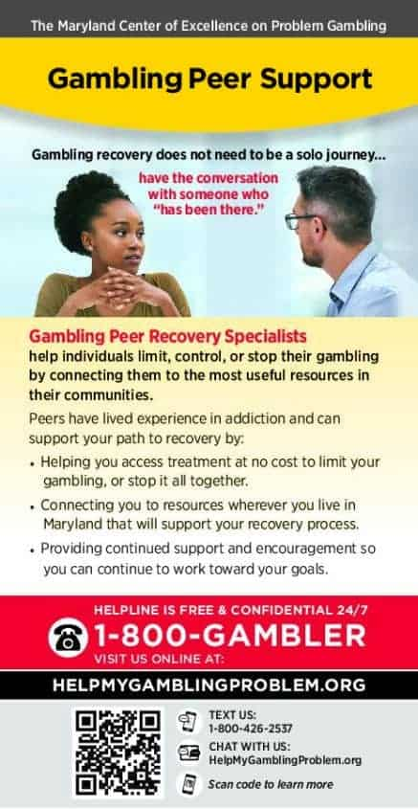
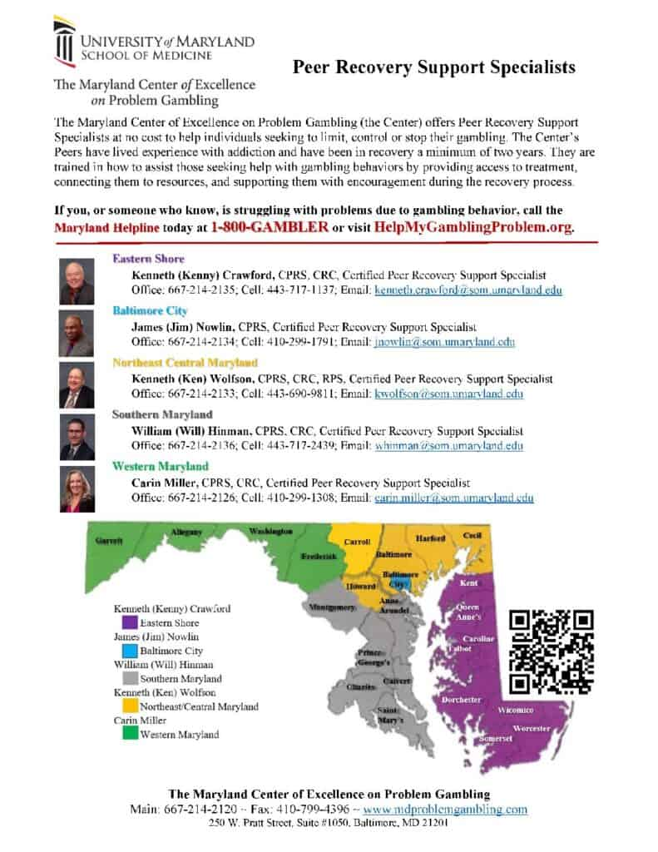
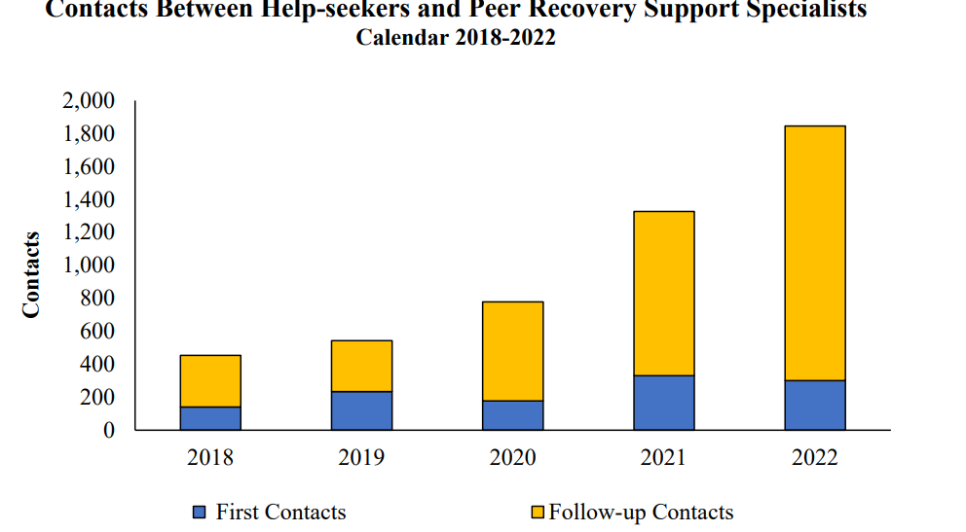
Peer Recovery Specialists
Program began in 2017 with 1 peer.
Now with 5 peers (and hiring 3 more).
Each covers a region of the state.
Liaison with various programs & community groups.
In FY2002, saw 330 new clients and followed > 400 clients.

Slide 54

Understanding Joy

Slide 55
Resources
Maryland Center of Excellence on Problem Gambling
www.MdProblemGambling.com
800-GAMBLER
National Council on Problem Gambling
www.ncpgambling.org
Gamblers Anonymous
www.gamblersanonymous.org

