Slide 1


Vaping–Facts and myths
Janaki Deepak
Associate Professor
Department Of pulmonary and critical Care medicine
University Of Maryland School Of Medicine
Director of Tobacco Health Practice
Director Of Lung Mass Clinic
VAMHCS Baltimore, MD

Slide 2

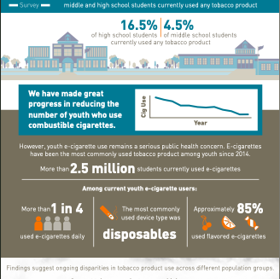
Park-Lee E, Ren C, Cooper M, Cornelius M, Jamal A, Cullen KA. Tobacco Product Use Among Middle and High School Students — United States, 2022. MMWR Morb Mortal Wkly Rep 2022;71:1429–1435. DOI: http://dx.doi.org/10.15585/mmwr.mm7145a1

Slide 3
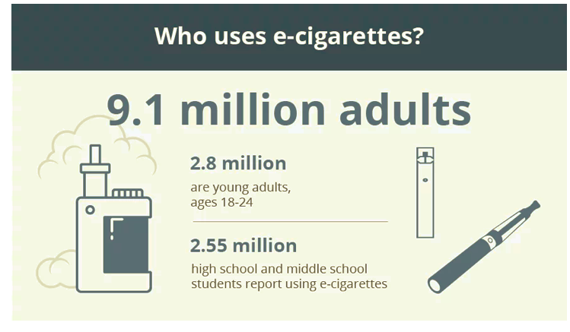

Slide 4
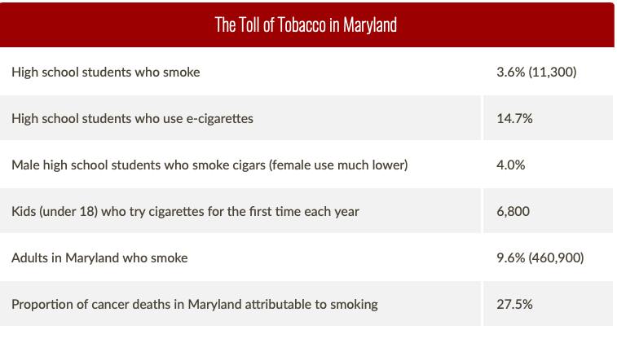

Slide 5
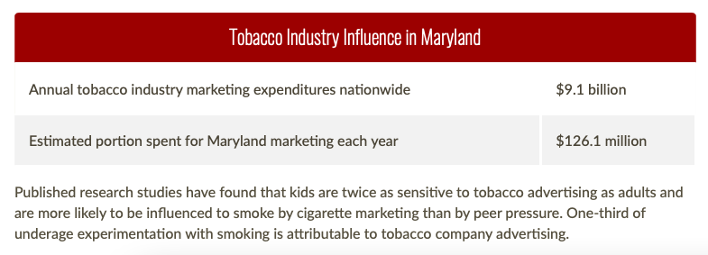

Slide 6
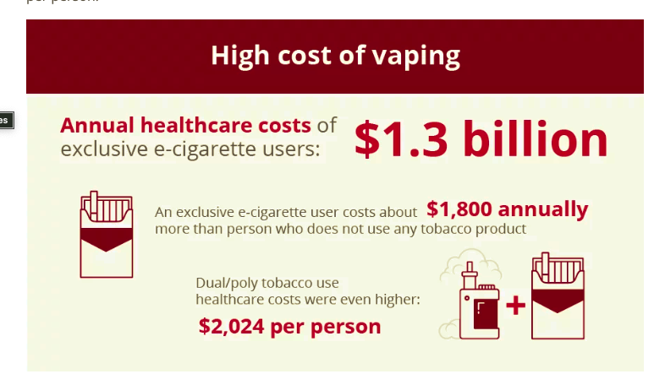

Slide 7
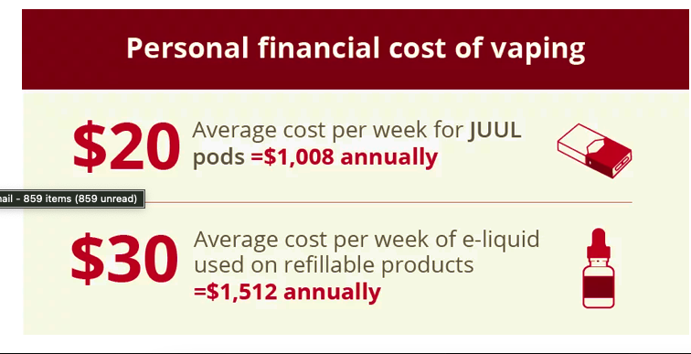

Slide 8
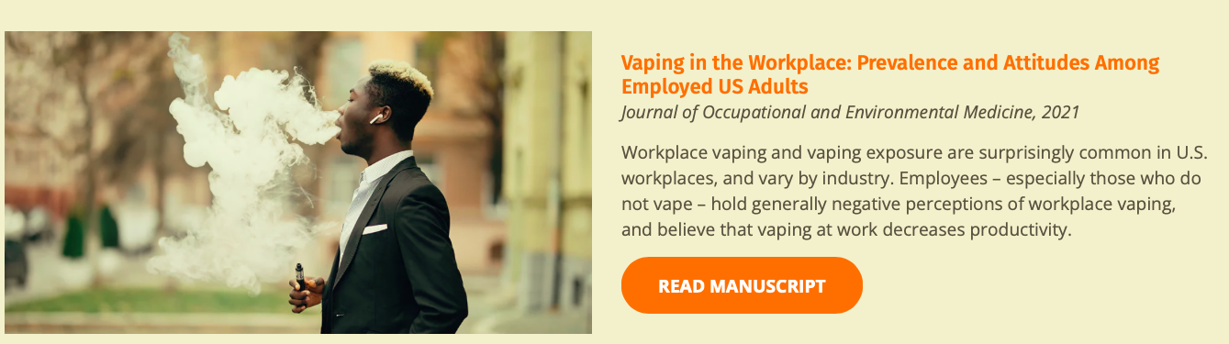

Slide 9

VAPING
“Refers to the use of an electronic device that ‘vaporizes’ a liquid to be inhaled by the user”
2019 AAP
Notes:
Many of these devices are distinguished from combustible tobacco products – that is tobacco product that involves burning the leaf for inhalation such as with traditional cigarettes.
Instead, generally, vaping refers to the use of an electronic devices that vaporizes a liquid (and more accurately could be described as an aerosol which is a suspension of particles in a gas); and as we will see…that liquid can be most anything, including nicotine, marijuana, amphetamines etc.) to be inhaled by the user.

Slide 10
VAPING OTHER TERMS
“Dripping,” directly dripping vape liquids onto the heated coils for inhalation_
Dripping involves higher temperatures, which leads to higher amounts of nicotine delivered, along with more formaldehyde, acetaldehyde, and acetone
Dabbing refers to inhalation of combustion of cannabinoid concentrates, --faster hallucinogenic
Notes:
Dripping – dripping liquids directly onto the coil to produce larger plumes, more flavors, and unpredictable chemicals
Dabbing – using the often viscous, semi solid THC –extract derivative used in the mods and superheating
The word “marijuana” refers to parts of or products from the plant Cannabis sativa that contain substantial amounts of tetrahydrocannabinol (THC). THC is the substance that’s primarily responsible for the effects of marijuana on a person’s mental state. Some cannabis plants contain very little THC.
The word “cannabis” refers to all products derived from the plant Cannabis sativa.
What are cannabinoids?
Cannabinoids are a group of substances found in the cannabis plant.
What are the main cannabinoids?
The main cannabinoids are THC and cannabidiol (CBD).

Slide 11
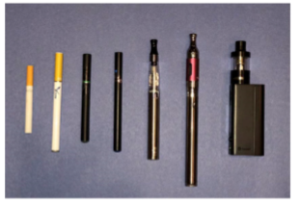


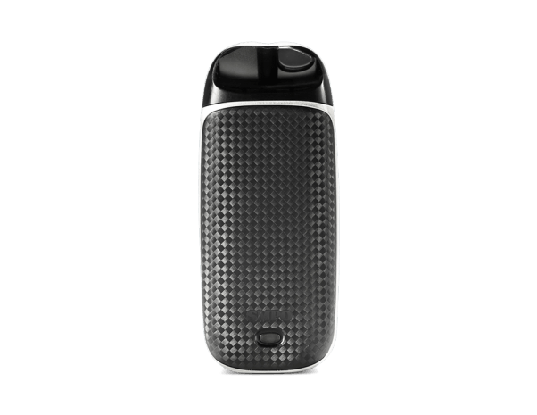
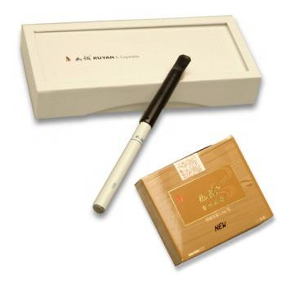
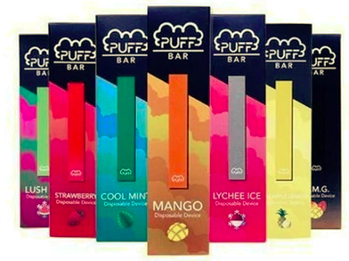

Vape devices – Evolution…
4th Generation - JUUL
4th Generation - SMPO
4th Generation - Suorin
Generations 1, 2, 3
2003, Ruyan
4th Generation –
Puff
4th Generation –
Ezzy

Slide 12

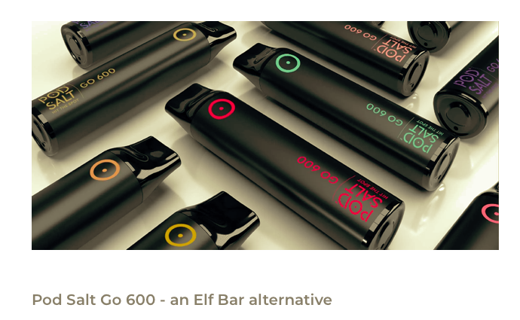

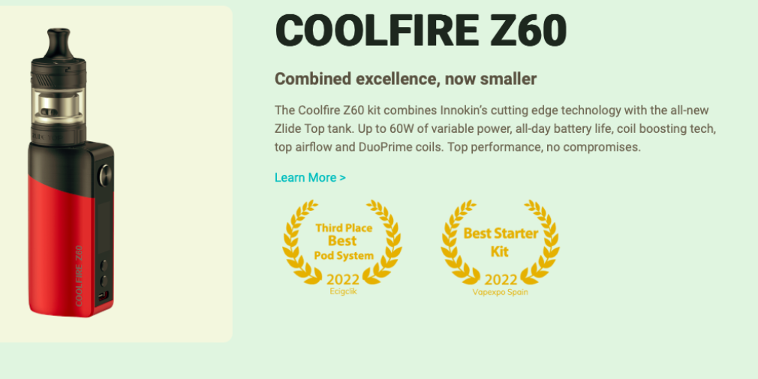
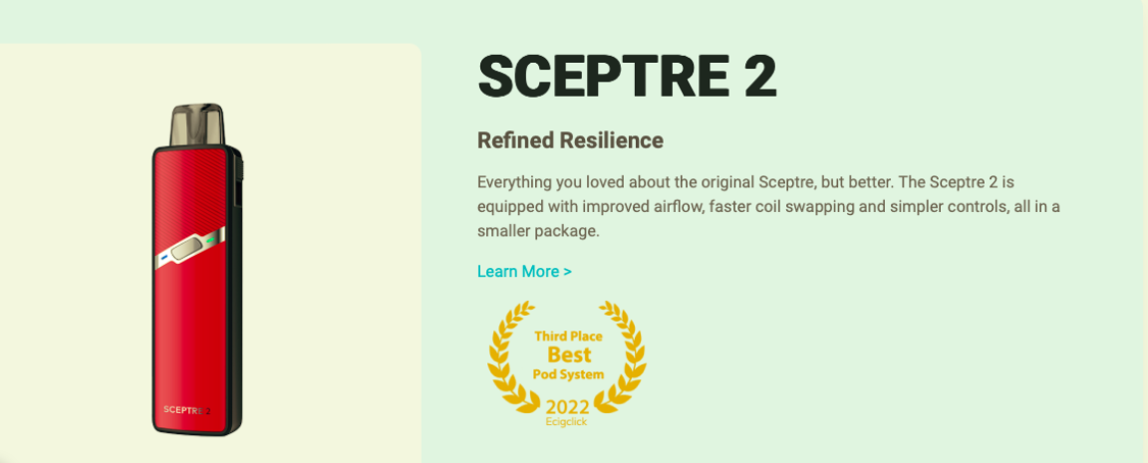
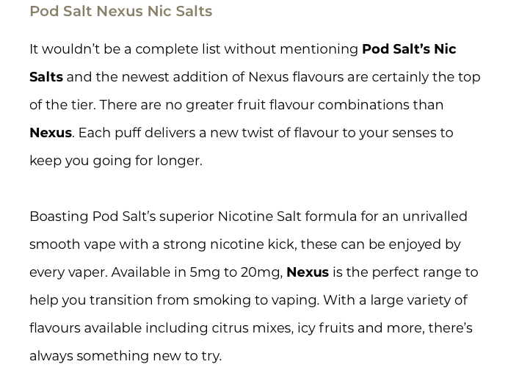



Slide 13
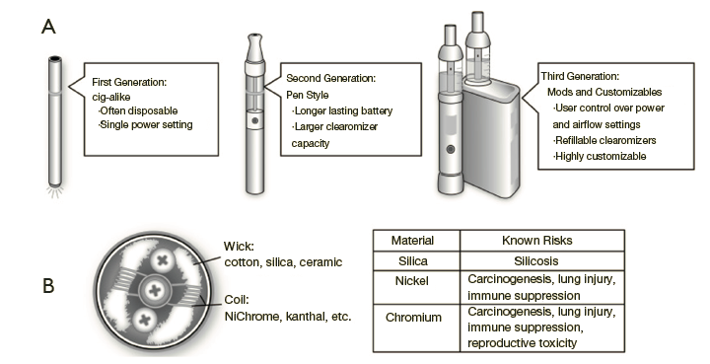
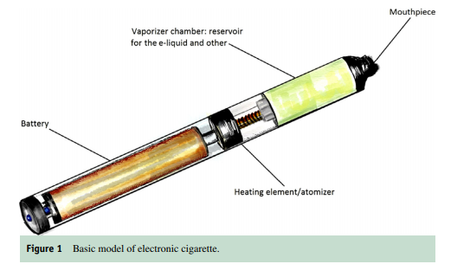

Vape devices
Silica : Coal miners Lungs
Brick Layers Lungs
Ceramic: also contains silica
Heavy Metals: Nickel and Chromium- Causes Cancer
Am J Med. 2020 Jun;133(6):657-663. doi: 10.1016/j.amjmed.2020.02.004. Epub 2020 Mar 13. PMID: 32179055.
2019 AAP
Notes:
While there are hundreds, maybe even thousands of different products, the basic anatomy shared by most vape device is depicted here.
Notice that this particular model has a “cigarette-like” appearance, but this is not standard.
What is standard includes:
Reservoir or tank containing an e-liquid
A wick that transfers that e-liquid to a heating coil
A heating coil which applies heat to vaporizes that liquid, which condenses into droplets then is inhaled by the user
Mouthpiece (self-explanatory)
Battery or power source
Button to activate power source
Note that within these products of vape devices there has been quite the evolution…

Slide 14
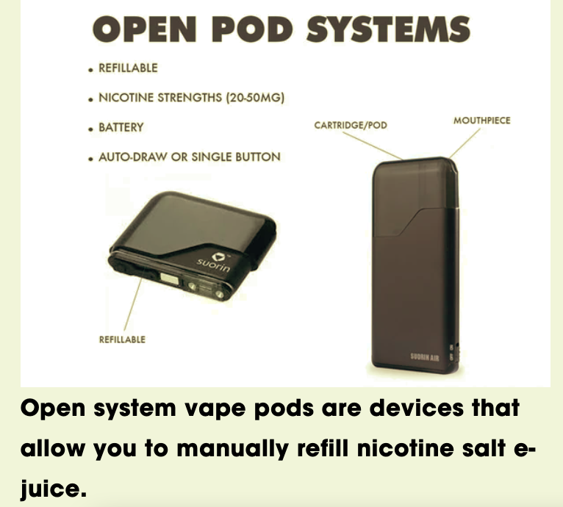
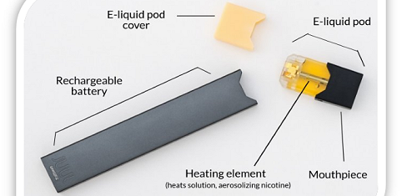
CLOSED PODS
DISPOSABLE
cdc.gov

Slide 15
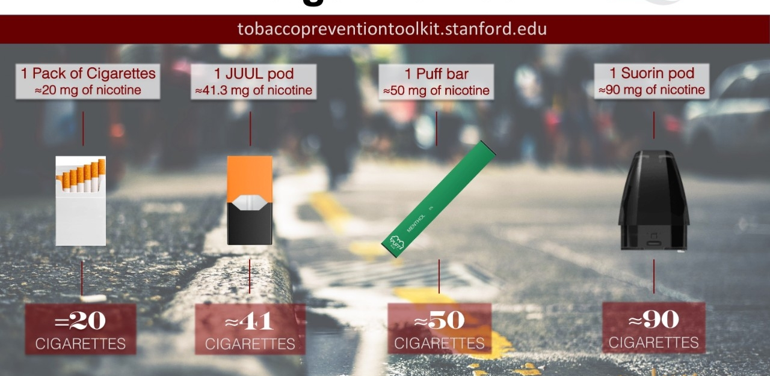

Slide 16
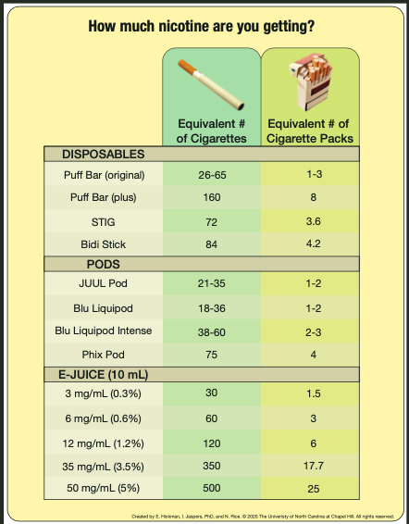

Slide 17
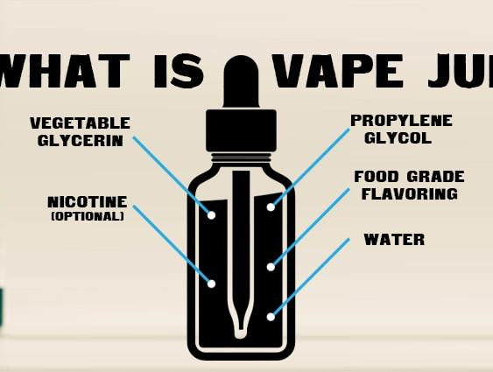
E-Juice
Liquid composition:
Active ingredient (i.e., nicotine, THC, Cannabis)
Solvents
Propylene Glycol
Glycerol
Flavorings
eucalyptol, camphor, methyl salicylate, ethyl salicylate, cinnamaldehyde, eugenol, diphenyl ether, benzaldehyde,
Improve the taste of tobacco products
Reduce the “harshness” or irritation

Slide 18
Gas composition
Gas and particulate composition:
Droplets
Particulates
Heavy metals
Carcinogens-Causes Cancers (Nitrosamines, formaldehyde)
Flavoring (diacetyl) Popcorn workers lungs
Formaldehyde

Slide 19
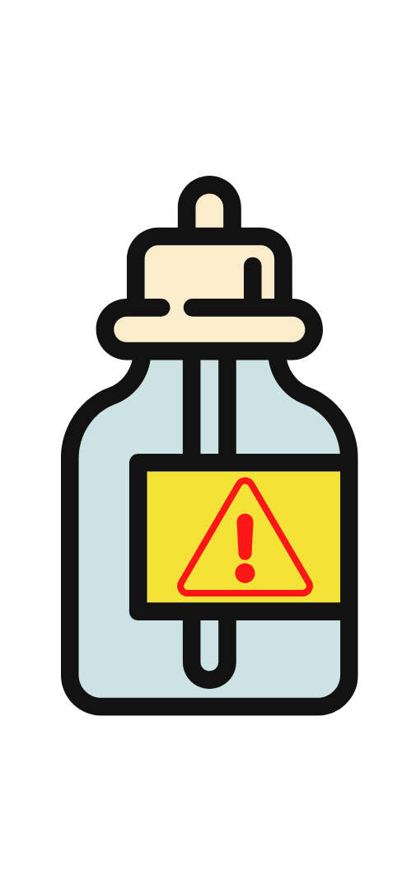
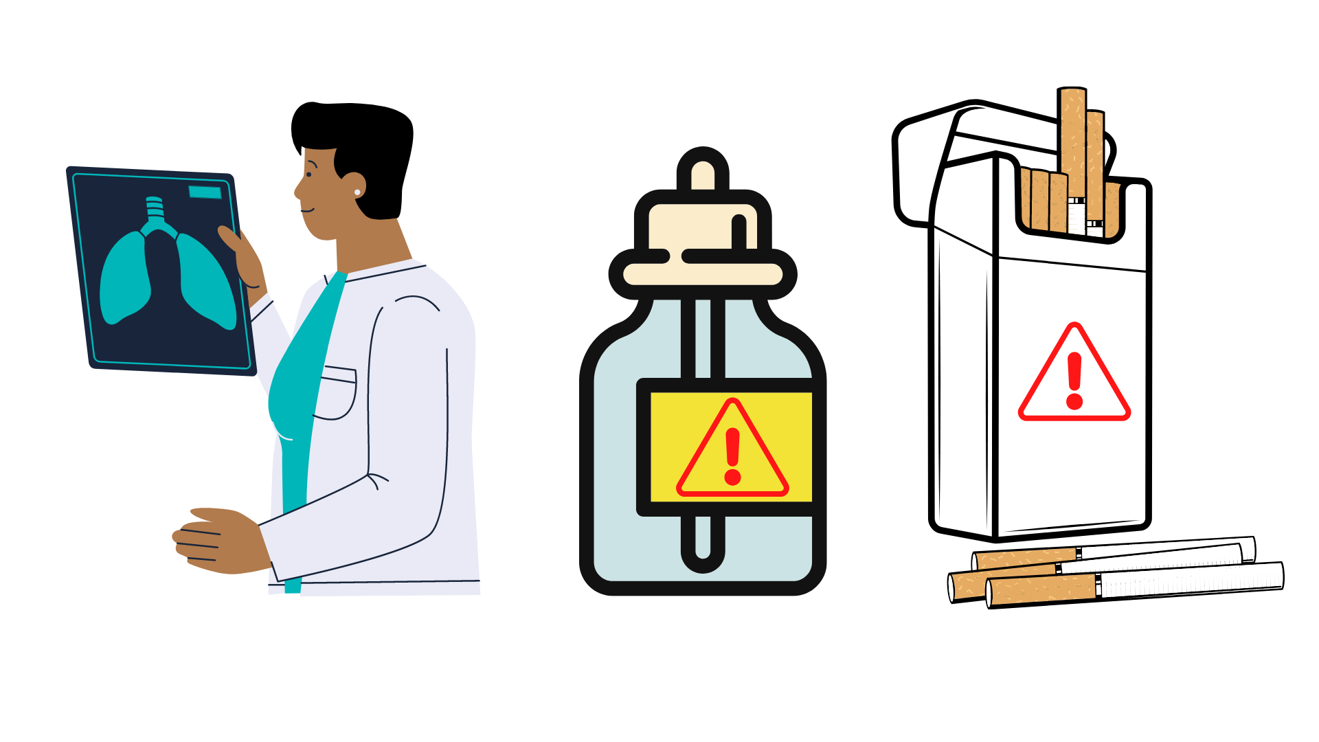
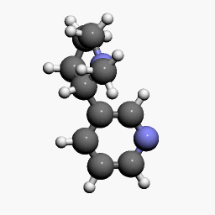
Effects of Nicotine
Notes:
Let’s start with talking about the specific effects of nicotine.

Slide 20
What is Nicotine?
Nicotine Molecule
Drug
Stimulant
Highly addictive
Causes changes in brain chemistry
Found in tobacco products
If nicotine is unsafe, why do you think people still choose to use products that have nicotine?
Notes:
Nicotine is a drug that is a stimulant, meaning it raises levels of physical or psychological activity in the body, and it is toxic at high doses.
It is highly addictive since it causes changes in brain chemistry quickly and leaves the brain craving more.
Nicotine is found in tobacco products and nicotine exposure during fetal development has lasting adverse consequences for brain development as it can affect maternal and fetal health during pregnancy.
Data from studies of mice suggest that nicotine exposure during adolescence may have lasting adverse effects on brain development.
(Click) If nicotine is unsafe, why do you think people still choose to use products that have nicotine?

Slide 21
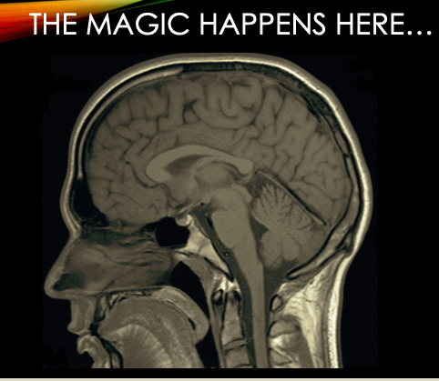
NICOTINE AND BRAIN
Nicotiana tabacum,
Notes:
"Tobacco" is a name used for plants of Nicotiana (nightshade family)
The English word tobacco originates from the Spanish and Portuguese word tabaco.
The name is also used for the product manufactured from tobacco leaves and used in cigars, cigarettes, E-cigarettes, vaping devices, hookah, snuff, and pipe and chewing tobacco.

Slide 22
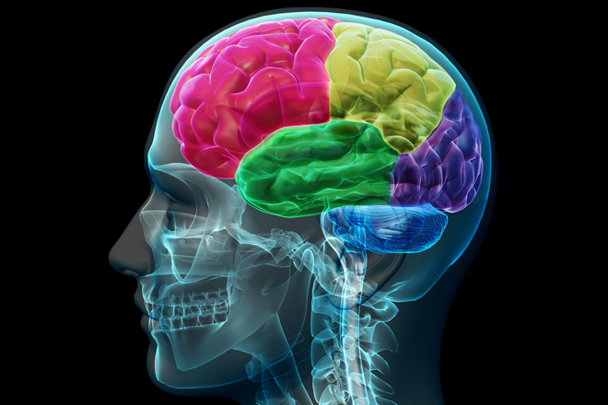
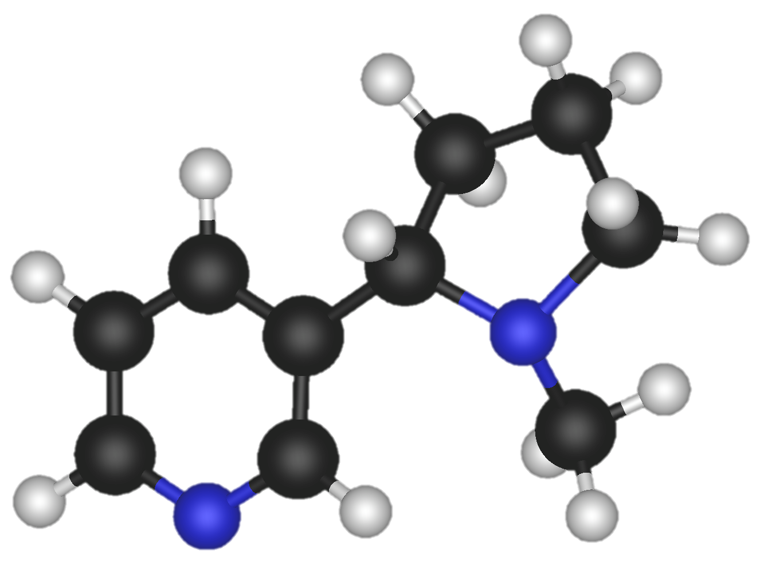
Nicotine in the Brain
Notes:
The reaction that nicotine has in the brain results in the stimulation of pleasure centers in the brain.
(Click) When inhaled, nicotine enters into the brain after passing through the lungs.
Then It binds to pleasure receptors in the brain.
(Click) That causes a release of pleasure chemicals such as dopamine, providing the user with a temporary feeling of pleasure.

Slide 23
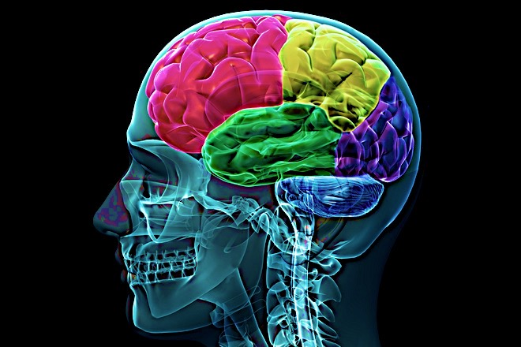
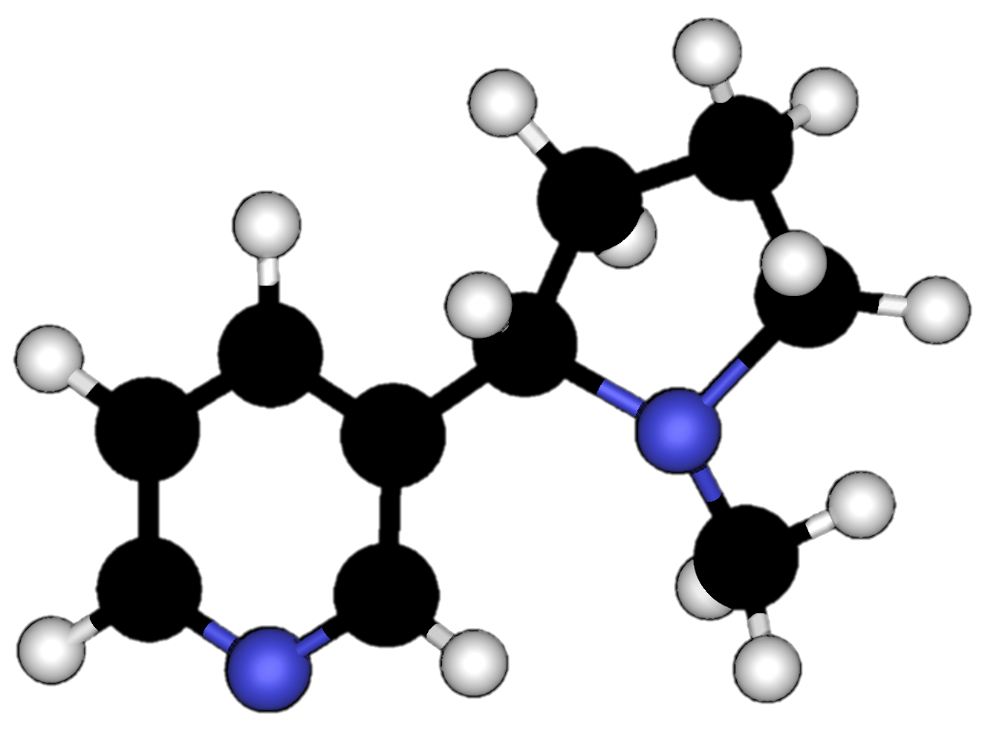
Nicotine Addiction
Notes:
This might not sound dangerous but in reality, the nicotine interferes with the body’s natural ability to experience/communicate pleasure.
Nicotine use creates floods of dopamine and intense feelings.
The pleasure centers in the brain adapts to drug use by sensing the extra dopamine and then begins to produce less of it.
This means that the user has a hard time creating natural feelings of pleasure without nicotine.
The user needs the nicotine just to feel normal.
Additionally, the pleasure centers in the brain creates a memory of nicotine and an appetite for it.
That appetite for nicotine, even despite its harmful consequences, is what we refer to as nicotine addiction.

Slide 24
The Nature of Nicotine’s Special Effect on the Brain
Hijacking Survival Instincts
Creating compulsion: connections between environment and behavior
The Connection to Emotion
The cigarette /Vape device as a highly engineered nicotine delivery device
chronic disease
Clin Pulm Med. 2012 March 1; 19(2): 53–61. doi:10.1097/CPM.0b013e318247cada.

Slide 25
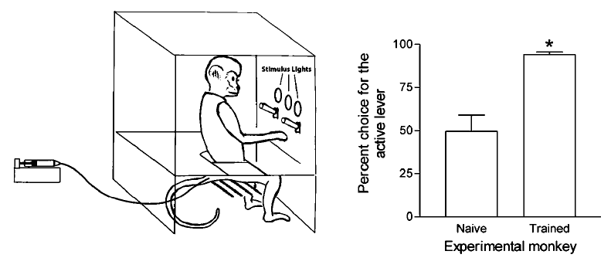

Slide 26
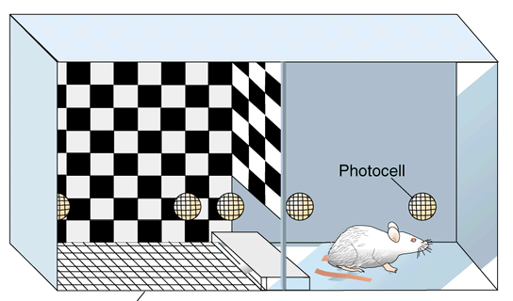

Slide 27
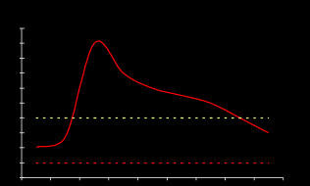
BRAIN RESPONDS TO CHANGES IN NICOTINE LEVEL

Slide 28
MEMORY
DECIDING RIGHT FROM WRONG
INITIATION OF BEHAVIOR
MOTIVATION/ SAFETY
Holgate, Joan & Bartlett, Selena. (2015). Early Life Stress, Nicotinic Acetylcholine Receptors and Alcohol Use Disorders. Brain sciences. 5. 258-74.

Slide 29
The cigarette should not be construed as a product but a package. The product is nicotine. Think of a puff of smoke as the vehicle for nicotine....Think of the cigarette as the dispenser for a dose unit of nicotine....Smoke is beyond question the most optimized vehicle of nicotine and the cigarette the most optimized dispenser of smoke.
William L. Dunn Jr., Philip Morris researcher, 19723)

Slide 30
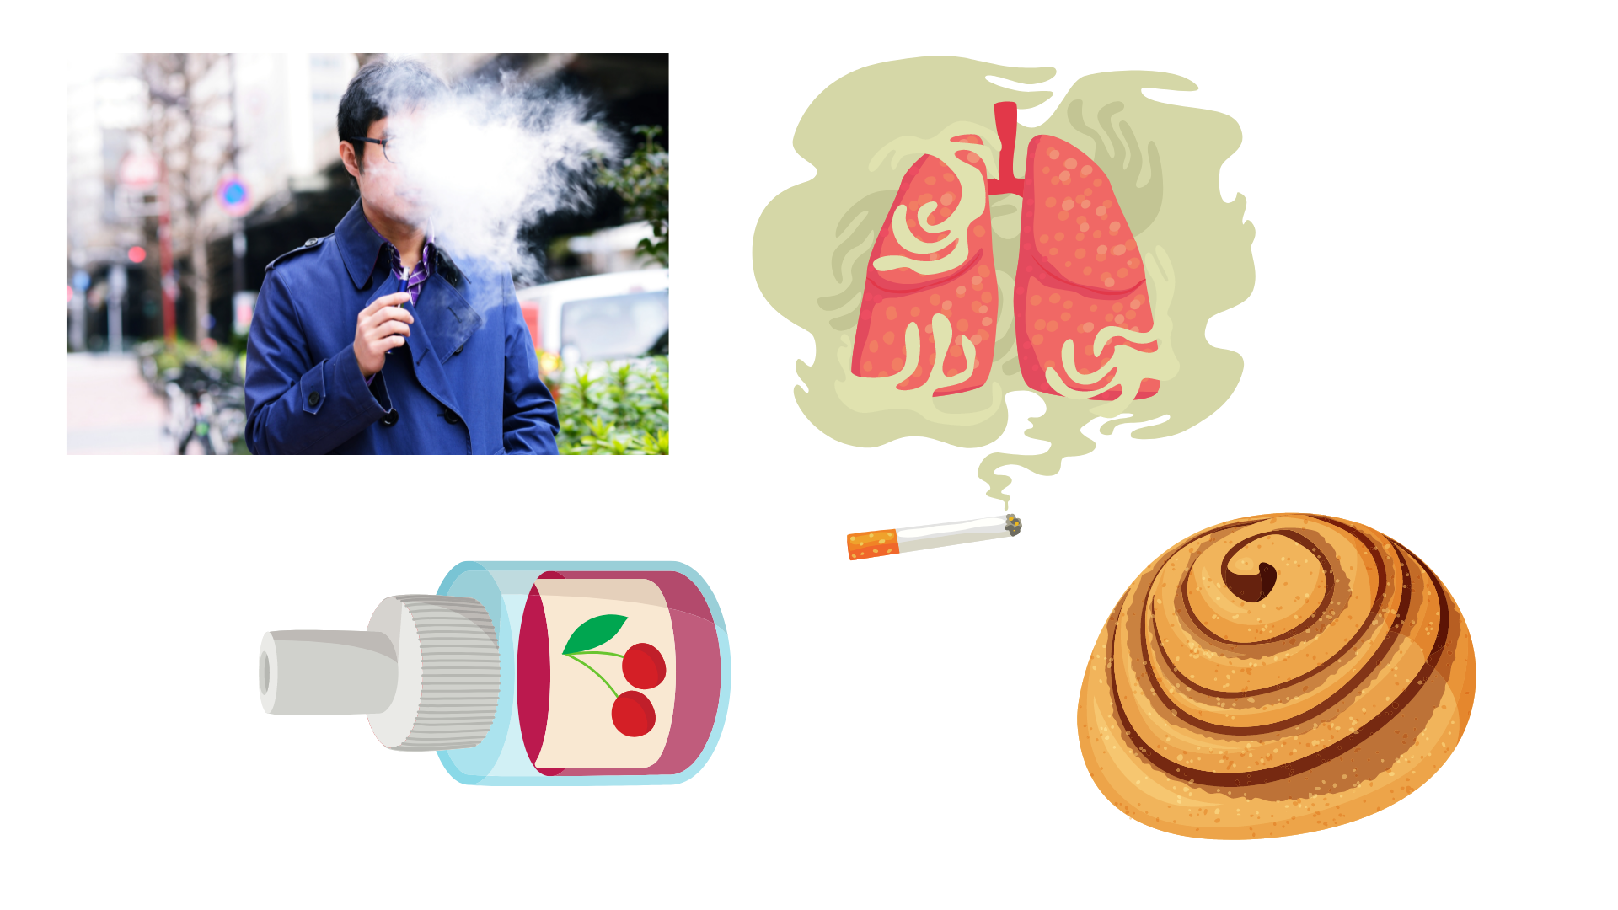
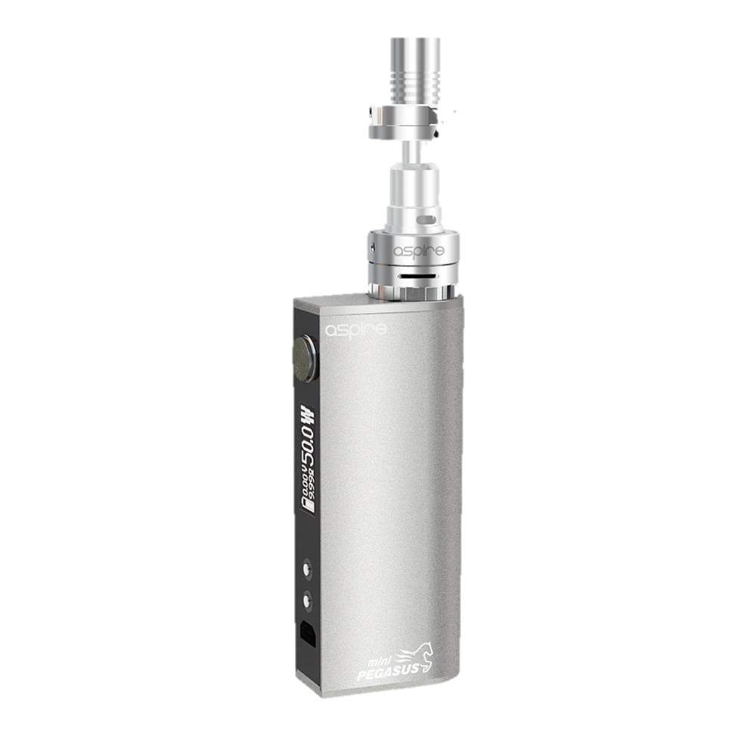
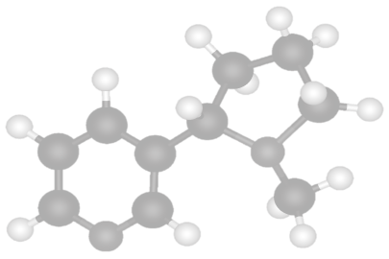
Cycle of Nicotine Addiction
Notes:
Nicotine is highly addictive. What that means is, the human brain can develop such a strong dependence on the drug that the nicotine user can no longer control their desire or smoking behaviors.
(Click) The cycle of nicotine addiction starts with bringing nicotine into the body. In this case it comes inhalation of cigarettes, hookah, and or e-cigs/vapes.
(Click) Nicotine enters the brain and activates the pleasure centers of the brain.
(Click) After, the level of nicotine in the body drops quickly.
(Click) This drop in nicotine levels causes the body to have a strong craving for nicotine that is satisfied by bringing more nicotine into the body.
This cycle is powered by the body’s biological reaction to nicotine and isn’t controlled by the person vaping.
Based on this information, what could you say to someone who says they won’t let themselves get addicted to nicotine?

Slide 31

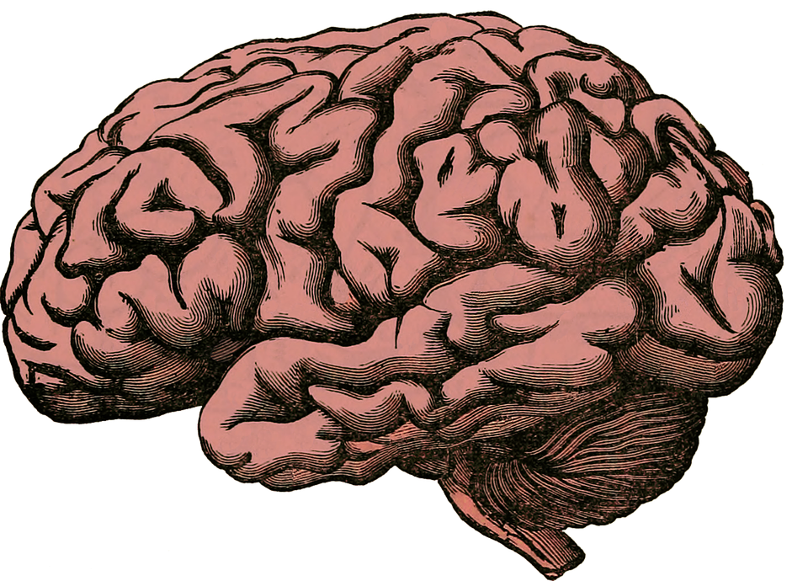
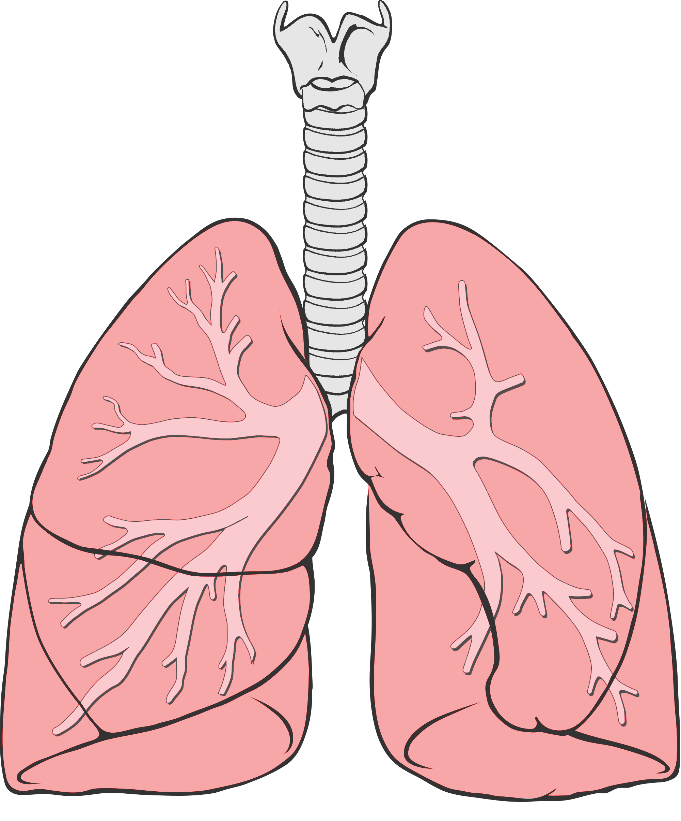
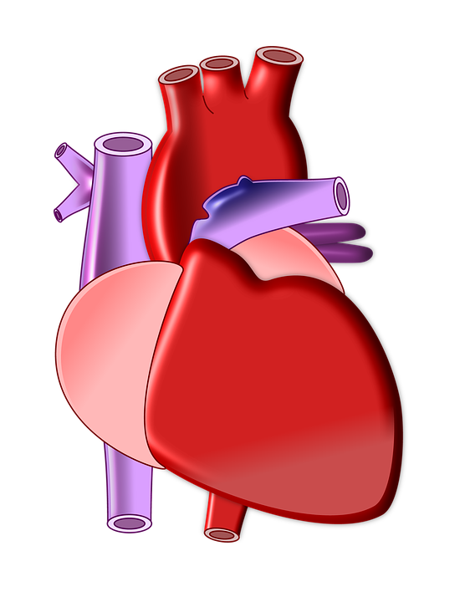
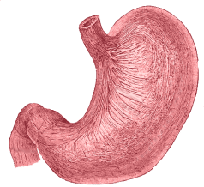
Nicotine Targets Your Whole Body
Rewire and changes the brain
Heart beats faster due to ”fight or flight” response
Trouble breathing and damage to the lungs
Increased acid reflux
Notes:
(Click) Nicotine rewires and changes a young person’s brain, making a person anxious when their brain is going through nicotine withdrawal. Nicotine doesn’t just affect your brain since there are “acetylcholine” receptors all over your body.
(Click) For example, using nicotine can make your heartbeat faster because it activates your “fight or flight response.”
Nicotine salt solutions in particular produce a faster and higher heart rate than other aerosolized nicotine solutions, which can put stress on the heart.
(Click) Outside of all the chemicals and toxins already in e-cigarettes, nicotine can independently cause trouble breathing and damage to the lungs. The lungs generally produce mucus and cough in response to the harmful chemicals inhaled.
(Click) Nicotine can also cause increased acid reflux, which leads to heartburn.
Last by not least, nicotine can even negatively impact your reproductive organs.
Reference:
http://www.ncbi.nlm.nih.gov/pmc/articles/PMC4363846/#ref1
https://patents.google.com/patent/CA2909967A1/en
Image Credit:
Pixabay.com, Deviantart.com, Wikimedia Commons

Slide 32

Effects of Flavors

Slide 33
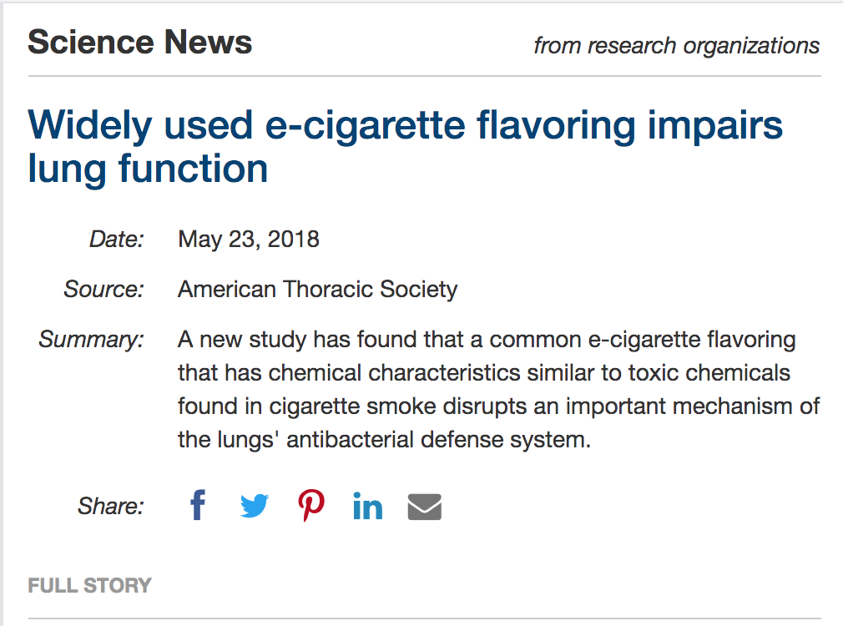


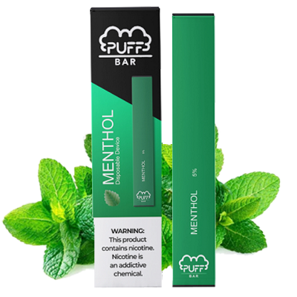


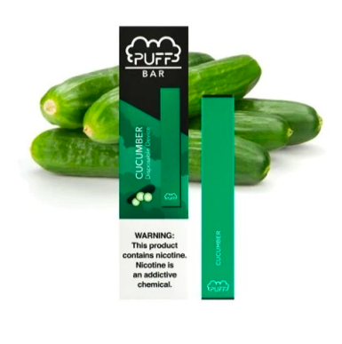
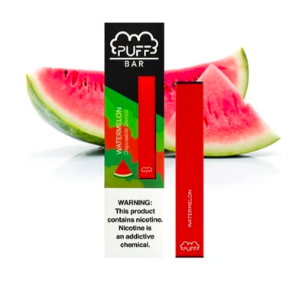
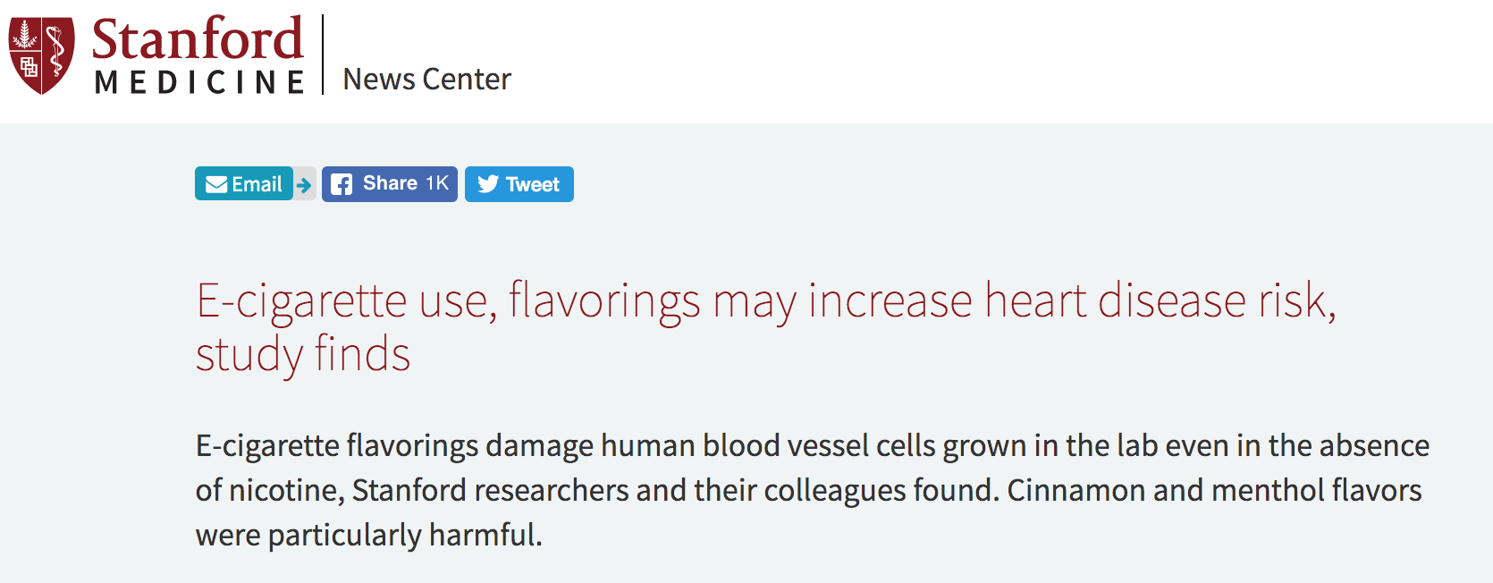


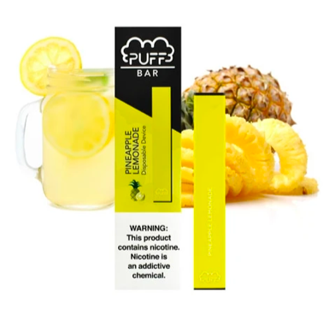
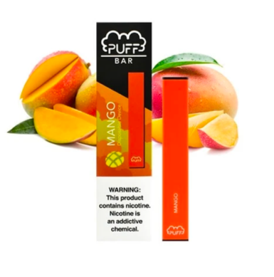


Why Flavors?
Notes:
Earlier we discussed how pod-based companies have fruity and sweet flavor pods along with colors.
(Click) Why would there be over 15,500 e-juice flavor options such as Banana Butt and Honey Doo Doo?
It’s important to be aware that this is another example of the pod-based companies following well-known advertising strategies from Big Tobacco’s playbook.
They know that flavors are a great way to attract young costumers because they are the group most interested in sweet flavors and bright colors.
This tactic is so effective that flavored cigarettes have been banned since 2009, since extensive research shows that they are more appealing to young people. The pod-based companies along with other e-cigarettes have yet to be regulated in this way.
(Click) More and more evidence is piling, proving that these flavors are dangerous in and of themselves.
(Click) So far we know that flavors can impair lung function and increase risk for heart disease.
But pod-based companies continue to use them because they know it makes their products seem appealing and safe to teens.
Reference:
https://www.flavorshookkids.org/
http://www.onlinejacc.org/content/73/21/2722
https://www.sciencedaily.com/releases/2018/05/180523172310.htm
Images:
http://www.liherald.com/rockvillecentre/stories/rockville-centre-coalition-for-youth-persists-to-stop-flavored-juul-sales,114268
https://thepodgod.shop/collections/puff-bars?page=1
https://thepodgod.shop/collections/puff-bars?page=2

Slide 34
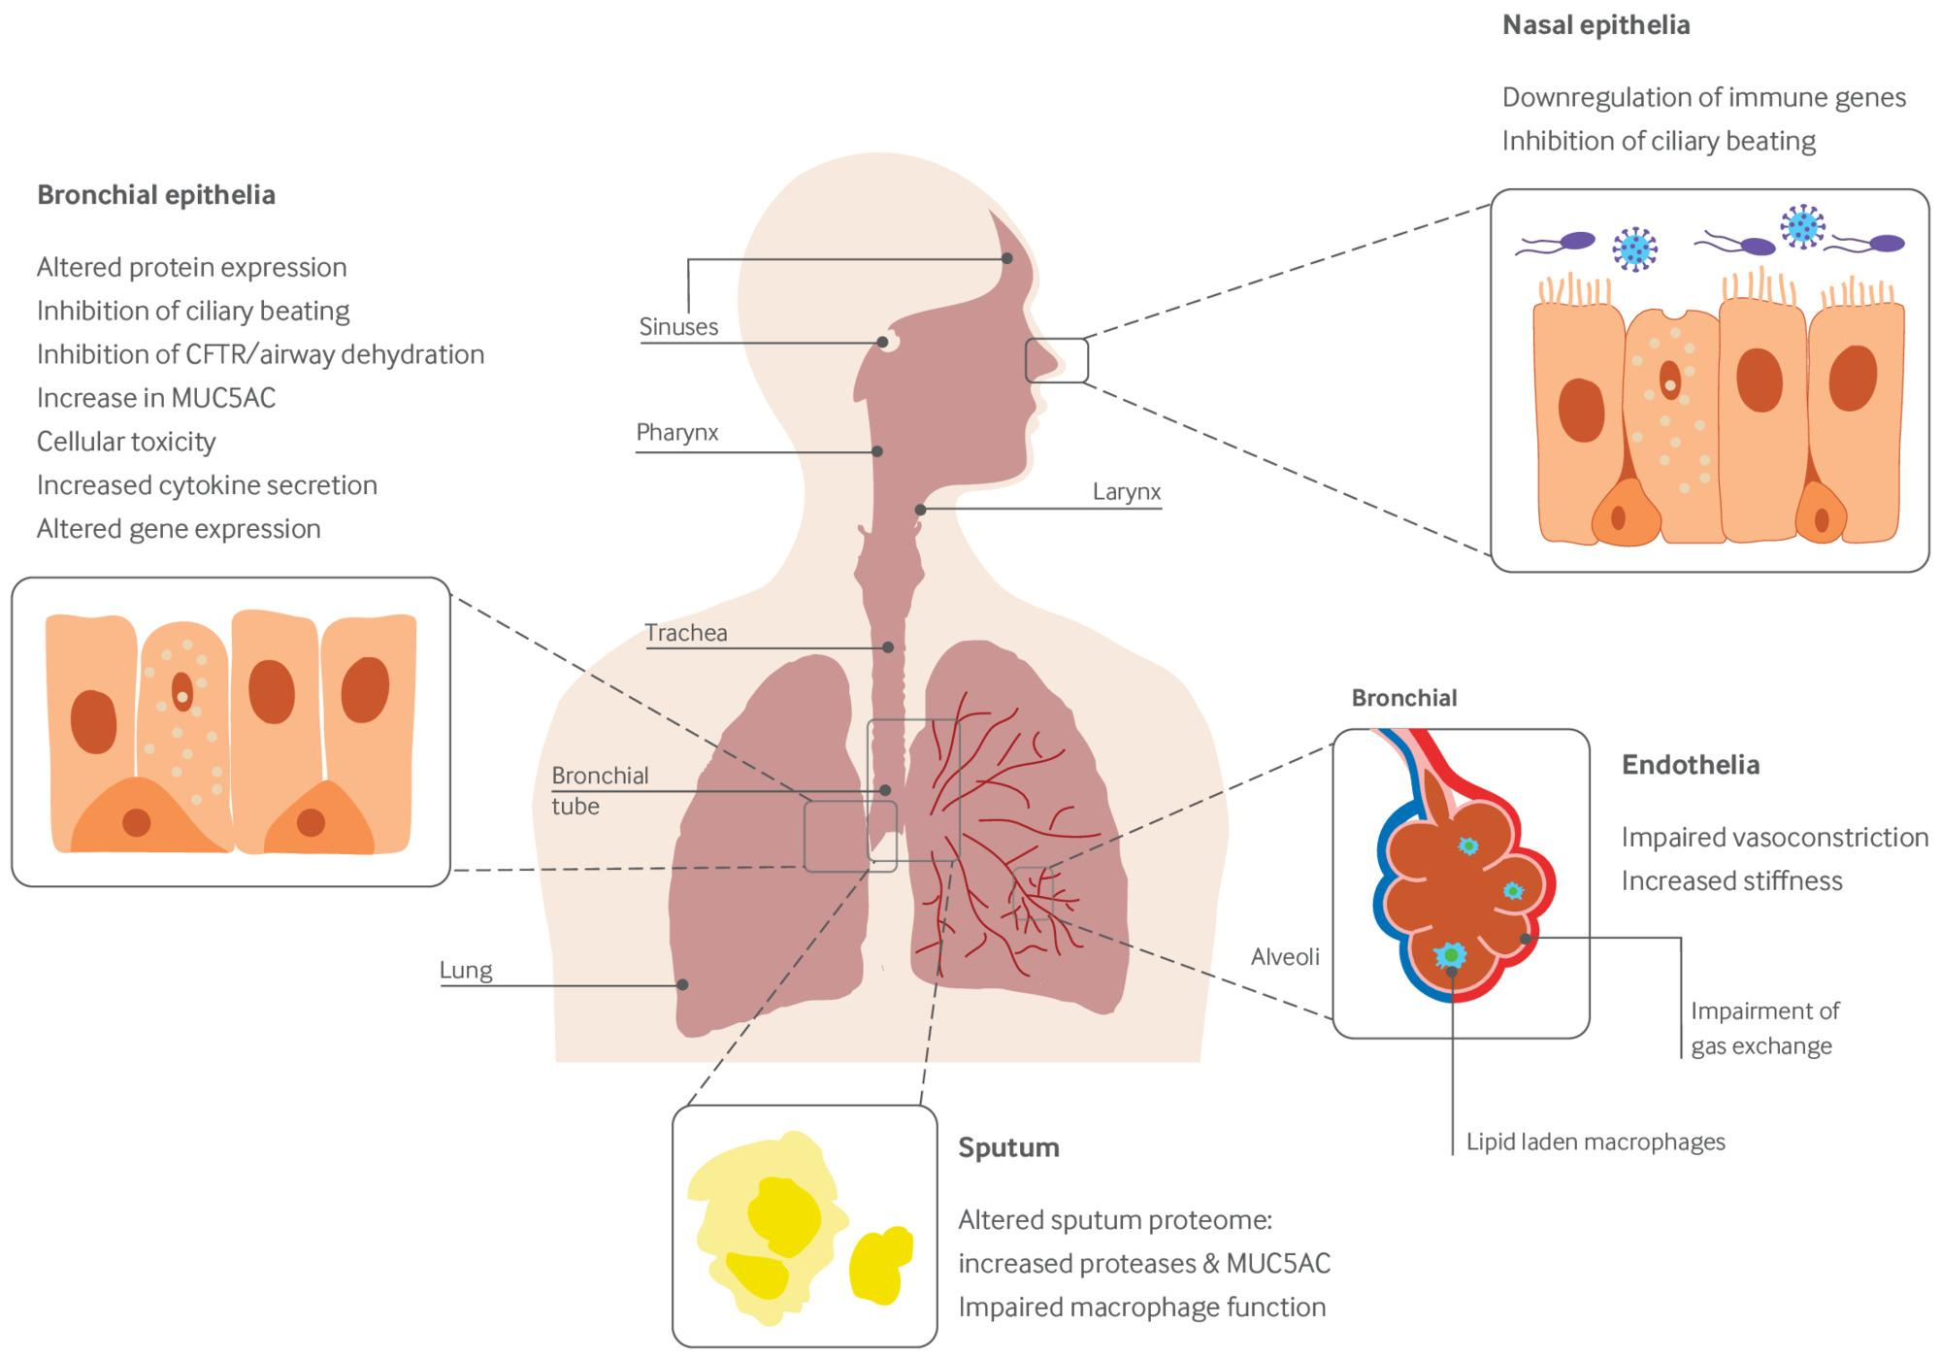
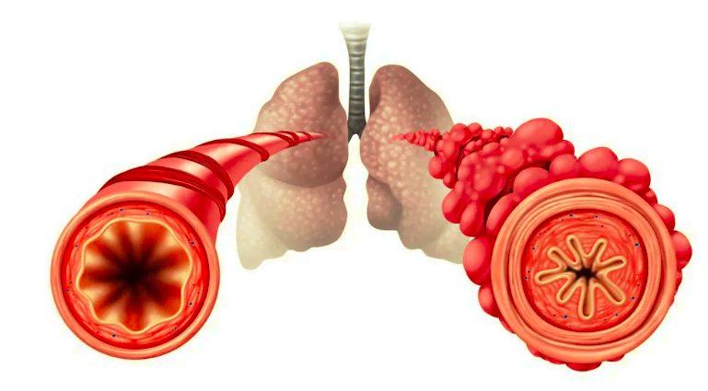
FLAVORINGS PRODUCE DIACETYL –POPCORN LUNG

Slide 35

Cytotoxic Flavors
Cinnamon flavors may contain:
Cinnamaldehyde, 2-Methoxycinnamaldehyde
Cherry flavors may contain:
Benzaldehyde
Notes:
Teacher Talking Points:
When a chemical is cytotoxic it means that the chemical to toxic to living cells in your body.
Various cinnamon flavors contain cytotoxic compounds.
The cherry flavor, benzaldehyde, is cytotoxic as well.

Slide 36
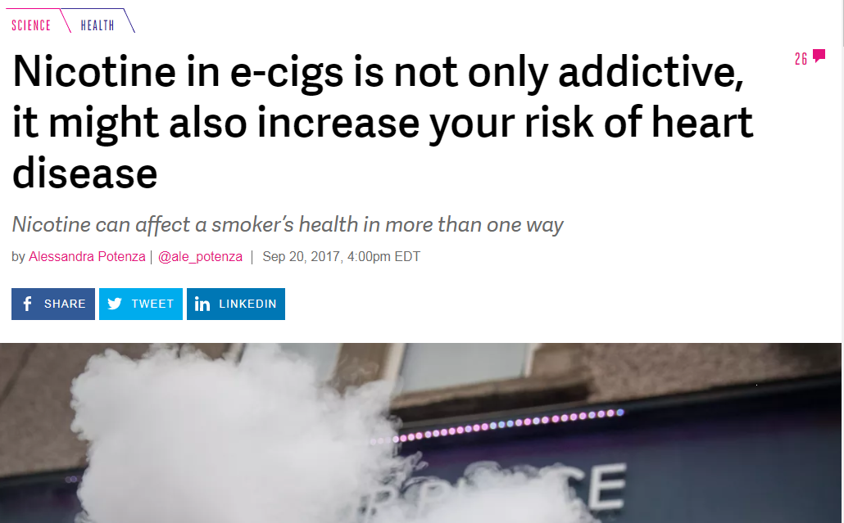






News Headlines of Health Effects
Notes:
Teacher Talking Points:
(Click) The e-cigarette aerosol enters the lungs and leaves chemical residue behind. The lungs cannot break down these chemicals, so they damage air pathways and the air sacs that bring oxygen into the body. Over time this can increase the risk of lung disease.
(Click) The aerosol has also been shown to damage specific parts of your circulatory system or blood network, increasing your risk for heart disease.
(Click) Ear, eye and throat irritation is common among e-cigarette/vape pen users.
(Click) Scientists are still studying how these aerosol chemicals impact the brain.
(Click) We are only beginning to understand the long-term health effects of using e-cigarettes. It took over 25 years to see the long-term health impacts from smoking tobacco cigarettes because the damage done on the body isn’t always noticeable right away.
Every chemical found in an e-cigarette aerosol has not been studied in detail yet. Researchers have identified harmful substances in the aerosol, some even known to cause cancer.
We wish we could tell you all the ways that e-cigarettes are harmful, but the truth is we can’t. Since they are so new and researchers can’t fast forward into the future, all of the long-term consequences of these products are impossible to predict.
Taking that into consideration, how is the e-cigarette industry using your generation as test subjects?
Possible answers: 1. the companies don’t even know the long-term effects of their products, but are still selling them, 2. the companies market these products as a healthier alternative, even though they don’t have the science to prove it, 3. they have created e-cigarettes with higher levels of nicotine than any other tobacco/nicotine products.
Sources:
https://www.theverge.com/2017/9/20/16338902/e-cigs-vaping-nicotine-heart-disease-health-risk
https://medicalxpress.com/news/2018-08-e-cigarettes-dna.html
https://www.ajmc.com/newsroom/ecigarettes-boost-heart-attack-risk-emotional-stress-findings-show
Images:
thenounproject.com

Slide 37


Slide 38


Slide 39

Marijuana
Traditional
Marijuana
Marijuana Wax AKA "Dab"

Slide 40

What Is Marijuana ?
Marijuana — also called weed, herb, pot, grass, bud, ganja, Mary Jane, and a vast number of other slang terms — is a greenish-gray mixture of the dried flowers of Cannabis sativa.
Source: https://www.dea.gov/factsheets/marijuana

Slide 41

Marijuana Strains
The forms of marijuana can fall under various names, which are known as strains.

Slide 42


Cannabis Strains

Slide 43
Marijuana Use & Youth
Marijuana, like some other brain-altering substances, can be addictive.
Nearly one in 10 marijuana users will become addicted.
Signs that someone might be addicted include being unable to stop using marijuana, using it even though they know it is causing problems, and using marijuana instead of joining important activities with friends and family.
People who frequently use marijuana often report withdrawal symptoms.
These symptoms include being irritable or restless, having a small appetite, experiencing cravings, and problems with mood and sleep.
These symptoms can last up to two weeks after the last use.
In 2015, about four million people in the United States met the standards for being diagnosed with a marijuana use disorder.
Source: https://www.hhs.gov/ash/oah/adolescent-development/substance-use/ marijuana/risks/index.html

Slide 44
Marijuana Use & Youth
Starting to use marijuana at a younger age can lead to a greater risk of developing a substance use disorder later in life.
Adolescents who begin using marijuana before age 18 are four to seven times more likely than adults to develop a marijuana use disorder.
Source: https://www.hhs.gov/ash/oah/adolescent-development/substance-use/ marijuana/risks/index.html

Slide 45

Ways to Ingest Marijuana
Smoke it from a bong, pipe, joint, or blunt
Vape
Edibles (in food or drink)
Dabbing (concentrated form)

Slide 46

New Forms of Marijuana

Slide 47

Marijuana Concentrates AKA "Dabs"
Street Names: dabs, concentrates, wax, ear wax, oil, essential oils (with THC), extracts

Slide 48
Marijuana Concentrates AKA "Dabs"
Smoking THC-rich resins extracted from the marijuana plant is on the rise. People call this practice "dabbing."
These extracts come in various forms, such as:
"hash oil" or "honey oil" — a gooey liquid
"wax" or "budder" — a soft solid with a texture like lip balm
"Shatter" — a hard, amber-colored solid
Source: https://www.drugabuse.gov/publications/drugfacts/marijuana

Slide 49

Marijuana Shatter

Slide 50
Dab Shatter Details
Some forms of shatter have as much as 90% THC, the psychoactive ingredient in marijuana.
That is about five times the potency of unrefined smoked marijuana.
It is more powerful than standard hash oil.
Shatter is a thin, hard layer that is similar to glass. It can shatter if dropped.
Source: https://drugfree.org/drug-and-alcohol-news/ law-enforcement-sees-high-potency-marijuana-called-shatter/

Slide 51

Marijuana (THC) Vapes

Slide 52

Marijuana Vapes
Marijuana vapes can be hard to distinguish from some nicotine vapes.
Many can work for:
Dry leaf marijuana
Dabs or concentrated forms of marijuana
Marijuana oils

Slide 53

Vapes Are Also Being Used for Some CBD Products

Slide 54
Vapes & Marijuana More Common
Vaping marijuana continues to dramatically increase in popularity among teens, according to numbers from the latest Monitoring the Future study.
In 2019, 14% of high school seniors admitted to vaping marijuana in the past month. This is almost double the percentage from 2018.
In addition, 21% of 12th-graders reported vaping marijuana within the past year - an increase from the 13.1% in 2018.

Slide 55




Hit or Miss, the Case of EVALI
For the first time, we have seen a vaping device cause sudden, immediate, serious and sometimes fatal damage to the lungs.
The Centers for Disease Control and Prevention (CDC) recommends to not use THC-containing e-cigarette/vape products particularly from informal sources like family/friends, dealers, online or other sources.
Since these products are not regulated, there is no guarantee that any part of an e-cigarette is safe for your health. Your lungs are the most happy and safe when you only breathe in oxygen and clean air.
Notes:
Teacher Talking Points:
We know that e-cigarette aerosol damages the lungs and increases the chances of developing a lung disease later in life. What if the aerosol or one chemical from vaping caused severe damage to the lungs after a few hits?
In August of 2019 this began to happen. People were hospitalized for injured lungs from vaping. This outbreak was later named EVALI which stands for E-cigarette or Vaping product use-Associated Lung Injury.
Most EVALI patients reported using THC-containing products and most said they got their products only from informal sources. THC is the chemical found in cannabis/marijuana that gives users a “buzz/high.”
Scientists found Vitamin E Acetate, an oily chemical found in some THC-containing e-liquid, in the lungs of EVALI patients and in e-cigarette/vape products that the patients said they used. Vitamin E Acetate was mostly likely the cause of the outbreak. Breathing in Vitamin E Acetate can cause inflammation of the airways and interfere with normal lung functioning.
What are some of your main takeaways after hearing about EVALI? (Wait for responses.)
To add to or summarize what you already said, some main takeaways for EVALI include:
(Click) This is the first time we’ve seen a vaping device cause sudden, immediate, serious and sometimes fatal damage to the lungs.
(Click) The Centers for Disease Control and Prevention, better known as the CDC, recommends to not use THC-containing e-cigarette/vape products particularly from informal sources like family/friends, dealers, online or other sources.
(Click) Since these products are not regulated by the government, there is no guarantee that any part of an e-cigarette is safe for your health. Something you can always be sure of is that your lungs are the most happy and safe when you only breathe in oxygen and clean air.
Reference:
https://www.cdc.gov/tobacco/basic_information/e-cigarettes/severe-lung-disease.html

Slide 56

Going Smoke-free or Vape-free
Notes:
We are going to watch a video that covers the benefits of going smoke-free or vape-free.
[Hover over slide and click the play button.]
If technical issues should arise then watch this video with your students on YouTube by using this link: https://www.youtube.com/watch?v=lYBWAQluuUg
Sources:
https://www.bmj.com/content/366/bmj.l5275
https://tobacco.ucsf.edu/comment/33096#comment-33096
https://www.scientificamerican.com/article/smoking-or-vaping-may-increase-the-risk-of-a-severe-coronavirus-infection1/?amp
https://journals.lww.com/cmj/Abstract/publishahead/Analysis_of_factors_associated_with_disease.99363.aspx

Slide 57




What the Industry Isn’t Telling Us
?
?
?
?
?
How do
ALL of
these parts affect
YOUR BODY and YOUR
COMMUNITY?
?
?
?
?
?
?
?
?
?
?
?
?
?
Notes:
If we take apart these devices, it is important to consider how each component will impact a young person’s health.
The plastic mouthpiece is coming in direct contact with the mouth, heavy metal parts are being heated up and degrading over time, and cartridges are being disposed of in the environment.
(Click) This raises concerns and the question of “How do all of these parts affect your body and your community?”
JUUL pods for example are single-used plastic pods. Like plastic straws, they take many years to break down and ultimately create more waste (click).
Because pod-based e-cigarettes can leak heavy metals and residual nicotine they are considered to be biohazard waste and e-waste.
We share this concern for all pod-based e-cigarettes (click).
Reference:
https://truthinitiative.org/research-resources/emerging-tobacco-products/3-ways-juul-harms-environment
Images:
https://www.theverge.com/2015/4/21/8458629/pax-labs-e-cigarette-juul
https://twitter.com/vaperankz/status/983474534945902594
http://jawwak-7eloo.com/wp-content/uploads/2019/05/smok_nord_pod_device_kit_black.png https://upload.wikimedia.org/wikipedia/commons/e/e7/History_of_e-cigarette.jpg
https://vaping.com/media/catalog/product/cache/1/image/602x465/9df78eab33525d08d6e5fb8d27136e95/s/u/suorin-drop-black.png

Slide 58

What is Secondhand & Thirdhand Aerosol?
Notes:
Someone might think that the individual using an e-cigarette or vape is the only person at risk for breathing in nicotine, heavy metals, and cancerous chemicals from the aerosol. That is not true though.
There are two major ways that aerosol from e-cigarettes can spread into the air and affect the health of others.

Slide 59

Secondhand Aerosol
Nicotine
Heavy
Metals
Ultrafine
Particles
Cancerous
Chemicals
VOCs
Notes:
(Click) You may be familiar with the concept of secondhand smoke. How would you define secondhand smoke?
Secondhand smoke is smoke from burning tobacco products, such as cigarettes, cigars, or pipes and is toxic when inhaled.
Secondhand aerosol, similar to secondhand smoke, is the plume of chemicals released into the environment directly from the e-cigarette/pod-based devices and from the lungs of the user.
Common places for exposure to secondhand aerosol include restaurants, parks, vehicles, and designated smoking areas.
Chemicals that are released (click) include harmful substances such as (click) nicotine, (click) heavy metals, (click) ultrafine particles that fall deep into the lungs, (click) cancerous chemicals, and (click) volatile organic compounds aka VOCs.
Exposure can lead to cancer, respiratory infections, and make someone’s asthma worse among other problems.
Reference:
https://tobaccofreeca.com/secondhand-smoke/secondhand-vapor-harmful/
Image:
https://www.cdc.gov/tobacco/infographics/secondhand-smoke/index.htm

Slide 60



Thirdhand Aerosol
Nicotine & other chemicals
Notes:
Another way that e-cigarettes/vape pens pose a danger to people other than the user is through thirdhand aerosol.
(Click) Thirdhand aerosol is the mixture of chemicals in e-cigarette/vape pen aerosol that remain on surfaces and in dust, even after the aerosol is gone, and react with other chemicals in the environment to form toxic chemicals.
These potentially harmful chemicals can be exposed to other people or animals through the respiratory system, through ingestions, and through skin exposure.
Small children are especially at risk for thirdhand aerosol exposure because they tend to put things into their mouths and they have more vulnerable skin.

Slide 61


Take Home POINTS
Talk to people around you who VAPE or Smoke
Understand that Nicotine is addictive
Get them to help
University of Maryland Tobacco Health Practice: 410-328-8141
TRUTH INITIATIVE
1-800-QUIT NOW

Slide 62

Smoking’s deadly stigma
The top cause of cancer deaths gets less research funding than other cancers, and its association with smoking is increasingly to blame.

