Slide 1
HEALTHY AGING AND THE BRAIN
Conrad May, M.D.
Division of Gerontology, Geriatrics and
Palliative Medicine
Department of Medicine
University of Maryland School of Medicine

Slide 2
DISCLOSURES
I have no financial interest in any of the products mentioned

Slide 3
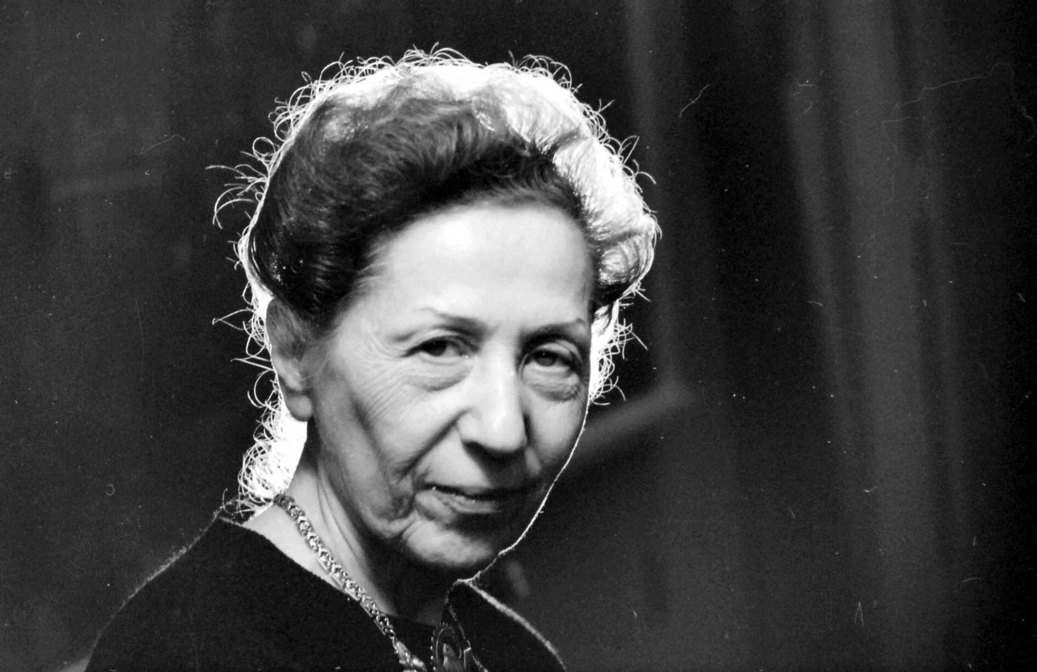
HENRIETTA MIDONICK, 1902 - 1985

Slide 4
COGNITIVE CHANGES WITH AGING
In general, there are declines in:
Response time, processing speed
Divided attention, e.g. “multi-tasking”
Working memory – manipulating information in short-term memory
Executive function (planning, organization, coordination)
Episodic memory, such as names and specific words; usually due to retrieval difficulty

Slide 5
ON THE OTHER HAND,
Some functions are well-preserved with aging
Sustained attention, concentration
Semantic memory (general information)
Procedural memory
Speech and language
Glisky EL. Changes in cognitive function in human aging. In: Brain Aging: Models, Methods, and Mechanisms. Riddle DR (ed) Boca Raton, Fl, 2007

Slide 6
CT SCAN OF THE BRAIN

Slide 7
AT THE MICROSCOPIC LEVEL

Slide 8
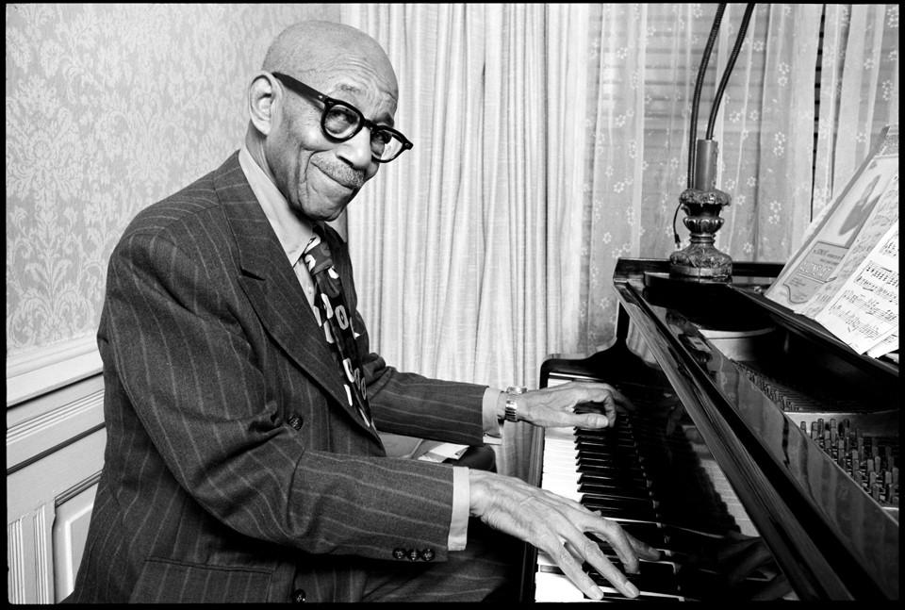
EUBIE BLAKE, 1887 - 1983

Slide 9
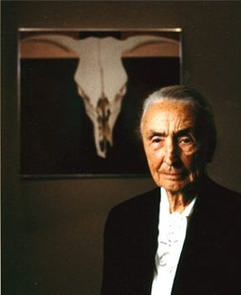
GEORGIA O’KEEFFE, 1887 - 1986

Slide 10
THE DELANEY SISTERS:
Elizabeth “Bessie” 1891-1995 and Sarah “Sadie” 1889-1999

Slide 11
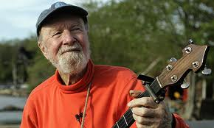
PETE SEEGER, 1919 - 2014

Slide 12
SUPER-AGERS
SuperAgers are people over the age of 80 years who have the cognitive abilities of those at least 30 years younger
The brains of SuperAgers show less atrophy than others of the same age
So how does one become a SuperAger?
Harrison TM, Weintraub S, Mesulam M-M, Rogalski E. Superior memory and higher cortical volumes in unusually successful cognitive aging. J Int Neuropsychol Soc 18(6):1081-1085, 2012

Slide 13
THE NUN STUDY
A longitudinal study of Catholic sisters
Linguistic abilities, assessed from autobiographies written at about age 22 years
Annual physical and cognitive evaluations
Post-mortem neuropathologic examinations
Snowdon DA, Kemper SJ, Mortimer JA, et al. Linguistic ability in early life and cognitive function and Alzheimer’s disease in late life. Findings from the Nun Study. JAMA 275:528-32, 1996.

Slide 14
COGNITIVE RESERVE
Higher idea density, a measure of linguistic ability derived from their autobiographies, was associated with better cognitive function in later life and the decreased likelihood of developing Alzheimer’s disease.
Persons with higher levels of education are thought to be more resistant to the effects of dementia.

Slide 15
MENTAL ACTIVITY
Bronx Aging Study of 469 people over the age of 75 years
They were asked about 6 cognitive activities and 11 physical activities
Neuropsychologic tests were performed at each visit
They were followed for an average of 5 years
Verghese J et al. Leisure activities and the risk of dementia in the elderly. N Engl J Med 348:2508-2516, 2003.

Slide 16
FINDINGS
Of the 469 people enrolled in the study, 124 developed dementia.
Reading, playing board games, playing musical instruments and dancing were associated with a reduced risk of developing dementia.
The frequency of participation in these activities was related to the risk.

Slide 17
MENTAL EXERCISES
Review of 43 studies involving 2,636 subjects
Evaluating 7 commercially available programs
There may have been improvement in processing speed, but other cognitive domains were not significantly improved
Nguyen L, Murphy K, Andrews G. A game a day keeps cognitive decline away? A systematic review and meta-analysis of commercially-available brain training programs in healthy and cognitively impaired older adults. Neuropsychol Rev 32(3):601-630, 2022.

Slide 18
PHYSICAL EXERCISE
ERNESTINE SHEPHERD

Slide 19
PHYSICAL FITNESS
Study of more than 19,000 persons who had undergone a preventive health examination through the Cooper Clinic in Dallas, Texas
The examination included a treadmill test, which was used as a measure of fitness
The outcome was the diagnosis of dementia in the Medicare database
DeFina LF et a. The association between midlife cardiopulmonary fitness levels and later-life dementia. Ann Int Med 158: 162-168, 2013

Slide 20
FINDINGS
There were 1,659 cases of dementia after at least 9 years
Higher fitness levels in midlife were associated with a lower risk of dementia
Similar results were found in the Canadian Study of Health and Aging, with 4615 participants and 5 years of follow-up

Slide 21
PHYSICAL EXERCISE
Aerobic exercise is associated with an increase in brain volume in the prefrontal and temporal regions (1)
Some studies have found that physical exercise can improve cognition (attention, processing speed, executive function and memory), but others have not (2)
1. Colcombe SJ, Erickson KI, Scaif PE, et al. Aerobic exercise training increases brain volume in aging. J Gerontol A Biol Sci Med Sci 61(11):1166-1170, 2006.
2. Kirk-Sanchez NJ, McGough EL. Physical exercise and cognitive performance in the elderly: current perspectives. Clin Interv Aging 9:51-62, 2014.

Slide 22
ACSM and CDC Recommendations
150 minutes of moderate exercise per week (30 minutes 5 days per week), or 60 minutes of high-intensity exercise (20 minutes 3 days per week)
2 days per week of resistance exercise (60-80% of maximum, for 8-12 repetitions)
https://www.acsm.org/education-resources/trending-topics-resources/physical-activity-guidelines

Slide 23
BLOOD PRESSURE
Uncontrolled high blood pressure is associated with worse cognition and increased risk of development of dementia (1)
Treatment of hypertension reduces the risk (2)
Lower systolic blood pressure (120 mm Hg) may further reduce the risk (3)
1. Knecht S, Wersching H, Lohmann H, et al. High-normal blood pressure is associated with poor cognitive performance. Hypertension 51(3):663-668, 2008.
2. Peila R, White LR, Masaki K, et al. Reducing the risk of dementia: efficacy of long-term treatment of hypertension. Stroke 37(5):1165-1170, 2006.
3. Williamson JD, Pakewski NM, Auchus AP, et al. Effect of intensive vs standard blood pressure control on probable dementia. JAMA 321(6): 553–561, 2019.

Slide 24
MEDICATIONS
Many medications have adverse effects on cognition, the most consequential of which are the anticholinergics
Anticholinergics are medications that oppose the action of acetylcholine, one of the neurotransmitters of the brain
Medications that have anticholinergic activity include older antidepressants and some agents used to treat an overactive bladder
Long-term use of anticholinergic medications is associated with a higher incidence of dementia
Richardson K, Fox C. Maidment I, et al. Anticholinergic drugs and risk of dementia: case-control study. BMJ 361:k1315, 2018.
Pieper NT, Grossi CM, Chan W-Y, et al. Anticholinergic drugs and incident dementia, mild cognitive impairment and cognitive decline: a meta-analysis. Age Ageing 49(6):939-947, 2020.

Slide 25
NUTRITION

Slide 26
THE MIND DIET
Mediterranean-Dietary Approach to Systolic Hypertension (DASH) diet intervention for neurodegenerative delay (MIND)
960 participants in the Memory and Aging Project
After 4.7 years, the MIND diet was associated with a slower decline in each of 5 cognitive domains (1)
However, a randomized controlled trial of 604 participants found no difference after 3 years (2)
1. Morris MC, Tangney CC, Wang Y, et al. MIND diet slows cognitive decline with aging. Alzheimers Dement. 11(9):1015-1022, 2015.
2. Barnes LL, Dhana K, Liu X, et al. Trial of the MIND diet for prevention of cognitive decline in older persons. N Engl J Med. 389(7):602-611, 2023.

Slide 27
SUPPLEMENTS
In general, have not been studied in a rigorous manner for benefit in cognition
Gingko biloba has extensively studied but has shown mixed results (1)
However, people who are on restrictive diets (vegetarians, vegans) or who have had bariatric surgery should take vitamins
1. Tan M-S, Yu J-T, Tan CC et al. Efficacy and adverse effects of ginkgo biloba for cognitive impairment and dementia: a systematic review and meta-analysis.
J Alzheimers Dis. 43(2):589-603, 2015

Slide 28
HEARING

Slide 29
HEARING
Hearing impairment is associated with an increased risk of development of dementia (1)
People with hearing impairment who used hearing aids had the same risk as those without hearing impairment (2)
A recent randomized, controlled trial did not demonstrate a clear benefit in cognition with hearing aid use (3)
1. Deal JA, Betz J, Yaffe K et al. Hearing impairment and incident dementia and cognitive decline in older adults: the Health ABC Study. J Gerontol A Biol Sci Med Sci 72(5):703-709, 2017.
2. Jiang F, Mishra SR, Shrestha N et al. Association between hearing aid use and all-cause and cause-specific dementia: an analysis of the UK Biobank cohort. Lancet Public Health 8(5):e329-338, 2023.
3. Lin FR, Pike JR, Albert MS, et al. Hearing intervention versus health education control to reduce cognitive decline in older adults with hearing loss in the USA (ACHIEVE): a multicentre, randomised controlled trial. Lancet 402(10404):786-797, 2023.

Slide 30
SOCIALIZATION
Cognitive Function and Ageing Study – Wales, with 2-year follow-up
Social isolation is associated with worse cognition
Hearing impairment coexists with social isolation, loneliness and depressed mood
Evans IEM, Llewellyn D, Matthews FE et al. Social isolation, cognitive reserve, and cognition in healthy older people. PLoS One 13(8):e0201008, 2018.

Slide 31
SO, WHAT DO I RECOMMEND?

Slide 32
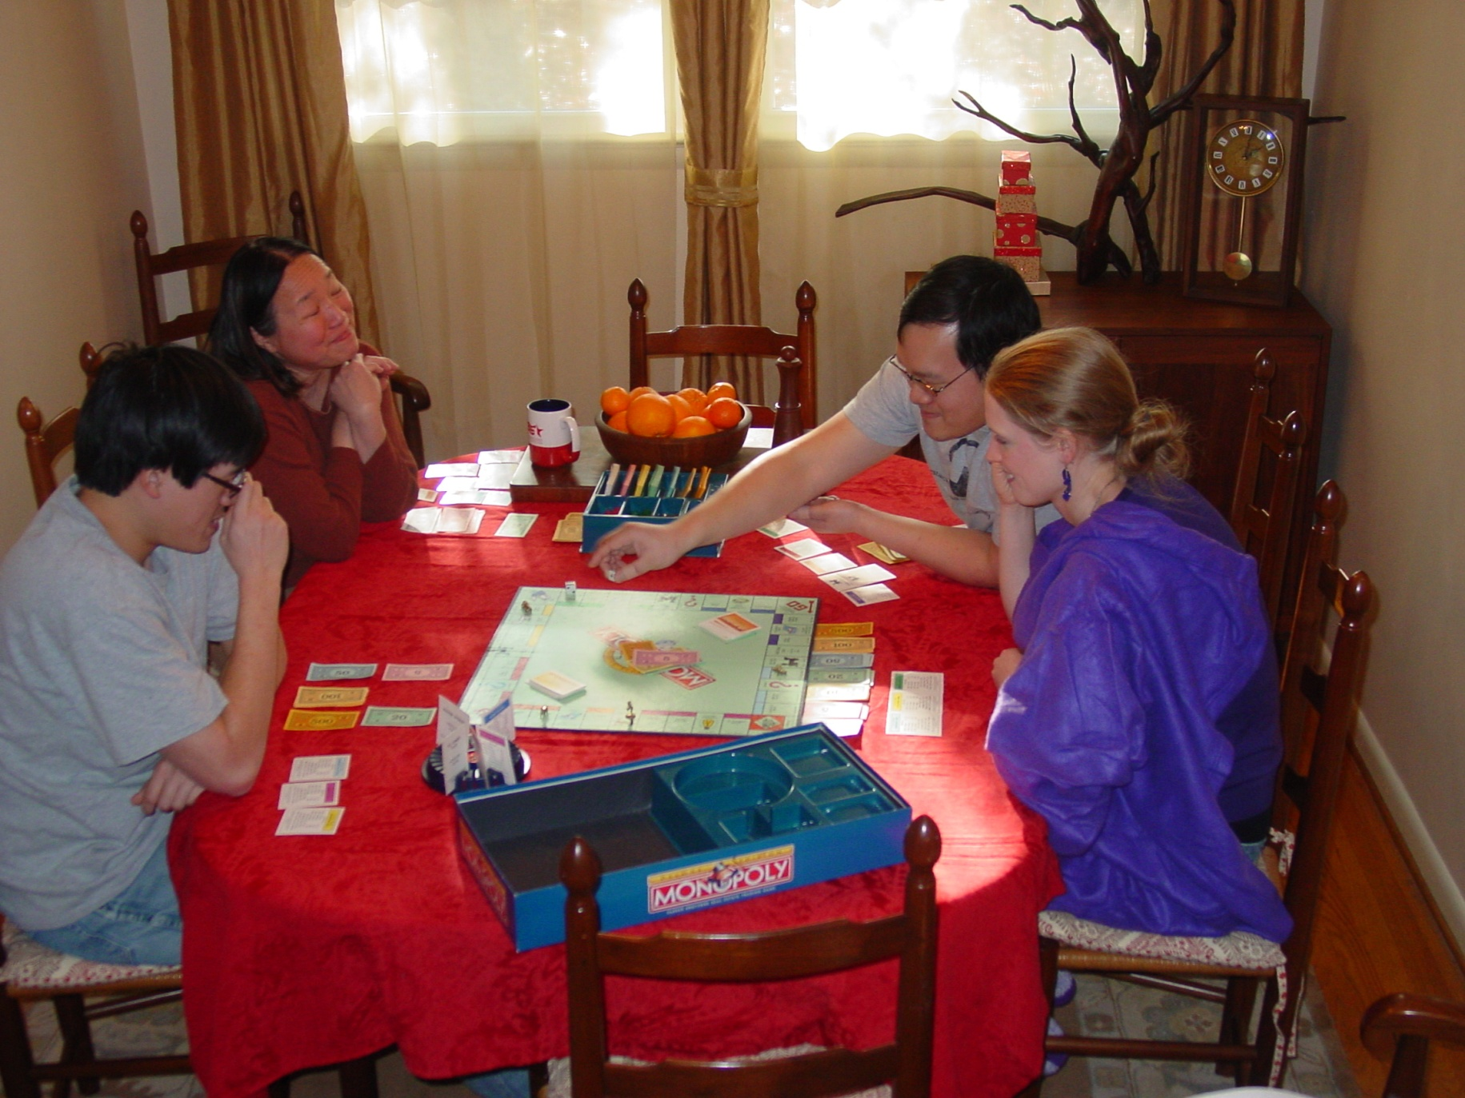
DO THINGS THAT YOU ENJOY

Slide 33
DO SOMETHING CHALLENGING

Slide 34
DO SOMETHING MEANINGFUL

Slide 35
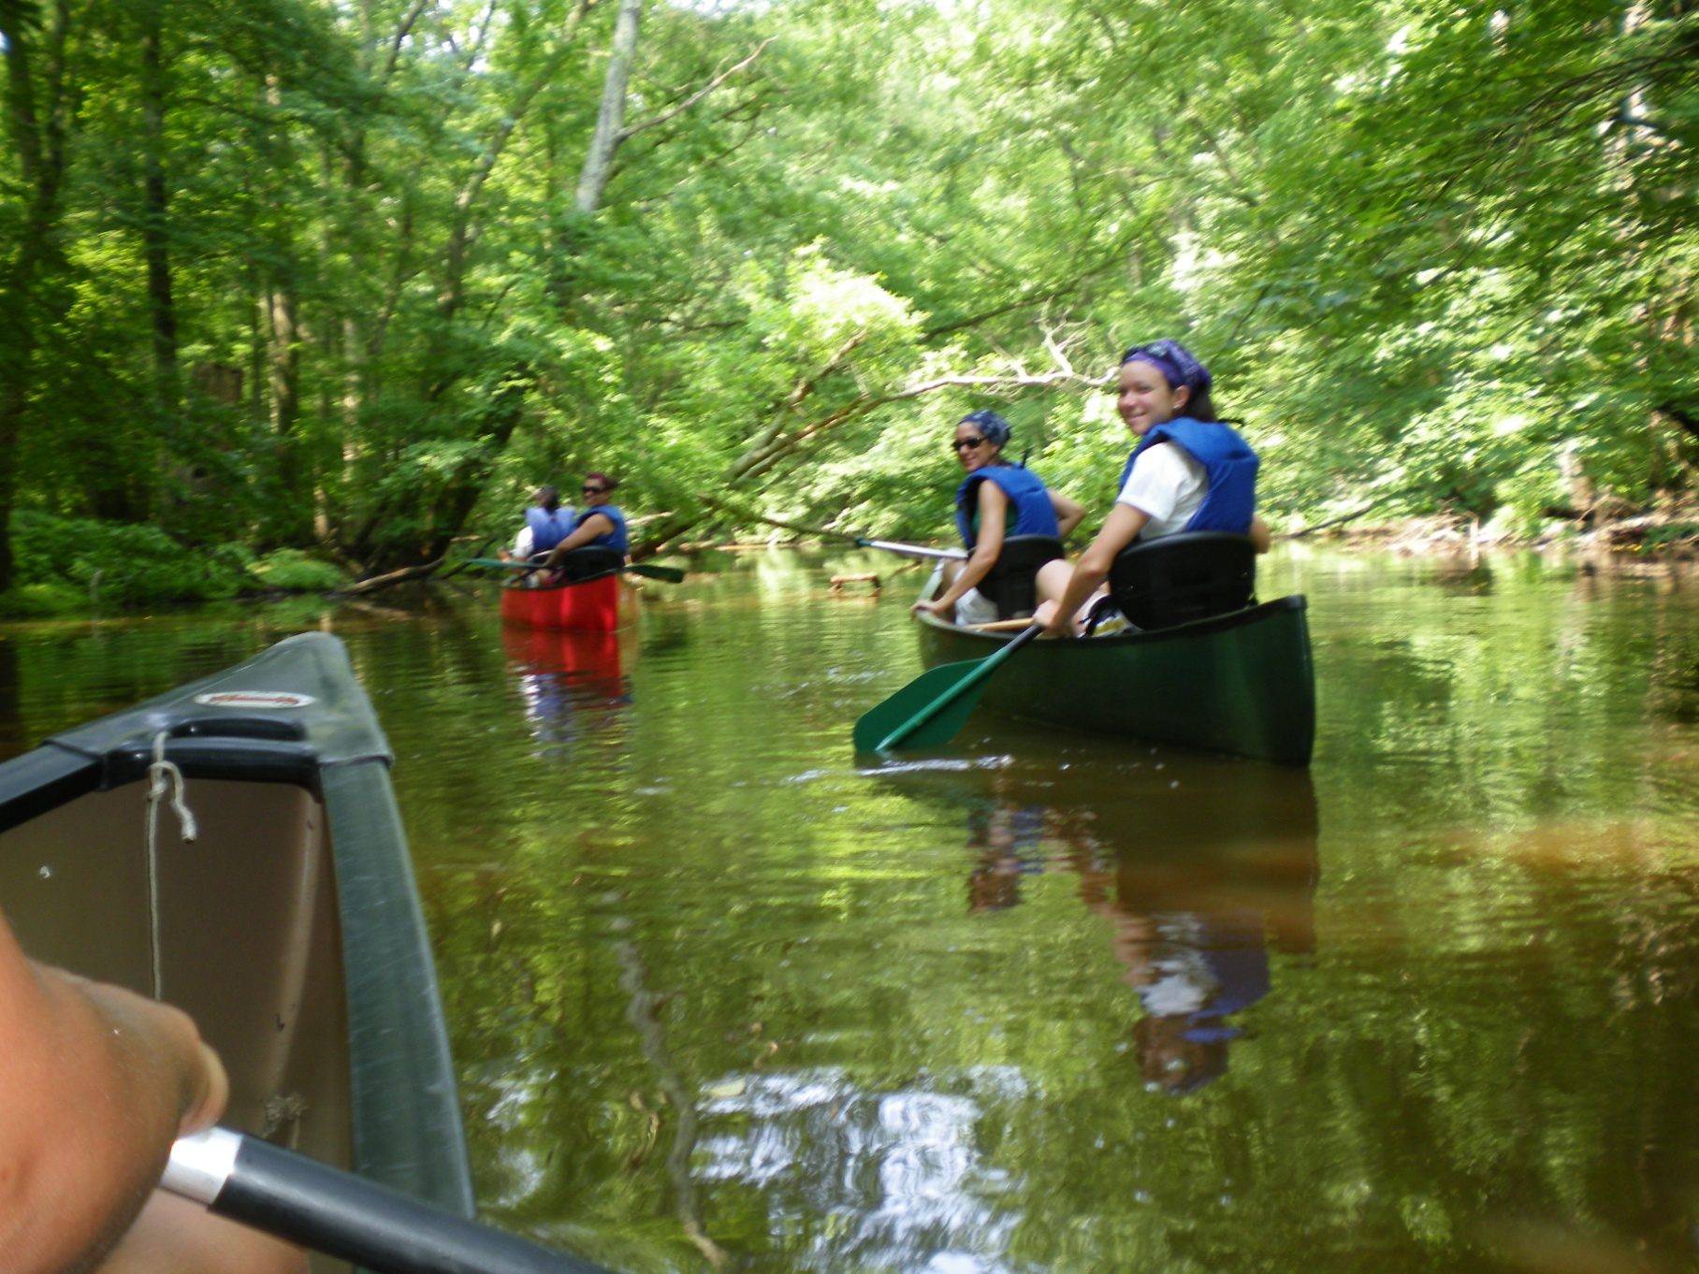
DO IT WITH OTHER PEOPLE

Slide 36
EAT SENSIBLY

Slide 37
LIMIT STRESS

Slide 38
TAKE CARE OF YOUR HEALTH

Slide 39
SUMMARY
Some cognitive changes are common in aging
Previous intellectual attainment may provide a “cognitive reserve”
Physical exercise and mental activity may be protective against the development of cognitive decline
Maintain a healthy lifestyle, manage hypertension, avoid harmful medications and correct any hearing loss

Slide 40
THANK YOU

