Slide 1
Menopause: Understanding the Cause, Symptoms, and Treatment
Natelaine E. Fripp, MD
Clinical Assistant Professor
Dept. of Family & Community Medicine
University of Maryland School of Medicine

Slide 2
Learning Objectives
Define menopause
Identify the stages of menopause
Discuss what triggers the onset of menopause
Identify the most common symptoms of menopause
Identify complications of menopause
Review potential treatment options to relieve symptoms

Slide 3
Stages of Menopause
Verywell Health/ Emily Roberts

Slide 4
Premenopause
Time between the first period and perimenopause
Typically, age 30 and under.
Might have shifts in hormone levels
Little to no symptoms

Slide 5
Perimenopause
“Around Menopause”
transitions to menopause
Age 40’s to 50’s but can start earlier
May last 10 years
Ovaries decrease production of estrogen and progesterone.

Slide 6
Perimenopause
Symptoms: Irregular periods, weight gain, changes in mood, sweats and flushes, headaches, vaginal dryness, breast tenderness, acne
Pregnancy is still possible

Slide 7
Menopause
Classic definition:
12 consecutive months with no periods
Ovaries stop or greatly slow down the production of reproductive hormones estrogen and progesterone and stop releasing eggs
Marks the end of fertility

Slide 8
Postmenopause
Body is adjusting to lower hormone levels
Typically age 55
Menopausal symptoms might go away or become milder
Increase risk of health conditions
Ex. Heart disease and osteoporosis

Slide 9
Menopause

Slide 10
Menopause factoids
Aristotle defined the age of menopause as 40 years
Term menopause was coined in 1821 by a French physician
1970’s: Menopausal societies began to emerge
Estrogen deficiency related to menopause
Bull Indian Inst Hist Med Hyderabad.2002 Jul-Dec;32(2):121-35.

Slide 11
Menopause factoids
Symptoms reported differ across the globe
US: hot flush
Japan: shoulder pain
India: low vision
Bull Indian Inst Hist Med Hyderabad.2002 Jul-Dec;32(2):121-35.

Slide 12
Menopause factoids
Women in the West harbor negative views of menopause
Feeling old
Looking like my mother
Drying up
1800’s menopause had positive view
Period of rest

Slide 13
What triggers menopause?
Natural causes
Age related decline in ovarian reserve
Leads to reduction in estrogen and progesterone levels
Surgical removal of ovaries (oophorectomy)
Causes abrupt onset of menopause
Symptoms can be more severe

Slide 14
What triggers menopause
Chemotherapy and radiation
Hormone therapy
Ex Lupron used for endometriosis and bleeding from fibroids
Often temporary

Slide 15
What triggers menopause?
Ovarian insufficiency
Occurs in 1% women by age 40 (MayoClinic)
Early menopause
Premature ovarian failure
Often treated with HRT (OCPs) until the natural age of menopause is reached

Slide 16
What triggers menopause?
Family history
Autoimmune disorders
Personal reproductive history
Chromosomal abnormalities
Unhealthy lifestyle habits

Slide 17
Is there a test for this?
Testing is not needed
Sometimes it is done
Follicle stimulating hormone (FSH) increased
Luteinizing hormone (LH) increased
Estrogen (estradiol) decreased
Thyroid stimulating hormone (TSH) increased
Hypothyroid can mimic menopause

Slide 18
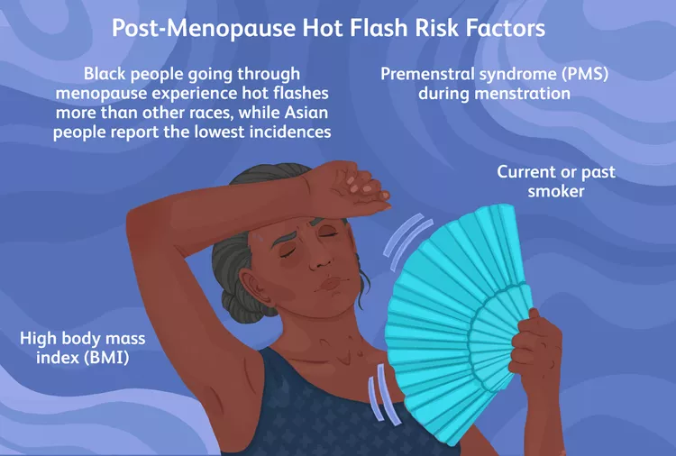
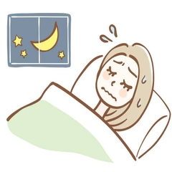
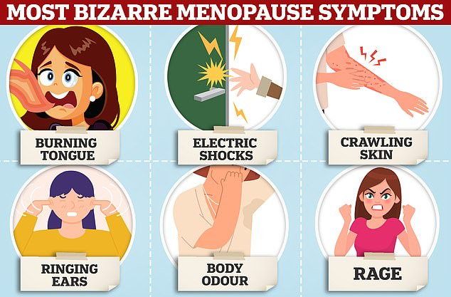
Symptoms

Slide 19
Symptoms related to Menopause
Estrogen and progesterone hormones affect many functions in a woman’s body other than menstruation and fertility
circulatory system, urogenital system, nervous system, skeletal system, memory, sexuality, skin, vision, and teeth.
Women will live a third of their lives after menopause
Be aware of the symptoms, systemic effects, and available treatment options associated with estrogen loss.

Slide 21
Symptoms
Hot flushes
Most commonly reported symptom
Loss of hormones restricts the body’s ability to regulate temperature
Night sweats
Second most common
Vaginal dryness
Lost lubrication and elasticity, painful intercourse, vaginal infections

Slide 22
Symptoms
Sleep disturbance
Insomnia, early awakening
Mood changes
Irritability, anxiety, depression
Urinary problems
incontinence, urinary frequency/urgency
Breast changes
Tenderness, smaller size
Fatty tissue on mammograms

Slide 23
Symptoms
Decreased libido
Fatigue
Hair dryness, loss, alopecia
Tooth decay
Bleeding and receding gums
Burning mouth
Dizziness
Weight gain
Change in taste and smell
Loss of confidence
Recurrent UTI
Feeling cold
Bloating and water retention
Acne
Poor concentration
Joint pain, muscle tension
Brian fog
Headaches
Memory changes
Palpitations
Tingling to extremities
Trouble breathing
Dry eyes
Change in skin texture

Slide 25
Complications of Menopause
Two common complications
Osteoporosis
Increased bone loss
decreased bone density
Cardiovascular Disease
the most common cause of death in women
rate of CVD increases steadily reaching parity with men by age 70
Cholesterol changes:
increased LDL “bad” cholesterol
decreased HDL “good” cholesterol

Slide 26
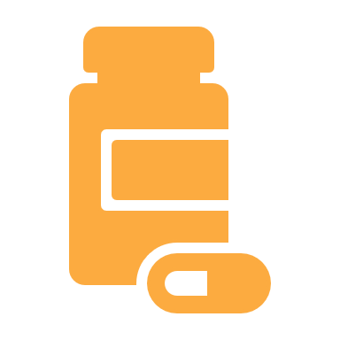
Treatment

Slide 27
Treatment
Vasomotor symptoms (hot flushes)
70% women report
More common with higher BMI, cigarette use, minorities
Symptoms last an average of 7 years
Lost ability to thermoregulate
Estrogen loss
Thermoregulatory center in hypothalamus
Most common indication for treatment
Am Fam Physician. 2016;94(11):884-889

Slide 28
Treatment
Vasomotor symptoms affect:
Sleep
Concentration
Energy
Mood
Work
Sexual activity
Social activities

Slide 29
Treatment
Vasomotor symptoms
Hormone therapy (HT or HRT) is standard of care
Uses one or more hormones to treat symptoms of menopause
Estrogen, progestin/progesterone, or both
Sometimes testosterone

Slide 31
HRT history
1800’s treatments were mostly herbal
Cannabis
Opium
1920’s estrogen compounds were isolated and oral estrogen was made available

Slide 32
HRT history
1942 Premarin hit the market as the first estrogen product
Ayerst successfully marketed Premarin as a cure for a non-disease
“Cure” for menopause
marketed to men to make a woman pleasant to live with
1970’s evidence emerged that unopposed estrogen can increase the risk of endometrial cancer
https://www.theguardian.com/world/2022/jan/18/she-will-not-become-dull-and-unattractive-the-charming-history-of-menopause-and-hrt

Slide 33
HRT history
Premarin was repackaged as estrogen-progesterone therapy – Prempro
2002 WHI stopped the HRT arm of the study stating women with a uterus had higher rate of CAD and breast cancer
Results had lasting effects
Results were found to be misreported
https://www.theguardian.com/world/2022/jan/18/she-will-not-become-dull-and-unattractive-the-charming-history-of-menopause-and-hrt

Slide 34
HRT history
84% decline in prescription writing in the last 2 decades
HRT prescriptions were down.
Doctors feared prescribing.
Women were on their own.
Menopausal education was taken out of some medical schools.
2017 authors of WHI paper published a correction
https://www.theguardian.com/world/2022/jan/18/she-will-not-become-dull-and-unattractive-the-charming-history-of-menopause-and-hrt

Slide 35
Uses for HRT
HRT helps to relieve Hot Flashes, Vaginal Dryness, Fatigue, Thinning Hair, Loss of Muscle Strength and Insomnia

Slide 36
Types of HRT
Estrogen and progestin
For women who still have a uterus
Estrogen only
For women who do not have a uterus

Slide 37
Types of HRT
Estrogen
Nasal spray
Pills
Skin gel and spray
Skin patches
Vaginal creams
Progesterone/Progestin
Pills
Skin patches
Vaginal creams
Vaginal suppositories
Intrauterine devices

Slide 38
How HRT is taken
Cyclic
Estrogen for 25 days
Add progestin during days 10-14
No hormones days 26-30
Might have monthly bleeding
Combined
Take estrogen and progestin together every day
Might stop bleeding

Slide 39
How HRT is taken
Start low dose and increase as needed
Give about 3 months to see effects
Adjust if necessary

Slide 40
Contraindications to HRT
Pregnancy or breastfeeding
Liver disease
Unexplained vaginal bleeding
History of certain cancers
Ovarian, breast, endometrial
History of DVT, PE, or clotting disorders

Slide 41
HRT Side Effects
Return of periods
Irregular vaginal bleeding/spotting
Headache
Nausea
Breast tenderness
Bloating (progesterone)
Weight gain (progesterone): generally only 2-3 pounds can be “blamed” on the hormones: the rest is decreased metabolism associated with menopause, increased caloric intake and/or decreased exercise.
May exacerbate depression (progesterone)
Enlargement of uterine fibroids
Exacerbation of endometriosis
Fluid retention (may exacerbate asthma, epilepsy, migraine, heart disease, kidney disease)
Spotty darkening of the skin

Slide 42
When to stop HRT
When menopausal symptoms end
Taper down the dose
Symptoms might return

Slide 43
Other Treatment Options
Lifestyle
Mind body techniques
Prescription medications
Dietary supplements
Acupuncture

Slide 44
Treatment Options
Lifestyle
Cooling techniques
Clothing: layers, breathable, sleeveless
Fans, cold packs, dual control blankets
Avoid triggers
Alcohol, caffeine, spicy food, hot food or liquid
Exercise and Yoga
Weight loss

Slide 45
Treatment Options
Mind body techniques
Cognitive behavioral therapy
Mindfulness
Hypnosis

Slide 46
Treatment options
Prescription medications
Paroxetine (Paxil) 7.5 mg FDA approved
Fezolenatant (Veozah) 45mg FDA approved
SSRIs and SNRIs
Ex. escitalopram (Lexapro), citalopram (Celexa) venlafaxine (Effexor), duloxetine (Cymbalta)

Slide 47
Treatment Options
Prescription medications
Gabapentin
Oxybutynin

Slide 48
Dietary Supplements
Phytoestrogens
3 types: isoflavones, lignans, and coumestans.
Isoflavones
“weak” estrogen receptor modulators
mimic the role of estrogen.
they can mimic the good actions and the not so good- they can also function to block the action of estrogen at some sites
unclear if safe for women at risk for breast cancer or its recurrence.
Recommended dose 6.5 g of soy per serving for a total of 25 g per day.

Slide 49
Phytoestrogens
Soy
contains 3 isoflavones:
preventive benefits in cardiovascular disease
reduce the frequency of hot flashes and to reduce the incidence of osteoporosis.
Six studies have shown that soy isoflavones can reduce the frequency of hot flashes.

Slide 50
Dietary Supplements
Black cohosh
Phytoestrogenic herbal
Most studies show it is effective in reducing frequency and intensity of hot flashes, improvement in “global” menopausal symptoms, and in vaginal lubrication
Red Clove
contains four isoflavones, including genistein, the most active component of soy. The most popular dietary supplement derived from red clover is Promensil ™.

Slide 51
Dietary Supplements
Promensil
Clinical trials with Promensil did survey women to test their level of satisfaction; 93% of users said they wanted to continue taking it.
500 mg Promensil tablet contains 40 mg of plant estrogens. This is the equivalent of one cup of soy milk and four cups of chickpeas.

Slide 52
Dietary Supplements
Ginkgo biloba
Used as a mood elevator or to improve memory and other cognitive functions.
Can cause bleeding problems in several individuals, with or without other medicines.
Speak with your physician if you plan to take this herb, especially if you are taking medicines for bleeding or clotting problems or for arthritis.

Slide 53
Dietary Supplements
Wild yam
source of “natural progesterone”
contains diosgenin, which is not converted to active hormones in the body
NO effects on estrogen or progesterone receptors.
Vaginal Lubricants
numerous non-prescription vaginal lubricants on the market
K-Y Jelly ™ and Vagisil ™
Never use a water insoluble preparation in the vagina, e.g. Vaseline ™.

Slide 54
Take Home Points
Menopause is part of the transition from childbearing years to nonchild bearing years
Stages: premenopause, perimenopause, menopause, postmenopause
Symptoms are numerous
Increases risk for osteoporosis and heart disease
70% of women report vasomotor symptoms
HRT remains standard of care
Several options for treatment are now available

Slide 55
Now you know! Let’s talk about it…questions?

Slide 56
Resources
Managing Menopausal Symptom: Common Questions and Answers. Am Fam Physician. 2023;108(1):28-39
Bull Indian Inst Hist Med Hyderabad.2002 Jul-Dec;32(2):121-35.
Hormone Therapy and Other Treatments for Symptoms of Menopause. Am Fam Physician. 2016;94(11):884-889
Menopause. The Journal o the North American Menopause Society. Vol 30. No 6. pp 573-590.2023
https://www.mayoclinic.org/diseases-conditions/menopause/symptoms-causes/syc-20353397
www.pennmedicine.org/updates/blogs/womens-health/2016/december/the-change-before-the-change#:~:text=Premenopause%20is%20the%20time%20between,the%20National%20Institute%20on%20Aging.
https://www.theguardian.com/world/2022/jan/18/she-will-not-become-dull-and-unattractive-the-charming-history-of-menopause-and-hrt
The Rise and Fall of Hormone Replacement Therapy. From the lecture series : The Skeptics’s Guide to health, mediciane and them edia. March 4, 2019 Health And Fitness, Medicine and Disease

Slide 57
The End

