Slide 1
Eliminating Preventable Maternal Morbidity & Mortality in the US
Doee Kitessa, MD, FACOG
Assistant Professor
Director, Program on Diversity, Inclusion, & Women’s Empowerment
Department of Obstetrics, Gynecology, & Reproductive Sciences
University of Maryland School of Medicine

Slide 2
Objectives
Understand the major medical causes of maternal mortality and morbidity
Discuss factors that impact the disparity in maternal mortality & morbidity
Discuss strategies to work toward decreasing maternal morbidity & mortality and eliminating disparities that exist

Slide 3
MATERNAL MORTALITY
Death of a woman while pregnant or within 1 year of the end of pregnancy from any cause related to or aggravated by the pregnancy

Slide 4
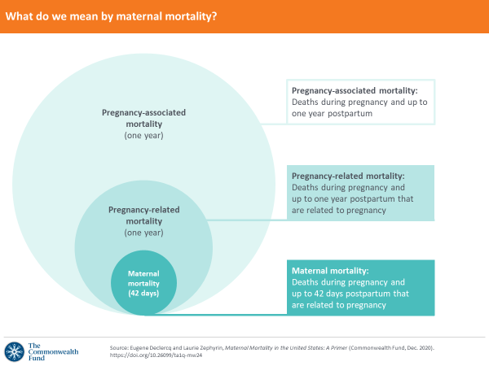
Notes:
pregnancy associated mortality – irrespective of cause. Starting point for analysis of maternal deaths
pregnancy related mortality – pregnancy complication, chain of events initiated by pregnancy, or aggravation of an unrelated condition by the physiologic effects of pregnancy.
Used by CDC to report US trends in maternal mortality
Typically reported as a ratio of deaths per 100K live births
Maternal mortality – irrespective of duration or site of pregnancy, from any cause related to or aggravated by pregnancy or its management, but not from accidental or incidental causes

Slide 6
US compared to other high-income countries

Slide 8
Leading causes of pregnancy - related deaths
Mental health conditions - 23%
Hemorrhage - 14%
Cardiac or coronary conditions - 13%
Infection - 9%
Thrombotic embolism (blood clot) - 9%
Cardiomyopathy (disease of heart muscle) - 9%
Hypertension (high blood pressure) - 7%
Notes:
Cardiac and coronary conditions are leading cause of death for Black people
Mental health conditions leading cause of death for Hispanic and White people
Hemorrhage is leading cause of death for Asian peple
Mental health and hemorrhage are leading causes of death among Indiginous people

Slide 9
How does maternal mortality affect populations differently

Slide 10
Maternal Mortality in US - 2021
1,205 women died of pregnancy related causes
2020 – 861 pregnancy related deaths
Black women are 2.6 times more likely to die during & around pregnancy
According to CDC, 84% of pregnancy-related deaths are preventable

Slide 11
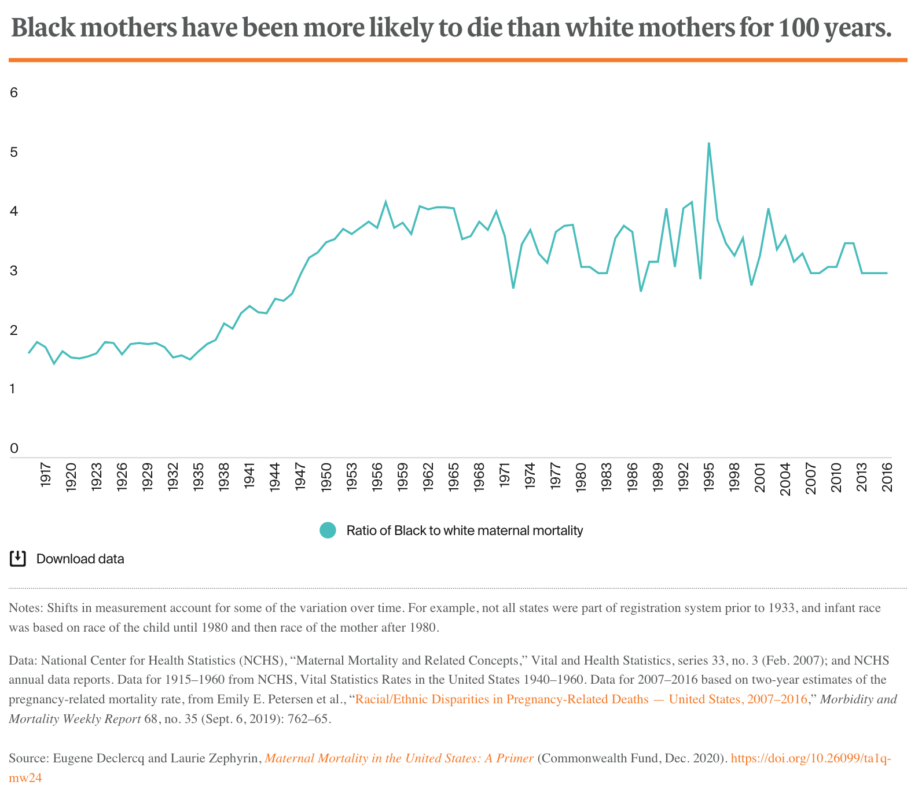
Notes:
- Graph shows the ratio of Black to White maternal mortality over time, dating back to 1917
- White MMR declined more rapidly than Black MMR after WWII, resulting in increased disparity where MMR for Blacks became as high as 4-5 times that for Whites
- Currently MMR for Black women is 2.6 times the rate for Whites, just to put that into context this is the same disparity that was seen in 1940s

Slide 12
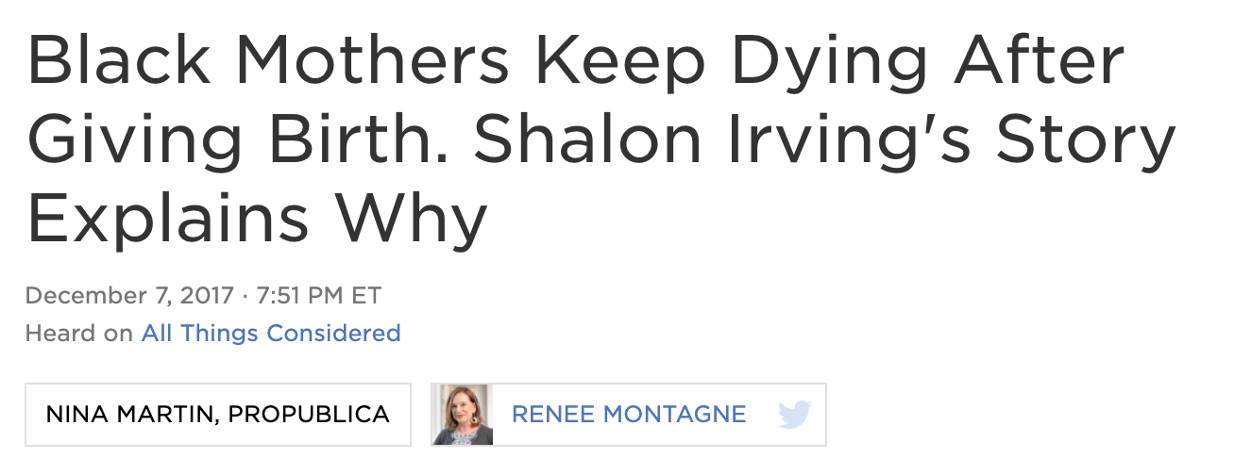
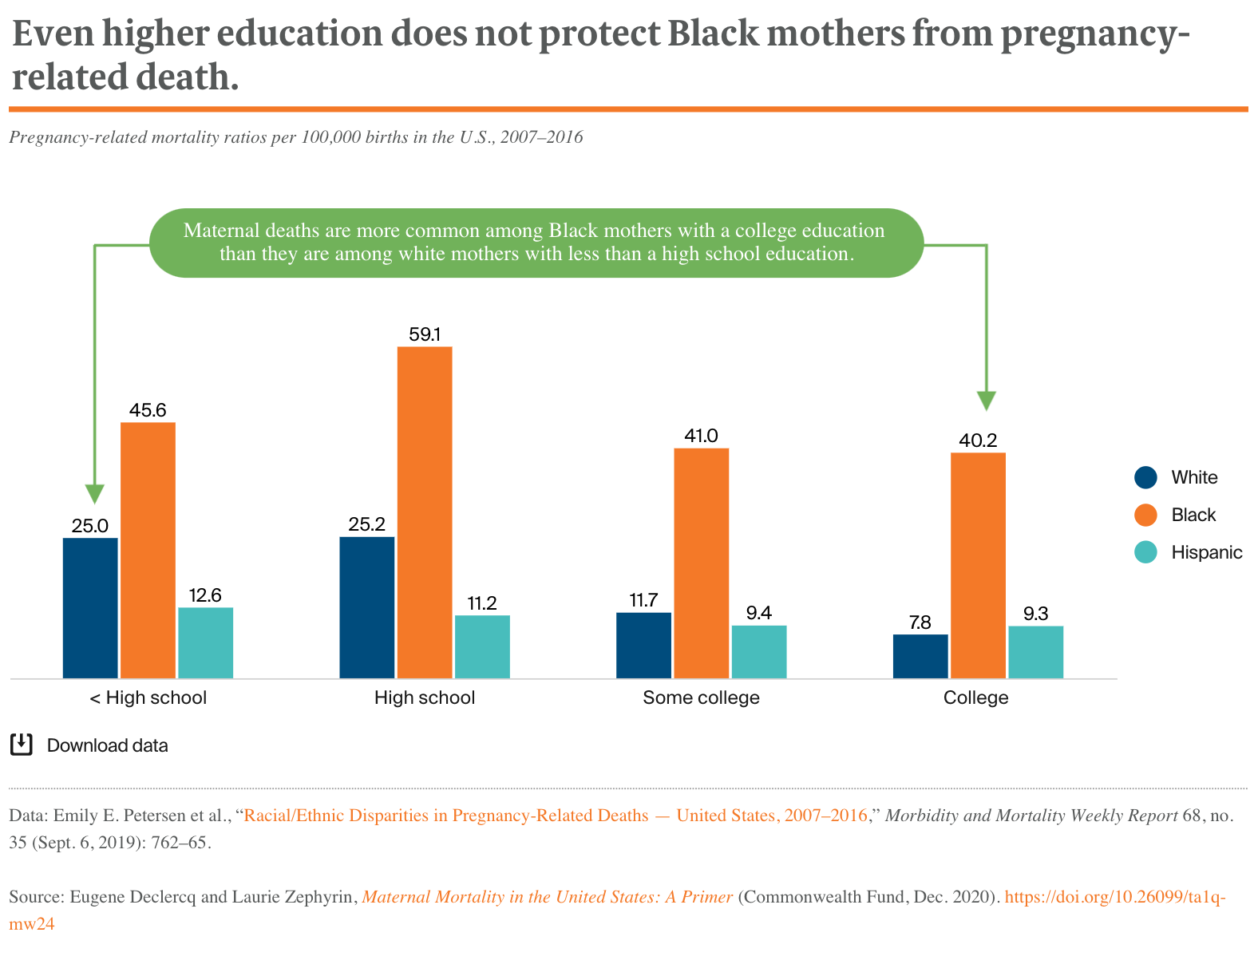
Notes:
Stories are powerful. And while there are unfortunately many patients & families with stories of loss, the story of Shalon Irving is a poignant one
Epidemiologist at CDC whose research focused on how structural inequality, trauma, & violence contribute to poor health outcomes
On Twitter she described her goal “to kind of uncover & undo the victim- blaming that sometimes happens, where people are like “poor people don’t care about their health”. She said “I see inequity wherever it exists, call it by name, and work to eliminate it”
Shalon became an unfortunate symbol of one of the start health disparities that exists in this country
Top graph – MMR by race and age. Notable the widest gap is among women with a college degree and that Black women with a college degree have higher MMR than white women with less than high school education.
Concept of “weathering” chronic stress leads to adverse health outcomes

Slide 13
MATERNAL MORBIDITY
Any health condition attributed to and/or aggravated by pregnancy and childbirth that has negative outcomes to a woman’s well-being
Notes:
- Maternal mortality does not capture everything related to maternal health & well-being

Slide 14
Maternal Morbidity
Important measure in efforts to prevent maternal mortality & address health inequities
About 60,000 women each year are affected by severe maternal morbidity
Unexpected outcomes of labor or delivery that have serious short- or long-term health impacts

Slide 15
Severe Maternal Morbidity
Heart
Myocardial infarction (Heart attack)
Cardiac arrest
Cardiomyopathy (Heart failure)
Blood or Blood Vessels
Pulmonary embolism (blood clot)
Aneurysm (enlarged vessel in brain)
Infection
Sepsis
Kidney
Acute renal failure (kidney disease)
Other
Shock (severe low blood pressure affecting organ function)
Anesthesia complications
Eclampsia
Blood transfusion**
Hysterectomy
Ventilation (breathing tube/machine)

Slide 17
Notes:
CDC analyzed data from Porter Novelli View Moms survey. Administered April 2023
2402 respondents. 20% (1 in 5) of all respondents reported experiencing mistreatment during maternity care
Most common types of mistreatment
Receiving no response to requests for help
Being shouted at or scolded
Not having their physical privacy protected
Being threatened with withholding treatment or made to accept unwanted treatment

Slide 18
Mistreatment During Maternity Care
29% reported discrimination during pregnancy care
Highest rates of discrimination: Black (40%), multiracial (39%) and Latinx (37%)
45% reported holding back from asking questions or discussing concerns
Thinking, or being told by friends/family, what they were feeling was normal
Not wanting to make a big deal about it or being embarrassed to talk about it
Thinking their health care provider would think they’re being difficult
Thinking their healthcare provider seemed rushed
Not feeling confident that they knew what they were talking about
Notes:
Effective communication among healthcare providers and patients can build trust and contribute to high quality care.
Important for patients to feel comfortable sharing health concerns with their providers, which could lead to more accurate & timely treatment for pregnancy-related complications

Slide 19
Institute of Medicine - 2003
Even among individuals with access to care, significant racial and ethnic disparities exist and are related to historic and current social & economic inequality, discrimination, and a fragmented US healthcare system
Notes:
Assess extent and sources of racial & ethnic disparities in health care not otherwise attributable to access to care, ability to pay, or insurance coverage

Slide 20
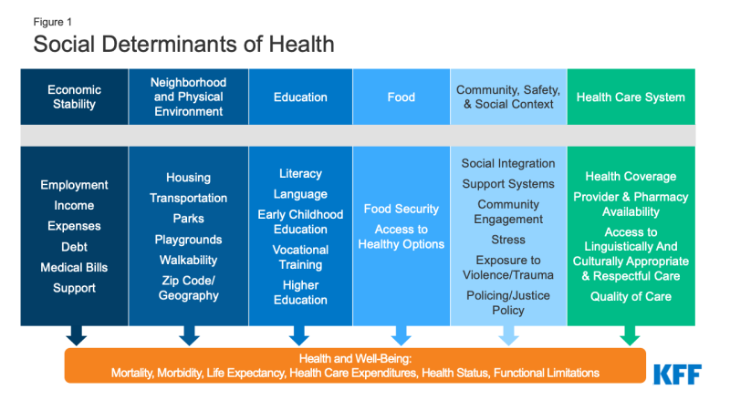
Notes:
Definition
- non-medical factors that influence health outcomes
- where one is born, grows up, lives, works, age and wider set of forces that affect daily life

Slide 21
Racism, not race contributes to disparities in maternal morbidity & mortality
Source: Being Antiracist National Museum of African American History and Culture

Slide 22
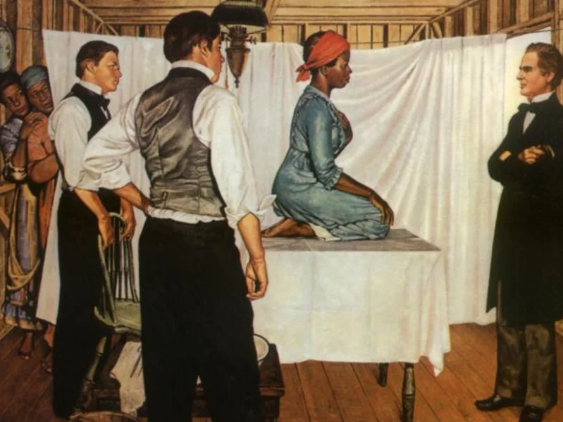
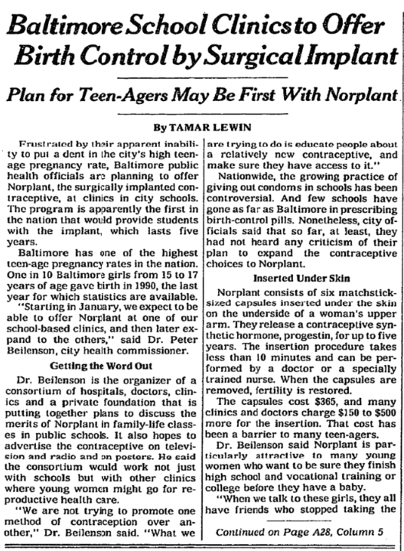

Slide 23
Notes:
Dr. Eberhardt is a professor of psychology at Stanford University and previous recipient of MacArthur genius gran
Leading expert in implicit bias and in her book Biased she provides perspective that is scientific, investigative, and informed by her personal experience in tackling bias
Addresses how racial bias is not the fault of or restricted to a few “bad apples” but present at all levels of society, and among us all
She describes it as a human problem that people can and need to play a role in solving
Dr. Geronimus is a professor of human behavior and human health at University of Michigan
How systemic injustices impact can take aa physical and sometimes deadly role
Chronic stress from racism contributes to aging and higher rates of chronic medical problems

Slide 24
What can we do What should we do

Slide 25
NATIONAL & STATE LEVEL

Slide 26
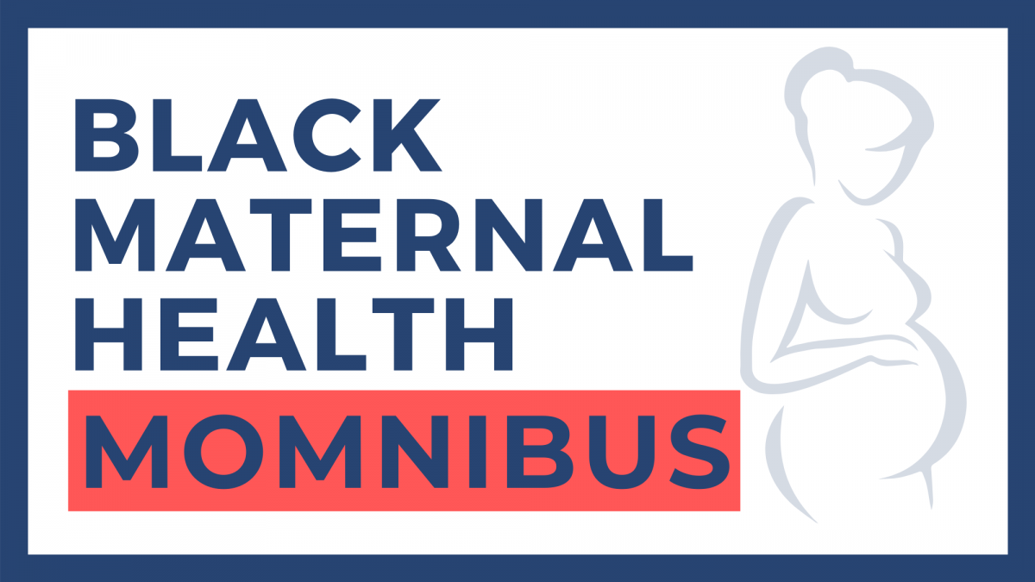
Maternal Mortality Review Programs
Extending postpartum Medicaid coverage
Expand Midwifery care
Expand access to Doula care
Notes:
MMR Program
Identify causes of maternal death
Review of medical records and other relevant data
Determination of preventability of death
Development of recommendations to prevent maternal death
Dissemination of findings & recommendations to policy makers, healthcare providers & facilities, & to the public
Momnibus Act – still hasn’t been passed by Congress
Investments in SDoH, support for maternal mental health, support for incarcerated pregnancy people
Fund community based organizations working on maternal health outcomes
Improve data collection & quality measures
Diversity maternal care workforce
Invest in digital tools

Slide 27
INSTITUTIONS
Diversity, Equity, & Inclusion
Incorporate discussion about bias, disparities, health equity/inequity into routine

Slide 28
Identify and address unconscious bias in healthcare
Standardize coordination of care & response to emergencies
Improve delivery of quality prenatal & postpartum care

Slide 29
Diversity, Inclusion, & Women’s Empowerment Program
Health Equity Minute
Quality & Patient Safety Rounds
(In)Equity Inbox
DEI Townhall Discussions
Obstetric Patient Advisory Council

Slide 30
HEALTH CARE PROVIDERS

Slide 31
Recognize and work toward eliminating one's biases
Understand the history contributing to disparities in maternal morbidity & mortality
Ask questions to know our patients and the things that may be affecting their lives
Help patients, and their support persons, understand urgent warnings signs and when to seek medical attention
Respond to concerns patients may have
Provide all patients with respectful & quality care

Slide 32
PATIENTS, FAMILIES, FRIENDS

Slide 33
Seek out a healthcare provider that you feel comfortable with
Bring a support person with you to appointments
Talk to your healthcare provider is anything doesn’t feel right or is concerning
Be aware of and seek immediate medical care of urgent warning signs
Talk to your health Care provider about any concerns or fears you may have about pregnancy, delivery, and/or postpartum
Notes:
Warning Signs
Report to your provider if you experience any of the following: severe headache, vision changes, shortness of breath, asthma not responsive to your usual medications, more difficulty breathing when you lay down flat, heart palpitations, chest pain or increased swelling, particularly in the hands, face and feet. These symptoms could also be signs of pre-eclampsia, which affects up to 15 percent of pregnancies worldwide. When Black women have pre-eclampsia, it often presents earlier and is more likely to be more severe than with white women.

Slide 34
“If Black women were free, it would mean that everyone else would have to be free since our freedom would necessitate the destruction of all the systems of oppression.”
- The Combahee River Collective, 2977

Slide 35
