Slide 1
Medication Adherence Mini-Med School | October 17, 2023 Katy Pincus, PharmD, BCPS, BCACP, CDCES Sharon Feinstein, MD

Slide 2
Introductions

Slide 3
Sharon Feinstein, MD
Assistant Professor
Director of Value Based Programs
University of Maryland, School of Medicine
Department of Family and Community Medicine
Katy Pincus, PharmD, BCPS, BCACP, CDCES
Associate Professor
University of Maryland, School of Pharmacy
Department of Practice, Science and Health Outcomes Research

Slide 4
What is Medication Adherence?
American Pharmacists Association Definition:
Medication Adherence is the extent to which a patient's behavior (e.g., taking medications with respect to timing, dosage, and frequency) corresponds with agreed-upon recommendations from a healthcare provider.
Notes:
Address stigma around this; and adherence vs. compliance

Slide 5
Learning Objectives
After attending this presentation, you will be able to:
Discuss the impact of medication nonadherence
Identify common barriers to medication adherence
Suggest potential approaches to address these barriers
Have a meaningful discussion with your prescriber(s) about your medications

Slide 6
Impact of Medication Adherence

Slide 7
Impact of Medication Adherence
Each year in the US, medication nonadherence accounts for:
50% of treatment failures
25% of hospitalizations
125,000 deaths
>80% adherence is needed for medications to work optimally
Adherence rates to chronic medications is around 50%
US Pharm 2018;43(1):30-34.

Slide 8
What are some reasons people do not take their medicines as prescribed?

Slide 9
Health Beliefs Model
Health Educ Q 1984;11(1):1-47.
Notes:
Image from: https://www.slidegrand.com/templates/health-belief-model-powerpoint-template-designs/
Shared decision making; trust in the prescriber / relationship
Enough information to make an informed decision about risks and benefits of taking a medication
Also perceived side effects / risks

Slide 10
Common Barriers to Medication Adherence

Slide 11
Common Barriers to Medication Adherence
Cost & Insurance Coverage
Prescription Refill Process
Perceived Side Effects
Lack of Perceived Benefit
Confusion & Memory Issues
Complexity of Medication Regimen

Slide 12
Cost & Insurance Coverage
Cost / Co-pays
Generic vs. Branded Medications
Insurance Formularies
Prior Authorization
Patient Assistance Programs

Slide 13
Prescription Refill Process
Requesting refills (pharmacy)
90-day supplies
Requesting new prescriptions (prescriber)
Prescription expirations
Out of stock / medication shortages
Transportation
Delivery / Mailorder pharmacies

Slide 14
Perceived Side Effects
Side effects
Drug-drug interactions
Dependence / addiction

Slide 15
Lack of Perceived Benefit
Susceptibility
Severity
Conditions without symptoms
Preventative medicine

Slide 16
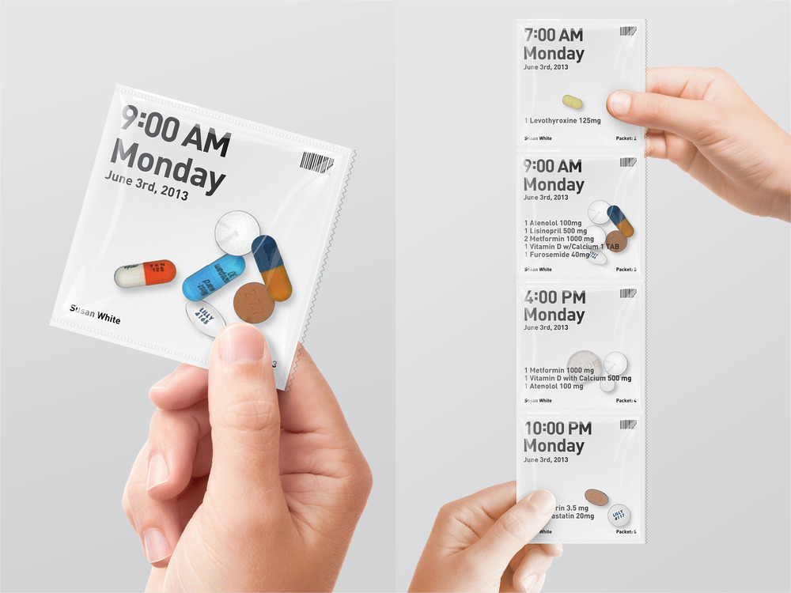
Confusion & Memory Impairment
Reminders / alarms
Pill boxes
Pill packs
Medication management assistance
Notes:
Images available from:
https://www.amazon.com/EZY-DOSE-Organizer-Medicine-Compartments/dp/B09Z61G77L/ref=asc_df_B09Z61G77L/?tag=hyprod-20&linkCode=df0&hvadid=598244663013&hvpos=&hvnetw=g&hvrand=10916873580945751029&hvpone=&hvptwo=&hvqmt=&hvdev=c&hvdvcmdl=&hvlocint=&hvlocphy=9007921&hvtargid=pla-1676299875522&psc=1
http://gestaltdesign.com/pillpack

Slide 17
Complexity of Medication Regimen
Frequency of administration
Need to take with or without food / specific timing
Multiple prescribers

Slide 18
Approaches to Discussing Medication Adherence

Slide 19
Approaches to Discussing Medication Adherence: STEP 1: Assessing Adherence
Allow
Allow for open dialogue and discussion without judgement | Establish Trust
How do you feel about taking all of these medications?
Avoid
Avoid medical terminology
You are prescribed XX medication for your high blood pressure... (vs. Hypertension)
Ask
Ask open ended questions | be specific about the medication
In the last 2 weeks, how many days of XX medication have you missed?
How often do you take your XX medication?
When is the last time you took your XX medication?
Move to more direct questions if needed
How often do you have difficulty remembering to take all of your blood pressure medications?
If you feel better, do you stop taking your medication?
Do any of your medications make you feel sick?
Tell me how you take your Advair inhaler.
Direct

Slide 20
Approaches to Discussing Medication Adherence STEP 2: Understanding Barriers
Avoid the "scold and scare"
Open dialogue
What keeps you from taking XX medication?
Tell me more about how you feel when you take XX medication.
How much do you pay each month for your medications? Has this been hard for you?
Are there any medications that you have a hard time getting from your pharmacy?

Slide 21
Approaches to Discussing Medication Adherence STEP 3: Addressing barriers/adherence
Adjusting medications
Changing/adjusting medication
Changing/adjusting dose
Education/Knowledge
Discussion regarding medication: use, cost, benefits, concerns
This includes exactly how and when to take the medication
What you can expect and not expect
Strategies to help with remembering to take medication
Close follow up and check in
"Teach back" method

Slide 22
Approaches to Discussing Medication Adherence Starting off on the right foot
Shared Decision Making
Use shared decision making when deciding whether or not to start a medication
Use shared decision making when selecting a medication
Medication Education
Discuss medication, what it is for, potential side effects
What do you if you have concerns about medication, cost, instructions
Deprescribing
Reduce (unnecessary) medications

Slide 23
Approaches to Discussing Medication Adherence Patient, Family Member, Advocate
As a Patient:
Bring medications with you to your visits (all medications)
Keep an up-to-date list of medications
Ask questions | Share concerns
Write notes
Be as honest as you can with information
Give your provider time to refill a medication
As a Family Member/Advocate:
Check in regarding medications
Ask questions | Share concerns
Non-judgmental language when asking about medications

Slide 24
Key Take-Home Points
Medications only work if you take them
There are many reasons a person doesn't take a medication as prescribed
Open discussions between patients and prescribers can help address barriers to medication adherence

Slide 25
Discussion

