Slide 1
Taxes
Sofia Cascio
2/10/2022

Slide 2
Taxes
Paycheck Tax Deductions
Tax Benefits for Higher Education
Other Tax Benefits

Slide 3
Paycheck Tax Deductions

Slide 4
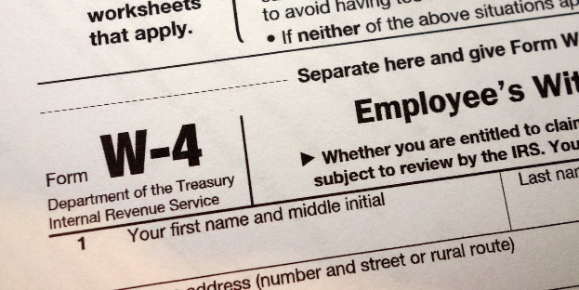
What are W-4 and W-2 Forms?
W-4 : Federal W-4 form is used by employer to know how much to deduct for withholding based on your income and your “Personal Allowances”
W-2 Wage and Tax Statement – Provided by employer at the end of the year.
The W-2 lists all the deductions that were taken from your paychecks.

Slide 5
Tax Benefits for Higher Education
Tax Deductions - allow certain expenses to offset earned income, thus reducing the amount of taxes you pay
Tax Credits - directly reduce the amount of taxes you must pay.
Education tax credits are limited to only currently enrolled students.
Tax deductions are available to both students and to those repaying education loans.

Slide 6
Tax Credit Programs (Enrolled Students Only)
The American Opportunity Credit
Up to a $2,500 credit for qualified education expenses per year for up to four years
Qualifications : Tuition, fees, and other expenses related to higher education were paid (even if they were paid with education loans).
You’re working towards a degree or other recognized credential and are enrolled on at least a half-time basis in the same tax year.
You haven’t completed the first four years of college prior to 2012 and have not previously claimed four years of the American Opportunity Credit or the (now discontinued) Hope Credit.
You haven’t been convicted of felony for possessing or distributing a controlled substance.
The Lifetime Learning Credit
A $2,000 credit for qualified education expenses for an unlimited number of years
Qualifications: Tuition, fees, and other expenses related to higher education were paid (even if they were paid with education loans).
Note: The Lifetime Learning Credit is a great option for those who take occasional classes or who have already exhausted their Hope and/or American Opportunity Credits.

Slide 7
Tax Deductions
Student Loan Interest Deduction
If you paid student loan interest in a given year, you can deduct up to $2,500 of your interest payments from your income.
Note: Tax deductions are used from students who are no longer in school or current students who choose not to accept the American Opportunity or Lifetime Learning Credit.

Slide 8
Other Tax Benefits
Business deductions for work-related education.
Penalty-free retirement account withdrawals.
Employer-provided educational assistance income exclusion.
Various college savings and pre-payment programs.

Slide 9
Reminder
Refer to IRS Publication 970 – Tax Benefits for Education.
Check with a qualified tax preparer

Slide 10
Send questions to scascio@som.umaryland.edu

