Slide 2
Financial Aid Budget
 | Fall Term | Spring Term
Living Expenses | $ 13,250 | $ 13,250
Based on living off campus which includes University Suites at Fayette Square

Slide 3
Benefits of Budgeting
Although the word “budget” often has negative connotations, it also offers many benefits. For example, you will find that a realistic budget will help you:
Maintain better control of your spending and be less likely to run into credit problems.
Cover your essential expenses before making optional purchases.
Prepare for an unexpected expense by building an emergency fund.

Slide 4
How to Set Up a Budget
Determine your monthly income
Look at your monthly expenses
Fixed expenses (stay the same every month)
Variable expenses (fluctuate from month to month)
Write it all down

Slide 5
How to Set Up a Budget
Calculate the difference between your income and expenses.
If you find that you don’t have enough money to cover your expenses, consider making adjustments to your variable expenses; this may be an area in which you can make up for some of your shortfalls. Use the Budgeting Worksheet for Students or the Budgeting Worksheet for Residents to help you create your budget.

Slide 6
Budgeting Ideas and Tips
Living on a budget as a medical student or resident is an essential step for minimizing the debt you’ll face upon entering repayment. Try to think of a budget the same way you’d think about maintaining a healthy diet: make sensible, responsible choices and you’ll reap the benefits

Slide 7
Save Money and Time
Make your own coffee or tea and buy a thermos. You’ve probably heard this before; endless cups of coffee from a coffee shop can really increase expenses. If you really must pay for coffee, consider opting for a smaller size or limiting yourself to plain drip-coffee instead of fancier drinks. Your wallet and your waistline will thank you. Bag your lunch. Being short on time and having irregular hours will be less stressful if you have easy, healthy, homemade food with you. Not only will you save time and money, but you may also eat better. Shop smart. If you buy your groceries online, you may save time. If you go to the store, always bring a list to minimize impulse buying and browsing time. Join your market’s “shopper’s club” to take advantage of weekly specials. Design your menu based on weekly sales while taking advantage of manufacturer’s coupons (available online as well as in the paper). Whenever possible, buy generic brands. Take control of your credit cards. Try not to carry a balance on your cards; this will save you money. Additionally, use credit cards that don’t charge an annual fee. Avoid late fees. Pay your bills on time and online. Late fees add up and they may have a negative effect on your credit rating. If you do miss a payment, call the creditor and ask to have the late fee waived. Avoid ATM fees. Try to bank locally and use your bank’s ATM for cash withdrawals. Bike to school/work. If your climate, schedule, and location are suitable, bike to school/work. It helps you keep in shape and it is less costly. To save even more money, buy a used bike. Take public trans­portation. It may be more cost effective not to rely on a car at all. Public trans­portation will alleviate the expenses of buying gas, maintenance, and parking. It might actually be less stressful too! The 30 Minute Rule: If you see something you “have to have” wait 30 minutes, then if you still can’t live without it—make the purchase. Think About It... Decide what makes sense for you. If you live more responsibly now and make smart choices about how you spend your money now, chances are, you’ll be paying a lot less when you enter repayment. Small changes can make big differences over time.

Slide 8
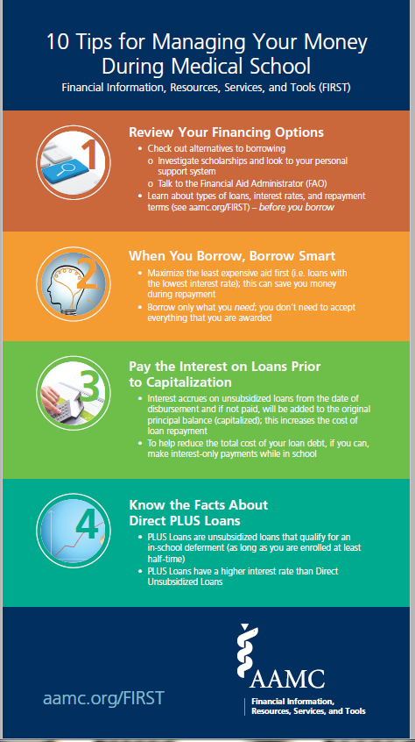
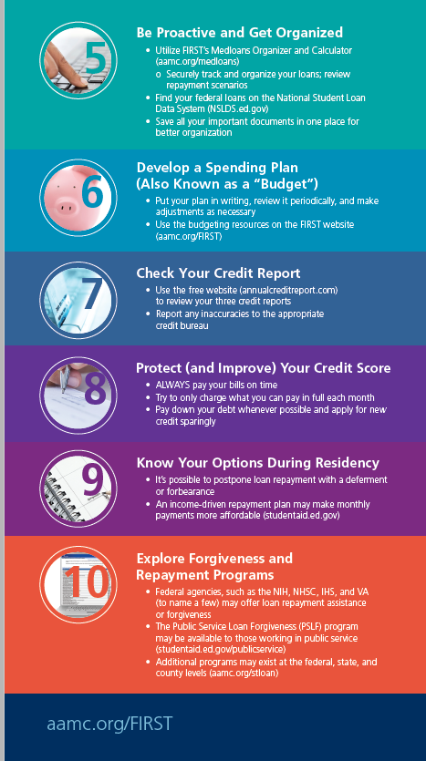

Slide 9
Unforeseen Emergencies and Financial Needs What to Do?

Slide 10
Occasionally unforeseen emergencies occur that can affect your finances, and your eligibility for financial aid. Financial aid administrators have the authority to make adjustments to your financial aid eligibility, under certain circumstances.

Slide 11
If this is you, contact Zhanna Goltser, Executive Financial Aid Director for additional information aidtalk@umaryland.edu

Slide 12
Next Steps?
Use the aamc.org/FIRST site
Develop your budget
Schedule an appointment to review your budget

