Slide 1
Understanding the MSPE and your 1:1 OSA Meeting
Kerri Thom, MD, MS
John Allen, MD

Slide 2
What is the mspe
Medical Student Performance Evaluation

Slide 3
The MSPE
Required component of residency application
Standardized document (AAMC MSPE Task Force Guidelines)
Summative statement of evaluation in medical school (no surprises)
Comparative data (pre-clerkship/clerkship performance) – compared to graduating class/peers
Not a letter of recommendation, instead an accounting of time and academics during med school
Serious academic or professionalism concerns must be addressed in the MSPE (no surprises)
AOA and GHHS will be noted in your MSPE

Slide 4
The MSPE – Zoom Out
A single component of your residency application
Residencies conduct holistic reviews of applicants
The MSPE will not be the reason you match (or don’t match) at a particular program
Represents body of work
What matters to Program Directors when deciding who to interview?
USMLE Step 2 (90% of PDs endorsed, 4.5/5 importance rating)
MSPE (85%, 4.1)
Specialty-specific LoRs (84%, 4.2)
What matters when deciding who to rank?
Interpersonal Skills, Interview Performance, Feedback from Residents

Slide 5
The MSPE – OSA Prepares the MSPE
The MSPE will be prepared by Drs. Allen, Flaherty, Lamos, Thom
Assigned by Specialty
List in Residency Application Manual – Specialty Advising
Can request any OSA Dean
Dr. Thom reviews and signs ALL MSPEs

Slide 6
Sample mspe
https://www.medschool.umaryland.edu/osa/residency-application-manual-/the-residency-application---components/the-mspe/

Slide 7
MSPE – Section headings
Identifying Information
Noteworthy Characteristics
Significant Challenges
Academic History
Academic Progress
Professional, Pre-Clerkship, Clerkship Performance
Summary

Slide 8
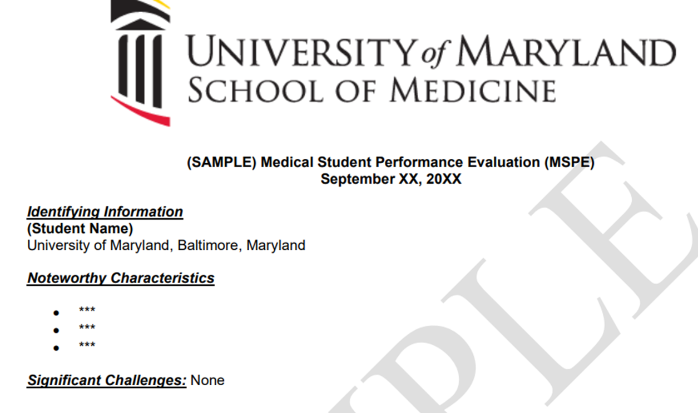
MSPE – Section headings
Identifying Information
Noteworthy Characteristics
Significant Challenges
Academic History
Academic Progress
Summary

Slide 9
MSPE – Section headings
Identifying Information
Noteworthy Characteristics
Significant Challenges
Academic History
Academic Progress
Summary

Slide 10
Noteworthy Characteristics & Significant Challenges
Due June 16th
You will write these!
3 Bullets, written in 3rd person, no more than 2 sentences or 40 words per bullet
Tips/Examples: Residency Application Manual – MSPE
Support your ‘narrative’; often used to define a theme
Can include values, hobbies, pre-clerkship elective participation, commitment to research/service/etc…
Avoid duplication of CV/List of Experiences
Significant Challenges – Optional 4th bullet, briefly address significant challenges or hardships in medical school

Slide 11
MSPE – Section headings
Identifying Information
Noteworthy Characteristics
Significant Challenges
Academic History
Academic Progress
Summary
Our Dates/terminology for "Extensions/Leaves/Gaps/Breaks" should match what you put in your application.

Slide 12
MSPE – Section headings
Identifying Information
Noteworthy Characteristics
Significant Challenges
Academic History
Academic Progress
Summary

Slide 13
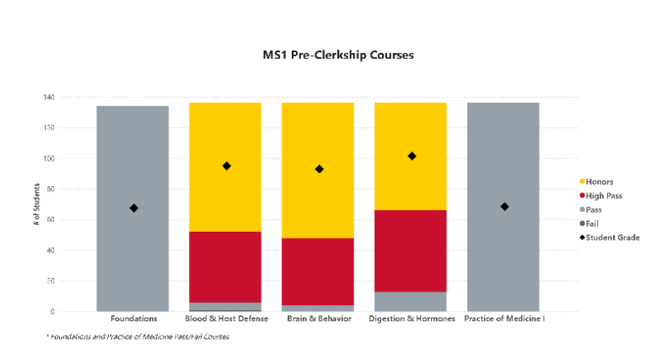
MSPE – Section headings
Identifying Information
Noteworthy Characteristics
Significant Challenges
Academic History
Academic Progress
M1, M2, Clerkship Graphs
Summary
*Comparisons to graduating class

Slide 14
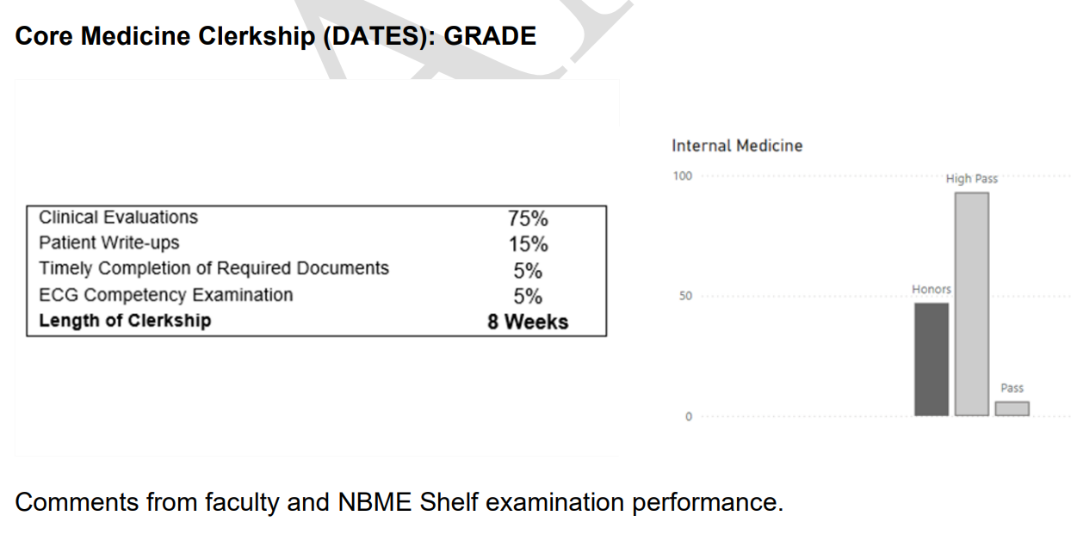
MSPE – Section headings
Identifying Information
Noteworthy Characteristics
Significant Challenges
Academic History
Academic Progress
Core Clerkships
Summary

Slide 15
MSPE – Core Clerkships
Core Clerkships listed in chronological order
Clerkship Title, Grade Received
Grading Rubric, Grade Distribution for Class
Narrative Assessments Directly from MedHub
Reviewed by OSA/you – can be edited for spelling/grammar/accuracy ONLY
We cannot change the content of the assessments
Clerkships completed by July 1 will be included

Slide 16
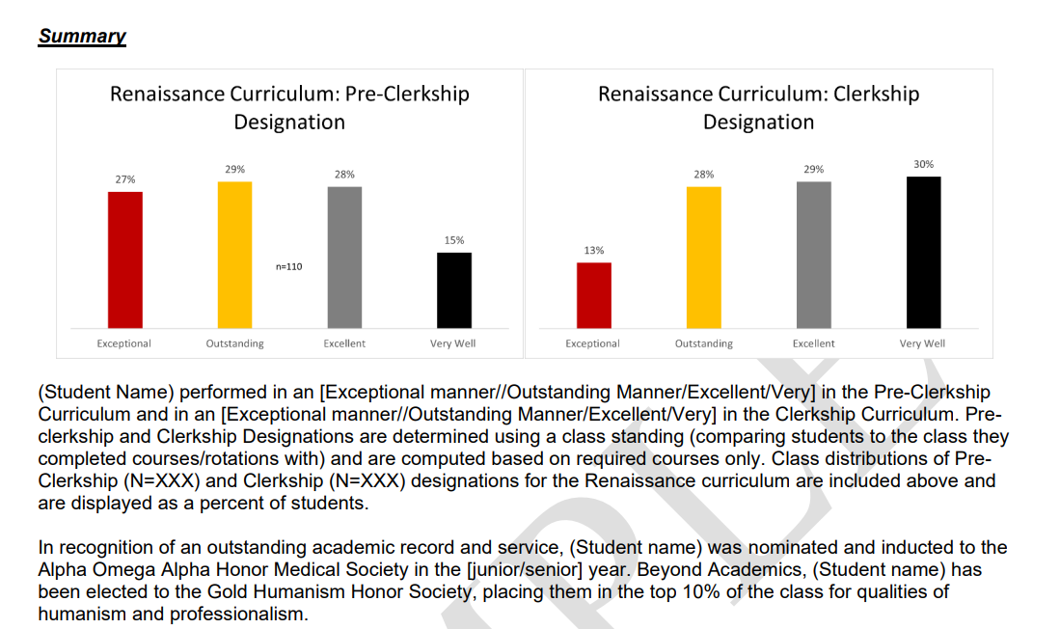
MSPE – Section headings
*Comparisons to graduating class
Identifying Information
Noteworthy Characteristics
Significant Challenges
Academic History
Academic Progress
Summary
Restates Academic Progress

Slide 17
MSPE – Appendix
The MSPE will be accompanied by an appendix which explains the UMSOM curriculum and grading schema

Slide 18
MSPE – What is NOT included
Protected health information (e.g., outlining medical details as part of leave)
Accommodations information
Details regarding leave beyond dates/categories (i.e., Personal/Medical, Academic, Research)
Absences/Lateness for required educational sessions
Private information shared with OSA/OME
Thoughts/opinions of OSA/OME
Specialty-specific statements – the MSPE is specialty neutral

Slide 19
MSPE Timeline

Slide 20
MSPE Timeline
Now/Ongoing MSPE preparation by OSA and OSA Deans
June 16 Students submit Noteworthy Characteristics
July 1 Clerkships taken by July 1 included in MSPE – Academic Progress section (ongoing)
Jul/Aug Final Preparations/Quality Checks
Aug 24 One week for student to review MSPE and offer edits
Sep 24 MSPE Standard Release Date – ALL applicants

Slide 21
What Happens After September
MSPEs are uploaded ONE time on standard release date
Application systems do NOT allow re-uploads
Significant changes in Academic History must be communicated directly to programs with an addendum – very rare
MSPEs will only include core clerkships
Equity
Clerkships taken by July 1
ACP experiences (e.g. Sub-Is and Key electives) will be captured by:
Transcripts
LoRs * Highly valued by Program Directors

Slide 22
Questions about the mspe?

Slide 23
https://www.medschool.umaryland.edu/osa/residency-application-manual-/the-mspe/
Reference the OSA Residency Applicant Manual for questions

Slide 24
1:1 Osa meeting

Slide 25
What do we discuss together
How competitive is my specialty?
How many programs should I apply to?
Which programs should I apply to?
Contingency planning (if needed)

Slide 26
Checklist to complete prior to your OSA advising meeting
Complete the MedScope Career Tab
Indicate your Preferred Pronouns
Review your current schedule/graduation requirements
Review the Residency Application Manual
The below are NOT required but may be helpful
Meet with Departmental Mentors
Create a preliminary list of programs of interest
Create a CV Draft
Create a Personal Statement draft

Slide 27
Other things to take care of
Confirm name/pronunciation in MedScope as you wish for graduation/diploma
Update your Preferred Pronouns in MedScope for the MSPE (if not indicated will default to he/him, she/her)
Update your contact information in MedScope
Pay it forward, sign up to be an Alumni Mentor (Career Tab, MedScope)
Use the MedScope Interview Tracker to ensure optimal advising!
Consider your mission/brand and ensure social media profiles are professional/clean
Complete the Graduation Questionnaire (online through AAMC) – available Jan – May

Slide 28
Questions about your meeting?

