Slide 1

Taking a Gap Year:
Considerations and Planning
Office of Student Affairs

Slide 2
Why take a gap year(s) during medical school?
Personal/Medical/Life Circumstances
Personal or Professional Growth and Development
    Dual Degree
    Research
    Service
    Advocacy
    Other

Slide 3
Considerations for taking a gap year?
Is it necessary/advised?
Do you want to do it? Are you excited about it?
Does it support your mission/brand? And how …
Will the experience make me a more competitive residency applicant?
Does it make sense right now?
If is logistically feasible right now?
How does it impact my schedule/timeline/graduation trajectory?
Have I considered the pros/cons?
How can I make the most out of the time?

Slide 4
Considerations for taking a gap year?
*Tip – get advice from many different people when weighing decision – including other students
Is it necessary/advised?
Do you want to do it? Are you excited about it?
Does it support your mission/brand? And how …
Will the experience make me a more competitive residency applicant?
Does it make sense right now?
If is logistically feasible right now?
How does it impact my schedule/timeline/graduation trajectory?
Have I considered the pros/cons?
How can I make the most out of the time?

Slide 5
Considerations for taking a gap year?
*Tip – get advice from many different people when weighing decision – including other students
Is it necessary/advised?
Do you want to do it? Are you excited about it?
Does it support your mission/brand? And how …
Will the experience make me a more competitive residency applicant?
Does it make sense right now?
If is logistically feasible right now?
How does it impact my schedule/timeline/graduation trajectory?
Have I considered the pros/cons?
How can I make the most out of the time?
Most students will later share with us that the experience was worth while

Slide 6
How is a gap year perceived?
In general, gap years are:
Supported by SOM
Perceived positively by future residency programs
  *especially if they fit your mission/brand
  * especially if you can speak eloquently about that time
  *time/gap must be explained

Slide 7
Additional-degrees
Students accepted into an approved dual-degree program
  A leave from the traditional 4-year curriculum; but not technically a leave
  In some scenarios (UMBC/College Park) student services shift to alternative campus
  Fulfills FRCT scholarly requirements
  DD requirements must be completed by Jan of graduating year
Formal LOA for degrees obtained from external programs
    A true leave is required
    Activities may or may not fulfill FRCT requirements
    Must complete full degree before your return

Slide 8
Leave of Absence (and other associated) Policy
Leave of Absence Policy, Link
  Students meet with OSA to initiate process
  Leave must be approved by the Dean’s Office
  Leave must be explained in MSPE
  Leave for Personal/Prof Development is taken after completion of clerkships
The “Six Year Rule” states that students must graduate within six years of matriculation which includes leave time (but excluded formal participation in a dual degree program)
Notes:
LOA Policy: https://www.medschool.umaryland.edu/media/SOM/Offices-of-the-Dean/Student-Affairs/Images/Leave-of-Absence-policy.pdf
Advancement, Graduation & Dismissal Policy (includes “The six-year rule” : https://www.medschool.umaryland.edu/media/SOM/Offices-of-the-Dean/Student-Affairs/Images/Advancement,-Graduation,-Dismissal-CCC-approved-2021.pdf

Slide 9
Leave of Absence (and other associated) Policy – MSPE
Leave of Absence Policy, Link
  Leave must be explained in MSPE
  Academic History: Extensions, Leaves, Gaps or Breaks:
  “[Student] took an approved leave of absence to participate in a research fellowship from [DATE], returning to the curriculum on [DATE].”
Notes:
LOA Policy: https://www.medschool.umaryland.edu/media/SOM/Offices-of-the-Dean/Student-Affairs/Images/Leave-of-Absence-policy.pdf
Advancement, Graduation & Dismissal Policy (includes “The six-year rule” : https://www.medschool.umaryland.edu/media/SOM/Offices-of-the-Dean/Student-Affairs/Images/Advancement,-Graduation,-Dismissal-CCC-approved-2021.pdf

Slide 10
Initiating any break from the curriculum (e.g. Gap/Leave)
Step 1: Meet with OSA
  * If associated with research, Meet with OSR
Step 2: Written request for leave addressed to Dean (given to OSA)
Step 3: Attend to and complete the LOA Checklist; submit to OSA
  *Contact Student Accounts to clear balances
  *Contact Financial Aid to discuss impact
Step 4: OSA will process approvals, status changes, drops
Notes:
LOA Checklist: https://www.medschool.umaryland.edu/media/SOM/Offices-of-the-Dean/Student-Affairs/Images/LOA_Checklist.pdf

Slide 11
Timing
Recommend starting process about 6 months before planned leave.
Confirm plans within 8-12 weeks of planned leave
OSR must have 8-week advanced notice of plans for a research elective for approval

Slide 12
What does it mean to be on “Leave” – elements of the checklist
You are on an approved leave from the medical school curriculum
You are NOT a registered student and are not paying tuition/fees
  Unable to access to campus services (student health, counseling, gym…)
  Not eligible for student health insurance or accident insurance
  Not covered under SOM malpractice insurance
  Cannot register for/take courses for credit at UMSOM / UMB
  Not eligible for financial aid

Slide 13
Are there other options?
Unscheduled block/blocks (clinical years)
Research Elective* – 1-2 credits towards graduation in Adv Clinical Phase
Decelerated Curriculum
  Extends Graduation
  Results in part-time student status
  May incur additional tuition and fees
Research selective*
  9-credits, tuition remitted; student pays fees
  Not eligible for financial aid
  Does provide access to student benefits including malpractice, health insurance
* Research Elective/Selective require prior approval by OSR (Dr. Greg Carey)

Slide 14
When to take leave and scheduling considerations
Individual OSA consultation
New/Spring term starts July 1, 2023
Careful balance between maximizing gap experience, creating ideal schedule, and financial implications
Recommend at least one Advanced Rotation before leave
TAKE STEP 2 EARLY IN YOUR LEAVE!!!!

Slide 15
Schedule can be personalized:
-Outstanding clerkships completed block 11/12 before leave
1-2 pre-clerkship electives translates to additional “Off” months
Most students use 1 month off for interviews
Graduation Requirements
- One SI or Elective in IM
- One SI or Elective is Ambulatory
-At least one Clinical in last semester

Slide 16
While you are on leave
Check emails!
  While on leave, you should routinely check your SOM email
  Note you will likely receive emails from two class listservs (original/new)
  Respond to important emails/expectations (e.g., clinical scheduling)
Keep SOM up to date with your status through regular check ins
  All - Routine check ins with OSA
  Research – Routine check ins with OSR/Dr. Carey
  Status checks – are you on track to meet your own goals?

Slide 17
What else should I be doing during my leave?
Consider re-evaluating your mission/brand and identify activities to support
Join a national medical society (or two!) and get involved
Consider reengaging with service/volunteering
Spend some time shadowing in your desired field (remember you do NOT have malpractice, so shadowing ONLY)
Take a course that supports your interests

Slide 18
Returning from leave
Notify OSA of your intention to return at least 8-weeks prior
  Failure to do so may result in inability to register or withdrawal
All students must attest to meeting technical standards prior to return
May have additional requirements depending on circumstances of leave
Student status, including class and graduation date, will be updated
Notes:
Technical Standards: https://www.medschool.umaryland.edu/media/SOM/Offices-of-the-Dean/Admissions/docs/technical-standards.pdf

Slide 19
Resources
Renaissance Curriculum Graduation Requirements
  https://www.medschool.umaryland.edu/osa/residency-application-manual-/requirements-for-graduation-per-class/
Residency Handbook
  https://www.medschool.umaryland.edu/osa/residency-application-manual-/
MedScope Class Page
  https://medscope.umaryland.edu/pg/cl/SOM2025
**Be sure you are receiving listserve emails for new class

Slide 20
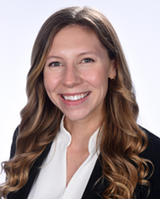
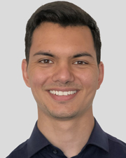
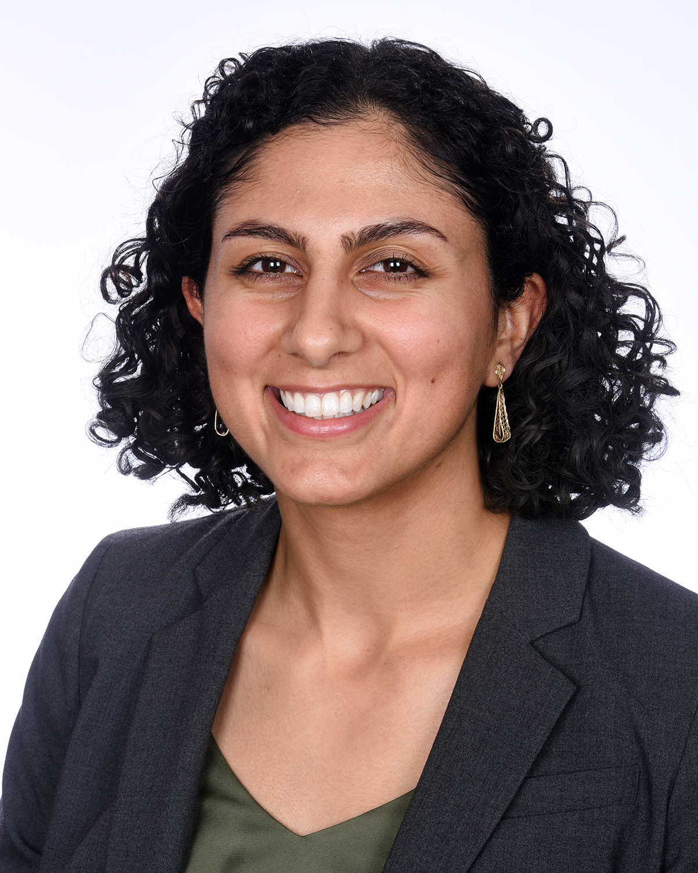
Peer Ambassadors
Lexi Green
Alexis.Green@som.umaryland.edu
“I spent 11 months at the National Institutes of Health in the Medical Research Scholars Program, which provided funding for an intensive research experience, as well as a longitudinal curriculum for improving research skills. This was an exceptional opportunity for me to publish and present, improve my skills, and enjoy life with a more relaxed schedule compared to our medical school years! ”
Bradley Wilhelmy
Bradley.Wilhelmy@som.umaryland.edu
“I enrolled in the research selective after completing M3 and I have spent this time performing translational research in various models of neurotrauma while also conducting clinical research. This dedicated research time has allowed me to better explore a potential career as a physician-scientist, strengthen my CV, and gain greater mentorship from faculty in my specialty of interest.”
Kimia Abtahi
Alexis.Green@som.umaryland.edu
Kimia participated in an internship at UMB Sustainability and
an internship in Annapolis on healthcare policy with a Maryland Senator
Listen to the OSA Insider Podcast Episode 103 – “Gap Years”

Slide 21
Questions?

