Slide 1
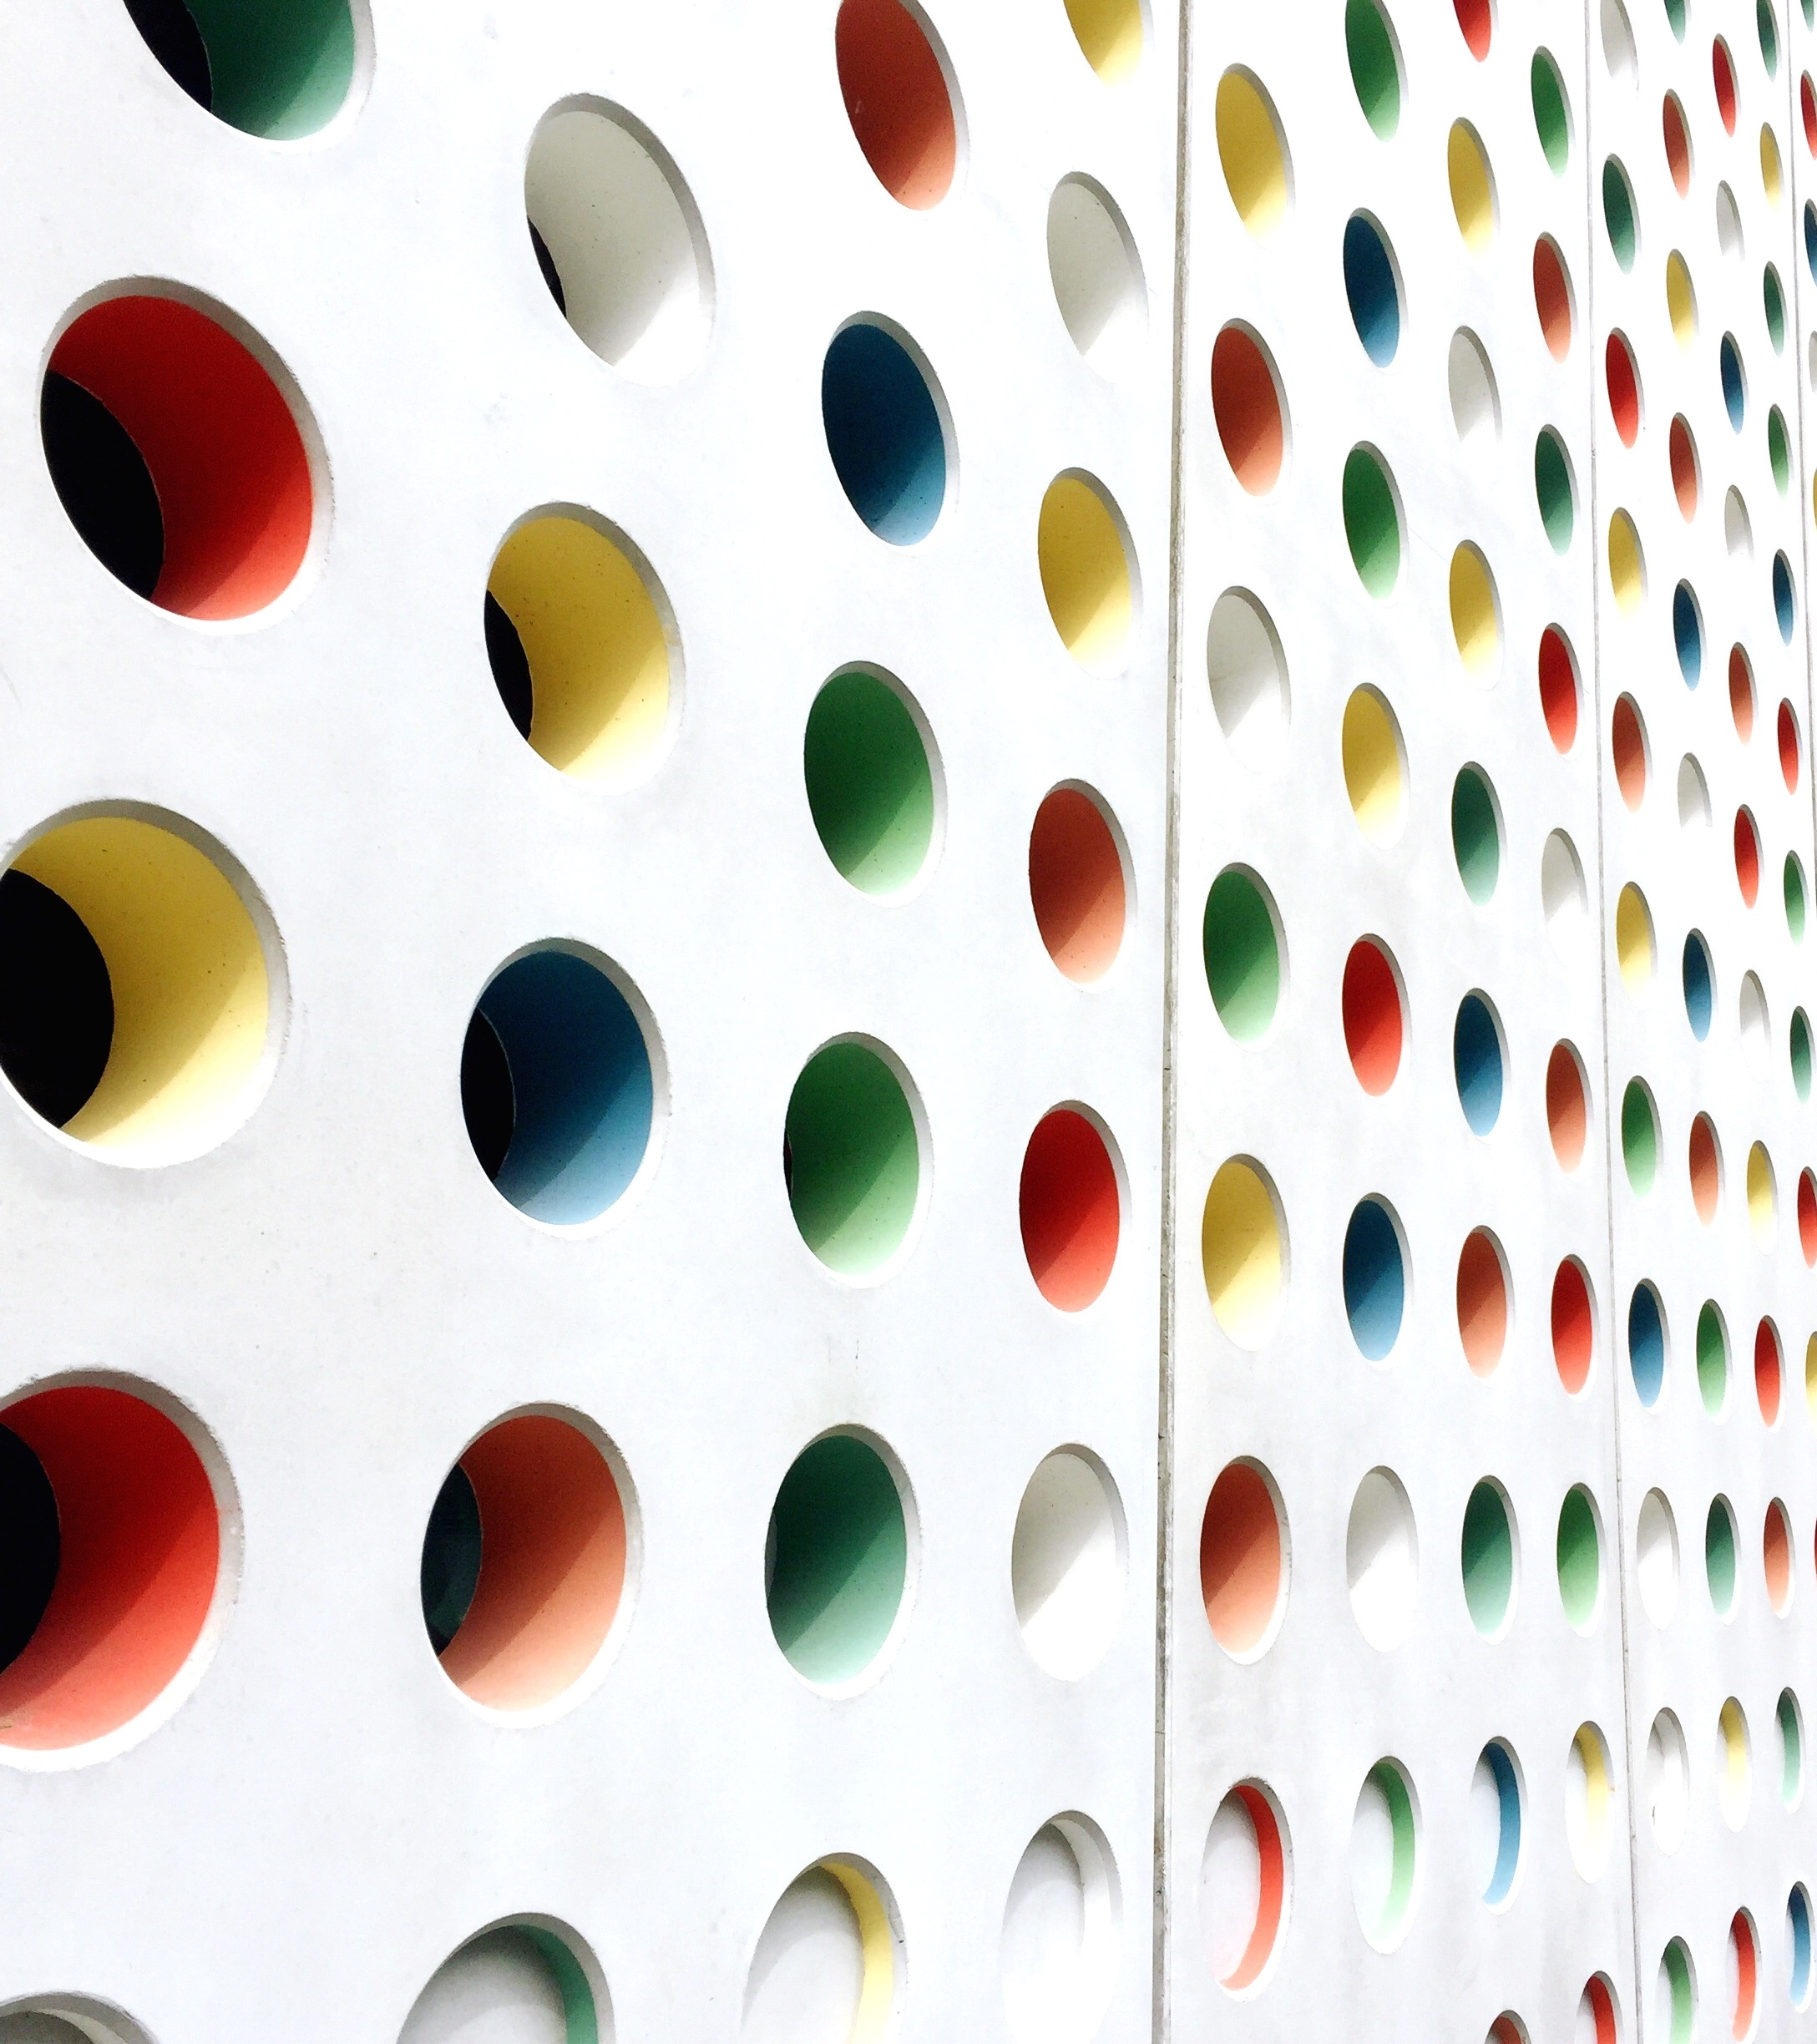
Plastic, Thoracic, Vascular Surgery
Class of 2026

Slide 2

Please review with this presentation
General Surgery Advising Session PPT
  Important Reminders
  Info on 1:1 Session with OSA
  MSPE
  Application Resources

Slide 3
ERAS/NRMP TIMELINE
Date | Activity
Jun 4, 2025 | ERAS season begins
Sep 3, 2025 | Residency applicants may begin submitting applications to programs
Sep 24, 2025 | Residency Application Deadline - Residency programs may begin reviewing applications and MSPEs
End of January | Register for NRMP Match and SOAP
Feb 2, 2026 | Ranking Opens in NRMP
Mar 4, 2026 | Rank Lists Certified
Mar 16 – 20, 2026 | SOAP and MATCH
PLASTIC *
https://aceplasticsurgeons.org/PSCA/
THORACIC
VASCULAR
*Note, these dates are subject to change.
Please reference NRMP and 2026 Main Residency Match Applicants Calendar

Slide 4
A Note on External Rotations (“Aways”)
These are REQUIRED component of applications
Required for PLASTICS, THORACIC and VASCULAR Integrated Programs
Away rotations MUST BE ADDED AT SOM!!!
Required forms are found on the Student Scheduling Page
Forms should be completed/signed by Departments
Submitted to Add/Drop
2-3 Plastics
1-2 Thoracic and Vascular

Slide 5
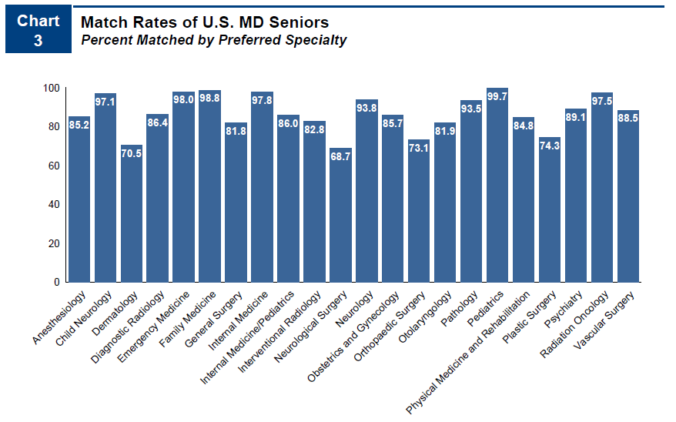
Competitiveness of Specialty
74 % Match Rate (P)
31% Match Rate (T)
89% Match Rate (V)
No unfilled Plastics, Thoracic or Vascular in the SOAP
NRMP Charting outcomes for the Match, 2024
https://www.nrmp.org/match-data/2024/08/charting-outcomes-characteristics-of-u-s-md-seniors-who-matched-to-their-preferred-specialty-2024-main-residency-match/

Slide 6
Average Number of Applications: UMSOM, National (Total vs MD Public School)
Year | Average Applications PLASTIC SURGERY | Average Applications THORACIC SURGERY | Average Applications VASCULAR SURGERY
2025 | UMSOM 87 * no central app data | UMSOM 25 | UMSOM 77
2024 | 36*(ERAS ONLY) National 28/29 | - National 23/25 | - National 22/32
2023 | UMSOM 71 National 52/60 | UMSOM 32 National 25/27 | UMSOM 40 National 22/19
2022 | UMSOM 70 National 58/65 | UMSOM 24 National 22/23 | UMSOM 39 National 38/43
2021 | UMSOM 76 National 59/67 | UMSOM 10 National 13/17 | - National 30/39
2020 | UMSOM 67 National 58/67 | UMSOM 26 National 20/22 | UMSOM 50 National 15/17
https://www.aamc.org/data-reports/data/eras-statistics-data

Slide 7
Average Number of Interviews and match rates 2018-2025: UMSOM
Year | PLASTIC SURGERY | THORACIC SURGERY | VASCULAR SURGERY
2025 | 87 apps for 19 69% | 25 for 9 60% | 77 apps for 37 67%
https://www.aamc.org/data-reports/data/eras-statistics-data

Slide 8
Letters of Reference:
Plastics Integrated | Thoracic Integrated | Vascular
4 letters | 3-4 letters | 3-4 letters
Home faculty | Home faculty | Home faculty
Away faculty | Away faculty | Away faculty
Other | Other | Other
Other/Research | Other | Other/Research

Slide 9
Contingency Planning
Some students may need a contingency
Apply to the right #/mix of programs
Prelim program
Parallel application
Rank ALL programs you interview at*
Be PROACTIVE – communicate with OSA
Update the MedScope tracker
Geographical constraints – Parallel Application?
SOAP is NOT a great contingency plan
More pre-lim general surgery unfilled programs in SOAP
NO plastics, vascular, thoracic positions
*All students applying to Plastics, Thoracic and Vascular should apply to the UMMC General Surgery PRELIMARY program
ALL students applying to Plastics, Thoracic and Vascular should PARALLEL APPLY to another specialty (most PARALLEL APPLY TO GENREAL SURGERY or IM)

Slide 10
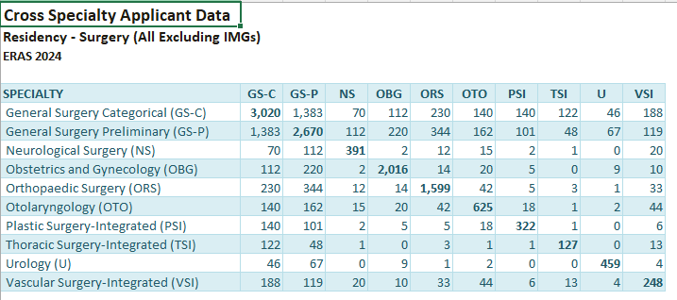
Rows = Applicants whose primary application was to that specialty.
Columns = Other specialties they also applied to.
Each cell represents the number of applicants who applied to both the row specialty and the column specialty.
The diagonal entries show the total number of applicants to that specialty.
In the row for Plastic Surgery Integrated (PSI) and the column for General Surgery Categorical (GS-C) and General Surgery – Preliminary (GS-P) , the values are 140 and 101.
This means that 140 applicants who applied to PSI also applied to GS-C and 101 applicants who applied to PSI also applied to GS-P (out of a total of 322 PSI applicants) .
https://www.aamc.org/data-reports/data/eras-statistics-data

Slide 11
Plastic Surgery
Application
Department | Plastic Surgery
Contacts (R = Required to Meet)
Chair | Sheri Slezak (Div Head)
Program Director | Combined with JHU (Scott Lifchez)
MSIV Advising | Yvonne Rasko/R
Competitive Applicant
Class Distinction | Typical Exceptional/Outstanding
Step 2 (goal) | 256 (240-270)
AOA/GHHS | Helpful
Research | Necessary
Preliminary Year | Not Applicable
Away Rotations
Expectations | Expected
Ideal Number | 2-3
Letters of Reference
Total Number | 4
Chair Letter | No
Ideal Make Up | Home Faculty
 | Away Faculty
 | Other/Research

Slide 12
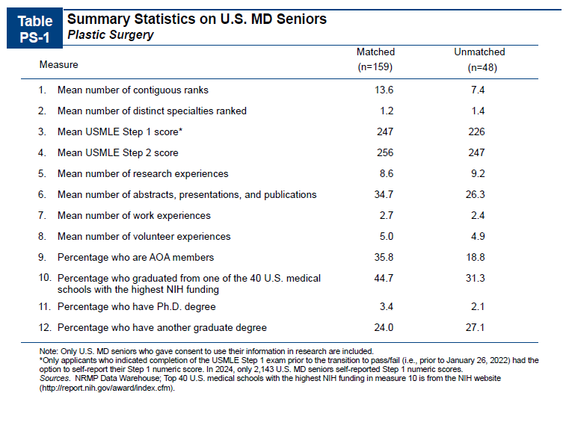
NRMP Charting outcomes for the Match, 2024
https://www.nrmp.org/match-data/2024/08/charting-outcomes-characteristics-of-u-s-md-seniors-who-matched-to-their-preferred-specialty-2024-main-residency-match/

Slide 13
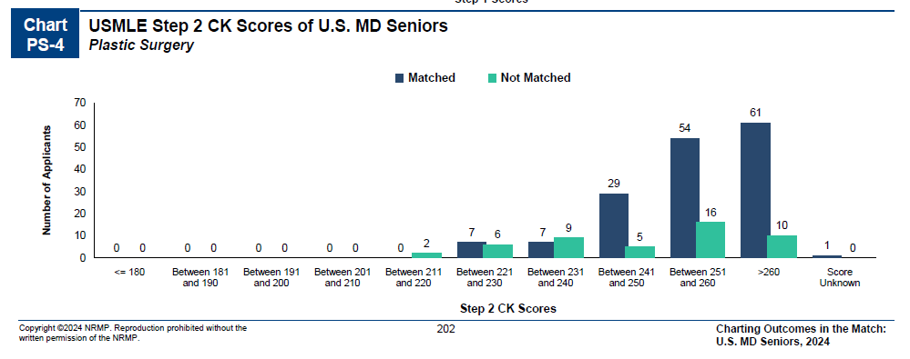
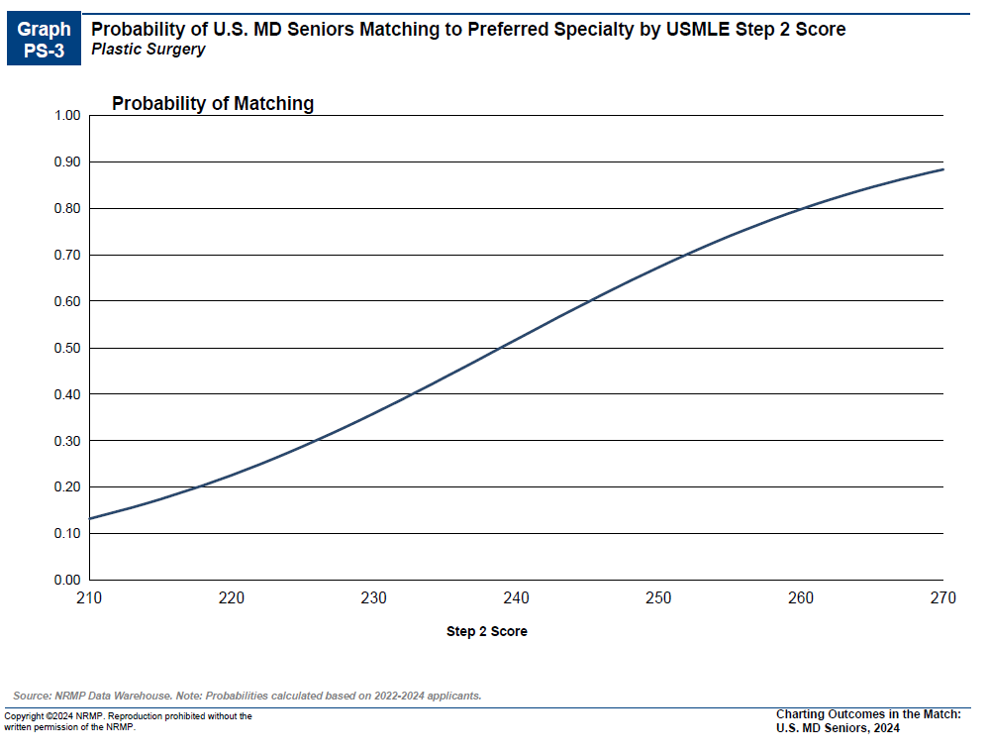
More on Step 2…
NRMP Charting outcomes for the Match, 2024
https://www.nrmp.org/match-data/2024/08/charting-outcomes-characteristics-of-u-s-md-seniors-who-matched-to-their-preferred-specialty-2024-main-residency-match/

Slide 14
More on Research….
Mehta K, Sinno S, Thanik V, Weichman K, Janis JE, Patel A. Matching into Integrated Plastic Surgery: The Value of Research Fellowships. Plast Reconstr Surg. 2019 Feb;143(2):640-645. PMID: 30531627.
Metric
Research Productivity
 | # of articles published/yr # of meetings with presentations/yr # of oral presentations/yr # of poster presentations/yr | 5 5 5 3
Program Director Survey
Rank in order of importance when evaluating an applicant (1 = most important) | Length of residency Academic Performance Research Medical School Reputation | 2 1.5 3 3.6
How important is an applicant’s research experience to you? | Very Important Somewhat Important Not Important | 31% 67% 2%
What do you consider productive with regards to publications? | 0-2 3-4 5-6 7-8 9-10 >10 | 10% 51% 27% 8% 0% 2%

Slide 15
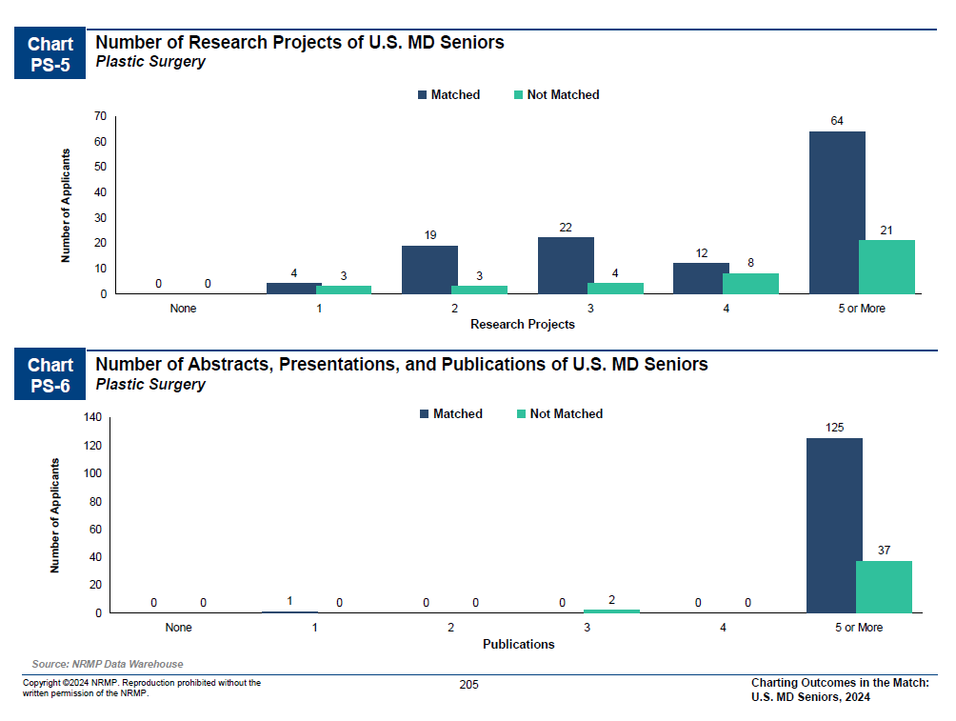
More on research
NRMP Charting outcomes for the Match, 2024
https://www.nrmp.org/match-data/2024/08/charting-outcomes-characteristics-of-u-s-md-seniors-who-matched-to-their-preferred-specialty-2024-main-residency-match/

Slide 16
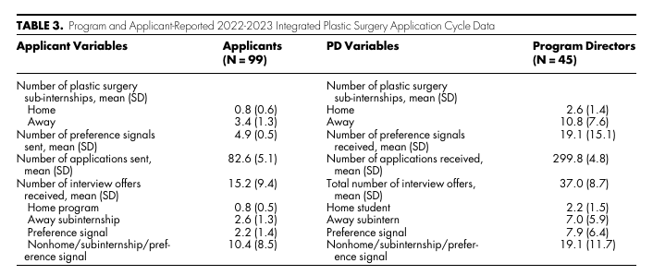
Applications: Plastics
Applicants applied to a mean of 83 programs
Between 3-4 away rotations
Mean of 15 interview offers
  1 from home
  2-3 from aways
  Mean of 2 (of 5) from preference signaling
  Mean of 10 from other programs
Sergesketter AR, Song E, Shammas RL, Tian WM, Eberlin KR, Ko JH, Momoh AO, Snyder-Warwick A, Phillips BT. Preference Signaling and the Integrated Plastic Surgery Match: A National Survey Study. J Surg Educ. 2024 May;81(5):662-670. Epub 2024 Mar 28. PMID: 38553367.

Slide 17
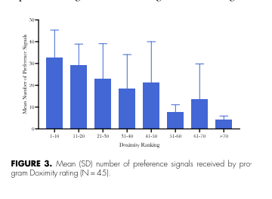
Signaling - Plastics
20 program signals for Plastics
Piloting program signaling statements
Overall, after analyzing student data in aggregate, students who sent a preference signal were 3.3 times more likely to receive an interview offer compared to students who did not rotate or send a preference signal*
Mean of 2 (of 5) from preference signaling
Sergesketter AR, Song E, Shammas RL, Tian WM, Eberlin KR, Ko JH, Momoh AO, Snyder-Warwick A, Phillips BT. Preference Signaling and the Integrated Plastic Surgery Match: A National Survey Study. J Surg Educ. 2024 May;81(5):662-670. Epub 2024 Mar 28. PMID: 38553367.

Slide 18
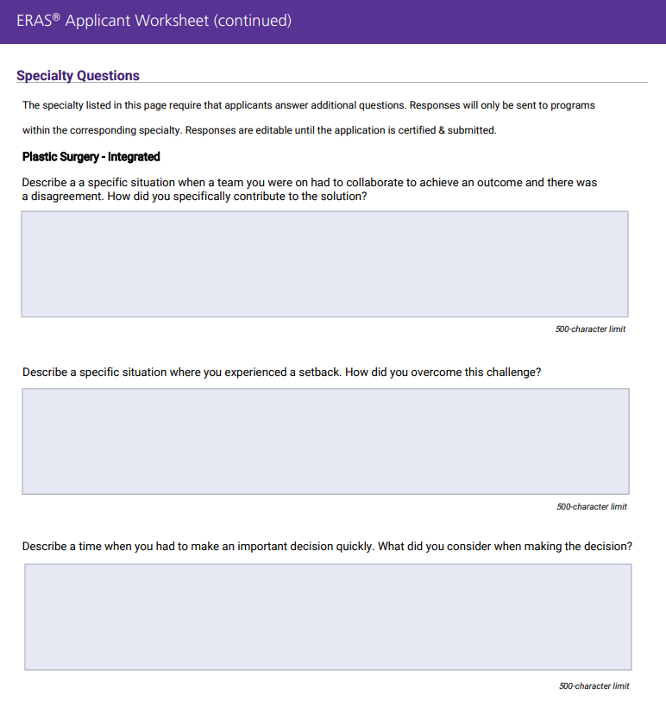
https://students-residents.aamc.org/media/9711/download

Slide 19
Thoracic Surgery
Application
Department | Thoracic Surgery
Contacts (R = Required to Meet)
Chair | Christine Lau
Program Director | Shelby Stewart/R
MSIV Advising | Shelby Stewart/R
Other
Competitive Applicant
Class Distinction | Typical Exceptional/Outstanding
 | 48% AOA
Step 2 (goal) | 255
Parallel Application | Most apply to Integrated Thoracic surgery AND general surgery residency programs
 | Research Recommended
Preliminary Year | Not Applicable
Away Rotations
Expectations | Expected
Ideal Number | 1-2
Letters of Reference
Total Number | 3-4
Chair Letter | No
Ideal Make UP | 1 letter from home faculty 1 letter from away faculty 1-2 other/research

Slide 20
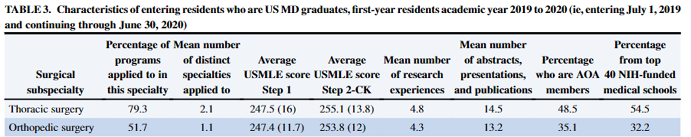
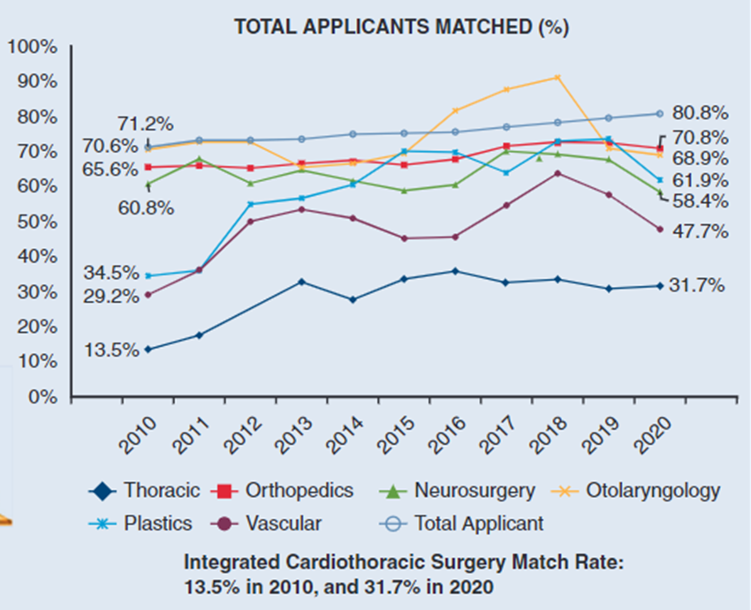
Thoracic Integrated
Lauren Bougioukas, Alyssa Heiser, Adrian Berg, Marek Polomsky, Chris Rokkas, Fuyuki Hirashima, Integrated cardiothoracic surgery match: Trends among applicants compared with other surgical subspecialties,
The Journal of Thoracic and Cardiovascular Surgery,2022

Slide 21
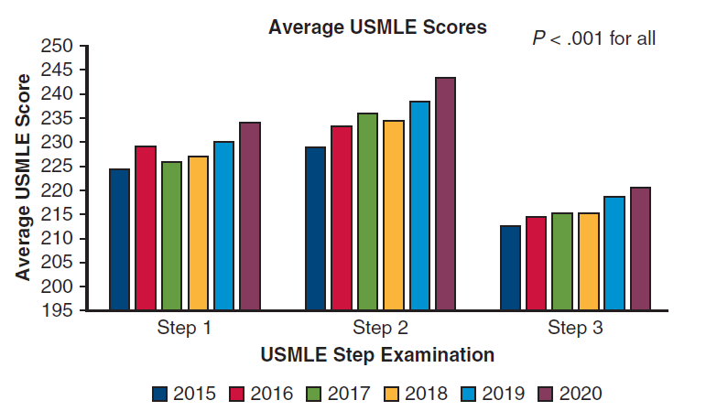
More on Step 2…
Deboever N, Bayley EM, Vaporciyan AA, Antonoff MB. Traits of the current traditional pathway cardiothoracic surgery training pool: Results of a cross-sectional study. J Thorac Cardiovasc Surg. 2023 May;165(5):1743-1750. Epub 2021 Nov 26. PMID: 34920868.

Slide 22
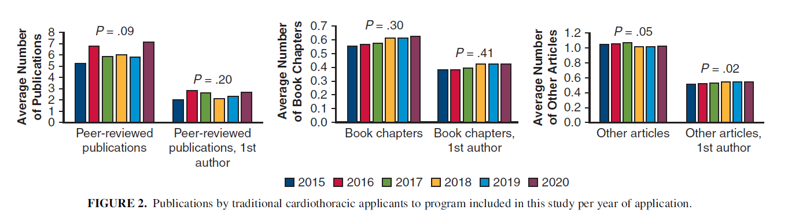
More on Research
The typical applicant had published more than 5 peer-reviewed manuscripts, with an average of 5.2 in 2015 to 7.1 in 2020. Average of two 1st author publications.
Deboever N, Bayley EM, Vaporciyan AA, Antonoff MB. Traits of the current traditional pathway cardiothoracic surgery training pool: Results of a cross-sectional study. J Thorac Cardiovasc Surg. 2023 May;165(5):1743-1750. Epub 2021 Nov 26. PMID: 34920868.

Slide 23
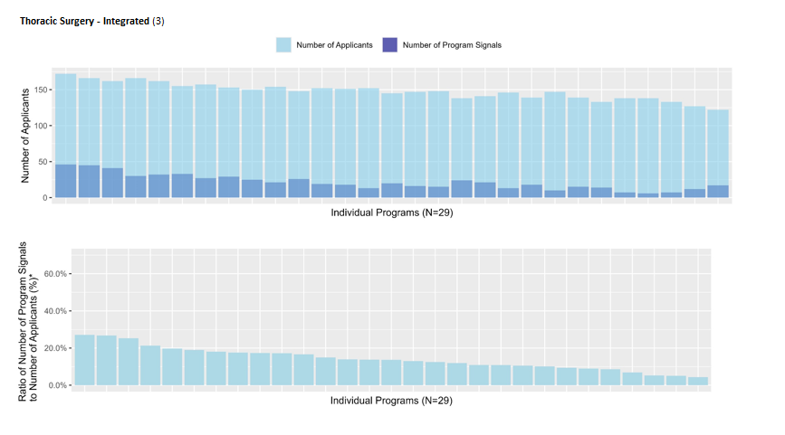
Signaling
3 program signals for Thoracic Integrated
An average of 15% of signals were sent to 10% of programs in Thoracic
https://www.aamc.org/data-reports/data/eras-statistics-data

Slide 24
Department | VASCULAR SURGERY
Contacts (R = Required to Meet)
Chair | Christine Lau
Program Director | Rajabrata Sarkar
MSIV Advising | Mike Lilly/R
Competitive Applicant
Class Distinction | Typical Exceptional/Outstanding
Step 2 (goal) | 250
 | Research Recommended
 | Contingency Plan Recommended (Parallel Application often in General Surgery)
Preliminary Year | NO
Away Rotations
Expectations | EXPECTED
Ideal Number | 1-2
Letters of Reference
Total Number | 3-4
Chair Letter | NOT Required
Ideal Make Up | HOME Faculty
 | AWAY Faculty
 | Other
Vascular Surgery
Application

Slide 25
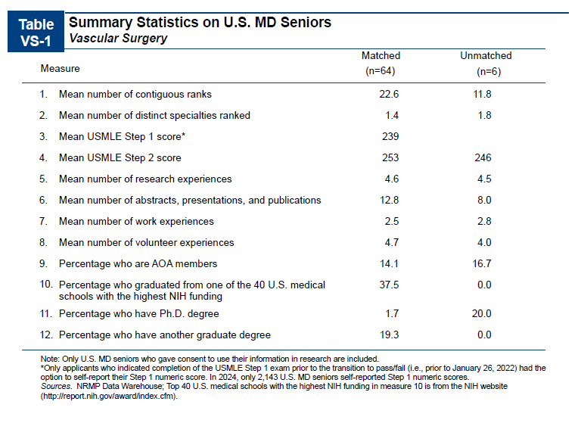
NRMP Charting outcomes for the Match, 2024
https://www.nrmp.org/match-data/2024/08/charting-outcomes-characteristics-of-u-s-md-seniors-who-matched-to-their-preferred-specialty-2024-main-residency-match/

Slide 26
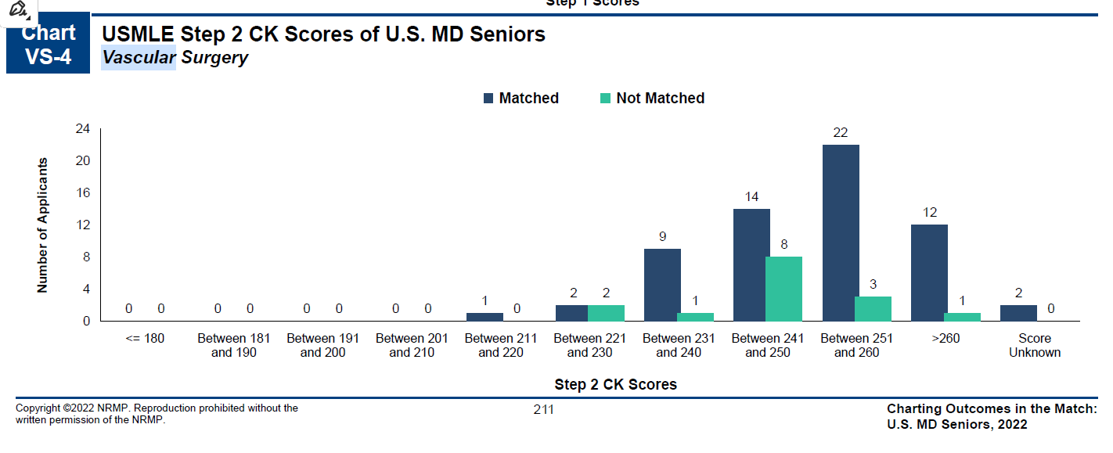
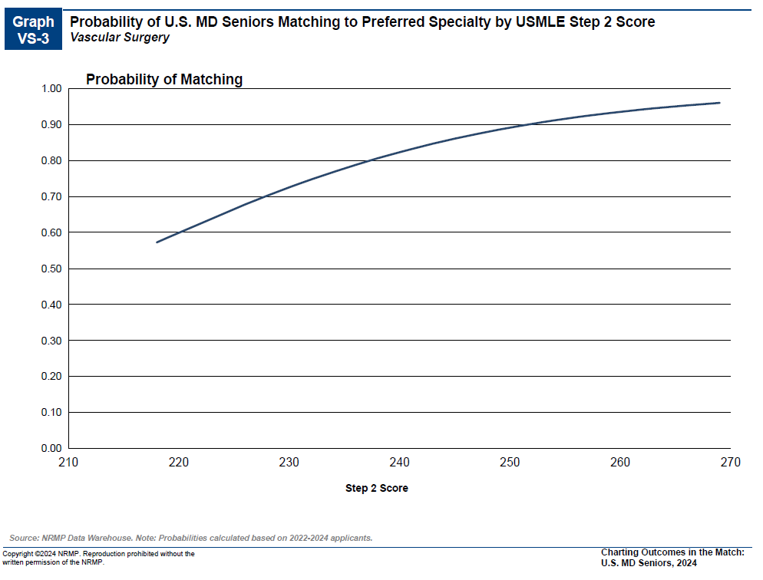
More on Step 2…
NRMP Charting outcomes for the Match, 2024
https://www.nrmp.org/match-data/2024/08/charting-outcomes-characteristics-of-u-s-md-seniors-who-matched-to-their-preferred-specialty-2024-main-residency-match/

Slide 27
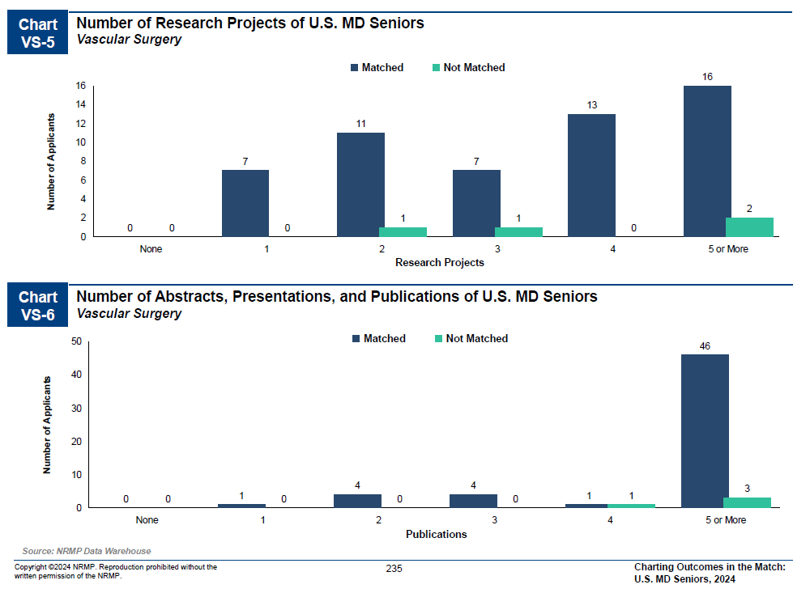
More on research
NRMP Charting outcomes for the Match, 2024
https://www.nrmp.org/match-data/2024/08/charting-outcomes-characteristics-of-u-s-md-seniors-who-matched-to-their-preferred-specialty-2024-main-residency-match/

Slide 28
Signaling
Pending

Slide 29
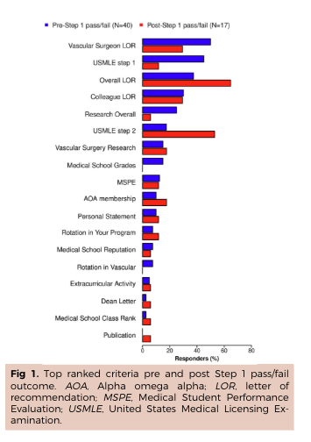
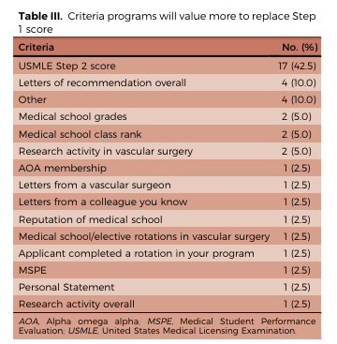
Sorour AA, Kirksey L, Caputo FJ, Dehaini H, Bena J, Rowe VL, Colglazier JJ, Smith BK, Shames ML, Lyden SP. Vascular surgery integrated resident selection criteria in the pass or fail era. J Vasc Surg. 2023 Feb;77(2):625-631.e8. doi: 10.1016/j.jvs.2022.08.012. Epub 2022 Aug 23. PMID: 36007844.

Slide 30
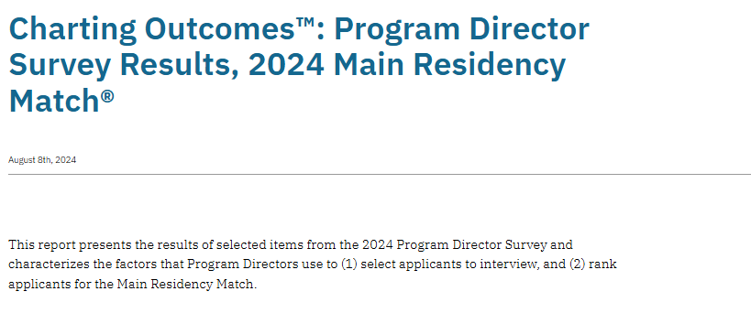
https://www.nrmp.org/match-data/2024/08/charting-outcomes-program-director-survey-results-main-residency-match/

Slide 31
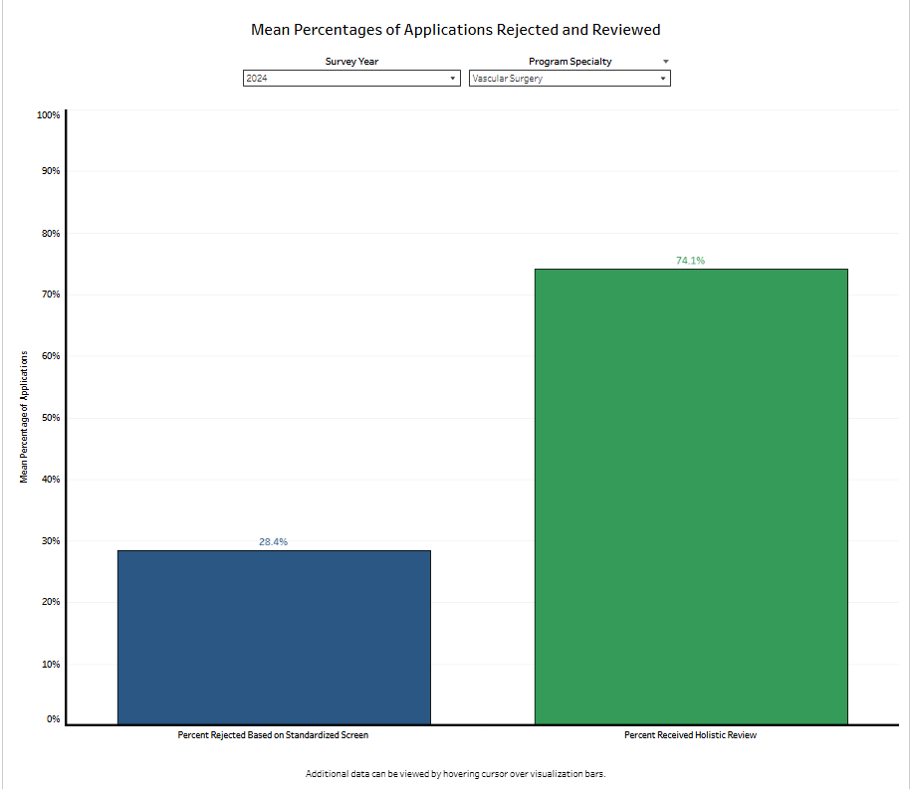
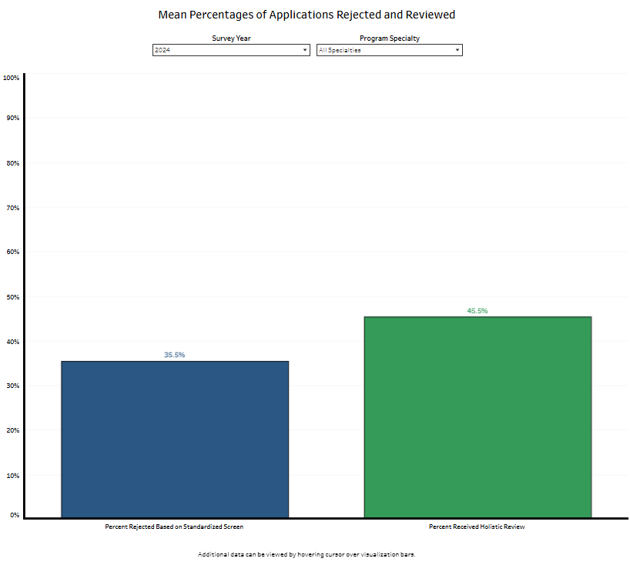
Rejection and Review of Applications
https://www.nrmp.org/match-data/2024/08/charting-outcomes-program-director-survey-results-main-residency-match/

Slide 32
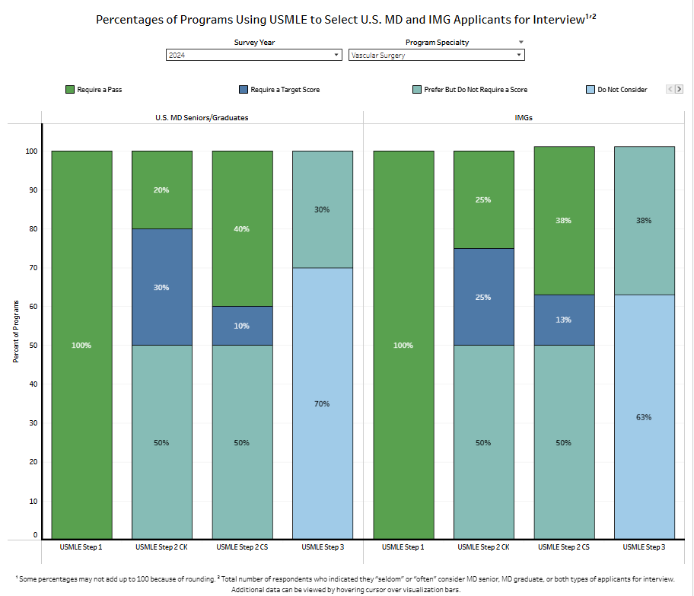
https://www.nrmp.org/match-data/2024/08/charting-outcomes-program-director-survey-results-main-residency-match/

Slide 33
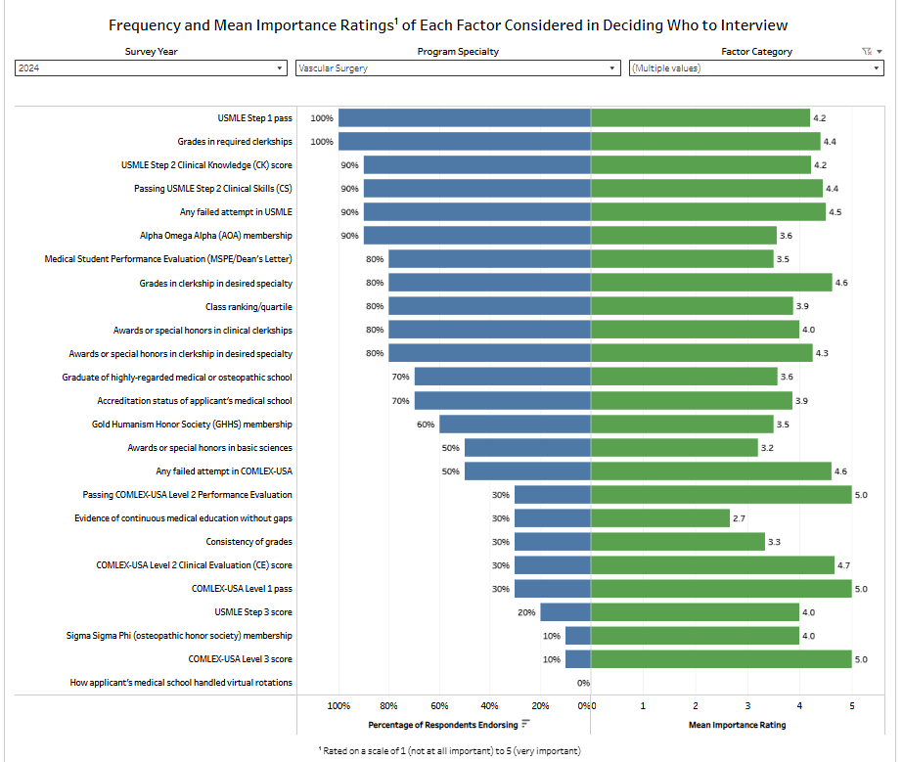
Education and Performance and Standardized Licensure Tests
https://www.nrmp.org/match-data/2024/08/charting-outcomes-program-director-survey-results-main-residency-match/

Slide 34
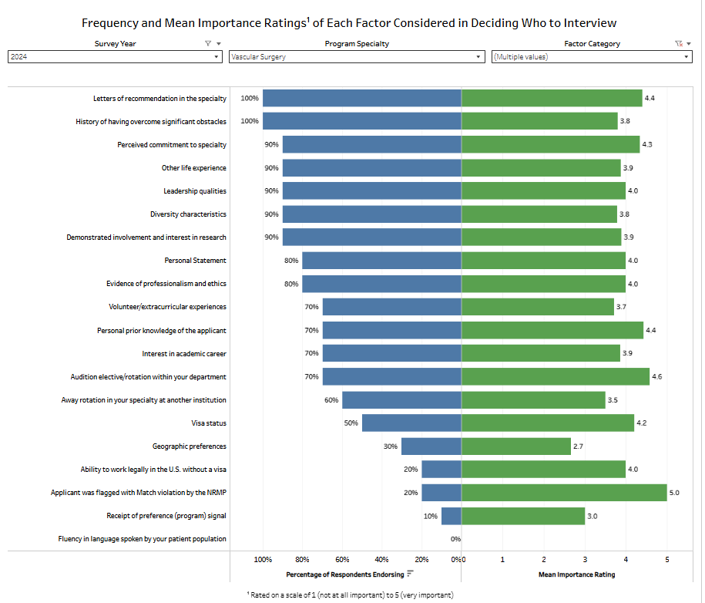
Other Knowledge and Personal Qualities
https://www.nrmp.org/match-data/2024/08/charting-outcomes-program-director-survey-results-main-residency-match/

Slide 35
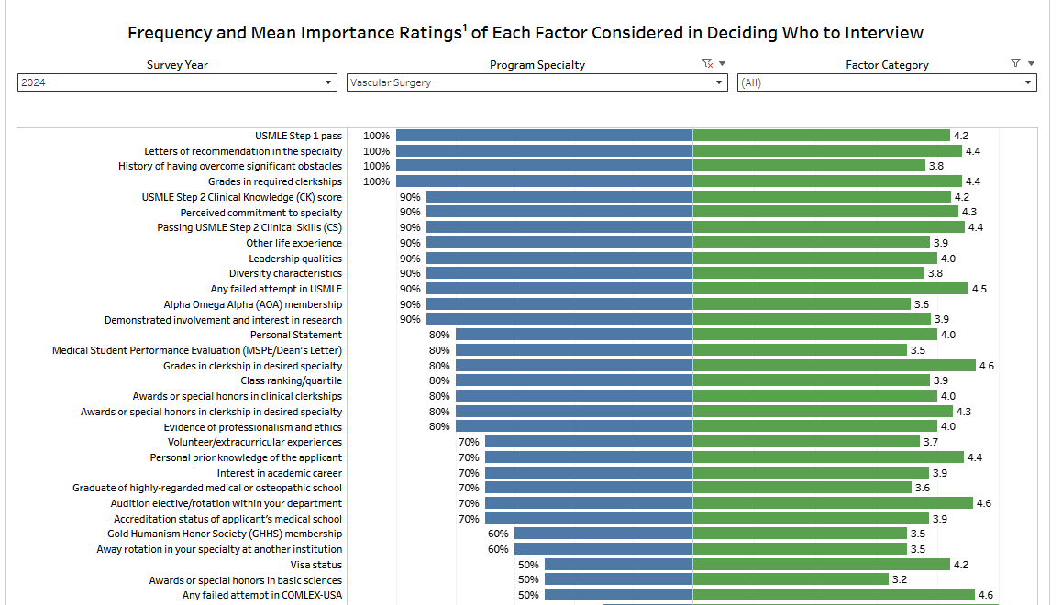
All factors combined with > 50% endorsement
https://www.nrmp.org/match-data/2024/08/charting-outcomes-program-director-survey-results-main-residency-match/

