Slide 1
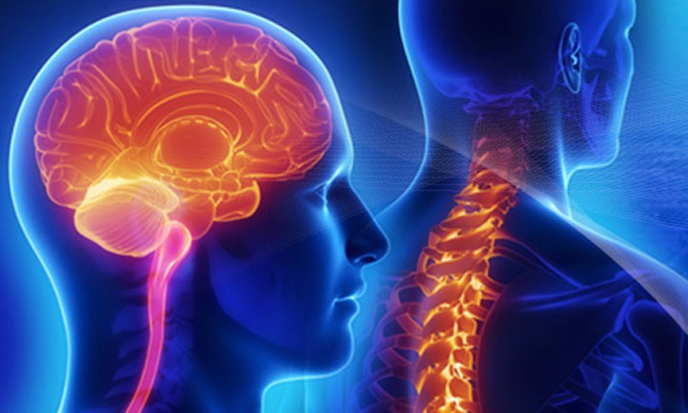
Neurosurgery
Class of 2026
2025-2026 CyCLE

Slide 2
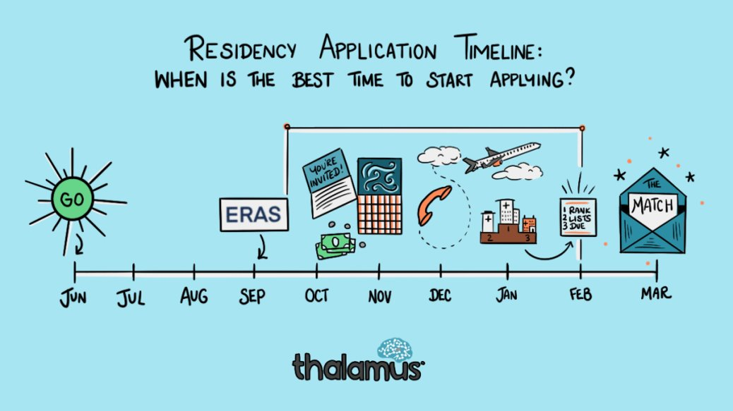

Original Slide Design by Dr. Kerri Thom

Slide 3
Upcoming workshops!
April-May: OSA Specialty-Specific Advising
Personal Statement Writing Workshops: Medscope recording; LIVE: 7/15 & 8/19 in Reid Rooms
June 3rd 400pm: Residency Application Workshop:
March 2026: SOAP Workshop (mandatory)
May-July: OSA 1:1 Advising Sessions
Workshop Links: OSA Advising Workshop Series | University of Maryland School of Medicine
Notes:
June 3rd Workshop: https://umaryland.zoom.us/j/99600677409?pwd=v7zb0wpiiZYi6pOXr2vvMhk67FJijx.1&from=addon

Slide 4
Graduation Requirements Class of 2026
Graduation Requirements | University of Maryland School of Medicine
Must be completed ONE week prior to graduation
Pass all third-year clerkships, including shelf examinations
Pass ONE 2-week elective (added to the Pediatric Clerkship)
Pass TWO sub-internships
Pass FIVE electives
      No more than TWO Pre-clerkship elective equivalents may be counted toward the total elective count
      Two electives must be on campus (i.e. in our electives catalogue)
      Pre-clerkship electives are considered “on campus”
Pass ONE PoM4: Transition to Residency (4 weeks)
Complete an FRCT Scholarly Project
Pass OSCE
Take USMLE Step 2: Clinical Knowledge examination
Complete Exit Interview with Financial Aid
Additional Requirements (next slide)
*NOTE – if you are off cycle, please discuss your graduation requirements with an OSA Faculty member

Slide 5
Graduation Requirements Class of 2026
Additional Requirements: Note: these are NOT in addition to the above, but fulfill an above elective or sub-internship requirement.
Ambulatory Requirement^: one (4-week) of the five above required electives or one (4-week) of the two above required sub-internships must be an Ambulatory rotation (as designated via the "Ambulatory" tab in the course catalog); in addition to the expectations of the elective, students will have designated curricular material to satisfy the ambulatory requirement; this requirement cannot be fulfilled with a pre-clerkship elective.
Internal Medicine Requirement^: one (4-week) of the five above required electives or one (4-week) of the two above required sub-internships must be in Internal Medicine (as designated via the "Internal Medicine" tab in the course catalog); cannot be fulfilled with a pre-clerkship elective.
^The same rotation cannot fulfill both the Ambulatory and Internal Medicine Requirement.
★ At least one clinical rotation (as designated via the "Clinical" tab in the course catalog) must be done in the second half of the 4th year.

Slide 6
Important Reminders
Confirm name/pronunciation in MedScope as you with for graduation/diploma
Update your Preferred Pronouns in MedScope for the MSPE (if not indicated will default to he/him, she/her)
Update your contact information
Pay it forward, sign up to be an Alumni Mentor (Career Tab, MedScope)
Use the MedScope Interview Tracker to ensure optimal advising!
Consider your brand and ensure social media profiles are professional/clean
Meet with Financial Aid (Sophia Cascio)
Complete Graduation Questionnaire (online through AAMC) – available Jan – May

Slide 7
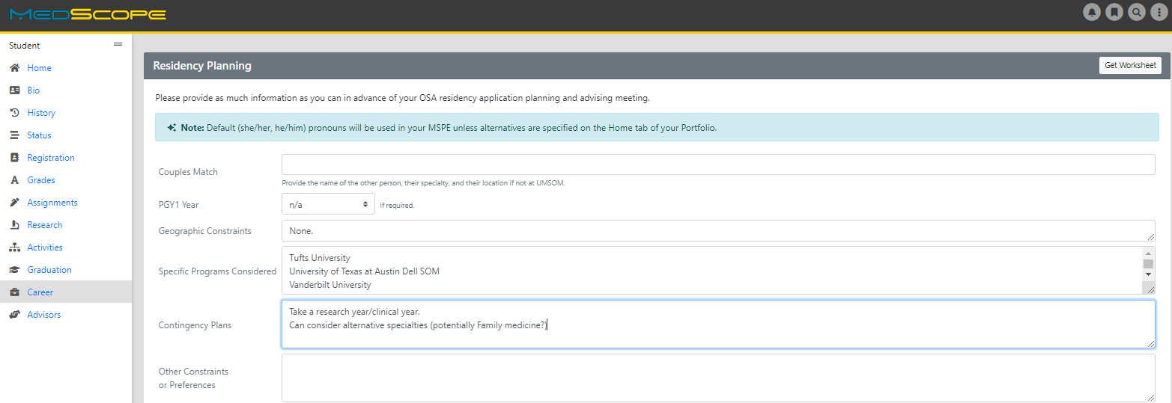
Career Tab (Please complete)

Slide 8
Residency Application Manual:
Your New Best Friend
Residency Application Manual | University of Maryland School of Medicine

Slide 9
1:1 OSA Residency Advising
Meeting Prep
You may review MSPE details, including a sample MSPE, here:
The MSPE | University of Maryland School of Medicine
[ ] Complete the Career Tab on MedScope to assist with MSPE data collection
*Be prepared to discuss any deviations from the traditional 4-year curriculum
*Be prepared to discuss any hardships (e.g. personal medical condition, bereavement, or other extenuating circumstance that may have had a negative effect on academic performance) if you wish to consider for inclusion in the MSPE
[ ] Closer to the application deadline, OSA will solicit Noteworthy Characteristics from you for inclusion in the MSPE; if you wish to get started on these now you may review examples in Link #1 above.
Note:
*AOA nominations will be noted in the MSPEs Noteworthy Characteristics and in the summary paragraph
*GHHS membership will be noted in the MSPEs Professional Performance section and in the summary paragraph

Slide 10
1:1 OSA Residency Advising Meeting Prep
The below are NOT required but may be helpful
[ ] Meet with Departmental Mentors
[ ] Think about programs of interest or geographical areas of interest
[ ] Create a CV Draft (CV Preparation Tips | University of Maryland School of Medicine); we will not go through this at the meeting but can answer specific questions
[ ] Create a Personal Statement draft; we are happy to review outside the meeting timeframe

Slide 11
ERAS/NRMP TIMELINE
Date | Activity
June 4, 2025 | ERAS 2026 season begins at 9 a.m. ET.
Sept. 3, 2025 | Residency applicants may begin submitting MyERAS applications to programs at 9 a.m. ET.
Sept. 24, 2025 | Residency programs may begin reviewing MyERAS applications and MSPEs in the PDWS at 9 a.m. ET.
End of January 2026 | Register for Match and SOAP
Early February 2026 | RANK OPENS
First week of March 2026 | RANK Lists Certified
2nd or 3rd week of March 2026 | SOAP and MATCH
*Note, these dates are subject to change. Please reference2026 ERAS® Residency Timeline | Students & Residentsfor the most updated schedules.

Slide 12






Original Slide Design by Dr. Kerri Thom

Slide 13
Neurosurgery
Application
Department | Neurosurgery
Contacts (R = Required to Meet)
Chair | Gramme Woodworth
Program Director | Howard Eisenberg (R)
MSIV Advising | Charles Sansur (R)
Administrative Contact | Sophie White
Competitive Applicant
Step 2 (goal) | 252 (UMSOM Average 261)
AOA/GHHS | Helpful
Research | Very Helpful/Consider Gap Research Year
Applications
Application System | ERAS
Program Signaling | 25 signals
Acuity Insights | N/A
Preliminary/Transitional Year | N/A
Match System | NRMP
Away Rotations
Expectations | Expected
Ideal Number | 2 approximately
Letters of Reference
Total Number | 3 to 4
Chair Letter | Not required
Ideal Make Up | Home Neurosurgery(1-2), Away Neurosurgery(1 standardized letter), Research(1)
Contingency | If dual applying, secure letters for that specialty
Mock Interview Program
 | OSA Advisor coordinates with Dr. Sansur and Ms. White for those who are interested
Contingency
 | Strongly Consider Research Year between M3/4
 | ALL Students MUST Have Contingency
 | Consider Dual Application

Slide 14
A Note on External Rotations (“Aways”)
Neurosurgery expects 2 away rotations.
YOU MUST ADD THIS COURSE AT SOM!!!
Required forms are found on the Student Scheduling Page
  Forms should be completed/signed by Departments
  Submitted to Add/Drop

Slide 15
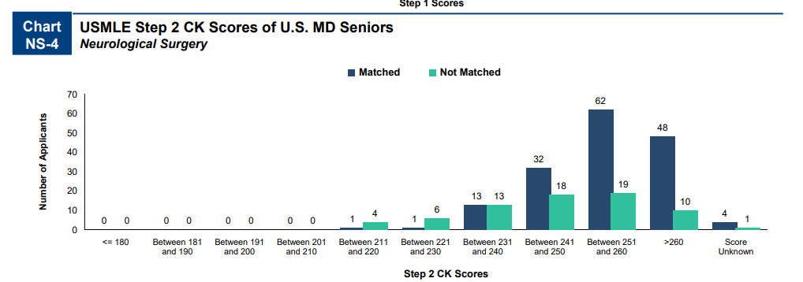
Charting_Outcomes_MD_Seniors2024 (5).pdf

Slide 16
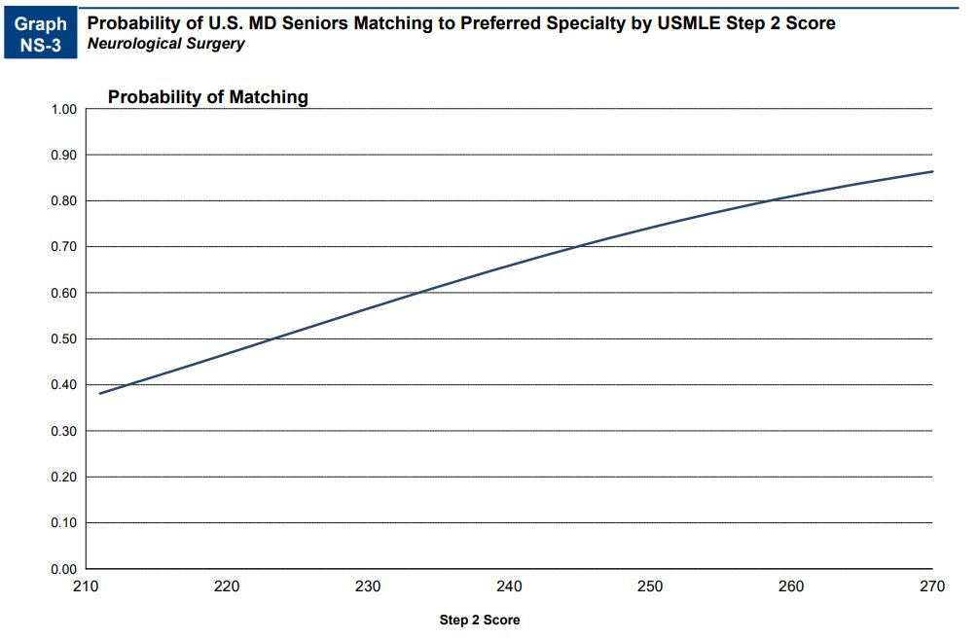
Charting_Outcomes_MD_Seniors2024 (5).pdf

Slide 17
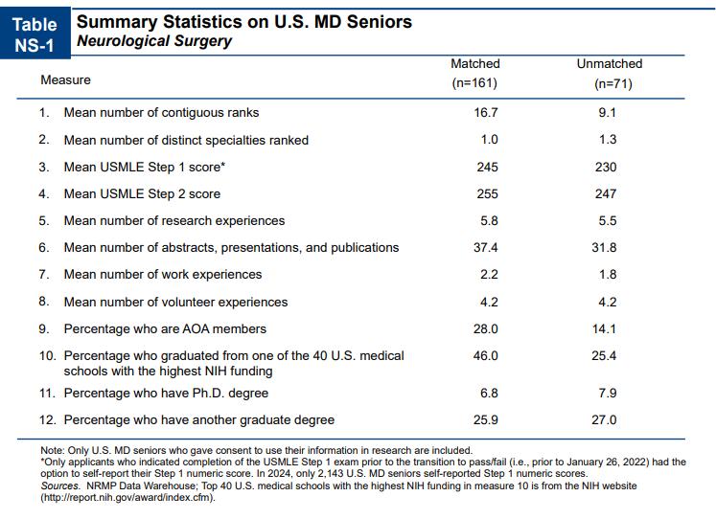
Charting_Outcomes_MD_Seniors2024 (5).pdf

Slide 18
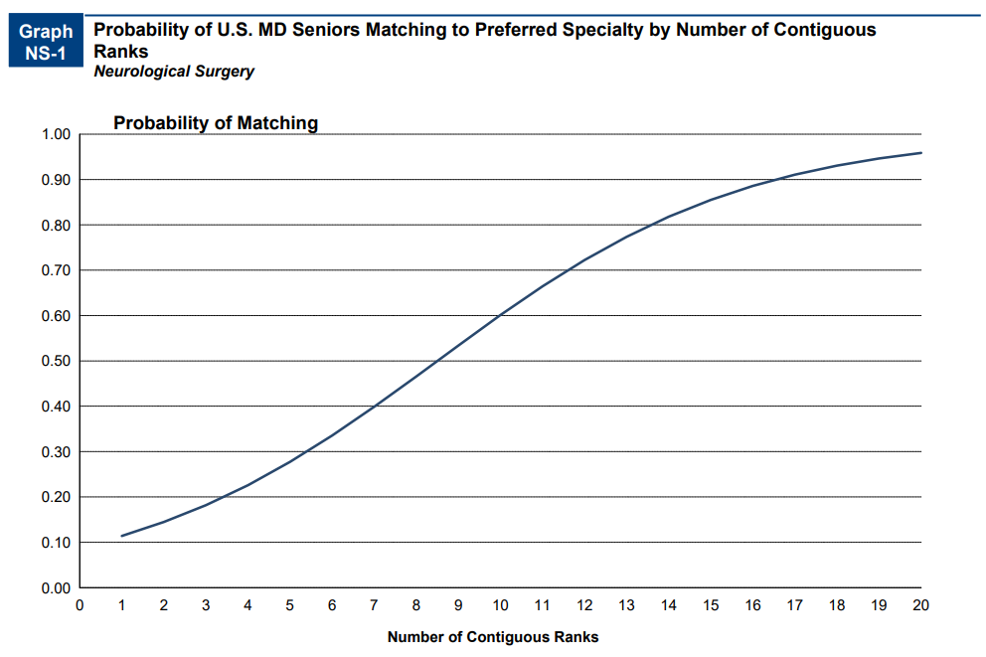
Charting_Outcomes_MD_Seniors2024 (5).pdf

Slide 19
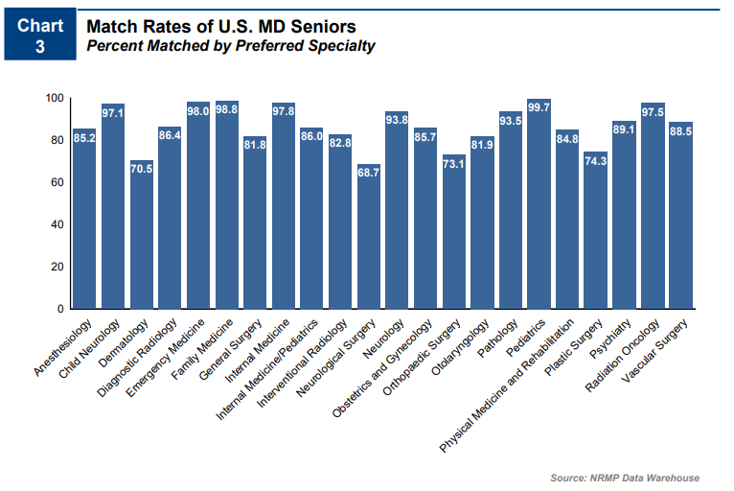
Neurosurgery is a competitive specialty regardless of the students' credentials. The match rate in Charting outcomes of the Match 2024 report for US Seniors was 68.7% and there were NO Unfilled Programs (SOAP in neurosurgery is NOT a contingency plan)
All students need some contingency
  Apply to the right #/mix of programs
  Rank ALL programs you interview at
  Be PROACTIVE – communicate with OSA
  Update the MedScope tracker
Geographical constraints – Dual Application
SOAP is NOT a contingency plan
  no unfilled Neurosurgery spots!
Charting_Outcomes_MD_Seniors2024 (5).pdf​
Notes:
More programs, fewer interviews, skewed because older 2013-2018

Slide 20
Goals
Apply to a range of programs in terms of competitiveness.
Ideally you will interview at 16 programs (discuss with the department how many applications you should submit to receive this many interview offers).
Students should rank all programs they interviewed at unless they would rather go unmatched
If you have a significant geographic constraint, consider a pre-liminary program back up or a dual-application.

Slide 21
Neurosurgery Data (UMSOM)
Stats
Year/Score | 2021-2025 | 2025
Average Step 2 | 261 | 260.0
Step 2 Goal (252)
95% Probability Match 20 interviews

Slide 22
Neurosurgery Data (UMSOM)
UMSoM: Neurosurgery | 2021-2025 | 2024-2025
Avg Applications | 71 | 78
Avg Interview Offers | 21 | 22
% Invites/Applications | 31% | 31%
No. Signals (25 signals) | NA | 2024-2025
Percent of Interview Offers from Signaled Programs | NA | 59%
Percent of Interview Offers from Non-Signaled Programs | NA | 40%
No. Additional Interview Offers from Non-Signaled Programs | NA | 5 to 14

Slide 23
Neurosurgery Data (UMSOM)
Neurosurgery Data from 2021-2025 ​
Neurosurgery | No. Students​ | Avg. No. Interviews​ | % Match ​
All ​ | 6 | 21 | 6 of 6 (100%)
​
AOA ​ | 2 | 23 | 2 of 2 (100%)
Non-AOA​ | 4 | 20 | 4 of 4 (100%)
​
Step 2 >= 240​ | 6 | 21 | 6 of 6 (100%)
Step 2 < 240​ | NA | NA | NA
​
Step 2 >= 245​ | 6 | 21 | 6 of 6 (100%)
Step 2 < 245​ | NA | NA | NA
​
GHHS ​ | 3 | 18 | 3 of 3 (100%)
Non-GHHS ​ | 3 | 24 | 3 of 3 (100%)
Clinical Designation​
Exceptional ​ | 2 | 15 | 2 of 2 (100%)
Outstanding ​ | 2 | 32.5 | 2 of 2 (100%)
Excellent​ | 1 | 11 | 1 of 1 (100%)
Very Well ​ | 1 | 20 | 1 of 1 (100%)

Slide 24
Signaling
Number of Signals Vary per Specialty
25 Signals for Neurosurgery in 2025-2026 Application Cycle
  Program Signaling for the 2026 MyERAS® Application Season | Students & Residents

Slide 25
Which Programs to apply to:
FREIDA is a really great tool that can help you look at accredited programs by specialty in different regions around the country. https://freida.ama-assn.org/Freida/#/
AAMC Residency Explorer is a useful tool in assessing your competitiveness at particular programs: https://www.residencyexplorer.org/Account/Login
MedScope Data *We will review together – this data allows you to see where you stand as a student at UMSOM
Departmental Advisors (as well as faculty advisors, and senior students) are another key source of program information

Slide 26
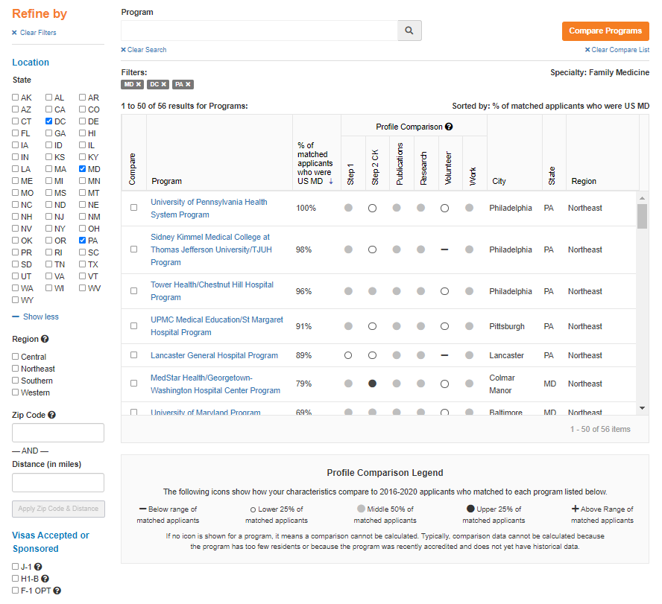
Step 1: 220
Step 2: 235

Slide 27
Compare Programs

Slide 28
Checklist to be completed prior to your meeting
[ ] Complete the Career Tab on MedScope
[ ] Review your schedule/graduation requirements
[ ] Review packet information, emailed after this meeting
[ ] Review the Residency Application Handbook
The below are NOT required but may be helpful
[ ] Meet with Departmental Mentors
[ ] Create a preliminary list of programs of interest (print/PDF Residency Explorer output)
[ ] Create a CV Draft (CV Tips); we will not go through this at the meeting but can answer specific questions
[ ] Create a Personal Statement draft; we are happy to review outside the meeting timeframe

Slide 29
What you can be doing now …
Scheduling Tweaks, Away Rotations, Graduation Requirements
Consider Narrative/Brand
Work on your CV Residency Application Manual | University of Maryland School of Medicine
Create a draft of your Personal Statement Residency Application Manual | University of Maryland School of Medicine
Meet with Mentors (OSA, Department, Peers)
Create a preliminary list of programs
Complete the Career Tab on MedScope

Slide 30

Any Questions?

