Slide 1
UMMC Safety Event and Professionalism Reporting
April 2023
Jason W. Custer, MD – Associate Professor of Pediatrics
Vice Chair Pediatrics, Division Head Pediatric Critical Care
University of Maryland School of Medicine
Director of Patient Safety
University of Maryland Medical Center
jcuster@som.umaryland.edu

Slide 2
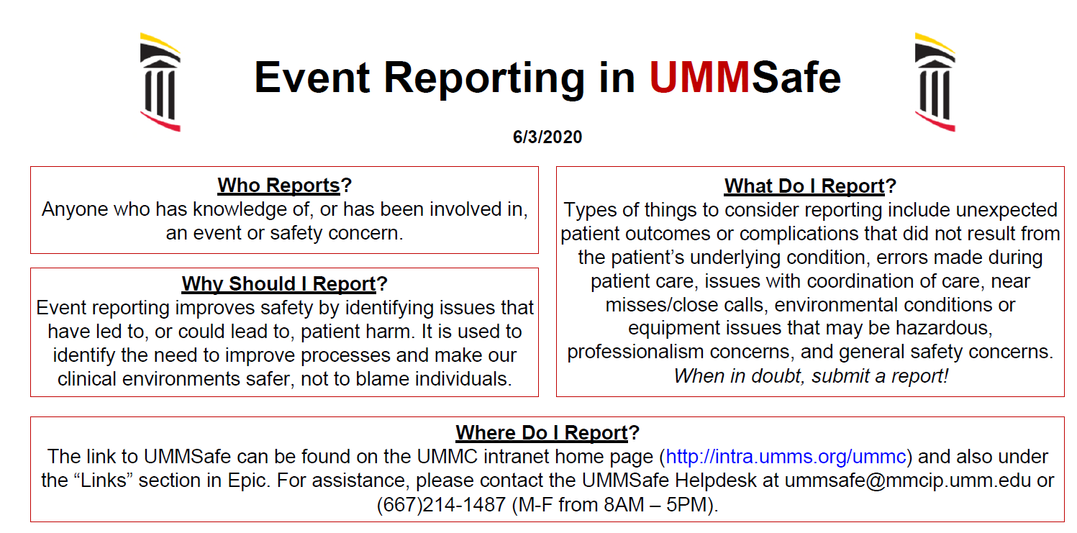
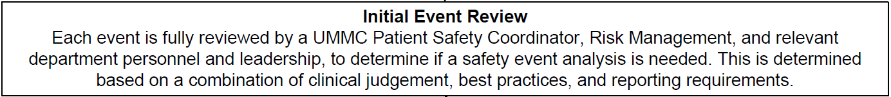

Slide 3
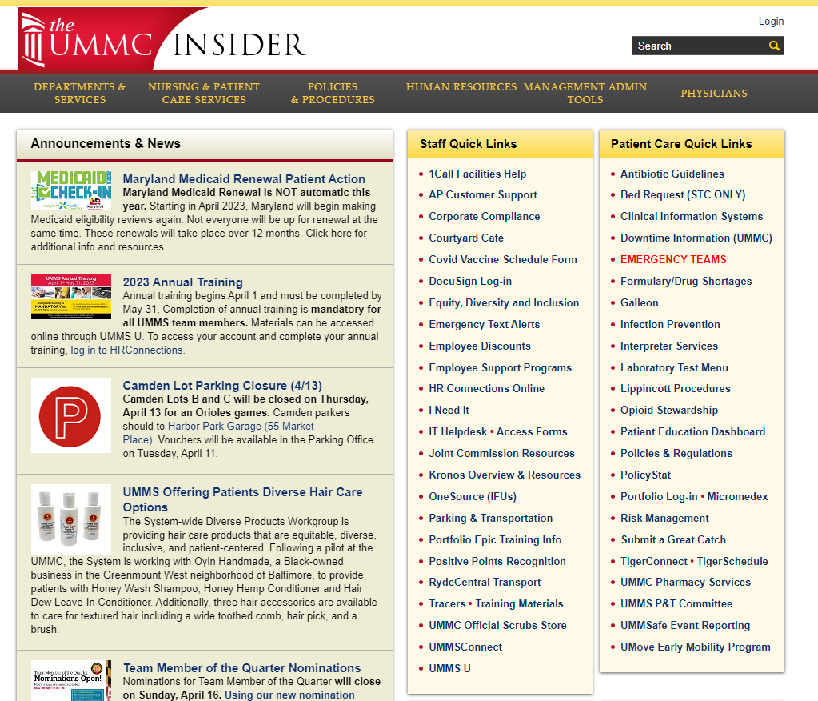
UMMSafe Event Reporting
Select UMMS from drop down
Log in with Epic username and password

Slide 4
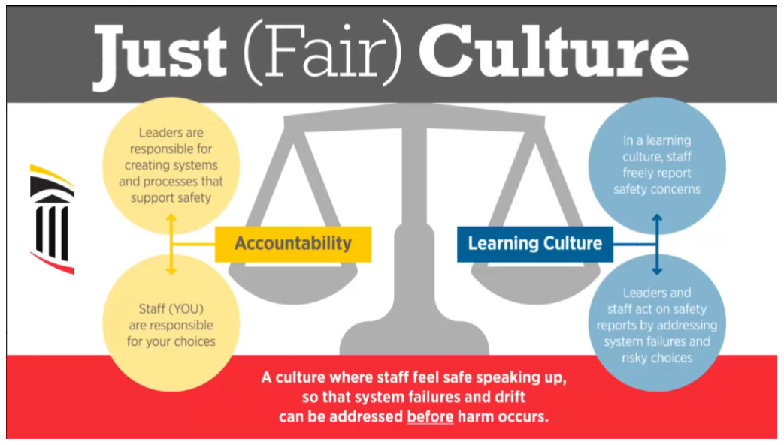

Slide 5
Patient Safety and Professionalism
Patient Safety
Professionalism

Slide 6
Professionalism – Key Traits
Primary orientation to public and community interest
High degree of self-control and ethical standards; seldom lose their cool
Heavy emphasis on excellence and good service - consistently
Clear commitment to honesty and integrity
Commitment to improving skills and staying current in their fields
Active role in developing standards for the practice; professionals are leaders among fellow employees
Exemplary representative of the practice and the medical profession
You are future physicians and are right on the front line! Your observations and voice count a great deal.

Slide 7
Physician Leadership and Professionalism
Professionalism
    Part of compact between the medical profession and society:
    Professionalism is the basis of medicine's contract with society. It demands placing the interests of patients above those of the physician, setting and maintaining standards of competence and integrity, and providing expert advice to society on matters of health. (ACP Ethics and Professionalism)
  Culture change
    Just culture
    Safety culture
    ACGME
    Professionalism Enhancement Committee
    “The concept of professionalism should permeate everything that ABMS and its Member Boards do.”

Slide 8
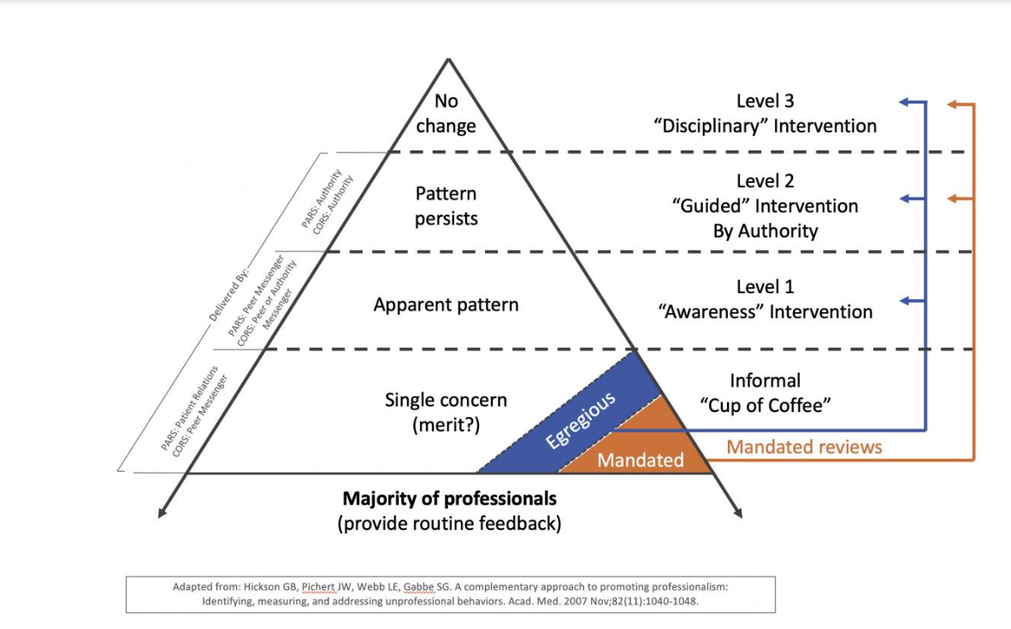
Use of UMMSafe/RL6
To report a professionalism/behavioral concern → Professionalism Oversight Committee
  Confidential, not anonymous
  No retribution tolerated
Process put in place about 4+ years ago
Anyone can enter a concern
HR processes for non-physicians
Disruptive Practitioner policy for physicians
  Similar to Vanderbilt University Medical Center
  Addressed quickly
  Escalated approach
  Recurrent patterns are addressed
  Awareness intervention
  Prescriptive

Slide 9
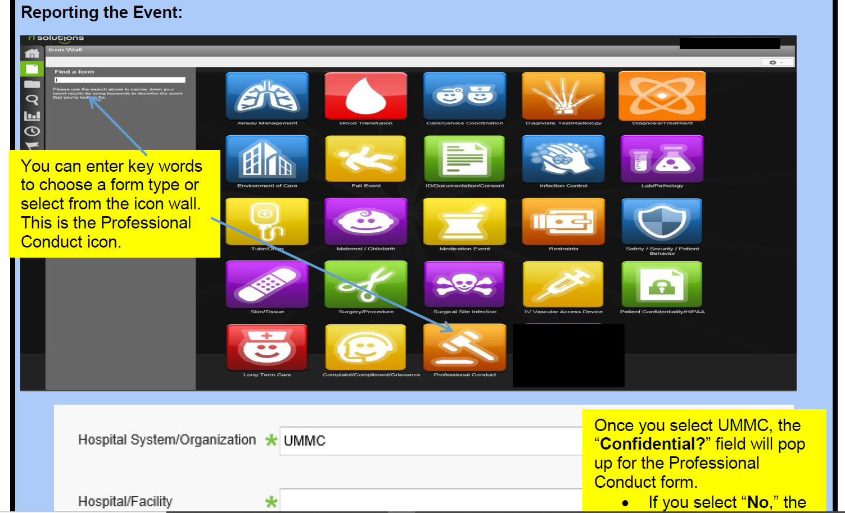
UMMSafe Event Reporting

Slide 10
Professional Conduct Event Reporting
Professional Conduct Event Reporting 6 Month Period
(December 2022 – April 2023):
Total events during this timeframe pertaining to ALL roles:
Total events pertaining to physicians (residents/fellows/attendings):
197
73

Slide 11

Questions or Concerns please reach out
Dr. Jason Custer – Associate Professor of Pediatrics
Vice Chair Pediatrics, Division Head Pediatric Critical Care
University of Maryland School of Medicine
Director of Patient Safety
University of Maryland Medical Center
jcuster@som.umaryland.edu
Dr. Mangla Gulati - Associate Professor of Medicine
University of Maryland School of Medicine
Chief Quality Officer
Associate Chief Medical Officer
Vice President, Patient Safety and Clinical Effectiveness
mgulati@som.umaryland.edu

