Slide 1
MS4 and Residency Application: What Can I be Doing Now?

Slide 2
What’s new?
ERAS
More Thalamus
Residency CAS
Plastic Common Application - Central App
Plastics returning*
Ob/Gynb
EM and EM combined programs*
Gone*
Acuity
No updates

Slide 3
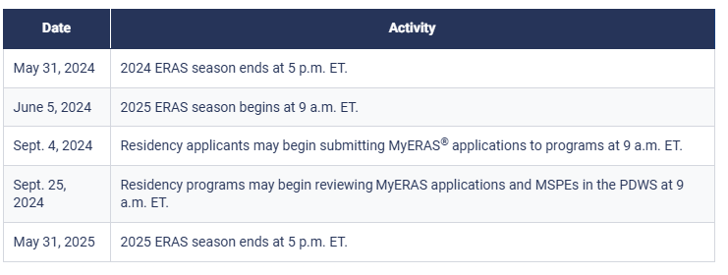
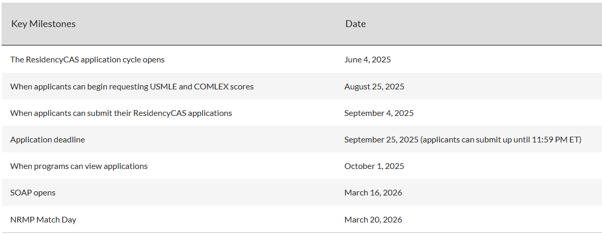
Timelines
ERAS: This should be updated soon, but the dates are roughly the same each year
ResidencyCAS
SF Match

Slide 4
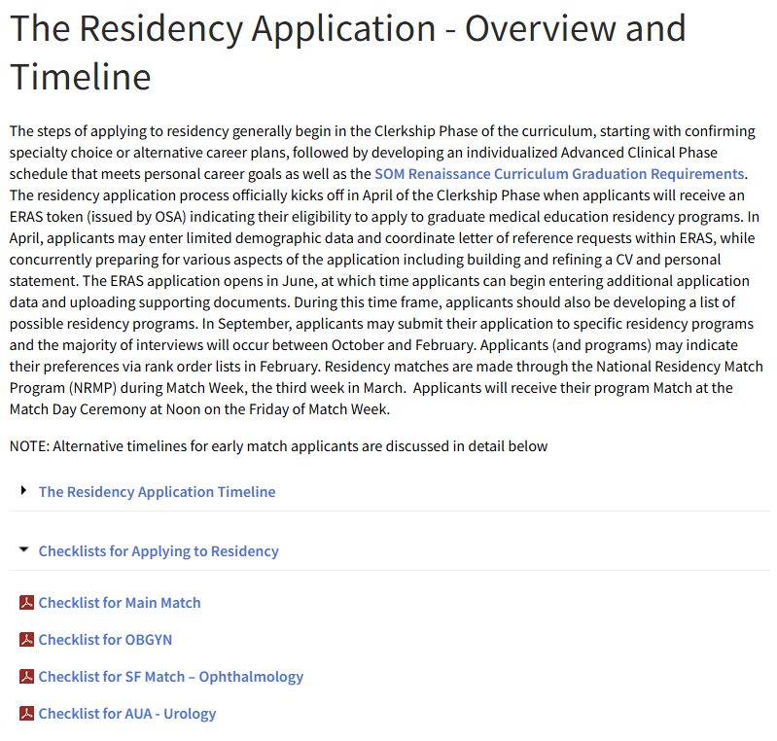
What now????
Now
Access application systems for basic demographics
Early June
Applications open
Sep.–Oct.
Programs can see your application

Slide 5
APPLICATION TOKENS
Everyone receives ERAS Token
Applying through Residency CAS
Email aesselman@som.umaryland.edu
Applying to Ophthalmology through SF Match
Email aesselman@som.umaryland.edu

Slide 6
What can ANYONE be doing now (regardless of specialty or platform)?
Letters of Recommendation
Experiences
Personal Statement
Building out your schedule
Understanding Competitiveness

Slide 7
Letters of Recommendation
Generally, 3 (maybe 4)
May include:
Chair/Departmental Letter
SubI letter
Specialty faculty letter
Other (research, mentor, etc)
Can come from clerkships or advanced phase rotations
You can request more letters than you will end up using

Slide 8
Letters of Recommendation
Email faculty to ask if they are willing to write a letter
Provide CV and Personal Statement if available
Offer to meet with the faculty member
Consider attaching any presentation material that you used during your rotation with them
Remind them of any memorable patient cases that you worked together on
Offer to shadow with the faculty member if it has been a while

Slide 9
If they say yes…
Indicate that you will contact them again close to the time of application to confirm their ability to assist you
2
For ERAS applications, aim for LOR by the first week in September
3
Indicate that you will remind them about 1 week prior to the planned upload date
4
Complete waiver for your right to see your LOR
1

Slide 10
How can OSA and your advisors help?
Review your list of letter writers at your 1:1 OSA advising meeting
Review your list of letter writers with your departmental advisor/meeting
OSA/faculty CANNOT see your LORs
If you apply through ERAS
OSA can see that your letter has been uploaded and assigned to programs

Slide 11
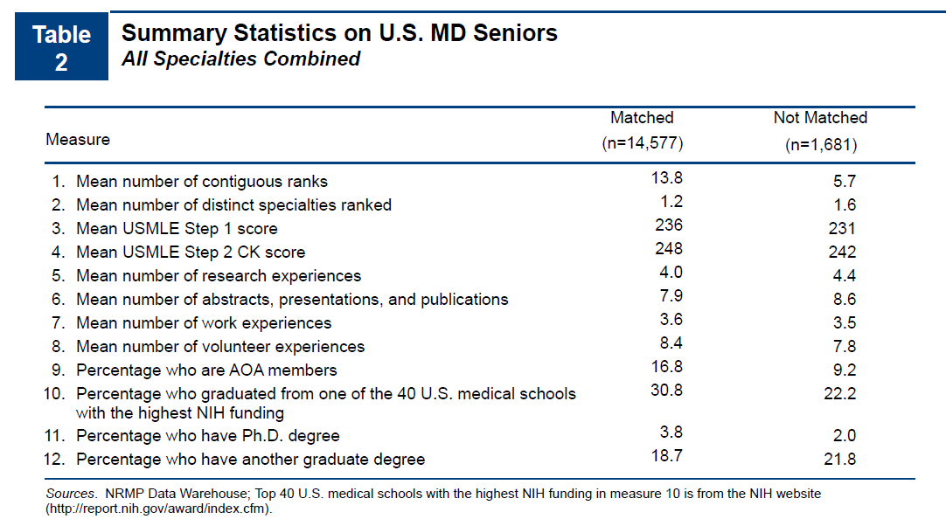
Experiences
10 experiences (ERAS)
May include:
Review your CV
Start bullet pointing the context, roles and responsibilities from these experiences
Work
Research
Volunteer/Service/advocacy
Education/Training
Military Service
Other extracurricular activity, club, hobby *
Professional Organization
Teaching Mentoring
12 experiences (ResidencyCAS EM)
12 experiences (ResidencyCAS OBGYN)

Slide 12
What if I have more experiences?
Most representative of your brand/mission/passion
Spent the most amount of time
You want to talk about
Combine similar experiences authentically

Slide 13
What if I don’t have “enough” experiences?
The Learning Institute –
Micro-certificates
Did you do extra service learning?
Volunteer and Service
(UMB Intercultural Leadership and Engagement)
Join a professional society
Join a research project that is already in progress
Maybe this is ok!

Slide 14
Meaningful/Most Important experiences
3 of your 10 ERAS
3 of your 12 ResidencyCAS (EM)
3 of your 12 ResidencyCAS (OBGYN)
Reflect on the experience, why it was meaningful, and how it influenced you.
Weave in the focus area or key characteristic you tagged
This should not describe what you did in the experience or list a set of skills that you developed or demonstrated during the experience

Slide 15
Personal Statement
1 page
See the Residency Application Manual for Tips and Worksheet
Come to a Personal Statement Workshop
UMB writing center
July 15th at 4PM
Aug 19th at 4 PM
View the quick tips video Recording

Slide 16
Personal Statement
Be authentic
Be clear and concise. This is not the same as a creative writing assignment ☺
Make it about YOU
Many people should read the PS. Some for content, others for grammar and syntax.
Some people need to wait till they have done a Sub-I or Key elective to gather their thoughts
Should you Journal?

Slide 17
Building out your schedule
Step 2 CK
1-2 months unscheduled for interviews
Electives that align, support or diverge from your specialty of choice
Generally, 4 weeks
Allow for 4-8 weeks to return score
Ideally 2 rotations in your specialty prior to applying
SubI + elective; SubI + SubI; SubI + away
Source of LORs
A rotation in Block 3 (Sep 1-Sept 26): possible to get LOR
Review course catalog
Review Elective and Rotations Options
July 26 for ERAS/ResidencyCAS, early July Early Match

Slide 18
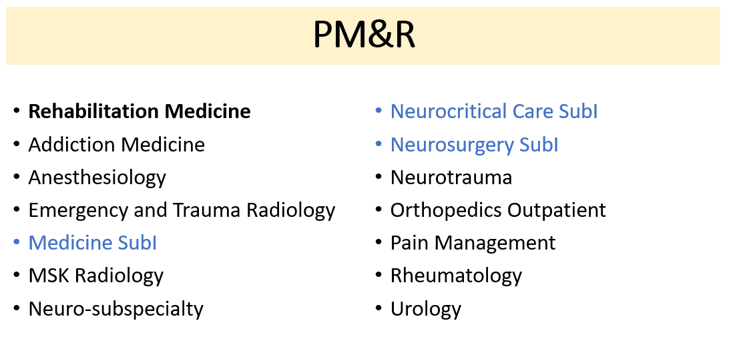
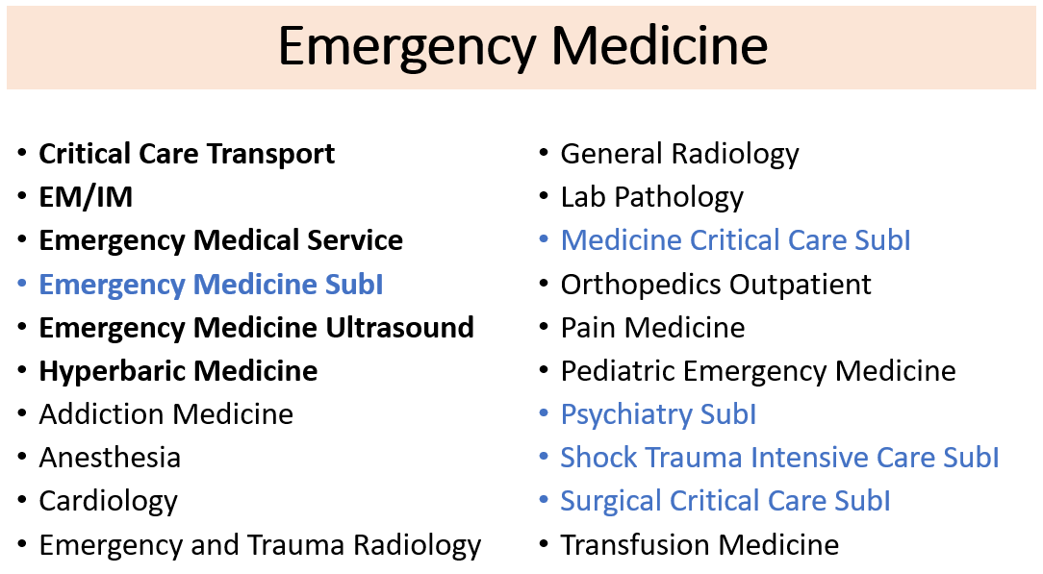
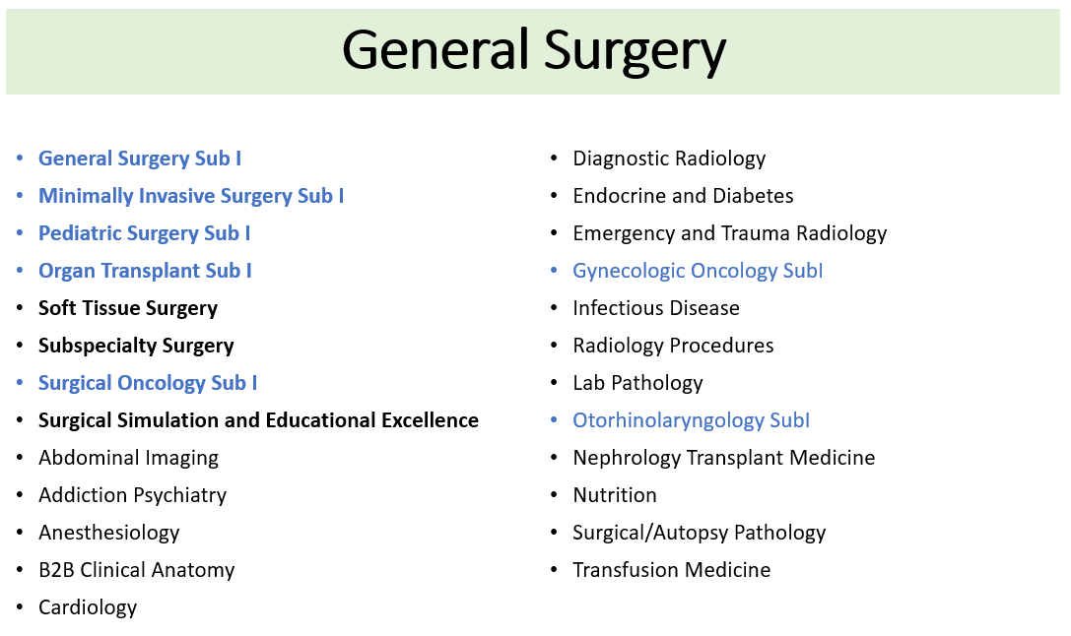

Slide 19
How can OSA and your advisors help?
Review your schedule at your 1:1 OSA advising meeting
Review your schedule with your departmental advisor/meeting
Help to suggest LOR writers from rotations
Help to talk through planned interview time
Universal release dates

Slide 20
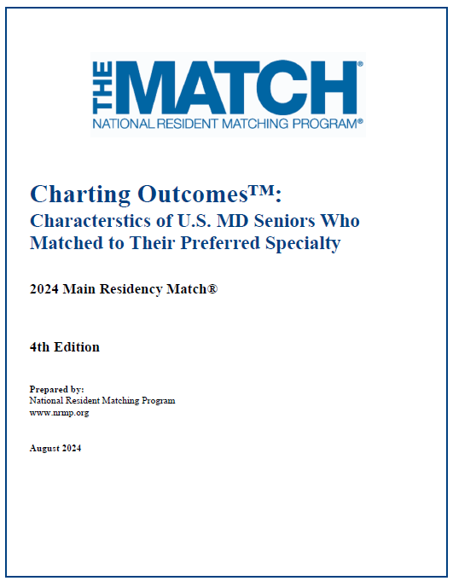
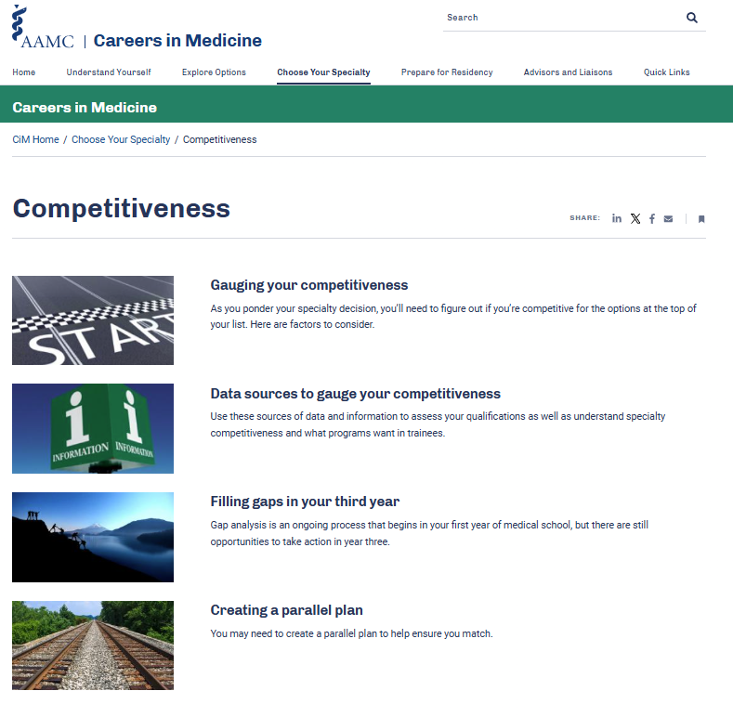
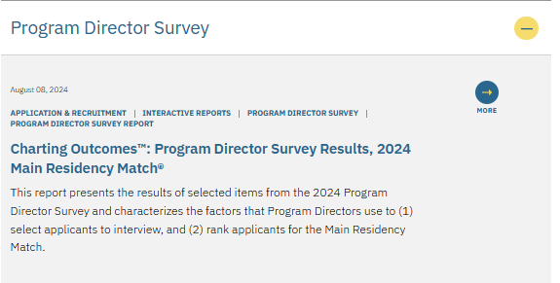
Understanding Competitiveness
Charting Outcomes in the Match
Student reported data
NRMP Program Director Survey
Specialty Data (Professional Societies)
Careers in Medicine
Specialty Profiles
1:1 Advising Meeting
Best after Step 2 & class distinction
Residency Explorer™
Specialty Faculty Mentors

Slide 21
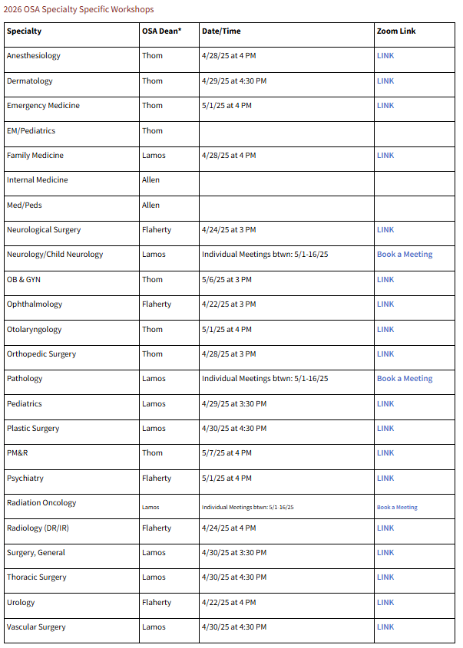
Get Excited! Residency Application Manual → OSA Advising Workshop Series https://www.medschool.umaryland.edu/osa/residency-application-manual-/osa-advising-workshop-series/

