Slide 1

Step 2 CK
Tess Gillis, MJ/MBA
  Director, Student Success
January 13, 2025

Slide 2
Step 2 CK Exam
8 Blocks
1 hour each – 40 questions max
9 hours total
Clinically-based
Similar to Shelf Exams
Passing Score: 214
https://www.usmle.org/

Slide 3
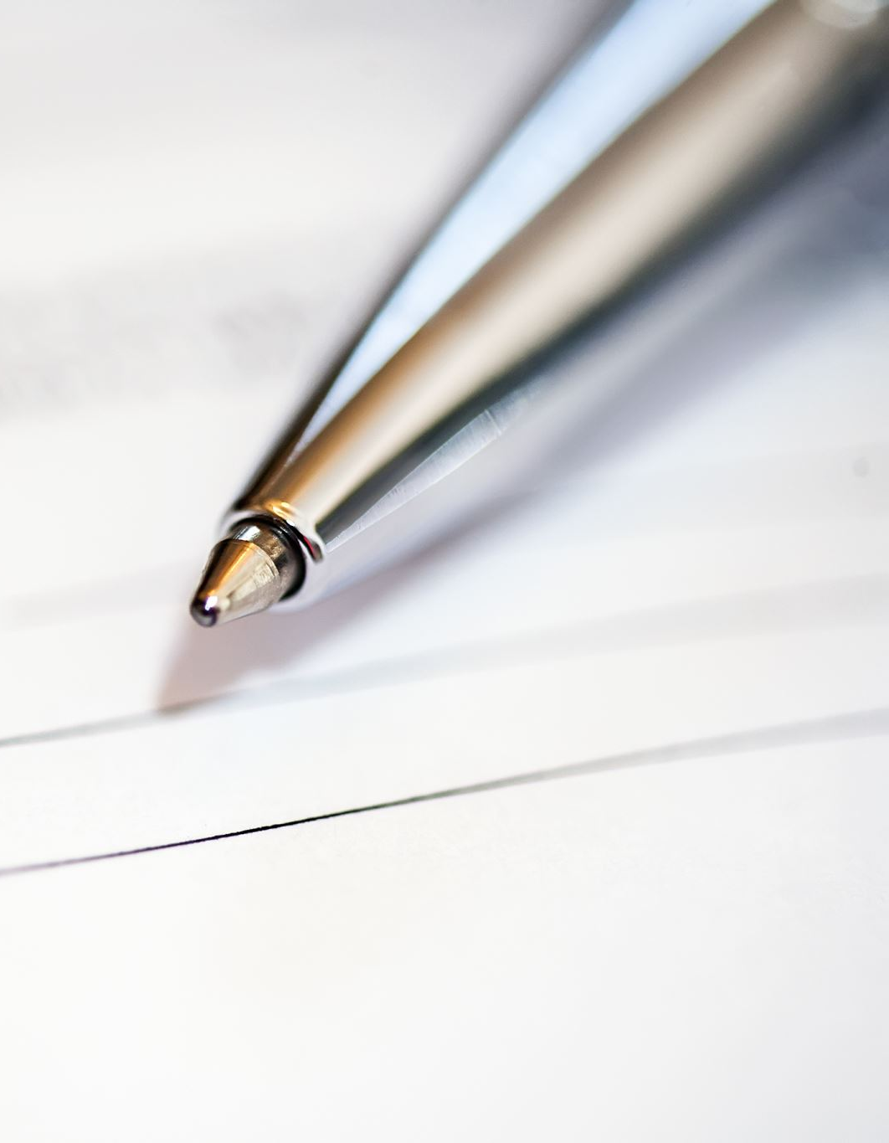
Accommodations for Step 2
Did you have accommodations for Step 1?
  Yes…shorter process
  No…begin now, if needed

Slide 4

When to Take Step 2 CK
Test date timing more individualized than Step 1
Typical to take 4-week block to study
  Some combine with Summer Break (June 17 – June 30)
Encourage late April to late May
  Consider with OSA: Sub-I, Aways, Applications, Scores
    Scores: typical 3-4 weeks
      Score report delays – typically April/May, receive in early June

Slide 5

Registering for Step 2 CK
NBME: https://apps.nbme.org/nlesweb/#/login
$680
Eligibility Period: 3 months
If Step 1 taken within 5 years, no need to print form
  NBME emails permit, go to Prometric to schedule
Register: have sense of timing/study period
  $70 fee to change eligibility period

Slide 6

Studying for Step 2 CK
Typically, 4 weeks, but can vary
Dedicated sometimes overlaps with electives
  Can be difficult
2 weeks of summer vacation can be buffer
Resources
  Uworld
  Review Text: First Aid for Step 2 CK, Step Up to CK, Step Up to Medicine
  Online MedEd – subscription (videos, flashcards, questions)
  Practice Exams: Uworld, NBMEs (9-15), Free 120

Slide 7

Shelf Exams
How are they going for you?
  Translate to CK
  Support: meet with Tess, Courtney, PLPs
Tweak your study strategies/resources/plan
Use practice exams, use explanations
  Insights feature - myNBME

Slide 8
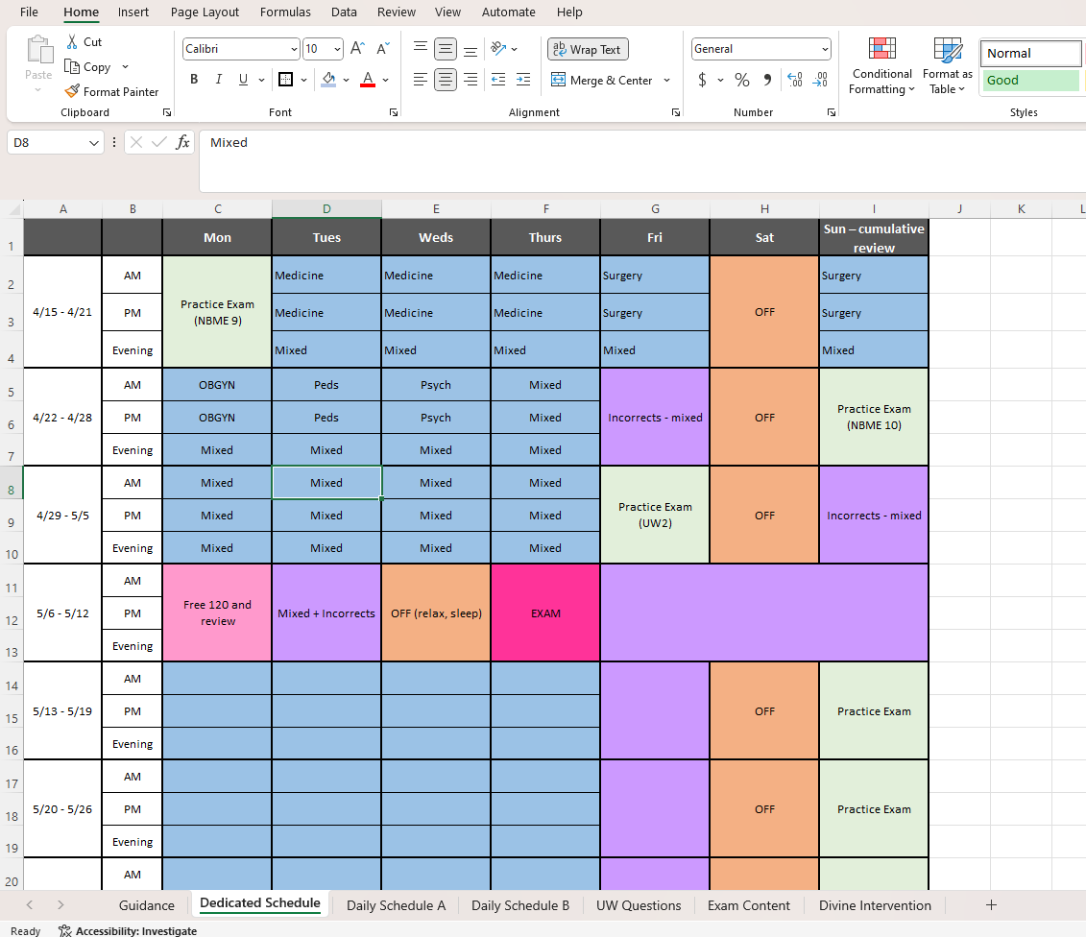
Write Out Your Plan
100-120 daily Uworld questions
Use of other resources
  First Aid: review chapters
    Reduce # of Uworld questions in conjunction
Practice Exam(s):
  How many
  Which order - UW2 week before
Build in day(s) off

Slide 9
Questions
Let’s talk!
  Study ideas – Shelf or CK
  Study Plans
Email for Schedule Link: tess.gillis@som.umaryland.edu
Courtney.Butler@som.umaryland.edu

