Slide 1

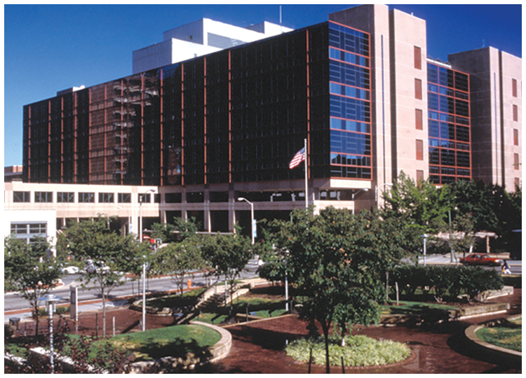
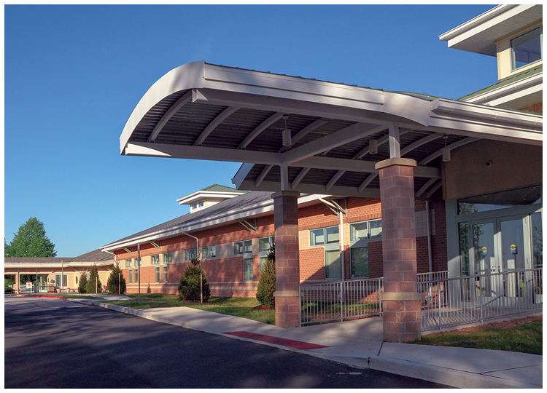
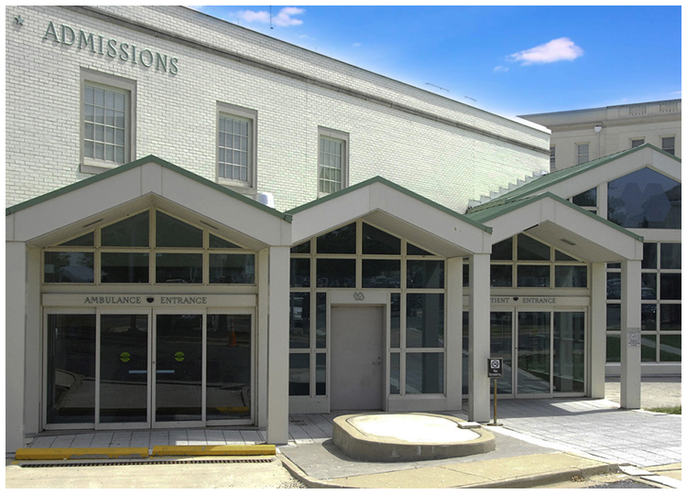


VA Electronic Incident Reporting
Ryan Scilla, MD, FACP, CPE
Deputy Associate Chief of Staff
Education & Academic Affairs
High Reliability Organization (HRO) Champion
VA Maryland Health Care System (VAMHCS)
June 18, 2020
www.maryland.va.gov

Slide 2

Overview
Introduction to VAMHCS HRO Initiative
  Three Pillars
  Five Principles
  Seven Values
Impact of Medical Errors
Joint Patient Safety Reporting (JPSR)
www.maryland.va.gov

Slide 3
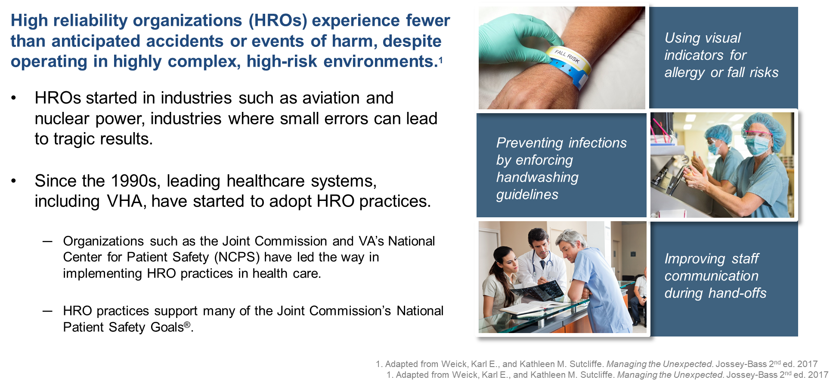
What is a High Reliability Organization?
www.maryland.va.gov

Slide 4
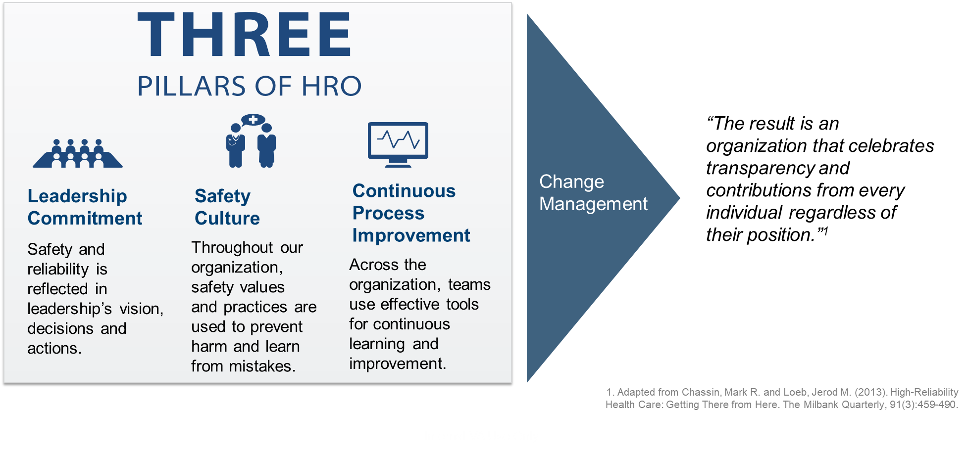
How Do We Get There?
www.maryland.va.gov

Slide 5
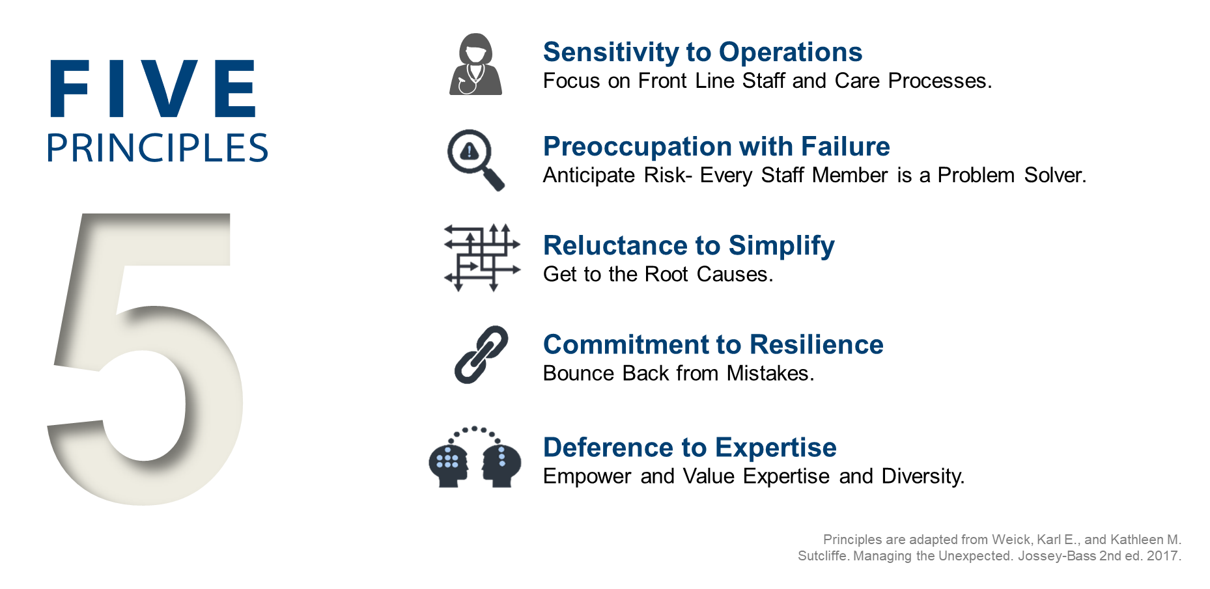
Our Principles Guide Our Journey
www.maryland.va.gov

Slide 6
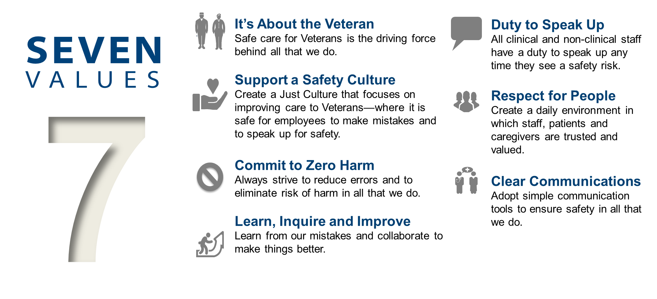
Our Values Guide Our Actions
www.maryland.va.gov

Slide 7
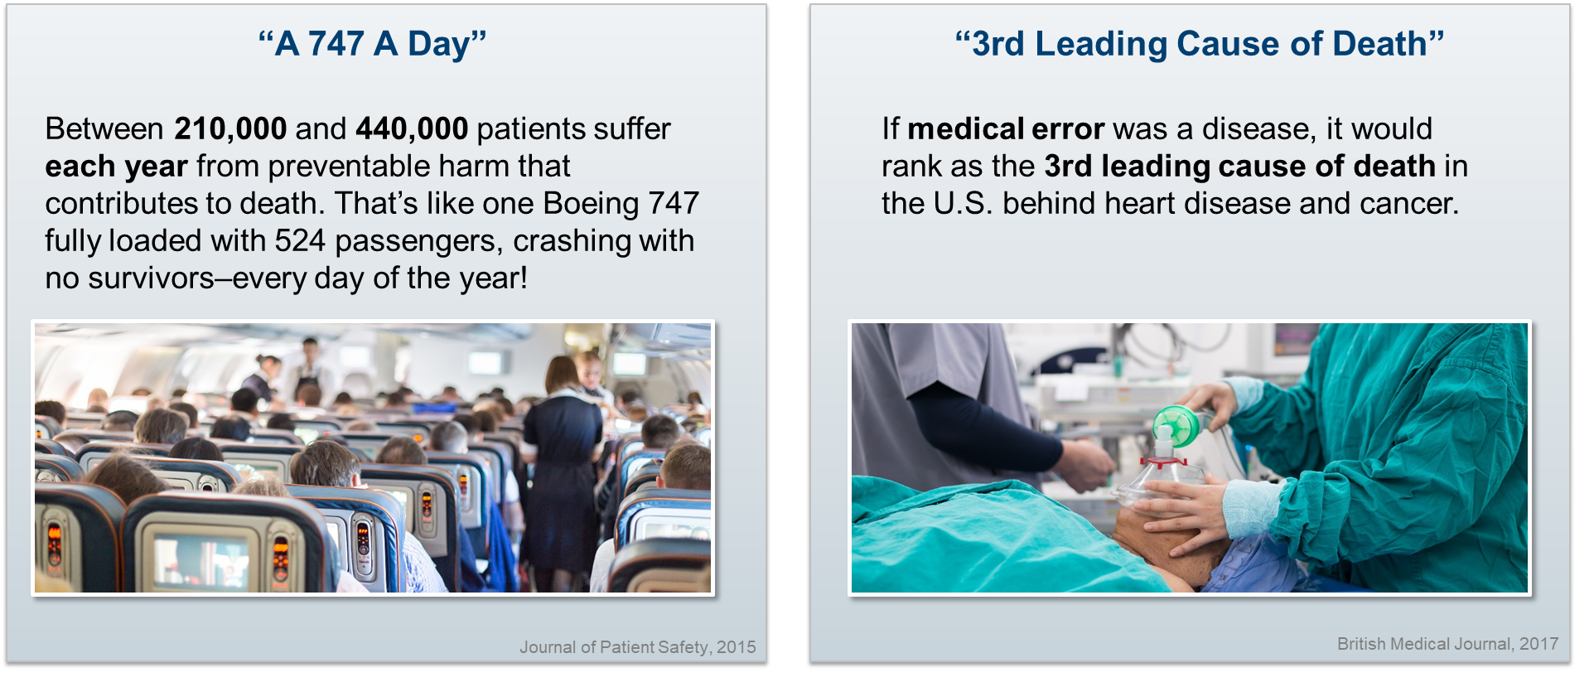
Why Should Healthcare Embrace High Reliability?
www.maryland.va.gov

Slide 8
The Joint Patient Safety Reporting (JPSR) System is a National Center for Patient Safety (NCPS) incident reporting system for reporting, tracking, and trending of patient incidents in a National database.
JPSR electronic incident report form is found on the VAMHCS Intranet page to be completed to document any adverse, unexpected or close call event associated with patient care. This includes events that have resulted or may result in harm to a Veteran.
What Close Call and Adverse Events Need to be Reported?
Report any adverse or unexpected events including but not limited to:
- Patient Abuse/Assault - Patient Falls - AMA Veterans
- Environmental concerns - Elopement - Iatrogenic Injury
- Medication Errors - Self-Harm - Missing Patients - Veteran with contraband - Supply shortages - Device failure
- Transfusion errors - Equipment failure - Close call events
www.maryland.va.gov

Slide 9
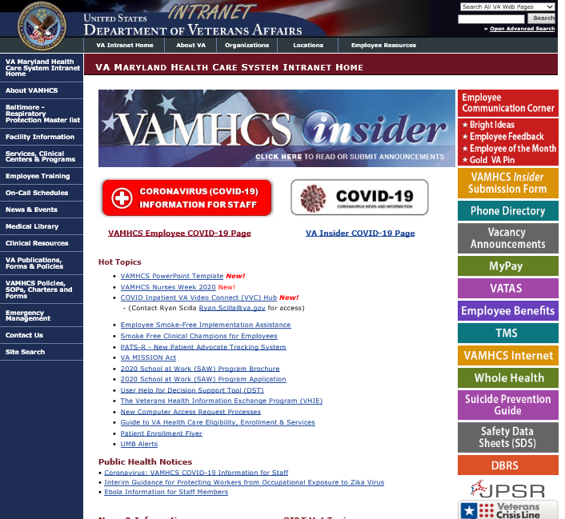

Slide 10
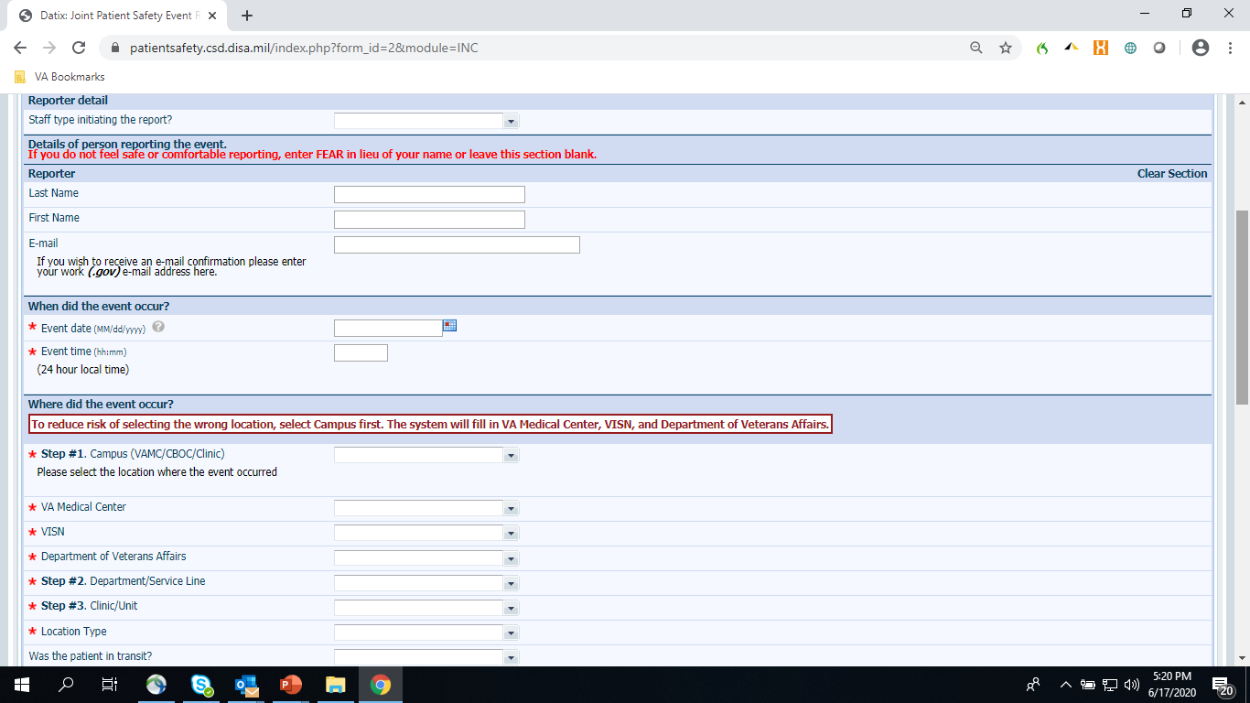
www.maryland.va.gov

Slide 11
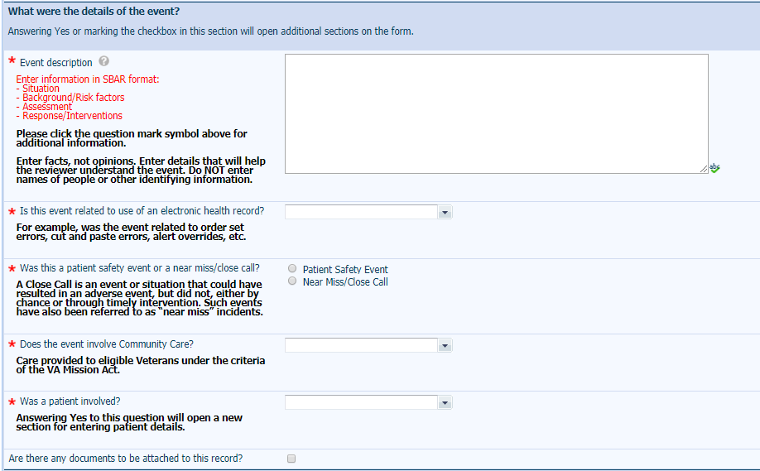
www.maryland.va.gov

Slide 12
What Happens Next?
Events are sent directly to the patient safety staff to investigate and develop an action plan
Events are communicated to facility leadership
Events are aggregated at a local level by patient safety and at a national level by the National Center for Patient Safety (NCPS) to detect trends and establish priorities
Best practices are disseminated and adopted
We prevent future harm, learn from our mistakes, and improve the care delivered to Veterans
www.maryland.va.gov

Slide 13
Thank You
Questions?
Contact Information
  Ryan Scilla, MD, FACP, CPE
  Office: Baltimore VA Medical Center room 2C-118
  Phone: (410) 605-7000 ext. 55545
  Email: Ryan.Scilla@va.gov
www.maryland.va.gov

