Slide 1
HOW TO RUN A SUCCESSFUL
STUDENT GROUP
University of Maryland School of Medicine
2026-2027 Academic Year

Slide 2
Key Contacts
Student Council (umb.som.council@gmail.com)
OSA
  Kerri Thom, Associate Dean for Student Affairs (kthom@som.umaryland.edu)
  Adam Esselman, Senior Academic Services Specialist (aesselman@som.umaryland.edu)

Slide 3
Leadership Expectations and Policies

Slide 4

11. Knowledge
12. Organization
13. Reliability
14. Problem Solving
15. Professionalism
15

Slide 5

Honing your leadership skills
1. Engage in honest, open communication
2. Connect with your team members
3. Encourage personal and professional growth
4. Keep a positive attitude
5. Teach instead of giving orders
6. Set clear goals and expectations
7. Give direct feedback about performance
8. Ask for feedback on your leadership
9. Be open to new ideas
10. Understand your own motivation
BuisnessNewsDaily.com

Slide 6
SOM Student Organizations
Student run organizations and activities align with the University's mission, vision, and core values
All-Comers policy: All Student Organizations must allow any student to participate, which includes becoming a member, regardless of their protected status or beliefs. All students shall be allowed to become an officer or serve on the executive board regardless of their protected status.
All-Comer expectations
All student groups get the same distribution of funds

Slide 7
UMB’s Core Values
Respect and Integrity
Well-Being and Sustainability
Equity and Justice
Innovation and Discovery
How to infuse core values into decision making
“At the University of Maryland, Baltimore, our core values demonstrate what we stand for and serve as a guide to how we behave. By acting on our core values, using them to guide our everyday interactions, we make UMB a place where everyone feels welcome, has a sense of belonging, and is supported to succeed.”
— President Bruce E. Jarrell, MD, FACS

Slide 8
Respect and Integrity
We value each other and hold ourselves accountable for acting ethically and transparently using compassion and empathy.
How to Be a Catalyst for Respect and Integrity
Promote open communication: Be honest and transparent with others, speak with sincerity and act with compassion, and learn and practice good listening skills.
Act ethically: Adhere to the highest standards of professional and personal responsibility, even when no one is looking.
Show empathy: Demonstrate consideration and compassion for people, help those in need, and act with patience and flexibility especially when unexpected circumstances arise.
Be accountable: Accept responsibility for your actions — good and bad — be reliable and trustworthy, and follow up and follow through on your commitments.

Slide 9
Well-Being and Sustainability
We care about the welfare of our people, planet, communities, and University.
How to Be a Catalyst for Well-Being and Sustainability
Support work-life harmony: Show grace, empathy, and be respectful of others’ workload, allow downtime for yourself and others to refresh and recharge, and make decisions consistent with a healthy quality-of-life philosophy.
Promote healthy behaviors: Practice and encourage activities that foster emotional, financial, mental, physical, and social wellness.
Protect the environment: Consider the immediate environmental impact of your decisions and actions and evaluate the future effects on the habitat.
Use resources responsibly: Encourage conservation and recycling, explore and implement efficient ways to reduce waste, and familiarize yourself with the four pillars of sustainability — social, human, economic, and environmental.
Plan for the future: Incorporate long-term considerations — regarding mission, finances, or other factors — into decision-making.

Slide 10
Equity and Justice
We embrace and are committed to diversity, and we value inclusive and just communities. We oppose racism and oppression in all their forms.
How to Be a Catalyst for Equity and Justice
Prioritize and integrate equity: Understand equity and its fundamental role to the University’s culture, promote a culture where all belong, and demonstrate and support equitable practices in the classroom and the workplace at all times.
Seek to listen and learn: Explore one’s own identity and implicit and explicit biases, and provide space to learn about different experiences, backgrounds, and how others might have encountered and overcome systemic barriers based on race, sex, ethnicity, disability, gender, gender identity, socioeconomic status, and/or other dimensions of their identities.
Create inclusive environments: Respect one another as colleagues across power differentials, use inclusive language, commit to anti-racist and anti-oppression practices, and welcome others to contribute ideas and perspectives.
Say and do something: Speak up when you recognize inequity or injustice, particularly if in a position of authority, and take action to address it, such as identifying and correcting policies and practices.
Invest in justice: Provide opportunities for University stakeholders from historically marginalized populations to guide and contribute to institutional efforts that influence and address issues of equity and inclusion, and create opportunities for persons from historically marginalized communities to serve as UMB leaders.

Slide 11
Innovation and Discovery
We imagine and explore new and improved ways to accomplish our mission through education, research, clinical care, and service.
How to Be a Catalyst for Innovation and Discovery
Promote ingenuity: Encourage thinking that challenges constraints and inertia, and imagine what is possible by exploring opportunities through creative ideas and collective talents.
Commit to continuous improvement: Learn from your failures or mistakes and be open to adopting new or changing knowledge, approaches, and ideas to influence positive outcomes.
Support informed courage: Create a culture in which taking thoughtful risks and proposing or pursuing bold ideas is encouraged and expected.
Bolster collaboration: Support interdisciplinary and multidisciplinary teamwork and the sharing of knowledge, leverage insights from others, and promote broad, interinstitutional community input and practice.
Celebrate impactful results: Measure and recognize the effectiveness of new ideas and publicize successes to internal and external audiences.

Slide 12

Stewards of UMB/SOM Mission
OUR MISSION
To improve the human condition and serve the public good of Maryland and society at-large through education, research, clinical care, and service.
Please familiarize yourself with the policy on professionalism, including professional conduct evaluations and commendations, which can be found in the academic handbook on the Office of Student Affairs website: https://www.medschool.umaryland.edu/osa/handbook/commitment-to-professionalism/

Slide 13
Student Group Policies, Procedures, & Finances

Slide 14
Out with the Old, In with the New
Student Interest Group Accounts are in the process of transition, with the spring semester being the final period with a mixture of both the old and new processes
Plan, Plan, Plan! – Group Expenses (food orders, supplies, etc.) will be purchased/paid for in advance by OSA
  Reverse from years past where reimbursements were most common
  Requests must be submitted at least 2 business days in advance of when they are needed
  There is a list of already approved restaurants/caterers to choose from
    Here's the list. We can also order through caternation
Alcohol CANNOT be purchased or reimbursed via state funds (if groups still have a balance from past years, that money will be used first)

Slide 15
Student Interest Group Funding Options
1) OSA manages the group money in a state account = subject to state rules
2) Interest Group sets up their own account using their own EIN (employer identification number) and manages and controls the group funds themselves = can use funds to purchase alcohol and any other expenses; in charge of filing taxes
3) Combination of 1 and 2 (note, no funds can be deposited/transferred from personal account to state account)
4) No Funding = group is still an active and officially recognized interest group, but does not utilize funds of any kind

Slide 16
Student Interest Group School Resources
For groups choosing the option of setting up their own account and EIN, we have asked the main UMB campus if they can provide support for groups, similar to what College Park has, in terms of a department/contact that sends reminders, shares pointers and tips around tax season, etc.
  OSA will provide additional information/feedback as we receive it.
Current guidance

Slide 17
How Can Student Groups Raise/Collect Funds
Large set fundraising (i.e. apparel, merchandise, etc.) will still be allowed, however, any funds raised will be deposited into the Student Organization state account and be subject to state guidelines.
  Groups can utilize Weebly (an OSA operated webpage) for fundraising, but their idea must be approved by OSA first (PLEASE SUBMIT THIS FORM) and all funds will be directed to the state account and subject to state rules
  Weebly can collect credit card payments and any order information you may need. (Ex: size, color, etc.)
  Any kind of apparel/merchandise with UMB/UMSOM logos or wording on them must first be approved by UMB Marketing.
Bake sale/sticker sale/pin sale, sales at a lower sum of funds collected are also allowed, however any funds collected will be deposited into the Student Organization state account and be subject to state guidelines
Groups can seek charitable donations (i.e. a department contributes to an interest group but does not receive anything in return) from departments/outside sources. Any funds collected will be placed in the state account and subject to state guidelines
Per UMB’s “All Comers Guidance” policy, all student groups need to have equal opportunities. Any support – whether financial, administrative, or other – that OSA, OME, or any UMB/UMSOM Deans Office gives to one group, they have to give to all; or at least each group has equal opportunity for it
For groups choosing the option of OSA managing the group money, there will still be funds divided amongst all groups via Student Activities Fees that will be able to be utilized

Slide 18
Bank Accounts
Adam Esselman (OSA) has all your accounting information and current balances - Room 154 in the OSA office (Suite 150)
Groups are unable to deposit more funds into their M&T account
M&T accounts will run through the remainder of the semester (May) and all funds will be transferred and operate out of the state account after May 29
If you ever want to know your current balance or see a list of recent/previous account transactions, please reach out to Mr. Esselman.

Slide 19
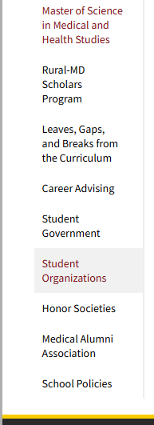
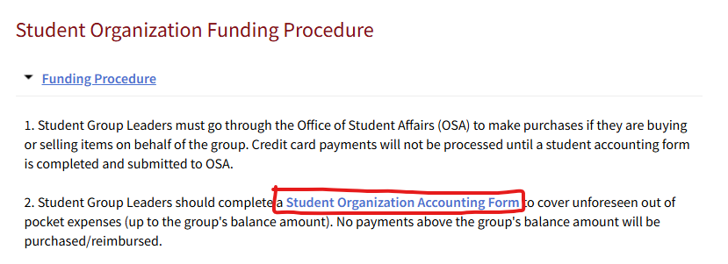
Student Organization Accounting Form
Can be found in the OSA Handbook

Slide 20
Student Organization Accounting Form
Group members should complete an accounting form in order to:
  Request a payment/purchase be made
  Cover unforeseen out of pocket expenses (up to the group’s balance amount). No payments above the group’s balance amount will be made and/or reimbursed.
  Request a reimbursement
REMINDER:
The payee and the approving e-mail cannot be the same on the student accounting form!
*A reminder that the approver needs to submit a form as well (will get an email sent to them after the
accounting form is submitted)

Slide 21
VidaNova
All student interest groups will operate and work out of VidaNova (transitioning fully out of MedScope)
Interest Group information (group advisor, group officers, group mission) has been added to VidaNova
Students can choose the groups they would like to be a part of and receive communication and news from
  All student interest group communication should go through VidaNova and NOT the class listservs
  If a student group wants to use the listserv to send out an announcement/information, they must first have it approved by OSA – please send an email to: studentaffairs@som.umaryland.edu
If you ever have a question or need assistance, please submit a “Help Request Form” found on the bottom of the home page in VidaNova, or reach out to Mr. Esselman (aesselman@som.umaryland.edu)

Slide 22
VidaNova How To Guides
Key Contact: Ms. Karen Webster – OME - Manager, Academic Programs Support
How to Join and Leave a Student Interest Group
How to Post Announcements
Adding Sessions to Student Interest Group Calendars
Add a Choice Activity to a Session

Slide 23
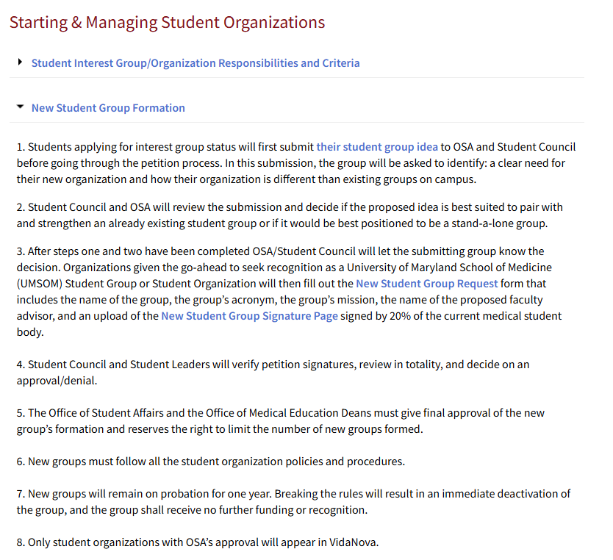
New Student Interest Group Formation
Previous process will continue, with some slight tweaks/additions
Groups will first submit their new group idea to Student Council and OSA via the New Student Interest Group Form (also found in the OSA Handbook)
The submission will be reviewed and decided if the proposed idea is best suited to pair with and strengthen an already existing student group or if it would be best positioned to be a stand-a-lone group.

Slide 24
New Student Interest Group Formation (Cont.)
Groups will be notified of the reviewed decision – if approved, groups will be asked to collect and show additional student support
Lastly, Student Council and Student Leaders will verify petition signatures, review in totality, and decide on an approval/denial
  The Office of Student Affairs and the Office of Medical Education Deans must give final approval of the new group’s formation and reserves the right to limit the number of new groups formed
New groups will remain on probation for one year
Benefits of being a Student Group
  Recognition
  Ability to use VidaNova events calendar and messaging
  Shared Funds
    *Groups can apply to be an Interest Group without needing/requesting funding

Slide 25
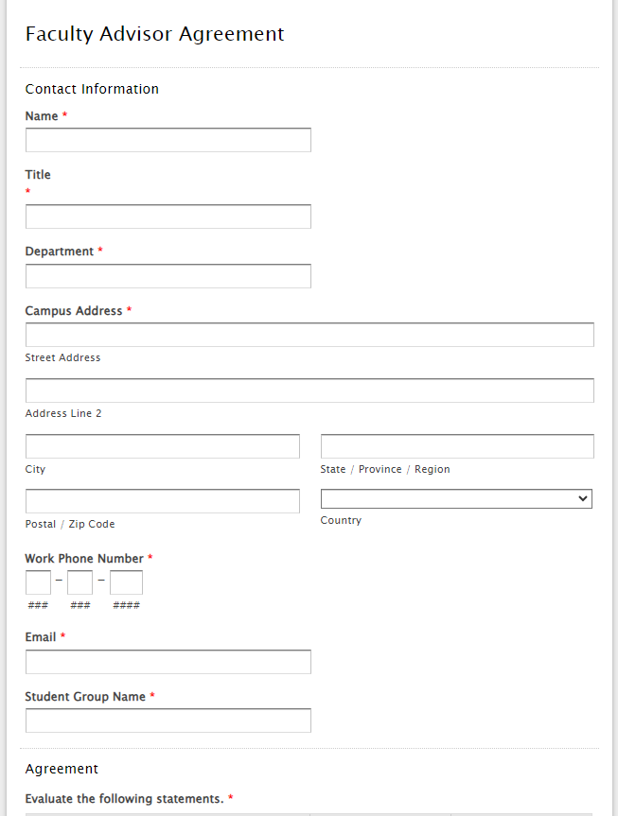
Faculty Advisor Form
Each active student interest group must obtain a Faculty Advisor
The group faculty advisor needs to complete the “Faculty Advisor Agreement” form each year (i.e. for 2026-2027)
Groups should have their faculty advisor forms completed by April 30, 2026

Slide 26
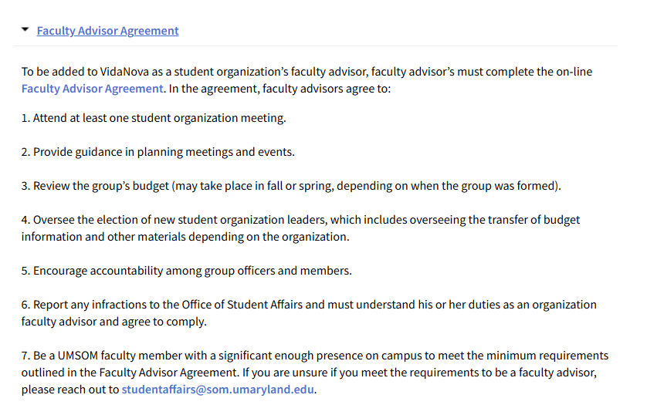
Faculty Advisor Overview

Slide 27
TIPS for Working with Faculty Advisors
Set some expectations both for leaders and advisors
Invite your Faculty Advisors to all meetings and keep them in the loop. If they can’t make it, send them minutes.
Give them a chance to talk to the group about what they do
Ask for help/funding
Develop that relationship… You might be asking them for an LOR in the future
Create a constitution and/or bylaws for your group
Do something unique different

Slide 28
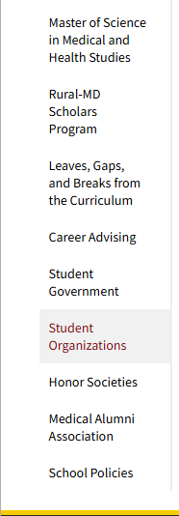
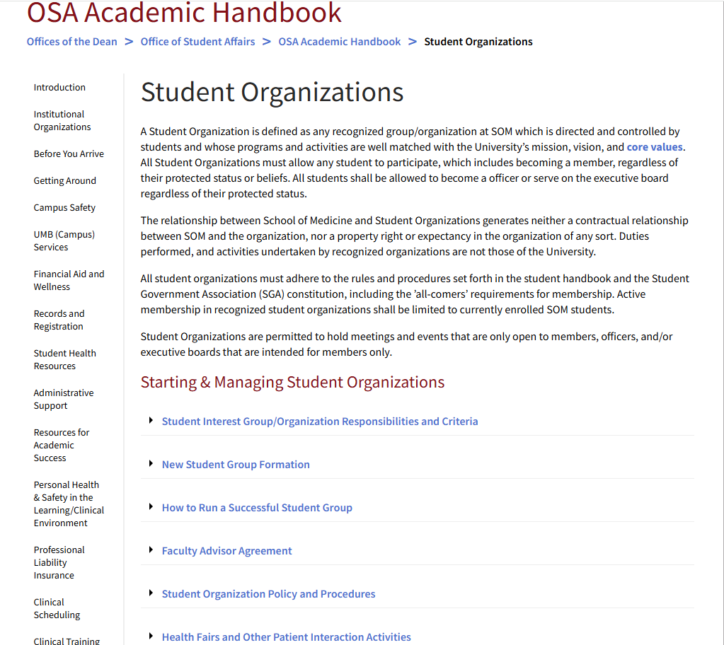
Student Organizations Overview

Slide 29
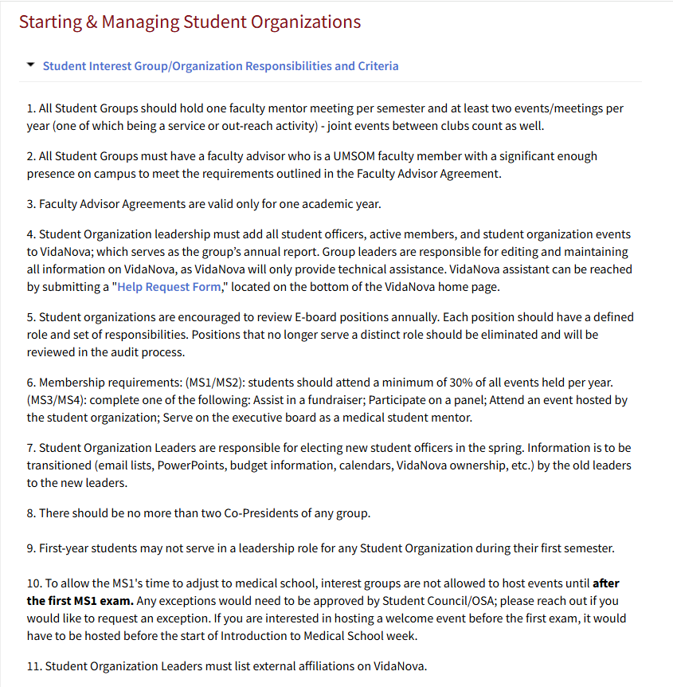
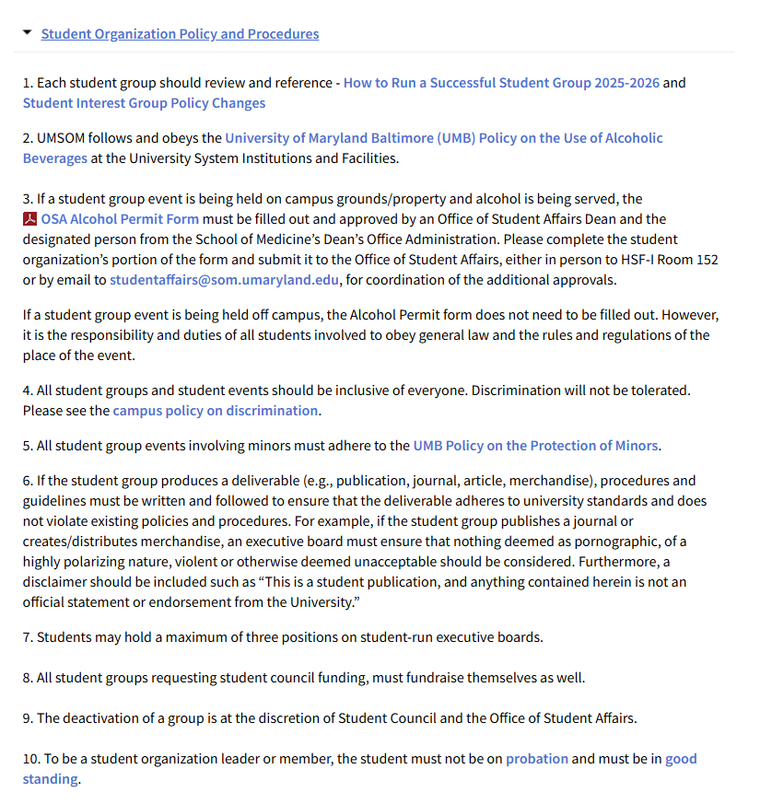
Student Group Responsibilities and Criteria
Full list found in the OSA Handbook
Full list found in the OSA Handbook
Notes:
Faculty advisor must be a full time faculty of the school

Slide 30
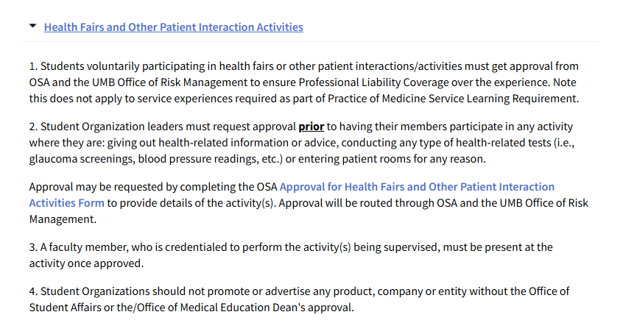
Approval for Health Fairs and Other Patient Activities
Any Student Interest Group activity where student groups/students are: giving out health-related information or advice, conducting any type of health-related tests (i.e., glaucoma screenings, blood pressure readings, etc.) or entering patient rooms for any reason, must complete this OSA approval form prior to the event.
Please complete at least two days prior to the event, in order to allow sufficient enough time for review and approvals

Slide 31
Student Organization Storage
(MSTF Atrium Room H)
Each student group gets access to the OSA student storage room (MSTF Atrium Room H)
Sign-out keys for the storage room are located in OSA (cannot keep them).
Please no food to be stored in the room
Keep it organized.
  Please pick up after your group and try your best to organize
Clean it out at the end of each semester and during the transition to the next year’s group officers, keep inventory/let them know on what is being stored in the room.
Please be selective with what is stored in the storage room, as there is limited space.

Slide 32

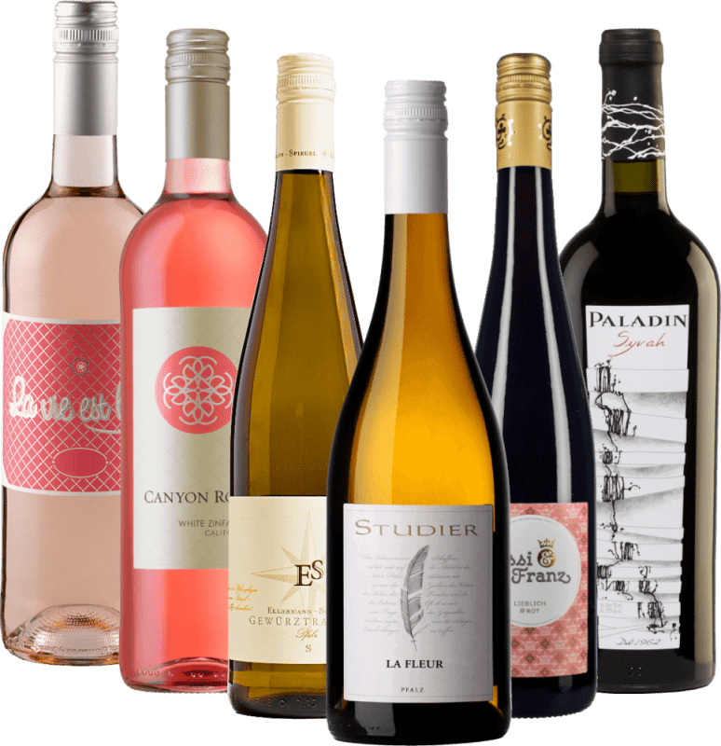
What about Alcohol?
Alcohol CANNOT be purchased by OSA managed student group funds, nor can you be reimbursed for alcohol related expenses. If alcohol is to be purchased, it must be done so by groups utilizing their own funds.
The alcohol form only needs to be completed if the event is being held on campus grounds/property, otherwise the group should obey general law and the rules and regulations of the place of the event.
The UMB Alcohol Policy can be found on pages 2 and 3 of the Alcohol Packet. Please review it!
After you fill out the form and submit it, and if approved, you will receive a copy back for yourself/your group.
Keep a copy of your approved permit and POST it somewhere on a wall during your event.
  If you notice inappropriate behavior, take action according to the policy!

Slide 33
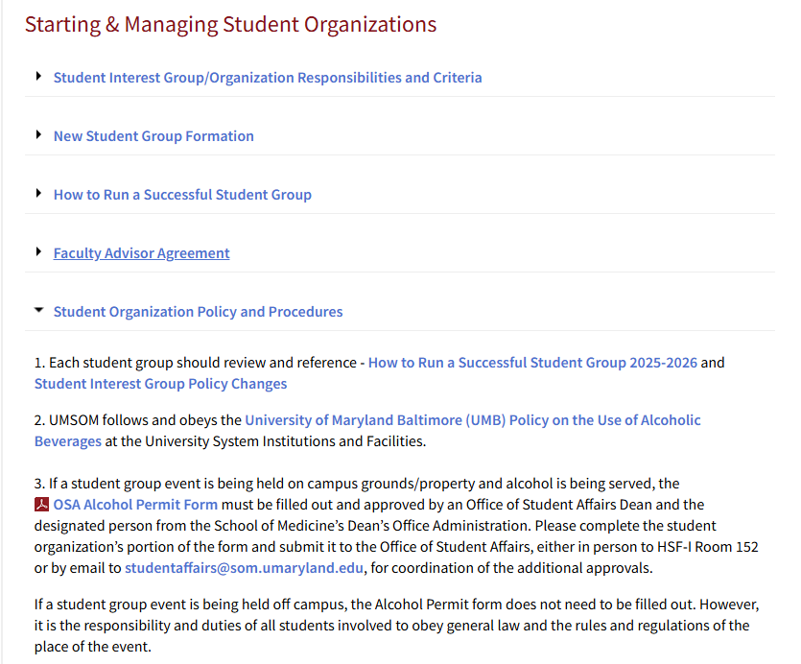
Alcohol Form/Policy
Notes:
PLEASE keep a copy of the permit and post it during your event so police won't shut you down.

Slide 34
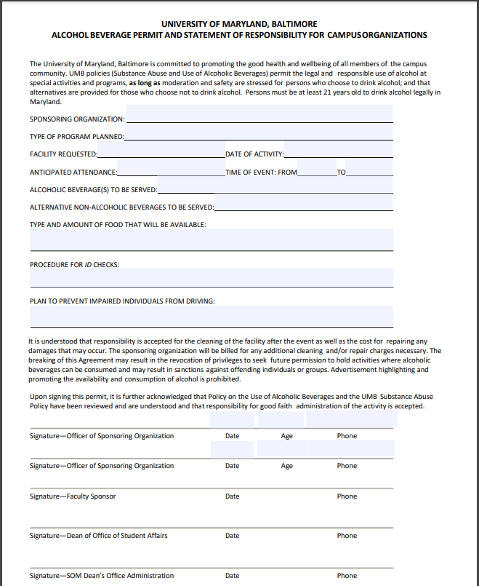
When downloaded, the alcohol permit is fillable. The top half of the first page is to be completed by the sponsoring organization. Drop off or send over to Adam Esselman in OSA RM 154 and he will submit for approval and send the group/person a copy for their records.

Slide 35
Tables and Chairs Request/Facilities Request
Reach out to Adam Esselman (aesselman@som.umaryland.edu) in OSA if you need a table(s) for your event
For smaller, singular table requests, Adam will work with the CSS team (Ronnie) in obtaining a folding table to use outside the Reid Rooms or lecture halls
If you need tables and/or chairs for a larger event, *Please reach out at least three weeks in advance of your event, as the request to facilities must be submitted at least 14 days prior to the event. Adam/OSA must submit the facilities request for the group.
*Chair and table renting from facilities has a fee
Facilities will bill for the labor needed to set up and break down the furniture, and there is no pricing specific to types of furniture. Available are – stacking chairs, 3x6’ rectangular tables and 5’-diameter round tables. They do not provide table linens.

Slide 36
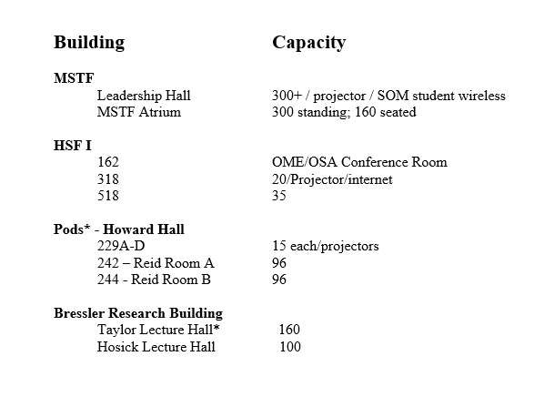
Room Reservations
Before scheduling your event, check VidaNova for other events to minimize overlap
Room Reservation:
rooms@som.umaryland.edu
To reserve AV equipment
    av@som.umaryland.edu
    css@som.umaryland.edu
Remember: Food events cannot be held in Leadership Hall, Taylor or Hosick Lecture Halls.

Slide 37
UMB Campus
Other Rooms Available on Campus can be found at https://www.umaryland.edu/university-life/rooms-available-on-campus/
SMC Campus Center
  https://www.umaryland.edu/campuscenter/host-an-event/
  eventservices@umaryland.edu
Davidge Hall, School of Dentistry, Nursing, SW, Law, HSHSL, Pharmacy, SMC, Lexington & Bio Park
(Other buildings may have different rules ex: alcohol, catering. We suggest asking about the rule when you make your reservation.)

Slide 38
Student Council
Stephen Cobbs – PRESIDENT
Jules Einhorn – VICE PRESIDENT
Asma Poshni – TREASURER
Lindsay Barrow – SECRETARY

Slide 39
Funding Request From Student Council
There is currently $5,500 to split amongst the 60+ student groups per semester.
Please DO NOT over request. Your fund request may not be fully allocated, depending on amount requested and timing of upcoming scheduled events.
Due Dates:
Spring: TBA (Mid-March)
Fall: TBA (approximately the middle of September)
The form will open in both the spring and the fall, and you are allowed to submit for each open period.
Notes:
Council – Look at OME/School Calendar re: above dates

Slide 40
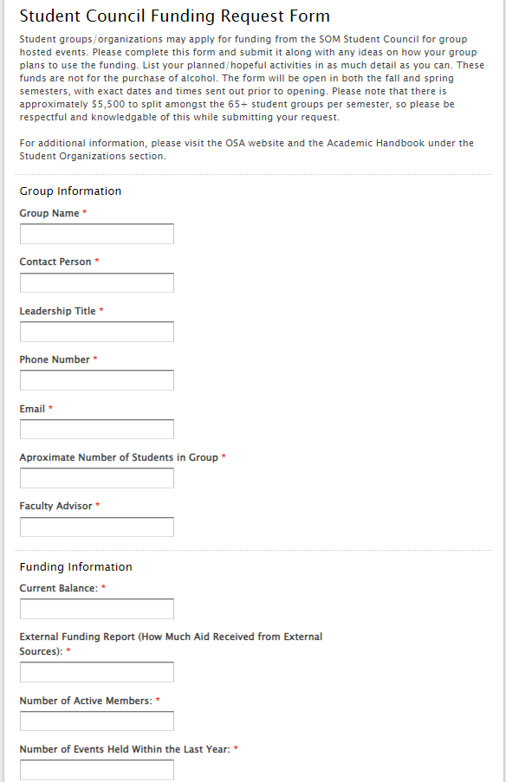
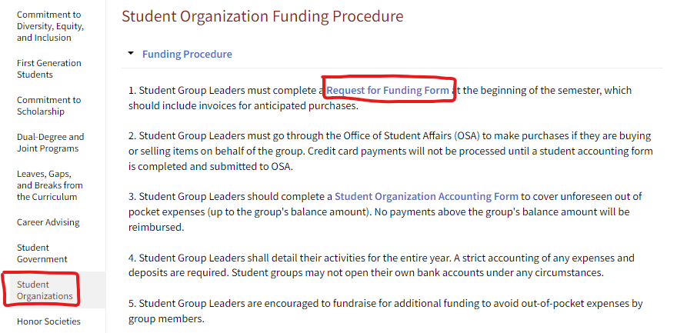
Student Council Funding Form
*Please note that the funding form will only be viewable/accessible during the open submission periods in both the spring and fall.*

Slide 41
Important Dates Summary
March
  Spring funding request
April 30, 2026
  Faculty Advisor Form due
Beginning of September
  Student Activities Fair
September
  Fall funding request
January 2027 (following year)
  Elect new officer positions and transition from M2 to M1 leadership
Notes:
Council – Will need to be updated

