Slide 1


General Surgery
Class of 2026

Slide 2
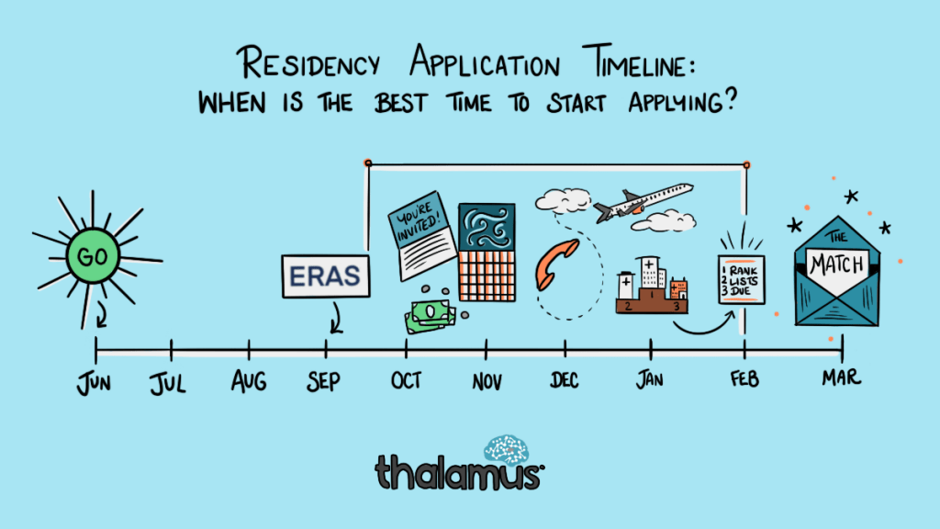


Slide 3
ERAS/NRMP TIMELINE
Date | Activity
Jun 4, 2025 | ERAS season begins
Sep 3, 2025 | Residency applicants may begin submitting applications to programs
Sep 24, 2025 | Residency Application Deadline - Residency programs may begin reviewing applications and MSPEs
End of January | Register for NRMP Match and SOAP
Feb 2, 2026 | Ranking Opens in NRMP
Mar 4, 2026 | Rank Lists Certified
Mar 16 – 20, 2026 | SOAP and MATCH
*Note, these dates are subject to change.
Please reference NRMP and 2026 Main Residency Match Applicants Calendar

Slide 4
Upcoming workshops …
29 Apr.
Developing your Personal Narrative @ 3:30
May–July
OSA 1:1 Advising Sessions
3 June
The Residency Application
15 July
Personal Statement Workshop
19 Aug.
Personal Statement Workshop
Aug
Interview Preparedness + Mock Interviews
Jan
Post-Interview Advising
March
Match Week and SOAP
July 10
Gen Surg ERAS Specialty Spotlight Webinar

Slide 5

What you can be doing now …
Scheduling Tweaks, Away Rotations, Graduation Requirements
Consider Narrative/Brand
Work on your CV (OSA CV Tips)
  to help you prepare for the applications sections
  brainstorm for your experiences/ personal statement
Create a draft of your Personal Statement (OSA PS Guidelines)
Meet with Mentors (OSA, Department, Peers)
Complete the Career Tab on MedScope
Create a preliminary list of programs (recommend once you have Step 2 CK score, class distinction and have discussed competitiveness with your department)

Slide 6
What you can be doing now …
Scheduling Tweaks, Away Rotations, Graduation Requirements
Consider Narrative/Brand
Work on your CV (OSA CV Tips)
  to help you prepare for the applications sections
  brainstorm for your experiences/ personal statement
Create a draft of your Personal Statement (OSA PS Guidelines)
Meet with Mentors (OSA, Department, Peers)
Complete the Career Tab on MedScope
Create a preliminary list of programs (recommend once you have Step 2 CK score, class distinction and have discussed competitiveness with your department)

Slide 7
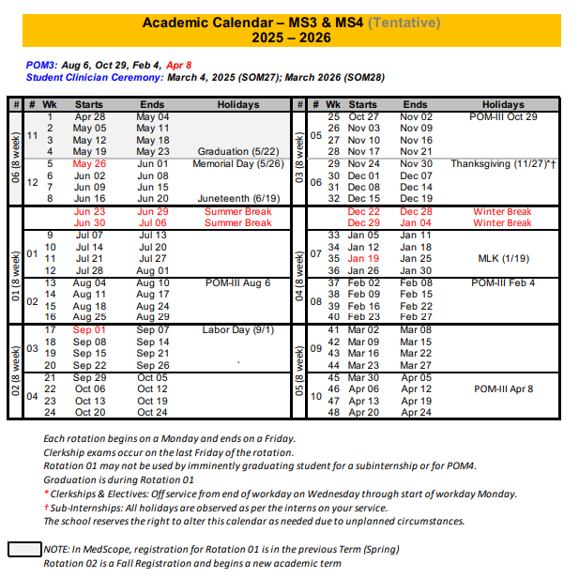
Scheduling, Resources
Course Catalog 2024-2025
Course Catalog 2025-2026
UMSOM Class of 2026
Academic Calendar
Graduation Requirements
Residency Application Manual - UMSOM

Slide 8
A Note on External Rotations (“Aways”)
These are NOT a required component of General Surgery applications
Can have PROS and CONS!
Away rotations MUST BE ADDED AT SOM!!!
Required forms are found on the Student Scheduling Page
Forms should be completed/signed by Departments
Submitted to Add/Drop

Slide 9
UMSOM Graduation Requirements
*NOTE – if you are off cycle, please discuss your graduation requirements with an OSA Faculty member
  Must be completed ONE week prior to graduation ​
  Pass all third-year clerkships, including shelf examinations ​
  Pass ONE 2-week elective (added to the Pediatric Clerkship)​
  Pass TWO sub-internships ​
  Pass FIVE electives ​
    No more than TWO Pre-clerkship elective equivalents may be counted toward the total elective count ​
    Two electives must be on campus (i.e. in our electives catalogue) ​
    Pre-clerkship electives are considered “on campus” ​
  Pass ONE PoM4: Transition to Residency (4 weeks)​
Additional Requirements: Note: these are NOT in addition to the above, but fulfill an above elective or sub-internship requirement.​
Ambulatory Requirement^: one (4-week) of the five above required electives or one (4-week) of the two above required sub-internships must be an Ambulatory rotation (as designated via the "Ambulatory" tab in the course catalog); in addition to the expectations of the elective, students will have designated curricular material to satisfy the ambulatory requirement; this requirement cannot be fulfilled with a pre-clerkship elective.​
Internal Medicine Requirement^: one (4-week) of the five above required electives or one (4-week) of the two above required sub-internships must be in Internal Medicine (as designated via the "Internal Medicine" tab in the course catalog); cannot be fulfilled with a pre-clerkship elective.​
  ^The same rotation cannot fulfill both the Ambulatory and Internal Medicine Requirement.​
★ At least one clinical rotation (as designated via the "Clinical" tab in the course catalog) must be done in the same semester as graduation.

Slide 10
Additional Graduation Requirements
Complete an FRCT Scholarly Project​
1
Pass OSCE ​
2
Take USMLE Step 2: Clinical Knowledge examination​
3
Complete Exit Interview with Financial Aid ​
4

Slide 11
What you can be doing now …
Scheduling Tweaks, Away Rotations, Graduation Requirements
Consider Narrative/Brand
Work on your CV (OSA CV Tips)
  to help you prepare for the applications sections
  brainstorm for your experiences/ personal statement
Create a draft of your Personal Statement (OSA PS Guidelines)
Meet with Mentors (OSA, Department, Peers)
Complete the Career Tab on MedScope
Create a preliminary list of programs (recommend once you have Step 2 CK score, class distinction and have discussed competitiveness with your department)

Slide 12
What you can be doing now …
Scheduling Tweaks, Away Rotations, Graduation Requirements
Consider Narrative/Brand
Work on your CV (OSA CV Tips)
  to help you prepare for the applications sections
  brainstorm for your experiences/ personal statement
Create a draft of your Personal Statement (OSA PS Guidelines)
Meet with Mentors (OSA, Department, Peers)
Complete the Career Tab on MedScope
Create a preliminary list of programs (recommend once you have Step 2 CK score, class distinction and have discussed competitiveness with your department)
General Surgery:
Chair: Christine Lau
PD: Steve Kavic
M4 Advisor: Kim Lumpkins

Slide 13
What you can be doing now …
Scheduling Tweaks, Away Rotations, Graduation Requirements
Consider Narrative/Brand
Work on your CV (OSA CV Tips)
  to help you prepare for the applications sections
  brainstorm for your experiences/ personal statement
Create a draft of your Personal Statement (OSA PS Guidelines)
Meet with Mentors (OSA, Department, Peers)
Complete the Career Tab on MedScope
Create a preliminary list of programs (recommend once you have Step 2 CK score, class distinction and have discussed competitiveness with your department)

Slide 14
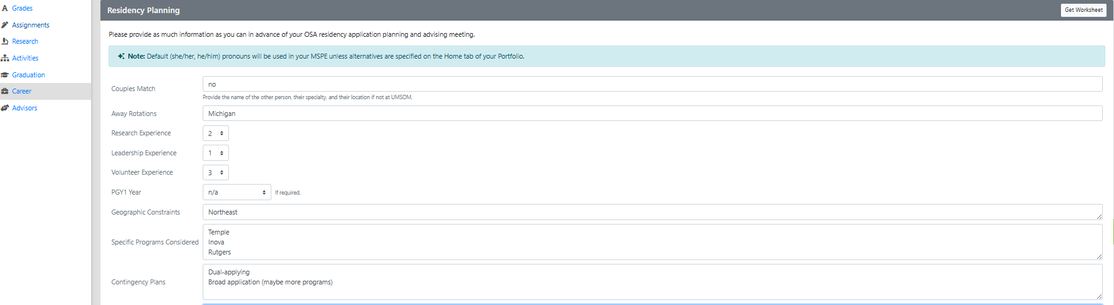
Career Tab (Please complete)

Slide 15
Important Reminders
Confirm name/pronunciation in MedScope as you with for graduation/diploma
Update your Preferred Pronouns in MedScope for the MSPE (if not indicated will default to he/him, she/her)
Update your contact information
Pay it forward, sign up to be an Alumni Mentor (Career Tab, MedScope)
Use the MedScope Interview Tracker to ensure optimal advising!
Consider your brand and ensure social media profiles are professional/clean
Meet with Financial Aid (Sophia Cascio)
Complete Graduation Questionnaire (online through AAMC) – available Jan – May

Slide 16
1:1 Sessions with OSA
These are FOR YOU!
Answer any questions: scheduling, graduation requirements, application logistics
Individualized application guidance
Competitiveness for Specialty
How many programs to apply to
Which programs to apply to
Contingency plans
Discuss your MSPE (Example MSPE)

Slide 17
MSPE
You may review MSPE details, including a sample MSPE, here: The MSPE
*Be prepared to discuss any deviations from the traditional 4-year curriculum
*Be prepared to discuss any hardships (e.g. personal medical condition, bereavement, or other extenuating circumstance that may have had a negative effect on academic performance) if you wish to consider for inclusion in the MSPE
* This is NOT a letter for recommendation
Note:
  AOA nominations will be noted in the MSPEs Noteworthy Characteristics and in the summary paragraph
  GHHS membership will be noted in the MSPEs Professional Performance section and in the summary paragraph

Slide 18
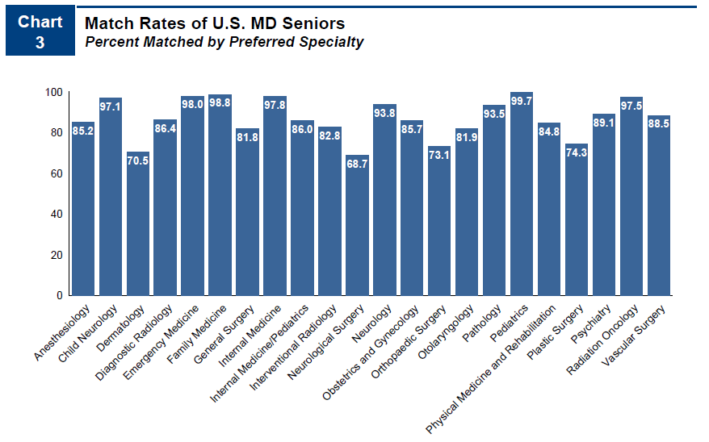
Competitiveness of Specialty
82 % Match Rate
More unfilled prelim gen surg surgery positions in SOAP
Rare categorical gen surg
NRMP Charting outcomes for the Match, 2024
https://www.nrmp.org/match-data/2024/08/charting-outcomes-characteristics-of-u-s-md-seniors-who-matched-to-their-preferred-specialty-2024-main-residency-match/

Slide 19
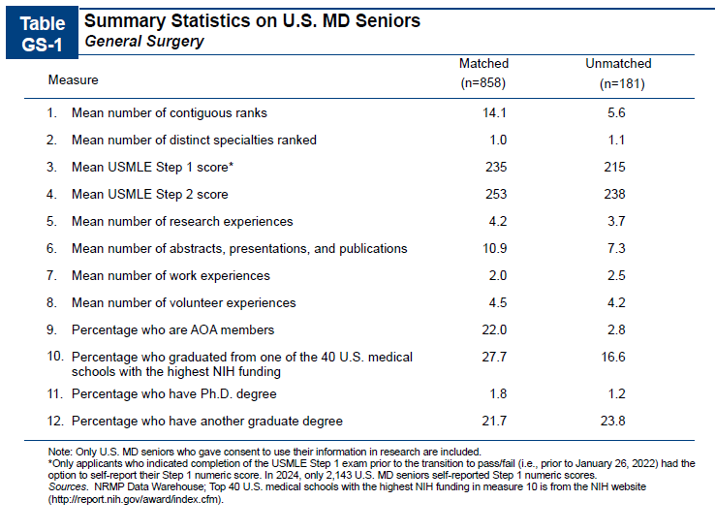
NRMP Charting outcomes for the Match, 2024
https://www.nrmp.org/match-data/2024/08/charting-outcomes-characteristics-of-u-s-md-seniors-who-matched-to-their-preferred-specialty-2024-main-residency-match/

Slide 20
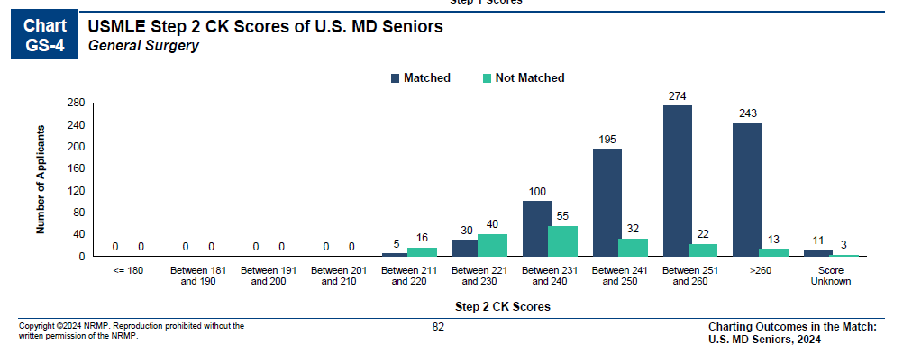
More on goals for Step 2 …
NRMP Charting outcomes for the Match, 2024
https://www.nrmp.org/match-data/2024/08/charting-outcomes-characteristics-of-u-s-md-seniors-who-matched-to-their-preferred-specialty-2024-main-residency-match/

Slide 21
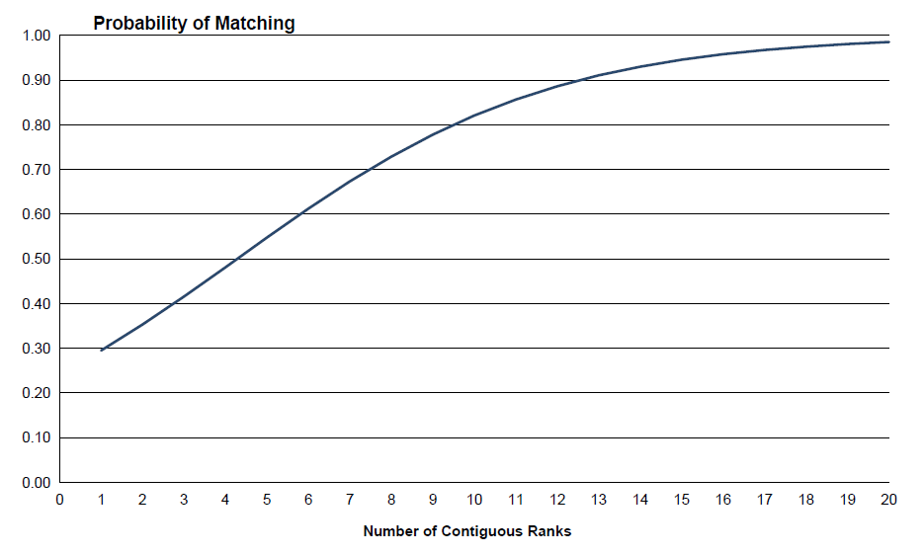
How many programs to apply to…
Students at UMSOM applying to primarily GENERAL SURGERY applied to on average 57 programs to secure an average of 16 interviews in 2025. Note, this includes students from all class ranks and range of step scores.
Year | Average Applications GENERAL SURGERY | National AAMC data Total vs MD- Public Schools
2025 | 57 | - | -
2024 | 104 | 75 | 72
2023 | 82 | 79 | 77
2022 | 55 | 72 | 70
https://www.nrmp.org/match-data/2024/08/charting-outcomes-characteristics-of-u-s-md-seniors-who-matched-to-their-preferred-specialty-2024-main-residency-match/
https://www.aamc.org/data-reports/data/eras-statistics-data

Slide 22
Department | Surgery – General
Contacts (R = Required to Meet)
Chair | Christine Lau
Program Director | Steve Kavic/R
MSIV Advising | Kim Lumpkins /R
Other | Eric Strauch/R
 | Christina Paluskievicz
Competitive Applicant
Class Rank | All
Step 2 (goal) | 250
 | Recommend all students apply to UMMC Gen Surg Prelim
Preliminary Year | Not Applicable
Away Rotations
Expectations | Not Expected
Ideal Number | N/A
Letters of Reference
Total Number | 3
Chair Letter | Required
Ideal Make UP | Chair (all students meet with Dr. Kavic who co-writes Chair letter with Dr. Lau) Departmental Faculty Departmental Faculty

Slide 23
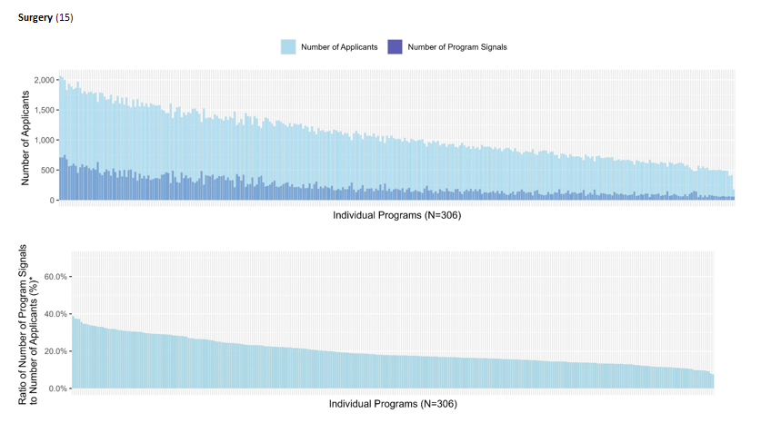
Signaling
15 program signals for General Surgery
Geographic Signaling
An average of 24% of signals were sent to 10% of programs in General Surgery
UMSOM had a 54% hit rate on 5 Signals 2025
  An average of 8 hits from 15 signals
https://www.aamc.org/data-reports/data/eras-statistics-data

Slide 24
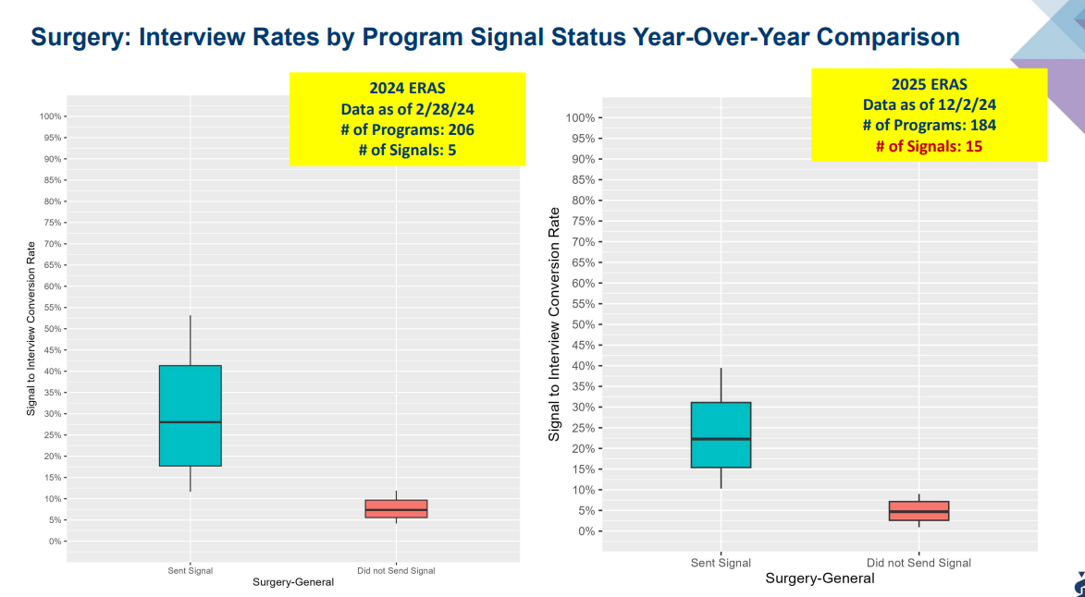
https://www.aamc.org/data-reports/data/eras-statistics-data

Slide 25
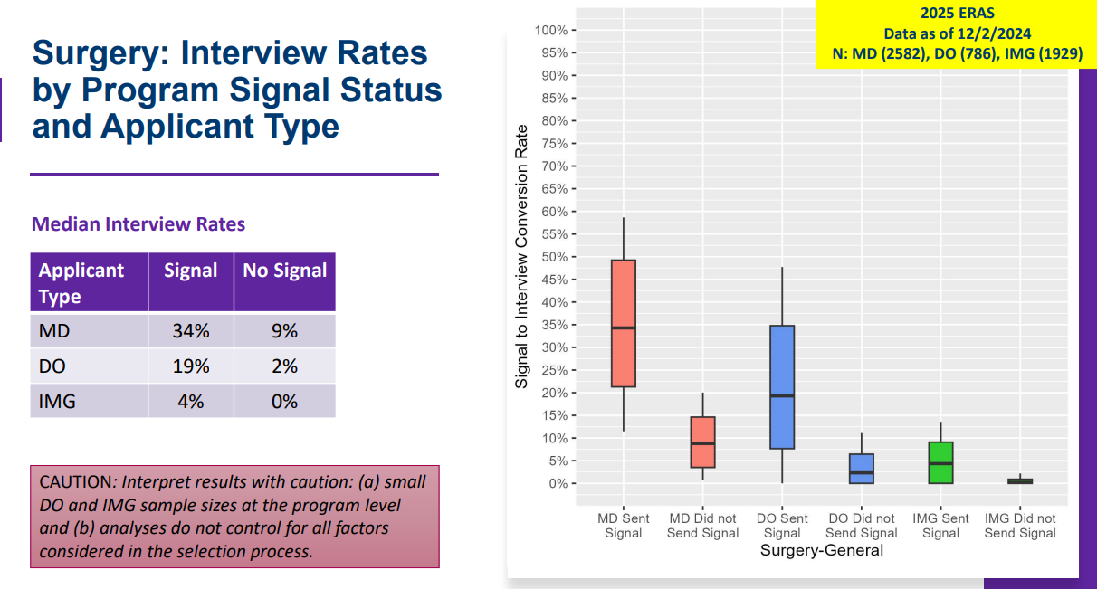
https://www.aamc.org/data-reports/data/eras-statistics-data

Slide 26
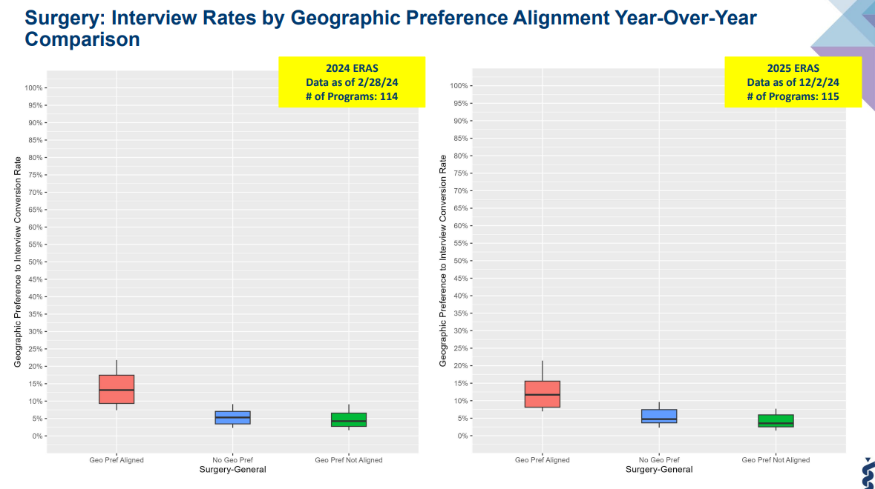
https://www.aamc.org/data-reports/data/eras-statistics-data

Slide 27
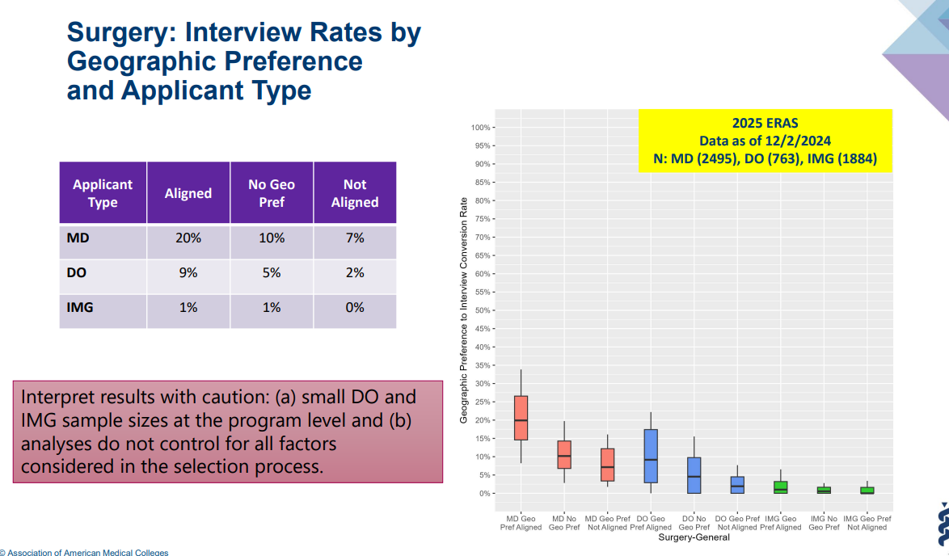
https://www.aamc.org/data-reports/data/eras-statistics-data

Slide 28
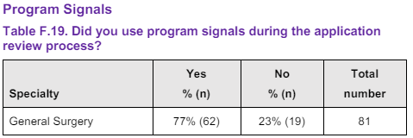
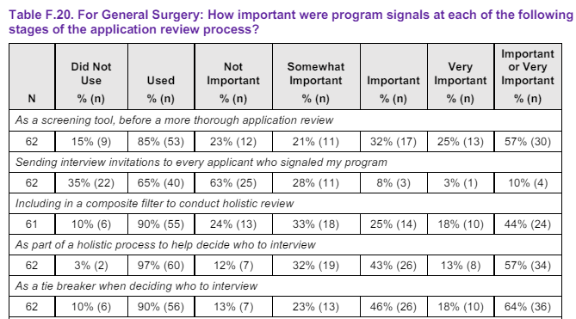
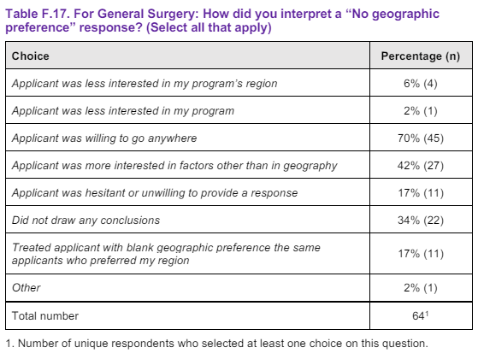
Results of the Program Director Survey 2022-2023 Application Cycle
https://www.aamc.org/media/64996/download

Slide 29
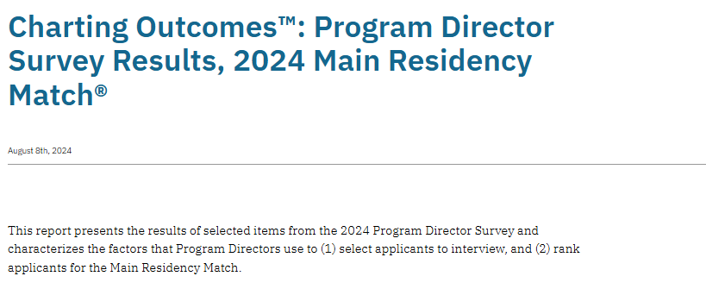
https://www.nrmp.org/match-data/2024/08/charting-outcomes-program-director-survey-results-main-residency-match/

Slide 30
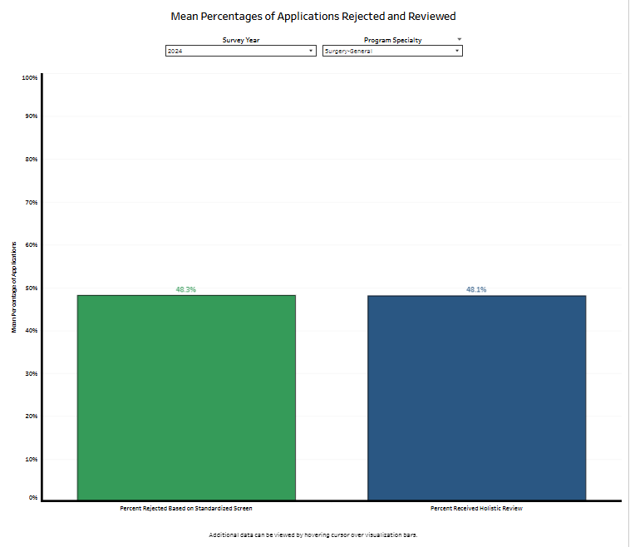
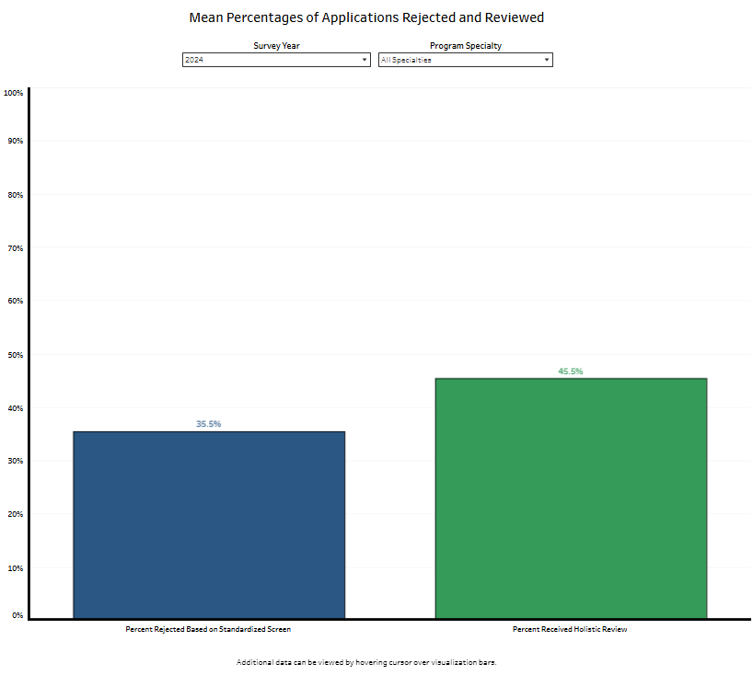
Rejection and Review of Applications
https://www.nrmp.org/match-data/2024/08/charting-outcomes-program-director-survey-results-main-residency-match/

Slide 31
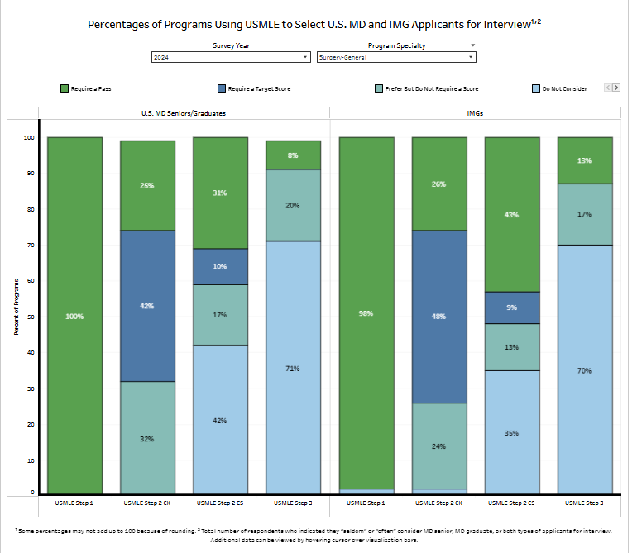
https://www.nrmp.org/match-data/2024/08/charting-outcomes-program-director-survey-results-main-residency-match/

Slide 32
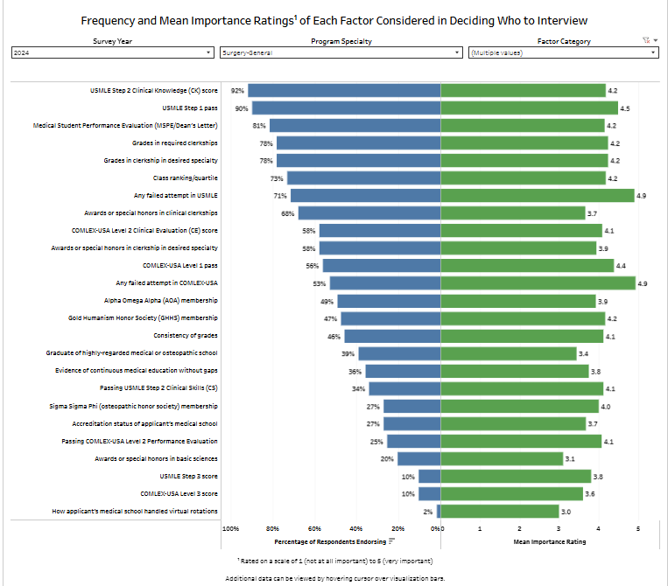
Education and Performance and Standardized Licensure Tests
https://www.nrmp.org/match-data/2024/08/charting-outcomes-program-director-survey-results-main-residency-match/

Slide 33
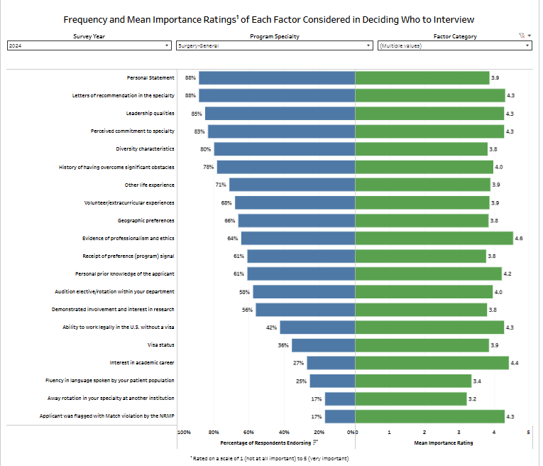
Other Knowledge and Personal Qualities
https://www.nrmp.org/match-data/2024/08/charting-outcomes-program-director-survey-results-main-residency-match/

Slide 34
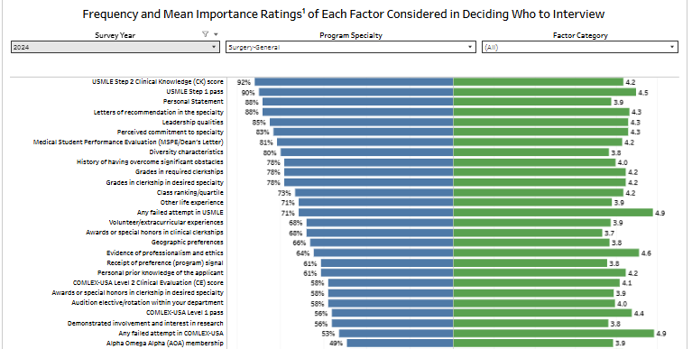
All factors combined with > 50% endorsement
https://www.nrmp.org/match-data/2024/08/charting-outcomes-program-director-survey-results-main-residency-match/

Slide 35
Contingency Planning
All students applying to General Surgery should apply to the UMMC General Surgery PRELIMARY program
Some students may need a contingency
Apply to the right #/mix of programs
Rank ALL programs you interview at
Be PROACTIVE – communicate with OSA
Update the MedScope tracker
Geographical constraints – Prelim Gen Surg Application?
SOAP is NOT a great contingency plan
More pre-lim general surgery unfilled programs in SOAP
Rare or zero categorical General Surgery

Slide 36
What you can be doing now …
Scheduling Tweaks, Away Rotations, Graduation Requirements
Consider Narrative/Brand
Work on your CV (OSA CV Tips)
  to help you prepare for the applications sections
  brainstorm for your experiences/ personal statement
Create a draft of your Personal Statement (OSA PS Guidelines)
Meet with Mentors (OSA, Department, Peers)
Complete the Career Tab on MedScope
Create a preliminary list of programs (recommend once you have Step 2 CK score, class distinction and have discussed competitiveness with your department)

Slide 37
Which Programs to apply to:
FREIDA is a really great tool that can help you look at accredited programs by specialty in different regions around the country. https://freida.ama-assn.org/Freida/#/
AAMC Residency Explorer is a useful tool in assessing your competitiveness at particular programs: https://www.residencyexplorer.org/Account/Login
MedScope Data *We will review together – this data allows you to see where you stand as a student at UMSOM
Departmental Advisors (as well as faculty advisors, and senior students) are another key source of program information

Slide 38
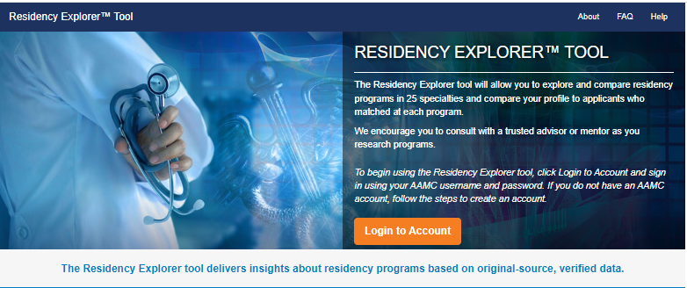
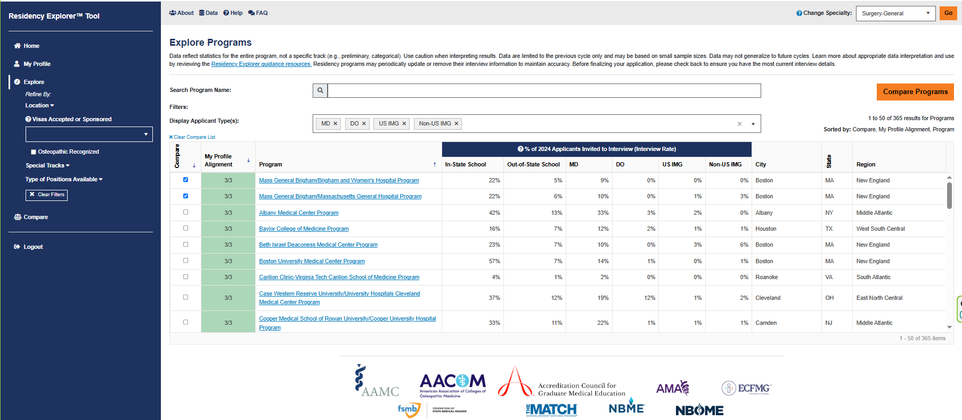
Residency Explorer

Slide 39
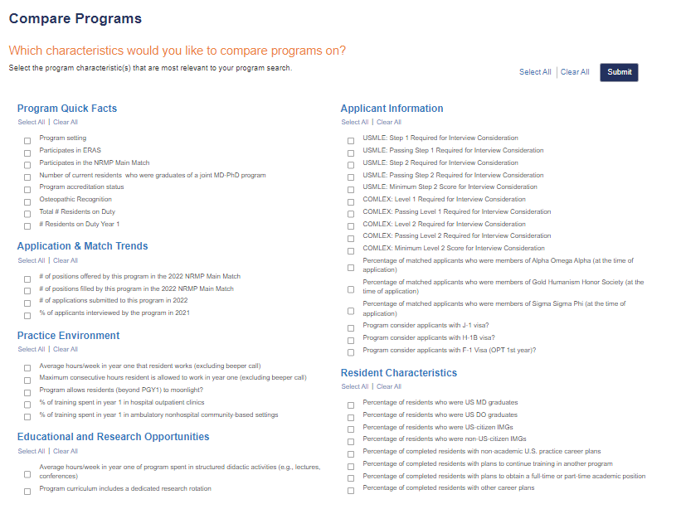

Slide 40
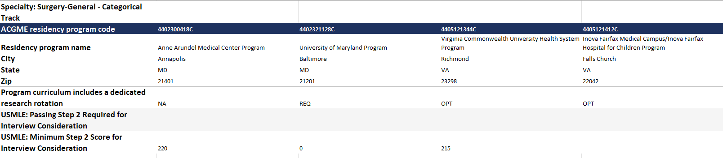
Compare Programs

Slide 41
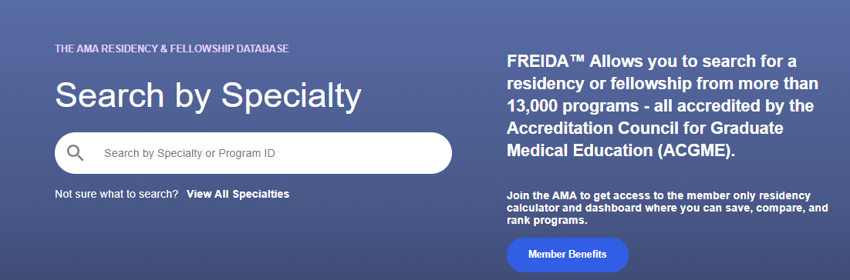
Frieda
Tag Specialty
Location
Program Type
  University Based
  Community Based/University Affiliated
  Community Based
Special Tracts
Map Feature
Overview
  Length
  Affiliated Programs
Program and Work Schedule
  Size of program
  Step 1 and 2 data
  Work schedule/Call
  % USMD and gender
Features and Benefits
  Compensation
  Offers additional training or educational experience beyond accredited length
  Off campus electives

Slide 42
