Slide 1

Family Medicine
Class of 2026

Slide 2
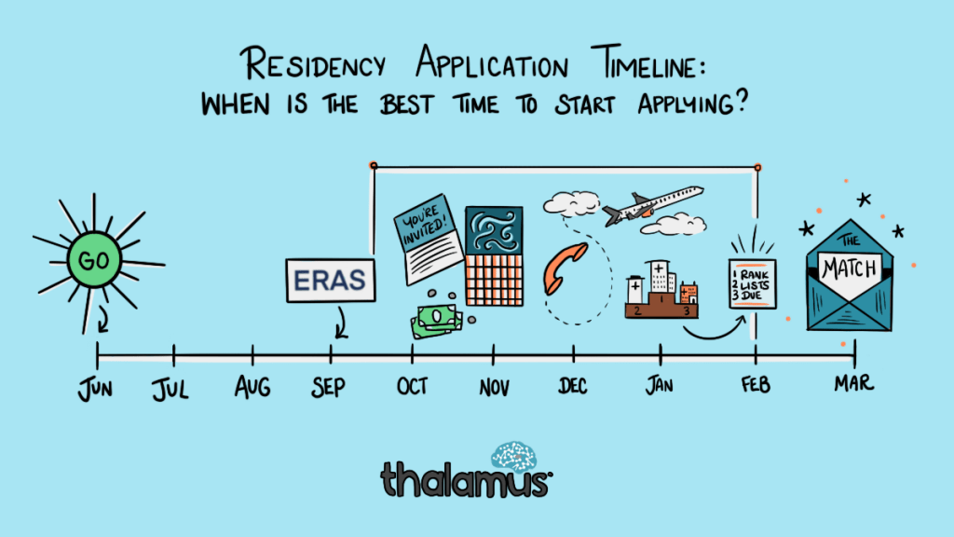


Slide 3
ERAS/NRMP TIMELINE
Date | Activity
Jun 4, 2025 | ERAS season begins
Sep 3, 2025 | Residency applicants may begin submitting applications to programs
Sep 24, 2025 | Residency Application Deadline - Residency programs may begin reviewing applications and MSPEs
End of January | Register for NRMP Match and SOAP
Feb 2, 2026 | Ranking Opens in NRMP
Mar 4, 2026 | Rank Lists Certified
Mar 16 – 20, 2026 | SOAP and MATCH
*Note, these dates are subject to change.
Please reference NRMP and 2026 Main Residency Match Applicants Calendar

Slide 4



Slide 5
Upcoming workshops …
29 Apr.
Developing your Personal Narrative @ 3:30
May–July
OSA 1:1 Advising Sessions
3 June
The Residency Application
15 July
Personal Statement Workshop
19 Aug.
Personal Statement Workshop
Aug
Interview Preparedness + Mock Interviews
Jan
Post-Interview Advising
March
Match Week and SOAP
July 8
FM ERAS Specialty Spotlight Webinar

Slide 6

What you can be doing now …
Scheduling Tweaks, Away Rotations, Graduation Requirements
Consider Narrative/Brand
Work on your CV (OSA CV Tips)
  to help you prepare for the applications sections
  brainstorm for your experiences/ personal statement
Create a draft of your Personal Statement (OSA PS Guidelines)
Meet with Mentors (OSA, Department, Peers)
Complete the Career Tab on MedScope
Create a preliminary list of programs (recommend once you have Step 2 CK score, class distinction and have discussed competitiveness with your department)

Slide 7
What you can be doing now …
Scheduling Tweaks, Away Rotations, Graduation Requirements
Consider Narrative/Brand
Work on your CV (OSA CV Tips)
  to help you prepare for the applications sections
  brainstorm for your experiences/ personal statement
Create a draft of your Personal Statement (OSA PS Guidelines)
Meet with Mentors (OSA, Department, Peers)
Complete the Career Tab on MedScope
Create a preliminary list of programs (recommend once you have Step 2 CK score, class distinction and have discussed competitiveness with your department)

Slide 8
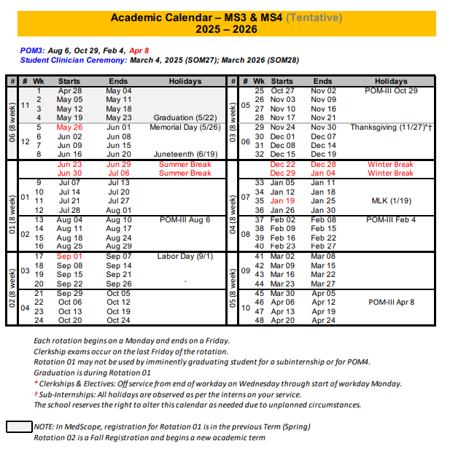
Scheduling, Resources
Course catalog 2024-2025
https://medscope.umaryland.edu/catalog/2025-2026/
UMSOM Class of 2026
Academic Calendar
Graduation Requirements

Slide 9
A Note on External Rotations (“Aways”)
These are NOT a required component of Family Medicine applications
Can have PROS and CONS!
Away rotations MUST BE ADDED AT SOM!!!
Required forms are found on the Student Scheduling Page
Forms should be completed/signed by Departments
Submitted to Add/Drop

Slide 10
UMSOM Graduation Requirements
*NOTE – if you are off cycle, please discuss your graduation requirements with an OSA Faculty member
  Must be completed ONE week prior to graduation ​
  Pass all third-year clerkships, including shelf examinations ​
  Pass ONE 2-week elective (added to the Pediatric Clerkship)​
  Pass TWO sub-internships ​
  Pass FIVE electives ​
    No more than TWO Pre-clerkship elective equivalents may be counted toward the total elective count ​
    Two electives must be on campus (i.e. in our electives catalogue) ​
    Pre-clerkship electives are considered “on campus” ​
  Pass ONE PoM4: Transition to Residency (4 weeks)​
Additional Requirements: Note: these are NOT in addition to the above, but fulfill an above elective or sub-internship requirement.​
Ambulatory Requirement^: one (4-week) of the five above required electives or one (4-week) of the two above required sub-internships must be an Ambulatory rotation (as designated via the "Ambulatory" tab in the course catalog); in addition to the expectations of the elective, students will have designated curricular material to satisfy the ambulatory requirement; this requirement cannot be fulfilled with a pre-clerkship elective.​
Internal Medicine Requirement^: one (4-week) of the five above required electives or one (4-week) of the two above required sub-internships must be in Internal Medicine (as designated via the "Internal Medicine" tab in the course catalog); cannot be fulfilled with a pre-clerkship elective.​
  ^The same rotation cannot fulfill both the Ambulatory and Internal Medicine Requirement.​
★ At least one clinical rotation (as designated via the "Clinical" tab in the course catalog) must be done in the same semester as graduation.

Slide 11
Additional Graduation Requirements
Complete an FRCT Scholarly Project​
1
Pass OSCE ​
2
Take USMLE Step 2: Clinical Knowledge examination​
3
Complete Exit Interview with Financial Aid ​
4

Slide 12
What you can be doing now …
Scheduling Tweaks, Away Rotations, Graduation Requirements
Consider Narrative/Brand
Work on your CV (OSA CV Tips)
  to help you prepare for the applications sections
  brainstorm for your experiences/ personal statement
Create a draft of your Personal Statement (OSA PS Guidelines)
Meet with Mentors (OSA, Department, Peers)
Complete the Career Tab on MedScope
Create a preliminary list of programs (recommend once you have Step 2 CK score, class distinction and have discussed competitiveness with your department)

Slide 13
What you can be doing now …
Scheduling Tweaks, Away Rotations, Graduation Requirements
Consider Narrative/Brand
Work on your CV (OSA CV Tips)
  to help you prepare for the applications sections
  brainstorm for your experiences/ personal statement
Create a draft of your Personal Statement (OSA PS Guidelines)
Meet with Mentors (OSA, Department, Peers)
Complete the Career Tab on MedScope
Create a preliminary list of programs (recommend once you have Step 2 CK score, class distinction and have discussed competitiveness with your department)
Family Medicine:
Chair: David Stewart
PD: Kyle Flekte
M4 Advisor: Kate Jacobson

Slide 14
What you can be doing now …
Scheduling Tweaks, Away Rotations, Graduation Requirements
Consider Narrative/Brand
Work on your CV (OSA CV Tips)
  to help you prepare for the applications sections
  brainstorm for your experiences/ personal statement
Create a draft of your Personal Statement (OSA PS Guidelines)
Meet with Mentors (OSA, Department, Peers)
Complete the Career Tab on MedScope
Create a preliminary list of programs (recommend once you have Step 2 CK score, class distinction and have discussed competitiveness with your department)

Slide 15
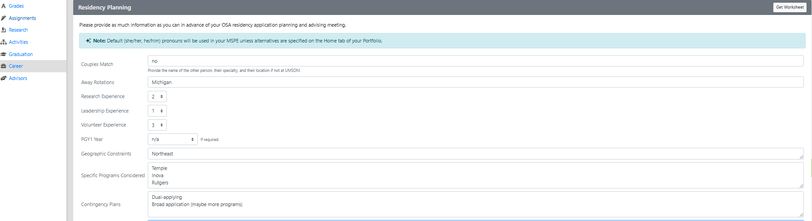
Career Tab (Please complete)

Slide 16
Important Reminders
Confirm name/pronunciation in MedScope as you with for graduation/diploma
Update your Preferred Pronouns in MedScope for the MSPE (if not indicated will default to he/him, she/her)
Update your contact information
Pay it forward, sign up to be an Alumni Mentor (Career Tab, MedScope)
Use the MedScope Interview Tracker to ensure optimal advising!
Consider your brand and ensure social media profiles are professional/clean
Meet with Financial Aid (Sophia Cascio)
Complete Graduation Questionnaire (online through AAMC) – available Jan – May

Slide 17
1:1 Sessions with OSA
These are FOR YOU!
Answer any questions: scheduling, graduation requirements, application logistics
Individualized application guidance
Competitiveness for Specialty
How many programs to apply to
Which programs to apply to
Contingency plans
Discuss your MSPE (Example MSPE)

Slide 18
MSPE
You may review MSPE details, including a sample MSPE, here: The MSPE
*Be prepared to discuss any deviations from the traditional 4-year curriculum
*Be prepared to discuss any hardships (e.g. personal medical condition, bereavement, or other extenuating circumstance that may have had a negative effect on academic performance) if you wish to consider for inclusion in the MSPE
* This is NOT a letter for recommendation
Note:
  AOA nominations will be noted in the MSPEs Noteworthy Characteristics and in the summary paragraph
  GHHS membership will be noted in the MSPEs Professional Performance section and in the summary paragraph

Slide 19
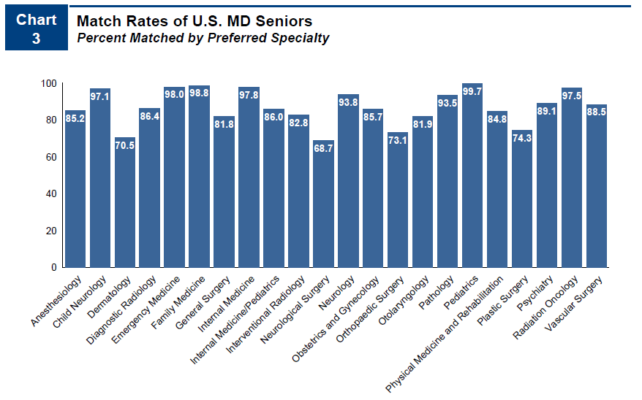
Competitiveness of Specialty
98.8 % Match Rate
Some unfilled positions in the match
NRMP Charting outcomes for the Match, 2024
https://www.nrmp.org/match-data/2024/08/charting-outcomes-characteristics-of-u-s-md-seniors-who-matched-to-their-preferred-specialty-2024-main-residency-match/

Slide 20
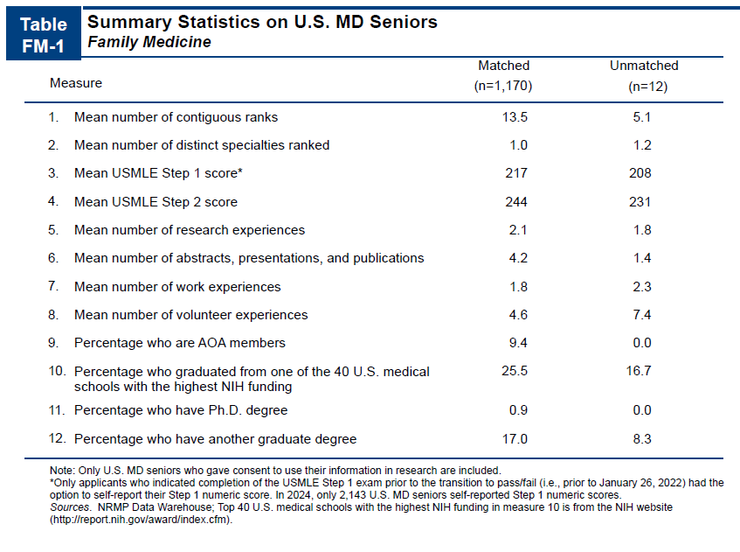
https://www.nrmp.org/wp-content/uploads/2021/08/Charting-Outcomes-in-the-Match-2020_MD-Senior_final.pdf
NRMP Charting outcomes for the Match, 2024
https://www.nrmp.org/match-data/2024/08/charting-outcomes-characteristics-of-u-s-md-seniors-who-matched-to-their-preferred-specialty-2024-main-residency-match/

Slide 21
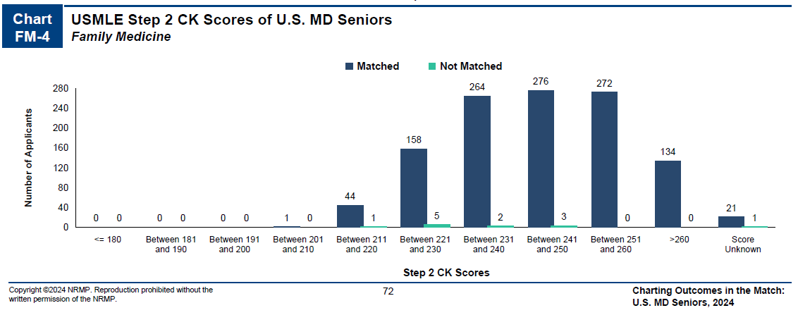
More on targets for Step 2 …
NRMP Charting outcomes for the Match, 2024
https://www.nrmp.org/match-data/2024/08/charting-outcomes-characteristics-of-u-s-md-seniors-who-matched-to-their-preferred-specialty-2024-main-residency-match/

Slide 22
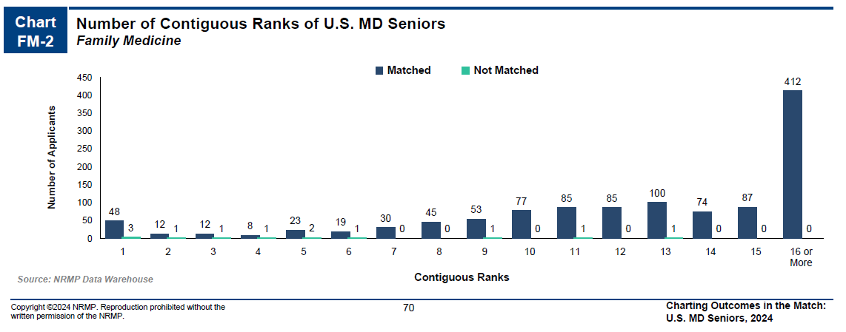
How many programs to apply to…
Students at UMSOM applying primarily to FAMILY MEDICINE applied to on average 32 programs in 2025 to secure an average of 23, Note, this includes students from all class distinctions and range of step scores.
Year | Average Applications | National AAMC Data (MD
2025 | 32 | 31
2024 | 45 | 31
2023 | 54 | 33
2022 | 41 | 36
2021 | 28 | 37
https://www.nrmp.org/match-data/2024/08/charting-outcomes-characteristics-of-u-s-md-seniors-who-matched-to-their-preferred-specialty-2024-main-residency-match/
https://www.aamc.org/data-reports/data/eras-statistics-data

Slide 23
Department | FAMILY MEDICINE
Contacts (R = Required to Meet)
Chair | David Stewart
Program Director | Kyle Fletke/R
MSIV Advising | Kate Jacobson
Other | Nel Trasybule
 | Amoreena Howell
Competitive Applicant
Class Rank | All
Step 2 (goal) | 240s
Preliminary Year | Not Applicable
Away Rotations
Expectations | Not Expected
Ideal Number | N/A
Letters of Reference
Total Number | 3
Chair Letter | NOT Required
Ideal Make Up | FM Faculty
 | Other – OR - FM Faculty
 | Other / Any

Slide 24
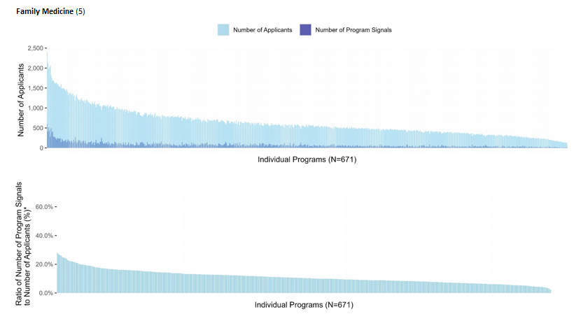
Signaling
5 program signals for Family Medicine
Geographic Signaling
An average of 29% of signals were sent to 10% of programs in Family Medicine
UMSOM had an 82% hit rate on 5 Signals in 2025
https://www.aamc.org/data-reports/data/eras-statistics-data

Slide 25
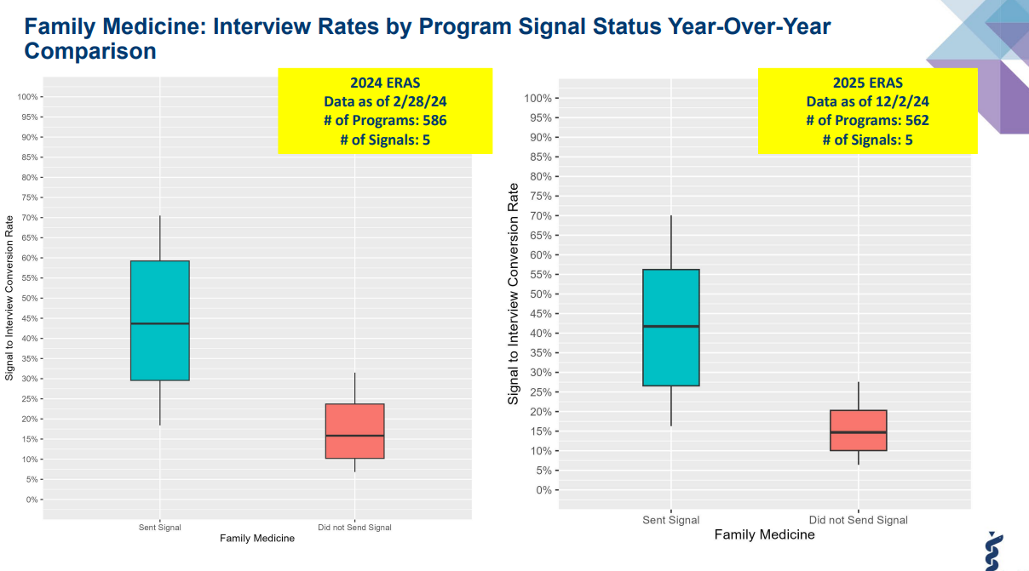
https://www.aamc.org/data-reports/data/eras-statistics-data

Slide 26
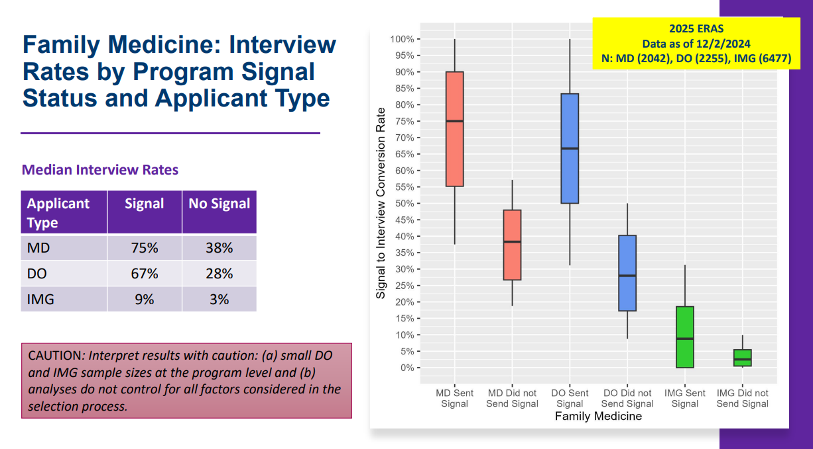
https://www.aamc.org/data-reports/data/eras-statistics-data

Slide 27
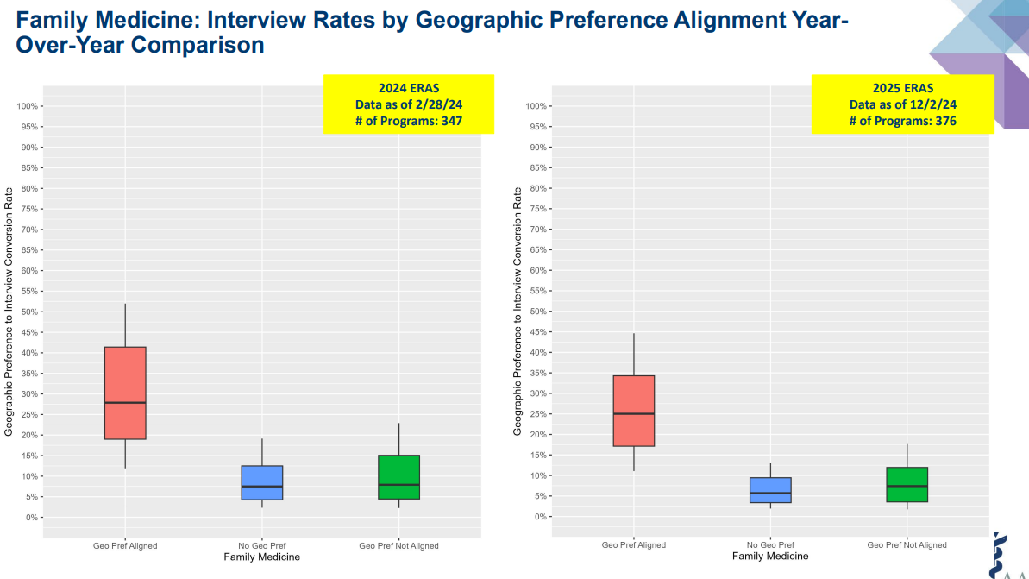
https://www.aamc.org/data-reports/data/eras-statistics-data

Slide 28
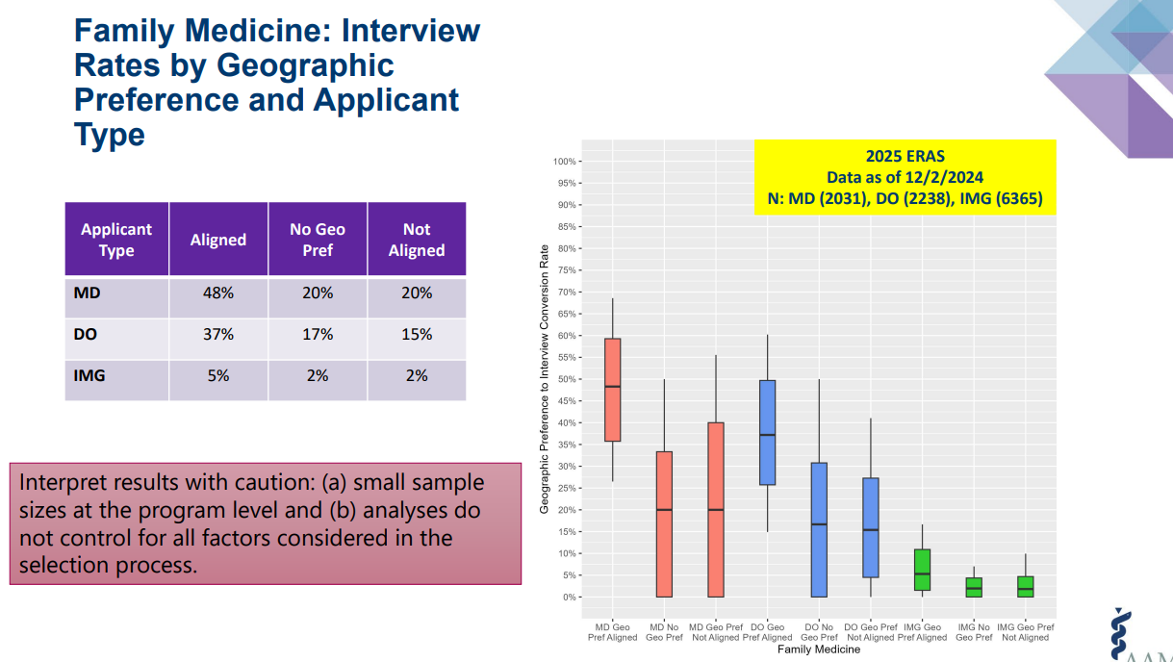
https://www.aamc.org/data-reports/data/eras-statistics-data

Slide 29
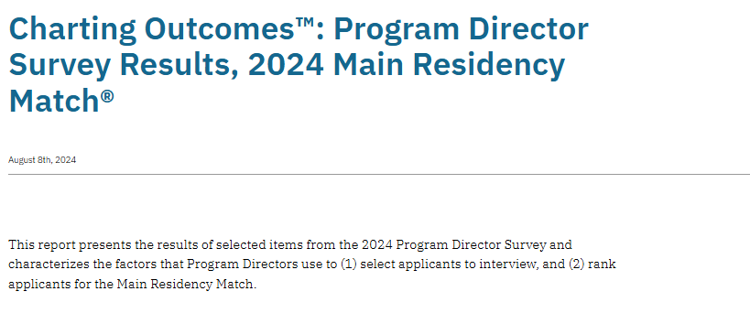
https://www.nrmp.org/match-data/2024/08/charting-outcomes-program-director-survey-results-main-residency-match/

Slide 30
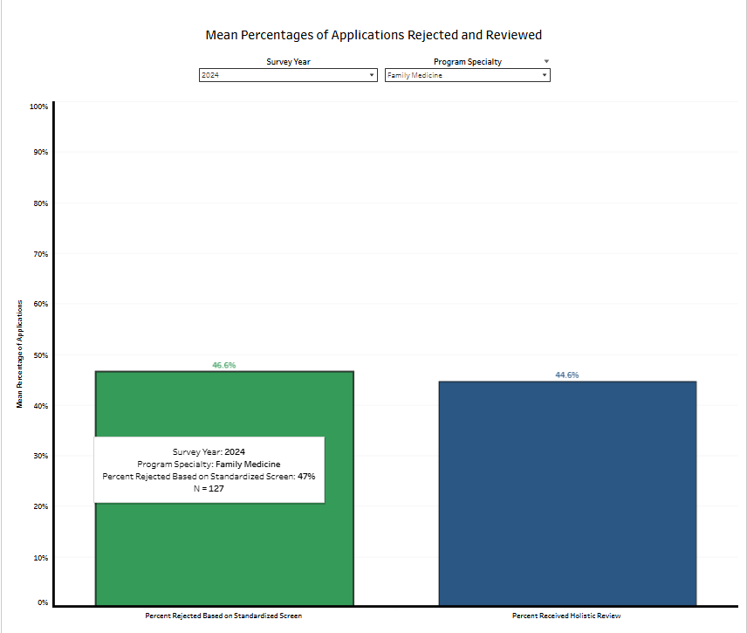
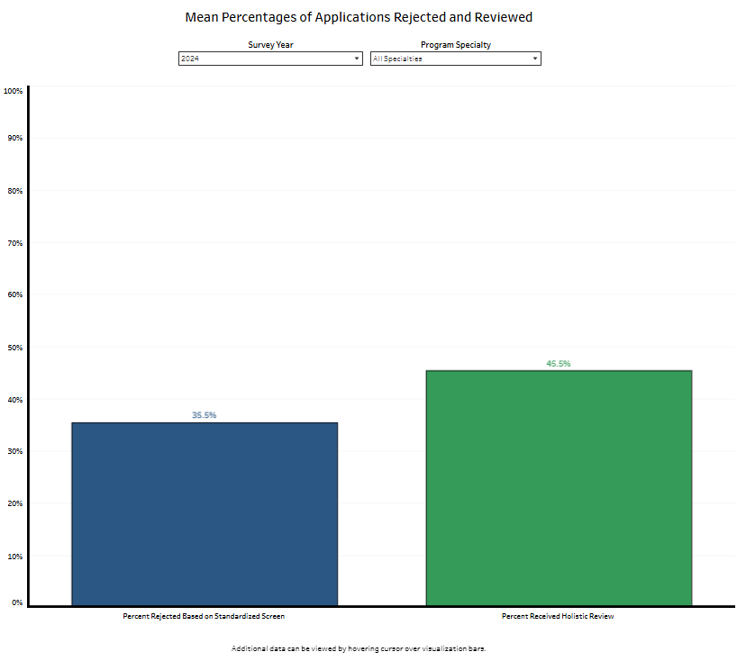
Rejection and Review of Applications
https://www.nrmp.org/match-data/2024/08/charting-outcomes-program-director-survey-results-main-residency-match/

Slide 31
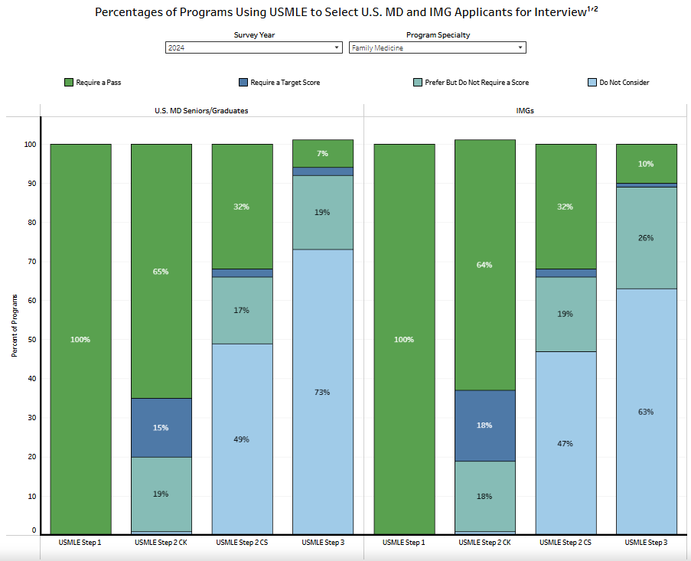
https://www.nrmp.org/match-data/2024/08/charting-outcomes-program-director-survey-results-main-residency-match/

Slide 32
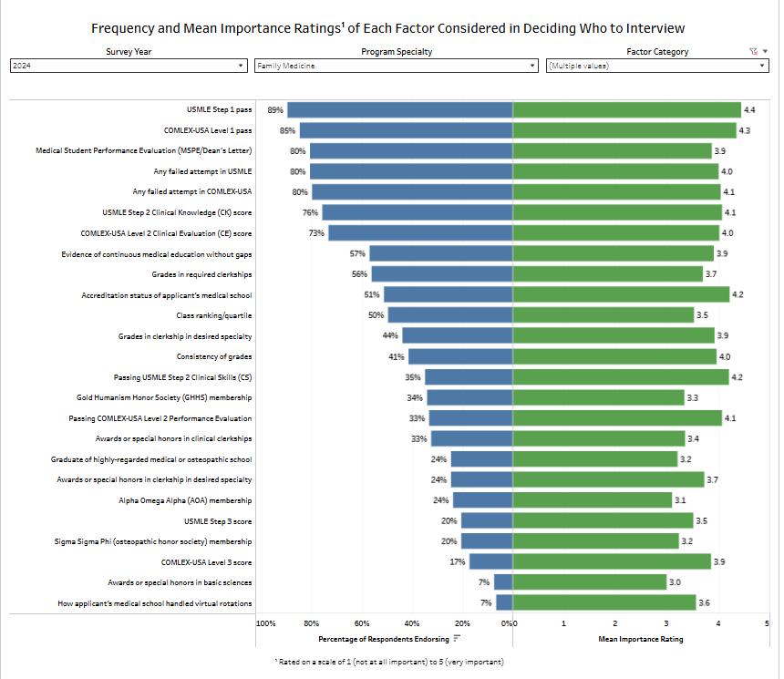
Education and Performance and Standardized Licensure Tests
https://www.nrmp.org/match-data/2024/08/charting-outcomes-program-director-survey-results-main-residency-match/

Slide 33
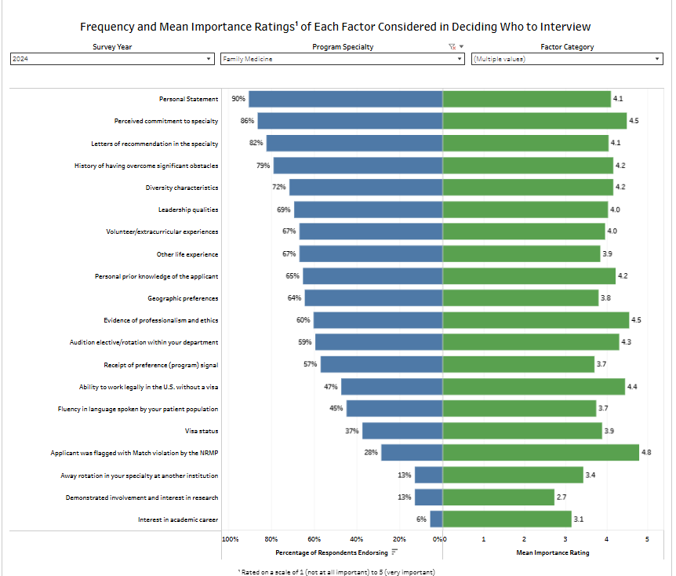
Other Knowledge and Personal Qualities
https://www.nrmp.org/match-data/2024/08/charting-outcomes-program-director-survey-results-main-residency-match/

Slide 34
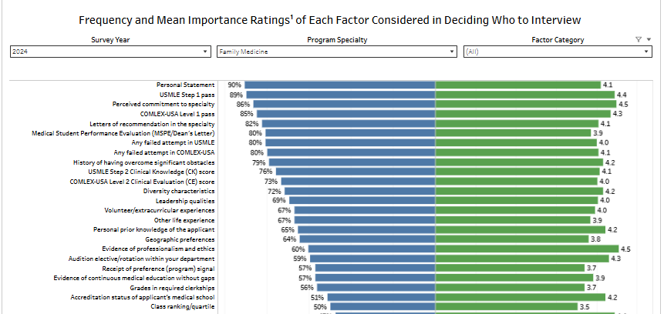
All factors combined with > 50% endorsement
https://www.nrmp.org/match-data/2024/08/charting-outcomes-program-director-survey-results-main-residency-match/

Slide 35
Contingency Planning
Some students may need a contingency
Apply to the right #/mix of programs
Rank ALL programs you interview at
Be PROACTIVE – communicate with OSA
Update the MedScope tracker
Geographical constraints – Dual Application?
SOAP is NOT a great contingency plan
More unfilled programs in SOAP

Slide 36
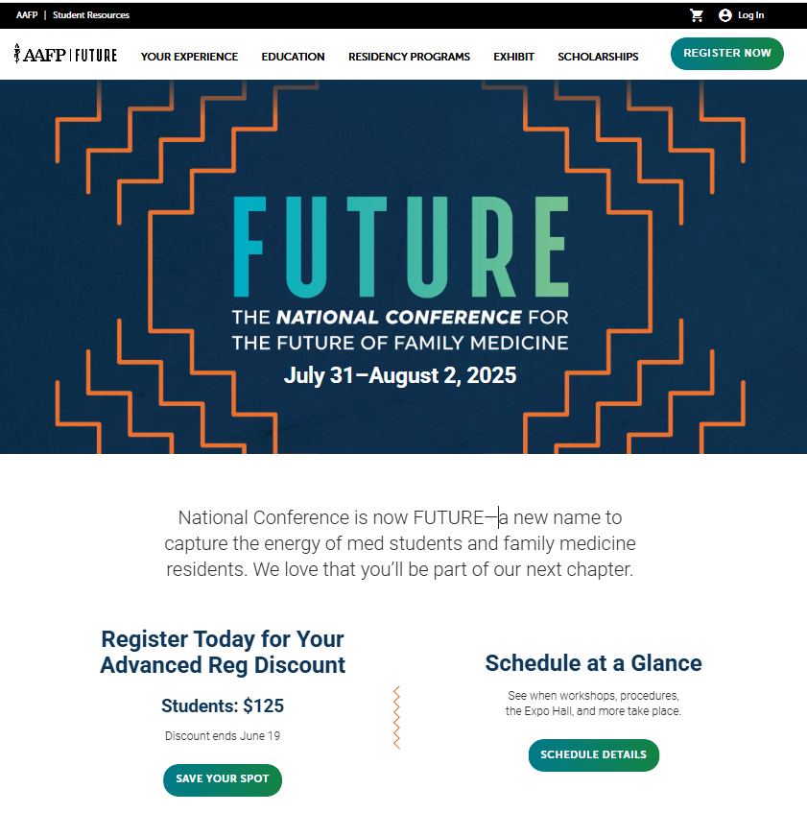

Slide 37
What you can be doing now …
Scheduling Tweaks, Away Rotations, Graduation Requirements
Consider Narrative/Brand
Work on your CV (OSA CV Tips)
  to help you prepare for the applications sections
  brainstorm for your experiences/ personal statement
Create a draft of your Personal Statement (OSA PS Guidelines)
Meet with Mentors (OSA, Department, Peers)
Complete the Career Tab on MedScope
Create a preliminary list of programs (recommend once you have Step 2 CK score, class distinction and have discussed competitiveness with your department)

Slide 38
Which Programs to apply to:
FREIDA is a really great tool that can help you look at accredited programs by specialty in different regions around the country. https://freida.ama-assn.org/Freida/#/
AAMC Residency Explorer is a useful tool in assessing your competitiveness at particular programs: https://www.residencyexplorer.org/Account/Login
MedScope Data *We will review together – this data allows you to see where you stand as a student at UMSOM
Departmental Advisors (as well as faculty advisors, and senior students) are another key source of program information

Slide 39
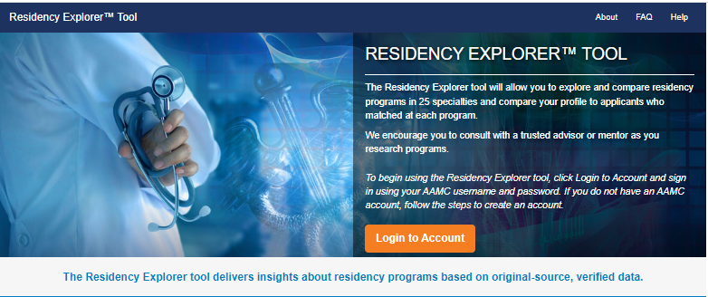
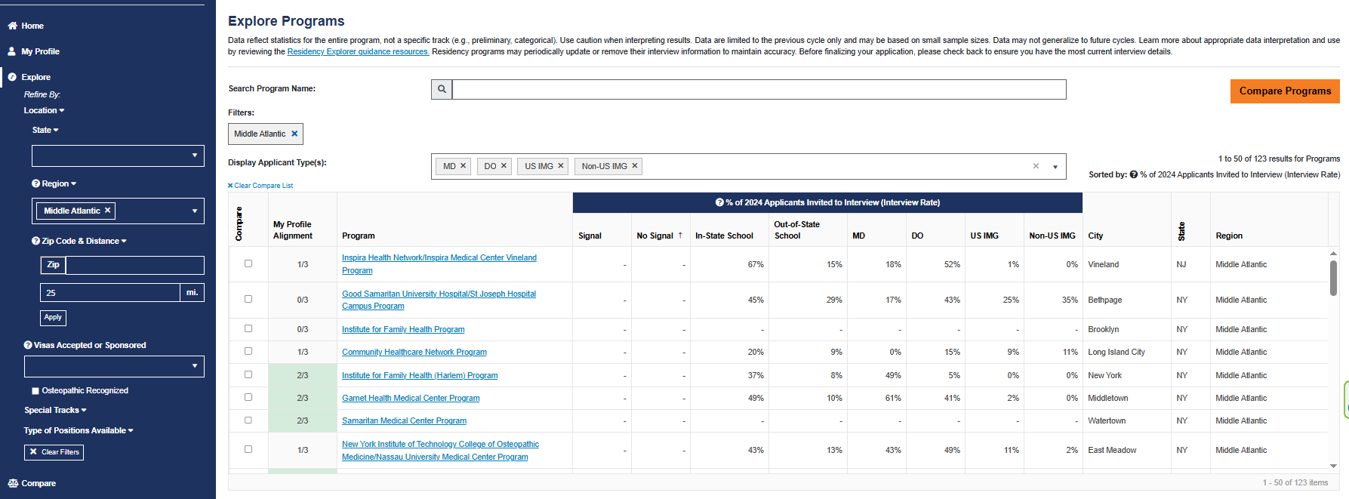
Residency Explorer

Slide 40
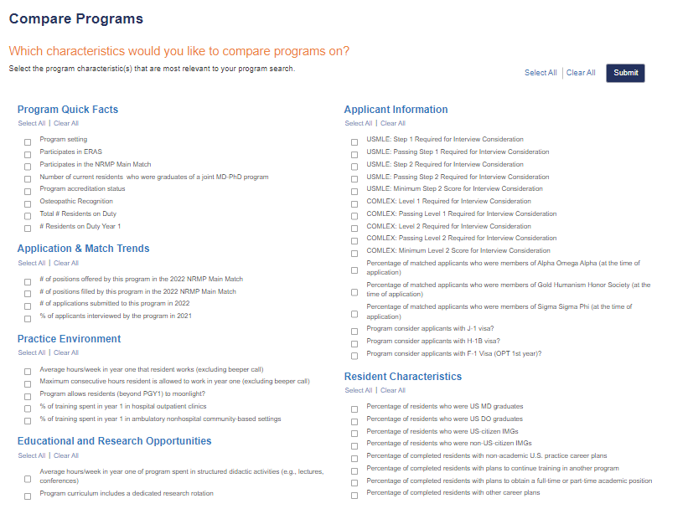

Slide 41
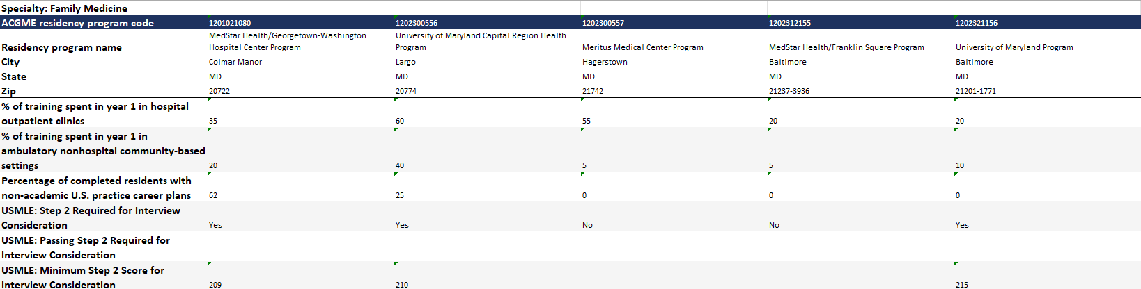
Compare Programs

Slide 42
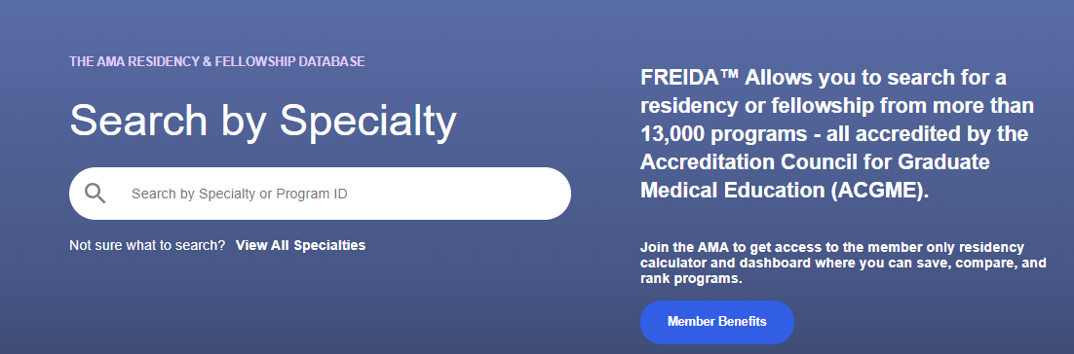
Frieda
Tag Specialty
Location
Program Type
  University Based
  Community Based/University Affiliated
  Community Based
Special Tracts
Map Feature
Overview
  Length
  Affiliated Programs
Program and Work Schedule
  Size of program
  Step 1 and 2 data
  Work schedule/Call
  % USMD and gender
Features and Benefits
  Compensation
  Offers additional training or educational experience beyond accredited length
  Off campus electives

Slide 43
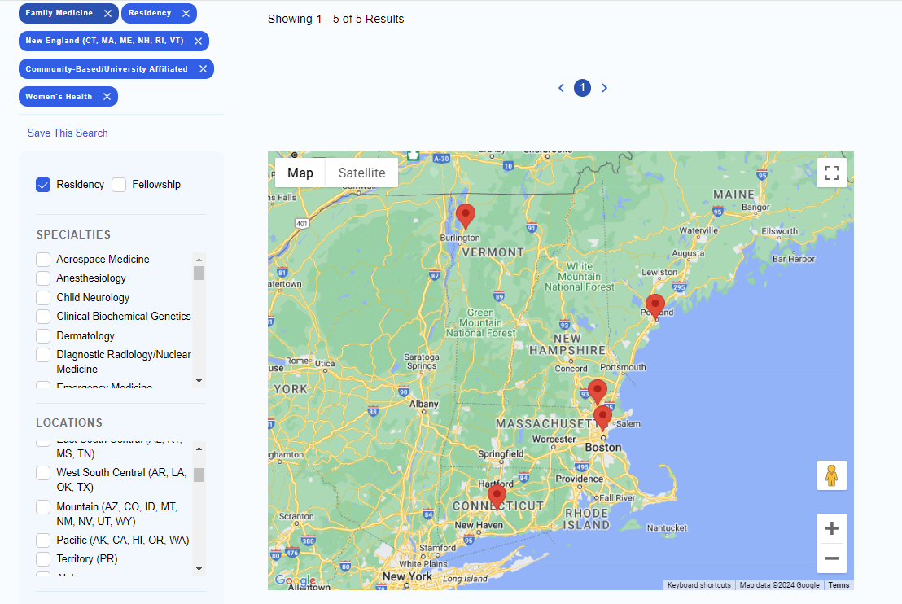

Slide 44
Checklist to be completed prior to your meeting
[ ] Complete the Career Tab on MedScope
[ ] Review your schedule/graduation requirements
[ ] Review the Residency Application Handbook
The below are NOT required but may be helpful
[ ] Meet with Departmental Mentors
[ ] Create a CV Draft (CV Tips); we will not go through this at the meeting but can answer specific questions
[ ] Create a Personal Statement draft; we are happy to review outside the meeting timeframe
[ ] Self reflect on your competitiveness

