Slide 1
ERAS Workshop
2025-2026 Application Season
Notes:
`

Slide 2
What is ERAS?
Electronic Residency Application Service (ERAS)
Application service for applying to residency and uploading your documents
ERAS is NOT the Match Program
Match Programs are NRMP or AUA (Urology) or SF (Ophthalmology)
You must register separately for the Match programs
NRMP: https://www.nrmp.org/
Urology: https://www.auanet.org/education/urology-and-specialty-matches.cfm
Ophthalmology is separate application AND Match
Overview - Ophthalmology Residency - SF Match - Residency and Fellowship Matching Services

Slide 3
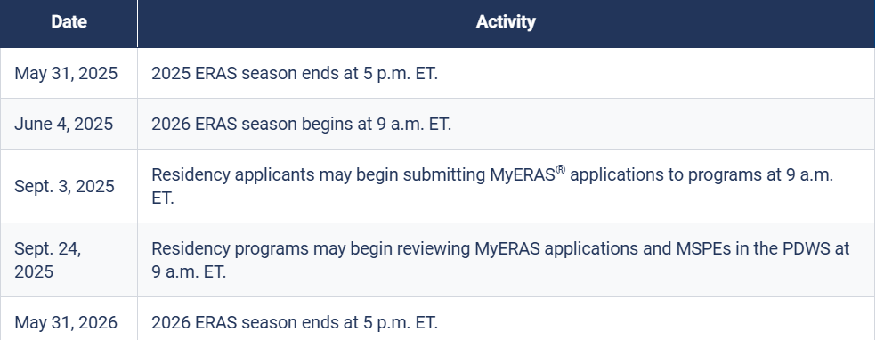
ERAS Timeline 2025-2026

Slide 4
Getting Started: The Basics
Register for MyERAS using ERAS Token (given to you all by us at OSA)
Complete and submit application
Upload Personal Statement
Authorize USMLE transcripts (if scores come in after applications are in, you need to re-authorize score
Send Letter of Recommendation requests to letter writers
Assign Documents (GO BACK AND DOUBLE CHECK!)
USMLE Transcripts
Letter of Recommendations
Photo
Personal Statement
Additional Documents
Certify and submit application
Apply to programs and pay fees
Notes:
Someone does assigning documents wrong every year and it effects interview offers.
People miss this step all together, not assign a photo or forget to assign USMLE, or miss specific elements for specific programs
DOUBLE CHECK
while we can go in and see some big picture things and do some double checks for them (for example, I can see who certified and that all the appropriate documents were uploaded) that there are other things we cannot see (e.g. that each program was assigned all documents; or that they assigned the “right” letter or the “right” PS to each of the programs.
Be VERY careful if you are writing different personal statements for different programs or specialties

Slide 5
The Application: Support Browsers
Google Chrome
Mozilla Firefox
Microsoft Edge
Safari*
*While most AAMC services support certain browsers, the PDWS does not fully support Safari. We recommend Mac users use Firefox or Chrome.
Enable Javascript!

Slide 6
Your two new best friends…..
Residency Application Manual | University of Maryland School of Medicine
2026 MyERAS® Applicant User Guide | Students & Residents

Slide 7
Helpful Links
ERAS® Tools and Worksheets for Residency Applicants

Slide 8
The Application: Sections
Basic Information (Name, DOB, Contact Information, Address)
Work Authorization (Are you authorized to work in US? Visa and sponsorship needs)
NRMP or AUA Match Information (if you don’t have this yet, you can add it once you have received it)- NRMP not available until mid-September
This is where Couples Matching Information goes to alert ERAS programs that you are couples matching
If you leave this blank, you can still couples match in the NRMP match program
https://www.nrmp.org/residency-applicants/get-ready-for-the-match/couples-in-the-match/
Biographic Information (self-identification and language designation)
Military Information
Hometown Information
Geography Preference*
Setting Preferences *
Education Information (Medical School, Post-graduate information)

Slide 9
The Application: Sections (continued)
Extensions and Interruptions → this year ERAS has separated Academic and Professional
Honors & Awards (Honor Societies, Professional Memberships)
Experiences* (Experiences, Selected/Meaningful Experiences)
Impactful Experiences*
Hobbies & Interests
License Information and Legal Information
Publications (if you have trouble navigating where to put a specific publication type, feel free to reach out to OSA)
Specialty Questions (NEW 2026)- Anesthesiology, Neurosurgery, Plastic Surgery-Integrated
Program Signaling*
CERTIFICATION! (DO NOT WAIT UNTIL THE LAST DAY, but you also don't have to have everything in by Sept 3rd at 9am, it is not a rolling type application process)
MUST be in by September 24th as this is when programs start looking.

Slide 10
Geographical Preferences
What is this?
Sharing geographic preferences that improves accuracy
Applicants can communicate the importance of a geographical area
How do programs use them?
Use to decide who to invite to interview
Help prepare questions for interview
The use of geographic preferences varies by specialty and some specialties prefer that you put No Preference
Talk with your OSA advisor about this and review AAMC Data Below
Exploring the Relationship Between Program Signaling & Interview Invitations Across Specialties
Program Director Survey

Slide 11
Geographical Preferences: Setting Preference
Designate a preference or lack of preference for:
Urban
Suburban
Rural
Mix of them
Ability to offer as short explanation of why
Be truthful
If you select only rural, big cities may overlook you
If you select only urban, you may be unlikely/less likely to get offers in rural areas

Slide 12
Geographical Preferences
Data showed that last couple years that applicants who had geographic preferences that were aligned with program location had more likelihood to get an interview
even over those who said they did not have a preference
If you select a geographic preference, only programs IN that division that you apply to will see your preference
If you select “No division preference,” all programs where you apply will see this response
If you skip this section, no information will be given to programs
*Certain specialties may have specific recommendations on this-->Talk to your departmental advisors and OSA Advisors

Slide 13
Setting Preferences
An opportunity to communicate your preference or lack of preference for urban or suburban settings (used for tagging for your Selected Experiences)
Guidance for Settings (definitions)- at the bottom of page 11 of worksheet
URBAN: The central part of a city; high population density; high density of structure such as houses, buildings, railways; public transportation more readily available for commuting; most jobs are non-agricultural.
SUBURBAN: Smaller urban area around a city; less populated than a city; serves mainly as residential area for city’s workforce; mostly residential with single-family homes, stores, and services; more parks and open spaces than a city; limited public transportation and private vehicles needed for commuting.
RURAL: Large amounts of undeveloped land; low population density; open areas of land with few homes or buildings; no public transportation; private vehicles needed for commuting; main industries likely to be agriculture or natural-resource extraction.
Notes:
For ENT geographical preferences decreased opportunities when discordant with signals and did not increase opportunities when concordant with signals

Slide 14
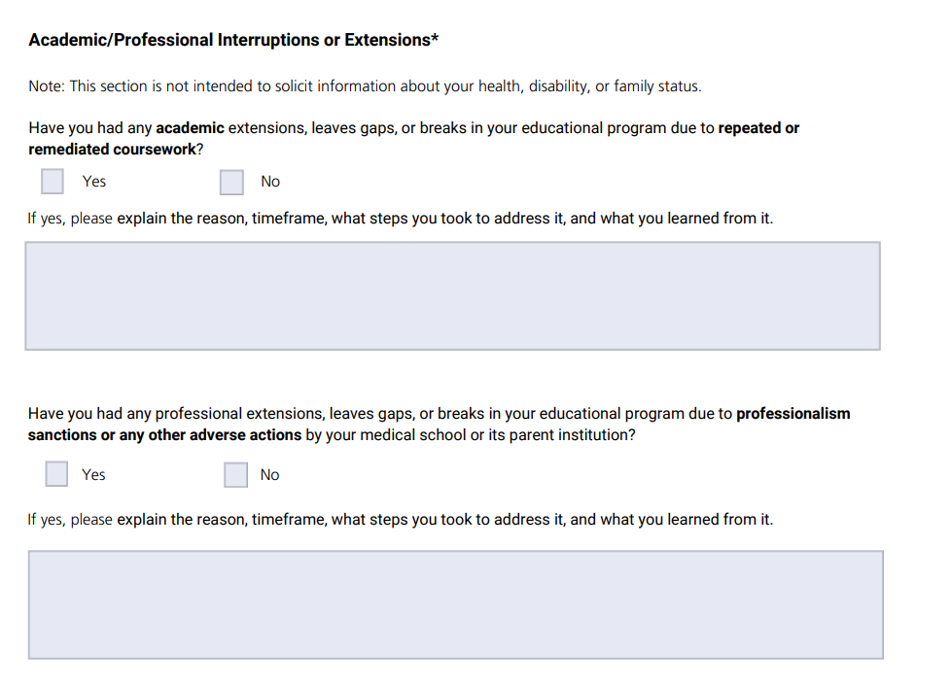
Extensions and Interruptions
What is this?
An opportunity to explain reasons for extensions and interruptions
You may or may not expand on this in the "Impactful Experience Section"
Make sure there is alignment between this section, the Impactful Experiences Section and your MSPE
MAKE SURE THIS ALIGNS WITH YOUR MSPE DOCUMENTED TIMELINE AS WELL-->
Talk to your OSA advisor

Slide 15
Experiences
This is how you build the narrative for your application (with your personal statement, noteworthy characteristics, letters etc)
How do programs use this?
Prepare for interviews
Tiebreakers for deciding who to interview
Holistic application review to determine interview offers
For applicants:
Highlight meaningful experiences
Allow holistic review in high volume applications
Allow applicants to clearly communicate what is most important
Select 10 Experiences
*This is where you would highlight/document your PRECLERKSHIP ELECTIVES!*

Slide 16
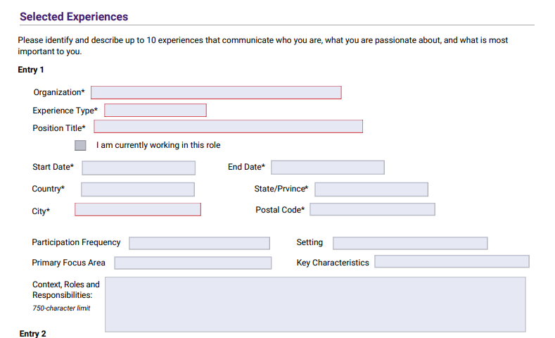
Experiences
Select 10 Experiences
Limited to 10 this year with hope to decrease pressure on applicants to create a long list
Help applicants use their energy and time to focus on the things that are important to them as an applicant
Notes:
Primary Focus Area: basic science, clinical/translational science, community involvement/outreach, customer service, healthcare administration, improving access to healthcare, medical education, music/athletics/arts, promoting wellness, public health, quality improvement, social justice/advocacy, technology
Key Characteristics: communication, critical thinking and problem solving, cultural humility and awareness, empathy and compassion, ethical responsibility, ingenuity and innovation, resilience and adaptability, reliability and dependability, self reflection and improvement, teamwork and leadership
Allows program directors and colleagues to filter in data that match the programs goals and mission

Slide 17
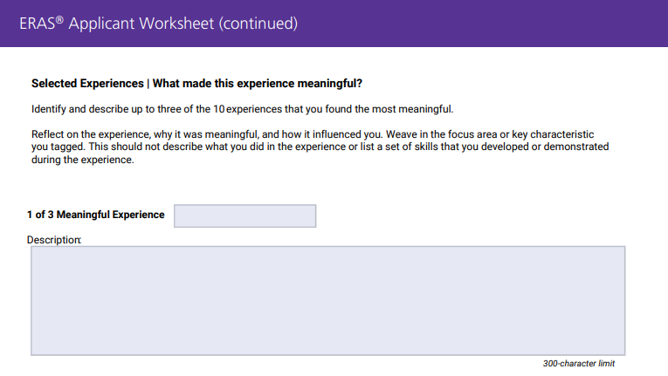
Experiences
Expand on 3 of your most meaningful experiences (of the 10, NOT in addition)

Slide 18
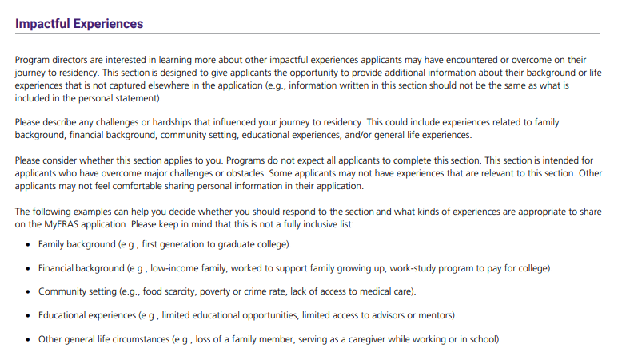
Impactful Experiences
OPTIONAL: Space to describe specific experiences that effected your path to residency that may not be described other places in your application
OSA is more than willing to
read over this section for you,
but no matter what, someone
should read this section before
Submission!
Should be consistent with gaps,
Extensions (if applicable)
Notes:
If you write one of these,

Slide 19
Program Signaling
Applicant’s ability to indicate true interest in a program
Supposed to be ONE of MANY data points for programs to decide who to interview
Not supposed to be used in isolation
How do programs use signals?
Filter applicants
Use signals as a screening tool before a more holistic review
Use signals as tie breaker to figure out who to interview
Use during interview to learn why an applicant applied to their program
Programs are using signals differently

Slide 20
Program Signaling
Program signals improved likelihood to get an interview
varied by specialty
If you signal a program, that program will see “Yes” or “Gold/Silver” (if tiered)
If applicant doesn’t signal a program, skips question or signals another program, the program will see NO information

Slide 21
AAMC says to signal any program that the applicant is interested in (including home program and away sites)

Slide 22
Program Signaling
Highest likelihood of interview invitation occurred when signal program and the geographical area signaled was concordant

Slide 23
Our OSA Observations
This may vary by specialty …
Signaling programs helps improve interview invite chances
There wasn’t much of a benefit to signaling reach programs and in fact students who signaled mostly reaches got fewer interview offers
For specialties that had 20+ signals, it was unlikely to get interviews outside of signaled programs
For specialties with fewer signals, there was an added benefit to applying to additional programs

Slide 24
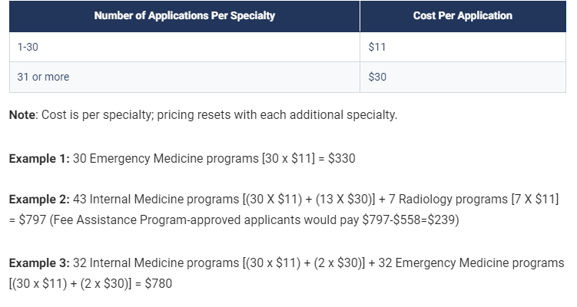
Fees
Plus:
USMLE Transcript: $80 (assessed once per season)
Tax (depending on billing address
No refunds ☹
If balance is overdue, your access to ERAS is revoked until balance is paid
Fee Assistance Program | Students & Residents (aamc.org)

Slide 25
TO DO
Start filling out ERAS
Noteworthy Characteristics- DUE JUNE 16th
Instructions/Examples: Writing the MSPE | University of Maryland School of Medicine (umaryland.edu)
Work on drafts of your personal statements
Come to Personal Statement Workshops
Tuesday, July 15th AND Tuesday, August 19th @4pm in Reid Rooms
Ask for letters of recommendation
Work on your program lists
Do well on your rotations!

Slide 26
QUESTIONS?

