Slide 1
Orthopaedic Surgery
My Best Fit Residency
2026

Slide 3
Your Mentoring Team
OSA Advisor
Kerri Thom
Specialty Advisor(s)
Frank Henn (R)
Peer Advising
Tony Koshar
Alumni Network
Vicky Norton (Admin)
Natalie Danna
Mohit Gilotra

Slide 4
Alumni Network
Access from your MedScope portfolio – Career Tab
You have to indicate specialty interest to access the list
At the bottom of the page – you can also register to become part of the Alumni Network

Slide 5
Residency Application Manual https://www.medschool.umaryland.edu/osa/residency-application-manual-/

Slide 6
Specialty Guidelines
American Orthopedic Association (AOA) Residency Application Resource Center
2025_2026 Residency Application Cycle Recommendation Guidelines

Slide 7
What is New for 2025?
No major changes anticipated specifically for Orthopedic Surgery
Anticipate In-Person OR Away Interviews (Program Dependent)
Lower Cost – New ERAS Fee Structure and Expanded Fee Assistance (Introduced 2025)
Updated Residency Explorer Tool (Typically updated in June/July; Anticipate Step 2 Included)
Greater integration with Thalamus for interview scheduling/management

Slide 8
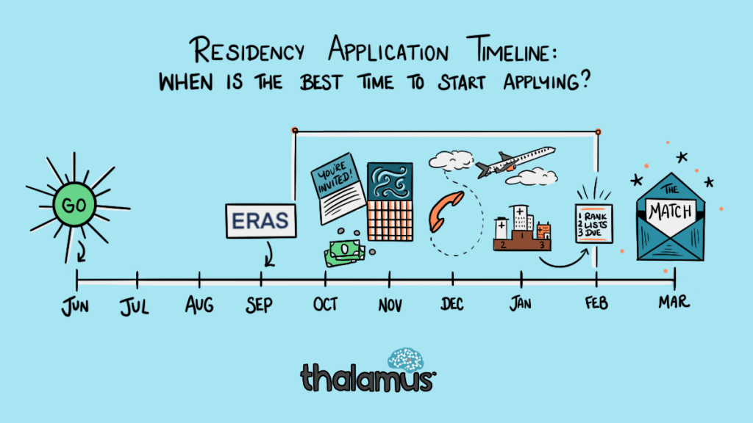

Slide 11
ERAS/NRMP TIMELINE
Date | Activity
Jun 4, 2025 | ERAS 2024 season begins at 9 a.m. ET.
Sep 3, 2025 | Residency applicants may begin submitting MyERAS applications to programs at 9 a.m. ET.
Sep 24, 2025 | Residency programs may begin reviewing MyERAS applications and MSPEs in the PDWS at 9 a.m. ET.
Nov 17. 2025 | Universal Interview Release Day
End of January | Register for NRMP Match and SOAP
Feb 2, 2026 | Ranking Opens in NRMP at Noon ET
Mar 4, 2026 | Rank Lists Certified by 9 p.m. ET
3rd week of March | SOAP and MATCH
*Note, these dates are subject to change. Please reference ERAS® Residency Timeline and the NRMP Match Calendar for the most updated schedules.

Slide 13
Upcoming workshops …
Personal Statement Writing Workshops: 7/15, 8/19
May-Jun: OSA 1:1 Advising Sessions
Jun: My ERAS Workshop
Mar: Match Week/SOAP Workshop (mandatory)
Aug: Interview Preparedness
Jan: Post-Interview Advising
May: OSA Specialty-Specific Advising (NOW!)
5/5: The Preliminary/TY Application – N/A
4/29: Mission and Brand with Dr. Lumpkins (TOMORROW!)
https://www.medschool.umaryland.edu/osa/residency-application-manual-/osa-advising-workshop-series/

Slide 14
What you can be doing now …
Scheduling Tweaks, Away Rotations, Graduation Requirements
Consider Narrative/Brand
Preview Application (2026 Residency Application Worksheet)
Work on your CV (OSA CV Tips)
Create a draft of your Personal Statement (OSA PS Guidelines)
Meet with Mentors (OSA, Specialty Advisors, Peers)
Create a preliminary list of programs
Complete Advising Survey

Slide 15
What you can be doing now …
Scheduling Tweaks, Away Rotations, Graduation Requirements
Consider Narrative/Brand
Preview Application (2026 Residency Application Worksheet)
Work on your CV (OSA CV Tips)
Create a draft of your Personal Statement (OSA PS Guidelines)
Meet with Mentors (OSA, Specialty Advisors, Peers)
Create a preliminary list of programs
Complete Advising Survey

Slide 16
Scheduling, Resources
Clinical Scheduling
Graduation Requirements: Renaissance Curriculum
MedScope Class of 2026 Page

Slide 17
Clerkship Phase
Complete all Clerkships by 12/31/2025 (x EM)
Complete 2-week Elective
TWO Sub-Internships
Sub-Internship #1
Sub-Internship #2
5 Electives
Elective #1
Elective #2
Elective #3
Elective #4
Elective #5
Transition to Residency
Block 10 or Block 9 (Gen Surg)
Graduation Requirements
*must be registered as Ambulatory
Other Requirements:
FRCT Scholarly Project
OSCE
Take USMLE Step 2
FA Exit Interview
Up to 2 Pre-clerkship
Two must be “in catalog”

Slide 18
A Note on External Rotations (“Aways”)
Away Rotations are Expected – Aim for 2 to 3
YOU MUST ADD THIS COURSE AT SOM!!!
Required forms are found on the Student Scheduling Page
Forms should be completed/signed by Departments
Submitted to Add/Drop
Where to apply – discuss with faculty advisors
Prior year away rotations, on MedScope Class page

Slide 19
What you can be doing now …
Scheduling Tweaks, Away Rotations, Graduation Requirements
Consider Narrative/Brand
Preview Application (2026 Residency Application Worksheet)
Work on your CV (OSA CV Tips)
Create a draft of your Personal Statement (OSA PS Guidelines)
Meet with Mentors (OSA, Specialty Advisors, Peers)
Create a preliminary list of programs
Complete Advising Survey

Slide 20
Your Mentoring Team
OSA Advisor
Kerri Thom
Specialty Advisor(s)
Frank Henn (R)
Peer Advising
Tony Koshar
Alumni Network
Vicky Norton (Admin)
Natalie Danna
Mohit Gilotra

Slide 21
What you can be doing now …
Scheduling Tweaks, Away Rotations, Graduation Requirements
Consider Narrative/Brand
Preview Application (2026 Residency Application Worksheet)
Work on your CV (OSA CV Tips)
Create a draft of your Personal Statement (OSA PS Guidelines)
Meet with Mentors (OSA, Specialty Advisors, Peers)
Create a preliminary list of programs More on this later!
Complete Advising Survey

Slide 22
What you can be doing now …
Scheduling Tweaks, Away Rotations, Graduation Requirements
Consider Narrative/Brand
Preview Application (2026 Residency Application Worksheet)
Work on your CV (OSA CV Tips)
Create a draft of your Personal Statement (OSA PS Guidelines)
Meet with Mentors (OSA, Specialty Advisors, Peers)
Create a preliminary list of programs
Complete Advising Survey - Link

Slide 23
Important Reminders
Confirm name/pronunciation in MedScope as you with for graduation/diploma
Update your Preferred Pronouns in MedScope for the MSPE (if not indicated will default to he/him, she/her)
Update your contact information in MedScope
Consider your brand and ensure social media profiles are professional/clean
Pay it forward, sign up to be an Alumni Mentor (Career Tab, MedScope)
Use the MedScope Interview Tracker to ensure optimal advising (More information to come)!
Meet with Financial Aid (Sophia Cascio/Juanita Sims)
Complete Graduation Questionnaire (online through AAMC) – available Feb 14, 2026

Slide 24
1:1 Sessions with OSA
These are FOR YOU!
Answer any questions: scheduling, graduation requirements, application logistics
Individualized application guidance
Competitiveness for Specialty
How many programs to apply to
Which programs to apply to
Contingency plans
Discuss your MSPE (Example MSPE)

Slide 25
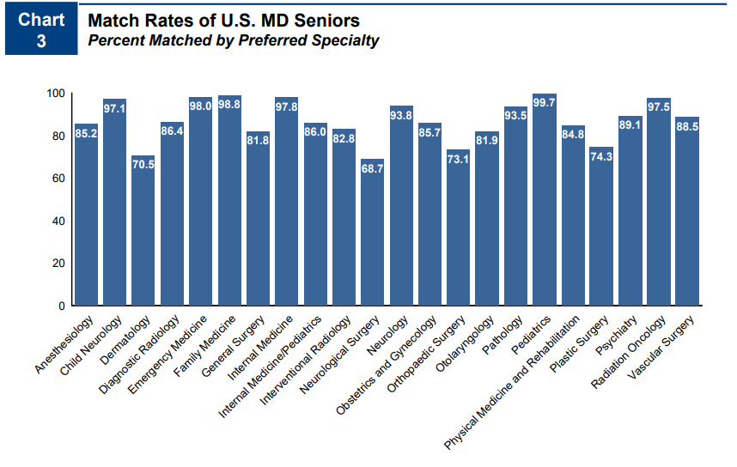
Competitiveness of Specialty
73.5 % Match Rate
No unfilled positions in the match
NRMP Charting Outcomes 2024

Slide 26
A Competitive Applicant looks like …
UMSOM
MedScope Data
*Note, SOM no longer uses “Thirds” for Class Standing

Slide 27
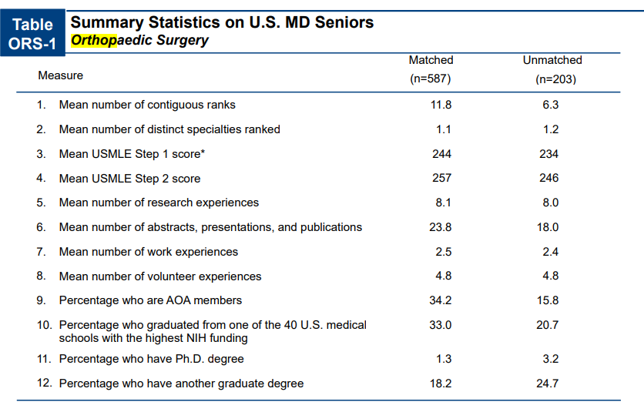
A Competitive Applicant looks like …
Goal Step 2, 257 -260s
Research is ESSENTIAL
Consider Gap Year
Productivity
Networking
Commitment to Field
Consider YOUR narrative
NRMP Charting Outcomes 2024

Slide 28
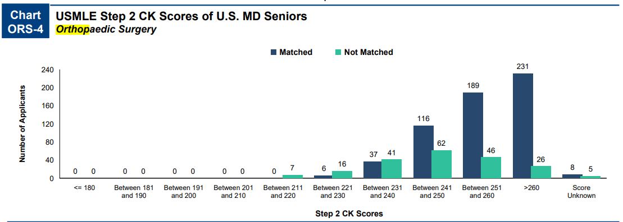
More on goals for Step 2 …
NRMP Charting Outcomes 2024
Orthopaedic Surgery:
Goal – 257 +
Contingency < 250

Slide 29
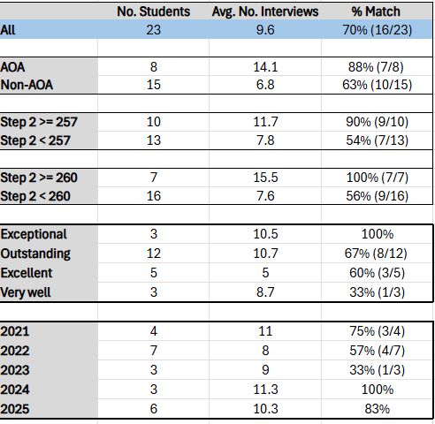
A Competitive Applicant looks like …
2021 to 2025 MedScope Data
Goal Step 2, 257 - 260s
Research is ESSENTIAL
Consider Gap Year
Productivity
Networking
Commitment to Field
Consider YOUR narrative

Slide 30
How many programs to apply to…
Students at UMSOM applying to ORTHOPEDIC SURGERY applied to on average 30.8 programs in 2025, Note, this includes students from all class ranks and range of step scores.

Slide 31
Which Programs to apply to …
FREIDA is a good tool to help you look at accredited programs by specialty in different regions around the country. https://freida.ama-assn.org/Freida/#/
AAMC Residency Explorer is a useful tool in assessing your competitiveness at particular programs: https://www.residencyexplorer.org/Account/Login
MedScope Data *We will review together – this data allows you to see where you stand as a student at UMSOM Where do our students match?
Departmental Advisors (as well as faculty advisors, and senior students) are another key source of program information

Slide 32
List of Programs that Extended Interviews
67 different programs extended interview offers to UMSOM students in the last four cycles
List can be found in your advising document
Consider applying to at least some of these places
Focus on programs where you have a connection (away, research, networking)

Slide 33
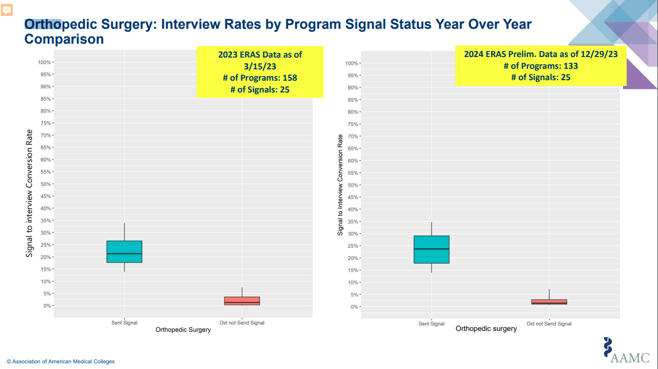
Signaling
Signals Vary by Specialty
Applying to Residencies with ERAS® | Students & Residents (aamc.org)
Orthopedic Surgery: 30
Pro Tip:
Use ALL available signals
Signals should include Reach/Target/Safety
No benefit to applying beyond signals

Slide 34
Signaling
Number of Signals Vary per Specialty
Applying to Residencies with ERAS® | Students & Residents (aamc.org)
Orthopedic Surgery: 30

Slide 35
Letters of Reference: 4 Total Letters
1. Chair Letter is Required by some programs
2. Orthopaedic Surgery/Home Faculty
3. Orthopaedic Surgery /Away Faculty
4. Other/Research
+ Non-Ortho as a back up

Slide 36
Contingency Planning
Required for ALL ORTHOPAEDIC SURGERY Applicants
All students need some contingency
Apply to right mix of programs / use signaling wisely
Rank ALL programs you interview at
Be PROACTIVE – communicate with OSA
Update the MedScope tracker
Consider Research Year
Consider Dual Application
SOAP is NOT a contingency plan
no unfilled Orthopaedic Surgery programs

Slide 37
Interviews
11/17 – Universal Interview Offer Day
Interviews will be VIRTUAL or IN PERSON
Interview Resources – RAM

