Slide 1
OBGYN
My Best Fit Residency
2026

Slide 3
Your Mentoring Team
OSA Advisor
Kerri Thom
Specialty Advisor(s)
Kiran Chawla (R)
Chair: Irina Burd (R)
Peer Advising
Maria Som
Alumni Network

Slide 4
Alumni Network
Access from your MedScope portfolio – Career Tab
Must indicate specialty interest to access the list
At the bottom of the page – you can also register to become part of the Alumni Network

Slide 5
Residency Application Manual https://www.medschool.umaryland.edu/osa/residency-application-manual-/

Slide 6
Specialty Guidelines
APGO Right Resident, Right Program, Ready Day One: Applicant Resources
APGO 2025-2026 OB-GYN Application Cycle Guidelines

Slide 7
What is New for 2026?
Same as 2025!
OBGYN will NOT participate in ERAS
All OBGYN Applications through ResidencyCAS platform
Timeline will remain the same
Match will still occur through NRMP
Application Preview is Available OBGYN Applicant Worksheet
12 Experiences, 3 Hobbies
Signals will remain the same (3 Gold, 15 Silver)
No geographic preference

Slide 8
2/2 Rank Lists Open
3/4 Rank Lists Due
6/4, Application Platform opens
9/25, Applications due
April
May
June
Jul
Aug
Sep
Oct
Nov
Dec
Jan
Feb
Mar
10/28 – Interview Release
9/4, Can Submit Applications
Virtual Interviews*

Slide 10
CAS/NRMP TIMELINE
Date | Activity
Jun 4, 2025 | Residency CAS Application Opens
Sep 4, 2025 | Residency applicants may begin submitting applications to programs.
Sep 25, 2025 | Residency Applications are due by 11:59 PM.
Oct 28, 2025 | Interview Release Day
By Jan 31, 2026 | Register for NRMP Match and SOAP
Feb 2, 2026 | Ranking Opens in NRMP
Mar 4, 2026 | Rank Lists Certified in NRMP
3rd week of March | SOAP and MATCH
*Note, these dates are subject to change. Current discrepancy between ResidencyCAS and Society Documents

Slide 12
Upcoming workshops …
Personal Statement Writing Workshops: 7/15, 8/19
May-Jun: OSA 1:1 Advising Sessions
Jun: My ERAS Workshop
Mar: Match Week/SOAP Workshop (mandatory)
Aug: Interview Preparedness
Jan: Post-Interview Advising
May: OSA Specialty-Specific Advising (NOW!)
5/5: The Preliminary/TY Application – N/A
https://www.medschool.umaryland.edu/osa/residency-application-manual-/osa-advising-workshop-series/

Slide 13
What you can be doing now …
Scheduling Tweaks, Away Rotations, Graduation Requirements
Consider Narrative/Brand
Preview Application (ResidencyCAS OBGYN Applicant Worksheet)
Work on your CV (OSA CV Tips)
Create a draft of your Personal Statement (OSA PS Guidelines)
Meet with Mentors (OSA, Specialty Advisors, Peers)
Create a preliminary list of programs
Complete Advising Survey

Slide 14
What you can be doing now …
Scheduling Tweaks, Away Rotations, Graduation Requirements
Consider Narrative/Brand
Preview Application (ResidencyCAS OBGYN Applicant Worksheet)
Work on your CV (OSA CV Tips)
Create a draft of your Personal Statement (OSA PS Guidelines)
Meet with Mentors (OSA, Specialty Advisors, Peers)
Create a preliminary list of programs
Complete Advising Survey

Slide 15
Scheduling, Resources
Clinical Scheduling
Graduation Requirements: Renaissance Curriculum
MedScope Class of 2026 Page

Slide 16
Clerkship Phase
Complete all Clerkships by 12/31/2025 (x EM)
Complete 2-week Elective
TWO Sub-Internships
Sub-Internship #1
Sub-Internship #2
5 Electives
Elective #1
Elective #2
Elective #3
Elective #4
Elective #5
Transition to Residency
Block 10 or Block 9 (Gen Surg)
Graduation Requirements
*must be registered as Ambulatory
Other Requirements:
FRCT Scholarly Project
OSCE
Take USMLE Step 2
FA Exit Interview
Up to 2 Pre-clerkship
Two must be “in catalog”

Slide 17
A Note on External Rotations (“Aways”)
Away Rotations are NOT required (pros/cons)
YOU MUST ADD THIS COURSE AT SOM!!!
Required forms are found on the Student Scheduling Page
Forms should be completed/signed by Departments
Submitted to Add/Drop
Where to apply – discuss with faculty advisors
Prior year away rotations, on MedScope Class page

Slide 18
What you can be doing now …
Scheduling Tweaks, Away Rotations, Graduation Requirements
Consider Narrative/Brand
Preview Application (ResidencyCAS OBGYN Applicant Worksheet)
Work on your CV (OSA CV Tips)
Create a draft of your Personal Statement (OSA PS Guidelines)
Meet with Mentors (OSA, Specialty Advisors, Peers)
Create a preliminary list of programs
Complete Advising Survey

Slide 19
Your Mentoring Team
OSA Advisor
Kerri Thom
Specialty Advisor(s)
Kiran Chawla (R)
Chair: Irina Burd (R)
Peer Advising
Maria Som
Alumni Network

Slide 20
What you can be doing now …
Scheduling Tweaks, Away Rotations, Graduation Requirements
Consider Narrative/Brand
Preview Application (ResidencyCAS OBGYN Applicant Worksheet)
Work on your CV (OSA CV Tips)
Create a draft of your Personal Statement (OSA PS Guidelines)
Meet with Mentors (OSA, Specialty Advisors, Peers)
Create a preliminary list of programs More on this later!
Complete Advising Survey

Slide 21
What you can be doing now …
Scheduling Tweaks, Away Rotations, Graduation Requirements
Consider Narrative/Brand
Preview Application (ResidencyCAS OBGYN Applicant Worksheet)
Work on your CV (OSA CV Tips)
Create a draft of your Personal Statement (OSA PS Guidelines)
Meet with Mentors (OSA, Specialty Advisors, Peers)
Create a preliminary list of programs
Complete Advising Survey - Link

Slide 22
Important Reminders
Confirm name/pronunciation in MedScope as you with for graduation/diploma
Update your Preferred Pronouns in MedScope for the MSPE (if not indicated will default to he/him, she/her)
Update your contact information in MedScope
Consider your brand and ensure social media profiles are professional/clean
Pay it forward, sign up to be an Alumni Mentor (Career Tab, MedScope)
Use the MedScope Interview Tracker to ensure optimal advising (More information to come)!
Meet with Financial Aid (Sophia Cascio/Juanita Sims)
Complete Graduation Questionnaire (online through AAMC) – available Feb 14, 2026

Slide 23
1:1 Sessions with OSA
These are FOR YOU!
Answer any questions: scheduling, graduation requirements, application logistics
Individualized application guidance
Competitiveness for Specialty
How many programs to apply to
Which programs to apply to
Contingency plans
Discuss your MSPE (Example MSPE)

Slide 24
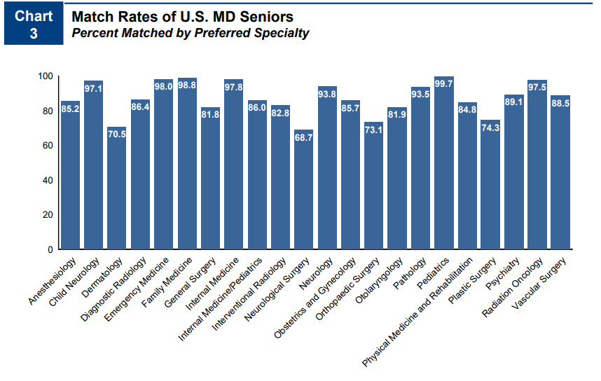
Competitiveness of Specialty
85.7 % Match Rate
No-few unfilled positions in the match
NRMP Charting Outcomes 2024

Slide 25
A Competitive Applicant looks like …
UMSOM
MedScope Data
*Note, SOM no longer uses “Thirds” for Class Standing

Slide 26
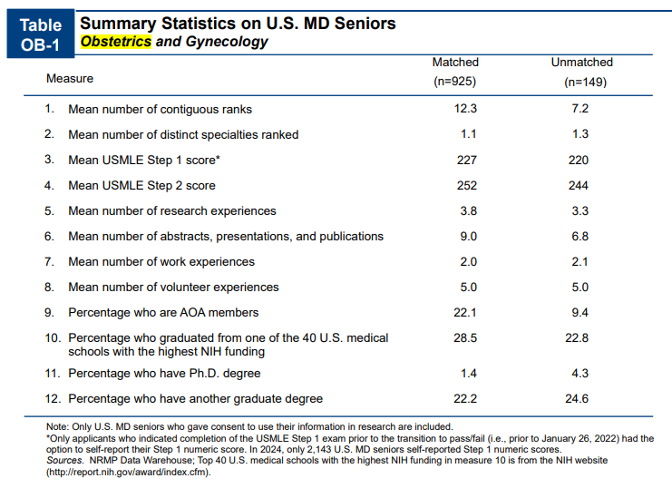
A Competitive Applicant looks like …
Goal Step 2, 240-250s
Research is NOT required
Consider YOUR narrative
NRMP Charting Outcomes 2024

Slide 27
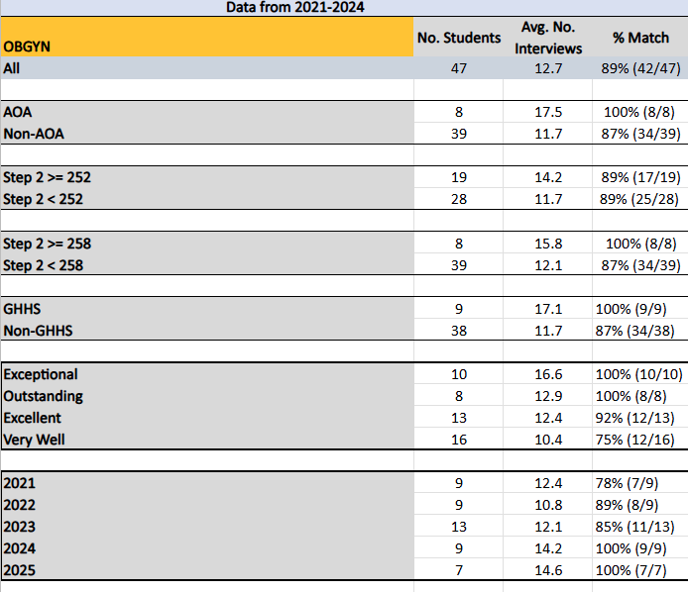
A Competitive Applicant looks like …
Goal Step 2, 240-250s
Research is NOT required
Consider YOUR narrative
NRMP Charting Outcomes 2024

Slide 28
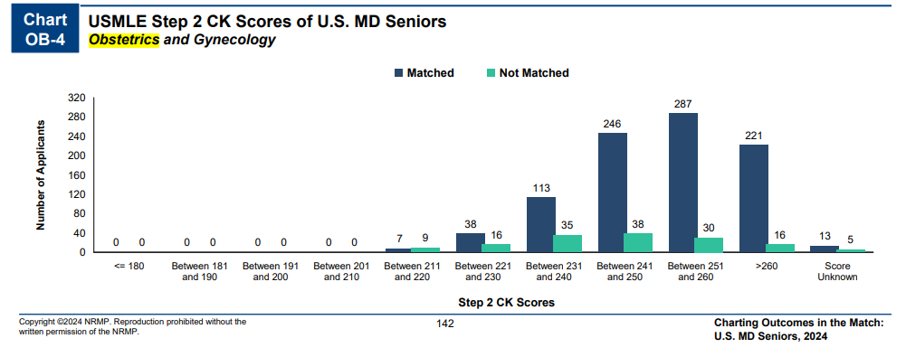
More on goals for Step 2 …
NRMP Charting Outcomes 2024
OBGYN:
Goal – 240-250s (252)
Contingency < 230

Slide 29
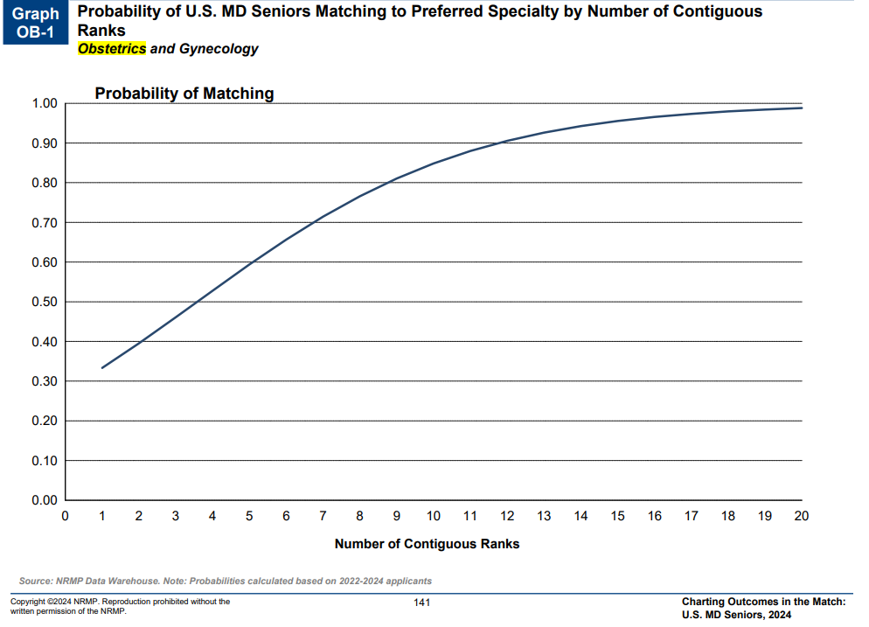
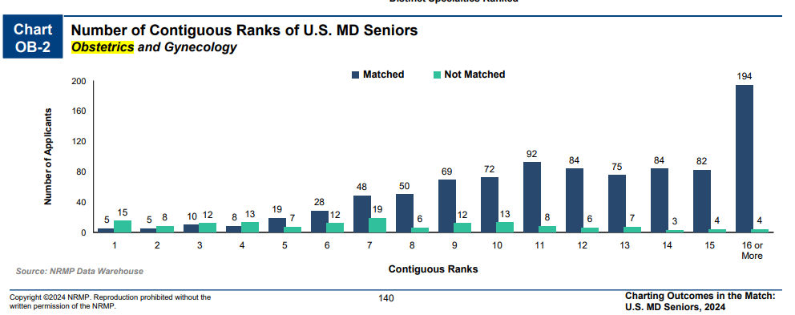
How many programs to apply to…
NRMP Charting Outcomes 2024

Slide 30
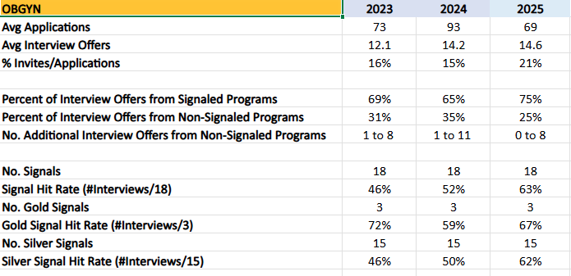
How many programs to apply to…
Students at UMSOM applying to OBGYN applied to on average 69 programs in 2026. Note, this includes students from all class ranks and range of step scores.
Most students hit 12-15 goal

Slide 31
How many programs to apply to…
My Recommendations:

Slide 32
Example – Average Student
Anne Arundel Medical Center
Christiana Care Health Services
Crozer-Chester Medical Center
Drexel University College of Medicine/St Peter's University Hospital
Lincoln Medical and Mental Health Center
MedStar Health/Washington Hospital Center
Penn State University/Milton S Hershey Medical Center
Sinai Hospital of Baltimore
St Barnabas Medical Center
SUNY Health Science Center at Brooklyn
Temple University
University of Maryland
No. Applications: 63
No. Offers: 12

Slide 33
Example – Below Average
Baylor University Medical Center
Geisinger Health System
Hofstra Northwell School of Medicine
Lehigh Valley Health Network/University of South Florida College of Medicine
Meharry Medical College
Newark Beth Israel Medical Center
St Joseph's University Medical Center
University of Maryland
University of Texas Southwestern Medical School
No. Applications: 103
No. Offers: 9

Slide 34
Example – Above Average
Albert Einstein College of Medicine
BronxCare Health System
Christiana Care Health Services
Hofstra Northwell School of Medicine at Lenox Hill Hospital
Hofstra Northwell School of Medicine
Icahn School of Medicine at Mount Sinai
Johns Hopkins University
Maimonides Medical Center
New York Medical College at Westchester Medical Center
New York Presbyterian Hospital (Columbia Campus)
New York Presbyterian Hospital (Cornell Campus)
Rutgers Robert Wood Johnson Medical School
Stamford Hospital/Columbia University College of Physicians and Surgeons
University at Buffalo
University of Maryland
No. Applications: 69
No. Offers: 14

Slide 35
Which Programs to apply to …
FREIDA is a good tool to look at accredited programs by specialty in different regions around the country. https://freida.ama-assn.org/Freida/#/
APGO Residency Directory is OB&GYN specific database. APGO Residency Directory
AAMC Residency Explorer is a useful tool in assessing your competitiveness at particular programs: https://www.residencyexplorer.org/Account/Login
MedScope Data *We will review together –allows you to see where you stand as a student at UMSOM Where do our students match?
Specialty Advisors (as well as faculty mentors and senior students) are another key source of program information

Slide 36
Which Programs to apply to …
Alignment Check Index
https://residencyalignment.com/
OBGYN is using the Alignment Check Index by AMA/Frieda.
This too allows YOU to compare your own experiences and characteristics that residency programs consider in their own assessments; with a goal to create an alignment index you can use to determine which programs most align with your values

Slide 37
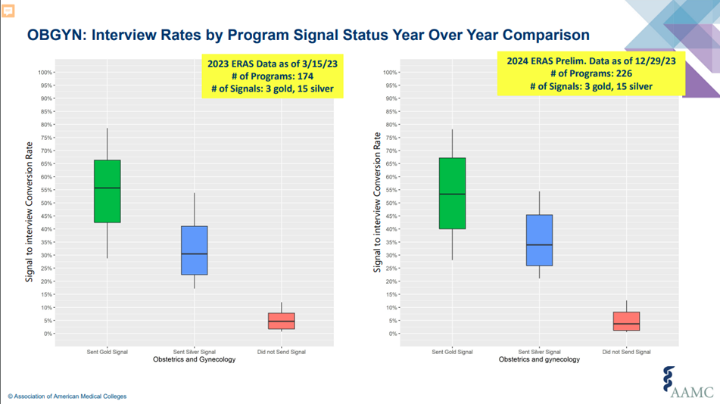
Signaling
OBGYN: 3 GOLD / 15 SILVER
*in past, signaling helped! But NOT at reach programs
Use all your signals!
Use a SMART signal strategy.

Slide 38
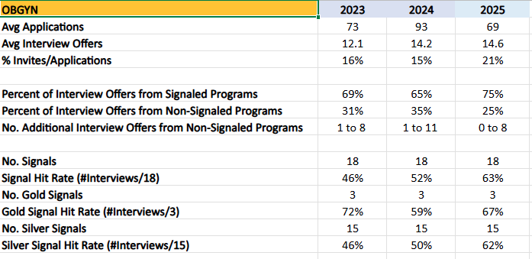
Signaling

Slide 39
Letters of Reference: 3-4 Total Letters
1. UMSoM SLOE/Chair – written by Drs. Burd and Chawla (meet with Dr. Chawla)
2. OBGYN Sub I Faculty (or other)
3. Non-OBYGN Letter – Surgery > FM or IM Faculty
4. Other – Second OBGYN faculty

Slide 40
Contingency Planning
All students need some contingency
Apply to the right #/mix of programs
Rank ALL programs you interview at
Be PROACTIVE – communicate with OSA
Update the MedScope tracker
Consider Research Year
Consider Dual Application – Will need ERAS
SOAP is NOT a contingency plan
no unfilled OBGYN programs

Slide 41
Should I apply through ERAS?
Yes
This is a huge pain, so why ? …
Any student who is dual applying, will require an ERAS application
If there is ANY chance you may consider SOAP in the event you did not match, you likely want to do a skeleton ERAS application so that your letters and other materials are uploaded
You can do this without applying to programs – so without incurring significant cost

Slide 42
Interviews
10/28 – Interview Release Date
11/1 – First Day of Interviews
11/26 – Final Notification of Status (Offer, Waitlist, Reject)
All Interviews will be VIRTUAL
Interview Resources – RAM

