Slide 1
Emergency Medicine
My Best Fit Residency
2026

Slide 3
Your Mentoring Team
OSA Advisor
Kerri Thom
Specialty Advisor(s)
Ryan Spangler (R)
PD: Sarah Dubbs
Peer Advising
Puja Patel
Alumni Network
Gillian Cooper
Other: Kat Stephanos

Slide 4
Alumni Network
Access from your MedScope portfolio – Career Tab
You have to indicate specialty interest to access the list
At the bottom of the page – you can also register to become part of the Alumni Network

Slide 5
Residency Application Manual https://www.medschool.umaryland.edu/osa/residency-application-manual-/

Slide 6
Specialty Guidelines
CORD (Council of Residency Directors in Emergency Medicine) 2025_2026 Application & Interview Best Practices
EMRA (Emergency Medicine Residency Association) – Medical Student

Slide 7
What is New for 2026?
EM will NOT participate in ERAS
All EM Applications through ResidencyCAS platform
Includes combined IM/EM and EM/Peds
Timeline will remain the same (very close)
Match will still occur through NRMP
Application preview available ResidencyCAS EM Applicant Worksheet
12 Experiences, 3 Hobbies
Signals will remain the same (5)
No geographic preference

Slide 8
2/2 Rank Lists Open
3/4 Rank Lists Due
6/4, Application Platform opens
9/25, Applications due
April
May
June
Jul
Aug
Sep
Oct
Nov
Dec
Jan
Feb
Mar
Rolling Interviews
9/4, Can Submit Applications
Virtual Interviews*

Slide 10
CAS/NRMP TIMELINE
Date | Activity
Jun 4, 2025 | Residency CAS Application Opens
Sep 4, 2025 | Residency applicants may begin submitting applications to programs.
Sep 25, 2025 | Residency Applications are due by 11:59 PM.
By Jan 31, 2026 | Register for NRMP Match and SOAP
Feb 2, 2026 | Ranking Opens in NRMP
Mar 4, 2026 | Rank Lists Certified in NRMP
3rd week of March | SOAP and MATCH
*Note, these dates are subject to change. Current discrepancy between ResidencyCAS and Society Documents

Slide 12
Upcoming workshops …
Personal Statement Writing Workshops: 7/15, 8/19
May-Jun: OSA 1:1 Advising Sessions
Jun: My ERAS Workshop
Mar: Match Week/SOAP Workshop (mandatory)
Aug: Interview Preparedness
Jan: Post-Interview Advising
May: OSA Specialty-Specific Advising (NOW!)
4/29: Mission and Brand with Dr. Lumpkins (TOMORROW!)
5/5: The Preliminary/TY Application – N/A
https://www.medschool.umaryland.edu/osa/residency-application-manual-/osa-advising-workshop-series/

Slide 13
What you can be doing now …
Scheduling Tweaks, Away Rotations, Graduation Requirements
Consider Narrative/Brand
Preview Application (ResidencyCAS EM Applicant Worksheet)
Work on your CV (OSA CV Tips)
Create a draft of your Personal Statement (OSA PS Guidelines)
Meet with Mentors (OSA, Specialty Advisors, Peers)
Create a preliminary list of programs
Complete Advising Survey

Slide 14
What you can be doing now …
Scheduling Tweaks, Away Rotations, Graduation Requirements
Consider Narrative/Brand
Preview Application (ResidencyCAS EM Applicant Worksheet)
Work on your CV (OSA CV Tips)
Create a draft of your Personal Statement (OSA PS Guidelines)
Meet with Mentors (OSA, Specialty Advisors, Peers)
Create a preliminary list of programs
Complete Advising Survey

Slide 15
Scheduling, Resources
Clinical Scheduling
Graduation Requirements: Renaissance Curriculum
MedScope Class of 2026 Page

Slide 16
Clerkship Phase
Complete all Clerkships by 12/31/2025 (x EM)
Complete 2-week Elective
TWO Sub-Internships
Sub-Internship #1
Sub-Internship #2
5 Electives
Elective #1
Elective #2
Elective #3
Elective #4
Elective #5
Transition to Residency
Block 10 or Block 9 (Gen Surg)
Graduation Requirements
*must be registered as Ambulatory
Other Requirements:
FRCT Scholarly Project
OSCE
Take USMLE Step 2
FA Exit Interview
Up to 2 Pre-clerkship
Two must be “in catalog”

Slide 17
A Note on External Rotations (“Aways”)
One (or two) Away Rotations are Required
YOU MUST ADD THIS COURSE AT SOM!!!
Required forms are found on the Student Scheduling Page
Forms should be completed/signed by Departments
Submitted to Add/Drop
Where to apply – discuss with faculty advisors
Prior year away rotations, on MedScope Class page
Notify me if you have yet to secure an away

Slide 18
What you can be doing now …
Scheduling Tweaks, Away Rotations, Graduation Requirements
Consider Narrative/Brand
Preview Application (ResidencyCAS EM Applicant Worksheet)
Work on your CV (OSA CV Tips)
Create a draft of your Personal Statement (OSA PS Guidelines)
Meet with Mentors (OSA, Specialty Advisors, Peers)
Create a preliminary list of programs
Complete Advising Survey

Slide 19
Your Mentoring Team
OSA Advisor
Kerri Thom
Specialty Advisor(s)
Ryan Spangler (R)
PD: Sarah Dubbs
Peer Advising
Puja Patel
Alumni Network
Gillian Cooper
Other: Kat Stephanos

Slide 20
What you can be doing now …
Scheduling Tweaks, Away Rotations, Graduation Requirements
Consider Narrative/Brand
Preview Application (ResidencyCAS EM Applicant Worksheet)
Work on your CV (OSA CV Tips)
Create a draft of your Personal Statement (OSA PS Guidelines)
Meet with Mentors (OSA, Specialty Advisors, Peers)
Create a preliminary list of programs More on this later!
Complete Advising Survey

Slide 21
What you can be doing now …
Scheduling Tweaks, Away Rotations, Graduation Requirements
Consider Narrative/Brand
Preview Application (ResidencyCAS EM Applicant Worksheet)
Work on your CV (OSA CV Tips)
Create a draft of your Personal Statement (OSA PS Guidelines)
Meet with Mentors (OSA, Specialty Advisors, Peers)
Create a preliminary list of programs
Complete Advising Survey - Link

Slide 22
Important Reminders
Confirm name/pronunciation in MedScope as you with for graduation/diploma
Update your Preferred Pronouns in MedScope for the MSPE (if not indicated will default to he/him, she/her)
Update your contact information in MedScope
Consider your brand and ensure social media profiles are professional/clean
Pay it forward, sign up to be an Alumni Mentor (Career Tab, MedScope)
Use the MedScope Interview Tracker to ensure optimal advising (More information to come)!
Meet with Financial Aid (Sophia Cascio/Juanita Sims)
Complete Graduation Questionnaire (online through AAMC) – available Feb 14, 2026

Slide 23
1:1 Sessions with OSA
These are FOR YOU!
Answer any questions: scheduling, graduation requirements, application logistics
Individualized application guidance
Competitiveness for Specialty
How many programs to apply to
Which programs to apply to
Contingency plans
Discuss your MSPE (Example MSPE)

Slide 24
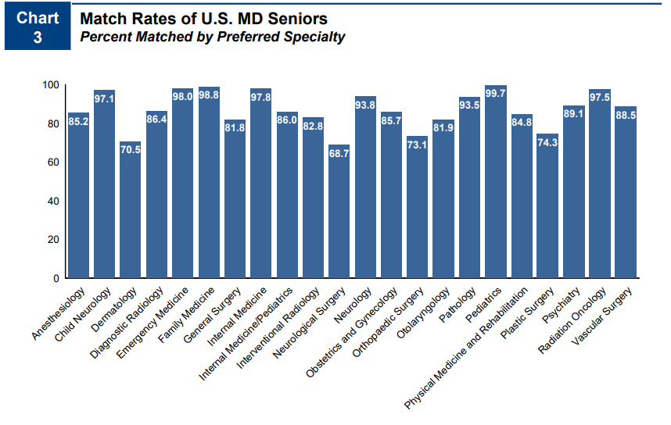
Competitiveness of Specialty
98% % Match Rate
Many unfilled positions in the match
NRMP Charting Outcomes 2024

Slide 25
A Competitive Applicant looks like …
UMSOM
MedScope Data
*Note, SOM no longer uses “Thirds” for Class Standing

Slide 26
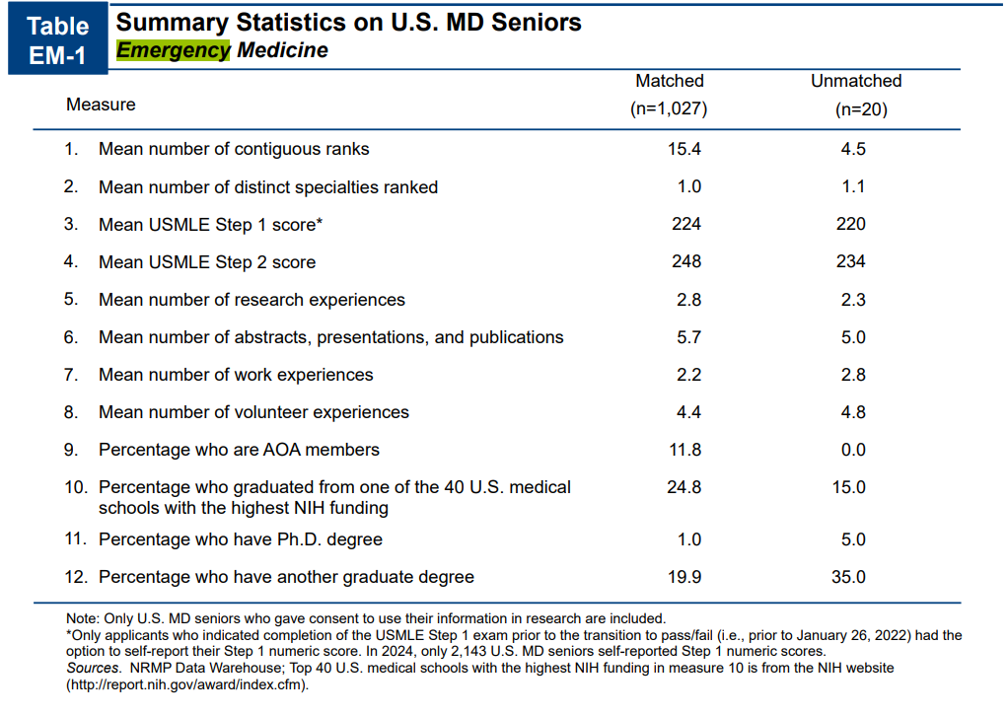
A Competitive Applicant looks like …
Goal Step 2, 240-250s
Research is NOT important
Consider YOUR narrative
NRMP Charting Outcomes 2024

Slide 27
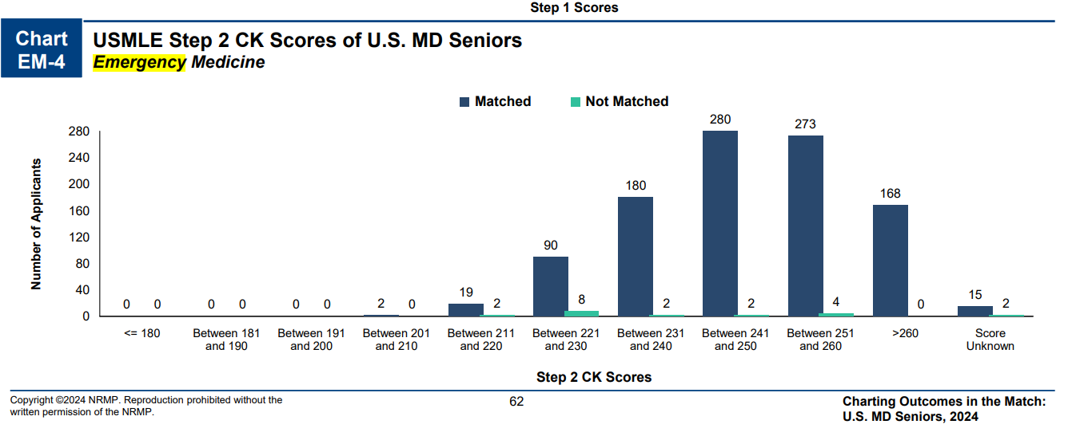
More on goals for Step 2 …
NRMP Charting Outcomes 2024
Emergency Med:
Goal – 240-250s
< 230, Contingency

Slide 28
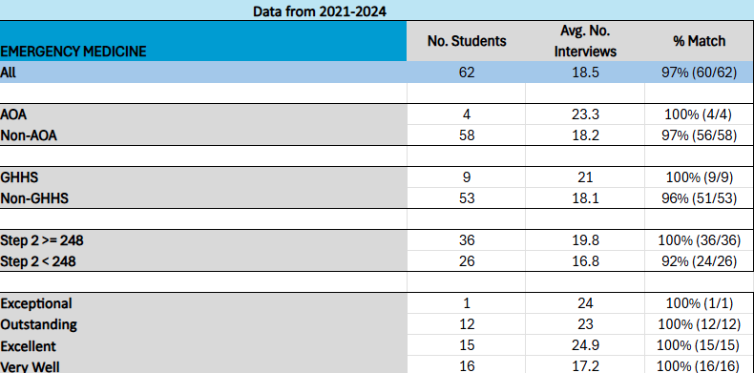
A Competitive Applicant looks like …
Research is NOT important
AOA, GHHS NOT required
Consider YOUR narrative

Slide 29
How many programs to apply to…
Students at UMSOM applying to EMERGENCY MEDICINE applied to an average of 49.5 programs in 2024. Note, this includes students from all class ranks and range of step scores.

Slide 30
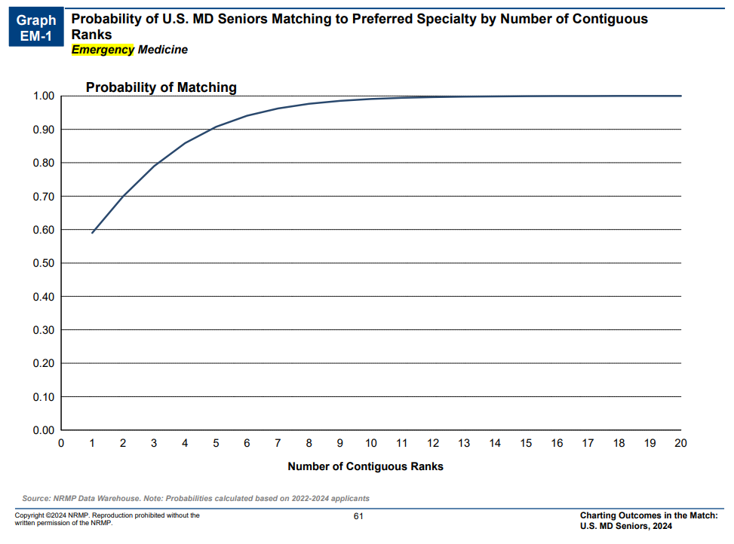
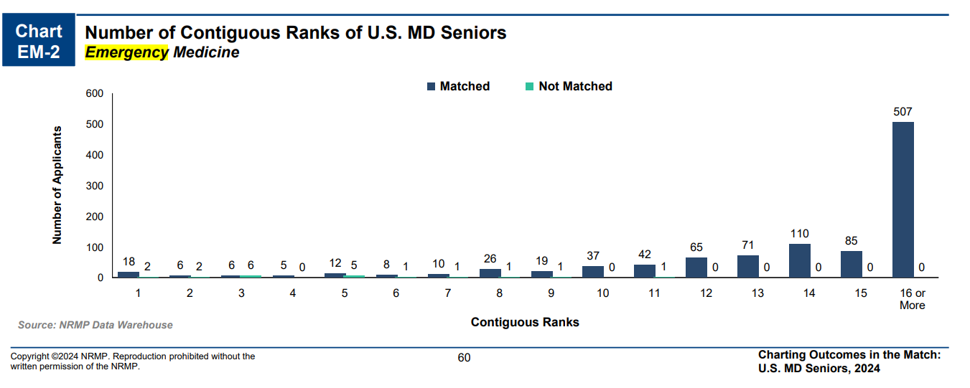
How many programs to apply to…
NRMP Charting Outcomes 2024

Slide 31
How many programs to apply to … Take Aways
You only need 12-14 programs to match (probably much less)
Everyone applied to MORE programs than they needed
Use signaling on reach programs or challenging geographical areas
Class Standing | No. Programs | Make Up of Programs
Exceptional | 18-25 | Mostly Academic
Exceptional/Outstanding | 20-25 | Mostly Academic
Outstanding/Excellent | 20-30 | Mostly Academic
Excellent/Very Well | 45-60 | Some Community
Very Well | 60-80 | 1/3 community
Red Flag | 75-100 | Half Community

Slide 32
Which Programs to apply to …
FREIDA is a good tool to help you look at accredited programs by specialty in different regions around the country. https://freida.ama-assn.org/Freida/#/; EMRA Match has specialty Specific Database
AAMC Residency Explorer is a useful tool in assessing your competitiveness at particular programs: https://www.residencyexplorer.org/Account/Login
MedScope Data *We will review together – this data allows you to see where you stand as a student at UMSOM Where do our students match?
Departmental Advisors (as well as faculty advisors, and senior students) are another key source of program information

Slide 33
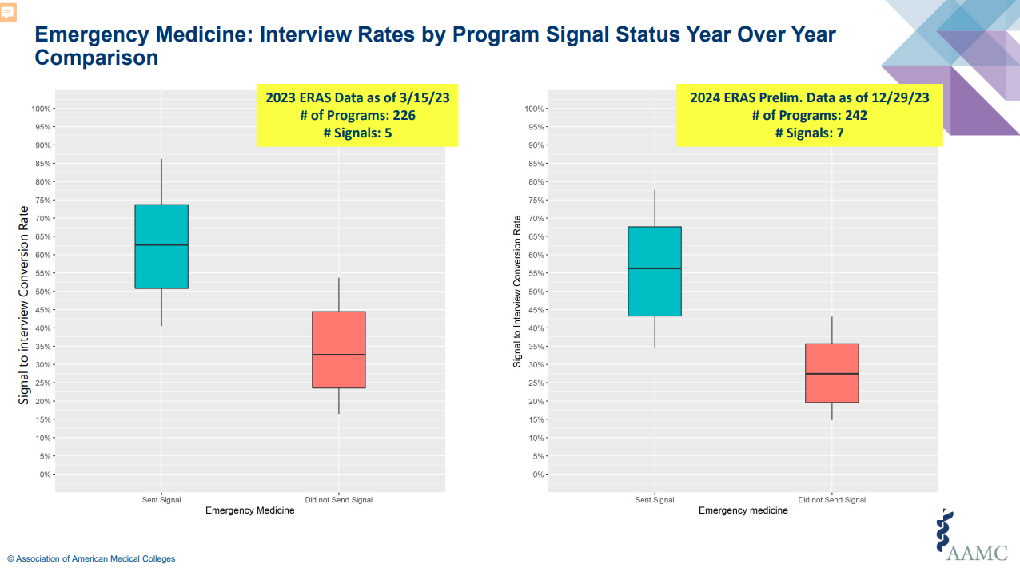
Signaling
Number of Signals Vary per Specialty
Applying to Residencies with ERAS® | Students & Residents (aamc.org)
EMERGENCY MED: 5
*Do not signal home/away

Slide 34
Should I apply through ERAS?
Probably
This is a huge pain, so why ? …
Any student who is dual applying, will require an ERAS application
If there is ANY chance you may consider SOAP in the event you did not match, you likely want to do a skeleton ERAS application so that your letters and other materials are uploaded
You can do this without applying to programs – so without incurring significant cost

Slide 35
Letters of Reference: 3-4 Total Letters
1. HOME SLOE
2. AWAY SLOE
3. Other (Preferably EM Faculty)
Chair Letter is NOT required
EM/IM - 4 letters: 2 SLOEs, IM Chair/IM Sub I EM/peds – 4 Letters: 2 SLOEs, 2 Peds

Slide 36
Contingency Planning
All students need some contingency
Apply to the right #/mix of programs
Rank ALL programs you interview at
Be PROACTIVE – communicate with OSA
Update the MedScope tracker
Geographical constraints – Dual Application

Slide 37
Interviews
Rolling Interview Release
All Interviews will be VIRTUAL (Society Recommendation)
Interview Resources – RAM

