Slide 1
CO2027 Advanced Clinical Phase (ACP) Scheduling

Slide 2
Today’s Schedule
1:00-1:15: Introduction to MS4 Year (Dr. Thom)
1:15-2:00: Advanced Clinical Scheduling (Dr. Flaherty)
2:00-2:30: USMLE Step 2 (Ms. Gillis & Ms. Butler)
2:30-2:45: Ambulatory Requirement (Dr. Millstein)
2:45-3:15: Transition to Residency (TTR) and OSCE (Dr. Siaton) and Holistic Care Requirement (Dr. Dittmar)
3:15-3:30: Break/Transition
3:30-4:00: Extramural/International/VSLO (Dr. Thom & Ms. Jenkins)
4:00- 4:30: Extramural Rotation Student Panel (MS4 Students)

Slide 3
Introduction to MS4 Year Advanced Clinical Phase (ACP) Outline
Introduction to OSA Workshops and Residency Application Manual (Dr. Thom)
Introduction to Residency Application Manual (Dr. Thom)
MS4 Timeline Calendar (Dr. Thom)
What is the ACP? (Dr. Flaherty)
Components of the ACP (Dr. Flaherty)
ACP Scheduling Process (Dr. Flaherty)
Specifics in Scheduling (Dr. Flaherty)
Sample Schedules (Dr. Flaherty)

Slide 4



The Advanced Clinical Phase: Big Picture Overview/Goals
Transition from student to resident
Exploration and confirmation of specialty choice
Build a strong residency application
Readiness for internship / independence
Complete graduation requirements
Celebrating milestones / peer bonding

Slide 5

Session Goals
Overview of the Advanced Clinical Phase
Overview scheduling process and resources available to you
Understand your personal goals
Consider how scheduling can help you achieve your big picture goals
M4 year is designed to individualized
Scheduling will not begin until January
Between now and then will have OSA Advising and JR SR Day
Collaboration between YOU + OSA/Specialty Advisors/near-peers

Slide 6





Slide 7

Resources and Tools
OSA STEPS to Success Career Advising Program
Workshop Series
Multiple 1:1 meetings with OSA
Residency Application Manual
OSA STEPS Newsletters
POM JR/SR Day
This is a collaboration between you and your advisors and support team including OSA, Specialty Advisors and near peers!

Slide 8
Fourth Year Calendar: 2026_2027
Finish M3 Clerkships
Variable
First M4 rotation*
Variable
Winter Break
12/19 – 1/3
*All holidays per TEAM/department
Last possible day of full rotations
4/23/27
Graduation
5/13/27 - tentative
Start of New Academic Year
July 5, 2026
Summer Break
6/20-7/5
OME Calendars
Notes:
NEED TO CHECK ON DATES

Slide 9
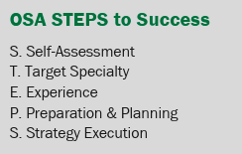
OSA STEPS to Success Career Advising
A longitudinal career advising program designed to support your personal and professional growth on your journey to becoming a physician.
Mentorship
Advising
Opportunities for Personal Growth
Career Counseling
Residency Application Support

Slide 10
Career Workshops for Class of 2027 Clinical Scheduling & Residency Planning
Feb 24 PoM 3: Jr/Sr Day Advising/Residency Application Overview/The MSPE*
Mar-Aug Personal Statement Writing Workshops
May-Jun OSA 1:1 Advising Sessions
Aug Interview Workshops, Mock Interview Programs
Mar: Match Week Workshop*
Dec 9 Advanced Clinical Phase Scheduling*
Aug 6 PoM 3: Introduction OSA Advising/Specialty Choice/CiM*
Nov 4 Taking a Gap Year: Considerations and Planning
Apr TBD The Preliminary and TY Application
Apr OSA Specialty-Specific Advising
Jun Residency Application Workshop (ERAS, SF, Central App and more)
Oct 28 PoM3: Professional Identity/Mission and Brand/CV Tips*
Jan Post Interview Advising/Rank Order Lists
Dec 9 Registration and Timing of Step 2*
Dec 9 Applying for Extramural Rotations: Navigating VSLO and Student Panel
Jan OSA 1:1 Career Decision Making/Scheduling Advising Sessions
*Mandatory Sessions

Slide 11
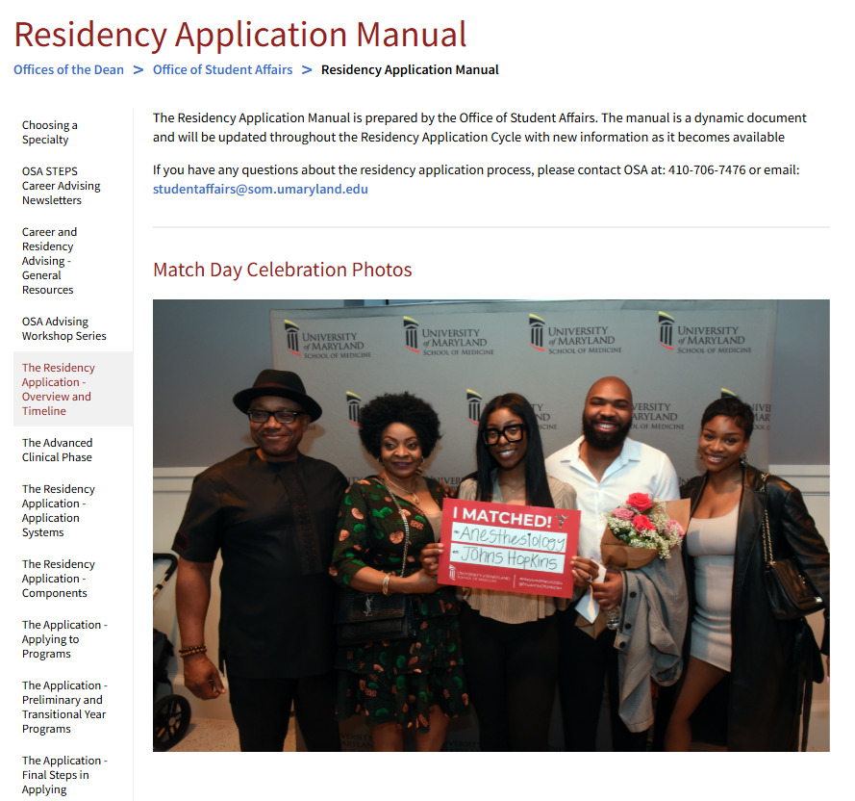
Residency Application Manual https://www.medschool.umaryland.edu/osa/residency-application-manual-/

Slide 12
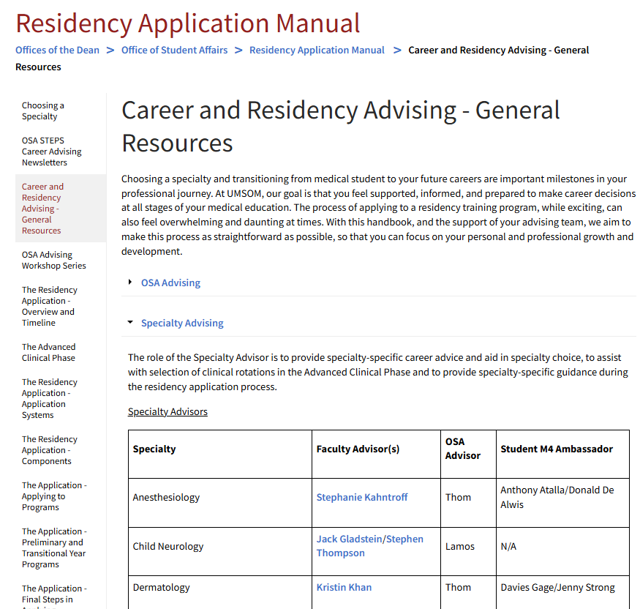
Residency Application Manual https://www.medschool.umaryland.edu/osa/residency-application-manual-/

Slide 13
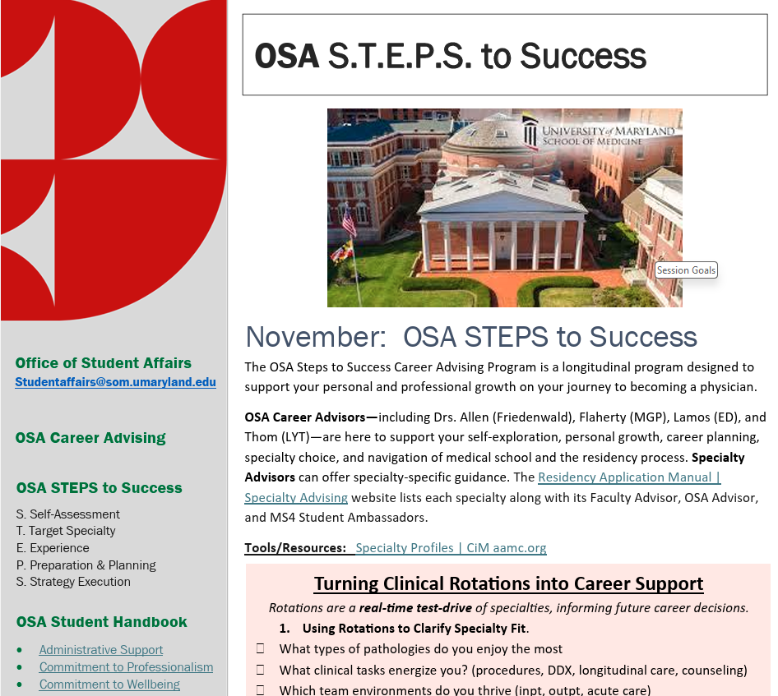
OSA STEPS Newsletter https://www.medschool.umaryland.edu/osa/residency-application-manual-/osa-steps-career-advising-newsletters/
Regular/Monthly Newsletter
Posted in Residency Application Manual
Timely guidance and tips throughout the residency process
Nov/Dec Newsletter
Specialty Decision Making during clinical rotations
Stress-free residency application building
Planning a gap year
The undecided student

Slide 14
I have not chosen a specialty yet …?
Clinical experiences (i.e., Clerkships) is an important deciding factor
You are only halfway through your clerkships!
Use your remaining clerkships to help identify fit
Talk to mentors, advisors, role models
Use tools by CiM
Medical Specialty Preference Inventory (MSPI)
Physician Values in Practice Scale (PVIPS)
Physician Skills Inventory (PSI)
CiM | How to get Unstuck
Specialty Indecision Scale

Slide 15
What is ACP Scheduling?
Begins after completion of the Clerkship Phase and includes clinical rotations beyond core clerkships
Individualized, personal schedules to meet personal and professional goals within the framework of graduation requirements
Flexible options within framework of graduation requirements
You may consider courses that will
Help you explore or confirm a specialty of interest
Fulfill a personal interest
Be useful in preparation for internship
Be useful in preparation for specialty-based courses (e.g. pre-reqs)
Achieve other professional goals, e.g., Research

Slide 16
Components of the ACP: Complete Graduation Requirements!
CO2027 Graduation Requirements
2 Sub-Internships (sub-I)
6 Electives
1 Transition to Residency (TTR)
Ambulatory Requirement
Holistic Care of the Patient
Additional Graduation Requirements → (OSCE, FRCT, USMLE Step 2, Exit Interview with Financial Aid)
Clinical Rotation in Semester of Graduation
Must all be completed ONE week prior to graduation

Slide 17
Components of the ACP: Sub-Internships and Electives
2 Sub-Internships
4-week clinical rotations with direct patient care at an intern level demonstrating independent thinking and clinical decision making
Must be completed “on campus” – i.e. in our catalog
High level of responsibility, absences should be minimized
6 Electives
4-week clinical rotations allowing students to add personalization as well as breadth and depth to their curriculum - Many different elective choices!
Up to (and no more than) TWO Pre-Clerkship Electives may count
Pre-clerkship electives are “on campus”
No more than THREE extramural electives (i.e. clinical rotations not in our course catalog/away rotations) may be counted toward the total elective count for graduation

Slide 18
Components of the ACP: Transition to Residency (TTR)
Designed to prepare you for your first day of residency
4-Weeks
1-week general bootcamp + 3-weeks specialty based
Mon-Fri, no overnights, no weekends
Block 10: March 29- April 23, 2027
Except General Surgery – Block TBD (usually Feb or Mar)
Specific schedules set ~ 1 month in advance
Dr. Siaton (Course Director)

Slide 19


Components of the ACP: Special Requirements
Requirement | Tag in Catalog
At least ONE elective or Sub-I that satisfies the Holistic Care of the Patient requirement
At least ONE elective must have an Ambulatory designation
One rotation CANNOT satisfy BOTH the Holistic Care and Ambulatory requirement
Must be 2 separate rotations

Slide 20
Components of the ACP: Ambulatory Requirement
Dr. Millstein, Course Director, will explain Ambulatory Scheduling
At least ONE of your Electives must have the “Ambulatory” designation/tag
All Ambulatory rotations MUST be scheduled through Course Administrator/Director
Cannot use Add/Drop process to add or change Ambulatory rotation without course approval

Slide 21
Components of the ACP: Holistic Care of the Patient
At least ONE elective or Sub-I that satisfies the Holistic Care of the Patient requirement
Dr. Dittmar will describe this requirement later
It is your responsibility to ensure that you are signing up for courses that meet this requirement
Note: Holistic Care “tags” are only in the 2026-2027 Catalog.
If you choose a rotation that counts for the Holistic Care requirement and take it in Block 11-12 (follows the 2025-2026 Catalog), you can still get credit for that requirement. It just will not be seen in the 2026-2027 catalog.
A list of the holistic care requirement rotations will be posted for reference.

Slide 22
Components of the ACP: Combining the Requirements
One rotation CANNOT satisfy BOTH the Holistic Care and Ambulatory requirement→ Must be 2 separate rotations
Ambulatory Rotation
Holistic Care Rotation
NO

Slide 23
Components of the ACP: OSCE
All students must take and pass an OSCE to graduate
Must complete core clerkships (except EM) first
Will occur in May/June (scheduling around March)
Must be a registered student to complete OSCE
Students on leave or off-cycle may need to schedule an alternative date in coordination with OME/OSA

Slide 24
Components of the ACP: FRCT
All students must complete an FRCT Scholarly Project to graduate
Course Director: Dr. Matteson
January 31, 2026: If you have not submitted an FRCT proposal by this date, you must schedule a Research Elective and an FRCT month in the Fall 2026 term
Research Elective counts as 1 of 5 electives; must be coordinated in advance with course director, Dr. Carey
FRCT month does NOT count as an elective; cannot be co-scheduled with another rotation
June 30, 2026: If you have not submitted a Final report by this date, you must schedule an FRCT month in the Fall 2026 term

Slide 25

Components of the ACP: USMLE Step 2
Ms. Gillis and Ms. Butler will go into more detail
Recommend taking an unscheduled month for study prep
Use materials provided by NBME for study
Do not schedule CK for first day of a rotation
Must take Step 2 CK before 4/23/2027 to graduate
In reality, must have score for residency applications (~ Sept 2026)
*2026 Match Cycle – Must take Step 2 by July 26th to get scores back
Episode 30: Step 2 CK

Slide 26

Graduation Requirements
Ellucian Degree Works Dashboard
Pass ALL (8) third-year clerkships, including shelfs
Pass TWO Sub-internships (4-weeks each)
Pass SIX 4-week electives (see elective specifics)
Pass ONE PoM 4: Transition to Residency
Complete the FRCT Scholarly Project
Pass OSCE
Complete Exit Interview with Financial Aid
Satisfy Ambulatory Requirement
Take USMLE Step 2 CK
Clinical Rotation in Semester of Graduation
Satisfy Holistic Care Requirement
*All requirements must be complete 1 week prior to graduation*

Slide 27

It is common to….
Take additional electives, away rotations or sub-internships beyond simple graduation requirements to…
Obtain letters of recommendation for residency.
Prepare for a contingency/back-up plan.
Prepare for dual-application.
Hone specific skills.
Try something you may never do again.
Have FUN (?!?!)

Slide 28
ACP Scheduling Process
Survey #1: SubI #1/Key Rotation (1/30-2/6)
Survey #2: Ambulatory (2/11-2/17)
Survey #3: Electives (2/24-3/2)
Survey #4: Holistic Care/SubI #2 (3/11-3/16)
Pre-Scheduling:
Outstanding Clerkships (NOW)
Phase 2 Scheduling: Add/Drop (starts 3/30)
Pre-Scheduling
Outstanding Clerkships
Phase 1 Scheduling
Series of 4 surveys February-March
Equity in adding key rotations to meet residency application goals and core requirements
Phase 2 Scheduling
Self-Schedule for everything else via Add/Drop Process
You likely will change your schedule in Add/Drop!
Dates listed are survey start/stop times; schedules will be posted within one week of survey closing​
Swap Period

Slide 29
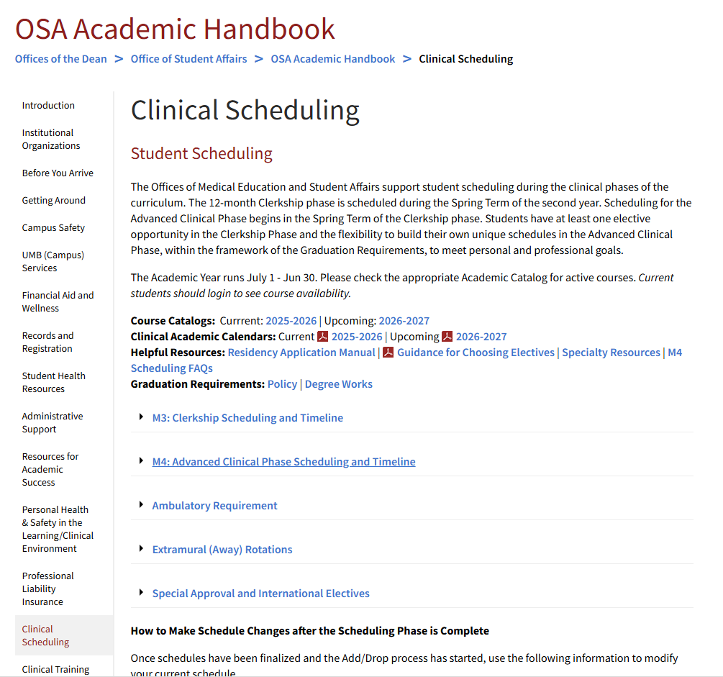
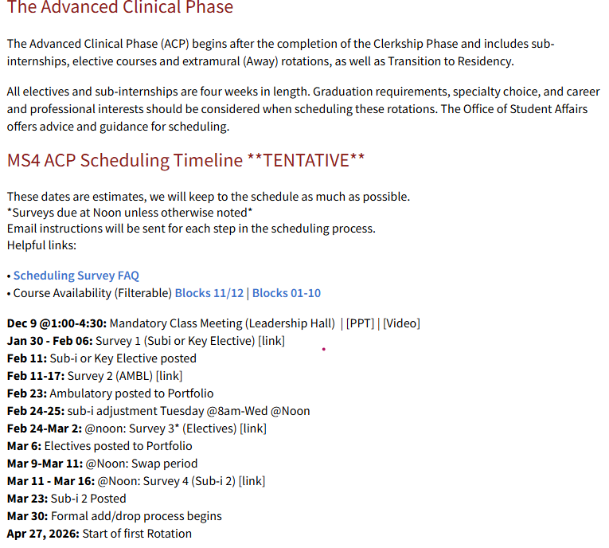
But I did not memorize those dates….!

Slide 30
ACP: Pre-Scheduling
All clerkships must be scheduled BEFORE the ACP (M4) scheduling begins
Outstanding clerkships are placed as early in your schedule as possible
Assigned by lottery
All clerkships (except EM) must be completed before Step 2
Can schedule electives/Sub-Internships before completing, but be aware of pre-requisites
Review your Medscope and Degree Works Profiles
It is your responsibility to ensure ALL requirements are scheduled and completed
Notes:
If you have clerkship work to complete during the advanced clinical phase and you are uncertain how to proceed with scheduling, you may make an appointment with an OSA dean soon to discuss options/constraints with your fourth-year schedule; We will enter your clerkships in advance of opening the scheduler to the Class of 2025

Slide 31
ACP Scheduling: Phase 1→Surveys
4 Surveys
Rotations assigned through best fit for the class
Rotations NOT assigned as first-come-first-serve
Strict opening and closing dates of the surveys
Includes “swap” period where you can adjust your schedule before survey phase is completed
“Must Have” rotations scheduled in this phase
No special approval electives scheduled during this phase
All remaining scheduling will be done in Phase 2→Add/Drop

Slide 32
Survey #1: Key Rotation (Sub-I/Key Elective)
Survey #3: Electives (up to 3) & EM Clerkship
Survey #2: Ambulatory Rotation
Survey #4: Holistic Care Rotation/Sub-I

Slide 33
ACP Survey #1: Key Rotation
Your Key Rotation may be a Sub-Internship OR an Elective
Some specialties do not have a specific Sub-I
e.g: Ophthalmology's key rotation is the Ophthalmology Elective, they don’t have a sub-I
Use this survey to secure the rotation that is most important for your residency application process
Likely the rotation that you will ask for an advanced clinical phase letter of recommendation (LOR) for your residency application
Aim to schedule in Blocks 11 (May), 12 (June), 1 (July), 2 (August)
Block 3 (September) and beyond will NOT be eligible for LORs due to timing
Therefore, use Blocks 11-2 to secure your important rotation

Slide 34
ACP Scheduling: Phase 2→Add/Drop
Once the surveys are completed, you will have the ability to finish scheduling or change your schedule via Add/Drop Process
YOU LIKELY WILL CHANGE YOUR SCHEDULE!
If you don’t get what you want initially on the surveys, that is OK.
If you change your specialty after the survey process, that is OK.
If you hate what you chose, that is OK.
If you want to do something different, that is OK.

Slide 35
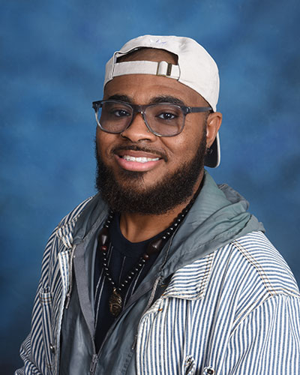
So, what if I want to change?
Dropping a Course: MUST Drop within specific time frames
Electives: TWO weeks notice
Sub-Is or Ambulatory*: FOUR weeks notice
*Any changes to Ambulatory block must be approved by Ambulatory Course Director/Administrator via e-mail PRIOR to changing (drop or add) the course
Drops within these time periods may be done by students through your medscope page
Add: Fill out Add Form
It is not added and complete until you see it on Medscope and/or Degree works
If you have not seen any movement in 1 week, please reach out to Mr. Wynder.
Questions
Brian Wynder SOM Records & Registration Coordinator Office: HSF 1 – Rm 147 Email: bwynder@som.umaryland.edu

Slide 36
Some Extras: Rotations with Special Parameters
These rotations will NOT be schedule through the Survey Scheduling Process
These rotations can add these later via Drop Add.
Course Contacts listed in Course Catalog
Extramural (Away) Rotations
International Electives
Special Permission Electives

Slide 37
Extramural (Away) Rotations
External Rotations are NOT required for all students
Student may choose to do ‘away’ rotations for multiple reasons
Dec 9, 2025 - External Rotation Workshop (TODAY!)
Certain specialties they are required: EM
Certain specialties they are expected:
PM&R, Child Neuro (no home programs)
Dermatology, Neuro Surg, Ophtho, Ortho, OTO, Plastics, Radiation Onc, Urology
May also be considered in some circumstances
Geographic preference
Competitiveness

Slide 38
OK, but how do Aways work anyway?
Most schools/programs schedule their away rotations through VSLO (Visiting Student Learning Opportunities)
You will receive authorization for VSLO in January
Schools not participating in VSLO – follow instructions on webpages
All students must review a short module and attest to expected practices to gain access to VSLO
UMSOM Contact: Bailey Jenkins
Deciding where to apply
Location/program of interest
Advice from specialty advisors
Discuss with OSA
Note: Calendars may not match – speak with OSA Dean

Slide 39
Away Rotations: THIS IS REALLY IMPORTANT
You MUST register with UMSOM before the rotation to get credit!
UMSOM Contact: Brian Wynder
IF YOU DO NOT REGISTER with UMSOM …
You will NOT receive credit toward graduation
It will NOT be on your transcript
You are NOT covered for Malpractice insurance
You WILL receive a professionalism citation, which may be noted on your MSPE

Slide 40
What about International Electives?
Follow process for off campus electives
Additional paperwork is required
Countries with Department of State Travel Advisories above level 1 may require additional approvals
UMSOM Registrar Contact: Brian Wynder
UMB Center for Global Engagement

Slide 41
Electives Requiring Special Permission
Advanced Dermatology
Eastern Shore AHEC Health Department
Family and Community Medicine- Ambulatory
Family Medicine- Ambulatory Sub-I
Family Medicine in Kenya
Indian Health
Infectious Disease – Zambia
Legislative Medicine
Neurology Elective ReVitalizing Education
Obstetric Ultrasound and Prenatal Genetics
Public Health
Patient Safety Quality Improvement
Research Elective
Rural Ambulatory Medicine
Sports Medicine
Women’s Health in Family Medicine, Eastern Shore

Slide 42
The ACP: Resources + Getting Started General Advising
UMSOM Residency Application Manual
Specialty Advisors & Senior Students: Feb 3rd: PoM 3 Junior/Senior Day
Advisors: A list of advisors (departmental faculty, students, and OSA) by specialty are included in the Career and Residency Advising
OSA Advisors: Scheduling Office Hours for your class in January

Slide 43
The ACP: Resources + Getting Started Logistics
OSA Academic Handbook – Clinical Scheduling
Course Catalog: Catalog (2026-2027)-Log in through MedScope
Academic Calendar: Calendars
Graduation Requirements: Graduation Requirements
Elective and Sub-I Considerations: Guidance for Choosing Rotations
Away Rotation Information: Extramural (Away) Rotations
Self Scheduling Guidance: Add/Drop Process

Slide 44
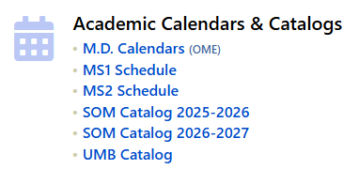
How to use the Course Catalog?
MedScope
Catalog (2026-2027) or Catalog (2025-2026)
Login

Slide 45
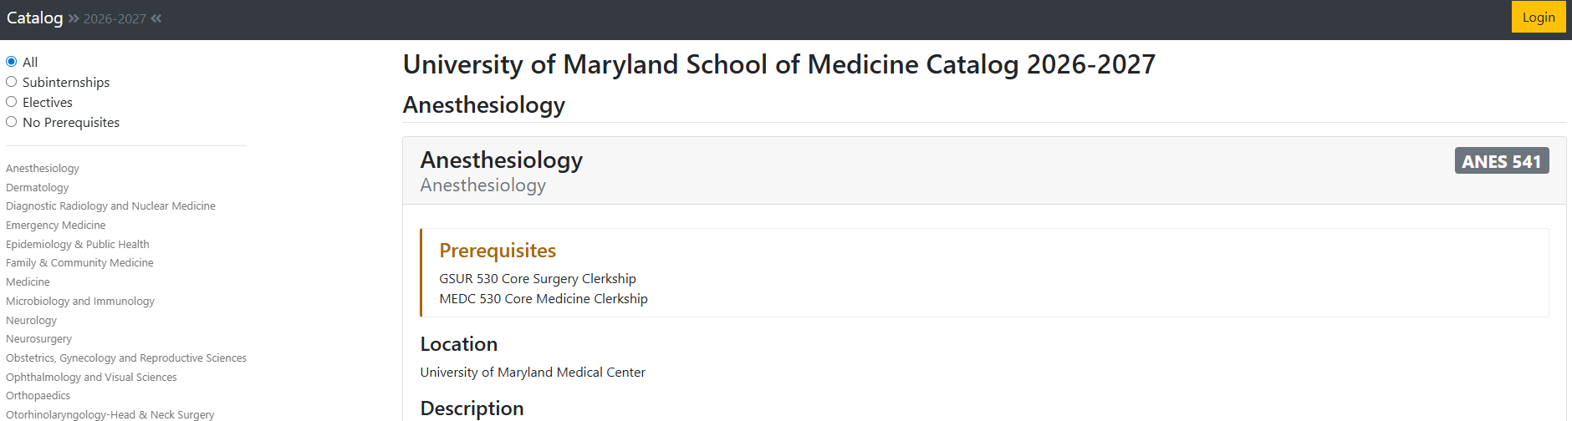
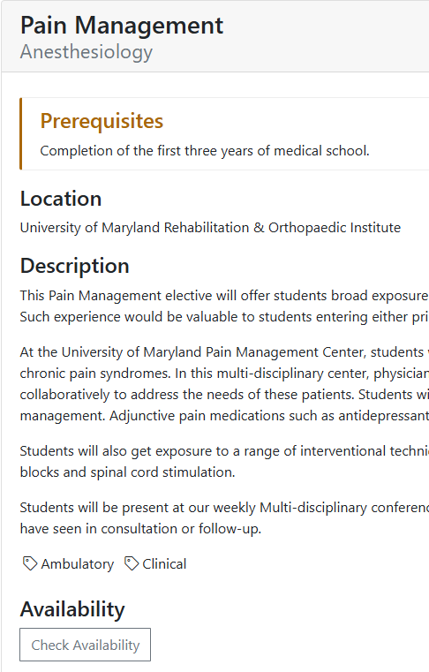
Course Catalog- Login
Must Login to see “tags” and Availability

Slide 46
What else should I be thinking about?
Students may leave one (or two) unscheduled months during peak interview times
Typically, Oct, Nov, Dec, Jan
Discuss ideal months with OSA/Department mentors
Do NOT schedule Away rotations and avoid Sub-Is during interview months if possible
There is very LITTLE room to miss days on those rotations and could end up in not passing the course or professionalism issues
Missing Days for Rotations
Some rotations can give leeway for missed days for interviews, BUT this is at discretion of course director and MUST be discussed in advance
Again, NOT away rotations or Sub-Is

Slide 47
Considering a Gap/Leave?
Review Leave of Absence Policy and LOA Resources Page
Review the PPT/Video Residency Application Manual: Workshop Series
Meet with an OSA Dean
Consider impact on Financial Aid (meet with FA Counselor)

Slide 48
Alternate/Non-Clinical Medical Careers
Some people choose to not apply to residency or pursue clinical medicine
How can you use your MS4 year to prepare for this type of path?
Review Options: Alternative Medical Careers
Find electives that hone specific skills important to those careers
Public Health
Patient Safety and Quality Improvement
Neurology Elective ReVitalizing Education
Adverse Childhood Experiences
Forensic Psychiatry
Eastern Shore AHEC Health Department
Rotations in specific areas to learn how that sub-set of medicine works
Consider Away rotations that are Non-Clinical
Examples can include Medical/Clinical Informatics, Business in Medicine, Medical Education Curriculum Design, Law and Medicine, Quality Improvement, Patient Safety, Medical Administration, Health Care Quality, Public Health

Slide 49
Sample Schedules

Slide 50
Sample MS4 Schedule (One of many possible schedules)
May (11) | Jun (12) | 6/22 to 7/5 | Jul (1) | Aug (2) | Sep (3)
4/27 to 5/27 | 5/25 to 6/19 |  | 7/6 to 7/31 | 8/3 to 8/28 | 8/31 to 9/25
Elective #1 | OFF (Step 2 Studying) | 2-week vacation | Sub-Intern #1 | Elective #2 (Or Away) | Elective #3 (or Away)
Oct (4) | Nov (5) | Dec (6) | 12/21 to 1/3 | Block 11, 12 – Spring 2025
9/28 to 10/23 | 10/26 to 11/20 | 11/23 to 12/18 | 11/20 to 12/15 | Block 1, 2 – Fall 2025
Elective #4 (Ambulatory) | OFF (Interviews) | OFF (Interviews) | Winter Break | Block 3 - Residency Applications Due (end of September)
Jan (7) | Feb (8) | Mar (9) | Apr (10) | May
1/4 to 1/29 | 2/1 to 2/26 | 3/1 to 3/26 | 3/29 to 4/23
Sub-Intern #1 (Clinical, Holistic Care) | Elective #5 | Elective #6 | TTR | Graduation / Unscheduled
Option 1:
-Clerkship Start
4/28/2025
- NO elective in MS3

Slide 51
Sample MS4 Schedule (One of many possible schedules)
May (11) | Jun (12) | 6/22 to 7/5 | Jul (1) | Aug (2) | Sep (3)
4/27 to 5/27 | 5/25 to 6/19 |  | 7/6 to 7/31 | 8/3 to 8/28 | 8/31 to 9/25
Elective #2 | OFF (Step 2 Studying) | 2-week vacation | Sub-Intern #1 | Elective #3 (Or Away) | Elective #4 (or Away)
Oct (4) | Nov (5) | Dec (6) | 12/21 to 1/3 | Block 11, 12 – Spring 2025
9/28 to 10/23 | 10/26 to 11/20 | 11/23 to 12/18 | 11/20 to 12/15 | Block 1, 2 – Fall 2025
Elective #5 (Ambulatory) | OFF (Interviews) | OFF (Interviews) | Winter Break | Block 3 - Residency Applications Due (end of September)
Jan (7) | Feb (8) | Mar (9) | Apr (10) | May
1/4 to 1/29 | 2/1 to 2/26 | 3/1 to 3/26 | 3/29 to 4/23
Sub-Intern #1 (Clinical, Holistic Care) | Elective #6 | OFF | TTR | Graduation / Unscheduled
Option 2
-Clerkship Start
4/28/2025
- 1 MS3 elective

Slide 52
Sample MS4 Schedule (One of many possible schedules)
May (11) | Jun (12) | 6/22 to 7/5 | Jul (1) | Aug (2) | Sep (3)
4/27 to 5/27 | 5/25 to 6/19 |  | 7/6 to 7/31 | 8/3 to 8/28 | 8/31 to 9/25
Elective #3 | OFF (Step 2 Studying) | 2-week vacation | Sub-Intern #1 | Elective #4 (Or Away) | Elective #5 (or Away)
Oct (4) | Nov (5) | Dec (6) | 12/21 to 1/3 | Block 11, 12 – Spring 2025
9/28 to 10/23 | 10/26 to 11/20 | 11/23 to 12/18 | 11/20 to 12/15 | Block 1, 2 – Fall 2025
Elective #6 (Ambulatory) | OFF (Interviews) | OFF (Interviews) | Winter Break | Block 3 - Residency Applications Due (end of September)
Jan (7) | Feb (8) | Mar (9) | Apr (10) | May
1/4 to 1/29 | 2/1 to 2/26 | 3/1 to 3/26 | 3/29 to 4/23
Sub-Intern #1 (Clinical, Holistic Care) | OFF | OFF | TTR | Graduation / Unscheduled
Option 3
-Clerkship Start
4/28/2025
1 elective in MS3 AND
1 preclerkship elective

Slide 53
Sample MS4 Schedule (One of many possible schedules)
May (11) | Jun (12) | 6/22 to 7/5 | Jul (1) | Aug (2) | Sep (3)
4/27 to 5/27 | 5/25 to 6/19 |  | 7/6 to 7/31 | 8/3 to 8/28 | 8/31 to 9/25
4-week clerkship | OFF (Step 2 Studying) | 2-week vacation | Sub-Intern #1 | Elective #2 (Or Away) | Elective #3 (or Away)
Oct (4) | Nov (5) | Dec (6) | 12/21 to 1/3 | Block 11, 12 – Spring 2025
9/28 to 10/23 | 10/26 to 11/20 | 11/23 to 12/18 | 11/20 to 12/15 | Block 1, 2 – Fall 2025
Elective #4 (Ambulatory) | OFF (Interviews) | OFF (Interviews) | Winter Break | Block 3 - Residency Applications Due (end of September)
Jan (7) | Feb (8) | Mar (9) | Apr (10) | May
1/4 to 1/29 | 2/1 to 2/26 | 3/1 to 3/26 | 3/29 to 4/23
Sub-Intern #1 (Clinical, Holistic Care) | Elective #5 | Elective #6 | TTR | Graduation / Unscheduled
Option 5
-Clerkship Start
5/26/2025
1 preclerkship elective

Slide 54
Sample MS4 Schedule (One of many possible schedules)
May (11) | Jun (12) | 6/22 to 7/5 | Jul (1) | Aug (2) | Sep (3)
4/27 to 5/27 | 5/25 to 6/19 |  | 7/6 to 7/31 | 8/3 to 8/28 | 8/31 to 9/25
Elective #2 | OFF (Step 2 Studying) | 2-week vacation | Sub-Intern #1 | Elective #3 (Or Away) | Elective #4 (or Away)
Oct (4) | Nov (5) | Dec (6) | 12/21 to 1/3 | Block 11, 12 – Spring 2025
9/28 to 10/23 | 10/26 to 11/20 | 11/23 to 12/18 | 11/20 to 12/15 | Block 1, 2 – Fall 2025
EM 4 week clerkship | OFF (Interviews) | OFF (Interviews) | Winter Break | Block 3 - Residency Applications Due (end of September)
Jan (7) | Feb (8) | Mar (9) | Apr (10) | May
1/4 to 1/29 | 2/1 to 2/26 | 3/1 to 3/26 | 3/29 to 4/23
Sub-Intern #1 (Clinical, Holistic Care) | Elective #5 (ambulatory) | Elective #6 | TTR | Graduation / Unscheduled
Option 5
-Clerkship Start
5/26/2025
1 MS3 Elective
Deferred EM into MS4 year

Slide 55
Option 6 and beyond…
There are many different iterations based on your specific situation..

Slide 56
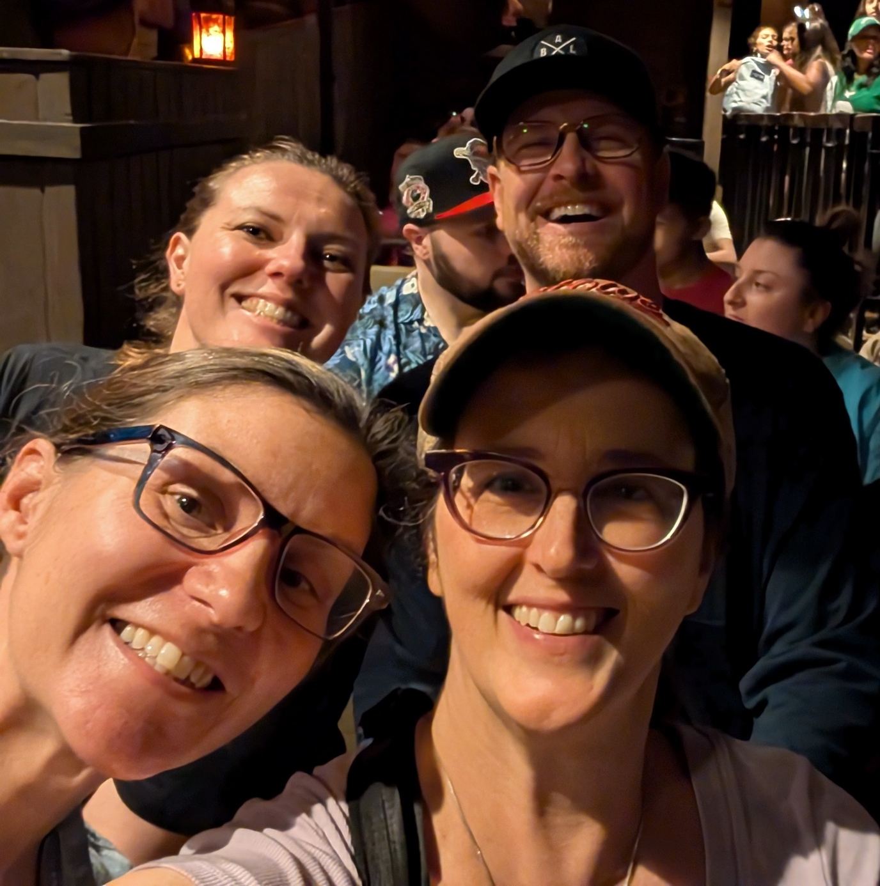
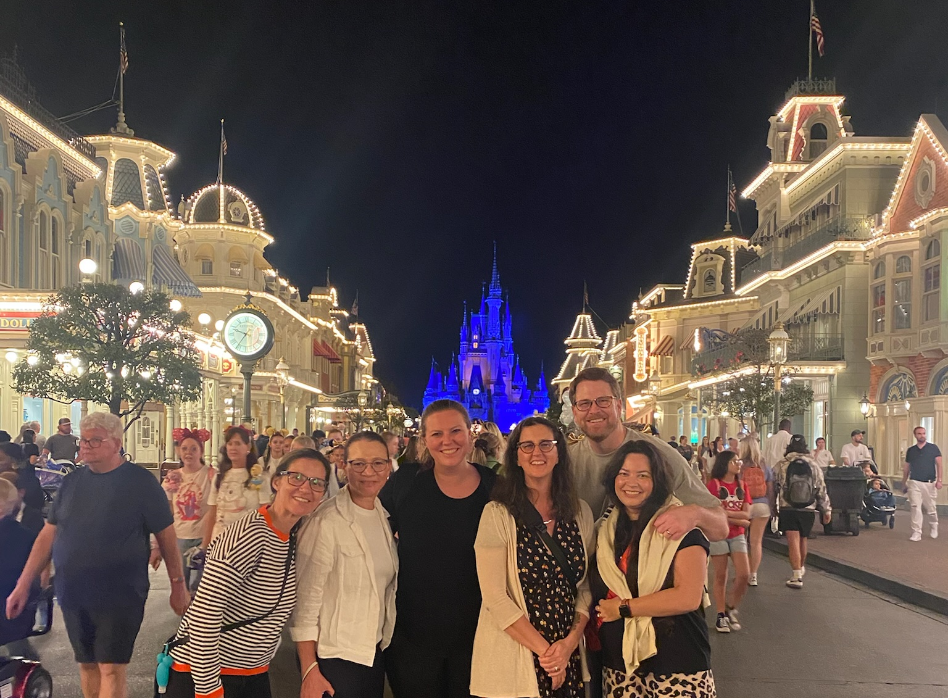
Meeting with an OSA Dean can help you figure it out!
Scheduling links to be sent out after meeting to schedule with an OSA Dean in January
Dr. Thom
Dr. Lamos
Dr. Allen
Dr. Flaherty

Slide 57
Today’s Schedule
1:00-1:15: Introduction to MS4 Year (Dr. Thom)
1:15-2:00: Advanced Clinical Scheduling (Dr. Flaherty)
2:00-2:30: USMLE Step 2 (Ms. Gillis & Ms. Butler)
2:30-2:45: Ambulatory Requirement (Dr. Millstein)
2:45-3:15: Transition to Residency (TTR) and OSCE (Dr. Siaton) and Holistic Care Requirement (Dr. Dittmar)
3:15-3:30: Break/Transition
3:30-4:00: Extramural/International/VSLO (Dr. Thom & Ms. Jenkins)
4:00- 4:30: Extramural Rotation Student Panel (MS4 Students)

Slide 58
Unpacking STEP 2 CK
Tess Gillis & Courtney Butler
Student Success

Slide 59
What is Step 2?
The Exam in A Snapshot
Written by NBME
Passing Score: 218 / 300
8 testing hours, 1 hour of break time = 9 hr. testing day!
40 questions, 1 hr. each = 320 total questions
One block worth of experimental questions
Accommodations will impact exam timing & conditions
Score reports turn around in 2-4 weeks, on Wednesdays
Benchmark in education & graduation requirement
3 attempts to pass
Tests medical knowledge, skills and clinical science essentials
UMB Student Mean: 251
99% PASS Rate in 2025 (98% National Avg.)
Woohoo!
STEP 1
STEP 2
STEP 3

Slide 60
Did you Have Accommodations for Step 1?
YES
No
It’s a shorter process
Subsequent Request form
Allow 60 business day turnaround, but often quicker the earlier you submit
Begin now, if needed
New Request form
60 business day turnaround time
Talk to Tess/Courtney about the process and for information

Slide 61
Registering for Step 2 CK
NBME: https://apps.nbme.org/nlesweb/#/login
Exam Fee: $695
Eligibility Period: 3-month window
If Step 1 within 5 years, no need for identity verification
NBME emails permit, go to Prometric site to schedule
If more than 5 years, the identity verification process now online
Register: have sense of timing/study period
$70 fee to change eligibility period

Slide 62
Timing of Step 2 CK
More individualized than Step 1
4-week block to study is most common
Can combine with Summer Break (June 22 – July 5) for 5-6 weeks
Timeline from Step 1 not necessarily an indicator for Step 2 CK
Closer to the end of rotations is best
Consider with OSA: Sub-I, Aways, Applications, Scores
May be able to study during electives, Sub-I's not so much
Score Return: typical 3-4 weeks
Score report delays: typically, April/May, receive in early June
Late July is safest last test dates for score return before applications

Slide 63
Consider Your Shelf Exams
Close translation to Step 2
How are they going for you?
Support: meet with Tess, Courtney, PLPs
Tweak your study strategies/resources/plan
Why are you getting things wrong?
Anki is not always the answer.
Use practice shelf exams, use explanations
Insights feature in myNBME
Review shelf exams: trends in tough systems, disciplines?
Question details for practice exam review

Slide 64
What's Being Tested: USMLE Content Charts
System | Range, %
Human Development** | 2–4
Immune System | 3–5
Blood & Lymphoreticular System | 3–6
Behavioral Health | 5–10
Nervous System & Special Senses | 5–10
Musculoskeletal System/Skin & Subcutaneous Tissue | 6–12
Cardiovascular System | 6–12
Respiratory System | 5–10
Gastrointestinal System | 5–10
Renal & Urinary System & Reproductive Systems | 7–13
Pregnancy, Childbirth & the Puerperium | 3–7
Endocrine System | 3–7
Multisystem Processes & Disorders | 4–8
Biostatistics & Epidemiology/Population Health/Interpretation of Medical Literature | 3–5
Social Sciences: Legal/Ethical Issues & Professionalism/Systems-based Practice & Patient Safety | 10-15
Physician Task: Competency | Range, %
Medical Knowledge: Applying Foundational Science Concepts | 0**
Patient Care: History and Physical Exam | 0***
Patient Care: Laboratory/Diagnostic Studies | 13–17
Patient Care: Diagnosis | 16–20
Patient Care: Prognosis/Outcome | 5–9
Patient Care: Health Maintenance/Disease Prevention | 5–10
Patient Care: Pharmacotherapy | 8–12
Patient Care: Clinical Interventions | 6–10
Patient Care: Mixed Management | 12–16
Practice-based Learning & Improvement | 3–5
Professionalism | 5–7
Systems-based Practice & Patient Safety | 5–7
Discipline: Competency | Range, %
Medicine | 55–65
Surgery | 20–30
Pediatrics | 17–27
Obstetrics & Gynecology | 10–20
Psychiatry | 10–15
Key Takeaways:
Weights of system may impact the order of study
When to study system vs discipline
UW questions roughly equate to % of the system

Slide 65
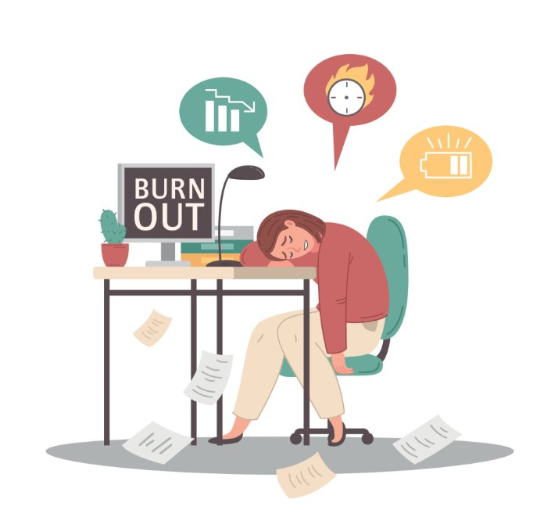
Elements of Study Plan
Baseline practice exam (NBME 12)
Use targeted UWorld questions based on baseline exam score report
System-based
Discipline-based
Aim for 100-120 daily UWorld questions
Consider 1-2 content + 1 mixed block
Practice shelf exams: once good chunk through UWorld, add in 1 shelf or split over two days
Helps create familiarity with NBME language
Use for discipline-specific questions
Anki is less-heavy emphasis
Practice Exam(s):
NBMEs: 9-16 (don’t recommend form 9)
UW2, 1 week before exam, Free 120 4-5 days out
~1 day off per week

Slide 66

Resources for Step 2 CK
Qbank
Uworld has 4,000+ questions
AMBOSS: qbank
Comprehensive Review:
Texts: First Aid for Step 2 CK, Step Up to CK, Step Up to Medicine
AMBOSS articles
Online MedEd: subscription (videos, flashcards, questions)
Podcast: Divine Intervention (especially for Medicine)

Slide 67
Questions
Connect with Us!
STEP Timeline
Study Planning
Shelf Exams
Email for Schedule Link:
tess.gillis@som.umaryland.edu
Courtney.Butler@som.umaryland.edu

Slide 68
Today’s Schedule
1:00-1:15: Introduction to MS4 Year (Dr. Thom)
1:15-2:00: Advanced Clinical Scheduling (Dr. Flaherty)
2:00-2:30: USMLE Step 2 (Ms. Gillis & Ms. Butler)
2:30-2:45: Ambulatory Requirement (Dr. Millstein)
2:45-3:15: Transition to Residency (TTR) and OSCE (Dr. Siaton) and Holistic Care Requirement (Dr. Dittmar)
3:15-3:30: Break/Transition
3:30-4:00: Extramural/International/VSLO (Dr. Thom & Ms. Jenkins)
4:00- 4:30: Extramural Rotation Student Panel (MS4 Students)

Slide 69
MS4 Ambulatory Rotation
Clinical education on outpatient Health care for rural and urban underserved marylanders

Slide 70
Topics to Cover:
Ambulatory Curriculum
Overview of Ambulatory Opportunities -- ** Do NOT count as “Aways”**
On Campus Electives
AHEC (Eastern, Western, Central)
Off Campus Electives
Out of State AHEC
Indian Health
Ambulatory Global Health
Scheduling, Switching

Slide 71
Ambulatory Curriculum
Regardless of rotation choice all students are required to complete the Ambulatory Curriculum during their ambulatory rotation.
Addiction Curriculum and Zoom meeting – also meets requirements for future DEA licensing
Healthcare Disparities Zoom meeting and Reflection
Details emailed prior to each block

Slide 72
Ambulatory Opportunities: On Campus Electives
An already established outpatient elective at UMSOM
Will have the “Ambulatory Tag” in Medscope
There are caps to how many students can do on campus electives for ambulatory credit each block
Designed to provide additional outpatient experiences that align with your future residency plans
Examples:
Dermatology Peds Endocrine
Outpatient Ortho Radiation Oncology
Women’s Health PACT

Slide 73
Ambulatory Opportunities: AHEC (Eastern, Western, Central)
Amazing and unique clinical experiences with established preceptors
Eastern and Western AHEC
Clinical areas include Family Medicine, Internal Medicine, Med Peds, Women’s Health, Pediatrics
Housing costs are covered in Eastern and Western AHEC
Additional preceptors in Southern MD
Your own housing needed
Central MD AHEC - FM in Bowie and IM in Annapolis
Your own housing needed

Slide 74
Ambulatory Opportunities: AHEC cont. (Eastern, Western, Central)
What is an AHEC?
“Area Health Education Center”
A National Program
Mission “To enhance access to quality health care, particularly primary and preventive care, by improving the supply, distribution, quality and diversity of health care professionals through community-academic educational partnerships”
AHEC AMBULATORY

Slide 75
Ambulatory Opportunities: Off Campus Electives
Designed to allow for continuation of Primary Care Longitudinal Elective or Medical Spanish Elective
Specific preceptors who have faculty appointments with UMSOM
St Clare Medical Outreach: Dr Saba (Requires medical Spanish)
Total Family Care: Dr Talwar (Requires prior rotation with practice)

Slide 76
Ambulatory Opportunities: Out of State AHEC, Amb Global Health, and Indian Health
Student must coordinate with site, processes available on Medscope
Out of State AHEC – must be affiliated with an established AHEC
Prior rotations: Hawaii, Kentucky, Pennsylvania
Ambulatory Global Health
Prior sites: Myanmar, Congo West Africa, Himalayan Health Exchange in Tibet, Primeros Pasos (Guatemala), Clinica Esperanza (Honduras)
Indian Health Service
www.ihs.gov
Southwest and Pacific North are most common

Slide 77
Potential Expenses
Some sites require drug screens or background checks
Accounted for in your financial aid package
Ask if a letter of good standing will suffice for background check
Housing
Free for AHEC West and AHEC East
Not covered by UMSOM for Global/ IHS but may be available at low cost
Travel
Not covered

Slide 78
Initial Scheduling
Ambulatory will be scheduled as part of the MS4 master scheduling process
Surveys will come from Medscope
Response by deadlines is essential for your choices to be considered
Surveys will ask block preferences and preference of ambulatory opportunity – ask your questions BEFORE the survey!
January and Feb are most requested for ambulatory – it is not possible to fit everyone in at this time. If you choose an alternate block, you are more likely to get first choice in rotation type!

Slide 79
Baltimore Criteria
Please notify us on the survey if you meet the following criteria which ensure that your rotation will be local:
You have children
You are primary caretaker of another family member
You have a personal health reason that prevents travel

Slide 80
Switching
Follow all directions from Medscope regarding switch periods
MS3 Switching
There will be times with No Switching due to focus on another part of the schedule
There will be times with Open Switching done by me/ medscope
There will be times with traditional Switching with add drop process
MS4 Switching
Switching occurs through add drop process
Must be communicated to me prior to changes as caps are not all visible to students
Cannot drop within 4 weeks of start date

Slide 81
QUESTIONS?
lmillste@som.umaryland.edu

Slide 82
Today’s Schedule
1:00-1:15: Introduction to MS4 Year (Dr. Thom)
1:15-2:00: Advanced Clinical Scheduling (Dr. Flaherty)
2:00-2:30: USMLE Step 2 (Ms. Gillis & Ms. Butler)
2:30-2:45: Ambulatory Requirement (Dr. Millstein)
2:45-3:15: Transition to Residency (TTR) and OSCE (Dr. Siaton) and Holistic Care Requirement (Dr. Dittmar)
3:15-3:30: Break/Transition
3:30-4:00: Extramural/International/VSLO (Dr. Thom & Ms. Jenkins)
4:00- 4:30: Extramural Rotation Student Panel (MS4 Students)

Slide 83
MSIV OSCE and Transition to Residency (TTR) Overview
Bernadette Siaton, MD, MEdHP
Assistant Dean for the UME-GME Transition

Slide 84
Summative Assessment
This OSCE takes place at the end of your 3rd year after you have completed your core clerkships
Occurs in May/June with an additional session in Jan for off-cycle students only
Scheduling outside of these times will incur a fee
Missed OSCEs will receive professionalism citation and no-show charge

Slide 85
OSCE Format
Number of cases TBD at this time (estimate 4-6 cases for this assessment)
15 mins per case with additional time for post-encounter documentation
Students will perform a focused history and physical for all cases. A telehealth case may be included.

Slide 86
OSCE Format
Scored on a Satisfactory/Fail grading scale
Final score is the average of each of the individual cases
The pass threshold is 2 SD below the class average
Students are offered 1 remediation after failure
Students are referred to the Advancement Committee if they fail the remediation exam

Slide 87
The Basics
Wash your hands
Drape your patient as needed
DO ALL maneuvers on the SKIN
Be sure to build rapport, offer empathy, and partner with your patient
PLEASE don't lose points on this exam by omitting these basics
Review the POM physical exam resources (checklists and videos)

Slide 88
Transition to Residency
Graduation requirement that occurs in block 10 (April) –EXCEPT SURGERY (Feb)
4-weeks: 1 core week for all then 3 weeks of subspecialty training
8 different sections: surgery, IM, pediatrics, FM, OB, anesthesia, EM, general
As of now, neuro and psychiatry are with IM
General includes anything else not mentioned above
Surgery course prioritizes gen surg then integrated surgery programs (thoracic/plastics) then other surgical subspecialties as space allows

Slide 89
Transition to Residency
Schedules vary by section but average around 30 hours/week
Typically daytime hours only but exceptions to cover call shift or do other relevant activities
2 excused absences across all 4 weeks, including core week
Additional absences may require make-up work/remediation
If you miss required session (ie, simulation), you will be assigned make-up work at the discretion of the course director

Slide 90
Transition to Residency
Curriculum reviews content that is relevant for internship
Arrhythmias, clinical emergencies, procedure review, etc.
Content varies by section but typically includes
Simulation
Small-group
Paging scenarios
Clinical experiences
lecture

Slide 91
Transition to Residency
Satisfactory/Fail grading scale
Any remediation must be completed before graduation

Slide 92
Holistic Care of the Patient Requirement
Phil Dittmar, MD
Assistant Dean of the Clinical Curriculum
Associate Professor of Medicine

Slide 93
Holistic Care of the Patient
This newly developed graduation requirement replaces the Internal Medicine graduation requirement for the CO2027
Simplified: the student will primarily address all medical issues for their patients on these rotations
The same rotation cannot fulfill the Ambulatory, the SubI, and Holistic Care of the Patient Requirement
But can fulfill 2 out of 3!

Slide 94
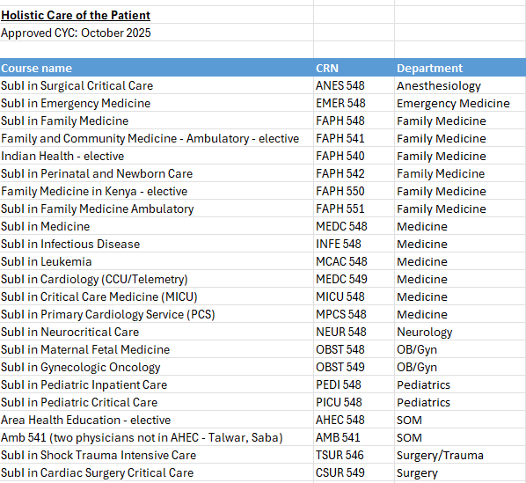

Slide 95
Today’s Schedule
1:00-1:15: Introduction to MS4 Year (Dr. Thom)
1:15-2:00: Advanced Clinical Scheduling (Dr. Flaherty)
2:00-2:30: USMLE Step 2 (Ms. Gillis & Ms. Butler)
2:30-2:45: Ambulatory Requirement (Dr. Millstein)
2:45-3:15: Transition to Residency (TTR) and OSCE (Dr. Siaton) and Holistic Care Requirement (Dr. Dittmar)
3:15-3:30: Break/Transition
3:30-4:00: Extramural/International/VSLO (Dr. Thom & Ms. Jenkins)
4:00- 4:30: Extramural Rotation Student Panel (MS4 Students)

Slide 96

EXTRAMURAL ROTATIONS
“THE AWAY”
Information for Students Considering an Away Rotation
Notes:
Dr. Thom

Slide 97
Presentation Agenda:
What is an Extramural Elective?
How do I decide where to rotate?
How does VSLO work?
Q&A
Student Panel Discussion
Notes:
Dr. Thom

Slide 98
What is an Extramural Elective
AKA Away Rotation?
An “Away” rotation is any course, not in the UMSOM course catalog, taken for credit at an external institution
Requires application to host school and registration at SOM
May be used toward SOM graduation requirements as one of the 5 required electives
Notes:
Dr. Thom

Slide 99
Why do students participate in
Aways Rotations?
Residency application requirement
Enhance competitiveness for a residency application
Student preference
Visit a program/location of interest
Participate in unique experience not offered here
Notes:
Dr. Thom

Slide 100
Are Away Rotations Required?
Required | Strongly Considered | Recommended | May Be Considered
Emergency Medicine
(at least ONE EM away rotation)
Child Neurology
PM&R
Specialties with no home program
Dermatology
Neurosurgery
Ophthalmology
Orthopedic
Otolaryngology
Plastic Surgery
Urology
Anesthesiology
OBGYN
Psychiatry
Surgery/General
Notes:
Dr. Thom

Slide 101

Factors to Consider
Opportunities | Challenges
Exposure to Different Clinical Settings
New hospital system, patient population, and workflow - can broaden clinical perspective
Networking Opportunities
Build relationships with faculty and residents at another institution, which can help if you’re considering applying there for residency
Showcase Your Skills
Performing well on an away rotation can strengthen your application and potentially lead to strong letters of recommendation
Clarify Career Goals
“Test-drive” program or specialty environment -see if learning style aligns with your goals before committing
Learn Unique Techniques or Resources
Specialized procedures or technology you might not see at your home
Financial Cost
Travel, housing, and application fees; Some rotations are in high-cost cities.
Stress and Adjustment
Adapting to a new environment, EMR system, and expectations can be stressful.
Limited Time to Impress
You have only a few weeks to make a strong impression, which can feel high-pressure.
Risk of Burnout
Away rotations often occur during busy periods -added travel and logistics can be exhausting.
Uncertainty
No guarantee the rotation will lead to an interview or match advantage, so the return on investment can vary.
Notes:
Dr. Thom

Slide 102


Top Three Tips: Financing Your Away
✅ Plan Ahead
Apply early through VSLO and research programs.
✅Understand the True Cost
Away rotations costs vary. Conduct diligent and thorough research, especially from a cost-of-living standpoint. Budget early and include application fees, transportation, housing, meals, and any additional costs like parking.
✅ Explore Financial Aid Options / Meet with OSA Financial Aid Team
Some schools allow students to request a Cost of Attendance (COA) increase for away rotations, enabling additional federal loans.
Questions? Contact Juanita Simmons or Sofia Cascio
Notes:
Dr. Thom

Slide 103
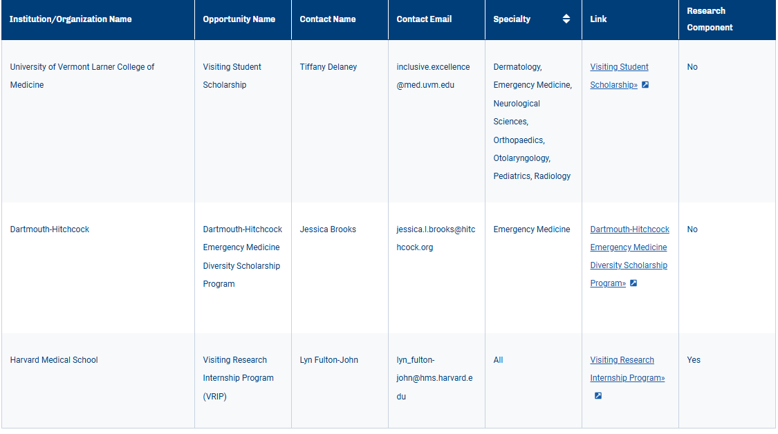


Visiting Scholars Resources Database
26-27 Updates Coming Soon!
https://students-residents.aamc.org/visiting-student-learning-opportunities/explore-visiting-scholars-resources-database
Notes:
Dr. Thom

Slide 104


Decisions, decisions!
Where should I rotate?
Notes:
Dr. Thom

Slide 105
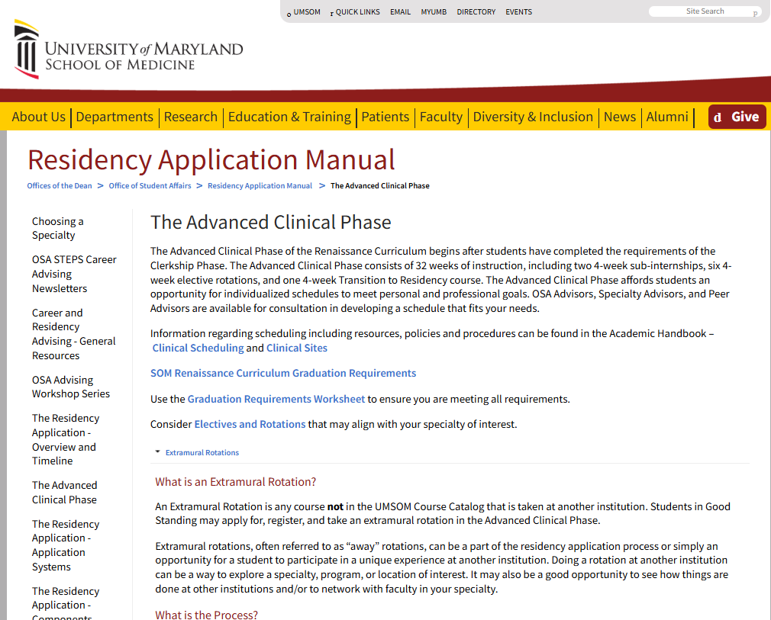

Residency Application Manual >
The Advanced Clinical Phase
Decisions, decisions!
continued...
Bookmark this page!
Plethora of resources and info!
Residency Application Manual >Advanced Clinical Phase
Notes:
Dr. Thom

Slide 106
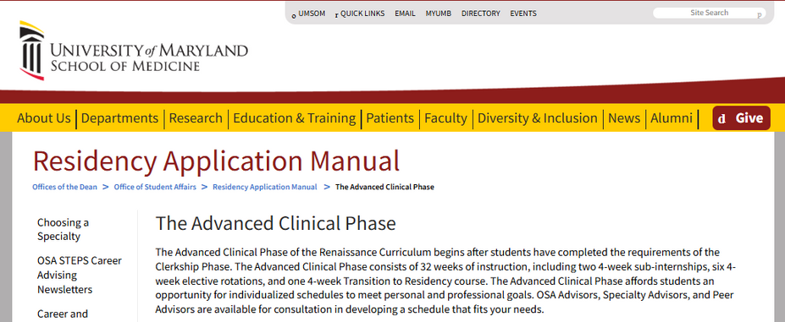
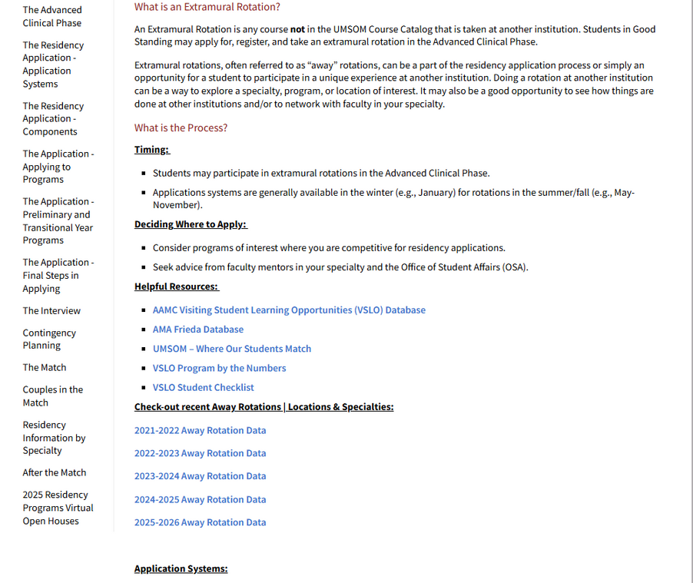
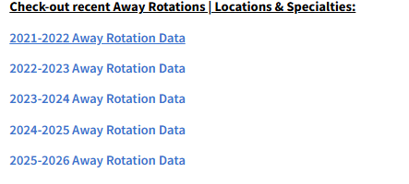


Decisions, decisions!
continued...
Check out info on previous rotations by year, specialty, and location:
(Residency Application Manual >Advanced Clinical Phase)
Notes:
Dr. Thom

Slide 107
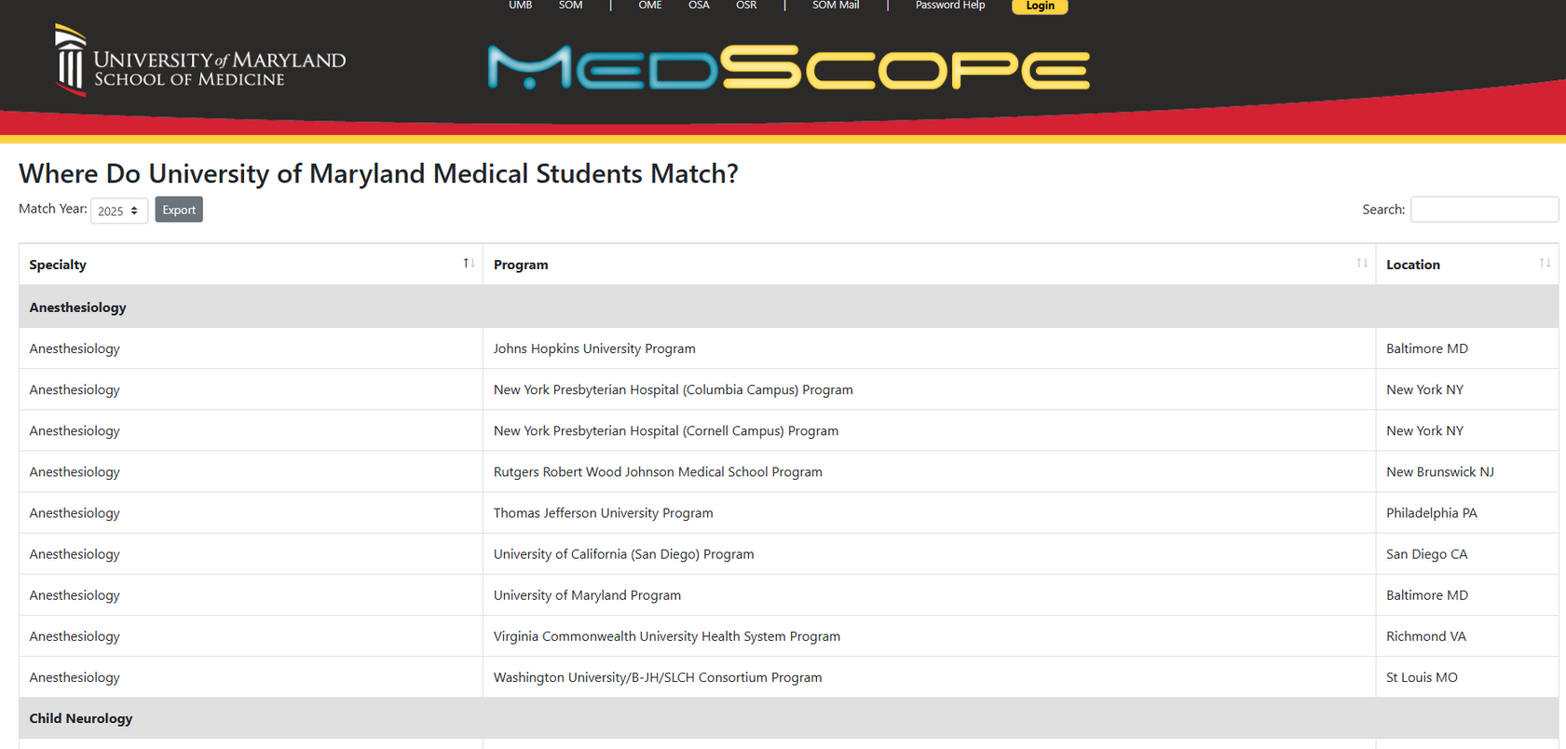
Decisions, decisions!
continued...
Check out where UMSOM Alumni have Matched:
https://medscope.umaryland.edu/thematch
Notes:
Dr. Thom

Slide 108
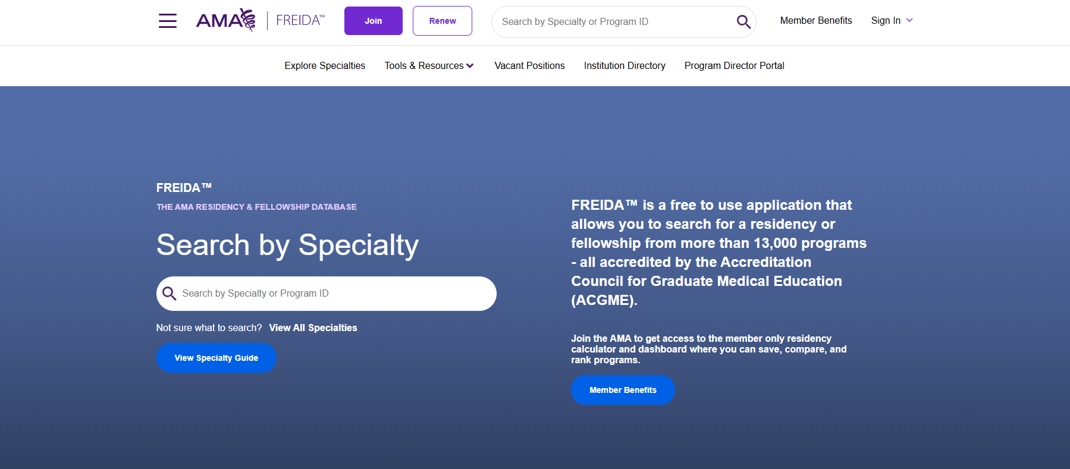
Decisions, decisions!
continued...
Check out the
AMA Frieda Database
search by specialty & location
Notes:
Dr. Thom

Slide 109


Decisions, decisions!
continued...
Pro Tip!
Engaging in conversations with peers and seeking guidance from specialty advisors and /or OSA Deans can provide valuable insights and support. Reach out and connect!
Notes:
Dr. Thom

Slide 110

VSLO 101: Away Rotations

Slide 111

VSLO 101: Away Rotations
Visiting Student Learning Opportunity, hosted by AAMC
Most institutions utilize VSLO
Schools who do not participate in VSLO – follow instructions on webpages
Anything notated with a
indicates that OSA will assist
Questions? Contact: Bailey Jenkins

Slide 112
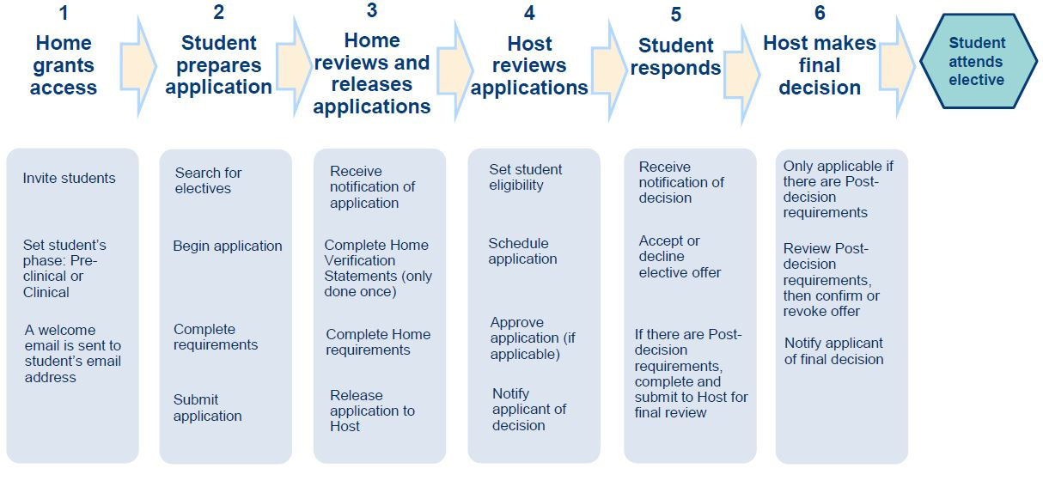
VSLO 101: Away Rotations
continued...
VSLO Process Flow
The VSLO program charges a flat fee of $15 per application. Application fees are per elective regardless of requested dates for that elective. Some institutions might have additional fees.

Slide 113

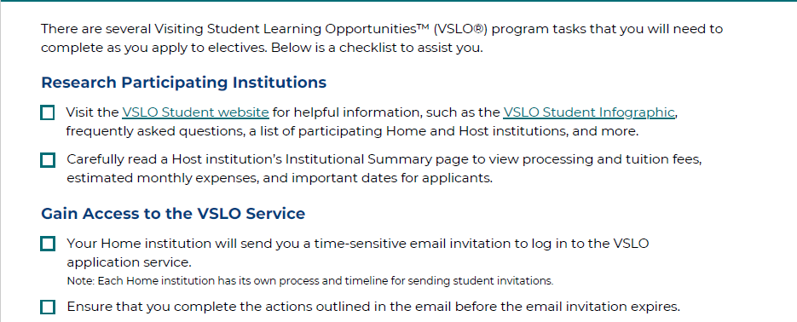

VSLO 101: Away Rotations
continued...

Slide 114
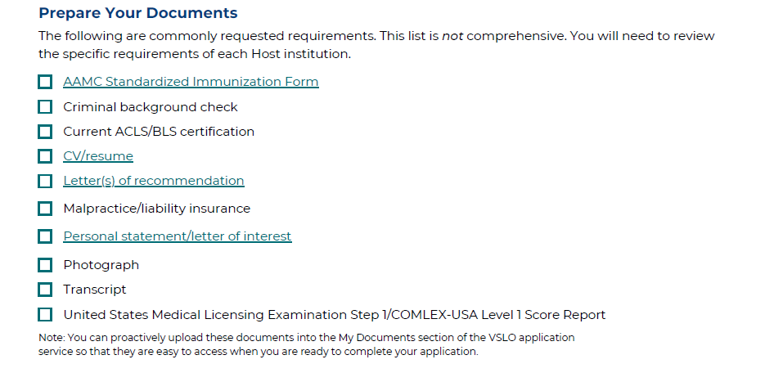

VSLO 101: Away Rotations
continued...
Pro Tip!
Give yourself plenty of time to gather documents!

Slide 115
What other documents might institutions request?
COVID-19 & Flu Vaccination Documentation
Mask Fit Test Documentation
HIPPA & OSHA Training Certificate
Toxicology Screening**
BLS/ACLS Certificate
Professional Liability and Malpractice Coverage
Proof of Personal Health Insurance
Letter of Recommendation(s)
Criminal Background Check**
**Student responsible for additional costs. Please note, requirements vary by state.
VSLO 101: Away Rotations
continued...

Slide 116
What documents can OSA help with?
Mask Fit Documentation *
Letter of Good Standing *
HIPPA Training (Good Guy Letter) *
Bloodborne Pathogen/OSHA Training (Good Guy Letter)*
Professional Liability and Malpractice Coverage *
Official Transcript
Uploading Letters of Recommendation
Affiliation Agreements
* Submit a request for these items via the Away Rotation Document Request Form
Pro Tip!
Give yourself plenty of time to gather documents!
VSLO 101: Away Rotations
continued...

Slide 117
VSLO 101: Away Rotations
continued...
What is an Affiliation Agreement?
Training Affiliation Agreement (TAA) is a required, formal contract between academic institutions.
Outlines terms for students or trainees to participate in clinical experiences.
Defines responsibilities, compliance requirements, liability, and supervision to ensure a safe, accredited educational experience without financial compensation.
Process completed by OSA staff, can take several weeks and sometimes months—initiate early after acceptance.
Questions about Affiliation Agreements? Contact: Bailey Jenkins

Slide 118
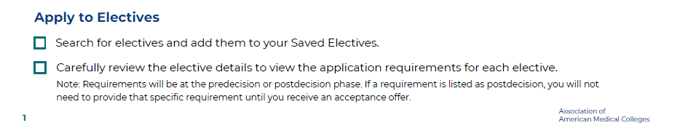
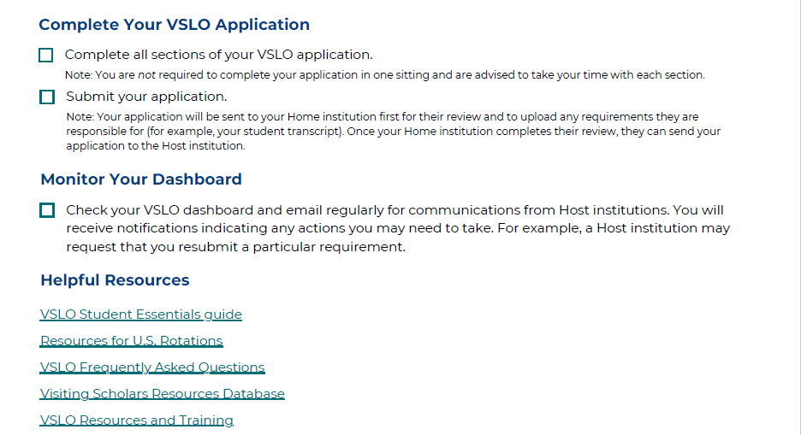
VSLO 101: Away Rotations
continued...

Slide 119
Important to Note:
All Advanced Clinical Phase rotations must be 4 weeks in length
Students may not receive graduation credit for 2-week rotations; cannot combine two 2-week rotations for credit
VSLO 101: Away Rotations
continued...

Slide 120



I received an offer, what’s next?
Accept or Deny Offer
Complete Post Requirements to make it official
Register with UMSOM using Extramural Elective Form
Registration requires faculty approval
Attach a copy of the official acceptance from the host institution to the Extramural Rotation Form
VSLO 101: Away Rotations
continued...

Slide 121

VSLO 101: Away Rotations
continued...
If you do not register with UMSOM 1 month before the rotation:
You will not receive credit toward graduation.
The rotation will not be on your transcript.
You are not covered by malpractice insurance.
You will receive a professionalism citation, which may be noted on the MSPE.
Questions about Registration? Contact: Brian Wynder

Slide 122






VSLO 101: Away Rotations
continued...
PLAN AHEAD FOR
HOUSING &
TRANSPORTATION
INTRODUCE YOURSELF TO EVERYONE
Pro Tips!
KNOW THE INSTITUTION’S CULTURE
BE PROACTIVE, NOT PUSHY
STAY ORGANIZED & DOCUMENT EVERYTHING
LEARN THE EMR BEFORE DAY 1

Slide 123


VSLO 101: Away Rotations
continued...
VSLO Student Webinar
Tuesday, January 13th, 2026 | 7pm
AAMC sponsored webinar will offer practical insights into choosing, preparing for, and making the most of your away rotations. Panelists will describe key advantages of completing away rotations and share tips for planning, selecting, scheduling, and succeeding in your away rotations.
Register Today!

Slide 124

VSLO 101: Away Rotations
continued...
VSLO is undergoing updates, with the portal reopening on January 20th!

Slide 125
VSLO 101: Away Rotations
continued...
Getting Started: Gaining Access to VSLO
Week of January 19th:
You will receive an email with detailed instructions on how to get started.
Complete the following steps:
Complete the Extramural Rotation Module [Extramural Rotation Registration Module]
Complete the Attestation [Attestation Form Link]
Once you have completed both the module and the attestation, the Office of Student Affairs (OSA) will send your VSLO token within 1–2 business days. This token will allow you to create your VSLO profile.

Slide 126

Interested in an International Elective?
Unique Rotations Virtual Presentation
Monday, Jan 23rd @12pm
Click Here for the Zoom Link!
FAPH 550 | Family Medicine in Kenya
GLHT 546 | Global Health Zambia IPE
ICME 543 | Ambulatory Global Health
INFE 542 | Infectious Diseases and Tropical Medicine (Lusaka, Zambia)

Slide 127
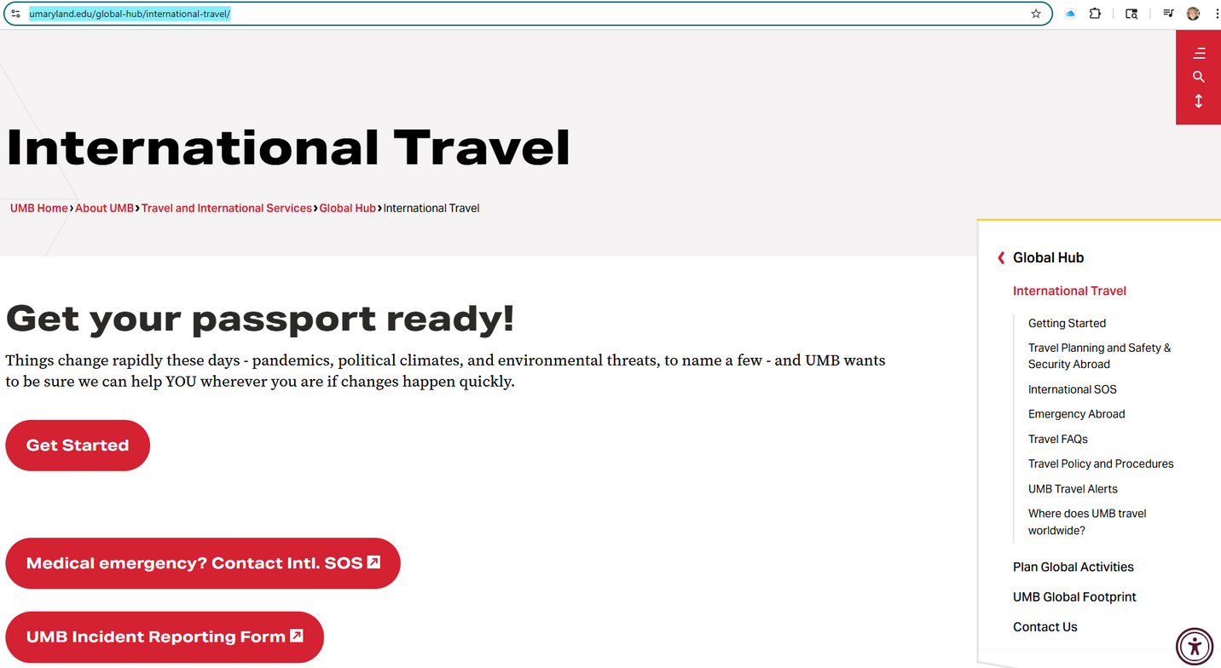
Interested in an International Elective?
https://www.umaryland.edu/global-hub/international-travel/

Slide 128
Interested in an International Elective?
Provost’s Global Scholar Program
The Provost's Global Scholar Program provides an opportunity for UMSOM students to engage in a global health experience of their own choosing with the support of a $2,000 stipend for educational expenses related to the proposed experience.
Before you start, review the Global Scholar Program Application PDF.
Applications accepted 12/15/2025 - 2/1/2026 at 11:59 p.m.
Questions? Reach out to Nick Cortina

Slide 129

LET’S
TALK!

Slide 130

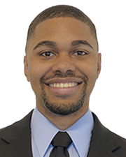
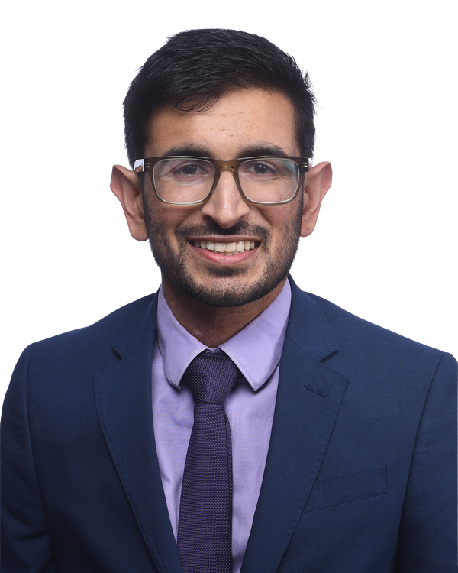
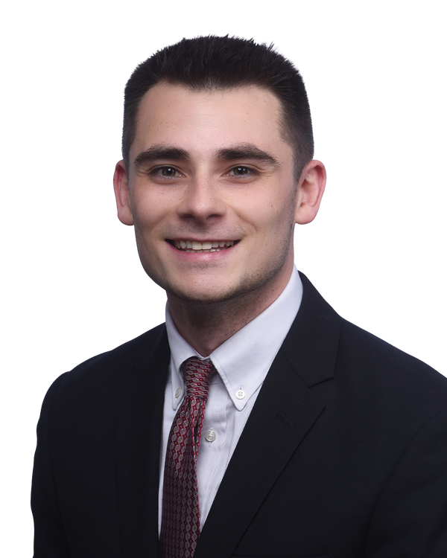
Student Panel Representatives
Darrian McAfee
Neurosurgery
Rotations:
Johns Hopkins University
University of California - San Francisco
Duke University
Saif Yasin
Pediatrics
Rotation:
University of Pennsylvania/ Children’s Hospital of Philadelphia
Nicholas Leahy
Psychiatry
Rotations:
New York University
Lusaka, Zambia

Slide 131
Things to think about…
Extramural Rotations: General Planning
Logistics
Budgeting
Personal Considerations
Maximizing Experience
Impact on Residency
Application Process

Slide 132
GENERAL
QUESTIONS?

