Slide 1

Urology
Class of 2026
2025-2026 Match

Slide 2
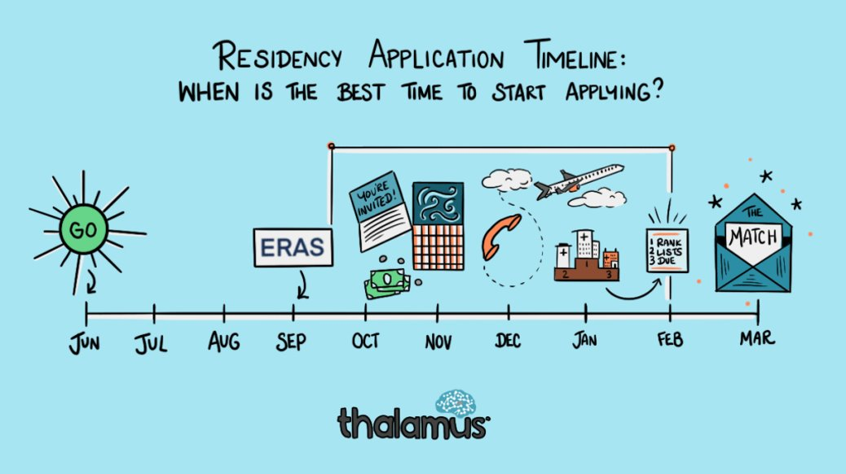

Original Slide Design by Dr. Kerri Thom

Slide 3
Upcoming workshops!
April-May: OSA Specialty-Specific Advising
Personal Statement Writing Workshops: Medscope recording; LIVE: 7/15 & 8/19 in Reid Rooms
June 3rd 400pm: Residency Application Workshop:
March 2026: SOAP Workshop (mandatory)
May-July: OSA 1:1 Advising Sessions
Workshop Links: OSA Advising Workshop Series | University of Maryland School of Medicine
Notes:
June 3rd Workshop: https://umaryland.zoom.us/j/99600677409?pwd=v7zb0wpiiZYi6pOXr2vvMhk67FJijx.1&from=addon

Slide 4
Graduation Requirements Class of 2026 Graduation Requirements | University of Maryland School of Medicine
Must be completed ONE week prior to graduation
Pass all third-year clerkships, including shelf examinations
Pass ONE 2-week elective (added to the Pediatric Clerkship)
Pass TWO sub-internships
Pass FIVE electives
No more than TWO Pre-clerkship elective equivalents may be counted toward the total elective count
Two electives must be on campus (i.e. in our electives catalogue)
Pre-clerkship electives are considered “on campus”
Pass ONE PoM4: Transition to Residency (4 weeks)
Complete an FRCT Scholarly Project
Pass OSCE
Take USMLE Step 2: Clinical Knowledge examination
Complete Exit Interview with Financial Aid
Additional Requirements (next slide)
*NOTE – if you are off cycle, please discuss your graduation requirements with an OSA Faculty member

Slide 5
Graduation Requirements Class of 2026
Additional Requirements: Note: these are NOT in addition to the above, but fulfill an above elective or sub-internship requirement.
Ambulatory Requirement^: one (4-week) of the five above required electives or one (4-week) of the two above required sub-internships must be an Ambulatory rotation (as designated via the "Ambulatory" tab in the course catalog); in addition to the expectations of the elective, students will have designated curricular material to satisfy the ambulatory requirement; this requirement cannot be fulfilled with a pre-clerkship elective.
Internal Medicine Requirement^: one (4-week) of the five above required electives or one (4-week) of the two above required sub-internships must be in Internal Medicine (as designated via the "Internal Medicine" tab in the course catalog); cannot be fulfilled with a pre-clerkship elective.
^The same rotation cannot fulfill both the Ambulatory and Internal Medicine Requirement.
★ At least one clinical rotation (as designated via the "Clinical" tab in the course catalog) must be done in the second half of the 4th year.

Slide 6
Important Reminders
Confirm name/pronunciation in MedScope as you with for graduation/diploma
Update your Preferred Pronouns in MedScope for the MSPE (if not indicated will default to he/him, she/her)
Update your contact information
Pay it forward, sign up to be an Alumni Mentor (Career Tab, MedScope)
Use the MedScope Interview Tracker to ensure optimal advising!
Consider your brand and ensure social media profiles are professional/clean
Meet with Financial Aid (Sophia Cascio)
Complete Graduation Questionnaire (online through AAMC) – available Jan – May

Slide 7
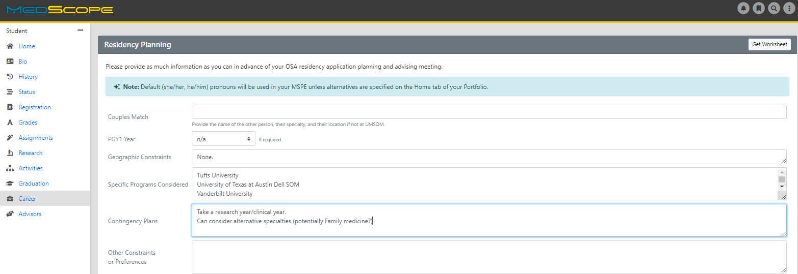
Career Tab (Please complete)

Slide 8
Residency Application Manual: Your New Best Friend
Residency Application Manual | University of Maryland School of Medicine

Slide 9
1:1 OSA Residency Advising Meeting Prep
You may review MSPE details, including a sample MSPE, here:
The MSPE | University of Maryland School of Medicine
[ ] Complete the Career Tab on MedScope to assist with MSPE data collection
*Be prepared to discuss any deviations from the traditional 4-year curriculum
*Be prepared to discuss any hardships (e.g. personal medical condition, bereavement, or other extenuating circumstance that may have had a negative effect on academic performance) if you wish to consider for inclusion in the MSPE
[ ] Closer to the application deadline, OSA will solicit Noteworthy Characteristics from you for inclusion in the MSPE; if you wish to get started on these now you may review examples in Link #1 above.
Note:
*AOA nominations will be noted in the MSPEs Noteworthy Characteristics and in the summary paragraph
*GHHS membership will be noted in the MSPEs Professional Performance section and in the summary paragraph

Slide 10
1:1 OSA Residency Advising Meeting Prep
The below are NOT required but may be helpful
[ ] Meet with Departmental Mentors
[ ] Think about programs of interest or geographical areas of interest
[ ] Create a CV Draft (CV Preparation Tips | University of Maryland School of Medicine); we will not go through this at the meeting but can answer specific questions
[ ] Create a Personal Statement draft; we are happy to review outside the meeting timeframe

Slide 11
ERAS/NRMP TIMELINE
Date | Activity
June 4, 2025 | ERAS 2026 season begins at 9 a.m. ET.
Sept. 3, 2025 | Residency applicants may begin submitting MyERAS applications to programs at 9 a.m. ET.
Sept. 24, 2025 | Residency programs may begin reviewing MyERAS applications and MSPEs in the PDWS at 9 a.m. ET.
End of January 2026 | Register for Match and SOAP
Early February 2026 | RANK OPENS
First week of March 2026 | RANK Lists Certified
2nd or 3rd week of March 2026 | SOAP and MATCH
*Note, these dates are subject to change. Please reference2026 ERAS® Residency Timeline | Students & Residentsfor the most updated schedules.

Slide 12
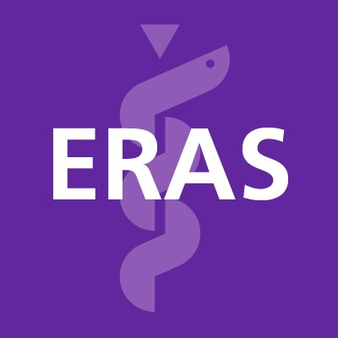







&
Signals
Original Slide Design by Dr. Kerri Thom

Slide 13
Application timeline:
AUA Timeline: TBD- 2025-2026 Application Cycle Timeline Pending
Urology and Specialty Matches - American Urological Association (auanet.org)
Match Week Schedule: TBD
*Note: Urology participates in the American Urologic Association (AUA) Match and is an ‘early’ match. While it is an "early" match, the upfront timeline is not too different from other specialties. The interview season and match turnaround is the faster/early part.
*Urology participates in the AUA Match. For Urology, you will fill out your application in ERAS, pick programs to apply to in ERAS, but signal and match through the AUA Match system (submit rank lists etc).
*This means you must register for ERAS and AUA Match.
*You should not have to register for NRMP match system.

Slide 14
Urology Application
Department | Urology
Contacts (R = Required to Meet)
Chair | Michael Naslund (Div Head)
Program Director | Minhaj Siddiqui/R
MSIV Advising | Minhaj Siddiqui/R
Other | Michael Phelan
Competitive Applicant
Step 2 (goal) | at least 240, but averages in UMSOM has been around 251; <240 (consider alternate plan/dual application)
AOA/GHHS | Helpful
Research | Necessary
Applications
Application System | ERAS
Program Signaling | 30 signals 2024-2025 (AUA signal system)
Acuity Insights | N/A
Preliminary/Transitional Year | N/A
Match System | AUA
Away Rotations
Expectations | Expected
Ideal Number | 2 to 3
Letters of Reference
Total Number | 3 to 4
Chair Letter | Required (Most Programs)
Ideal Make Up | Urology Home Faculty (1-2), Urology Away Faculty (1), Other (1, can be second urology home)
Contingency | If dual applying, secure letters for that specialty
Mock Interview Program
 | OSA Advisor cordinates with Dr. Siddiqui for those who are interested
Contingency
 | Strongly Consider Research Year between M3/4
 | ALL Students MUST Have Contingency
 | Consider Dual Application

Slide 15
A Note on External Rotations (“Aways”)
Urology does require Away rotations. Speak with your OSA advisor about pros/cons.
YOU MUST ADD THIS COURSE AT SOM!!!
Required forms are found on the Student Scheduling Page
Forms should be completed/signed by Departments
Submitted to Add/Drop

Slide 16
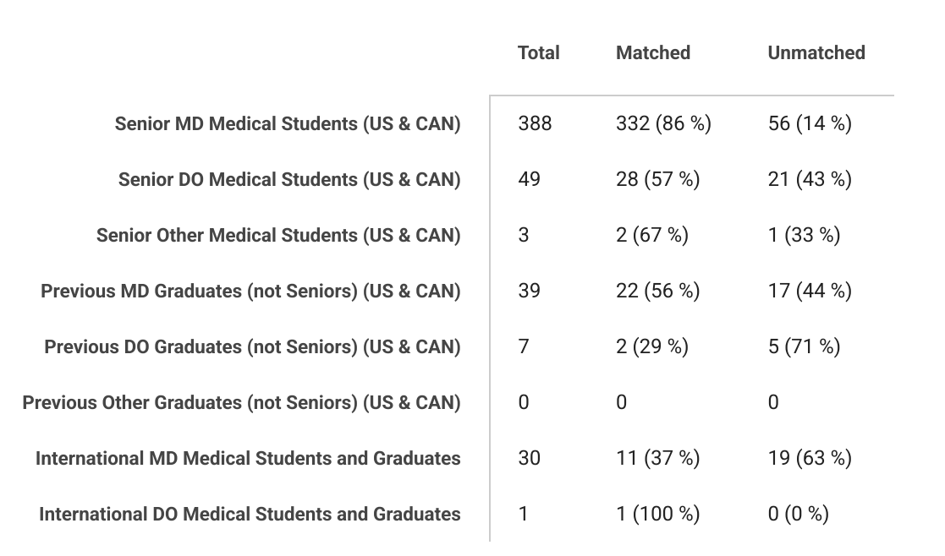
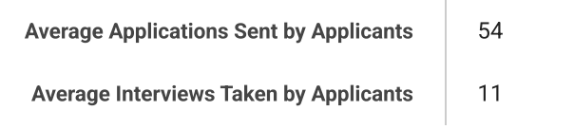
2025 Urology Residency Match Statistics 2.3.2025 (1).pdf

Slide 17
Urology is a competitive specialty regardless of the students' credentials.
The match rate in 2025 for US Seniors was 86%. A contingency plan is vital.
Notes:
More programs, fewer interviews, skewed because older 2013-2018

Slide 18
Signaling
??? Signals for Urology in 2025-2026 Application Cycle
There were 30 signals in 2023-2024 cycle and 2024-2025 Cycle
Urology and Specialty Matches - American Urological Association (auanet.org)

Slide 19
Urology Data (UMSOM)
UMSoM: Urology | 2023-2025 Average (Ranges)
Avg No. Applications | 80 (53-120)
Avg No. Interview Offers | 21 (8-37)
% Invites/Applications | 30% (15%-47%)
No. Signals (30 signals) | 2024-2025 Average (Ranges)
Percent of Interview Offers from Signaled Programs | 75% (68%-81%)
Percent of Interview Offers from Non-Signaled Programs | 24% (18%-32%)
No. Additional Interview Offers from Non-Signaled Programs | 2 to 8
Stats | 2023-2025 Average (Ranges)
Average Step 2 (2023-2025) | 251 (228-274)

Slide 20
Urology Data (UMSOM)
Data 2022-2025 |  |  | ​
Urology | No. Students​ | Avg. No. Interviews​ | % Match ​
All ​ | 9 | 21 | 89% (8 of 9)
​
AOA ​ | 4 | 28 | 100% (4 of 4)
Non-AOA​ | 5 | 11 | 80% (4 of 5)
​
Step 2 >= 240​ | 8 | 19 | 87% (7 of 8)
Step 2 < 240​ | 1 | 15 | 100% (1 of 1)
​
Step 2 >= 245​ | 5 | 24.6 | 100% (5 of 5)
Step 2 < 245​ | 4 | 11 | 75% (3 of 4)
​
GHHS ​ | 4 | 16.75 | 100% (4 of 4)
Non-GHHS ​ | 4 (including 1 considered) | 20 | 75%(3 of 4)
​
Exceptional ​ | 3 | 28 | 100% (3 of 3)
Outstanding ​ | 1 | 25 | 100% (1 of 1)
Excellent​ | 3 | 12 | 100% (3 of 3)
Very Well ​ | 2 | 11.5 | 50% (1 of 2)

Slide 21
Urology Data (UMSOM)
Year | No. Matched Applicants | Avg. No. Aways | Matched Home | Matched Away | Matched Home/Away
2022-2025 | 8 of 9 | 2.1 | 11% (1/9) | 33% (3/9) | 44% (4/9)

Slide 22
ALL STUDENTS APPLYING TO UROLOGY SHOULD HAVE A CONTINGENCY PLAN.
For students applying to specialties a little beyond their academic reach or for any student applying to a competitive subspeciality:
Consider applying to a second, less competitive specialty concurrently.
Consider applying to a preliminary program, such as internal medicine or surgery concurrently.
If you would rather improve your credentials and apply again if unmatched, be clear on what you can do to improve your credentials.
If research experience is important, consider applying concurrently to research programs so that you have that as an option if you do not match.
If additional clinical work is important, consider applying to a preliminary program
Consider earning an additional degree (MPH, JD, MBA) to either improve your credentials or as an alternate career option.
Understand that it takes 2 years to really improve your application…1 year to do something and then the application year.

Slide 23
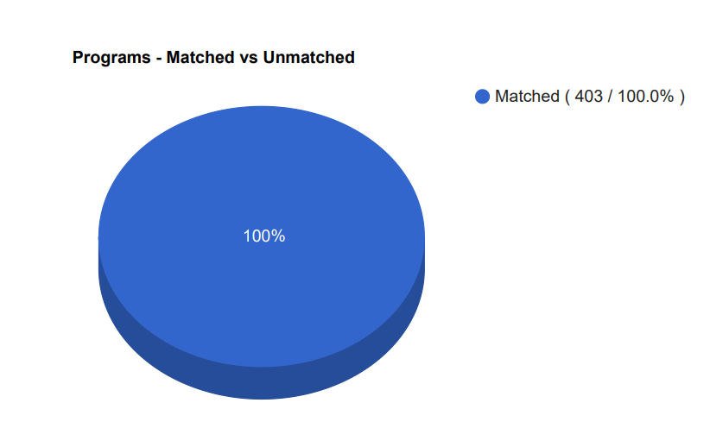
Secondary Urology Pilot Program
2025- Pilot Program of a SOAP Program for programs that did not fill.
All programs spots filled
ERAS/AUA may not do this in the coming year- TBD

Slide 24
Which Programs to apply to:
FREIDA is a really great tool that can help you look at accredited programs by specialty in different regions around the country. https://freida.ama-assn.org/Freida/#/
You do not have to pay- on the main page, click under the search bar “View All Specialties”
AAMC Residency Explorer is a useful tool in assessing your competitiveness at particular programs: https://www.residencyexplorer.org/Account/Login
MedScope Data *We will review together – this data allows you to see where you stand as a student at UMSOM
Departmental Advisors (as well as faculty advisors, and senior students) are another key source of program information

Slide 25
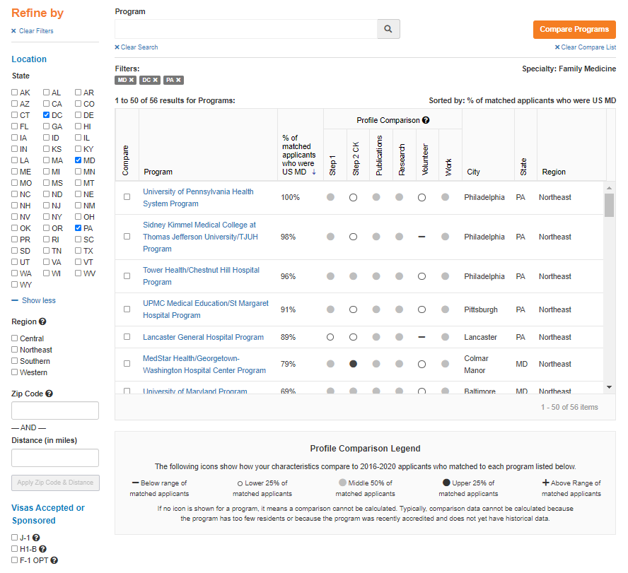
Step 1: 220
Step 2: 235

Slide 26
Compare Programs

Slide 27
Checklist to be completed prior to your meeting
[ ] Complete the Career Tab on MedScope
[ ] Review your schedule/graduation requirements
[ ] Review the Residency Application Manual | University of Maryland School of Medicine
The below are NOT required but may be helpful
[ ] Meet with Departmental Mentors
[ ] Create a preliminary list of programs of interest (print/PDF Residency Explorer output)
[ ] Create a CV Draft (CV Tips); we will not go through this at the meeting but can answer specific questions
[ ] Create a Personal Statement draft; we are happy to review outside the meeting timeframe

Slide 28

Any Questions?

