Slide 1

Radiology
Diagnostic and Interventional
2025-2026 Match cycle

Slide 2
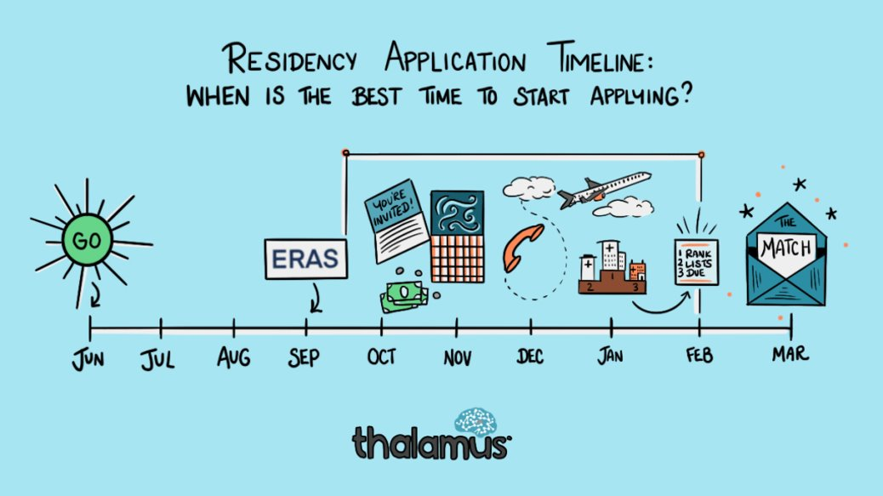

Original Slide Design by Dr. Kerri Thom

Slide 3
Upcoming workshops!
April-May: OSA Specialty-Specific Advising
Personal Statement Writing Workshops: Medscope recording; LIVE: 7/15 & 8/19 in Reid Rooms
June 3rd 400pm: Residency Application Workshop:
March 2026: SOAP Workshop (mandatory)
May-July: OSA 1:1 Advising Sessions
Workshop Links: OSA Advising Workshop Series | University of Maryland School of Medicine
Notes:
June 3rd Workshop: https://umaryland.zoom.us/j/99600677409?pwd=v7zb0wpiiZYi6pOXr2vvMhk67FJijx.1&from=addon

Slide 4
Graduation Requirements Class of 2026 Graduation Requirements | University of Maryland School of Medicine
Must be completed ONE week prior to graduation
Pass all third-year clerkships, including shelf examinations
Pass ONE 2-week elective (added to the Pediatric Clerkship)
Pass TWO sub-internships
Pass FIVE electives
No more than TWO Pre-clerkship elective equivalents may be counted toward the total elective count
Two electives must be on campus (i.e. in our electives catalogue)
Pre-clerkship electives are considered “on campus”
Pass ONE PoM4: Transition to Residency (4 weeks)
Complete an FRCT Scholarly Project
Pass OSCE
Take USMLE Step 2: Clinical Knowledge examination
Complete Exit Interview with Financial Aid
Additional Requirements (next slide)
*NOTE – if you are off cycle, please discuss your graduation requirements with an OSA Faculty member

Slide 5
Graduation Requirements Class of 2026
Additional Requirements: Note: these are NOT in addition to the above, but fulfill an above elective or sub-internship requirement.
Ambulatory Requirement^: one (4-week) of the five above required electives or one (4-week) of the two above required sub-internships must be an Ambulatory rotation (as designated via the "Ambulatory" tab in the course catalog); in addition to the expectations of the elective, students will have designated curricular material to satisfy the ambulatory requirement; this requirement cannot be fulfilled with a pre-clerkship elective.
Internal Medicine Requirement^: one (4-week) of the five above required electives or one (4-week) of the two above required sub-internships must be in Internal Medicine (as designated via the "Internal Medicine" tab in the course catalog); cannot be fulfilled with a pre-clerkship elective.
^The same rotation cannot fulfill both the Ambulatory and Internal Medicine Requirement.
★ At least one clinical rotation (as designated via the "Clinical" tab in the course catalog) must be done in the second half of the 4th year.

Slide 6
Important Reminders
Confirm name/pronunciation in MedScope as you with for graduation/diploma
Update your Preferred Pronouns in MedScope for the MSPE (if not indicated will default to he/him, she/her)
Update your contact information
Pay it forward, sign up to be an Alumni Mentor (Career Tab, MedScope)
Use the MedScope Interview Tracker to ensure optimal advising!
Consider your brand and ensure social media profiles are professional/clean
Meet with Financial Aid (Sophia Cascio)
Complete Graduation Questionnaire (online through AAMC) – available Jan – May

Slide 7
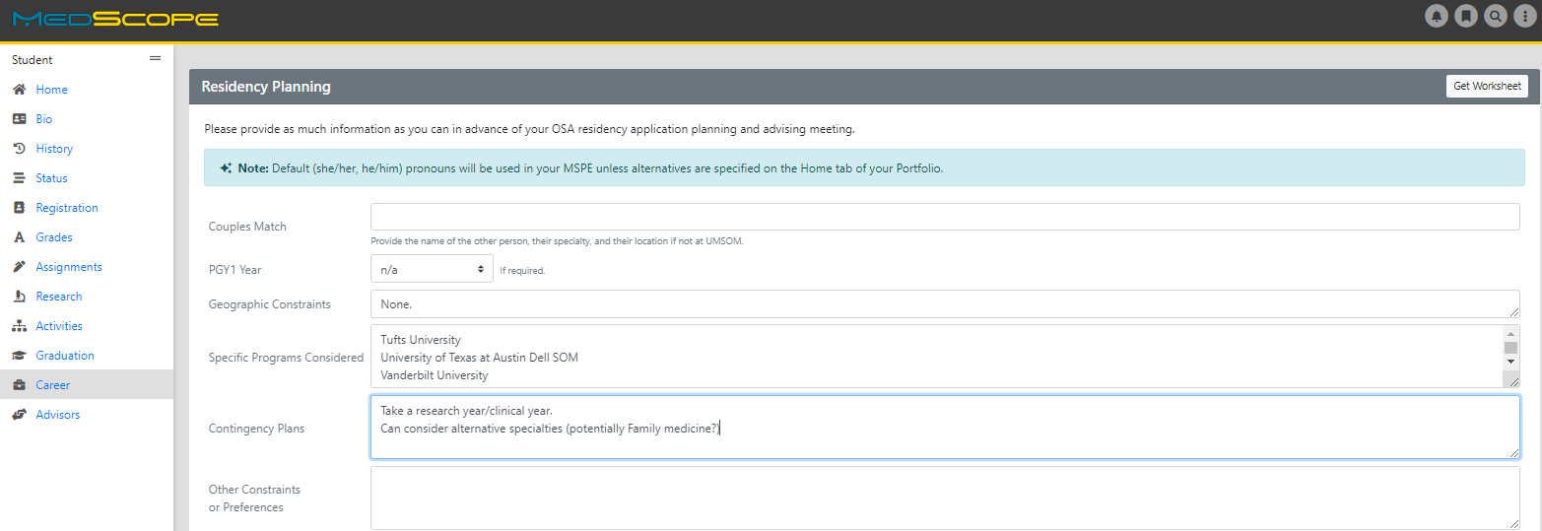
Career Tab (Please complete)

Slide 8
Residency Application Manual: Your New Best Friend
Residency Application Manual | University of Maryland School of Medicine

Slide 9
1:1 OSA Residency Advising Meeting Prep
You may review MSPE details, including a sample MSPE, here:
The MSPE | University of Maryland School of Medicine
[ ] Complete the Career Tab on MedScope to assist with MSPE data collection
*Be prepared to discuss any deviations from the traditional 4-year curriculum
*Be prepared to discuss any hardships (e.g. personal medical condition, bereavement, or other extenuating circumstance that may have had a negative effect on academic performance) if you wish to consider for inclusion in the MSPE
[ ] Closer to the application deadline, OSA will solicit Noteworthy Characteristics from you for inclusion in the MSPE; if you wish to get started on these now you may review examples in Link #1 above.
Note:
*AOA nominations will be noted in the MSPEs Noteworthy Characteristics and in the summary paragraph
*GHHS membership will be noted in the MSPEs Professional Performance section and in the summary paragraph

Slide 10
1:1 OSA Residency Advising Meeting Prep
The below are NOT required but may be helpful
[ ] Meet with Departmental Mentors
[ ] Think about programs of interest or geographical areas of interest
[ ] Create a CV Draft (CV Preparation Tips | University of Maryland School of Medicine); we will not go through this at the meeting but can answer specific questions
[ ] Create a Personal Statement draft; we are happy to review outside the meeting timeframe

Slide 11
ERAS/NRMP TIMELINE
Date | Activity
June 4, 2025 | ERAS 2026 season begins at 9 a.m. ET.
Sept. 3, 2025 | Residency applicants may begin submitting MyERAS applications to programs at 9 a.m. ET.
Sept. 24, 2025 | Residency programs may begin reviewing MyERAS applications and MSPEs in the PDWS at 9 a.m. ET.
End of January 2026 | Register for Match and SOAP
Early February 2026 | RANK OPENS
First week of March 2026 | RANK Lists Certified
2nd or 3rd week of March 2026 | SOAP and MATCH
*Note, these dates are subject to change. Please reference2026 ERAS® Residency Timeline | Students & Residentsfor the most updated schedules.

Slide 12
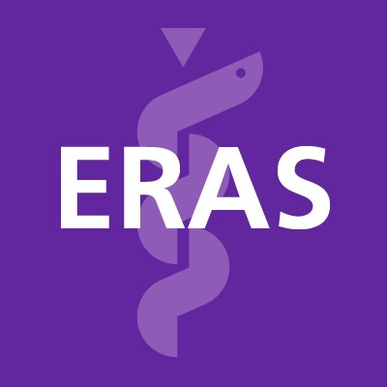





Original Slide Design by Dr. Kerri Thom

Slide 13
Radiology (Diagnostic and Interventional) Application
Department | Radiology (Diagnostic) | Radiology (Interventional)
 |  | Integrated, Independent, Independent with ESIR
 |  | Integrated IR Residency | Society of Interventional Radiology
Contacts (R = Required to Meet)
Chair | William F. Regine, MD, FACR, FACRO (Interim) | William F. Regine, MD, FACR, FACRO (Interim)
Program Director | Chuck Resnik, MD | Howard Richard, MD
MSIV Advising | Rydhwana Hossain, MD | Rydhwana Hossain, MD
 | Omer Awan, MD | Omer Awan, MD
Competitive Applicant
Step 2 (goal) | 256 (National Average); 257 (UMSOM 22-25 Avg) | 253 (National Average); 256(UMSOM 22-25)
Preliminary/Transitional Year | yes, integrated, joint and independent | yes, integrated, joint and independent
Applications
Application System | ERAS | ERAS
Program Signaling | 6 Gold, 6 Silver (12 total, split between DR and IR) | 6 Gold, 6 Silver (12 total, split between DR and IR)
Acuity Insights | N/A | NA
Preliminary/Transitional Year | N/A | NA
Match System | NRMP | NRMP
Away Rotations
Expectations | Not expected | Many do one
Ideal Number | na | usually 1 away
Letters of Reference
Total Number | 3 to 4 | 3 to 4
Chair Letter | Not required | Sometimes required
Ideal Make Up | Radiology Faculty (1), Other (radiology or other) (1), IM Prelim Dittmar (1) | IR Faculty(1), DR Faculty (1), IM Prelim Dittmar (1), Prelim Surgery (Kavik),
Contingency | If dual applying, secure letters for that specialty
Mock Interview Program
 | OSA Advisor may be able to coordinate with the Chief residents in Radiology | OSA Advisor may be able to coordinate with the Chief residents in Radiology
Contingency
 |  | Consider Research Year
 | ALL Students MUST Have Contingency | ALL Students MUST Have Contingency
 | Consider Dual Application | Consider Dual Application

Slide 14
A Note on External Rotations (“Aways”)
Diagnostic Radiology does not require Away rotations. Speak with your OSA advisor about pros/cons.
Interventional Radiology- it is common to do an away rotation
YOU MUST ADD THIS COURSE AT SOM!!!
Required forms are found on the Student Scheduling Page
Forms should be completed/signed by Departments
Submitted to Add/Drop

Slide 15
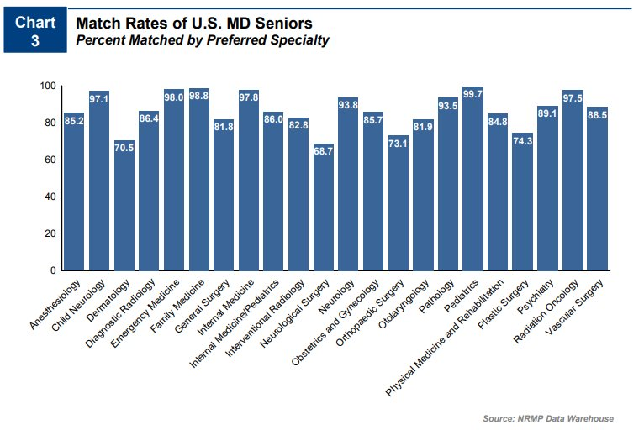
Charting_Outcomes_MD_Seniors2024 (5).pdf​

Slide 16
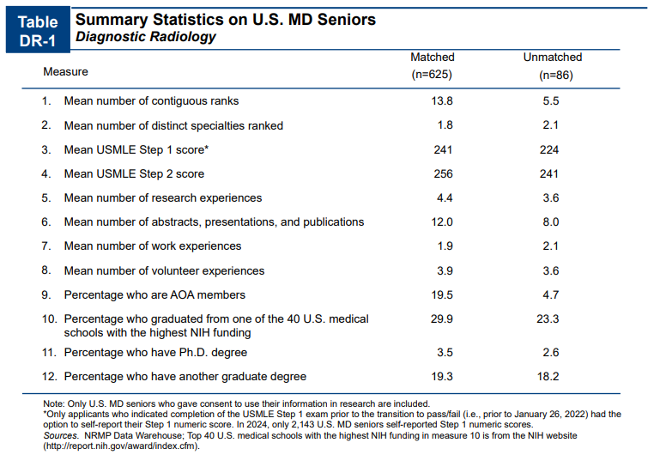
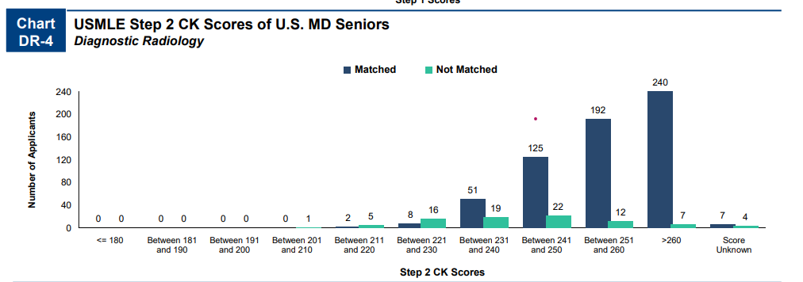
Charting_Outcomes_MD_Seniors2024 (5).pdf​
Notes:
More programs, fewer interviews, skewed because older 2013-2018

Slide 17
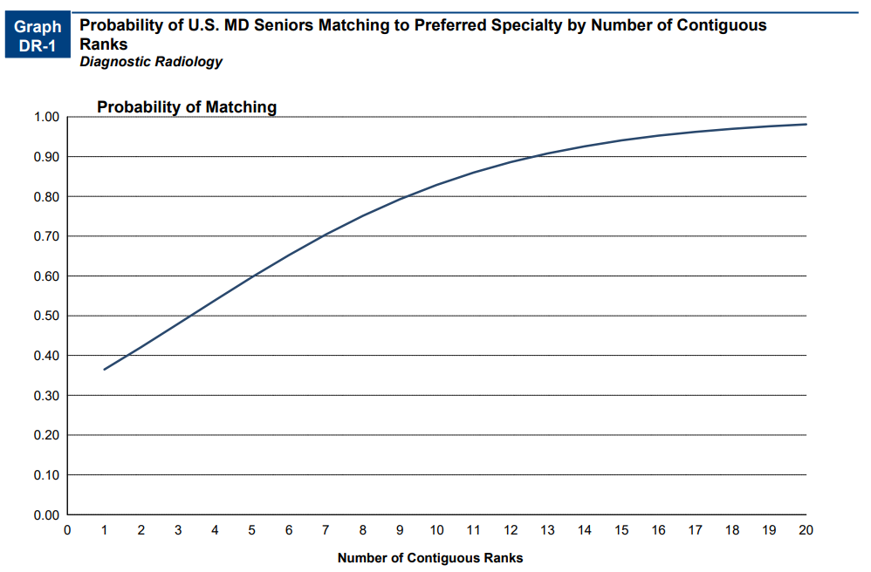
Charting_Outcomes_MD_Seniors2024 (5).pdf​

Slide 18
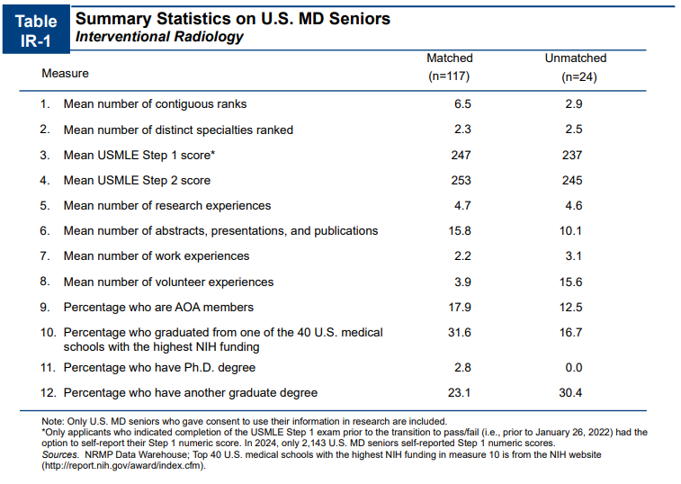
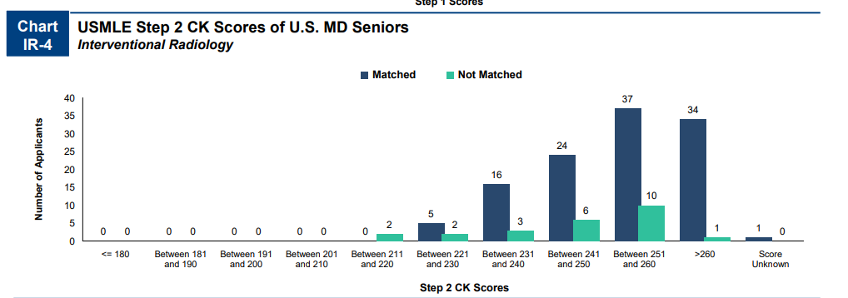
Charting_Outcomes_MD_Seniors2024 (5).pdf​
Notes:
More programs, fewer interviews, skewed because older 2013-2018

Slide 19
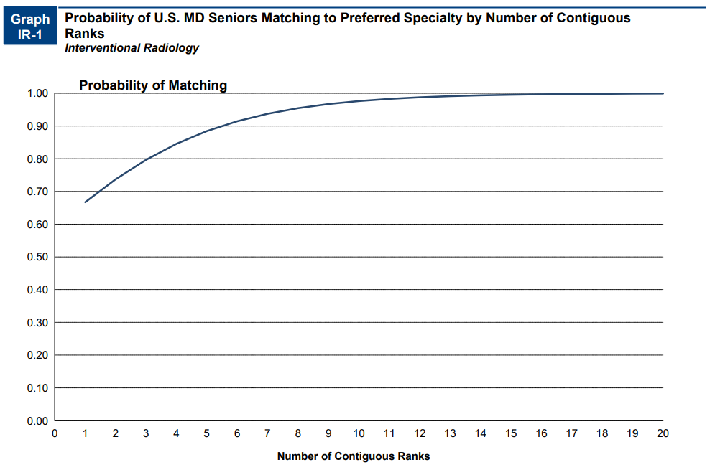
Charting_Outcomes_MD_Seniors2024 (5).pdf​

Slide 20
Goals
Apply to a range of programs in terms of competitiveness.
Students should rank all programs they interviewed at unless they would rather go unmatched
If you have a significant geographic constraint, consider a pre-liminary program back up or a dual-application.

Slide 21
Signaling
Number of Signals Vary per Specialty​
Diagnostic Radiology and Interventional Radiology (6 Gold, 6 Silver) in 2025-2026 cycle
Same number of signals as 2023-2024 cycle​
The 12 signals are SHARED between DR and IR (you can use all 12 for IR, all 12 for DR or split between the two
Program Signaling for the 2026 MyERAS® Application Season | Students & Residents

Slide 22
UMSOM Data-
Coming!

Slide 23
DR Data (UMSOM)
Stats- DR | 2023 | 2024 | 2025
Average Step 2 | 251 | 256.0 | 257.0
Step 2 Average 2022-2025 | 254.6666667
Step 2 Goal (256)-Charting Outcomes | 256
99% Probability Match | 20 interviews

Slide 24
DR Data (UMSOM)
Diagnostic Radiology | 2023 | 2024 | 2025
Avg Applications | 54.6 | 116 | 59
Avg Interview Offers | 15 | 12 | 12
% Invites/Applications | 35.00% | 11% | 22%
No. Signals | 6 | 12 (6 Gold/ 6 Silver) | 12 (6 Gold/ 6 Silver)
Percent of Interview Offers from Signaled Programs | 32% | 48% | 69%
Percent of Interview Offers from Non-Signaled Programs | 67% | 51% | 30%
No. Additional Interview Offers from Non-Signaled Programs | 4 to 23 | 4 to 7 | 3 to 4
Signal Hit Rate (#Interviews/#signals) | 36% | 50% | 60%
Non Signal Hit Rate (# Non signal Inter/#nonsignal apps | 38% | 6% | 7%
Average No. Gold Signals Interviews | NA | missing data | 5
Gold Signal Hit Rate (#Interviews/6) | NA | missing data | 83%
Average No. Silver Signals Interviews | NA | missing data | 3.5
Silver Signal Hit Rate (#Interviews/6) | NA | missing data | 58%

Slide 25
DR Data (UMSOM)
Data from 2022-2025
Diagnostic Radiology | No. Students | Avg. No. Interviews | % Match
All | 16 | 13 | 100% (16/16)
AOA | 3 | 18 | 100%(3/3)
Non-AOA | 13 | 12.2 | 100%(13/13)
Step 2 >= 240 | 15 | 14.2 | 100%(15/15)
Step 2 < 240 | 1 | 8 | 100%(1/1)
Step 2 >= 253 | 9 | 14.6 | 100%(9/9)
Step 2 < 253 | 7 | 12.9 | 100%(7/7)
GHHS | 0 | NA | NA
Non-GHHS | 16 (1 considered) | 13 | 100%(16/16)
Exceptional | 3 | 22.7 | 100%(3/3)
Outstanding | 3 | 11 | 100%(3/3)
Excellent | 6 | 12.7 | 100%(6/6)
Very Well | 4 | 11 | 100%(4/4)

Slide 26
DR Data (UMSOM)
Clerkship Standing | Interview Hit Rate | Average Applications | Range
Exceptional | 61% | 39.3 | 30-50
Outstanding | 28% | 40.7 | 35-55
Excellent | 18% | 82.7 | 65-90
Very Well | 14% | 84.3 | 80-100
Concerns | NA | NA | 100+

Slide 27
IR Data (UMSOM)
Stats- IR
Step 2 Average 2022-2025 | 256
Step 2 Goal (253)-Charting Outcomes
99% Probability Match | 14 interviews

Slide 28
IR Data (UMSOM)
Interventional Radiology | 2019-2022 | 2023-2025
Avg Applications | 49 | 86
Avg Interview Offers | 15 | 21
% Invites/Applications | 41% | 26%%
No. Signals |  | 6 gold, 6 silver*
Percent of Interview Offers from Signaled Programs | N/A | 42%%
Percent of Interview Offers from Non-Signaled Programs | N/A | 57%
No. Additional Interview Offers from Non-Signaled Programs | N/A | 7 to 16
Signal Hit Rate (#Interviews/#signals) | N/A | 70-100%
Gold Signal Hit Rate (#Interviews/6 to 7) | N/A | 42-100%
Silver Signal Hit Rate (#Interviews/2 to 6) | N/A | 83-100%
*Silver and Gold signals (total of 12) shared with DR

Slide 29
IR Data (UMSOM)
Data from 2022-2025
Interventional Radiology | No. Students | Avg. No. Interviews | % Match
All | 4 | 19 | 100%(4/ 4)
AOA | 0 | NA | NA
Non-AOA | 4 | 19 | 100%(4 /4)
Step 2 >= 240 | 3 | 21.7 | 100%(3/3)
Step 2 < 240 | 1 | 12 | 100% (1/1)
Step 2 >= 253 | 2 | 25.5 | 100%(2/2)
Step 2 < 253 | 2 | 13 | 100%(2/2)
GHHS | 0 | NA | NA
Non-GHHS | 4(1considered) | 19 | 100%(4 /4)
Exceptional | 1 | 25 | 100%(1/1)
Outstanding | 1 | 26 | 100%(1/1)
Excellent | 1 | 14 | 100%(1/1)
Very Well | 1 | 12 | 100% (1/1)

Slide 30
IR Data (UMSOM)
Year | No. Matched Applicants | Avg. No. Aways | Matched Home | Matched Away | Matched Home/Away
2019-2025 | 6 of 6 | 1 | 2 of 6 (33%) | 1 of 6 (16%) | 3 of 6 (50%)

Slide 31
Which Programs to apply to:
FREIDA is a really great tool that can help you look at accredited programs by specialty in different regions around the country. https://freida.ama-assn.org/Freida/#/
AAMC Residency Explorer is a useful tool in assessing your competitiveness at particular programs: https://www.residencyexplorer.org/Account/Login
MedScope Data *We will review together – this data allows you to see where you stand as a student at UMSOM
Departmental Advisors (as well as faculty advisors, and senior students) are another key source of program information

Slide 32
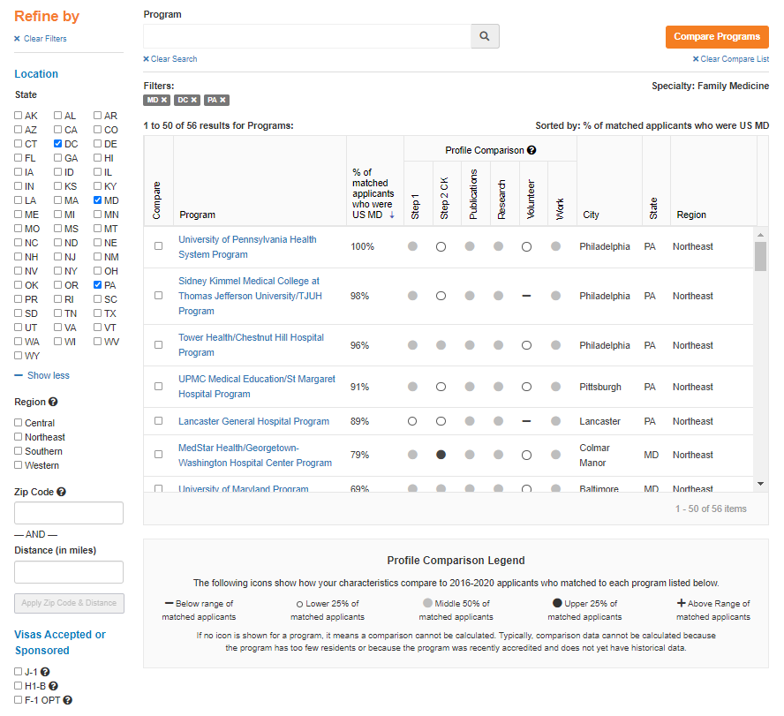
Step 1: 220
Step 2: 235

Slide 33
Compare Programs

Slide 34
Checklist to be completed prior to your meeting
[ ] Complete the Career Tab on MedScope
[ ] Review your schedule/graduation requirements
[ ] Review packet information, emailed after this meeting
[ ] Review the Residency Application Handbook
The below are NOT required but may be helpful
[ ] Meet with Departmental Mentors
[ ] Create a preliminary list of programs of interest (print/PDF Residency Explorer output)
[ ] Create a CV Draft (CV Tips); we will not go through this at the meeting but can answer specific questions
[ ] Create a Personal Statement draft; we are happy to review outside the meeting timeframe

Slide 35
What you can be doing now …
Scheduling Tweaks, Away Rotations, Graduation Requirements
Consider Narrative/Brand
Work on your CV Residency Application Manual | University of Maryland School of Medicine
Create a draft of your Personal Statement Residency Application Manual | University of Maryland School of Medicine
Meet with Mentors (OSA, Department, Peers)
Create a preliminary list of programs
Complete the Career Tab on MedScope

Slide 36

Any Questions?

