Slide 1
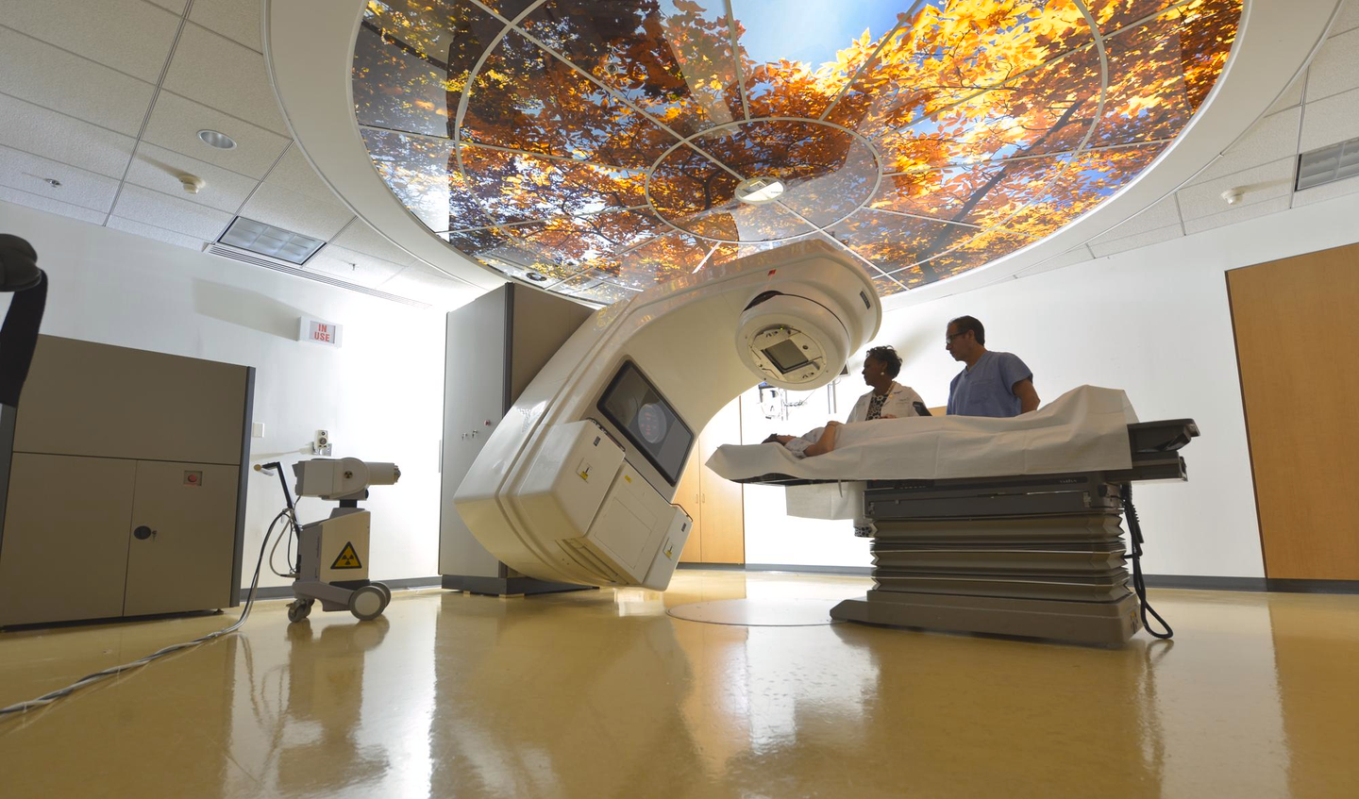
Radiation Oncology
Class of 2026
2025-2026 match cycle

Slide 2
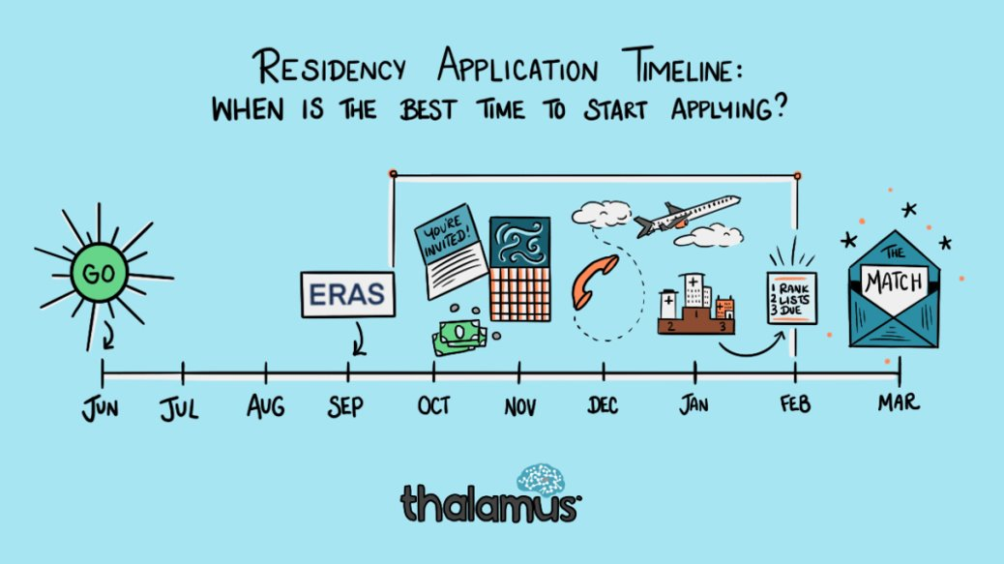
Original Slide Design by Dr. Kerri Thom

Slide 3
Upcoming workshops …
29 Apr.
Developing your Personal Narrative @ 3:30
May–July
OSA 1:1 Advising Sessions
3 June
The Residency Application
15 July
Personal Statement Workshop
19 Aug.
Personal Statement Workshop
Aug
Interview Preparedness + Mock Interviews
Jan
Post-Interview Advising
March
Match Week and SOAP

Slide 4
What you can be doing now …
Scheduling Tweaks, Away Rotations, Graduation Requirements
Consider Narrative/Brand
Work on your CV (OSA CV Tips)
to help you prepare for the applications sections
brainstorm for your experiences/ personal statement
Create a draft of your Personal Statement (OSA PS Guidelines)
Meet with Mentors (OSA, Department, Peers)
Complete the Career Tab on MedScope
Create a preliminary list of programs (recommend once you have Step 2 CK score, class distinction and have discussed competitiveness with your department)

Slide 5
What you can be doing now …
Scheduling Tweaks, Away Rotations, Graduation Requirements
Consider Narrative/Brand
Work on your CV (OSA CV Tips)
to help you prepare for the applications sections
brainstorm for your experiences/ personal statement
Create a draft of your Personal Statement (OSA PS Guidelines)
Meet with Mentors (OSA, Department, Peers)
Complete the Career Tab on MedScope
Create a preliminary list of programs (recommend once you have Step 2 CK score, class distinction and have discussed competitiveness with your department)

Slide 6
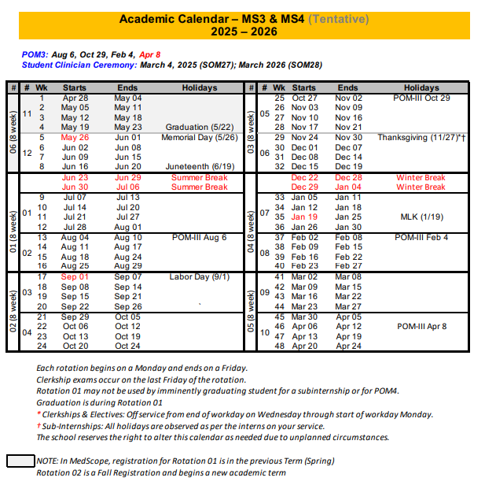
Scheduling, Resources
Course catalog 2024-2025
https://medscope.umaryland.edu/catalog/2025-2026/
UMSOM Class of 2026
Academic Calendar
Graduation Requirements

Slide 7
A Note on External Rotations (“Aways”)
These are a recommended component of Radiation Oncology applications
Can have PROS and CONS!
Away rotations MUST BE ADDED AT SOM!!!
Required forms are found on the Student Scheduling Page
Forms should be completed/signed by Departments
Submitted to Add/Drop
Generally 1

Slide 8
UMSOM Graduation Requirements
*NOTE – if you are off cycle, please discuss your graduation requirements with an OSA Faculty member
Must be completed ONE week prior to graduation ​
Pass all third-year clerkships, including shelf examinations ​
Pass ONE 2-week elective (added to the Pediatric Clerkship)​
Pass TWO sub-internships ​
Pass FIVE electives ​
No more than TWO Pre-clerkship elective equivalents may be counted toward the total elective count ​
Two electives must be on campus (i.e. in our electives catalogue) ​
Pre-clerkship electives are considered “on campus” ​
Pass ONE PoM4: Transition to Residency (4 weeks)​
Additional Requirements: Note: these are NOT in addition to the above, but fulfill an above elective or sub-internship requirement.​
Ambulatory Requirement^: one (4-week) of the five above required electives or one (4-week) of the two above required sub-internships must be an Ambulatory rotation (as designated via the "Ambulatory" tab in the course catalog); in addition to the expectations of the elective, students will have designated curricular material to satisfy the ambulatory requirement; this requirement cannot be fulfilled with a pre-clerkship elective.​
Internal Medicine Requirement^: one (4-week) of the five above required electives or one (4-week) of the two above required sub-internships must be in Internal Medicine (as designated via the "Internal Medicine" tab in the course catalog); cannot be fulfilled with a pre-clerkship elective.​
^The same rotation cannot fulfill both the Ambulatory and Internal Medicine Requirement.​
★ At least one clinical rotation (as designated via the "Clinical" tab in the course catalog) must be done in the same semester as graduation.

Slide 9
Additional Graduation Requirements
Complete an FRCT Scholarly Project​
1
Pass OSCE ​
2
Take USMLE Step 2: Clinical Knowledge examination​
3
Complete Exit Interview with Financial Aid ​
4

Slide 10
What you can be doing now …
Scheduling Tweaks, Away Rotations, Graduation Requirements
Consider Narrative/Brand
Work on your CV (OSA CV Tips)
to help you prepare for the applications sections
brainstorm for your experiences/ personal statement
Create a draft of your Personal Statement (OSA PS Guidelines)
Meet with Mentors (OSA, Department, Peers)
Complete the Career Tab on MedScope
Create a preliminary list of programs (recommend once you have Step 2 CK score, class distinction and have discussed competitiveness with your department)

Slide 11
What you can be doing now …
Scheduling Tweaks, Away Rotations, Graduation Requirements
Consider Narrative/Brand
Work on your CV (OSA CV Tips)
to help you prepare for the applications sections
brainstorm for your experiences/ personal statement
Create a draft of your Personal Statement (OSA PS Guidelines)
Meet with Mentors (OSA, Department, Peers)
Complete the Career Tab on MedScope
Create a preliminary list of programs (recommend once you have Step 2 CK score, class distinction and have discussed competitiveness with your department)
William Regine (R)
Sarah McAvoy (R)
Zakar Rana
Radiation Oncology:
Chair: William Regine
PD: Sara McAvoy
M4 Advisor: Zakar Rana

Slide 12
What you can be doing now …
Scheduling Tweaks, Away Rotations, Graduation Requirements
Consider Narrative/Brand
Work on your CV (OSA CV Tips)
to help you prepare for the applications sections
brainstorm for your experiences/ personal statement
Create a draft of your Personal Statement (OSA PS Guidelines)
Meet with Mentors (OSA, Department, Peers)
Complete the Career Tab on MedScope
Create a preliminary list of programs (recommend once you have Step 2 CK score, class distinction and have discussed competitiveness with your department)

Slide 13
Career Tab (Please complete)

Slide 14
Important Reminders
Confirm name/pronunciation in MedScope as you with for graduation/diploma
Update your Preferred Pronouns in MedScope for the MSPE (if not indicated will default to he/him, she/her)
Update your contact information
Pay it forward, sign up to be an Alumni Mentor (Career Tab, MedScope)
Use the MedScope Interview Tracker to ensure optimal advising!
Consider your brand and ensure social media profiles are professional/clean
Meet with Financial Aid (Sophia Cascio)
Complete Graduation Questionnaire (online through AAMC) – available Jan – May

Slide 15
1:1 Sessions with OSA
These are FOR YOU!
Answer any questions: scheduling, graduation requirements, application logistics
Individualized application guidance
Competitiveness for Specialty
How many programs to apply to
Which programs to apply to
Contingency plans
Discuss your MSPE (Example MSPE)

Slide 16
MSPE
You may review MSPE details, including a sample MSPE, here: The MSPE
*Be prepared to discuss any deviations from the traditional 4-year curriculum
*Be prepared to discuss any hardships (e.g. personal medical condition, bereavement, or other extenuating circumstance that may have had a negative effect on academic performance) if you wish to consider for inclusion in the MSPE
* This is NOT a letter for recommendation
Note:
AOA nominations will be noted in the MSPEs Noteworthy Characteristics and in the summary paragraph
GHHS membership will be noted in the MSPEs Professional Performance section and in the summary paragraph

Slide 17
Residency Application Manual: Your New Best Friend
Residency Application Manual | University of Maryland School of Medicine

Slide 18
ERAS/NRMP TIMELINE
Date | Activity
June 4, 2025 | ERAS 2026 season begins at 9 a.m. ET.
Sept. 3, 2025 | Residency applicants may begin submitting MyERAS applications to programs at 9 a.m. ET.
Sept. 24, 2025 | Residency programs may begin reviewing MyERAS applications and MSPEs in the PDWS at 9 a.m. ET.
End of January 2026 | Register for Match and SOAP
Early February 2026 | RANK OPENS
First week of March 2026 | RANK Lists Certified
2nd or 3rd week of March 2026 | SOAP and MATCH
*Note, these dates are subject to change. Please reference2026 ERAS® Residency Timeline | Students & Residentsfor the most updated schedules.

Slide 19
Original Slide Design by Dr. Kerri Thom

Slide 20
Radiation Oncology Application
Department | Specialty Name
Contacts (R = Required to Meet)
Chair | William Regine (R)
Program Director | Sarah McAvoy (R)
MSIV Advising | Zakar Rana
Competitive Applicant
Step 2 (goal) | 252 (National Average); 245 (UMSOM 21-25 Avg)
Preliminary/Transitional Year | Yes, integrated and independent programs
Applications
Application System | ERAS
Program Signaling | 4
Acuity Insights | N/A
Preliminary/Transitional Year | Yes, integrated and independent programs
Match System | NRMP
Away Rotations
Expectations | Recommended
Ideal Number | 1 away
Letters of Reference
Total Number | 3 to 4
Chair Letter | Required
Ideal Make Up | Rad Onc Faculty (1), Rad Onc Faculty (1), Other/Research/Department/Medicine (1), Also can consider away rotation
Contingency | If dual applying, secure letters for that specialty
Mock Interview Program
 | OSA will coordinate with Dr. McAvoy
Contingency
 | Research Year
 | ALL Students MUST Have Contingency
 | Consider Dual Application

Slide 21
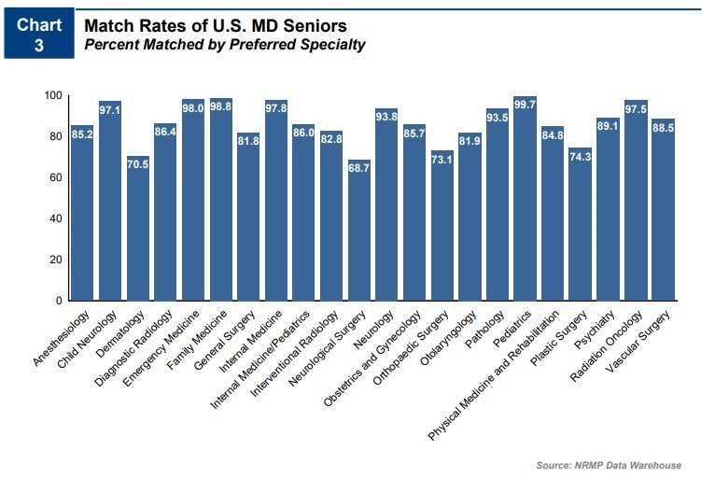
From NRMP Main Residency Match Data, 2024​
Charting Outcomes™: Characteristics of U.S. MD Seniors Who Matched to Their Preferred Specialty: 2024 Main Residency Match® | NRMP

Slide 22
From NRMP Main Residency Match Data, 2024​
Charting Outcomes™: Characteristics of U.S. MD Seniors Who Matched to Their Preferred Specialty: 2024 Main Residency Match® | NRMP
From NRMP Main Residency Match Data, 2023
https://www.nrmp.org/wp-content/uploads/2023/03/2023-Advance-Data-Tables-FINAL.pdf

Slide 23
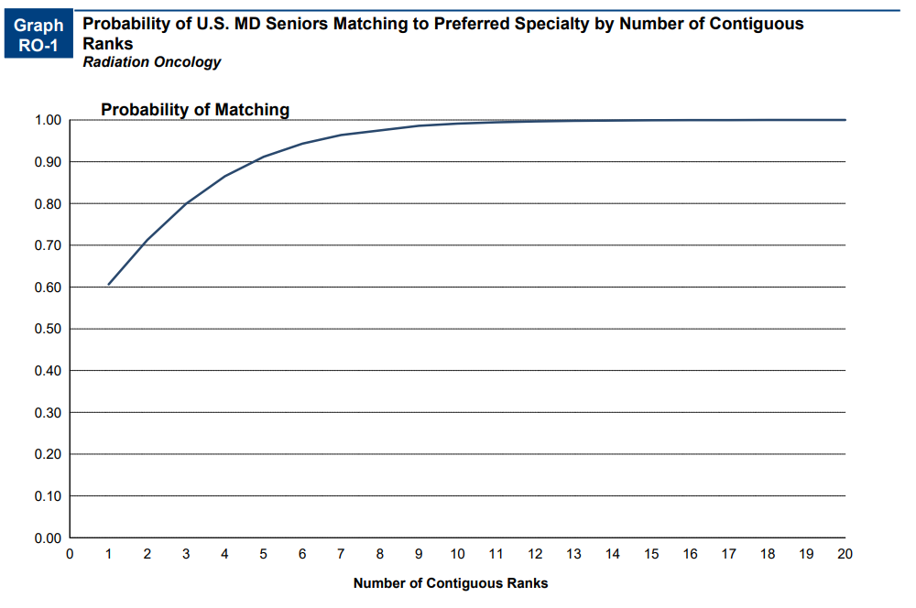
From NRMP Main Residency Match Data, 2024​
Charting Outcomes™: Characteristics of U.S. MD Seniors Who Matched to Their Preferred Specialty: 2024 Main Residency Match® | NRMP
Notes:
More programs, fewer interviews, skewed because older 2013-2018

Slide 24
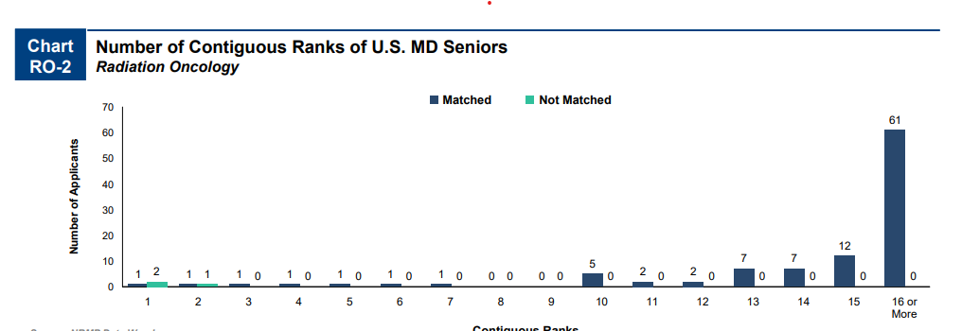
From NRMP Main Residency Match Data, 2024​
Charting Outcomes™: Characteristics of U.S. MD Seniors Who Matched to Their Preferred Specialty: 2024 Main Residency Match® | NRMP
Notes:
More programs, fewer interviews, skewed because older 2013-2018

Slide 25
Goals
Apply to a range of programs in terms of competitiveness.
Ideally you will interview at 12 programs (discuss with the department how many applications you should submit to receive this many interview offers).
Students should rank all programs they interviewed at unless they would rather go unmatched
If you have a significant geographic constraint, consider a pre-liminary program back up or a dual-application.

Slide 26
Signaling
Number of Signals Vary per Specialty
4Signals for Rad Onc in 2025-2026 Application Cycle
There were 4Signals for Rad Onc in 2024-2025 Application Cycle
Program Signaling for the 2026 MyERAS® Application Season | Students & Residents

Slide 27
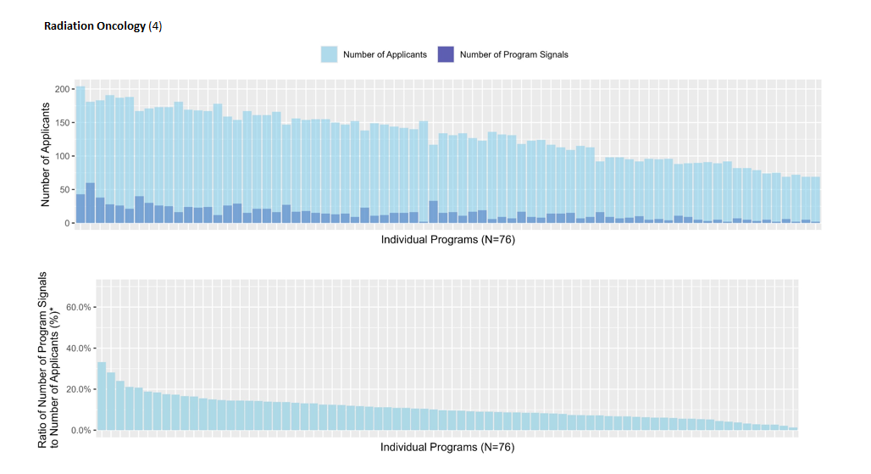
The percentage of all signals that were received by the top 10% of programs in radiation oncology was 24%
https://www.aamc.org/data-reports/data/eras-statistics-data

Slide 28
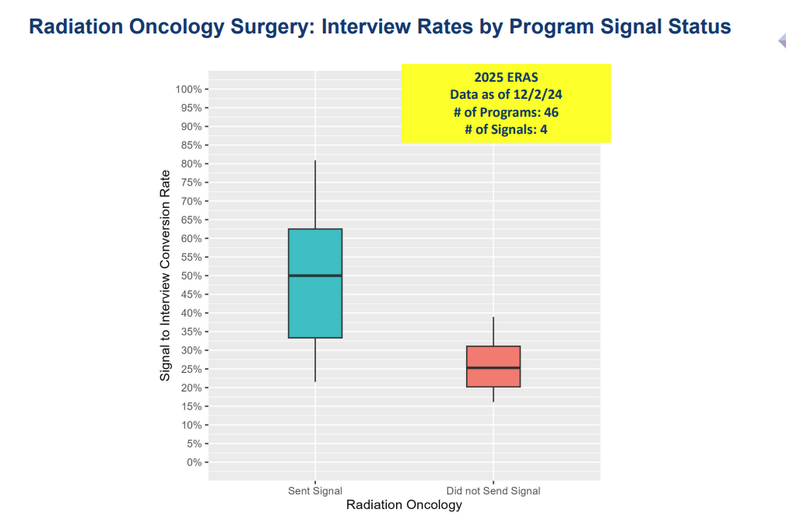
https://www.aamc.org/media/81251/download?attachment

Slide 29
https://www.aamc.org/media/81251/download?attachment

Slide 30
https://www.aamc.org/media/81261/download?attachment

Slide 31
https://www.aamc.org/media/81261/download?attachment

Slide 32
Radiation Oncology Data (UMSOM)
Stats- Radiation Oncology | 2021-2025
Step 2 Average 2021-2025 (Range) | 245 (241-273)
Step 2 Goal (252)-Charting Outcomes | 256
99% Probability Match | 13 interviews

Slide 33
Radiation Oncology Data (UMSOM)
UMSoM: Radiation Oncology | 2021-2025
Avg No. Applications (Range) | 48 (25-77)
Avg No. Interview Offers (Range) | 34 (19-48)
% Invites/Applications | 75%
No. Signals | 2025 (4 signals)
Percent of Interview Offers from Signaled Programs | 10%
Percent of Interview Offers from Non-Signaled Programs | 90%

Slide 34
Radiation Oncology Data (UMSOM)
Radiation Oncology 2021-2025
Radiation Oncology | No. Students | Avg. No. Interviews | % Match
All | 3 | 35 | 100%
AOA | 3 | 33 | 100%
Non-AOA | 1 | 40 | 100%
Step 2 >= 240 | 4 | 35 | 100%
Step 2 < 240 | 0 | NA | 100%
Step 2 >= 245 | 3 | 33 | 100%
Step 2 < 245 | 1 | 40 | 100%
GHHS | 1 | 40 | 100%
Non-GHHS | 3 | 33 | 100%
Clerkship Standing
Exceptional | 2 | 40 | 100%
Outstanding | 0 | na | 100%
Excellent | 2 | 30 | 100%
Very Well | 0 | na | 100%

Slide 35
Radiation Oncology Data (UMSOM)
Clerkship Standing | Interview Hit Rate | Average Applications | App Range
Exceptional | 85% | 46.0 | 40-50
Outstanding | none | none | 50-60
Excellent | 64% | 51.0 | 55-65
Very Well | none | none | 70-80
Concerns | none | none | 80+

Slide 36
Radiation Oncology (UMSOM)
Year | No. Matched Applicants | Avg. No. Aways | Matched Home | Matched Away | Matched Home/Away
2021-2025 | 4 of 4 | 1.25 | 1 of 4 (25%) | 3 of 4 (75%) | 4 of 4 (100%)

Slide 37
Which Programs to apply to:
FREIDA is a really great tool that can help you look at accredited programs by specialty in different regions around the country. https://freida.ama-assn.org/Freida/#/
AAMC Residency Explorer is a useful tool in assessing your competitiveness at particular programs: https://www.residencyexplorer.org/Account/Login
MedScope Data *We will review together – this data allows you to see where you stand as a student at UMSOM
Departmental Advisors (as well as faculty advisors, and senior students) are another key source of program information

Slide 38
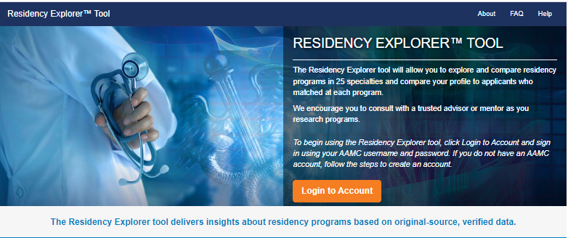
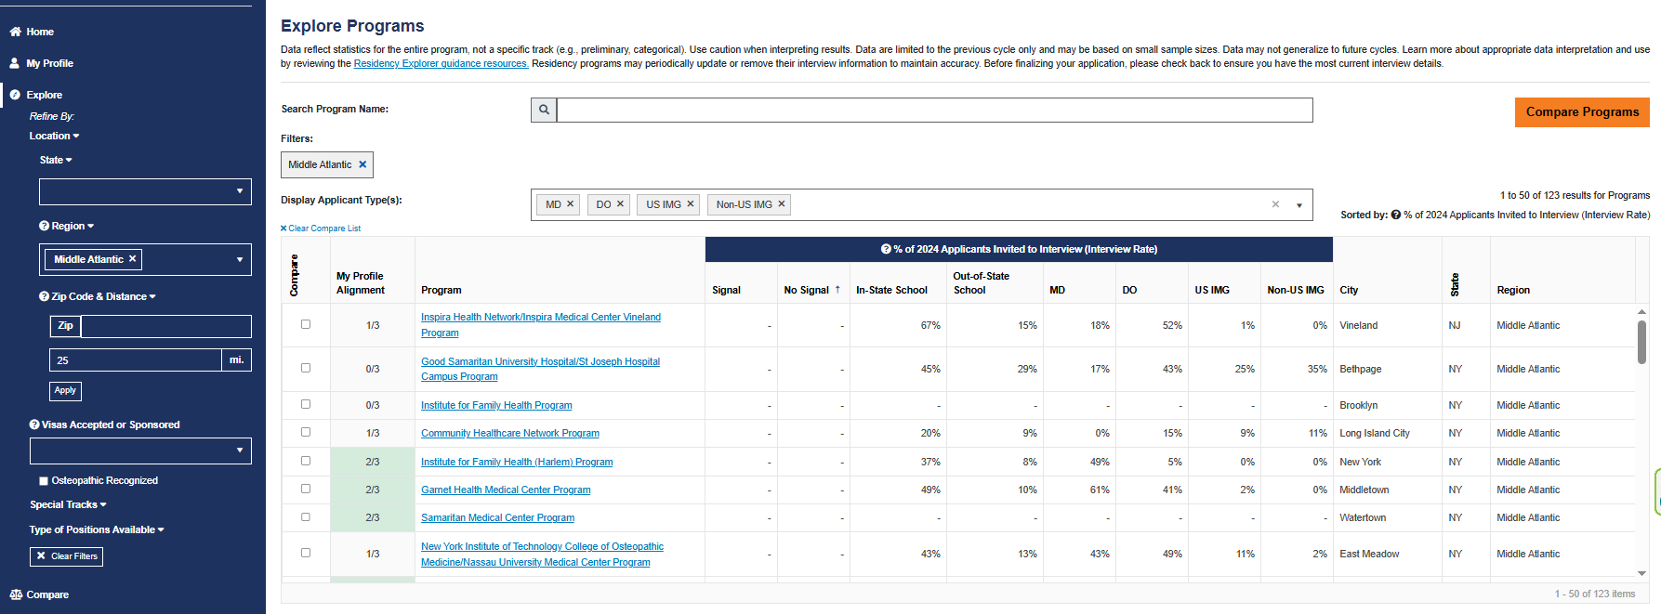
Residency Explorer

Slide 39
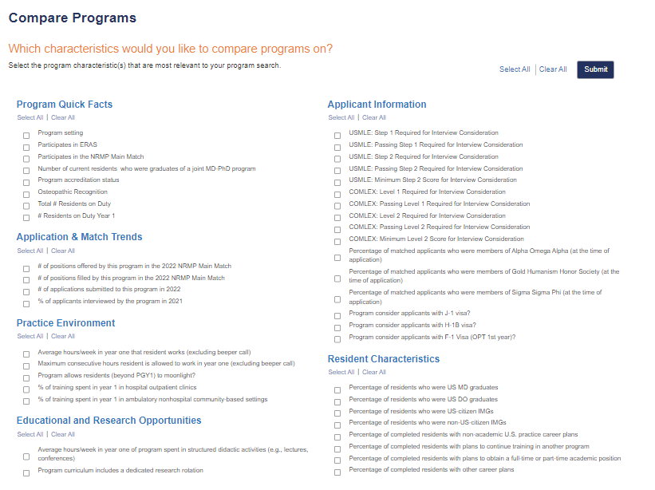

Slide 40
Compare Programs

Slide 41
Frieda
Tag Specialty
Location
Program Type
University Based
Community Based/University Affiliated
Community Based
Special Tracts
Map Feature
Overview
Length
Affiliated Programs
Program and Work Schedule
Size of program
Step 1 and 2 data
Work schedule/Call
% USMD and gender
Features and Benefits
Compensation
Offers additional training or educational experience beyond accredited length
Off campus electives

Slide 42
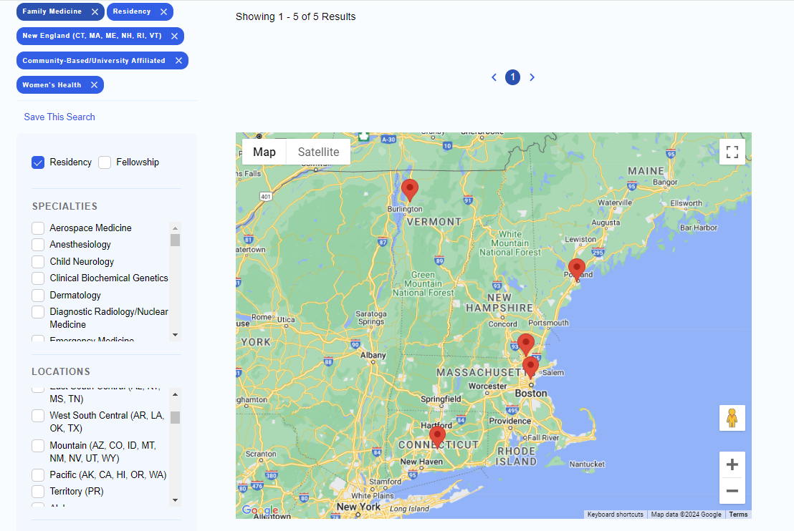

Slide 43
Checklist to be completed prior to your meeting
[ ] Complete the Career Tab on MedScope
[ ] Review your schedule/graduation requirements
[ ] Review the Residency Application Handbook
The below are NOT required but may be helpful
[ ] Meet with Departmental Mentors
[ ] Create a CV Draft (CV Tips); we will not go through this at the meeting but can answer specific questions
[ ] Create a Personal Statement draft; we are happy to review outside the meeting timeframe
[ ] Self reflect on your competitiveness

