Slide 1
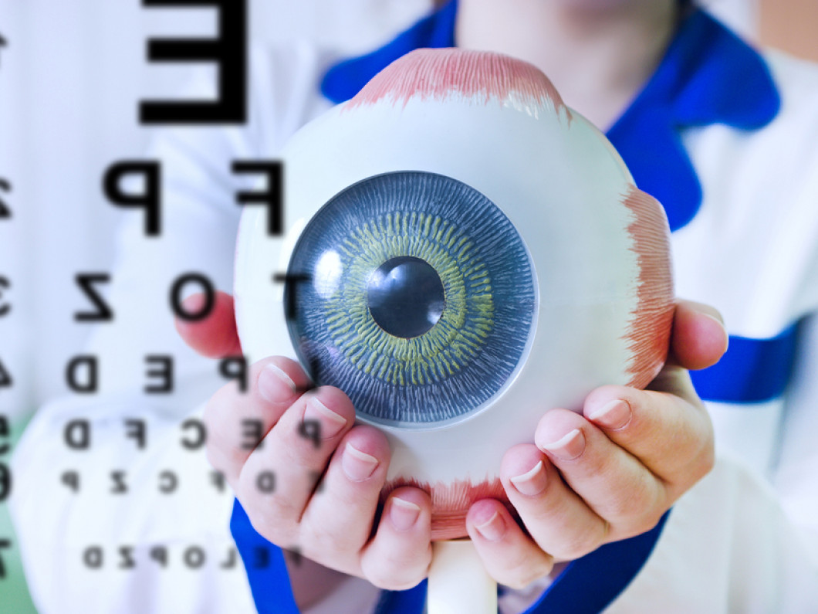
Ophthalmology
Class of 2026
2025-2026 Match Cycle

Slide 2
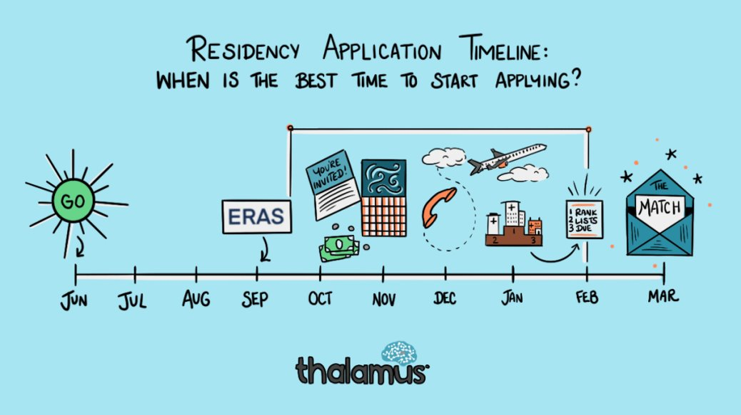

Original Slide Design by Dr. Kerri Thom

Slide 3
Upcoming workshops!
April-May: OSA Specialty-Specific Advising
Personal Statement Writing Workshops: Medscope recording; LIVE: 7/15 & 8/19 in Reid Rooms
June 3rd 400pm: Residency Application Workshop:
March 2026: SOAP Workshop (mandatory)
May-July: OSA 1:1 Advising Sessions
Workshop Links: OSA Advising Workshop Series | University of Maryland School of Medicine
Notes:
June 3rd Workshop: https://umaryland.zoom.us/j/99600677409?pwd=v7zb0wpiiZYi6pOXr2vvMhk67FJijx.1&from=addon

Slide 4
Graduation Requirements Class of 2026
Graduation Requirements | University of Maryland School of Medicine
Must be completed ONE week prior to graduation
Pass all third-year clerkships, including shelf examinations
Pass ONE 2-week elective (added to the Pediatric Clerkship)
Pass TWO sub-internships
Pass FIVE electives
      No more than TWO Pre-clerkship elective equivalents may be counted toward the total elective count
      Two electives must be on campus (i.e. in our electives catalogue)
      Pre-clerkship electives are considered “on campus”
Pass ONE PoM4: Transition to Residency (4 weeks)
Complete an FRCT Scholarly Project
Pass OSCE
Take USMLE Step 2: Clinical Knowledge examination
Complete Exit Interview with Financial Aid
Additional Requirements (next slide)
*NOTE – if you are off cycle, please discuss your graduation requirements with an OSA Faculty member

Slide 5
Graduation Requirements Class of 2026
Additional Requirements: Note: these are NOT in addition to the above, but fulfill an above elective or sub-internship requirement.
Ambulatory Requirement^: one (4-week) of the five above required electives or one (4-week) of the two above required sub-internships must be an Ambulatory rotation (as designated via the "Ambulatory" tab in the course catalog); in addition to the expectations of the elective, students will have designated curricular material to satisfy the ambulatory requirement; this requirement cannot be fulfilled with a pre-clerkship elective.
Internal Medicine Requirement^: one (4-week) of the five above required electives or one (4-week) of the two above required sub-internships must be in Internal Medicine (as designated via the "Internal Medicine" tab in the course catalog); cannot be fulfilled with a pre-clerkship elective.
^The same rotation cannot fulfill both the Ambulatory and Internal Medicine Requirement.
★ At least one clinical rotation (as designated via the "Clinical" tab in the course catalog) must be done in the second half of the 4th year.

Slide 6
Important Reminders
Confirm name/pronunciation in MedScope as you with for graduation/diploma
Update your Preferred Pronouns in MedScope for the MSPE (if not indicated will default to he/him, she/her)
Update your contact information
Pay it forward, sign up to be an Alumni Mentor (Career Tab, MedScope)
Use the MedScope Interview Tracker to ensure optimal advising!
Consider your brand and ensure social media profiles are professional/clean
Meet with Financial Aid (Sophia Cascio)
Complete Graduation Questionnaire (online through AAMC) – available Jan – May

Slide 7
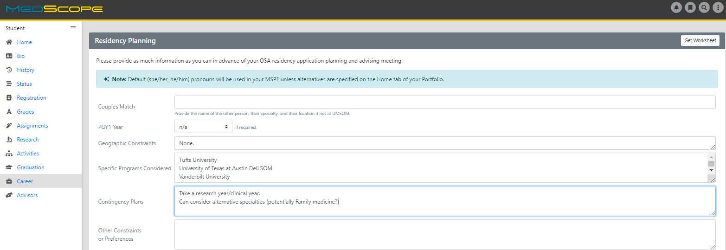
Career Tab (Please complete)

Slide 8
Residency Application Manual:
Your New Best Friend
Residency Application Manual | University of Maryland School of Medicine

Slide 9
1:1 OSA Residency Advising
Meeting Prep
You may review MSPE details, including a sample MSPE, here:
The MSPE | University of Maryland School of Medicine
[ ] Complete the Career Tab on MedScope to assist with MSPE data collection
*Be prepared to discuss any deviations from the traditional 4-year curriculum
*Be prepared to discuss any hardships (e.g. personal medical condition, bereavement, or other extenuating circumstance that may have had a negative effect on academic performance) if you wish to consider for inclusion in the MSPE
[ ] Closer to the application deadline, OSA will solicit Noteworthy Characteristics from you for inclusion in the MSPE; if you wish to get started on these now you may review examples in Link #1 above.
Note:
*AOA nominations will be noted in the MSPEs Noteworthy Characteristics and in the summary paragraph
*GHHS membership will be noted in the MSPEs Professional Performance section and in the summary paragraph

Slide 10
1:1 OSA Residency Advising Meeting Prep
The below are NOT required but may be helpful
[ ] Meet with Departmental Mentors
[ ] Think about programs of interest or geographical areas of interest
[ ] Create a CV Draft (CV Preparation Tips | University of Maryland School of Medicine); we will not go through this at the meeting but can answer specific questions
[ ] Create a Personal Statement draft; we are happy to review outside the meeting timeframe

Slide 11
Application and Match
SF Match and Central Application Service are integrated.
You may need to also fill out ERAS and register for NRMP.

Slide 12
Application timeline:
SF MATCH Timeline: See in 2 slides :) - 2025-2026 Pending TBD
  Timetable - Ophthalmology Residency - SF Match - Residency and Fellowship Matching Services
Match Week Schedule: TBD
*Note: Ophthalmology participates in the San Francisco (SF) Match and is an ‘early’ match. *While it is an "early" match, the upfront timeline is not too different from other specialties. The interview season and match turnaround is the faster/early part.
*Students who are applying for Ophthalmology only, do not need to apply to ERAS (see caveat next slide)
*Students who are dual applying will need to apply through ERAS as well.

Slide 13
SF Match-Ophthalmology
For Ophthalmology, you will fill out your application on the SF Match website and will match through the SF Match (submit rank lists).
Most ophthalmology programs at this point are integrated/joint programs, meaning when you match with the SF Match, you will have a PGY1 position through the NRMP match process. This means that you MAY need to register for the NRMP Match.

Slide 14
SF Match/Application
TIMELINE
(Still pending 25-26)
Date | 2024-2025 Season (waiting for 2025-2026)
July 1, 2024 | SF Portal Opens
September 3, 2024 | Applications Released to Programs
September 25, 2024 | MSPE Letters Released to Programs
July 1, 2024-Jan 25, 2025 | Programs open house organization
October 8, 2024 | First Day Interviews can begin (ALL INTERVIEWS VIRTUAL)
October 23, 2024 | Applicants Open Hour Tour Sign-Up Period
December 20, 2024 | Last Day of Interviews
January 3, 2025 @12pm PT | Program Rank List DUE
January 4, 2025 | Live Open House Tours Start (optional) - In person
January 25, 2025 | Last Day for Live Open House Tours (optional) -in person
January 28, 2025 @12pm PT | Applicant Rank Lists DUE
February 4, 2025 @5pm PT | MATCH Results Released
MATCH DAY | 3rd week March

Slide 15
EERAS/NRMP Timeline 2025-2026
Date | Activity
June 4, 2025 | ERAS 2026 season begins at 9 a.m. ET.
Sept. 3, 2025 | Residency applicants may begin submitting MyERAS applications to programs at 9 a.m. ET.
Sept. 24, 2025 | Residency programs may begin reviewing MyERAS applications and MSPEs in the PDWS at 9 a.m. ET.
End of January 2026 | Register for Match and SOAP
Early February 2026 | RANK OPENS
First week of March 2026 | RANK Lists Certified
2nd or 3rd week of March 2026 | SOAP and MATCH
*Note, these dates are subject to change. Please reference2026 ERAS® Residency Timeline | Students & Residents for the most updated schedules.

Slide 16
Ophthalmology Application
Department | Ophthalmology
Contacts (R = Required to Meet)
Chair | Lisa S. Schocket, MD
Program Director | Sarah Ullah, MD
MSIV Advising | Moran Levin, MD (R)
Competitive Applicant
Step 2 (goal) | 250 (UMSOM Average 255)
AOA/GHHS | Helpful
Research | Necessary/Consider Gap Research Year
Applications
Application System | SF Match/CAS Application
Program Signaling | 7 signals 2024-2025 (SF signal system- waiting 25-26 announcement)
Acuity Insights | N/A
Preliminary/Transitional Year | Integrated or Joint
Match System | SF Match
Away Rotations
Expectations | Expected
Ideal Number | 2 max
Letters of Reference
Total Number | 3 letters
Chair Letter | Required (Most Programs)
Ideal Make Up | Home Ophthalmology (1-2), Other (medicine)
Contingency | If dual applying, secure letters for that specialty
Mock Interview Program
 | OSA Advisor coordinates with Dr. Levin for those who are interested
Contingency
 | Strongly Consider Research Year between M3/4
 | ALL Students MUST Have Contingency
 | Consider Dual Application

Slide 17
A Note on External Rotations (“Aways”)
Opthalmology DOES require Away rotations (Ideally 2 away rotations)
YOU MUST ADD THIS COURSE AT SOM!!!
Required forms are found on the Student Scheduling Page
  Forms should be completed/signed by Departments
  Submitted to Add/Drop

Slide 18
Signaling
Ophthalmology is planning to have 7 “tokens” or “signals." Pending 2025-2026 Season
Waiting on AUPO for announcements
  AUPO champions an inclusive academic ophthalmology community to promote and advocate for excellence and equity in ophthalmic education, professional development, research, and clinical care. | Association of University Professors of Ophthalmology

Slide 19
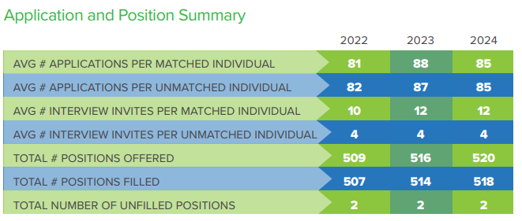
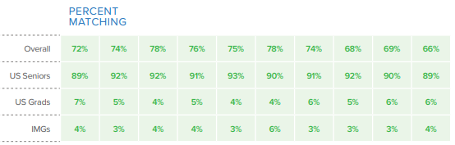
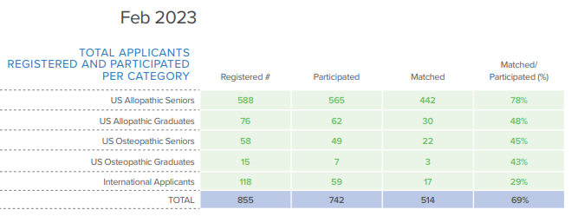
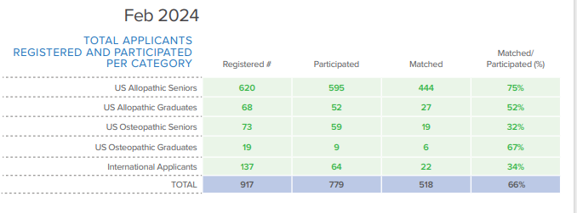
This is 2024 Data. We are still waiting for 2025 data to be released from SF.
From SF Residency Match Data, 2024 2024Ophthalmology-Residency-Match-Report.pdf (aupo.org)

Slide 20
Goals
Apply to a range of programs in terms of competitiveness.
Students should rank all programs they interviewed at unless they would rather go unmatched
If you have a significant geographic constraint, consider a pre-liminary program back up or a dual-application.
INTERVIEW CAP WAS 15 2024-2025

Slide 21
ALL STUDENTS APPLYING TO OPTHO SHOULD HAVE A CONTINGENCY PLAN.
For students applying to specialties a little beyond their academic reach or for any student applying to a competitive subspeciality:
Consider applying to a second, less competitive specialty concurrently.
Consider applying to a preliminary program, such as internal medicine or surgery concurrently.
If you would rather improve your credentials and apply again if unmatched, be clear on what you can do to improve your credentials.
If research experience is important, consider applying concurrently to research programs so that you have that as an option if you do not match.
If additional clinical work is important, consider applying to a preliminary program
Consider earning an additional degree (MPH, JD, MBA) to either improve your credentials or as an alternate career option.
Understand that it takes 2 years to really improve your application…1 year to do something and then the application year.

Slide 22
OphthalmologyUMSOM Data
UMSoM: Ophthalmology | 2023 | 2024 | 2025
Avg Applications | 76.4 | 84 | 83
Avg Interview Offers | 17.2 | 18.5 | 10
% Invites/Applications | 25.00% | 22.02% | 13%
No. Signals (7 signals) | 2023 | 2024 | 2025
Percent of Interview Offers from Signaled Programs | NA | NA | 49%
Percent of Interview Offers from Non-Signaled Programs | NA | NA | 50%
No. Additional Interview Offers from Non-Signaled Programs | NA | NA | 0 to 10
Stats
Average Step 2 | 257 | 255.0 | 254
Step 2 Average 2022-2024 | 255.3333333

Slide 23
Ophthalmology Data (UMSOM)
Ophthalmology 2023-2025
 | No. Students | Avg. No. Interviews | % Match
All | 14 | 15.5 | 85.7% (12 of 14)
AOA | 7 | 17 | 100% (7 of 7)
Non-AOA | 7 | 11 | 71% (5 of 7)
Step 2 >= 240 | 14 | 15.5 | 85.7% (12 of 14)
Step 2 < 240 | 0 | NA | NA
Step 2 >= 245 | 14 | 15.5 | 85.7% (12 of 14)
Step 2 < 245 | 0 | NA | NA
GHHS | 4 | 17 | 100% (4 of 4)
Non-GHHS | 10 | 13 | 80% (8 of 10)
Clinical Designation
Exceptional | 2 | 18 | 100% (6 of 6)
Outstanding | 6 | 17.5 | 100% (6 of 6)
Excellent | 5 | 11 | 80% (4 of 5)
Very Well | 1 | 4 | 0% (0 of 1)

Slide 24
Ophthalmology Data (UMSOM)
Year | No. Matched Applicants | Avg. No. Aways | Matched Home | Matched Away | Matched Home/Away
2023-2025 | 12 of 14 | 2 | 2 of 14 (14%) | 6 of 14 (43%) | 8 of 14 (57%)

Slide 25
Which Programs to apply to:
SF Match Program Profiles: Ophthalmology - Program Profile Info - SF Match - Residency and Fellowship Matching Services
FREIDA is a really great tool that can help you look at accredited programs by specialty in different regions around the country. https://freida.ama-assn.org/Freida/#/
MedScope Data *We will review together – this data allows you to see where you stand as a student at UMSOM
Departmental Advisors (as well as faculty advisors, and senior students) are another key source of program information

Slide 26
Checklist to be completed prior to your meeting
[ ] Complete the Career Tab on MedScope
[ ] Review your schedule/graduation requirements
[ ] Review the Residency Application Manual | University of Maryland School of Medicine
The below are NOT required but may be helpful
[ ] Meet with Departmental Mentors
[ ] Create a preliminary list of programs of interest (print/PDF Residency Explorer output)
[ ] Create a CV Draft (CV Tips); we will not go through this at the meeting but can answer specific questions
[ ] Create a Personal Statement draft; we are happy to review outside the meeting timeframe

Slide 27

Any Questions?

