Slide 1
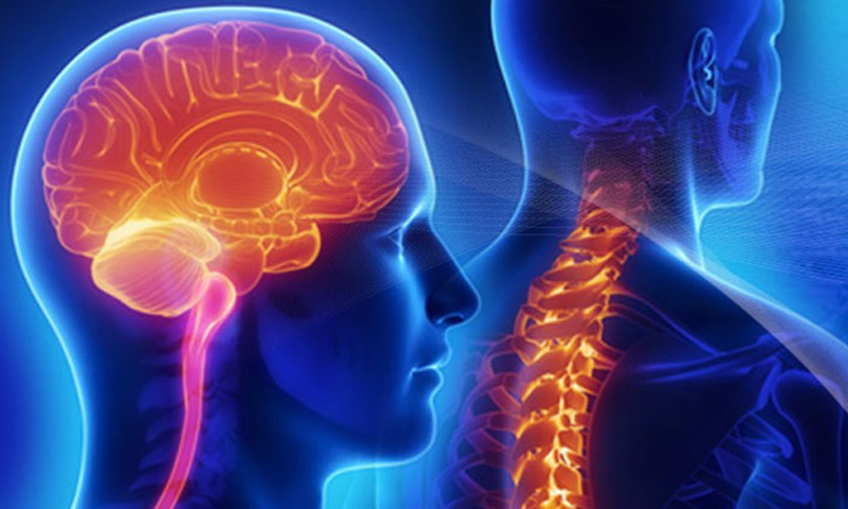
Neurology
Class of 2026
2025-2026 match cycle

Slide 2
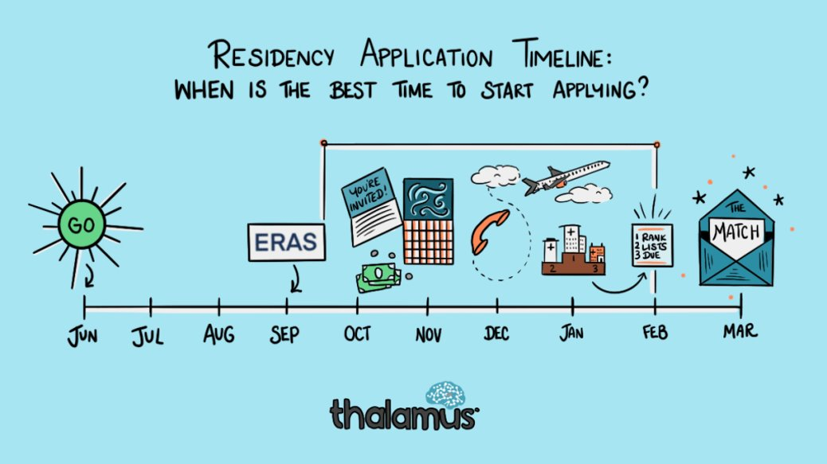

Original Slide Design by Dr. Kerri Thom

Slide 3
Upcoming workshops!
April-May: OSA Specialty-Specific Advising
Personal Statement Writing Workshops: Medscope recording; LIVE: 7/15 & 8/19 in Reid Rooms
June 3rd 400pm: Residency Application Workshop:
March 2026: SOAP Workshop (mandatory)
May-July: OSA 1:1 Advising Sessions
Workshop Links: OSA Advising Workshop Series | University of Maryland School of Medicine
Notes:
June 3rd Workshop: https://umaryland.zoom.us/j/99600677409?pwd=v7zb0wpiiZYi6pOXr2vvMhk67FJijx.1&from=addon

Slide 4
Graduation Requirements Class of 2026
Graduation Requirements | University of Maryland School of Medicine
Must be completed ONE week prior to graduation
Pass all third-year clerkships, including shelf examinations
Pass ONE 2-week elective (added to the Pediatric Clerkship)
Pass TWO sub-internships
Pass FIVE electives
      No more than TWO Pre-clerkship elective equivalents may be counted toward the total elective count
      Two electives must be on campus (i.e. in our electives catalogue)
      Pre-clerkship electives are considered “on campus”
Pass ONE PoM4: Transition to Residency (4 weeks)
Complete an FRCT Scholarly Project
Pass OSCE
Take USMLE Step 2: Clinical Knowledge examination
Complete Exit Interview with Financial Aid
Additional Requirements (next slide)
*NOTE – if you are off cycle, please discuss your graduation requirements with an OSA Faculty member

Slide 5
Graduation Requirements Class of 2026
Graduation Requirements | University of Maryland School of Medicine
Additional Requirements: Note: these are NOT in addition to the above, but fulfill an above elective or sub-internship requirement.
Ambulatory Requirement^: one (4-week) of the five above required electives or one (4-week) of the two above required sub-internships must be an Ambulatory rotation (as designated via the "Ambulatory" tab in the course catalog); in addition to the expectations of the elective, students will have designated curricular material to satisfy the ambulatory requirement; this requirement cannot be fulfilled with a pre-clerkship elective.
Internal Medicine Requirement^: one (4-week) of the five above required electives or one (4-week) of the two above required sub-internships must be in Internal Medicine (as designated via the "Internal Medicine" tab in the course catalog); cannot be fulfilled with a pre-clerkship elective.
^The same rotation cannot fulfill both the Ambulatory and Internal Medicine Requirement.
★ At least one clinical rotation (as designated via the "Clinical" tab in the course catalog) must be done in the second half of the 4th year.

Slide 6
Important Reminders
Confirm name/pronunciation in MedScope as you with for graduation/diploma
Update your Preferred Pronouns in MedScope for the MSPE (if not indicated will default to he/him, she/her)
Update your contact information
Pay it forward, sign up to be an Alumni Mentor (Career Tab, MedScope)
Use the MedScope Interview Tracker to ensure optimal advising!
Consider your brand and ensure social media profiles are professional/clean
Meet with Financial Aid (Sophia Cascio)
Complete Graduation Questionnaire (online through AAMC) – available Jan – May

Slide 7
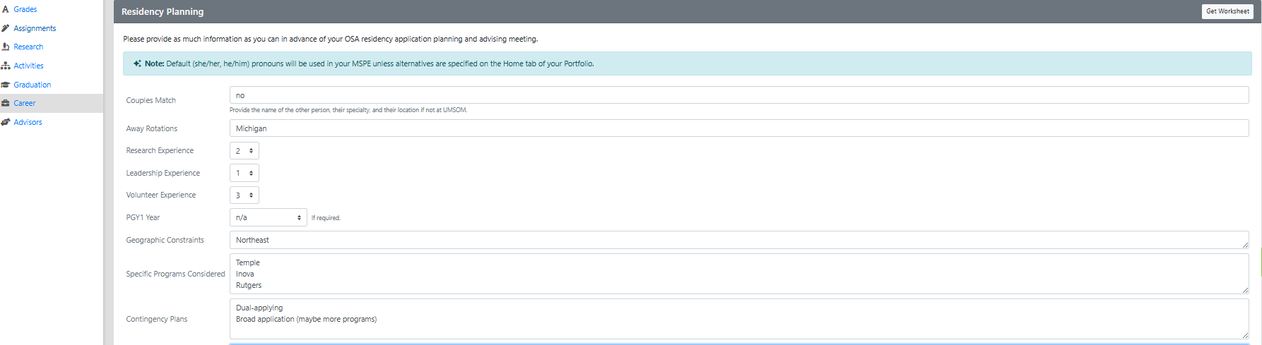
Career Tab (Please complete)

Slide 8
Residency Application Manual:
Your New Best Friend
Residency Application Manual | University of Maryland School of Medicine

Slide 9
1:1 Sessions with OSA
These are FOR YOU!
Answer any questions: scheduling, graduation requirements, application logistics
Individualized application guidance
Competitiveness for Specialty
How many programs to apply to
Which programs to apply to
Contingency plans
Discuss your MSPE (Example MSPE)

Slide 10
MSPE
You may review MSPE details, including a sample MSPE, here: The MSPE
*Be prepared to discuss any deviations from the traditional 4-year curriculum
*Be prepared to discuss any hardships (e.g. personal medical condition, bereavement, or other extenuating circumstance that may have had a negative effect on academic performance) if you wish to consider for inclusion in the MSPE
* This is NOT a letter for recommendation
Note:
  AOA nominations will be noted in the MSPEs Noteworthy Characteristics and in the summary paragraph
  GHHS membership will be noted in the MSPEs Professional Performance section and in the summary paragraph

Slide 11
ERAS/NRMP TIMELINE
Date | Activity
June 4, 2025 | ERAS 2026 season begins at 9 a.m. ET.
Sept. 3, 2025 | Residency applicants may begin submitting MyERAS applications to programs at 9 a.m. ET.
Sept. 24, 2025 | Residency programs may begin reviewing MyERAS applications and MSPEs in the PDWS at 9 a.m. ET.
End of January 2026 | Register for Match and SOAP
Early February 2026 | RANK OPENS
First week of March 2026 | RANK Lists Certified
2nd or 3rd week of March 2026 | SOAP and MATCH
*Note, these dates are subject to change. Please reference2026 ERAS® Residency Timeline | Students & Residentsfor the most updated schedules.

Slide 12






Original Slide Design by Dr. Kerri Thom

Slide 13
Neurology Application
Department | Neurology
Contacts (R = Required to Meet)
Chair | Peter Crino, MD
Program Director | Carolyn Cronin, MD
MSIV Advising | Melissa Motta, MD (R)
Competitive Applicant
Step 2 (goal) | 250 (National Average); 246 (UMSOM 22-25 Avg)
Preliminary/Transitional Year | yes, some independent, some integrated, some joint
Applications
Application System | ERAS
Program Signaling | 8 signals
Acuity Insights | NA
Preliminary/Transitional Year | yes, some independent, some integrated, some joint
Match System | NRMP
Away Rotations
Expectations | Not expected
Ideal Number | NA
Letters of Reference
Total Number | 3 to 4
Chair Letter | Not Required
Ideal Make Up | Neurology Faculty (1), Neurology Faculty (1), Other Faculty (any specialty) OR research advisor/volunteer etc, IM Prelim (Dittmar)
Contingency | If dual applying, secure letters for that specialty
Mock Interview Program
 | OSA coordination with Neurology Chief Residents
Contingency
 | ALL Students MUST Have Contingency
 | IM Preliminary Applications
Notes:
CO 2024 Average step 2 was 245 too

Slide 14
A Note on External Rotations (“Aways”)
Neurology does not require Away rotations. Speak with your OSA advisor about pros/cons.
YOU MUST ADD THIS COURSE AT SOM!!!
Required forms are found on the Student Scheduling Page
  Forms should be completed/signed by Departments
  Submitted to Add/Drop

Slide 15
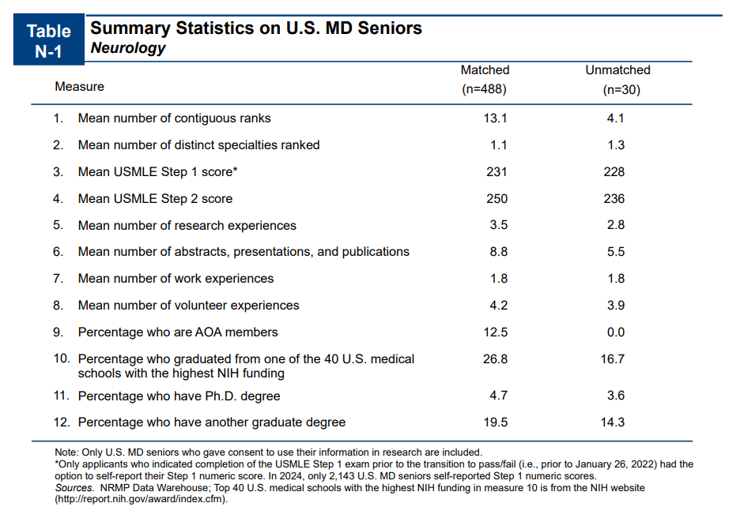
From NRMP Main Residency Match Data, 2024
Charting Outcomes™: Characteristics of U.S. MD Seniors Who Matched to Their Preferred Specialty: 2024 Main Residency Match® | NRMP

Slide 16
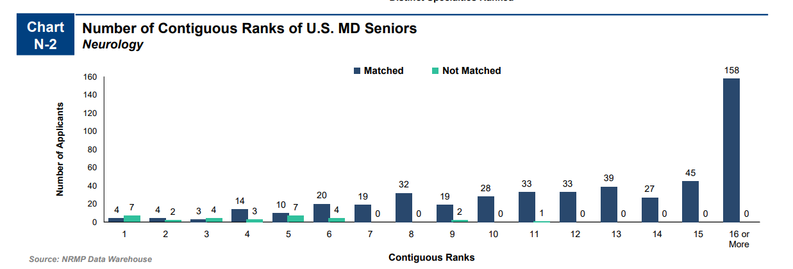
From NRMP Main Residency Match Data, 2024
Charting Outcomes™: Characteristics of U.S. MD Seniors Who Matched to Their Preferred Specialty: 2024 Main Residency Match® | NRMP

Slide 17
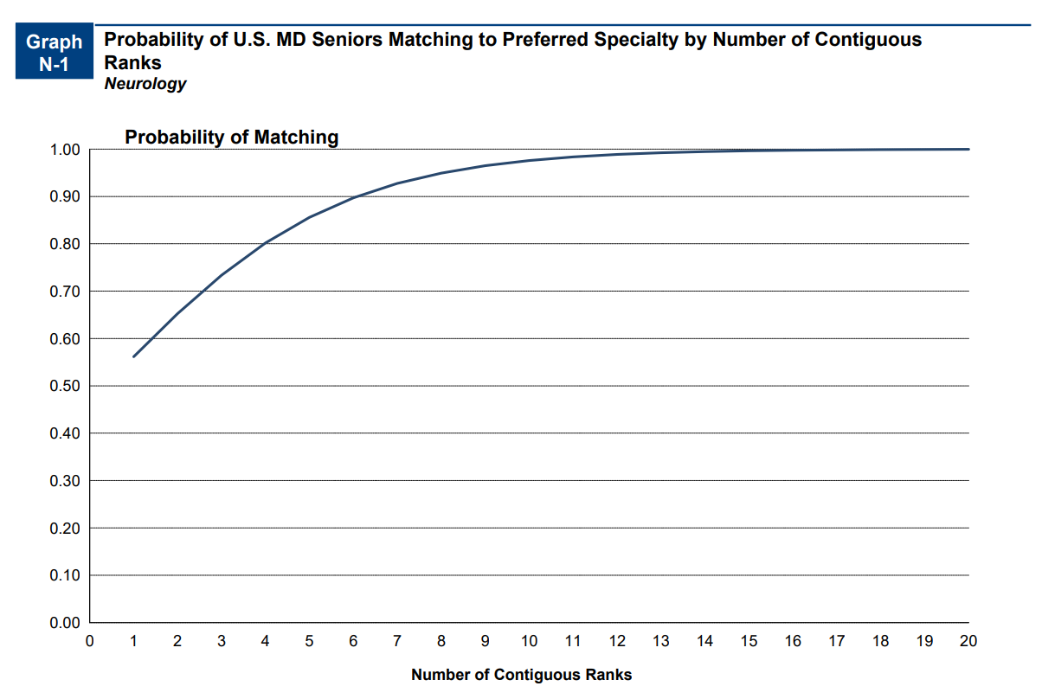
From NRMP Main Residency Match Data, 2024
Charting Outcomes™: Characteristics of U.S. MD Seniors Who Matched to Their Preferred Specialty: 2024 Main Residency Match® | NRMP

Slide 18
Goals
Apply to a range of programs in terms of competitiveness.
Ideally you will interview at 12- 14 programs
Students should rank all programs they interviewed at unless they would rather go unmatched
If you have a significant geographic constraint, consider a pre-liminary program back up or a dual-application.

Slide 19
Signaling
Number of Signals Vary per Specialty
8 Signals for Neurology in 2025-2026 Application Cycle
  There were 8 signals for the 2024-2025 Application Cycle
  There were 3 signals in 2023-2024 cycle
Program Signaling for the 2026 MyERAS® Application Season | Students & Residents

Slide 20
Neurology Data (UMSOM)
Stats- Neurology | 2023 | 2024 | 2025
Average Step 2 (UMSOM) | 249 | 245.0 | 248
Step 2 Average 2022-2025 (UMSOM) | 247
Step 2 Goal (250)-NRMP Charting Outcomes
99% Probability Match
13 interviews

Slide 21
Neurology Data (UMSOM)
UMSoM: Neurology | 2023 | 2024 | 2025
Avg No. Applications | 35 | 39 | 40
Avg No. Interview Offers | 18 | 16 | 14
% Invites/Applications | 53% | 43% | 35%
No. Signals | 0 | 3 | 8
Percent of Interview Offers from Signaled Programs | N/A | 15% | 40%
Percent of Interview Offers from Non-Signaled Programs | N/A | 85% | 60%
No. of Interviews outside of Signals | N/A | 8 to 25 | 7 to 10

Slide 22
Neurology Data (UMSOM)
Neurology Data 2022-2025
Neurology | No. Students | Avg. No. Interviews | % Match
All | 12 | 14 | 100%
AOA | 3 | 22 | 100%
Non-AOA | 9 | 13 | 100%
Step 2 >= 240 | 10 | 13 | 100%
Step 2 < 240 | 2 | 16 | 100%
Step 2 >= 245 | 6 | 14 | 100%
Step 2 < 245 | 6 | 14 | 100%
GHHS | 3 | 21 | 100%
Non-GHHS | 9 | 11 | 100%
Clinical Designation
Exceptional | 1 | 23 | 100%
Outstanding | 2 | 22 | 100%
Excellent | 7 | 11 | 100%
Very Well | 2 | 11 | 100%

Slide 23
Neurology Data (UMSOM)
Clerkship Standing | Interview Hit Rate | Avg. No. Apps Suggested | Range
Exceptional | 64% | 36 | 30-40
Outstanding | 58% | 38 | 35-45
Excellent | 36% | 38 | 40-45
Very Well | 28% | 39 | 45+

Slide 24
Which Programs to apply to:
FREIDA is a really great tool that can help you look at accredited programs by specialty in different regions around the country. https://freida.ama-assn.org/Freida/#/
AAMC Residency Explorer is a useful tool in assessing your competitiveness at particular programs: https://www.residencyexplorer.org/Account/Login
MedScope Data *We will review together – this data allows you to see where you stand as a student at UMSOM
Departmental Advisors (as well as faculty advisors, and senior students) are another key source of program information

Slide 25
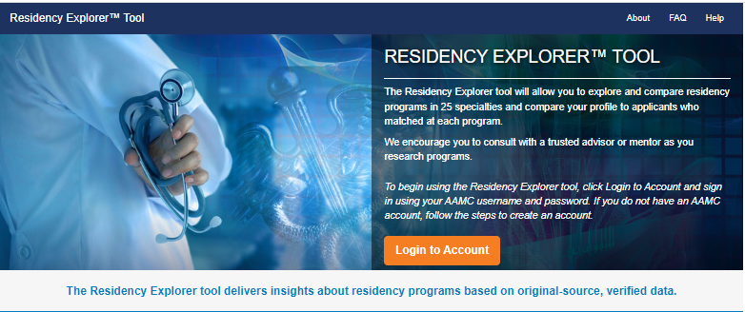
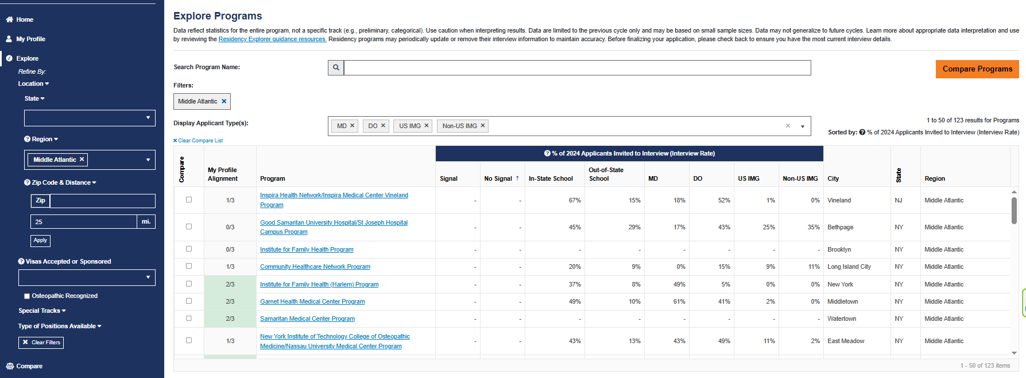
Residency Explorer

Slide 26
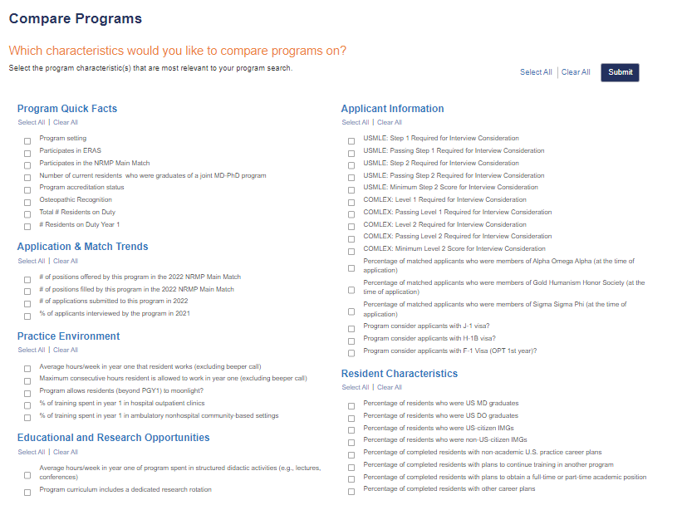

Slide 27
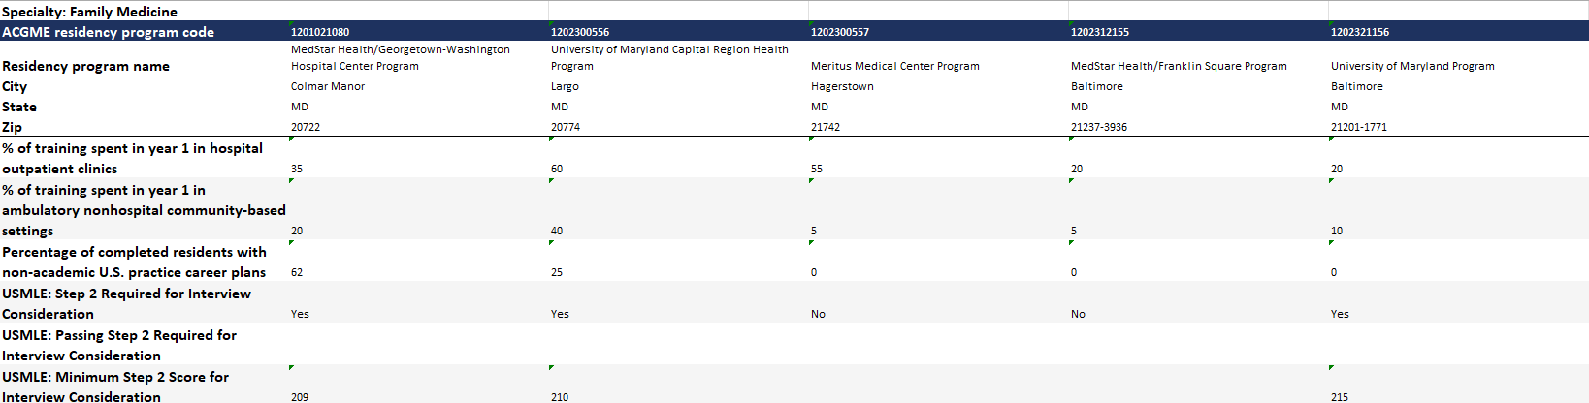
Compare Programs

Slide 28
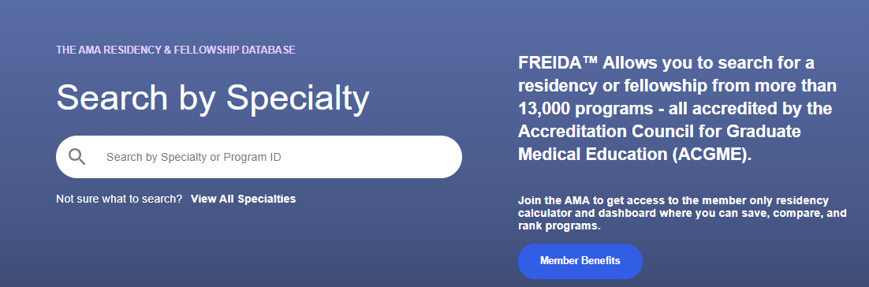
Frieda
Tag Specialty
Location
Program Type
  University Based
  Community Based/University Affiliated
  Community Based
Special Tracts
Map Feature
Overview
  Length
  Affiliated Programs
Program and Work Schedule
  Size of program
  Step 1 and 2 data
  Work schedule/Call
  % USMD and gender
Features and Benefits
  Compensation
  Offers additional training or educational experience beyond accredited length
  Off campus electives

Slide 29
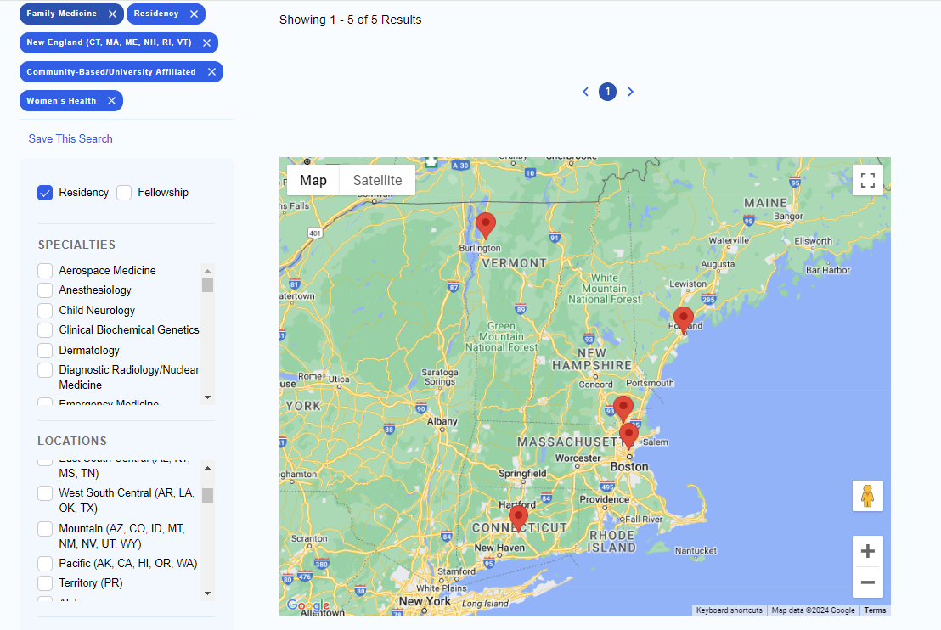

Slide 30
Checklist to be completed prior to your meeting
[ ] Complete the Career Tab on MedScope
[ ] Review your schedule/graduation requirements
[ ] Review packet information, emailed after this meeting
[ ] Review the Residency Application Handbook
The below are NOT required but may be helpful
[ ] Meet with Departmental Mentors
[ ] Create a preliminary list of programs of interest (print/PDF Residency Explorer output)
[ ] Create a CV Draft (CV Tips); we will not go through this at the meeting but can answer specific questions
[ ] Create a Personal Statement draft; we are happy to review outside the meeting timeframe

Slide 31
Checklist to be completed prior to your meeting
[ ] Complete the Career Tab on MedScope
[ ] Review your schedule/graduation requirements
[ ] Review the Residency Application Handbook
The below are NOT required but may be helpful
[ ] Meet with Departmental Mentors
[ ] Create a CV Draft (CV Tips); we will not go through this at the meeting but can answer specific questions
[ ] Create a Personal Statement draft; we are happy to review outside the meeting timeframe
[ ] Self reflect on your competitiveness

Slide 32

Any Questions?

