Slide 1
eDisclose
Annual Disclosure Instructions

Slide 2
To Gain Access to eDisclose (CICERO Research Evaluation Portal)
Login to CICERO. For your information, the URL for CICERO is listed below.
http://cicero.umaryland.edu

Slide 3
Login to eDisclose
If you are an UMB employee, or UMB affiliate, or UMB Student, with a UMID and have an existing CICERO user account, click on “UMB Employee/Affiliate/Student Login,” enter your UMB system login credentials. You will be asked to enter your CICERO user account login for one-time mapping of your UMID with your CICERO credentials.
If you are an UMB employee or UMB affiliate or UMB Student, with a UMID and do not have a CICERO user account, you should request a CICERO account first, and then follow the steps above.

Slide 4
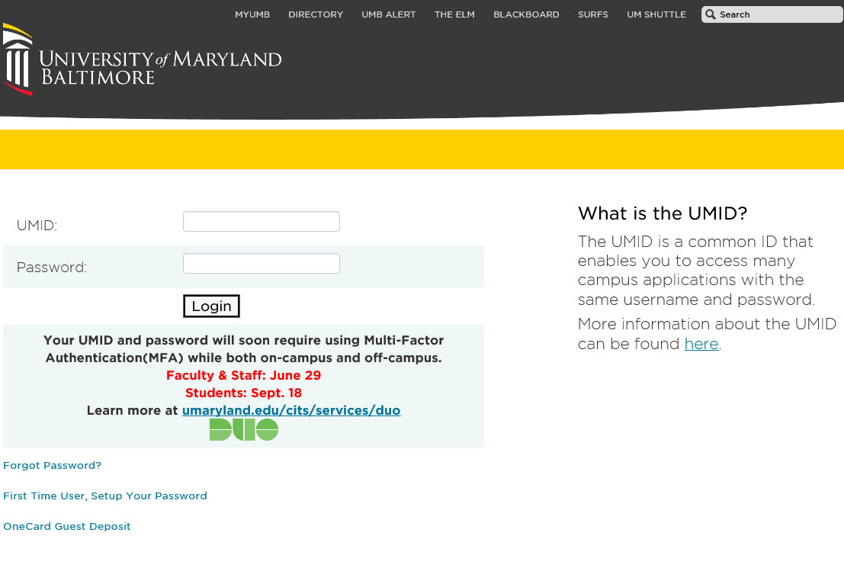
Login To eDisclose – UMB Employee
If you are an UMB Employee, UMB Affiliate or UMB Student, you will be directed to this login screen, asking you to login using Multi-factor Authentication (DUO).
Enter your UMID and Password

Slide 5
Login to eDisclose – UMB Employee
You will be asked to choose an authentication method.

Slide 6
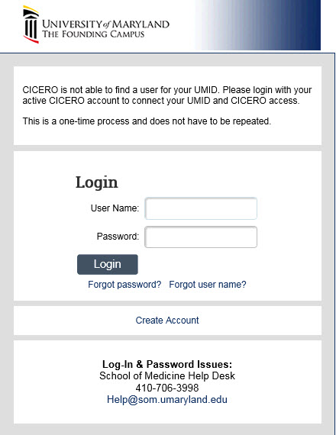
UMB Employee with CICERO Account
If you are an UMB employee, UMB Affiliate or UMB Student, and do have a CICERO user account, enter your CICERO username and password to do one-time mapping. You will only need to go through this local log in page once.

Slide 7
Login to eDisclose – Non-UMB Employee, and Affiliates
If you are a non-UMB Employee or Affiliate, select Local CICERO Login

Slide 8
Login to eDisclose – Non-UMB Employee

Slide 9
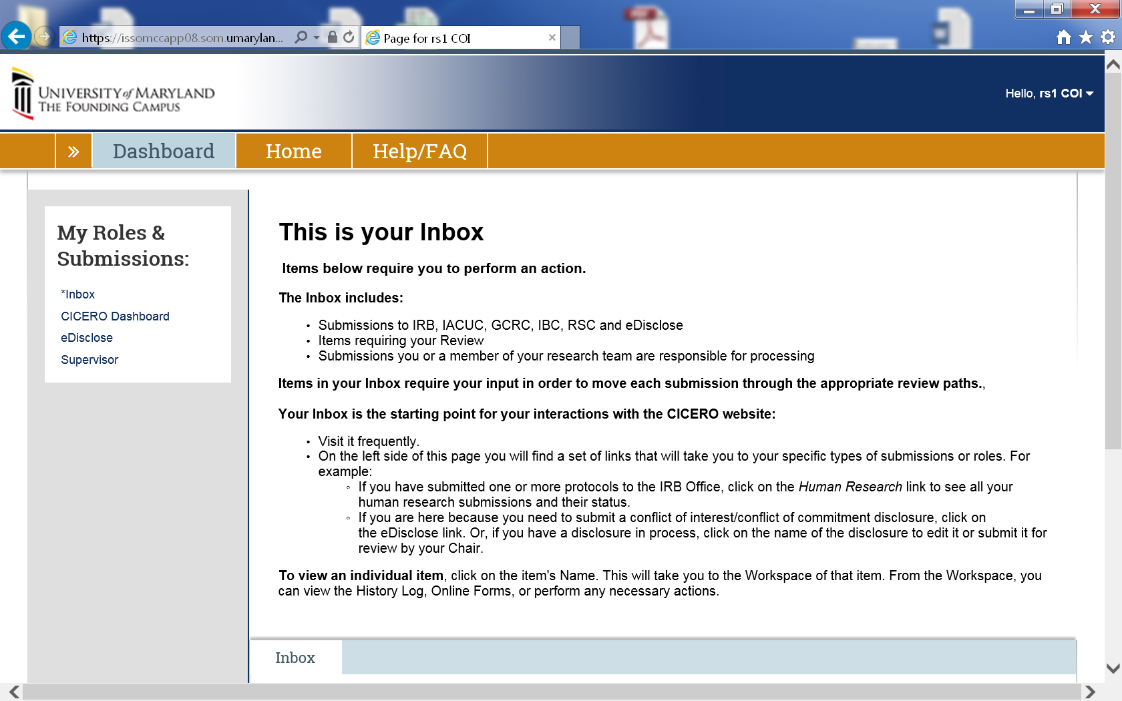
Dashboard
After logging in, you will arrive at your Dashboard. On the left-hand side of the Dashboard, select eDisclose

Slide 10
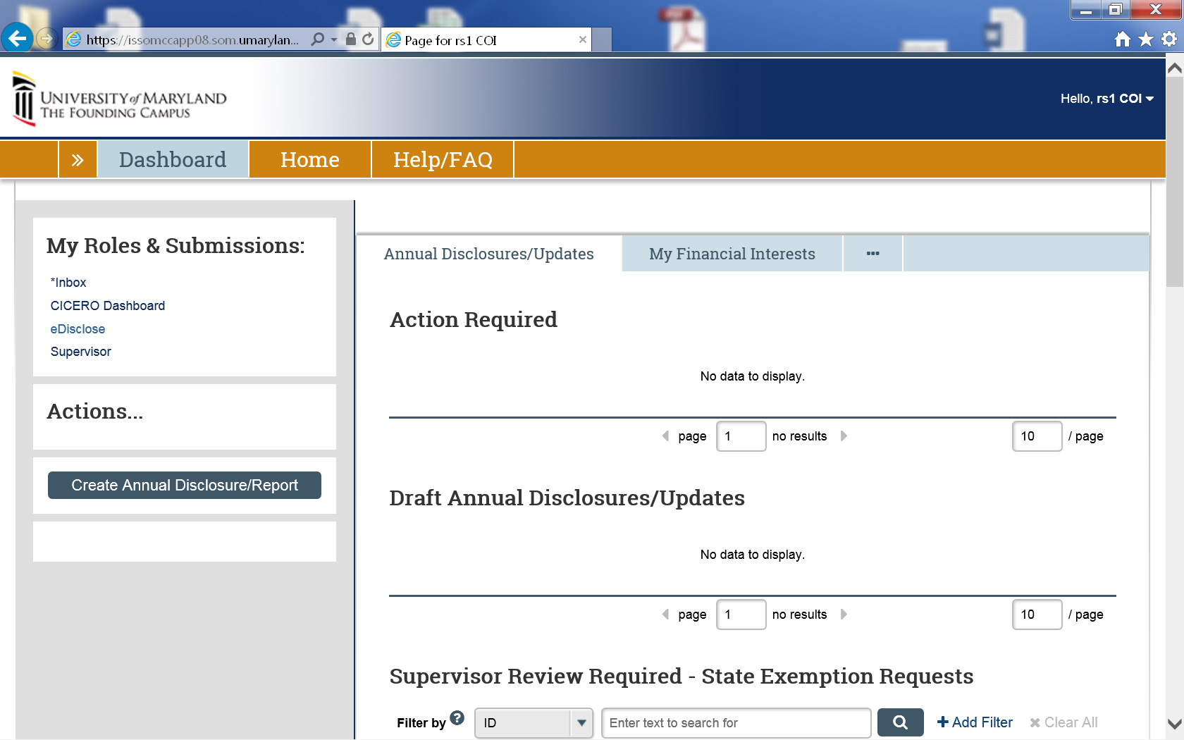
Create Annual Disclosure
Under “Actions”, select Create Annual Disclosure

Slide 11
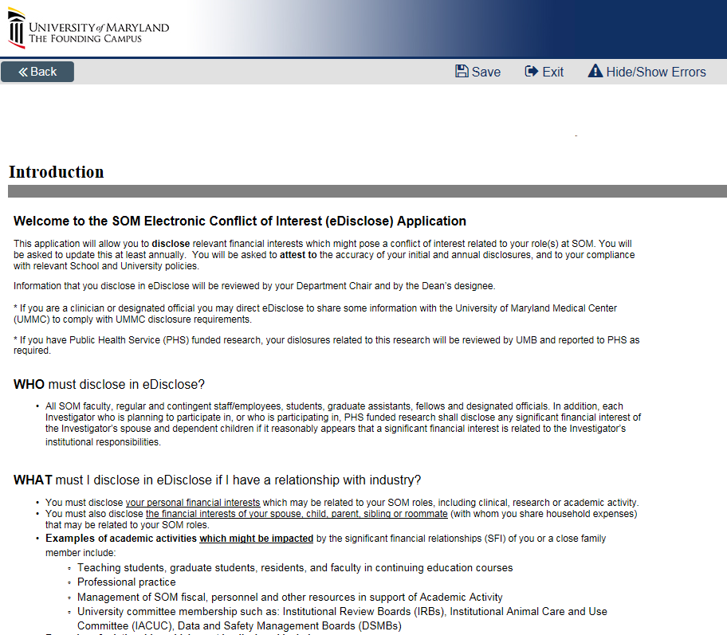
Create Annual Disclosure
You will arrive at an Introduction Screen
Please read all information before proceeding
Click the “Continue” button

Slide 12
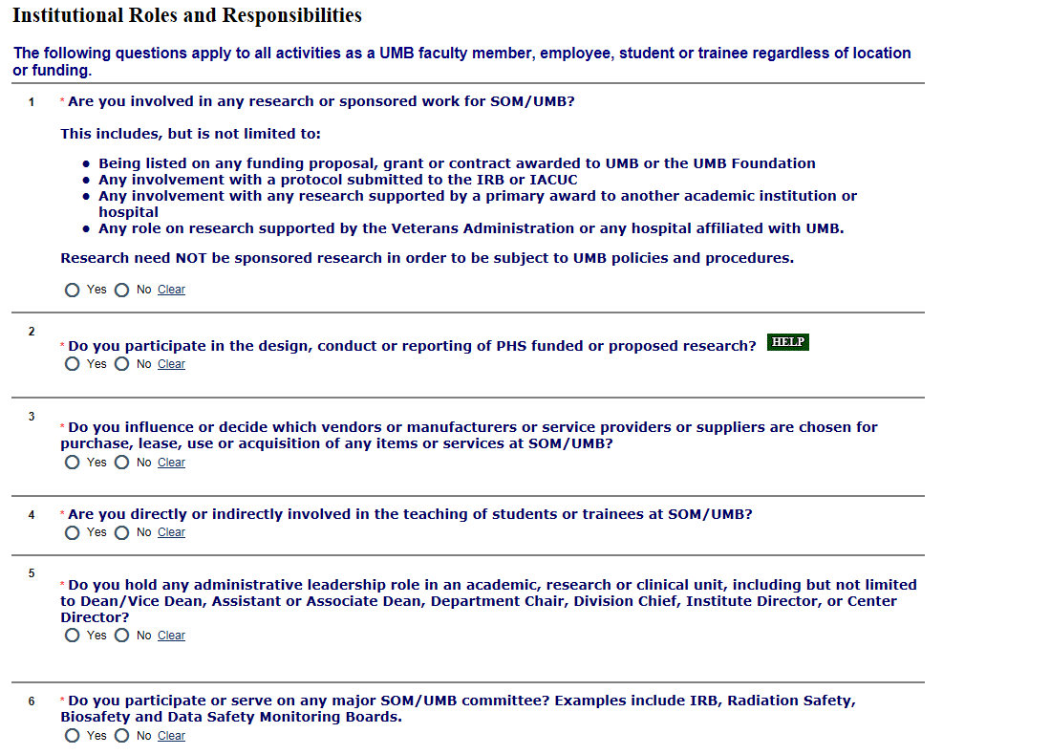
Institutional Roles and Responsibilities
Respond to Questions 1 – 6

Slide 13
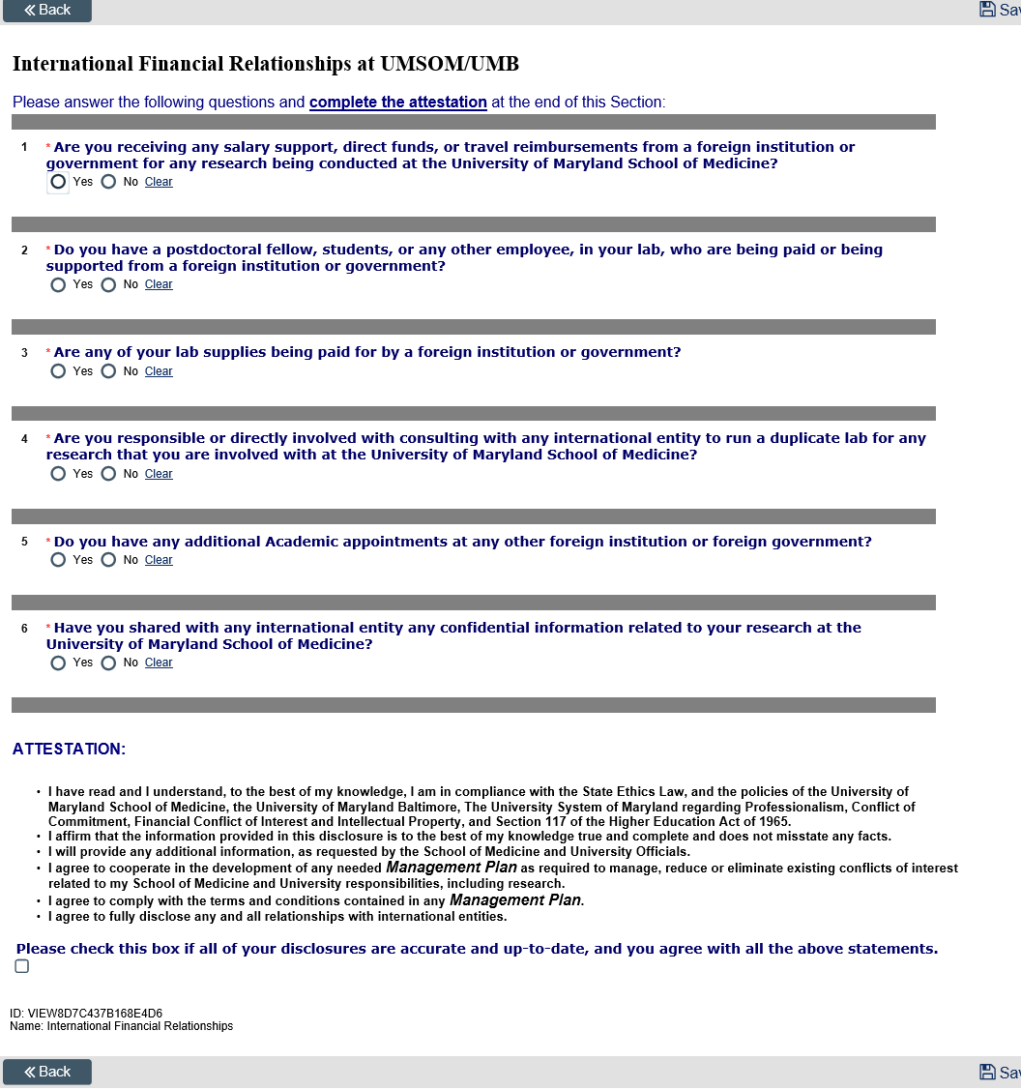
International Financial Relationships at UMSOM/UMB
13

Slide 14
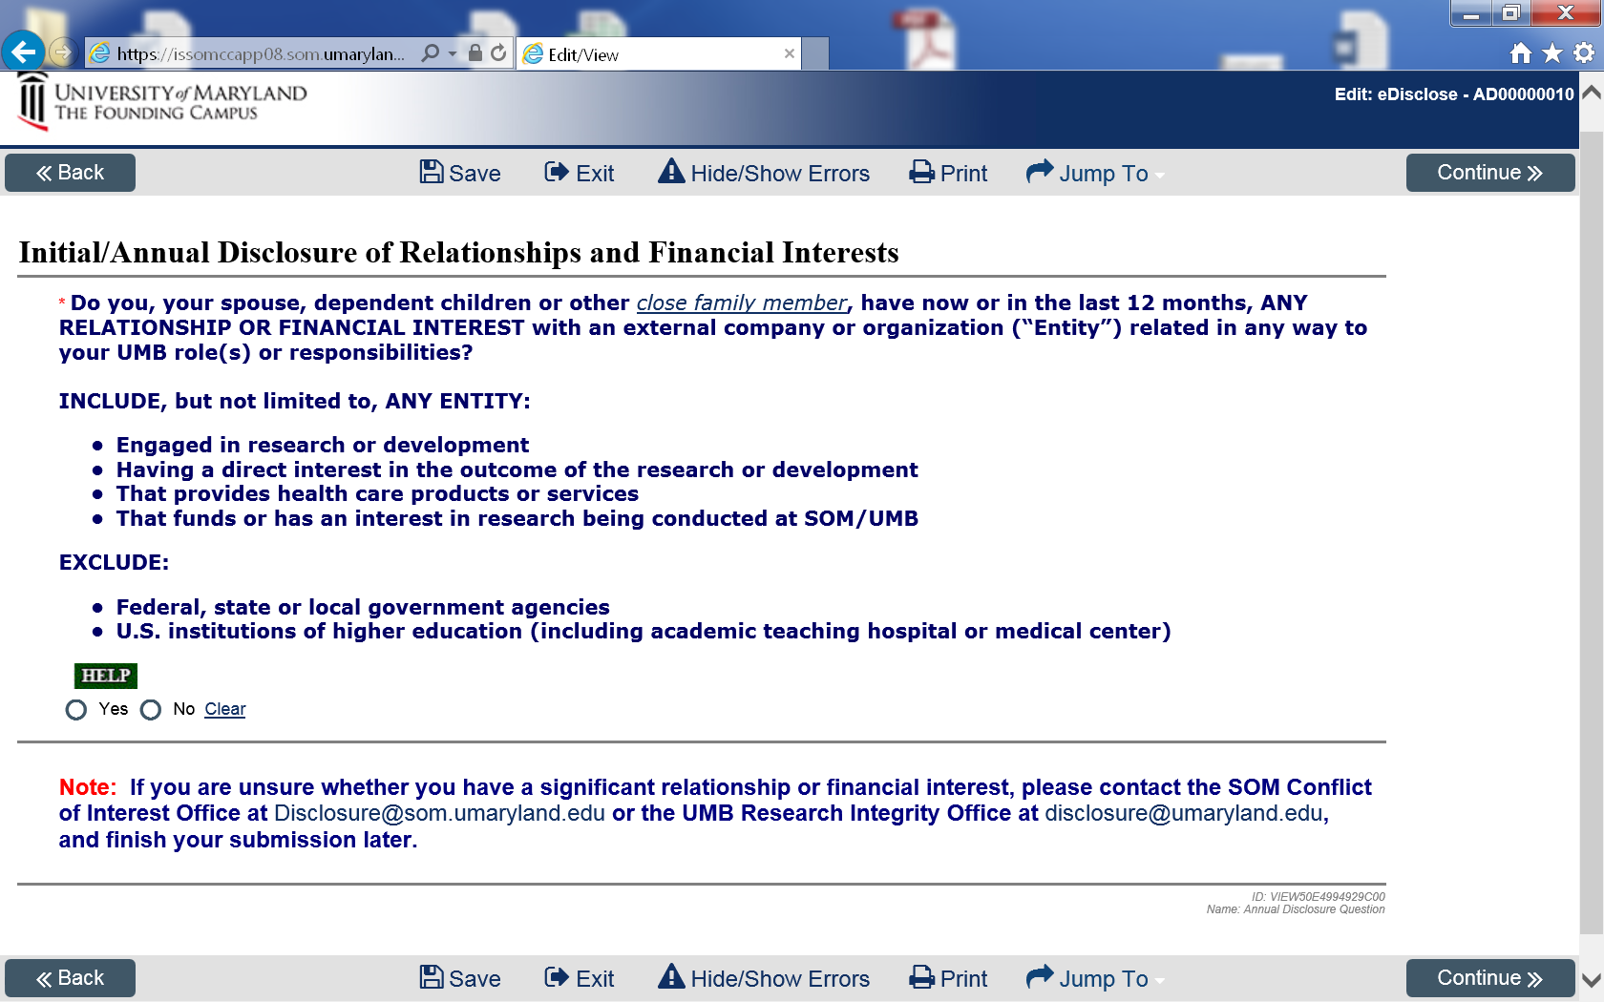
Initial/Annual Disclosure of Relationships and Financial Interests

Slide 15
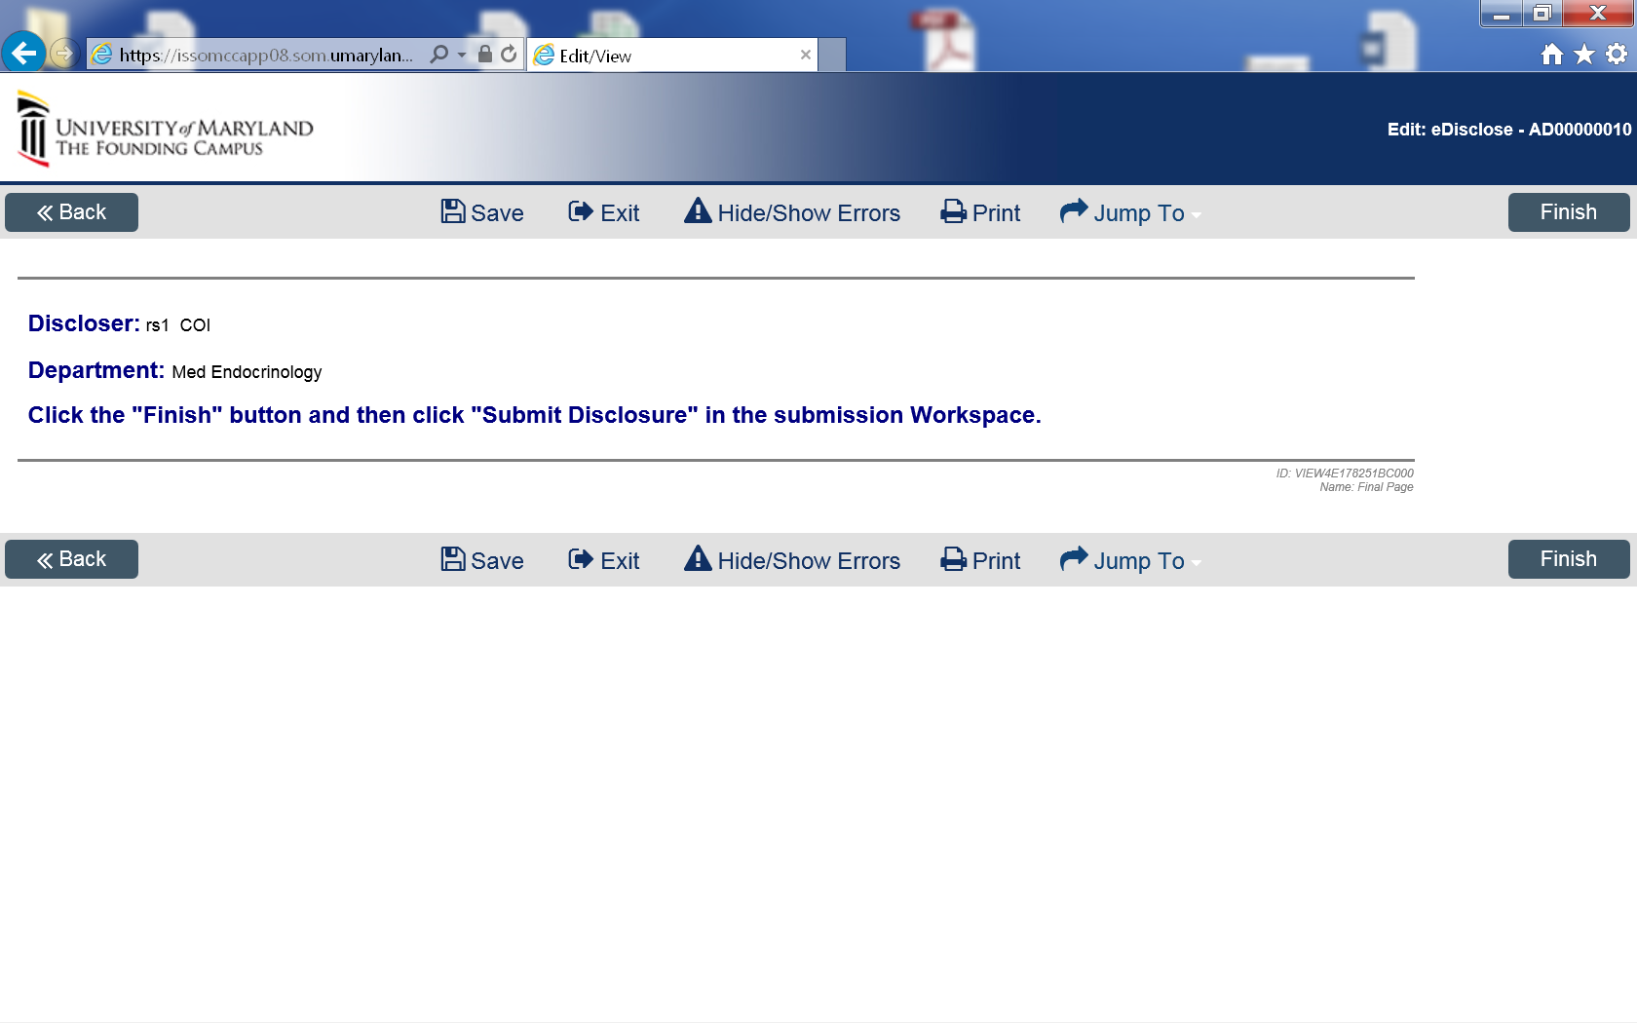
Final Page
If you answered “No” to the Financial Interest question, click the “Finish” button. If you answered “Yes” to the Financial Interest Question, please proceed to slide 20.

Slide 16
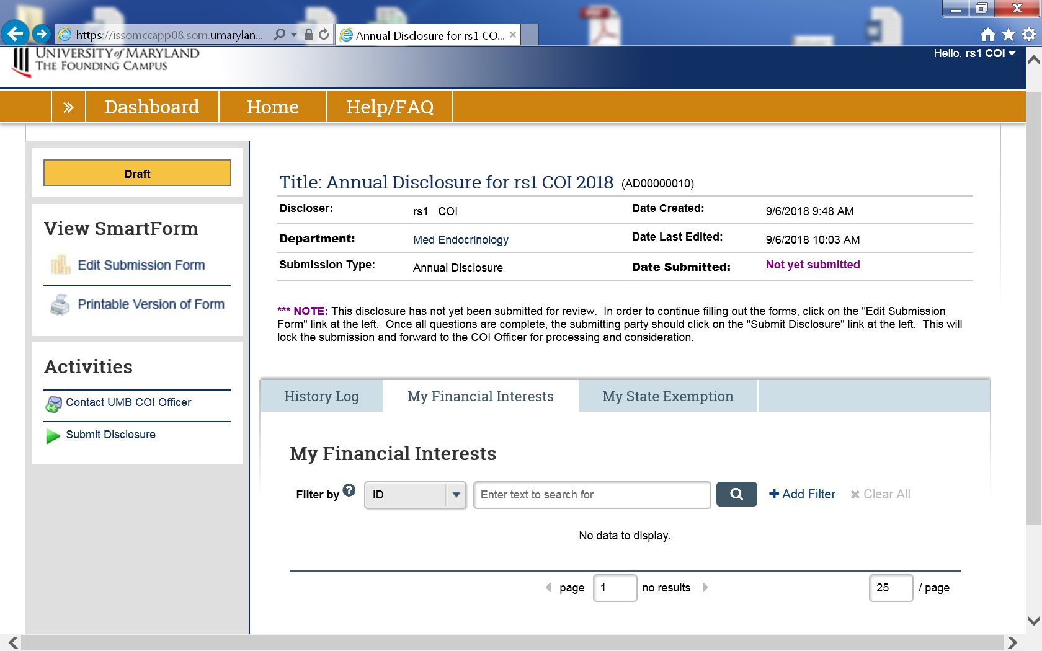
Submit Annual Disclosure
NOTE: Your submission will not be complete until you click the Submit Disclosure Activity.

Slide 17
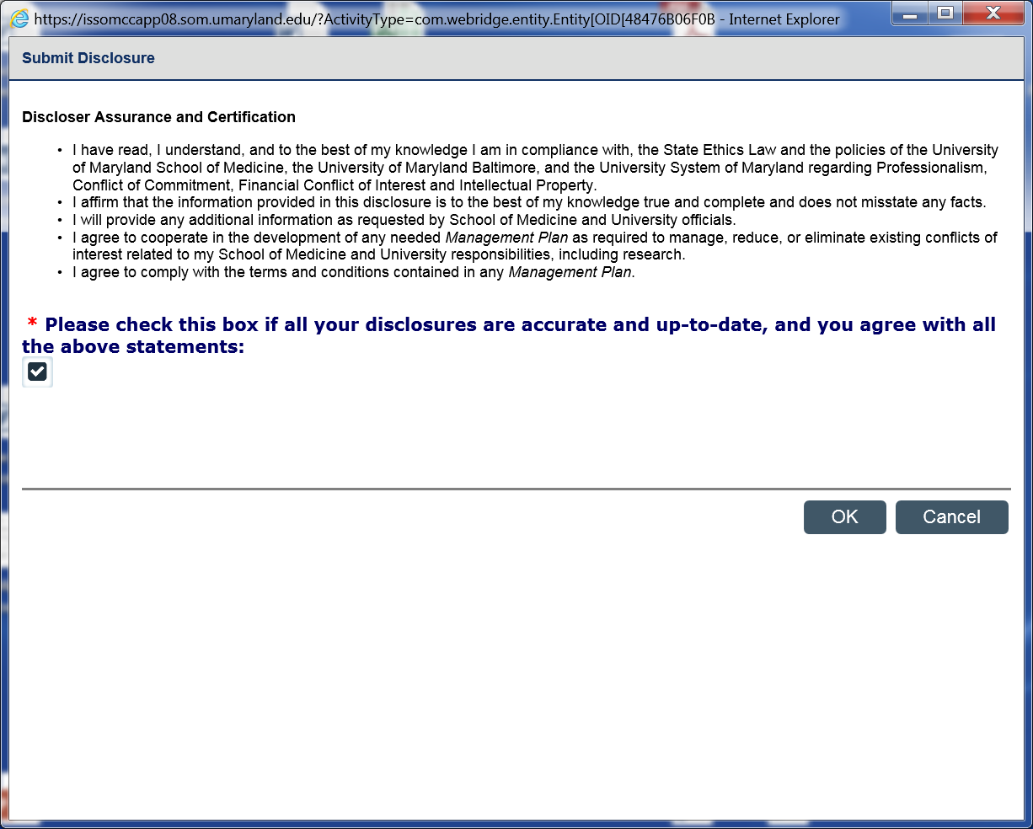
Submit Annual Disclosure
Read the Discloser Assurance and Certification language. Attest and certify your disclosure by checking the box. Select the OK button.

Slide 18
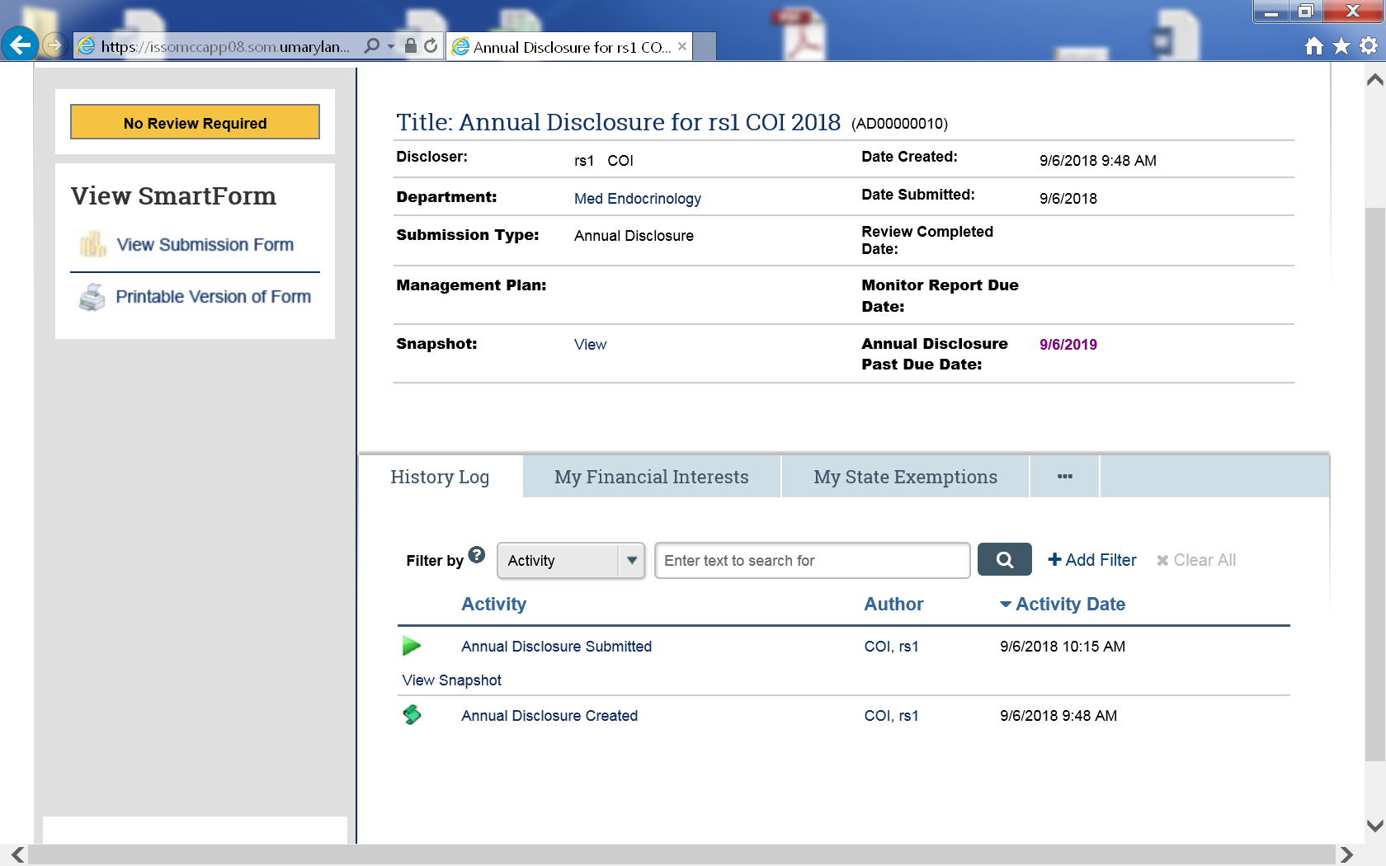
Nothing to Disclose – No Further Review Required
When you have no PHS research and no financial interest to disclose, under the History Log, you will see Annual Disclosure Submitted. Your Annual Disclosure is complete, and no Review is required. Thanks for submitting your Annual Disclosure!!
For those who answered Yes to the Financial Interest question, your screen will look different.

Slide 19
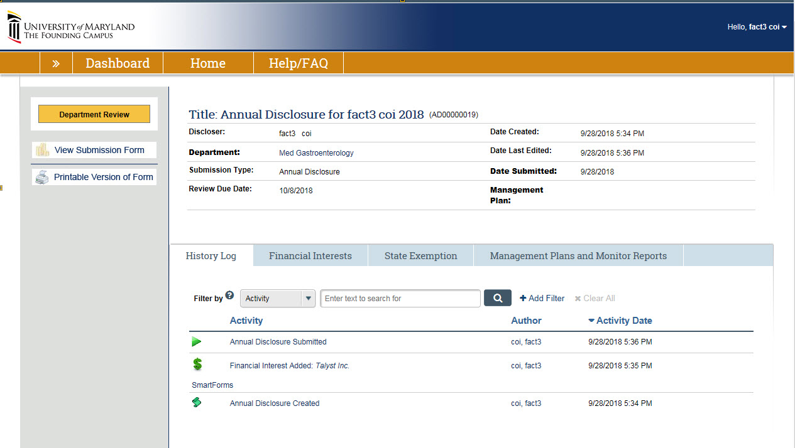
Print Disclosure
View or print your Disclosure

Slide 20
Instructions for Previous Submissions
Edit Previously Submitted Annual Disclosure
Edit Previously Submitted Financial Disclosure(s)
Add a new financial relationship after you have submitted your initial annual disclosure
Delete A Disclosure

Slide 21
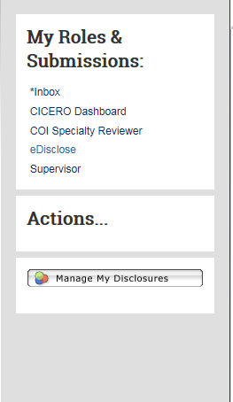
Edit Previously Submitted Annual Disclosure Form
If you need to make an edit to a Disclosure previously submitted during the annual disclosure period (12 months):
Log into CICERO
Click on “eDisclose” link on the left-hand side, under My Roles & Submissions
Click on the “Manage My Disclosures” button under the Actions
Go through the previous submission, to find page needed to make change
Make the change(s), and resubmit

Slide 22
Add New Financial Relationship(s)
If you need to add a new financial relationship after you have submitted your initial annual disclosure (within 12 months), click the “New Disclosure” button to add new financial relationship(s)

Slide 23
Questions
University of Maryland School of Medicine:
Terry B. Rogers, PhD
Associate Dean for Research Development & Administration
Executive Director, Office of Research Affairs
Professor, Department of Biochemistry & Molecular Biology University of Maryland School of Medicine
BRB, Rm 14-019b
655 W. Baltimore Street
Baltimore, MD 21201
410-706-8727
trogers@som.umaryland.edu
Joni M. Prasad, PhD
Director, Office of Research Affairs
Assistant Professor, Department of Microbiology & Immunology
Deputy Chief Conflict of Interest Officer
University of Maryland School of Medicine
655 West Baltimore St., Room 14-016D
Baltimore, MD 21201
410-706-6353
jprasad@som.umaryland.edu
UMB COI Office
Alison Watkins, JD, MS
AVP for Enterprise Risk and Policy Oversight
UMB Conflict of Interest Officer
Athom001@umaryland.edu
410-706-1266

