Slide 1
eDisclose
Annual Disclosure Instructions

Slide 2
To Gain Access to eDisclose
(CICERO Research Evaluation Portal)
Login to CICERO. For your information, the URL for CICERO is listed below.
http://cicero.umaryland.edu
2

Slide 3
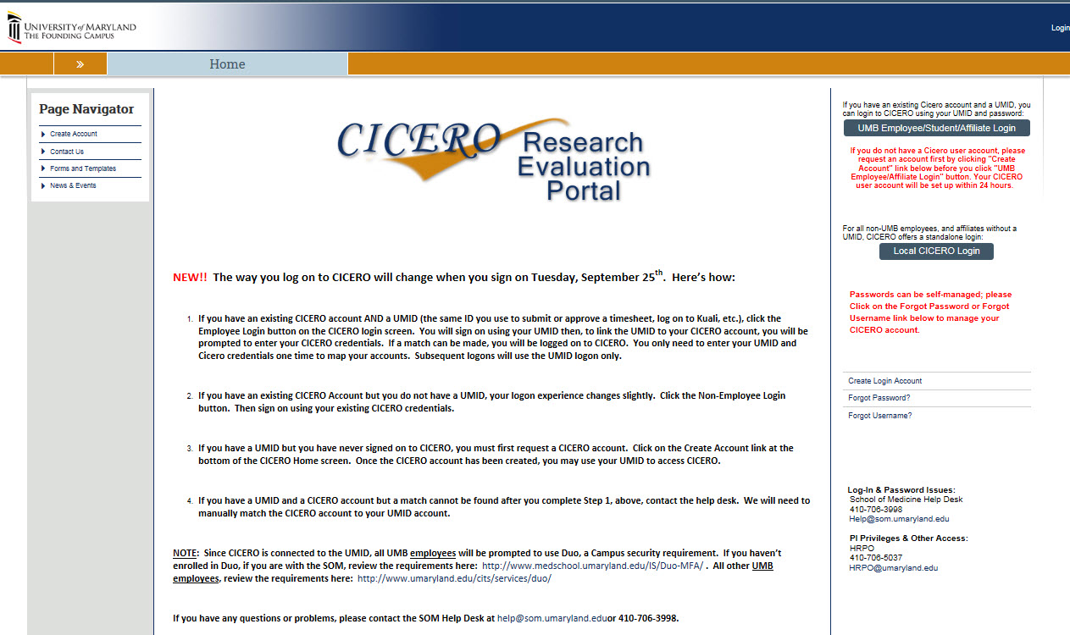
Login to eDisclose
If you are an UMB employee, or UMB affiliate, or UMB Student, with a UMID and have an existing CICERO user account, click on “UMB Employee/Affiliate/Student Login,” enter your UMB system login credentials. You will be asked to enter your CICERO user account login for one-time mapping of your UMID with your CICERO credentials.
If you are an UMB employee or UMB affiliate or UMB Student, with a UMID and do not have a CICERO user account, you should request a CICERO account first, and then follow the steps above.
3

Slide 4
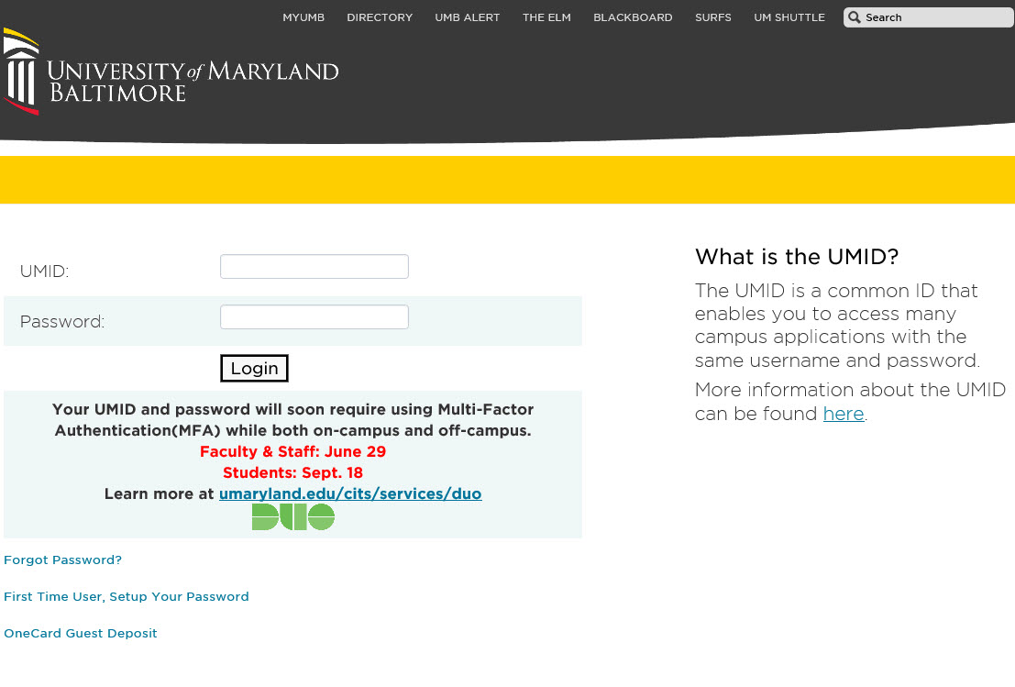
Login To eDisclose – UMB Employee
If you are an UMB Employee, UMB Affiliate or UMB Student, you will be directed to this login screen, asking you to login using Multi-factor Authentication (DUO).
Enter your UMID and Password
4

Slide 5
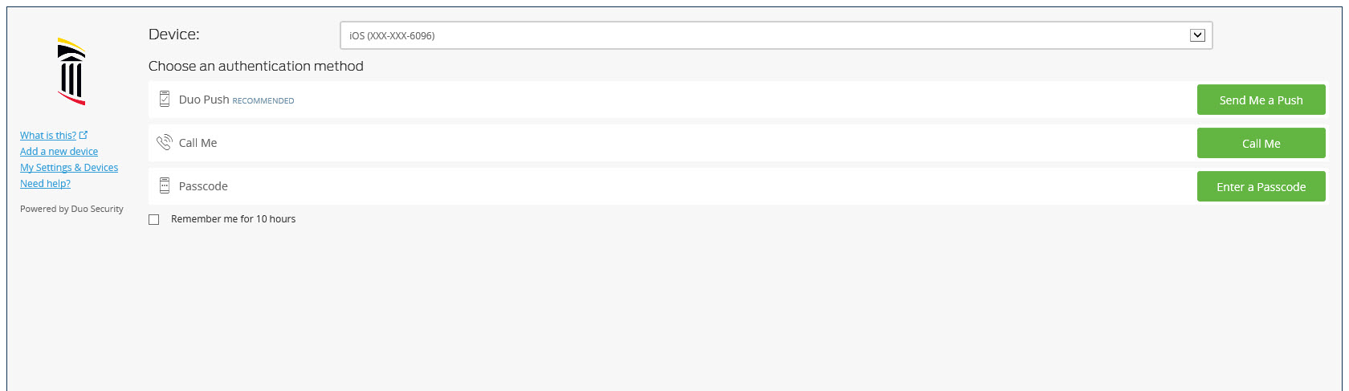
Login to eDisclose – UMB Employee
You will be asked to choose an authentication method.
5

Slide 6
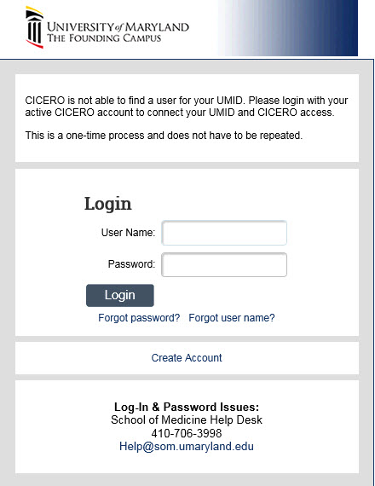
UMB Employee with CICERO Account
If you are an UMB employee, UMB Affiliate or UMB Student, and do have a CICERO user account, enter your CICERO username and password to do one-time mapping. You will only need to go through this local log in page once.
6

Slide 7
Login to eDisclose – Non-UMB Employee, and Affiliates
If you are a non-UMB Employee or Affiliate, select Local CICERO Login
7

Slide 8
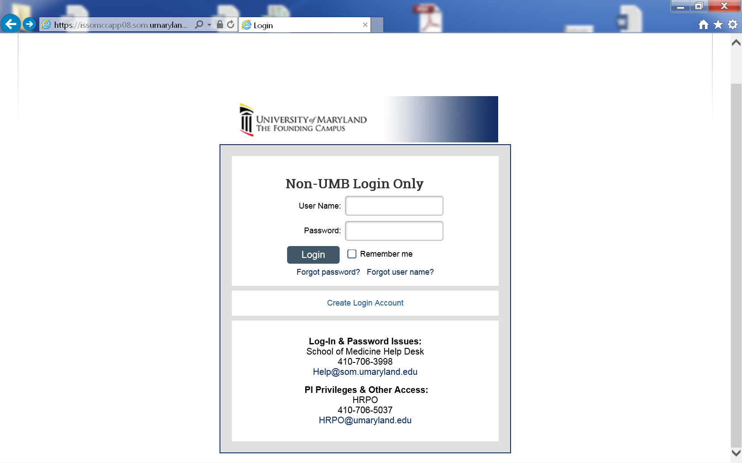
Login to eDisclose – Non-UMB Employee
8

Slide 9
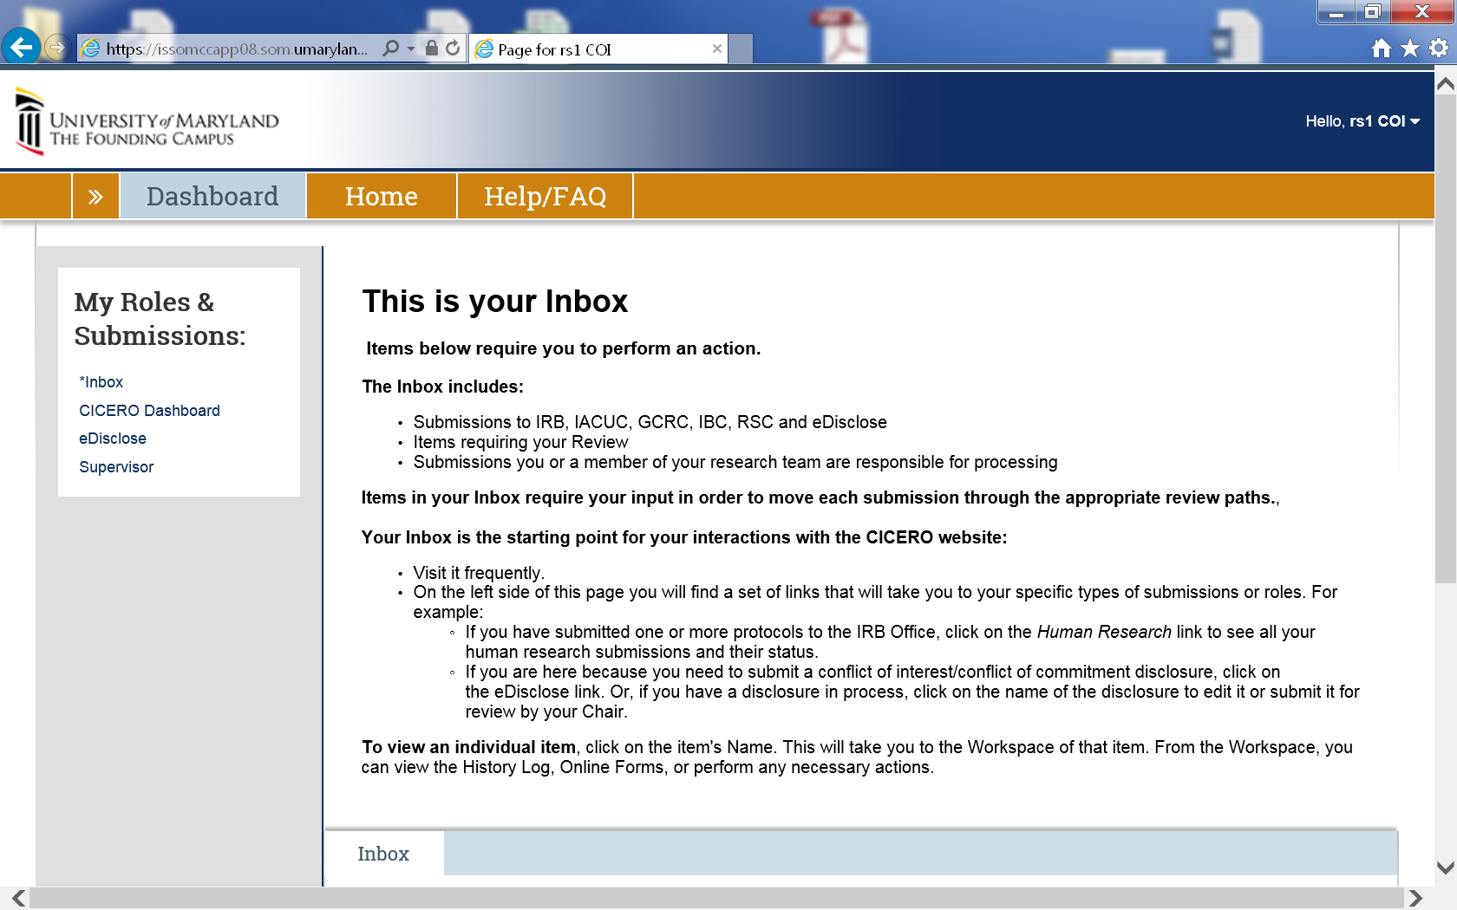
Dashboard
After logging in, you will arrive at your Dashboard. On the left-hand side of the Dashboard, select eDisclose
9

Slide 10
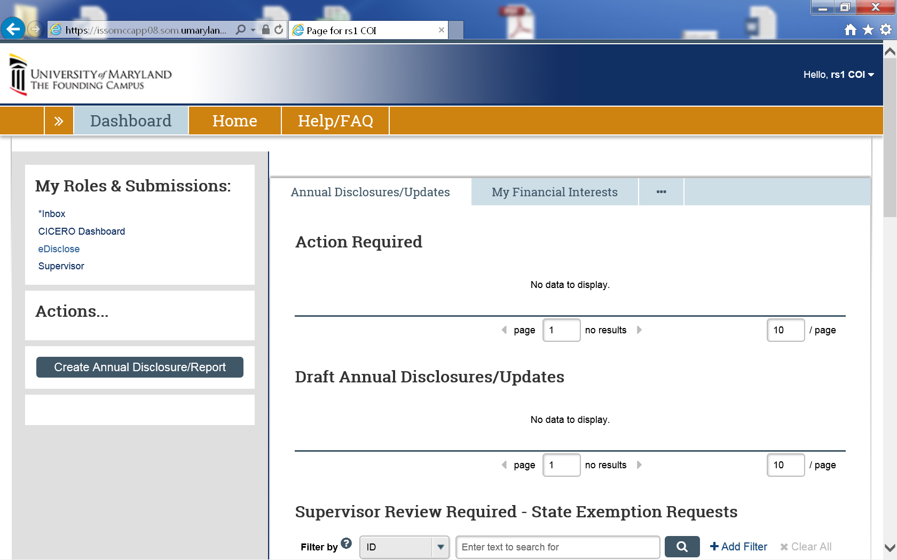
Create Annual Disclosure
Under “Actions”, select Create Annual Disclosure
10

Slide 11
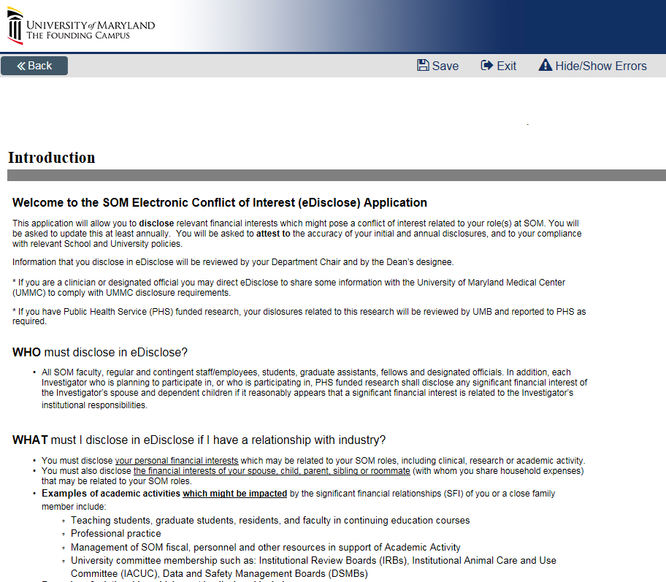
Create Annual Disclosure
You will arrive at an Introduction Screen
Please read all information before proceeding
Click the “Continue” button
11

Slide 12
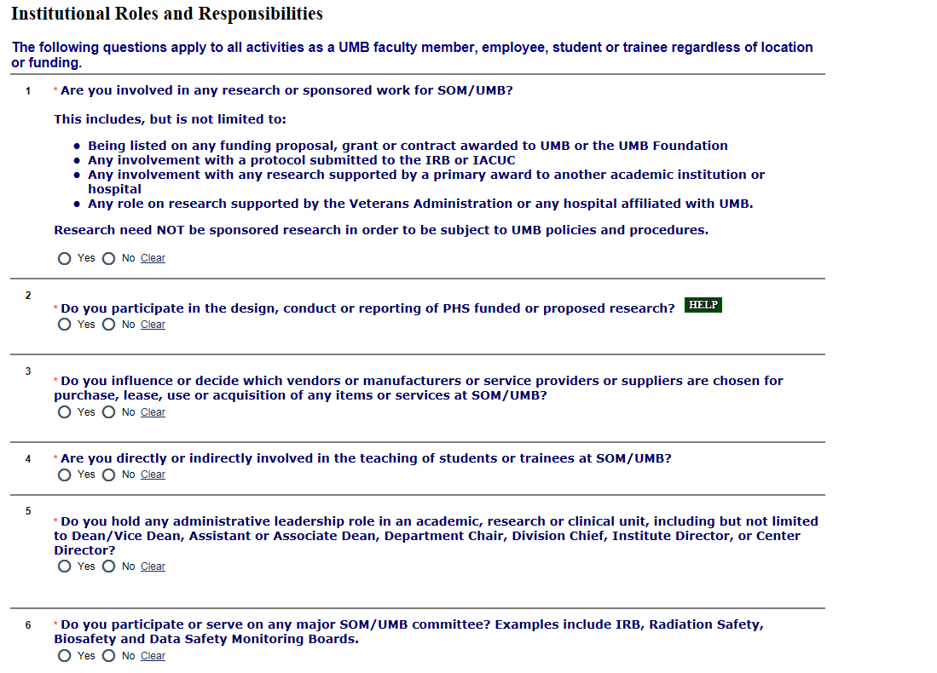
Institutional Roles and Responsibilities
Respond to Questions 1 – 6
12

Slide 13
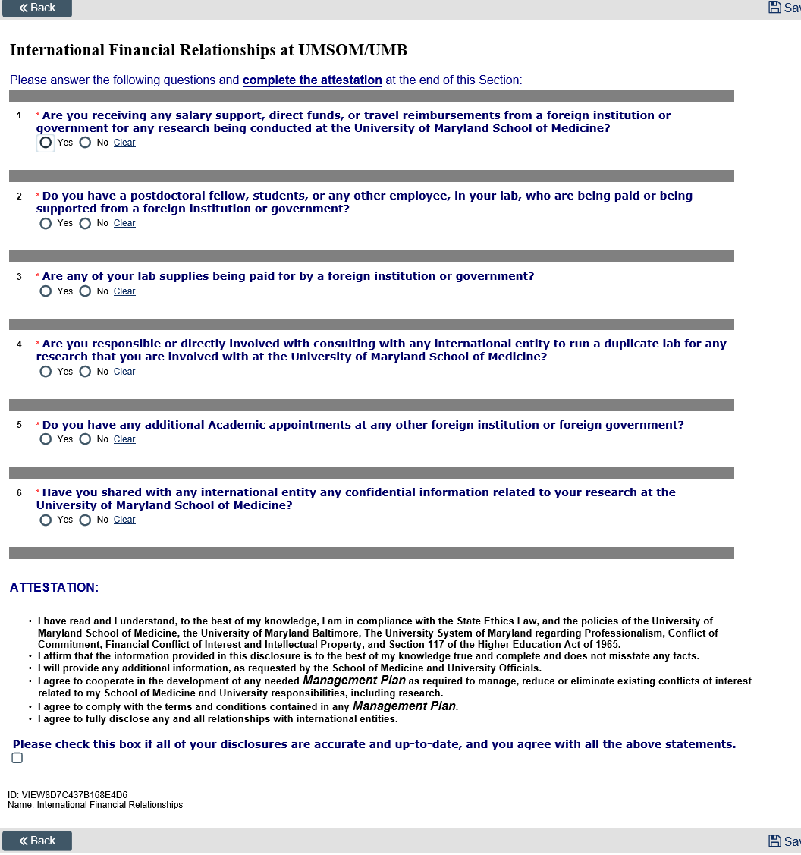
International Financial Relationships at UMSOM/UMB
13

Slide 14
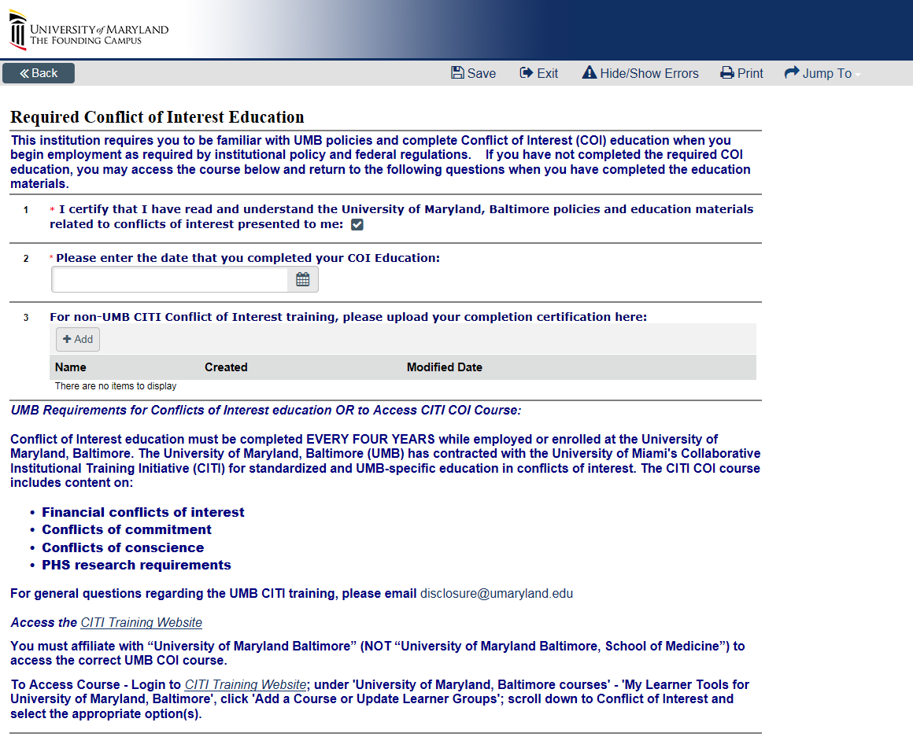
Required Conflict of Interest Education
If you answered “Yes” to PHS related question in previous page (Question 2), complete the corresponding sections.
14

Slide 15
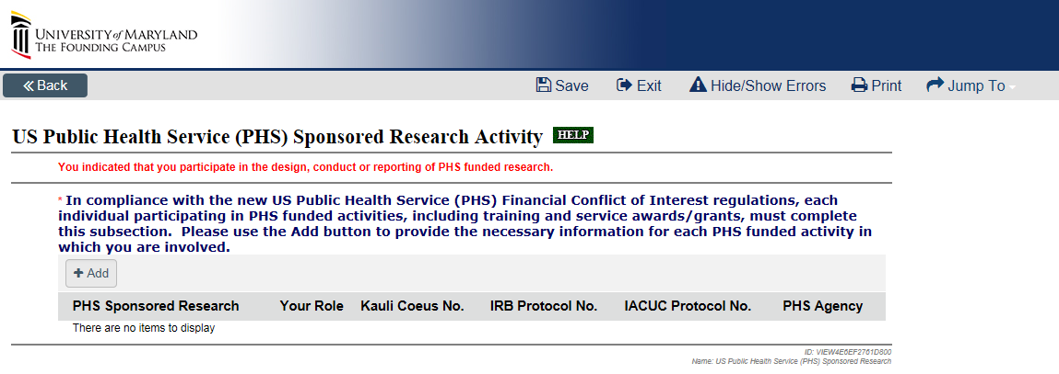
US Public Health Service (PHS) Sponsored Research Activity
15

Slide 16
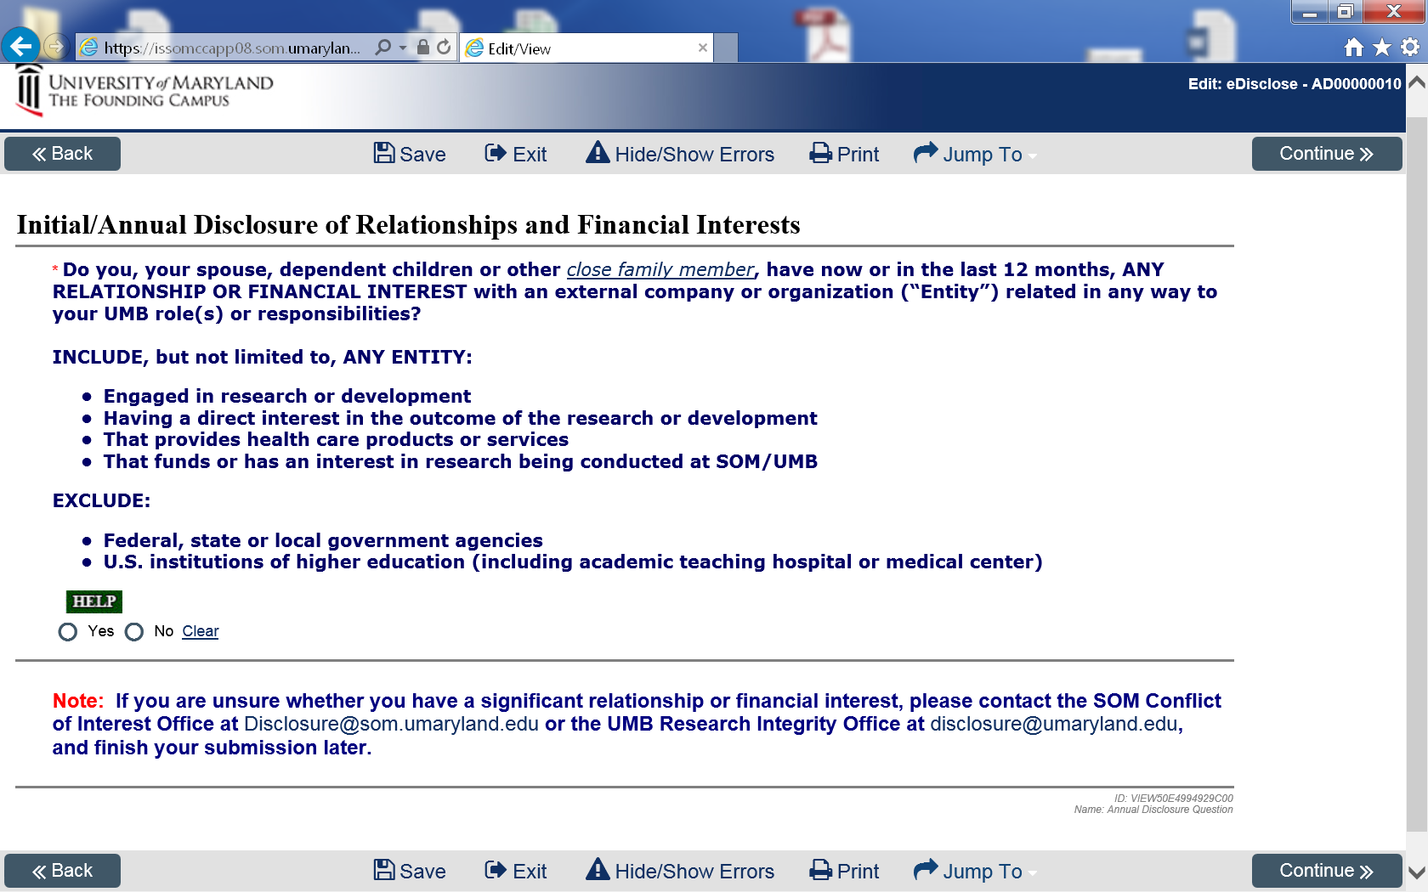
Initial/Annual Disclosure of Relationships and Financial Interests
16

Slide 17
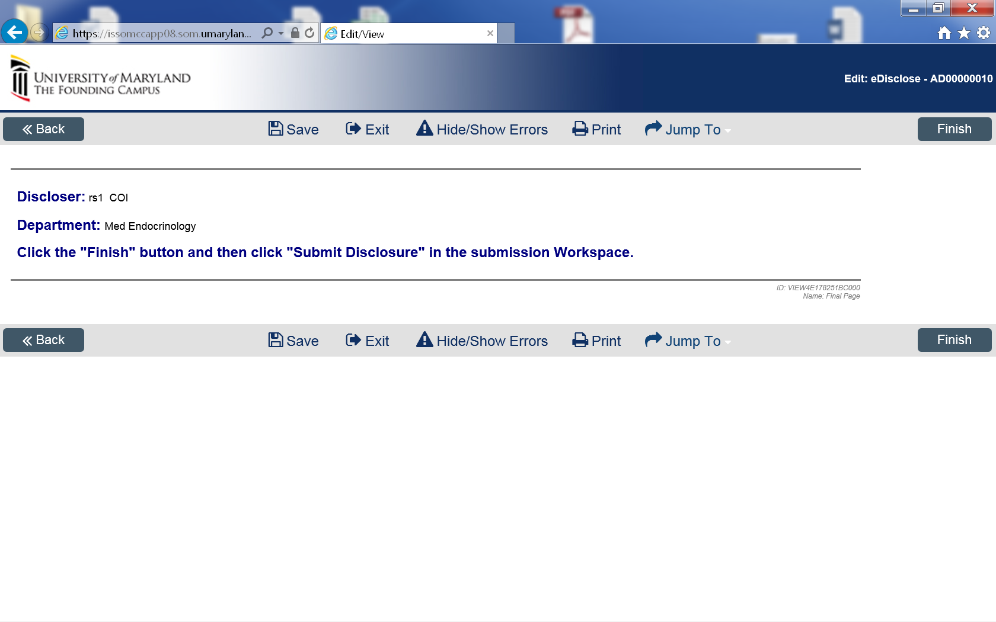
Final Page
If you answered “No” to the Financial Interest question, click the “Finish” button. If you answered “Yes” to the Financial Interest Question, please proceed to slide 20.
17

Slide 18
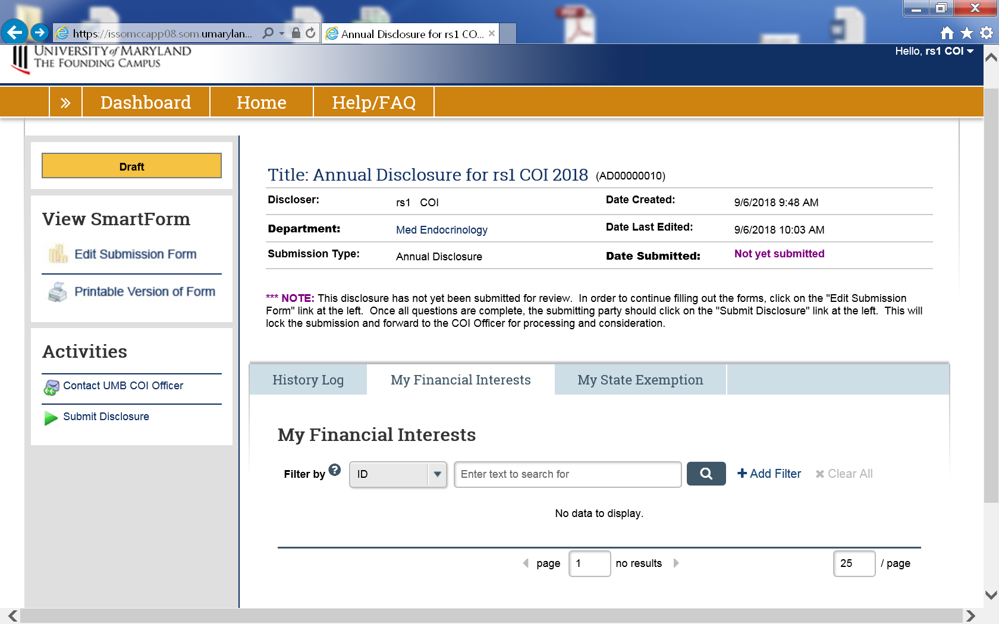
Submit Annual Disclosure
NOTE: Your submission will not be complete until you click the Submit Disclosure Activity.
18

Slide 19
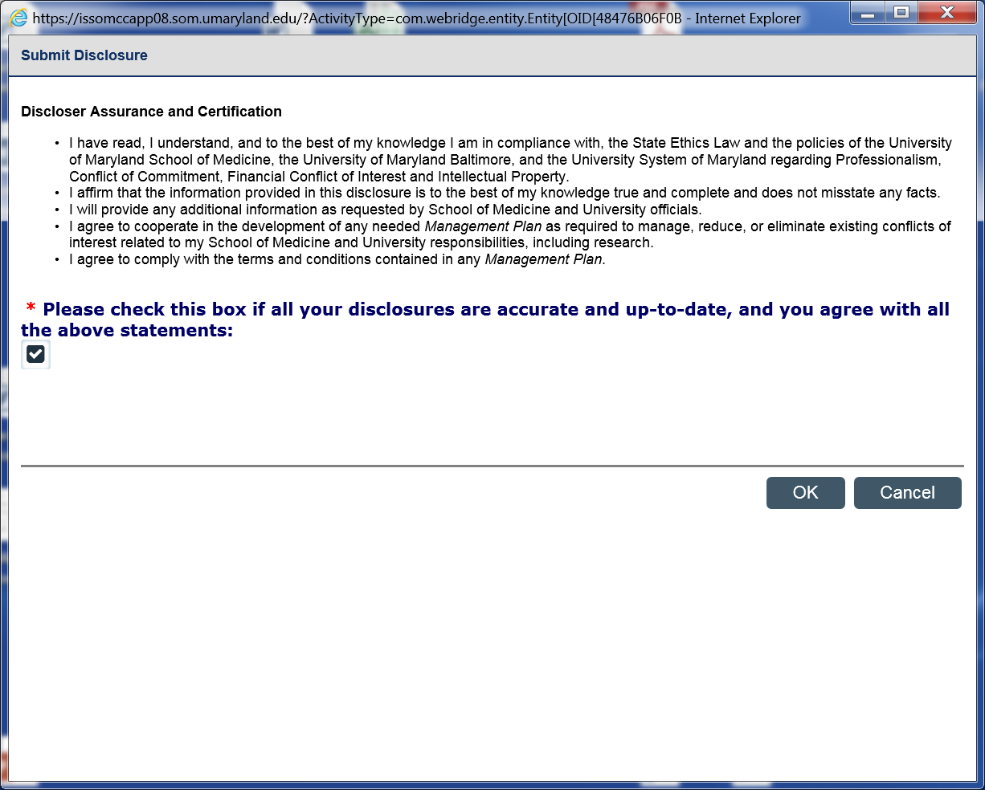
Submit Annual Disclosure
Read the Discloser Assurance and Certification language. Attest and certify your disclosure by checking the box. Select the OK button.
19

Slide 20
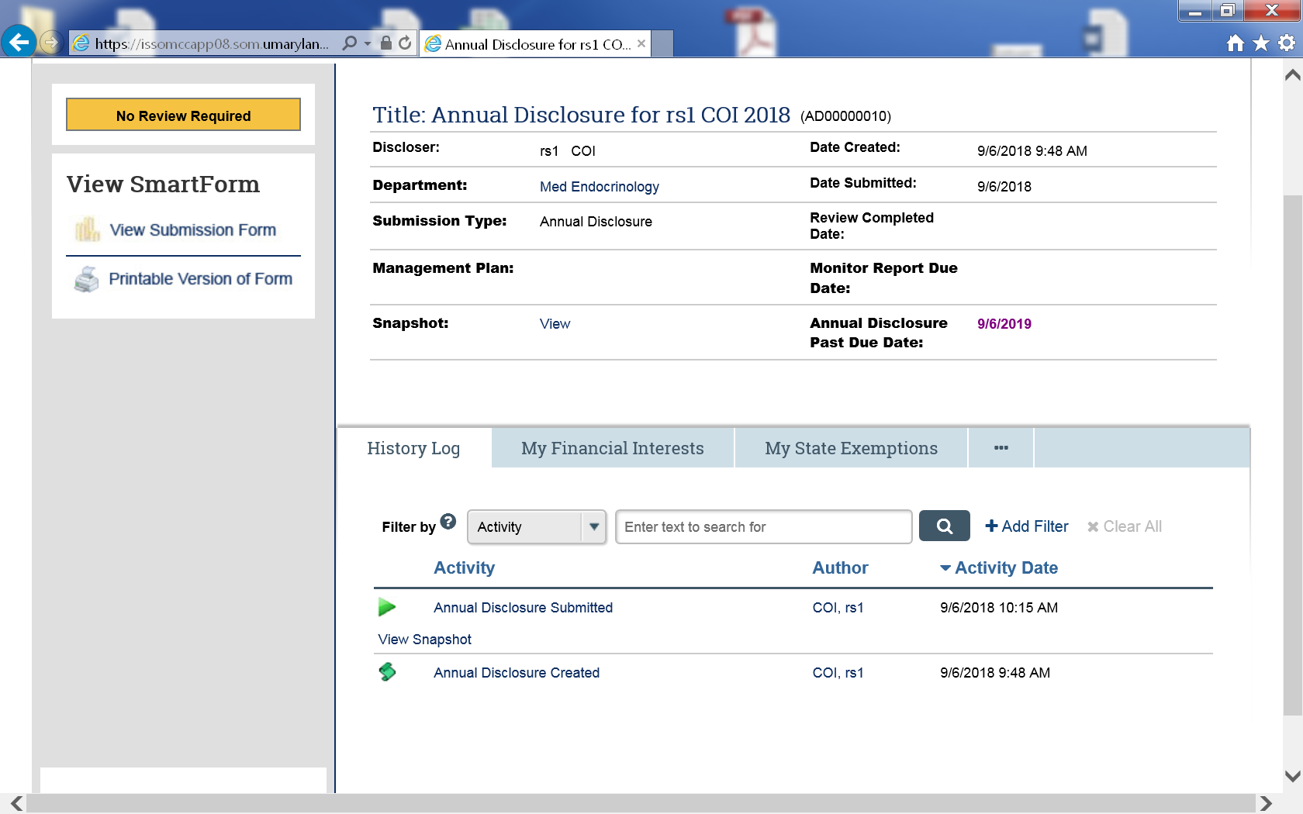
Nothing to Disclose – No Further Review Required
When you have no PHS research and no financial interest to disclose, under the History Log, you will see Annual Disclosure Submitted. Your Annual Disclosure is complete, and no Review is required. Thanks for submitting your Annual Disclosure!!
For those who answered Yes to the Financial Interest question, your screen will look different.
20

Slide 21
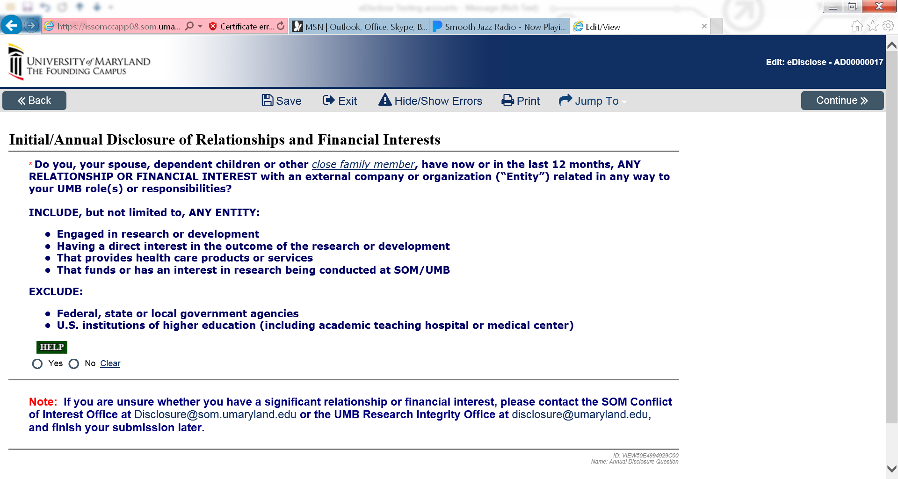
Begin to disclose Financial Interest
Disclose any financial relationship that you, your spouse or dependent children or other close family member have now, or in the last 12 months.
21

Slide 22
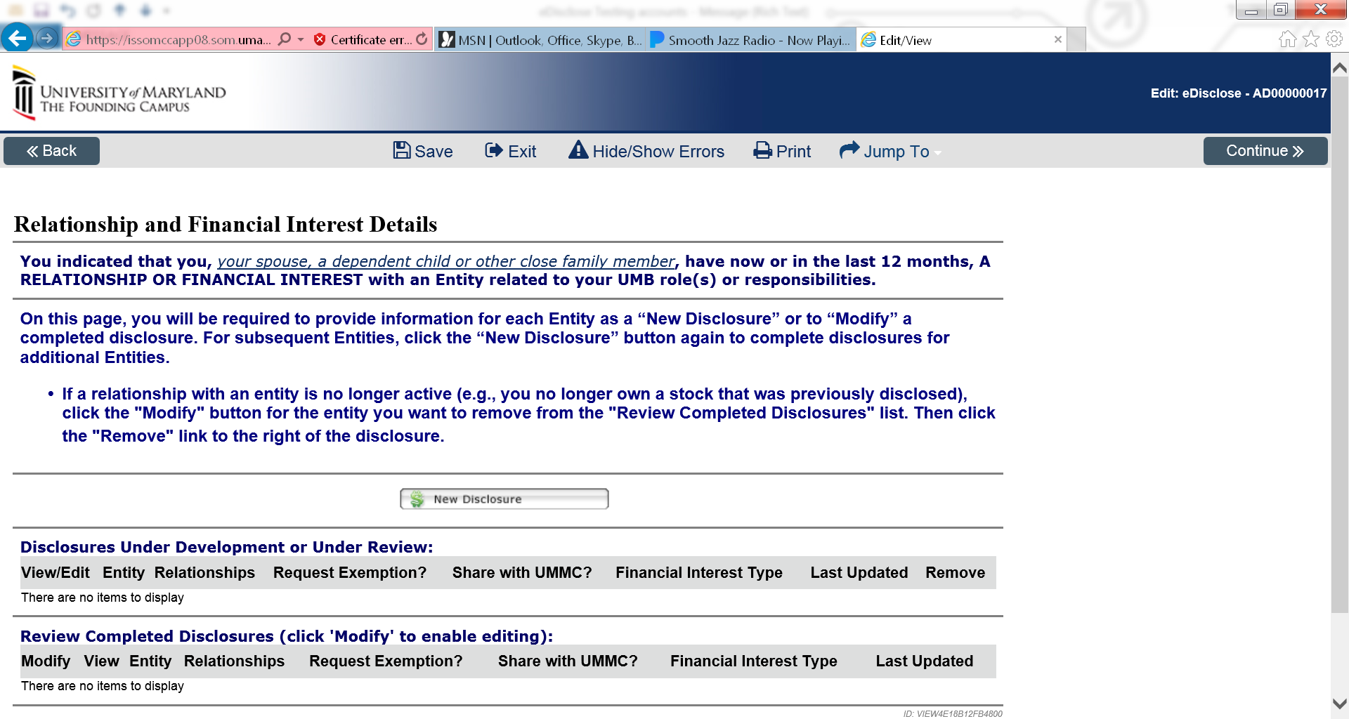
Relationship and Financial Interest Details
Provide information for each Financial Entity as a “New Disclosure”.
22

Slide 23
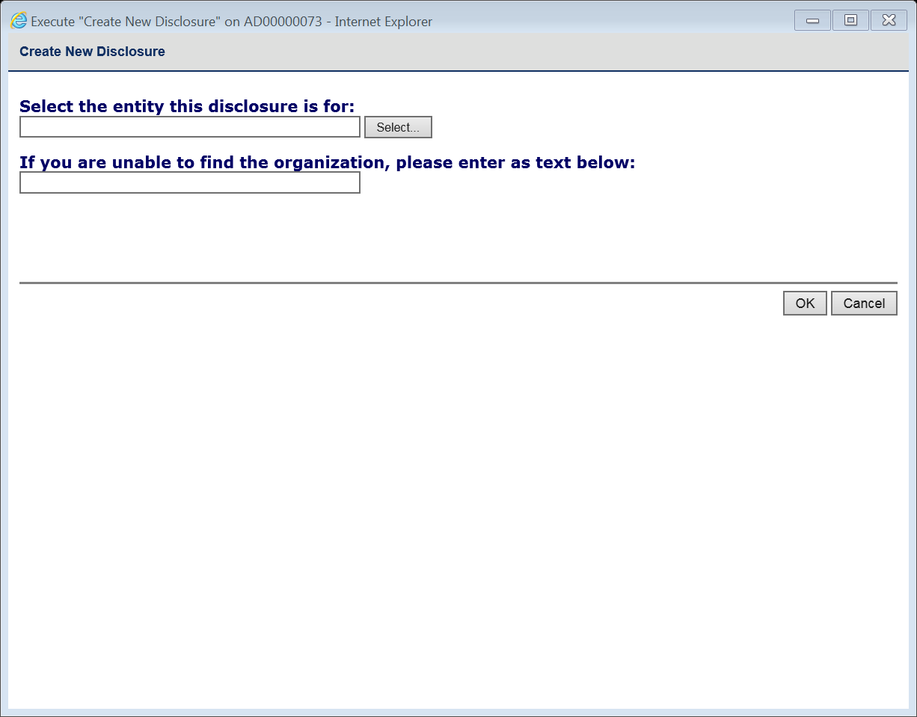
Relationship and Financial Interest Details
Select an entity for your disclosure by using the drop-down “Select” button or typing the organization’s name.
Select the “OK” button.
23

Slide 24
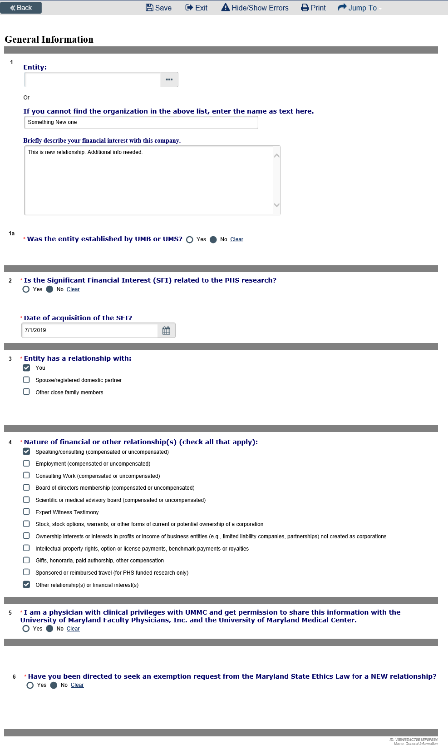
General Information
Complete the General Information section related to the disclosure
If applicable, indicate if you will authorize UMB and UMSOM to furnish to FPI and the University of Maryland Medical Center the information that you have provided specifically about this one entity.
Please indicate if you have been directed to seek an exemption from the Maryland State Ethics Law for a new relationship.
Select “Continue”
24

Slide 25
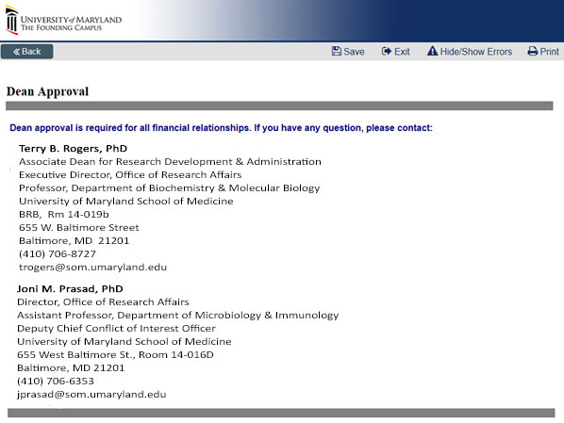
Dean’s Approval
If you selected any of the first 5 financial relationships from the general information page, Dean’s Office approval is required.
Contact Terry B. Rogers, PhD or Joni M. Prasad, PhD if you have questions.
25

Slide 26
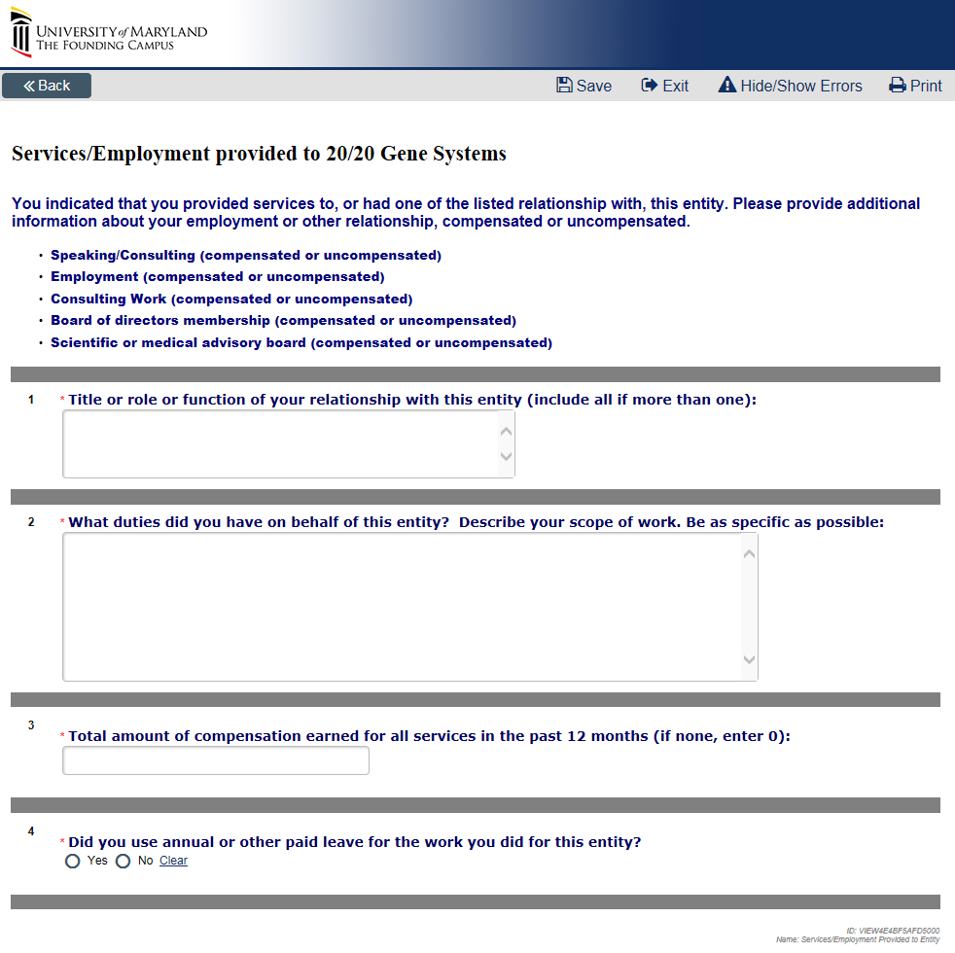
Services/Employment Provided to an Entity
List the title or role or function of your relationship with the entity
Describe duties
Enter total amount of compensation earned within last 12 months
Indicate if any paid leave was used. If leave was not used, explain.
26

Slide 27
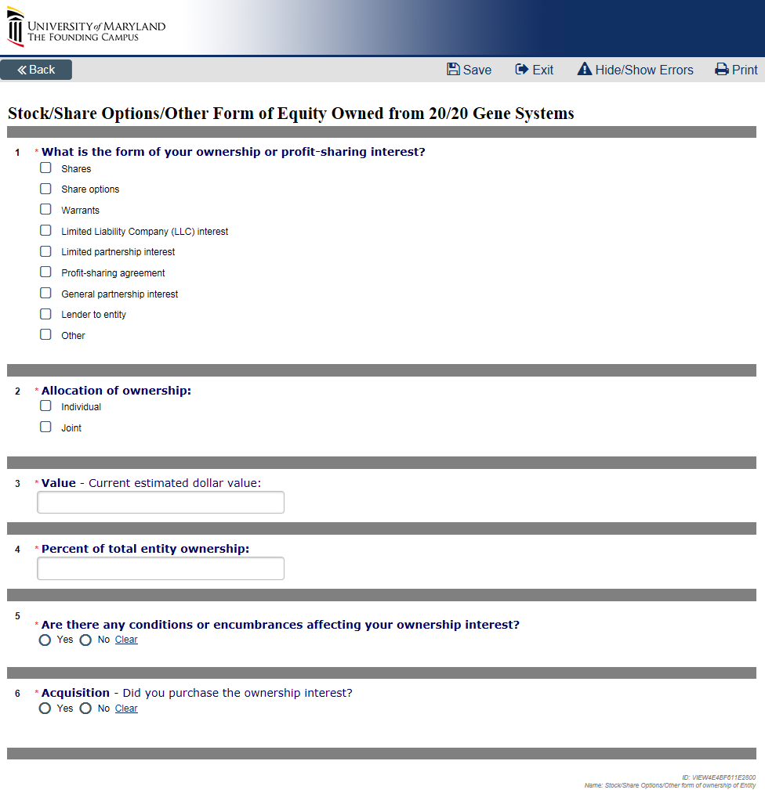
Stock/Share Options/Other Form of
Equity Owned from an Entity
27

Slide 28
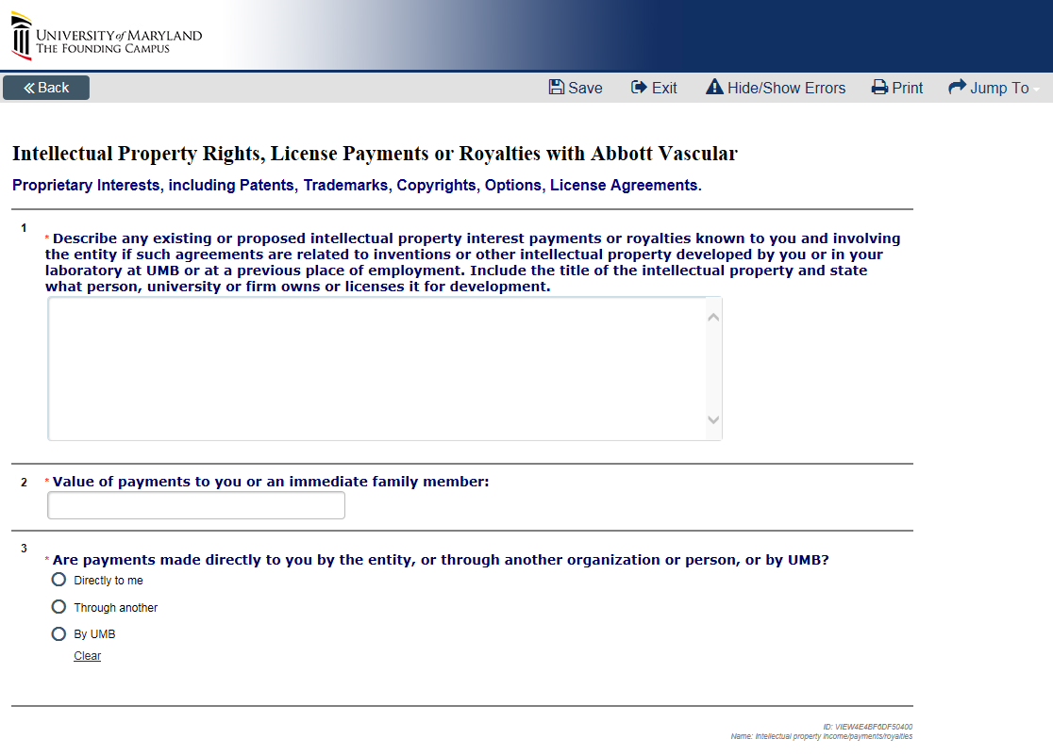
Intellectual Property Rights, License Payments or Royalties with an Entity
28

Slide 29
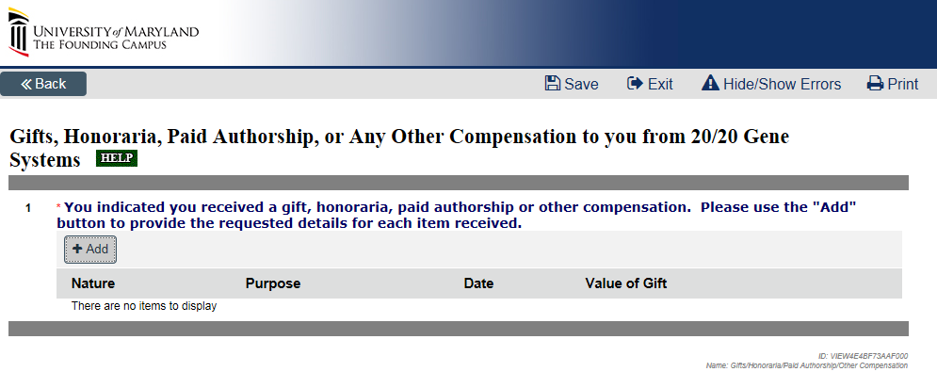
Gifts, Honoraria, Paid Authorship, or Any Other Compensation to you from an Entity
29

Slide 30
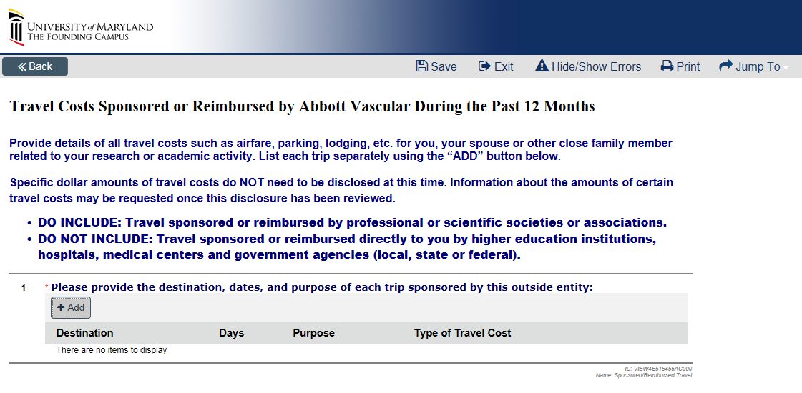
Travel Costs Sponsored or Reimbursed by an Entity During the Past 12 Months
30

Slide 31
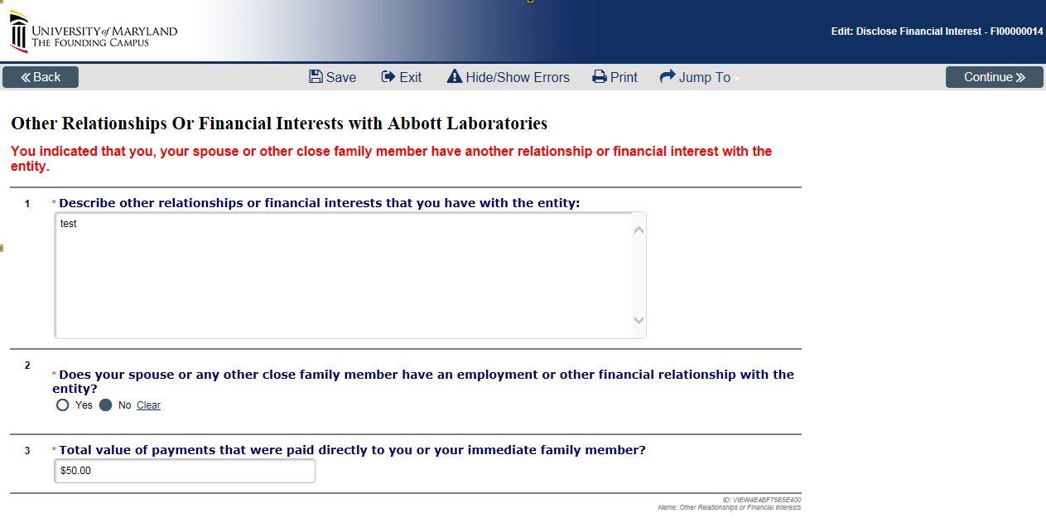
Other Relationships Or Financial Interests with an Entity
31

Slide 32
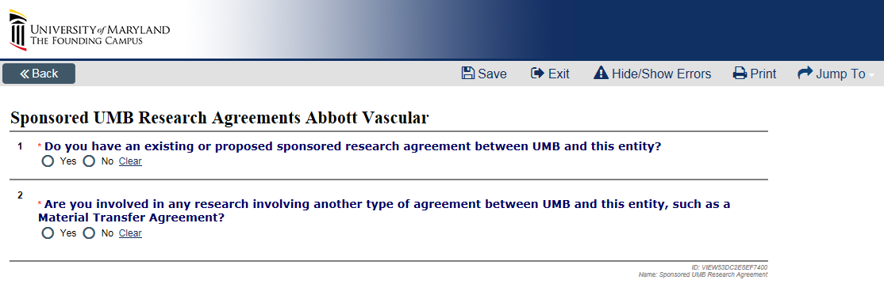
Sponsored UMB Research Agreements with an Entity
32

Slide 33
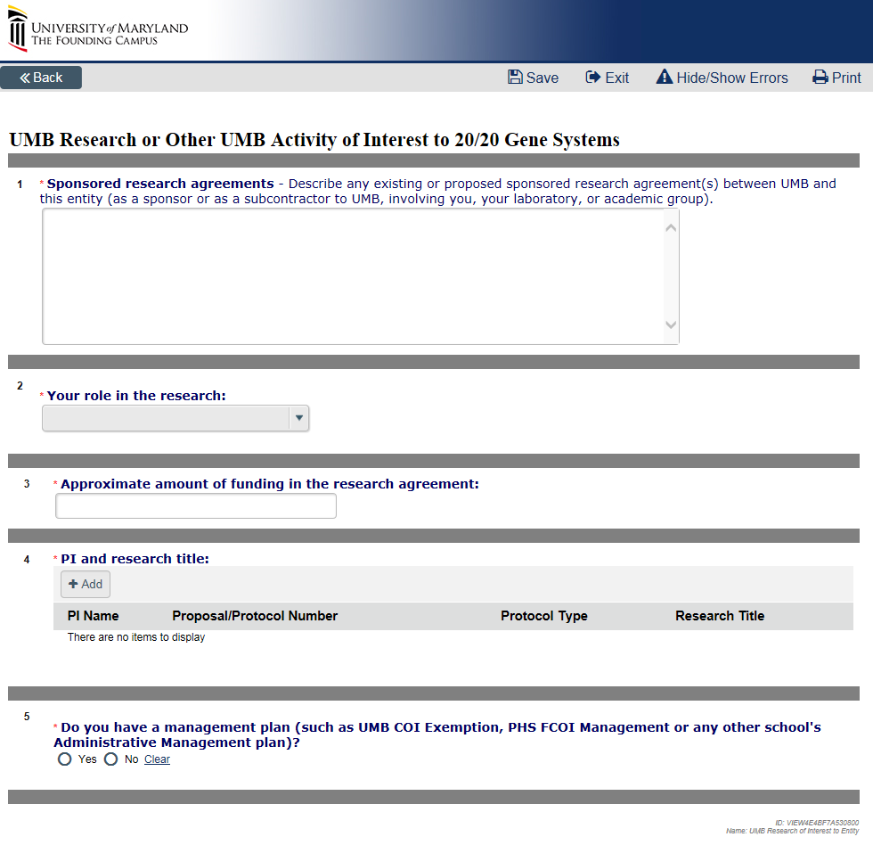
UMB Research or Other UMB Activity of Interest to an Entity
If you answered Yes to the questions on “Sponsored UMB Research Agreement” page, please complete these additional questions.
33

Slide 34
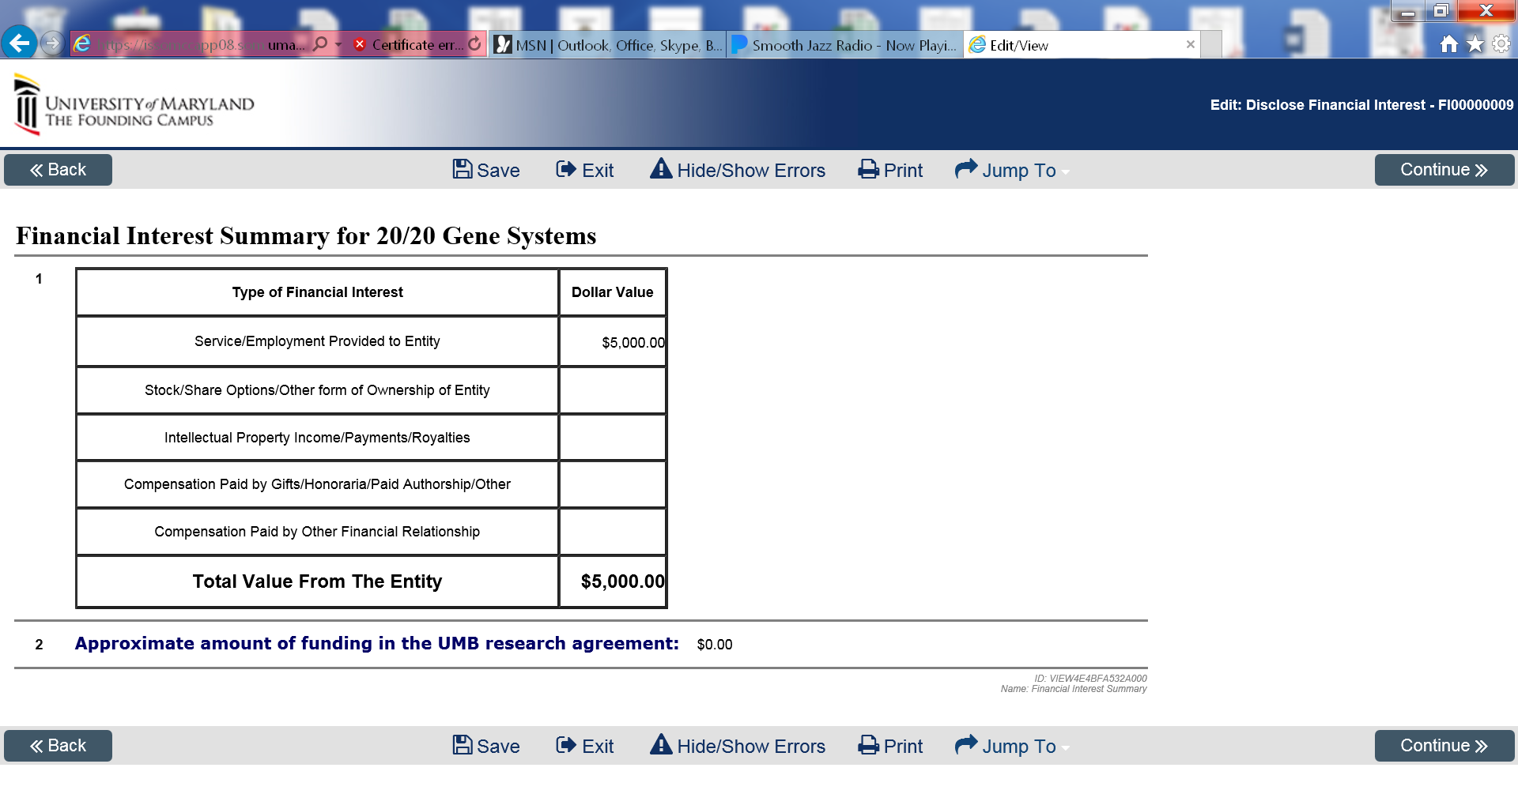
Financial Interest Summary for an Entity
Verify that the type of Financial Interest is accurate
Verify the total value from the entity is correct.
34

Slide 35
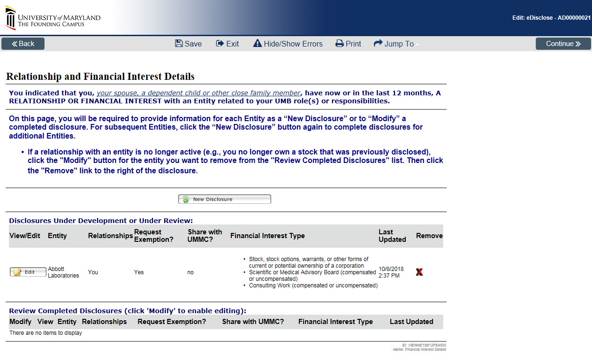
Relationship and Financial Interest Details
If you have additional relationship(s) with other entities, please add a new disclosure for each.
35

Slide 36
Final Page
Click the Finish button and submit your Disclosure.
36

Slide 37
Submit Annual Disclosure
NOTE: Your submission will not be complete until you click Submit Disclosure Activity
37

Slide 38
Submit Annual Disclosure
Read the Discloser Assurance and Certification language. Attest and certify your disclosure by checking the box. Select the OK button.
38

Slide 39
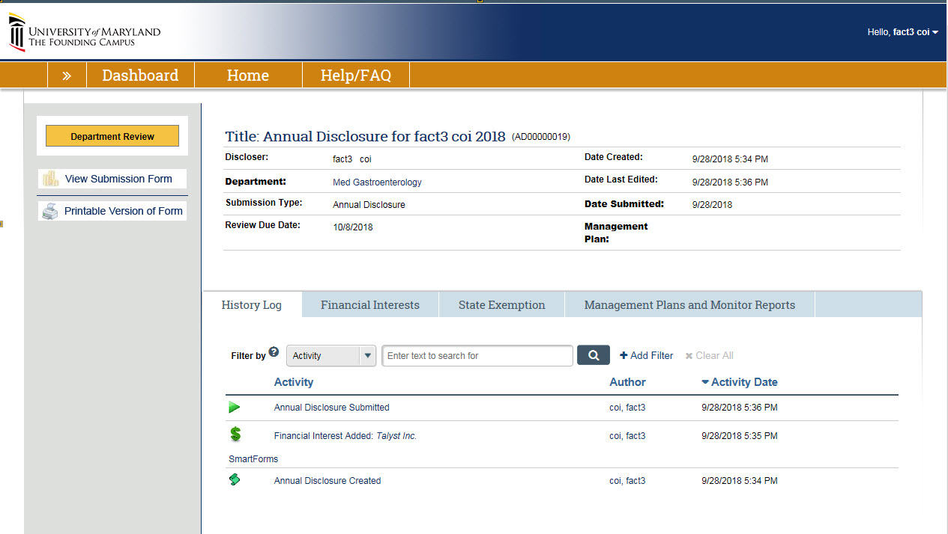
Disclosure with Financial Interest
If you submitted a disclosure with a financial interest, your disclosure has been submitted and has transitioned to the state called “Department Review.”
39

Slide 40
Print Disclosure
View or print your Disclosure
40

Slide 41
Instructions for Previous Submissions
Edit Previously Submitted Annual Disclosure
Edit Previously Submitted Financial Disclosure(s)
Add a new financial relationship after you have submitted your initial annual disclosure
Delete A Disclosure
41

Slide 42
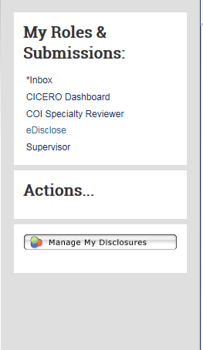
Edit Previously Submitted Annual Disclosure Form
If you need to make an edit to a Disclosure previously submitted during the annual disclosure period (12 months):
Log into CICERO
Click on “eDisclose” link on the left-hand side, under My Roles & Submissions
Click on the “Manage My Disclosures” button under the Actions
Go through the previous submission, to find page needed to make change
Make the change(s), and resubmit
42

Slide 43
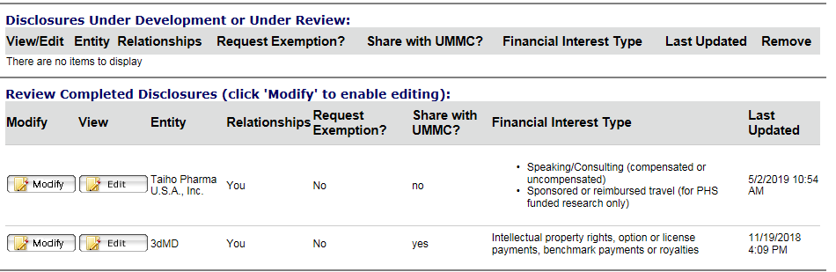
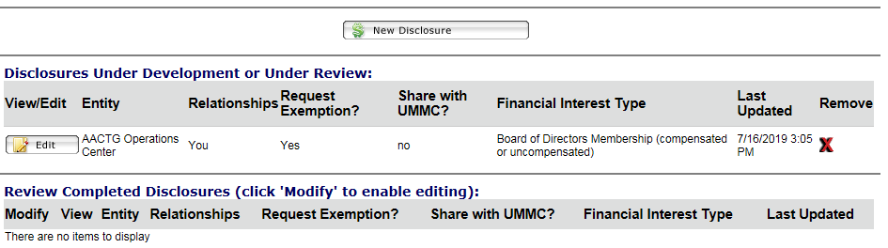
Edit Previously Submitted Financial Relationship(s)
Go to “Financial Interest Detail” page
Scroll down to the “Review Completed Disclosures” table, Click on “Modify” button
A screen will pop up, and submitter will need to confirm the edit to the disclosure
Click on “Edit” button to edit your existing financial relationship.
43

Slide 44
Add New Financial Relationship(s)
If you need to add a new financial relationship after you have submitted your initial annual disclosure (within 12 months), click the “New Disclosure” button to add new financial relationship(s)
44

Slide 45
Delete A Disclosure in Draft State
Go to “Financial Interest Detail” page
Scroll down to the “Review Completed Disclosures” table, Click on “Modify” button
If you need to delete an existing financial relationship, click on the red “X”
A screen will pop up, you need to justify and confirm the deletion
Once submission is reviewed and sent to the end state, the deleted SFI will disappear
45

Slide 46
Questions
University of Maryland School of Medicine:
Terry B. Rogers, PhD
Associate Dean for Research Development & Administration
Executive Director, Office of Research Affairs
Professor, Department of Biochemistry & Molecular Biology
University of Maryland School of Medicine
BRB, Rm 14-019b
655 W. Baltimore Street
Baltimore, MD 21201
410-706-8727
trogers@som.umaryland.edu
Joni M. Prasad, PhD
Director, Office of Research Affairs
Assistant Professor, Department of Microbiology & Immunology
Deputy Chief Conflict of Interest Officer
University of Maryland School of Medicine
655 West Baltimore St., Room 14-016D
Baltimore, MD 21201
410-706-6353
jprasad@som.umaryland.edu
UMB COI Office
Alison Watkins, JD, MS
AVP for Enterprise Risk and Policy Oversight
UMB Conflict of Interest Officer
Athom001@umaryland.edu
410-706-1266
46

