Slide 1
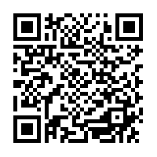
This is a Mandatory Training for all Psychiatry Faculty, Staff & Trainees Register your Attendance!! Please use the QR code below or click on the link in the Chat.

Slide 2
The 21st Century Cures Act and Open Notes
University of Maryland Medical Center
Documentation Using
New Lens:
No Information blocking!

Slide 3
Source of material:
Opennotes.org
Media articles about open notes
Sharing Clinical Notes With Patients Improves Treatment Effectiveness, OpenNotes.org
Patient access to electronic psychiatric records: A pilot study, ScienceDirect
Boston hospital pilot gives patients electronic access to their therapists’ notes, Washington Post
What the therapist thinks about you, New York Times
Doctors’ notes on mental health shared with patients, Boston Globe
Would You Want to Read Your Therapist’s Notes?, Shape Magazine
Clinic lets patients read their therapist’s notes, BBC World Service
Should therapists give their patients access to mental health notes?, KPCC-FM 89.3 Southern California Public Radio
Beth Israel Opens Mental Health Notes To Some Patients,, WBUR-FM 90.9 Boston’s NPR News Station

Slide 4
Objectives
To understand the new Federal Mandates for medical record transparency
To understand the benefits and potential pitfalls of open notes
How to move forward: To learn important approach to writing notes read by patients and other care team members and the proper use of ‘sensitive note’ and ‘share with patient’

Slide 5

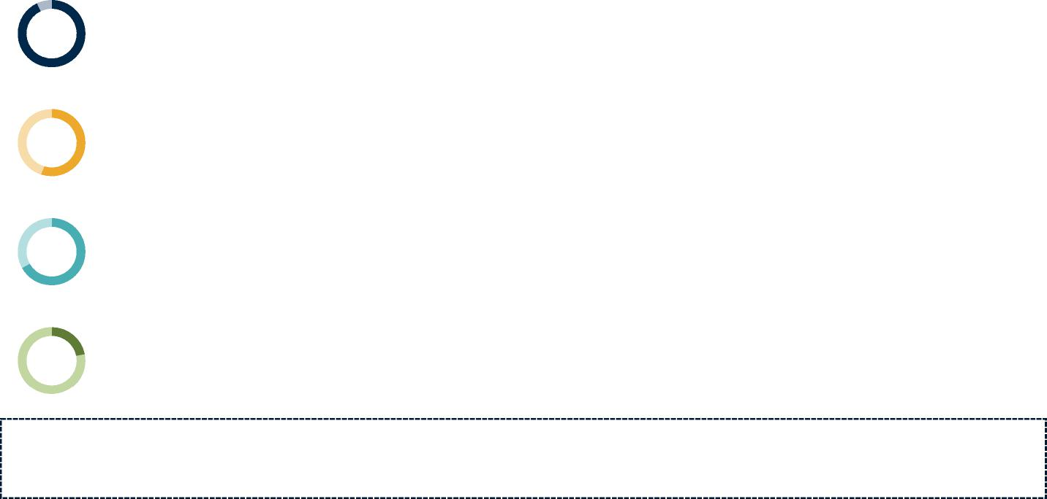
Consumer Demand for Interoperability Survey Results
Consumers are beginning to understand the impacts that lack of interoperability in healthcare has on their lives. Ownership and easy access of their data is prevalent in other industries and causing disappointment in healthcare.
93%
55%
67%
22%
Of consumers polled in July expressed disappointment of the lack of data sharing during COVID-19 across separate vendor systems.¹
Placed the blame on the provider, 31% placed blame on the EHR the provider chose to utilize.¹
Of consumers revealed they will consider changing their physician and hospital providers in the coming year after learning how their health record was not shareable or available or was blocked in the past year.¹
Of consumers noted that they had difficulty obtaining records electronically, via fax or in person in 2020.¹
CHARTIS POINT OF VIEW
Organizations that embrace these Rules and facilitate interoperability will have a competitive advantage in the new consumer-driven healthcare marketplace.
1. Black Book Market Research Interoperability Survey 2020. http://www.digitaljournal.com/pr/4761739
© 2020 The Chartis Group, [[C. All Rights Reserved. Page 9

Slide 6
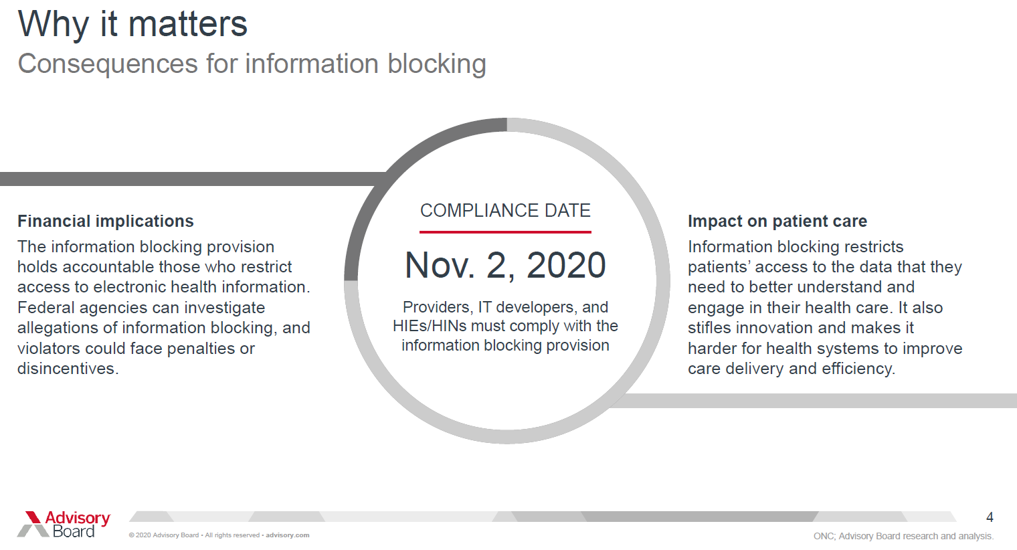
APRIL 5
2021

Slide 7
The Federal Cures Act
The rule is designed to give patients and their healthcare providers secure access to health information.
It calls on the healthcare industry to adopt standardized application programming interfaces (APIs), which will help allow individuals to securely and easily access structured electronic health information using electronic and smartphone applications.
The rule includes a provision requiring that patients can electronically access all of their electronic health information (EHI), structured and/or unstructured, at no cost and without delay.

Slide 8
What Notes Must be Shared:
This includes inpatient and outpatient notes!
consultation notes
discharge summary notes
history & physical
imaging narratives
laboratory report narratives
pathology report narratives
procedure notes
progress notes

Slide 9
Required Content to be Shared
Note: All clinicians and organizations are required to share:
medication prescription and monitoring,
counseling session start and stop times,
the modalities and frequencies of treatment furnished,
results of clinical tests, and
any summary of the following items: diagnosis, functional status, the treatment plan, symptoms, prognosis, and progress to date.

Slide 10
What notes are NOT shared
Personal Psychotherapy notes (PPN) that are separated from the rest of the individual’s medical record and are recorded (in any medium) by a health care provider who is a mental health professional documenting or analyzing the contents of conversation during a private counseling session or a group, joint, or family counseling session.
Information compiled in reasonable anticipation of, or use in a civil, criminal or administrative action or proceeding.

Slide 12
Exceptions- Category 1 Involve not fulfilling requests for access
Preventing Harm Exception: It will not be information blocking for a clinician to engage in practices that are reasonable and necessary to prevent harm to a patient or another person, provided certain conditions are met.
Key Conditions of the Exception:
• The clinician must hold a reasonable belief that the practice will substantially reduce a risk of harm;
• The clinician’s practice must be no broader than necessary; (Case by Case- not default)
• The clinician’s practice must satisfy at least one condition from each of the following categories: type of risk, type of harm, and implementation basis; and
• The practice must satisfy the condition concerning a patient right to request review of an individualized determination of risk of harm.
What is considered ‘Harm’- Harm refers to physical harm to a patient. In mental health, if reading a note is likely to increase the risk of suicide or homicide, this would be considered appropriate.

Slide 13
What is not considered ‘Harm’
A patient may disagree with content
A patient may get angry
A patient may get confused
The therapeutic relationship may be harmed
The patient may terminate treatment

Slide 14
Other Category I Exceptions
Privacy Exception: It will not be information blocking if the clinician does not fulfill a request to access, exchange, or use EHI in order to protect an individual’s privacy, provided certain conditions are met.
Security Exception: It will not be information blocking if the purpose of refusal is to protect the security of EHI. i.e. : If a website or third-party app seeks access to EHI but doesn’t protect it, we can refuse to send to them.
Infeasibility Exception: It will not be information blocking ifIf a particular request is too technically or technologically complex to comply (ex: send me an electronic copy ONLY of all notes that have the word “jelly” in them – we don’t have a note-reader that could do that)
Health IT Performance Exception: It will not be information blocking to make health IT temporarily unavailable or to degrade the health IT's performance for the benefit of the overall performance of the health IT. Legit downtimes are not considered information “blocking” – if we plan downtime for three hours every quarter with upgrade, we’re not “blocking” during those 3 hours

Slide 15
SUBSTANCIATED BENEFITS & POTENTIAL CONSEQUENCES
What we have learned through formal research and actual implementation

Slide 16
Historical Context
The VA system has had open mental health notes since 2013 & 9 million veterans have viewed their notes
There are 260 organizations and 55 million people currently with access to their notes across the US.
Studies have demonstrated that
Patient want access & 90% report a better understanding of their care,
only 3-5% report confusion or worry after reading
PCP report better relationships with patients
Once adapted, minimal change in workflow or burden
Trust across the care team is greatly enhanced.
Clinician's concern that care will be eroded is unfounded

Slide 17
OpenNotes Study Findings
Three out of four patients reported:
taking better care of themselves;
understanding their health and medical conditions better;
feeling more in control of their health and health care;
being better prepared for visits;
and doing better with taking their medications as prescribed
Delbanco, Walker, et al, Annals of Internal Medicine

Slide 18
Caregivers Benefit as Much as Patients with OpenNotes
88% of patients and 86% of caregivers had better formulated questions for the doctor.
86% of patients and 82% of caregivers had more productive discussions about the patient’s care.
94% of patients and their caregivers said they had a better understanding of patient health conditions, better remembered the patient’s care plan, and felt more in control of care.
71% of both patient and caregivers reported patients taking medications as prescribed more often.
Wolff, et al. JAMIA

Slide 19
What We’re Learning from Clinicians Using OpenNotes
Many expect a change to workflow, but those concerns do not bear out. In the initial study and over time, very few clinicians report any impact on workflow, with only 3% reporting longer visits or more questions.
Clinicians have expressed concerns that patients will worry or be confused by notes, but this rarely happens. Patients are more likely to report gratitude for having access to their notes and greater satisfaction with their care.
Clinicians report little change in the way they write notes, and those who do, remark that the changes are minor and doable, such as using less jargon and spelling out abbreviations and acronyms, and that the changes make their notes better.

Slide 20
Observed Benefits
Demonstrating Respect and reducing stigma
Can bridge the gap between mental and physical care and making sure the approach is the same for both
Empowering Patients
By Inviting patient to view their own notes gives a very clear message that they are competent and capable to reading and contributing to their care. This can mitigate the power differential and engages patient to be an active participant
Organizing Care and Tracking Progress
Through providing a therapeutic opportunity to manage their illness more effectively, including homework, skills development, follow through with recommendations
Providing a tool for behavioral Change
By giving access to sensitive material from a visit, a person can feel motivated to confront challenging problems and difficult changes in their own behaviors
Enhancing trust and the therapeutic relationship
Transparency Builds Trust and engagement and reduces anxiety and paranoia
Making Care Safer
Validation of recorded information
Potential for reduced workload
Open notes can extend the work of the session between visits- serve as reminders to follow up , make other appointments, review recommendations and reduce phone calls and emails between sessions.

Slide 21
Mental Health Notes
Typically contain more details and sensitive information
Special circumstances that can be challenging:
• Documentation of trauma
• Personality disorders
• Substance Use disorders
• Violent behaviors
• Psychosis/delusions
• Private information about other individuals close to patient
We will need to carefully think how we write our notes

Slide 22
Consequences
Increased Distress- <20% of patients experience some distress- but by inviting discussion about the notes and even discussing how to word difficult content with the patient in advance- gives control over amt. of detail included etc.
Damage to the therapeutic relationship or with the care team- with the use of derogatory, condescending, stigmatizing, unprofessional, disrespectful language. Examples include:
‘Malingering’
‘Manipulative’
‘Drug-seeking’
‘Attention seeking’
‘Non-compliant’
These terms must be eliminated from our professional vocabulary!!

Slide 23
A Therapy Example
https://youtu.be/oqi6AeMcjtw

Slide 24
Approaching the Open Note Culture
How to work with patients and construct notes that work!

Slide 25
Why do we want to do this?
“By writing notes useful to both patients and ourselves and then inviting them to read what we write, we may help patients address their mental health issues more actively and reduce the stigma they experience.”
— Kahn, et al, JAMA, 2014

Slide 26
How to Write Open Notes
The invitation is important
Whether patients choose to engage with the notes or not, the simple act of inviting them to read their notes helps establish a safe environment for discussion. And patients who do read the notes are often relieved to see what their therapist/physician is writing. This type of transparency can lead to more mutual trust and enhance the therapeutic relationship.

Slide 27
Promote transparency
It’s natural to want to curb or avoid some challenging conversations with patients, but as part of an overarching strategy, transparency may encourage more open and active communication.
Unless you believe a conversation might harm your patient, a good rule of thumb is to write about things you discussed and, conversely, to discuss with your patients content you will write about.

Slide 28
Avoid or define medical jargon. Spell out acronyms and abbreviations
We’ve learned that patients don’t expect health professionals to change the way they write notes. Still, small changes can help make the note more useful for patients between sessions.
Use the Dictionary Function in EPIC
Right click in the body of your note and select ‘dictionary’
Select the tab ‘Auto Correct’
Fill in the ‘word to add/update’ field [i.e. mse or ah]
Fill in the ‘Replace word with’ field [mental status exam or auditory hallucinations]
Keep case of original word should remain checked
Select the next tab ‘ Add/Update word’ to add to your existing list
Select ‘ACCEPT” to make the addition apply

Slide 29
Use plain language
Open notes can reinforce trust when the notes are transparent and respectful, but they can diminish trust when notes are disrespectful or don’t accurately represent a session.
Using ‘plain language’ helps in understanding what is recommended. As an example, some patients have expressed concerns that the term ‘affect dysregulation’ might be a judgmental term. In this case, it’s an easy switch to simply use the word ‘upset.’
Use the patient’s description if appropriate. ‘Ms. Acher describes her mood as ‘all over the place’. This is more meaningful and useful to the patient.
It’s important to explain to patients that there are professional standards and health insurance requirements that need to be satisfied. Again, explaining and setting expectations is key. It is also a requirement for proper informed consent.

Slide 30
Engage patients in the documentation
Let your patients know it’s okay to ask, “How are you going to document this?” This doesn’t mean the patient decides what can or cannot be written. It may be helpful to communicate that while the patient has a right to access to the record, the health professional must still satisfy professional requirements and standards.
After concluding a discussion about a particularly sensitive subject, the clinician could ask: “ for my note, is it acceptable to you if I write….”

Slide 31
Develop options if a patient’s access to notes may carry more risk than benefit
You may decide with the patient to keep the notes invisible and select ‘un-share with patient’. You might suggest reading the note together. Therapists may want to revisit these options at any point during treatment. Explanation of ‘un-sharing’ is necessary.
Personal Notes or Personal Psychotherapy Notes are an option in a case where content would be consider damaging for a patient to see.
Keep separate from the EMR
Owned by the writer
Not discoverable for a Medical Record request
Are notes solely for the writers use
Secured and destroyed when the work is complete or the notes not needed.

Slide 32
Discuss the diagnosis
We recommend that diagnoses and other important details be discussed with patients before documenting, so they aren’t learning something for the first time in the note.

Slide 33
Create a plan
Consider having a discussion with your patients and together coming up with a plan for what they should do if they become worried or upset by reading their notes, or if they disagree with something in them. Setting realistic expectations is highly important, just as it is with any other aspect of a patient-health professional relationship.

Slide 34
Examples of Challenging Situations
Remember!
You want to write mental health notes that are clinically meaningful and educational for you, your patient, and your patient’s care team.

Slide 35
#1: The Delusional Patient
Scenario: Mr. A is a man with schizophrenia who believes that the FBI has placed “invisible” microphones and cameras in his apartment. He takes 1 mg of risperidone daily “to keep my family off my back,” but you are trying to get him to take a higher dose. You have tried to discuss his diagnosis with him, but he dismisses it, and believes that “schizophrenia was made up by the FBI to incarcerate subversives.”
Sample note: Mr. A says he is taking risperidone 1 mg daily, but he continues to be convinced that the FBI is monitoring him. We disagree on this, as we do about whether he has a psychiatric problem in the first place. I believe that a higher dose of risperidone would help him with the anxiety he feels about being monitored, but he firmly refused to increase the dose to 2 mg daily. I nevertheless urged him to consider a brief trial of the higher dose, to see if he noticed any benefit. We will continue to assess his overall level of anxiety and how it affects his daily functioning. I am concerned that his anxiety limits his ability to feel safe on a day-to-day basis. But on a happier note, he continues to be very interested in current events and reads newspapers and books extensively.

Slide 36
#2: Borderline Personality
Scenario: Ms. B is a young woman who frequently self-mutilates to manage stress. She is taking fluoxetine and aripiprazole for anxiety and depression. They help to increase her stress tolerance to a certain extent, but she finds that ongoing use of alcohol and marijuana “help me more” with anxiety. Her relationship with her boyfriend continues to be marked by frequent verbal fights and occasional pushing. You are trying to explore other medication options and also to encourage her to try dialectical behavior therapy.
Sample note: Ms. B’s condition remains about the same as it was during our last visit. She feels the medication helps somewhat, but I have shared my concerns with her that her continued use of marijuana and alcohol likely interferes with the ability of the medication to help. She recognizes her frustration and unhappiness, however, and was open to discussing a referral for dialectical behavior therapy. I think this could be very helpful for her. I also raised the question of AA. We agreed to see how she felt after a week of going without alcohol, and if she can do this, we will consider a low dose of lithium to help her with her moods. While she has her ups and downs at her job as a receptionist, she does feel her boss is supportive, and that’s encouraging.

Slide 37
#3: The Survivor of Sexual Trauma
Scenario: Ms. C is a woman in her thirties whom you have seen for a year for depression and who now reveals that she was molested by an uncle several times when she was 9. She has never revealed this to anyone before and was overwhelmed with feelings when she mentioned it. She asks you not to reveal this in the medical record.
Sample note: Ms. C is functioning well on citalopram 40 mg qd, sleeping and eating well, and doing well at work. Today she mentioned some incidents in her past that we have not discussed before and that were very significant for her. We will continue the citalopram and explore the incidents when we meet next.

Slide 38
#4: The manipulative/dishonest patient
Scenario: Mr. D. is a man in his twenties whom you have been treating for anxiety. You get a call from a pharmacy saying he has been filling prescriptions for a benzodiazepine from a physician you have never heard of. You tactfully confront Mr. D with this information, and he gets very upset and leaves the visit prematurely, saying he can’t trust you anymore.
Sample note: Mr. D. said he has been doing well on fluoxetine 20 mg qd and clonazepam 1 mg bid for anxiety, and that he enjoys his new job as a mechanic. I told him I had been contacted by a pharmacy to ask me if I knew he was getting alprazolam from a different doctor, and I asked him if we could discuss the issue. Unfortunately, he became very upset and told me that the alprazolam was “none of your business.” I told him I thought perhaps his anxiety was under treated on the regimen I have been giving him, but he did not want to discuss it and left the office suddenly. He did not make a follow-up appointment, and I will send a letter inviting him to do so.

Slide 39
Guidelines for Open Notes
Clinicians should strive to write notes that are accurate and representative of what occurs during the appointments while demonstrating professionalism and respect for the patient. The “”CLEAR” strategy provides guidelines to enhance note writing and avoid common pitfalls.
C- Connect
L-Language
E- Encourage
A- Audience
R- Respect

Slide 40
Connect
Documentation should include only information pertinent to what transpired in that visit. You are communicating with the patient (and other clinicians) through your note to provide a summary of what was reported, discussed and planned that visit.
What does this mean?
No more Note Bloat!
No more pulling forward old notes, old results or history for your own convenience. This habit is confusing and disorienting to the outside reader. It is also misleading for billing purposes.
Stay specific to the visit which is a nice check to verify what was decided and recommended during the visit.
Notes that appear redundant , or unchanged from former notes lowers your credibility and misrepresents the visit.

Slide 41
Language
Carefully select your words!
Use simple, easy to understand language
Avoid acronyms- spell phrases out. ( use the dictionary function in EPIC to make this easy)
Avoid medical jargon- Use simple language
DO include everything you need to justify billing (physical and mental status exams. Labs reviewed etc.) You may need to explain to the patient why you are always including certain types of information

Slide 42
Encourage
Remember to use encouraging language in your notes, recognizing a person’s strengths, accomplishments and progress overall.
This should also include their goals and how you are working together to reach them. (Serves to engage the person and encourage accountability and adherence to the treatment plan both of you agreed on in the visit.)

Slide 43
Audience
Remember who will be reading your note!
Compose your note as if the individual is sitting on your shoulder reading along
Avoid any stigmatizing, derogatory, disrespectful or unprofessional terminology
Compose your note assuming that the person will be reading it and ask yourself: “What will assist this person with follow through?”
Discuss what you will be documenting with the person ahead of time , particularly if it is sensitive material, and agree on terms and language used.

Slide 44
Respect
Be respectful in your documentation.
Provide education about the Open Note Access and talk about the benefits to them and you!
Invite them to read their notes and assure them that if they read anything upsetting or what the perceive as incorrect, that you can talk about it in the next visit.
All of this builds TRUST and Partnership= Better outcomes!!

Slide 45
Changing our Culture
Divisions, Programs and Clinicians
Inform our patients, clients and families at first appointments and in welcome packets
Include in orientation of new staff, faculty etc.
Self monitor
Write a note as if the patient is looking over your shoulder!
Monitor each other
Pay attention to your peers and reports- GIVE FEEDBACK
Provide supervision for all trainees and talk about it!
Re-read the note before you sign it!!
** We still have to document what is necessary to reflect our work so we can bill.

Slide 46
Options in EPIC: The 'Sensitive Note’ & ‘Sharing w/ Patient’

Slide 47
Sensitive Note= information Blocking
Current definition in Psychiatry-(Pre-April 5th, 2021)
A note marked sensitive in Psychiatry restricts anyone outside of psychiatry from viewing the content of the note.
The use of this was to protect the confidentiality of the patient by restricting sensitive material from being viewed by other health professionals. (Maintained the confidentiality of the clinician-patient relationship within the therapy.)
We used it to prevent the patient’s information from flowing into CRISP
We also didn’t want patient’s to see their notes if requested.
The majority of Psychiatric notes default to sensitive
Has been problematic in continuity of care and communication across divisions.
Current definition in Med-Surg- (Pre-April 5, 2021)
A note marked sensitive can be viewed across the organization by nurses and providers. Any other role can not view the notes ( SW, techs, etc. )
Do not flow into Crisp

Slide 48
Sensitive notes as of April 5th
Considered information blocking- Proceed with caution
Should only be used in situations where patient confidentiality is critical and the decision to block other health professionals from seeing the content is agreed upon between the clinician and patient.
These notes will be viewed by the patient in My Portfolio
Expectation- minimal use!

Slide 49
Conditions to Mark Notes as Sensitive
The decision to mark a note sensitive is made between the clinician and the patient and is for the purpose of preserving confidentiality access pf sensitive information by other health care providers or flowing into CRISP.
The consent from the patient to mark the note sensitive must be documented in the note.
By selecting ‘share with patient’ the sensitive note will be viewed by the patient in My Portfolio
The use of ‘Sensitive note’ Will be monitored for use and abuse

Slide 50
The ‘share w/ patient’ option
The Share with patient option should be the default for all notes. Assures flow into My Portfolio & visibility by the patient. .
Marking a note ‘ Do not Share’ is considered information blocking and must meet an approved exception (i.e. physical harm to patient) to select.
The patient has a right to know why they are not able to view their notes in My Portfolio and this reason must be documented in the note.

Slide 51
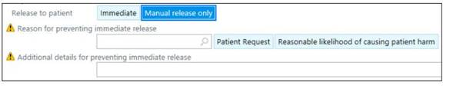
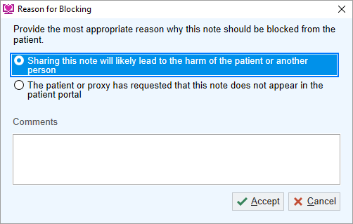
First Glimpse of New Epic Tools
How to prevent: 1. Immediate release of a result (when appropriate)
2. Sharing of a Note with a Patient (when appropriate)

Slide 52
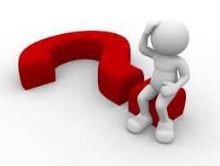
Questions??
preventinfoblocking@umm.edu

