Slide 1
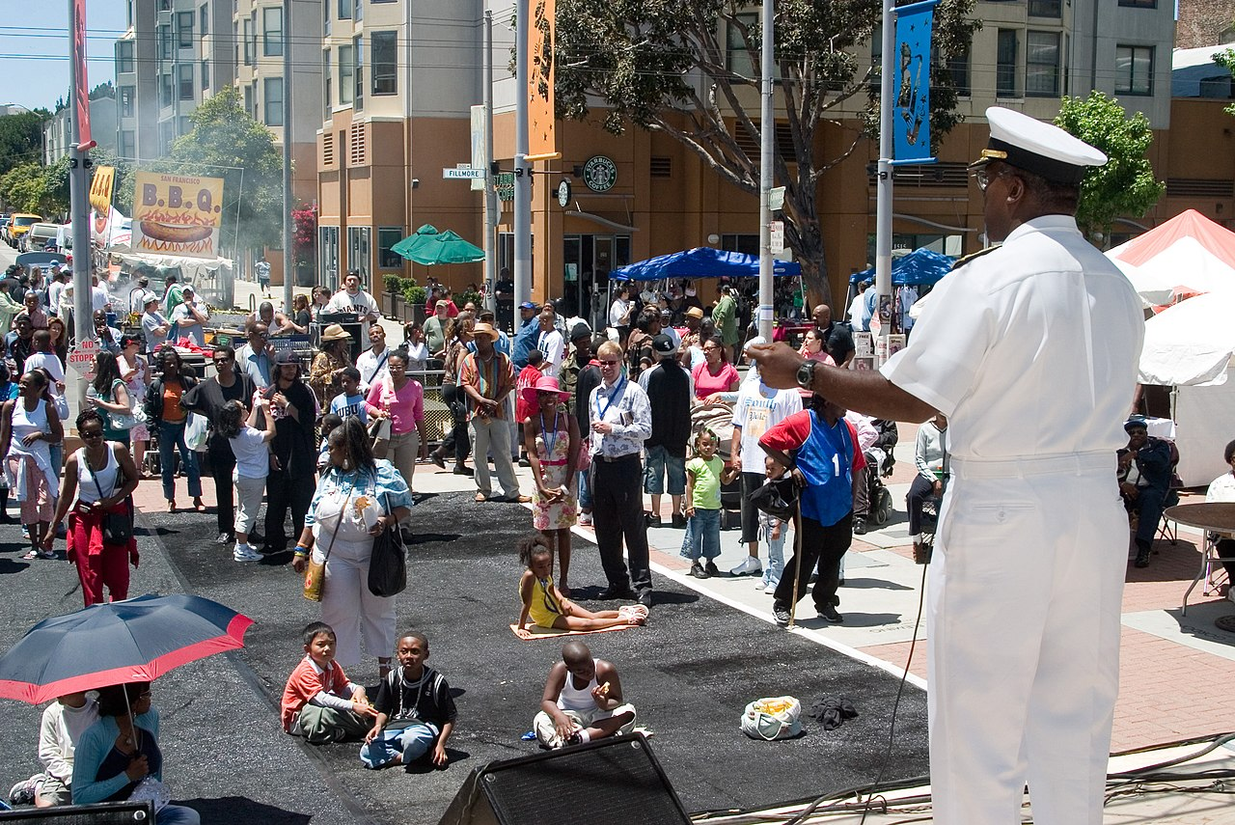
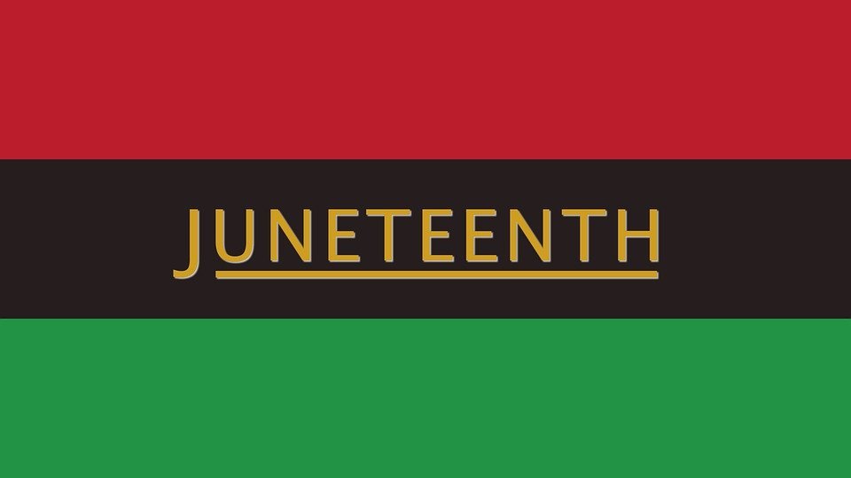
June 19th , 1865

Slide 2
WHAT IS JUNETEENTH?
President Lincoln issued the preliminary emancipation proclamation order in 1862
The emancipation proclamation “officially” took affect on January 1st, 1863
Many states were slow to implement the proclamation and were slow to free all of the enslaved people
“Juneteenth (short for “June Nineteenth”) marks the day when federal troops arrived in Galveston, Texas in 1865 to take control of the state and ensure that all enslaved people be freed” History channel website
June 19th, 1865-Texas, the last state to implement the emancipation proclamation, announced the following:
“The people of Texas are informed that, in accordance with a proclamation from the Executive of the United States, all slaves are free. This involves an absolute equality of personal rights and rights of property between former masters and slaves, and the connection heretofore existing between them becomes that between employer and hired labor. The freedmen are advised to remain quietly at their present homes and work for wages. They are informed that they will not be allowed to collect at military posts and that they will not be supported in idleness either there or elsewhere.” —General Orders, Number 3; Headquarters District of Texas, Galveston, June 19, 1865
This Photo by Unknown Author is licensed under CC BY-NC-ND

Slide 3
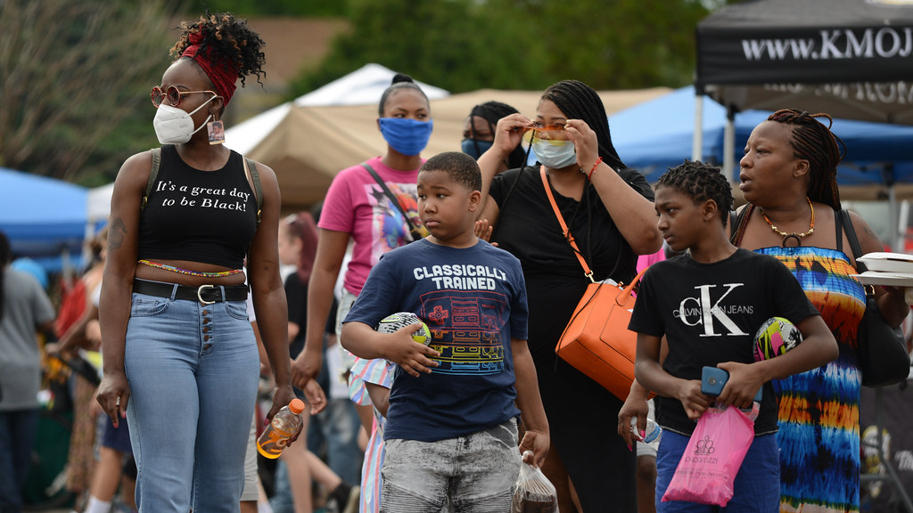
Juneteenth video
https://www.youtube.com/watch?v=JOOguH71--E
This Photo by Unknown Author is licensed under CC BY

Slide 4
Traditional Juneteenth celebrations
Parades, rodeos, street fairs, cookouts, family gatherings, block parties
Barbecue and soul food—Food has long been a centerpiece of this celebration
Wearing the color red or the colors of the pan-African flag-red, black and green
Playing baseball, praying, singing, storytelling, reading the proclamation
This Photo by Unknown Author is licensed under CC BY-NC-ND

Slide 5
How can I celebrate & support Juneteenth?
Celebrate black joy and creativity-support local black businesses and artists, support your black co-workers, clients, friends and family
Do your research-educate yourself on the history of the holiday and the history of the enslavement of black people in our country
Organize an outing to a site of significance in your area and use is at a moment to learn about a piece of the black experience
Organize a community cleanup or other act of service for your community
As health care providers, recognize the holiday to those that you serve!

Slide 6
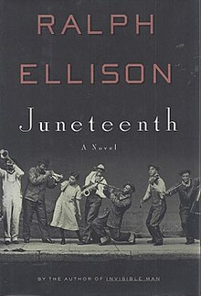
References/resources
PBS blog “The African Americans: Many rivers to cross” with henry louis gates, JR.
The history channel website
https://www.youtube.com/watch?v=t4tvAY5rwK8
https://www.youtube.com/watch?v=JOOguH71--E
Juneteenth by ralph Ellison
On Juneteenth by Annette Gordon-reed
Juneteenth for mazie by Floyd cooper
A very comprehensive resource compiles by Chad lennon, MD, https://mdpsych.org/resources/diversity-and-cultural-competency/the-cbt-of-racism/
This Photo by Unknown Author is licensed under CC BY-NC-ND
This Photo by Unknown Author is licensed under CC BY-SA

