Slide 1

University of Maryland Department of Psychiatry
Office/Outpatient E&M Coding Guidelines
Effective Jan 2021
Jill rachbeisel, md
Kim Erskine, ms

Slide 2
Office/Outpatient E&M Changes
Effective January 1, 2021
Changes Apply Only to Office/Outpatient E&M Codes Only
Inpatient, ER, and Consult E&M Coding Rules Remain the Same
New Rules Apply to All Payers

Slide 3
Office/Outpatient E&M
Office/Outpatient E&M Codes Current
90791 & 90792 – Initial Visit/Diagnostic Evaluation
99211-99215 – Follow-ups (Established)
  Level is Determined By
    HPI, Exam, & Medical Decision Making
Office/Outpatient E&M Codes effective January 1st 2021
90791 & 90792 – Initial Visit/Diagnostic Evaluation – No Change
99211-99215 – Follow-ups (Established)
  Level is Determined By
    Total Time OR
    Medical Decision Making
  *Therapy add-on codes: +90833 (16-37 minutes), +90836 (38-52 minutes), +90838 (53+ minutes) Remain the same

Slide 4

Whether to Use Time or Medical Decision Making?
Time May Seem Like an Easier Approach, However:
  Time May Not Result in the Code that Most Accurately Depicts the Services Delivered
Medical Decision Making
  Allows Billing at a Higher Code Due to Complexity Rather than Time Restrictions

Slide 5
E&M Level Based on Elements of Medical Decision Making
HPI and Exam Are No Longer Used to Determine the Level of Care
Level is Determined by Medical Decision-Making
Medical Decision-Making Elements:
  Number and Complexity of Problems Addressed
  Risk of Complications and/or Morbidity or Mortality of Patient Management
  Amount and Complexity of Data to be Reviewed and Analyzed

Slide 6
 | GENERAL DESCRIPTION | History | PE- MSE | Medical Complexity/Management Options | Example case
CODE | All visits must have reason for the visit (chief complaint) documented |  |  | (Thought Process and Decision Making)
99211 | Seen without doc | (Not using) |  |  | NOT USE
99212 | 1 established chronic stable problem Problem Focused | 1-3 elements of HPI - severity of current S&S, timing, duration, stressors, etc. No ROS needed No past family, social or psych hx needed | 1-5 elements | Straightforward, stable problem with no need to change tx. Can be managed with psychotherapy or over the counter meds. Straight Forward | Mr. Smith is seen with Bipolar Disorder, presents with stable mood, sleeping well, maintaining work and no new complaints. Meds continued and f/u in 1-2 months
99213 | -1 established chronic problem worsening S&S OR -2 established stable problems Expanded Problem Focused | 1-3 elements of HPI 1 ROS (psych) No past family, social or psych hx needed | 6- 8 MSE elements | One treatment change – increase or different medication OR 2 or more stable problems with no change in treatment. Low Complexity | Ms. Jones is seen with Major Depression and insomnia. No other S&S- Sleep hygiene and reduced caffeine after 12N. New or continued med management
99214 | -2 established chronic problems with at least one worsening S&S OR -1 new problem Detailed | 4 or more elements of HPI 2 ROS (medical) 1 past family, social or psych hx needed | 9-13 MSE elements | Requiring cont. meds or new meds and/or higher level of care but not acute care. Gathering additional information from other sources and ordering reviewing labs etc. inc. complexity to this level Moderate Complexity | Mr. Steve seen with Schizophrenia reports worsening AH and paranoid delusions requiring an increase in his current Risperidone and addition of clonazepam med change and moderate risk
99215 | 1 chronic or new problem with severe increase in S&S accompanied by significant functional deterioration Comprehensive | 4 or more elements of HPI full ROS (medical) 2 past family, social or psych hx needed | Full MSE with all elements examined | Requiring emergency interventions with ER or Inpatient referral. High Complexity | Ms. Mable presents with OCD and acute suicidal ideation with clear plan to jump into the harbor. + hx. Past attempts- requires ER & inpatient admission
Old Coding Tool

Slide 7
Code determined by 2 of 3 categories | Category#1: Number and Complexity of Problems | Category #2: Data Review |  |  | Category #3: Complexity of tx/ Risk involved
 |  | Review of results | Review information | Discussion of result/case with external provider/professional
99211 | NA
99212 Straight Forward | -1 self limited or minor problem | none | none | none | Minimal Risk- no medications
 |  | For 99213- need to meet ONE Data review section Only
99213 Low | -2 or more minor problems -1 stable chronic problem -1 acute (new) uncomplicated problem or side effect) | Need 2 of the following 3 possibilities: 1. Review of prior external notes ( i.e. D/C summary or PCP note) 2. Review results of test(s) 3. Ordering tests ** if you order or review TWO lab panels, that counts for 2 items.= requirement met 2 notes reviewed- met | Assessment from an independent historian *family/caretaker/therapist |  | Low Complexity i.e. therapy behavioral changes sleep hygiene
 |  | For 99214- must meet ONE data review section
99214 Moderate | -1 or more chronic problems with worsening S&S OR side effects -2 or more stable chronic problems -One new problem that if untreated will have consequences -1 acute complicated | Need 3 elements from the following 4 possibilities to meet this section 1.Review of prior external note ( i.e. D/C summary or PCP note) 2.Reveiw results of each unique test (panel) 3. Ordering a unique test 4. assessment from independent historian. | * Independent interpretation of a test result | *Discussion of test result or case with external Source i.e. PCP/Lawyer/Teacher | Moderate Complexity *Prescription Meds = automatic Moderate *Diagnosis or treatment are significantly impacted Social determinants (no transportation, homelessness, literacy, poor support)
 |  | For 99215- must meet TWO data sections as listed under 99214
99215 High | 1 chronic or new problem with severe symptoms and deterioration | As noted in 99214 above ⬆ ⬆ ⬆ | * Independent interpretation of a test result | *Discussion of test result or case with external provider | High complexity/Risk Refer to ED, Inpt tx, Day hospital, 24/7 supervision at home
New
Coding
Tool
*Lab Panel refers to battery of levels- i.e. CMP, Lipids, TFT’s, LFT’s- each considered a panel

Slide 8
Number and Complexity of Problems Addressed
New Clarification/Key Points:
Problems:
  Must be Addressed by the Provider Reporting the Service
  Listing Problems Treated by Another Provider Does Not Count
Complexity Definitions:
  Stable – If a patient is not at their treatment goal, their condition is not stable - even if the condition has not changed
  Undiagnosed Problem – Differential Diagnosis that represents a condition likely to result in a high-risk morbidity without treatment

Slide 9
Amount &/or Complexity of Data To Be Reviewed and Analyzed
Limited Must meet the requirements of at least 1 category
Definitions:
Unique test is defined as a Clinical Laboratory Panel
Single Test Examples: Basic or Comprehensive Metabolic Panels or General Health Panel
Independent Historian includes parent, guardian, spouse or caregiver
Appropriate Source includes professionals who are not in health care – for ex lawyer, case manager, teacher
Moderate/Extensive - Same Options -The level is determined by the Number of Categories Met
Moderate = At least 1 category
Extensive = At least 2 categories

Slide 10
Risk
Level of Risk is Based Upon Consequences of the Problem(s) Addressed
Includes Management Options Selected & Those Considered, but Not Selected After Shared Medical Decision-Making with the Patient &/or Caregiver
Includes Social Determinants that Significantly Limit Diagnosis or Treatment
Risk of Complications &/or Morbidity or Mortality of Patient Management

Slide 11
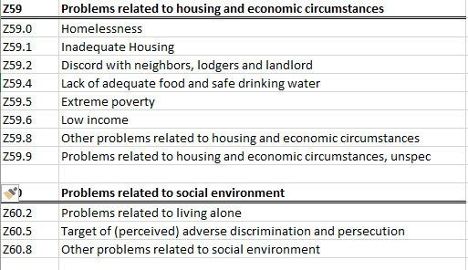
Risk of Complications &/or Morbidity or Mortality of Patient Management - Social Determinants
Common ICD-10 Codes (Z55-Z65)

Slide 12

E&M Level Based on Time
99212 – 10-19 minutes
99213 – 20-29 minutes
99214 – 30-39 minutes
99215 – 40-54 minutes
99417 – 55+ minutes
  *One additional billing is used for every 15-minute increment
  *For MA – Preauthorization will be Needed

Slide 13
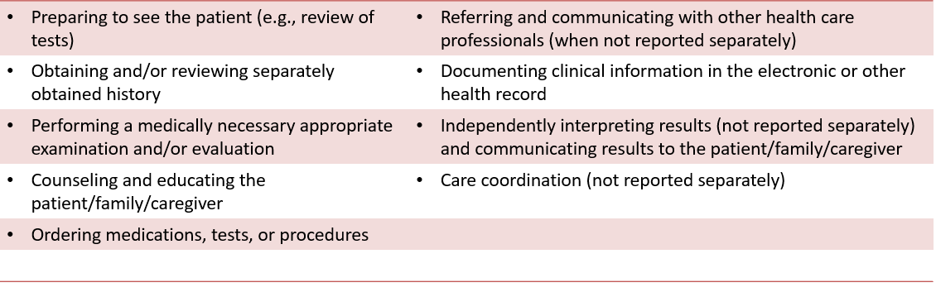
Total Time Includes

Slide 14
Total Time
Total Time Must be Spent on the Date of Encounter – Prep the Day Before the Visit is NOT counted
Psychotherapy Sessions are Still Billed Separately from a Med Check – 2 Discrete Notes are Needed (Even if They are Done in the Same Encounter)
Specific Number of Minutes Spent Must be Documented – Not a Range or “Approximate”
Time Spent by Resident/Fellow is Not Included. This is Where a Medical Complexity-based Coding Would be More Advantageous.

Slide 15
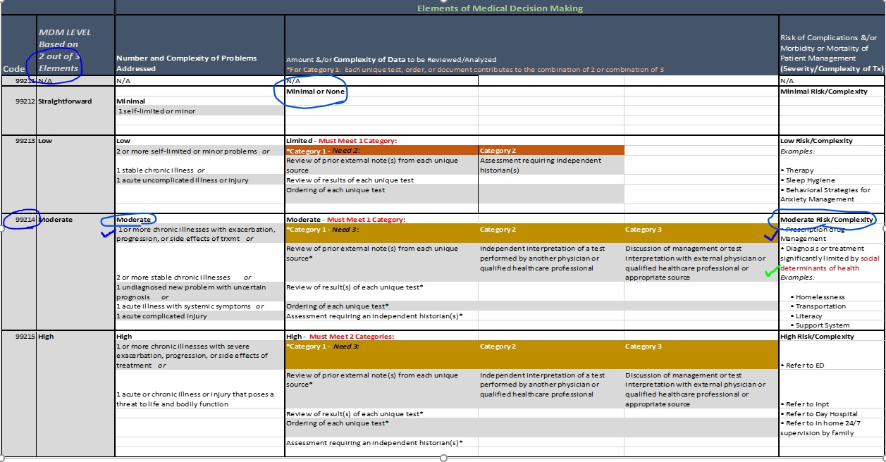
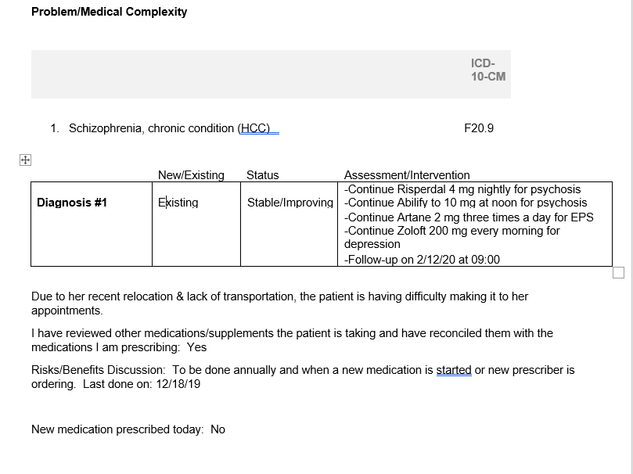
MDM Coding Example
CPT - 99214
ICD-10 = F20.9 & Z59.8

Slide 16
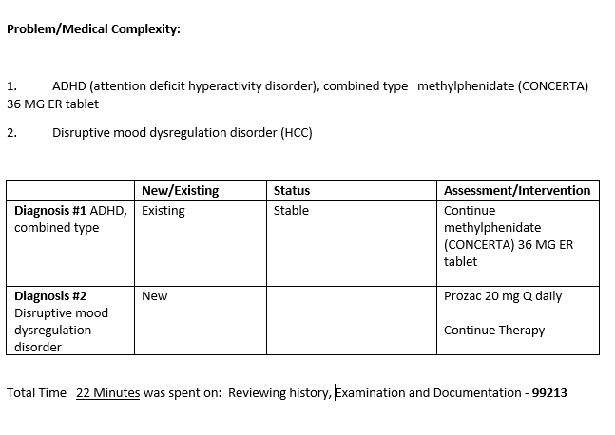
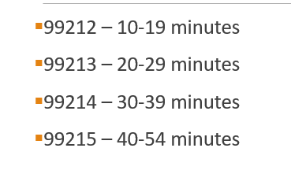
Coding Example Based on Time

Slide 17
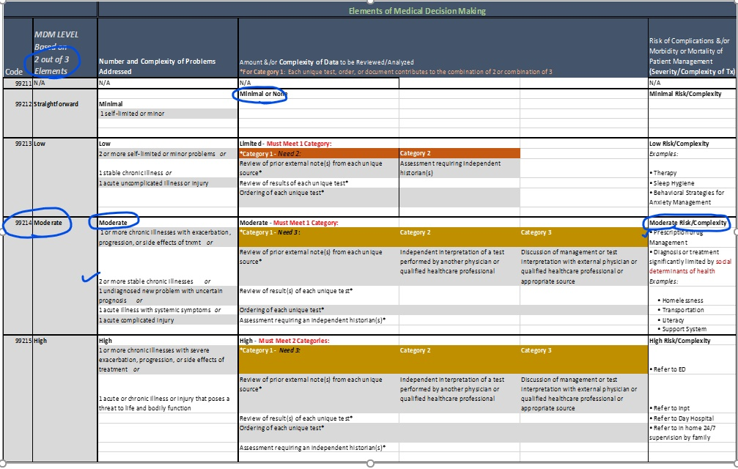
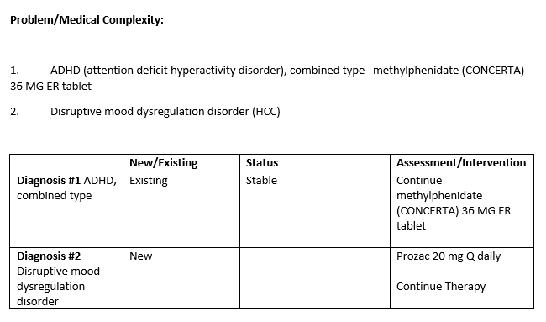
Coding Example Based on MDM

Slide 18

Documentation & Coding
History & Exam
  document a “clinically appropriate history and exam”
  Not counted towards coding
Include details
  include test interpretations and lab results in your note
  When coding based on time, if something is taking a great deal of time, document the reason
When social determinants limit diagnosis/treatment, include icd-10 z code
Use .MDM2021 – for documentation & coding assistance

