Slide 1
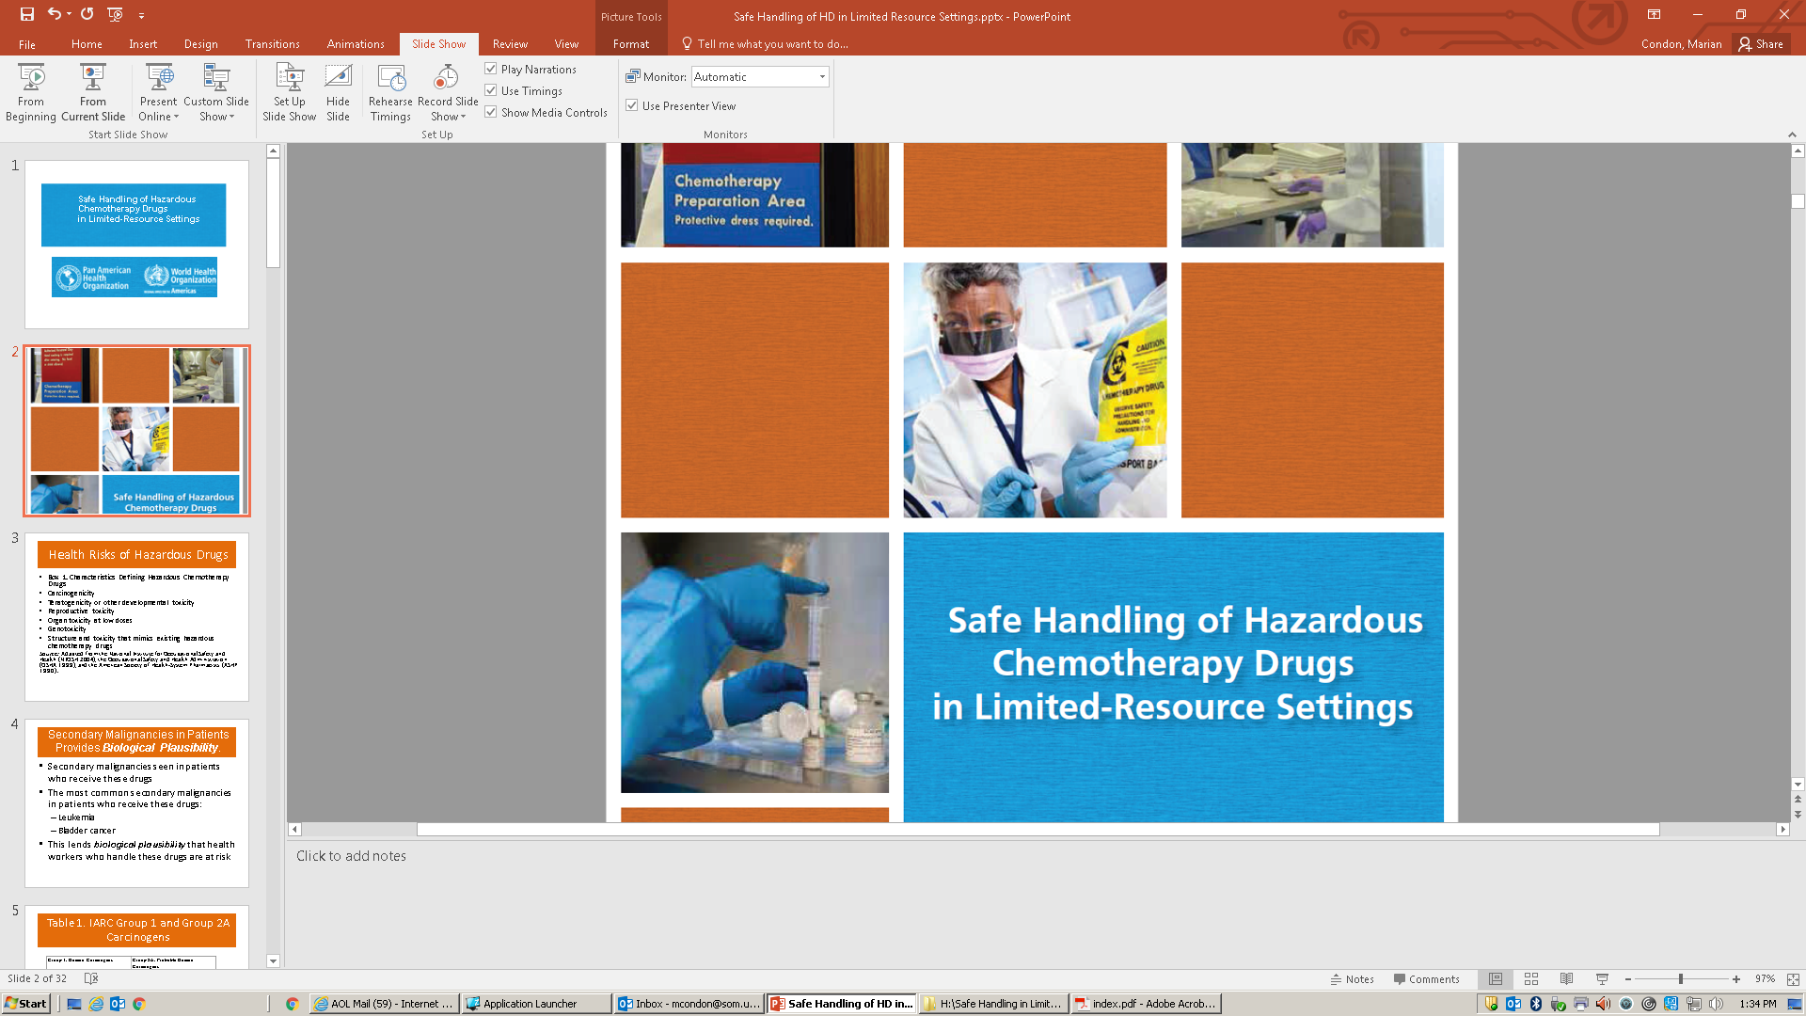

Notes:
In Part 3 of this presentation, some of the slides (45, 48, 50, 52, 57, 60, 64, and 66) have videos linked to them through the on-line sharing platform, Vimeo. You will need to have internet access to view these videos.
To access the videos just hover cursor over the blue box you see on slide and click on it. When you are connected to the video on Vimeo you can enter “full screen” view by hovering over the bottom of the screen.

Slide 2
Definición de droga peligrosa (DP)
Características que definen a una droga peligrosa
  Carcinogenicidad
  Teratogenicidad o toxicidad el desarrollo
  Toxicidad reproductiva
  Toxicidad de órganos a dosis bajas
  Genotoxicidad
  Estructura y toxicidad similares a drogas utilizadas en quimioterapia ya existentes
  Source: Adapted from the National Institute for Occupational Safety and Health (NIOSH 2004), the Occupational Safety and Health Administration (OSHA 1999), and the American Society of Health-System Pharmacists (ASHP 1990).
La mayoría de las DP son agentes quimioterapéuticos
Notes:
In 1990, the American Society of Health-System Pharmacists defined a drug as “hazardous” based on its qualitative toxicity, including:
Its carcinogenicity, mutagenicity, reproductive and developmental toxicity, or other acute toxicity (see Box 1).
This definition was expanded by NIOSH (2004) and acknowledged that drugs with these toxic properties could pose a hazard to health care personnel.
While the term “hazardous drug” can be assigned to medications used for purposes other than cancer treatment, the majority of hazardous drugs are anticancer chemotherapeutic agents.

Slide 3
Agencia Internacional para la Investigación en Cáncer (IARC)
La Agencia Internacional para la Investigación en Cáncer (IARC) corresponde a la agencia especializada en cáncer de la Organización Mundial de la Salud, la cual identifica a las sustancias causantes de cáncer
La IARC ha designado varias DPs como carcinógenos en humanos basado en sus perfiles de toxicidad y evidencia epidemiológica en pacientes que tratados con estos agentes.

Slide 4
Tabla 1. Grupo 1 y 2 de carcinógenos según la IARC
Fármaco anticáncer
Grupo 1: Carcinógeno en humanos | GRupo 2A: Probable carcinógeno en humanos
Arsenic trioxide | Azacitidine
Azathioprine | BCNU
Chlorambucil | CCNU
Chlornaphazine | Chlorozotocin
Cyclophosphamide | Cisplatin
Etoposide | Doxorubicin HCl
Busulfan | N-Ethyl-N-nitrosourea
Melphalan | Mechlorethamine HCl
Semustine | N-Methyl-nitrosourea
Tamoxifen | Procarbazine HCl
Thiotepa | Teniposide
Treosulfan
MOPP¹
ECB²
Notes:
Table 1 lists the known and probable human carcinogens among anticancer drugs in common clinical use.
An additional 12 pharmaceuticals/antineoplastic agents are considered to be possible human carcinogens by IARC

Slide 5
Riesgos para la salud de las DPs
Como muchas de las DPs ejercen el efecto terapéutico causando mutaciones o interactuando con el AND, éstas pueden generar cáncer
Evidencia de los efectos cancerígenos es observado en pacientes que reciben quimioterapia, a traves de la generación de cánceres secundarios
Los tipos de cáncer secundarios más communes en pacientes que reciben terapia corresponden a :
Leucemia
Cáncer de vejiga
Notes:
HDs are mutagenic or interact with DNA, therefore they themselves can cause cancer
A number of the antineoplastic drugs, especially many of the alkylating agents, have been associated with secondary cancers in treated patients (IARC 2012).

Slide 6
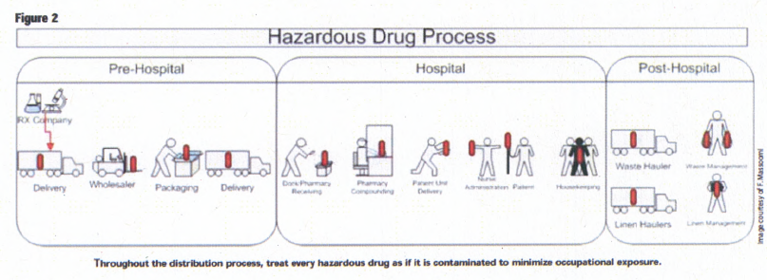
Exposición Ocupacional
Adapted with permission from Massoomi, 2009.
Notes:
Workers can be exposed to the hazards throughout the full life cycle of these drugs, including before it enters and after it leaves the healthcare facility; from
Manufacturing to transport
Distribution
use in institutional or home care settings
To waste disposal
Massoomi et al, 2009. Pharmacy Purchasing & Products. July 2015 : Hazardous Drug Handling - Vol. 12 No. 7 - Page #4

Slide 7
Indicadores de Exposición Ocupacional
  Aproximadamente, 20 estudios han detectado la presencia de DPs en orina de trabajadores expuestos, lo cual indicaría absorción de estas sustancias
  Algunas de estas DPs son las mismas utilizadas en la quimioterapia y que han sido identificadas en estudio de monitoreo ambiental en el lugar de trabajo
  Tres estudios informaron la presencia de DPs en orina de trabajadores que no participaron de la manipulación directa de estos agentes, indicando exposición secundaria
Notes:
Approximately 20 studies have measured drugs in the urine of health care workers (Turci et al. 2003; NIOSH 2004; Connor and McDiarmid 2006).
These are some of the same drugs used therapeutically and recovered in work place environmental sampling studies.
Interestingly, three of the studies reported the presence of antineoplastic drugs in the urine of workers who were not actually handling the drugs, indicating secondary exposure from environmental contamination

Slide 8
Evidencia de Exposición Ocupacional
Enfermeras que manipulaban agentes antineoplásicos resultaron con presencia de un alto nivel de sustancias mutagénicas en orina
En numerosos estudios en los cuales se incluyó a enfermeras y químicos farmacéuticos que manipulaban agentes antineoplásicos se encontró:
  Presencia de sustancias mutagénicas en orina
  Aberraciones cromosómicas
  Intercambio de cromátidas hermanas
  (Baker and Connor 1996; Sorsa and Anderson 1996; Sessink and Bos 1999; Suspiro and Prista 2011)
Notes:
The first evidence of occupational exposure in health care workers resulted from a study carried out which indicated nurses who prepared and administered antineoplastic drugs had
higher mutagenic substances in their urine than unexposed workers.
Although the health consequences are unknown, this study suggested that nursing personnel were occupationally exposed to antineoplastic drugs, many of which are mutagenic.
This finding was supported by numerous studies examining exposure markers, including; urine mutagenicity, chromosomal aberrations, sister chromatid exchanges, and other endpoints in pharmacists and nurses who handle antineoplastic drugs (Baker and Connor 1996; Sorsa and Anderson 1996; Sessink and Bos 1999; Suspiro and Prista 2011).

Slide 9
Otros estudios demostraron riesgo de cáncer para personal que manipulaba DPs
Dos estudios demostraron un incremento en el riesgo de desarrollar leucemia en personal de oncología
-Un estudio demostró incremento significativo en personal de enfermería (Skov et al. 1992)
-El otro encontró un aumento en médicos (no estadísticamente significativo) (Skov et al. 1990)
Estos casos son biológicamente relevantes porque se detectó el desarrollo de cáncer secundario (leucemia), el cual se asocial a pacientes que reciben quimioterapia (Erlichman and Moore 1996)
Recientemente, un estudio demostró que personal de enfermería expuesto a DPs presentaba mayor probabilidad de ser diagnosticado con cáncer en comparación con el personal no expuesto (Martin, 2005)
Notes:
Investigations of a cancer excess in exposed workers are limited to two Danish studies.
One showed a significantly increased risk of leukemia among oncology nurses identified in the Danish cancer registry for the period 1943–1987 (Skov et al. 1992).
The other (Skov et al. 1990) found an increased risk of leukemia in physicians employed for at least six months in a department where patients were treated with antineoplastic drugs. However, the increase was not statistically significant.
Despite the small number of cases, these cases are biologically relevant because of the commonly observed hematopoetic second malignancies (leukemia is a hematopoetic malignancy) observed in treated patients, previously discussed (Erlichman and Moore 1996).
More recently, Martin (2005) found that exposed nurses were significantly more likely to report a cancer diagnosis than unexposed nurses

Slide 10
Efectos Reproductivos y del Desarrollo
Muchas DPs han sido asociadas con efectos adversos a nivel del Sistema reproductiva y del desarrollo en animales y en pacientes que reciben quimioterapia
Más de 50 agentes presentan “evidencia clara que demuestra riesgo para el feto”
Efectos adversos similares, a nivel del Sistema reproductivo y del desarrollo, a los experimentados en pacientes han sido reportados en trabajadores del sector salud expuestos a las DPs in dosis más bajas que las que reciben los pacientes en tratamiento
(Baker and Connor 1996; Sorsa and Anderson 1996; Sessink and Bos 1999; Suspiro and Prista 2011)
Notes:
Refer to table 2 in WHO/PAHO document, page 4
Many antineoplastic agents have been associated with adverse reproductive and developmental effects observed in animals and in treated male and female patients (Meirow and Schiff 2005).
Some of these effects are explained by the mutagenic and carcinogenic mechanisms of HDs
More than 50 drugs present “clear evidence of risk to the human fetus,” according to the U.S. Food Drug Administration. While the benefits may outweigh the risk for patients, this is not the case for health care workers.
Reproductive and developmental effects similar to those observed in patients have been reported in health care workers exposed to antineoplastic agents lower doses than those administered to patients (Valanis et al. 1993a, 1993b; Lawson et al. 2012).

Slide 11
Estudios en Enfermeras expuestas a DPs encontraron que:
Efectos adversos a nivel del Sistema reproductivo asociados a la manipulación de DPs
  Resultados de 14 meta-análisis (1966-2004) demostraron la asociación con efectos reproductivos (Dranitsaris et al. 2005)
  Incremento significativo en abortos espontáneos (Lawson et al. 2012)
Notes:
Reproductive health effects associated with antineoplastic drug handling

Slide 12

Notes:
The Lawson study demonstrated significant increase in spontaneous abortions especially in first trimester, Lawson et al, American Journal of Obstetrics and Gynecology. 2012
Antineoplastic drug exposure was associated with a 2-fold increased risk of spontaneous abortion & 3.5 fold inc among nulliparous women (show statement in slide)
A large sample size (7,482) and the long-trusted source of the data: the Nurses’ Health Study II

Slide 13
Efectos adversos agudos
Efectos adversos agudos en personal de enfermería han sido reportados:
  Pérdida de cabello
  Dolor de cabeza
  Rash cutáneo
  Reacciones alérgicas
  (Valanis et al. 1993a, 1993b; Baykal, Seren, and Sokmen 2009; Constantinidis et al. 2011)
Notes:
Surveys have associated workplace exposure to HD with acute health effects, primarily in nursing personnel
It is important to note that these studies that have found adverse effects in health workers who handle these drugs document the plausibility of occupational exposure intensity sufficient to cause clinically significant adverse outcomes in routinely exposed workers

Slide 14
Vías de exposición
Vías de exposición más comunes:
  Tópica (piel): contacto con superficies contaminadas
  Inhalación: aerosoles, vapores y polvos
  Oral (mano-boca): ingestion de alimentos, fumar, maquillaje
Notes:
Workers may inhale droplets, particulates, and vapors when they create aerosols or generate dust during drug preparation or while cleaning up spills.
Dermal exposure may occur when workers touch contaminated surfaces during the preparation, administration, or disposal of hazardous chemotherapy drugs or patient wastes
Oral exposure may occur from hand-to-mouth contact.
Other drug manipulations and work tasks also involve activities that may result in exposure through inhalation, skin contact, ingestion, or injection (NIOSH 2004, 2008).

Slide 15

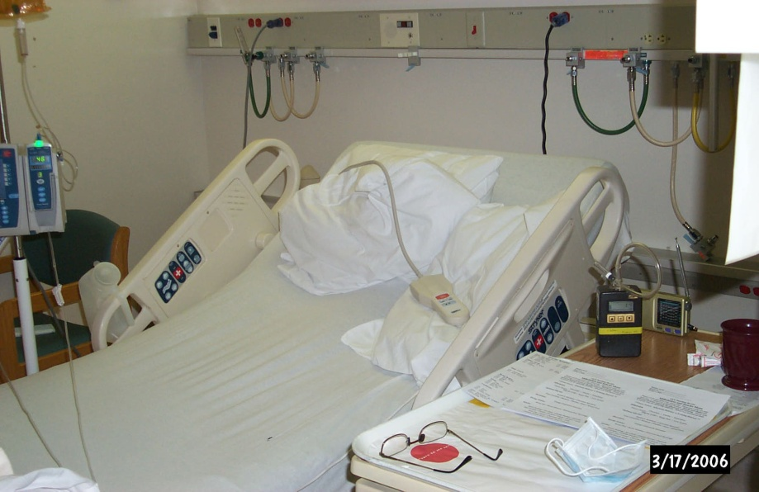
Vías de exposición: Tópica
La mayoría de las superficies de trabajo resultan contaminadas con DPs:
  Cabinas de seguridad biológica
  Mesones
  Pisos
  Instrumental
  Superficies donde los pacientes reciben quimioterapia
Notes:
Workers unknowingly come into contact when touching these surfaces

Slide 16
Vías de Exposición: Inhalatoria
La vía inhalatoria no es tan común como la tópica
Partículas de los fármacos en solución pierden el solvente y pueden movilizarse en los ambientes de trabajos
Vaporización de algunos fármacos antineoplásicos puede ocurrir (BCNU, ifosfamida, thiotepa, y ciclofosfamida)
Notes:
Most studies involving air sampling for hazardous chemotherapy drugs have detected little to no airborne contamination with these agents.
However, this may be related to problems with the methodology used (Larson, Khaaeli, and Dillon 2003).
A recent study by Mason et al. (2005) reported significant levels of several drugs in both personal and area air samples.
Drug particulates can become airborne after drying on contaminated surfaces.
Vaporization of antineoplastic agents has also been reported with various drugs such as BCNU, ifosfamide, thiotepa, and cyclophosphamide (Connor, Shults, and Fraser 2000; Kiffmeyer et al. 2002).

Slide 17
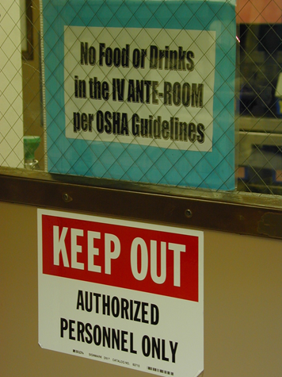
Vías de Expsición: Ingestión
Ingestión casual puede ser una vía de entrada al organismo del trabajor
Puede ocurrir cuando alimentos, bebidas, manos, cigarillos, cosméticos resultan contaminados en el área de trabajo
Notes:
Inadvertent ingestion may be an additional route of exposure.
When food or beverages are prepared, stored, or consumed in work areas, they may be contaminated with airborne particles of cytotoxic drugs or by contact with contaminated hands.
Hands, cigarettes, cosmetics, and chewing gum can be contaminated.
A potential source of exposure is direct skin contact with contaminated surfaces or during an accident or incident with spillage or leakage where a large volume of drug is released to the environment; this may result in hand-to-mouth contact.

Slide 18
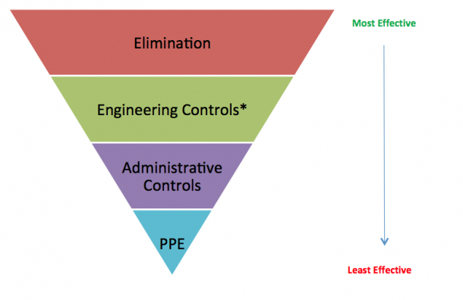
Control de la Exposición
  Eliminar o sustituir el peligro (no se puede eliminar la quimioterapia)
  Controles de ingeniería (uso de cabinas de seguridad biológica, aisladores, dispositivos cerrados de transferencia de fármacos, aunque son costosos)
Jerarquía de control en higiene industrial
Notes:
The basic occupational health approach to minimizing exposure to any workplace hazard uses a combination of industrial hygiene control methods that are applied in a specified order or hierarchy.
In most cases, the elements of this hierarchy can be applied to the health care setting
The hierarchy of hazard control technologies relies on engineering controls, such as a biological safety cabinet (BSC) or a compounding aseptic containment isolator (CACI), as the first technology applied
However, these are often the most costly type of hazard control.

Slide 19
Controles administrativos y uso de Elementos de Protección Personal (EPP)
En recintos con limitaciones económicas, los controles administrativos y uso de EPP minimizan la exposición y no son costosos.
  Programas de capacitación
  Disponibilidad de hojas de seguridad
  Buenas prácticas de trabajo
  Políticas de seguridad establecidas
  Vigilancia médica
  EPP (guantes, batas, protección
  respiratoria y lentes de seguridad
Notes:
In resource-limited settings where engineering controls are unaffordable administrative controls which include scrupulous use of work practices that minimize aerosol and dust generation , and use of PPE will minimize exposure

Slide 20
Flujograma de DPs en un hospital o clínica
Recepción de DPs
Preparación de DPs
Administración de DPs
Disposición de desechos contaminados
Recoleción de desechos contaminados
Área de lavanderia
Notes:
Within the health care facility, workers in all areas of the facility where the drugs are present are at risk of exposure
These locations include the areas for receiving, storage, and compounding of drugs; areas through which drugs are transported; patient treatment areas; laundry services; and waste collection and storage areas
Therefore, all workers in these areas should have appropriate hazard awareness and job task training in order to take precautions to reduce exposure
The rest of this presentation will describe how safety practices in the category of administrative controls can help protect workers in each of these areas from exposure

Slide 21
Áreas communes para fomenter la seguridad entre los trabajadores expuestos
Educar al personal respecto de los riesgos para la salud al exponerse a las DPs
Educar al personal acerca de las vías de exposición a las DPs
Capacitación acerca de las buenas prácticas de trabajo
Capacitación acerca de una correcta elección del EPP
Capacitación en el uso del kit de derrames
Capacitación acerca del uso de kits de derrames
Notes:
While the following slides will address safety at specific stages of the HD life cycle
All health workers who may be exposed to hazardous chemotherapy drugs must undergo education and training for safe handling.
Training should begin when the worker is first assigned to an area where chemotherapy agents are present and should be repeated annually.
The educational content should be specific to the activities for which the worker is responsible
Educating personnel on the risks
Routes of exposure
Training in work practices
Training in the selection and use of personal protective equipment (PPE), (including a respirator)
Training in the use of HD spill kits

Slide 22
Recepción de fármacos antineplásicos
Al revisar frascos potencialmente dañados, usar un par de guantes
Si el cargamento resultó dañado, utilizar EPP, incluyendo doble par de guantes, bata o traje, protección ocular y respiratoria (ver apéncide A)
Utilizar el kit de derrames para manipular los elementos dañados, incluyendo frascos y envase de embalaje
Notes:
This process should be used if a medication shipment has been damaged or broken
Appendix A goes into detail about each type of PPE; gloves, gowns, respiratory protection and eye and face protection

Slide 23
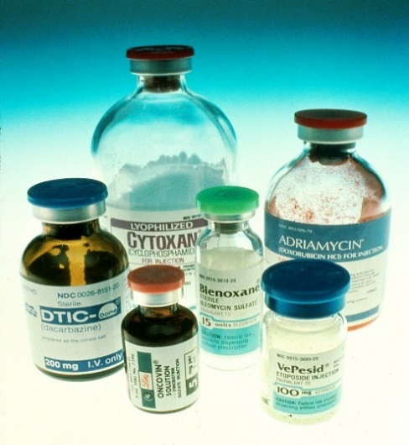
Almacenamiento de DPs…
Es sabido que viales de los fármacos antineoplásicos contienen traszas de estos agentes en la superficie externa
La próxima diapositiva presenta
algunas recomendaciones que
deberían ser tomadas encuenta
por todo el personal involucrado en el almacenamiento, retiro e inventariado de las DPs

Slide 24
Almacenamiento de DPs…
El personal debe estar capacitado para la manipulación de DPs, el uso de EPP y el control de derrames.
Kit para derrames deben estar disponibles
Las zonas de almacenamiento deben contar con ventilación apropiada
El personal debe utilizar uno o dos pares de guantes según corresponda
El personal debe preocuparse de limpiar cada vial o ampolla previa preparación del fármaco
Las áreas de almacenamiento deben limpiarse al menos cada 30 días, utilizando detergentes y solución de hipoclorito de sodio diluida
Limpiar las zonas contaminada con materiales desechable humedecido con el producto de limpieza, no rociar el producto sobre la superficie de trabajo
Notes:
Personnel is educated on the hazards posed by HDs and trained in the use of PPE, including a respirator for use in the event of breakage or a spill.
Spill kits must be available in the HD storage area, and all personnel must be trained to perform spill cleanup.
The storage area for HDs must have appropriate ventilation. Ideally, storage areas should have negative air pressure in relation to surrounding areas, with at least 12 air changes per hour to reduce drug residue in breathable air.
Personnel should wear one or two pairs of gloves that have been tested and approved for use with HDs (ASTM 2005).
Personnel should wipe each HD vial or ampoule before use. Never spray the HD container directly, as that transfers contamination to the air and other surfaces. The wiper should be contained and discarded after use.
Storage areas must be cleaned at least every 30 days with detergent solution. Diluted bleach solution may also be used if the container is resistant to damage from bleach.
Wipe, don’t spray, HD storage bins.

Slide 25
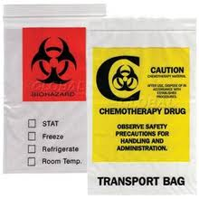
Transporte de DPs desde la zona de preparación hacia la zona de administración
Utilizar doble bolsa sellada u otro tipo de contenedor sellado
Prefiera el transporte manual por sobre otro método mecánico que pueda dañar el preprarado
Bolsas selladas evitan que el personal que transporta esté directamente en contacto con el preprarado que puede resultar contaminado en la superficie externa
Mantenga a mano el kit de derrames (en el carro de transporte)
Sólo personal entrenado para atender un derrame con DPs debería transportar DPs
Notes:
All HD doses should be double-bagged or placed in a sealed container for transport to the patient care area.
The compounded sterile preparation (CSP) of a hazardous drug should be taken to the area manually, rather than by mechanical transport (such as a pneumatic tube system), which may result in breakage or leakage.
Use of the transport bag prevents the handler from being exposed to HDs that could be on the external surface of the finished product, if the bag is dropped and the container breaks or leaks, there is another barrier to prevent the HD from spilling on the handler or the external environment.
HD spill kits should be on the transport cart in case of an accident during transport
Only personnel trained to clean up an HD spill may transport HD doses.

Slide 26
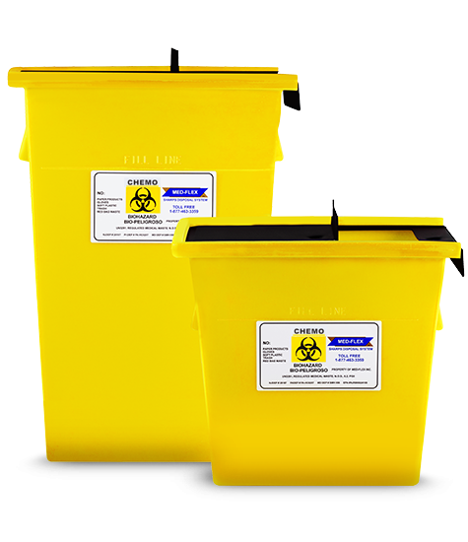
Manipulación de desechos contaminados
Es importante conocer la legislación local en cuanto a la disposición del material contaminado con DPs.
Minimice le riesgo de contaminación de las Fuentes de agua y del suelo cercanos al lugrar donde se manipulan DPs
El método que se prefiere para la eliminación de los desechos contaminados es la incineración
Desechos de DPs no deben ser eliminados en el desague o en vertederos municipales
Notes:
It is important to determine state and local regulations governing waste disposal and air and water quality to ensure compliance
Waste handling efforts should minimize the risk of contaminating the local water supply and/or soil with HDs, as they are toxic
Incineration is the preferred disposal method for most HD waste, although only special incinerators are effective in removing some of the HD residue
HD waste should never be discarded into wastewater (sink or toilet) or into a landfill.

Slide 27
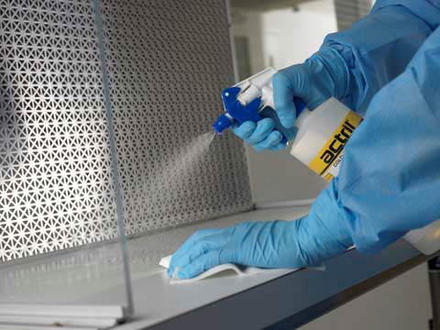
Limpieza y descontaminación de instrumentación y superficies contaminadas
Descontaminación puede ser definida como limpieza o desactivación de la contaminación
Desactivación de DPs es lo recomendado, pero no existe un método universal que sea totalmente efectivo
Alcohol (etanol) no desactiva ninguna DPs
Agentes oxidantes, tales como hipoclorito de sodio tienen la capacidad de desactivar algunas DPs
Notes:
Decontamination may be defined as cleaning or deactivating.
Deactivating a hazardous substance is preferred, but no single process has been found to deactivate all currently available HDs.
Alcohol for disinfecting will not deactivate any hazardous chemotherapy drugs and may result in the spread of contamination rather than in any actual cleaning.
Research has shown that strong oxidizing agents, such as sodium hypochlorite, are effective deactivators of many hazardous chemotherapy drugs.

Slide 28
Limpieza y descontaminación de instrumentación y superficies contaminadas
Recomendaciones
  Limpie las superficies contaminadas con solución de hipoclorito de sodio al 2% y detergente apropiado
  Dejar al menos 30 segundos actuar al agente oxidante
  Adicione una solución de tiosulfato al 1% sobre la misma superficie para neutralizar
  Retirar la mezcla de soluciones con un paño húmedo (agua) y luego aplique alcohol (etanol 70%)
  Cada solución debe permanecer en contacto con la superficie por al menos 30 segundos
Notes:
A 2% sodium hypochlorite solution with detergent may be wiped onto contaminated surfaces, then rinsed; this is followed by a neutralizing solution of 1% sodium thiosulfate, wiped on and off, followed by a rinse solution of water, then alcohol.
Surface contact for each solution should be at least 30 seconds
The hazardous chemotherapy drugs may not be fully deactivated, but the wiping action followed by rinsing appears to be effective in cleaning. This technique may be used on any surface that will not be harmed by a bleach solution.
All cleaning solutions, wipers, and rinsates must be contained and discarded as hazardous
Refer participants to pages 15-16 of WHO/PAHO companion booklet for details

Slide 29
Limpieza de derrames de DPs
Kits de derrames de DPs deberían estar ubicados en todas las áreas donde se manipule este tipo de compuestos
  Incluyendo área de recepción de DPs, almacenamiento, transporte, preparación, y zonas en donde se manipulen desechos de DPs y de pacientes que reciben quimioterapia
  Kits de derrame debería ubicarse en los carros de transporte
  Cada trabajador que manipule DPs debe conocer la ubicación de los kits de derrames
Notes:
Essential to have a hazardous drug spill kit immediately available in all areas where HDs are in use
These should ideally be located in places where HDs are received, stored, transported, compounded, and administered and where patient waste and drug waste are handled
HD spill kits should be placed on the transport cart when HD doses are moved throughout a facility
Each employee involved with handling HDs should be familiar with the location and use of these kits.
Refer participants to Appendix D; Emergency Procedures for Personnel Contamination with Hazardous Chemotherapy Drugs and for Hazardous Drug Spills, pages 39-40 of WHO/PAHO companion booklet

Slide 30
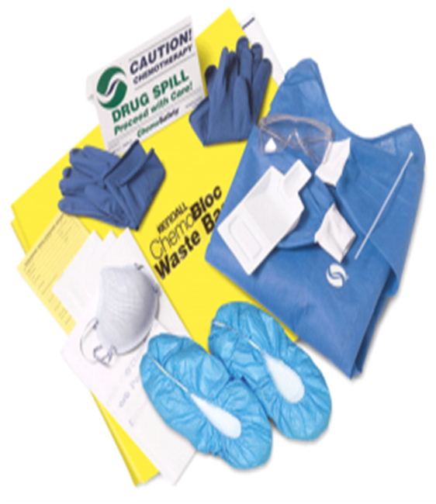
Contenido mínimo para un kit de derrames
Dos pares de guantes desechables compatibles con la manipulación de agentes antineoplásicos
Indumentaria desechable de baja permeabilidad a los agentes antineoplásicos (bata, traje y cubre-calzado)
Protector de rostro
Máscara/respirador (N95 o superior )
Notes:
Recommended content of HD spill kit includes personal protective equipment to be donned before clean up

Slide 31
Contenido mínimo para un kit de derrames
Material absorbente (pads para derrames)
Toallas desechables
Al menos dos bolsas selladas de plástico grueso para disponer de los desechos
Una pala desechable para recoger fragmentos
Un contenedor para elementos cortopunzantes
Una señal de advertencia, indicando la presencia de derrame de DPs
Notes:
HD spill kit should also include …

Slide 32
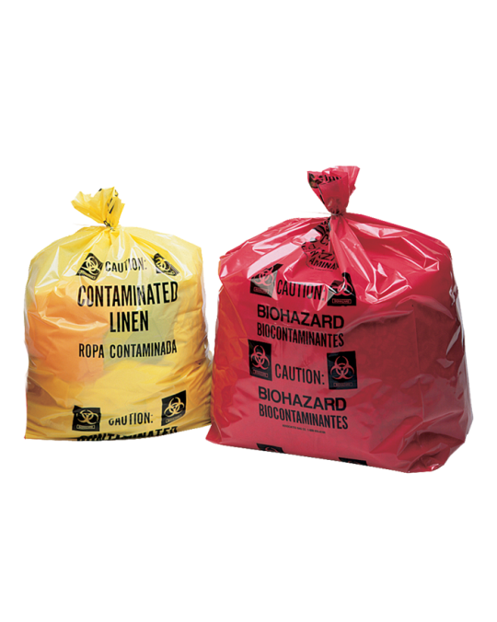
Ropa de cama puede resultar contaminada con DPs
Las DPs o sus metabolitos pueden estar presents en la orina, sangre, heces sudor y vómito de pacientes
Por lo tanto, ropa de cama puede estar contaminada con estos compuestos ductos
Utilice guantes de protección cuando manipule ropa de cama de pacientes bajo quimioterapia. Segregue estos elementos contaminados en bolsas especiales para desechos de DPs y luego envíe a lavandería. Se recomienda realizar un prelavado y luego un lavado con el resto de elementos que no resultan contaminados con DPs
Notes:
Because HDs or the metabolites of HDs can be present in urine, blood, feces, sweat, and vomit, bed linen can be contaminated with drugs or drug products
Care should be taken when handling these materials, as with other waste products
Wear protective gloves when handling contaminated linen and place it in a labeled bag so that it can be prewashed separately and then washed with the regular laundry

Slide 33
Trabajadores expuestos a DPs deberían estar enlistados en algún programa médico de vigilancia
En centros oncológicos donde se realise una evaluación periódica del trabajador, elementos adicionales de vigilancia deben incluirse para detectar a los trabajadores que participan de la manipulación y los riesgos asociados
Para centros oncológicos con restricciones económicas, algunos elementos clave suelen server para seguir los eventos de exposición de los trabajadores
Notes:
In health care institutions where some form of periodic employee health evaluation is already in place, new elements of surveillance may be added to screen HD handlers for their specific health risks.
A sample medical history questionnaire is found in Appendix E.
Facilities with limited resources may not be able to have a comprehensive medical surveillance program for health care workers who handle HDs.

Slide 34
Componentes esenciales de la vigilancia médica para trabajadores expuestos a DPs
Mantener una lista actualizada de los trabajadores expuestos a DPs
Todos los trabajadores expuestos a DPs deben completar cuestionarios periódicos (ver anexo E)
Realizar un seguimiento a los eventos de salud particulares o que se repitan en exceso por parte de los trabajadores
Observación periódica de los procesos de preparación y administración de las DPs
Notes:
For institutions that do not have the means to develop a comprehensive surveillance program, a few key elements may serve to track employees’ exposures. Program elements to include in either case are as follows:
• Maintain a list of all workers who are exposed to HDs as a part of their job assignment.
• Have all HD handlers complete periodic questionnaires to track the frequency and duration of contact with these agents, their use of PPE, and any health events that are potentially related to HD exposure (see Appendix E, pages 41 to 43 of WHO/PAHO companion booklet)
• Conduct periodic observations of drug preparation and administration practices to determine the need for refresher training in work practices that reduce exposure.

Slide 35
Componentes esenciales de la vigilancia médica para trabajadores expuestos a DPs
Documentar eventos de exposición de los trabajadores a derrames, limpieza de derrames y exposiciones accidentales
Compartir los resultados de la vigilancia médica con los trabajadores. La información debe ser des individualizada
Si el centro oncológico no posee un programa de vigilancia medica para los trabajadores, sugerir a los trabajadores que sean evaluados a través de las aseguradoras laborales
Notes:
• Carefully document spills, spill cleanup activities, and accidental exposure.
• Confidentially share the results of medical surveillance with the employees who handle HDs.
• Develop policies that guide employees in how to pursue surveillance through their primary care providers in settings without employee health services.

Slide 36
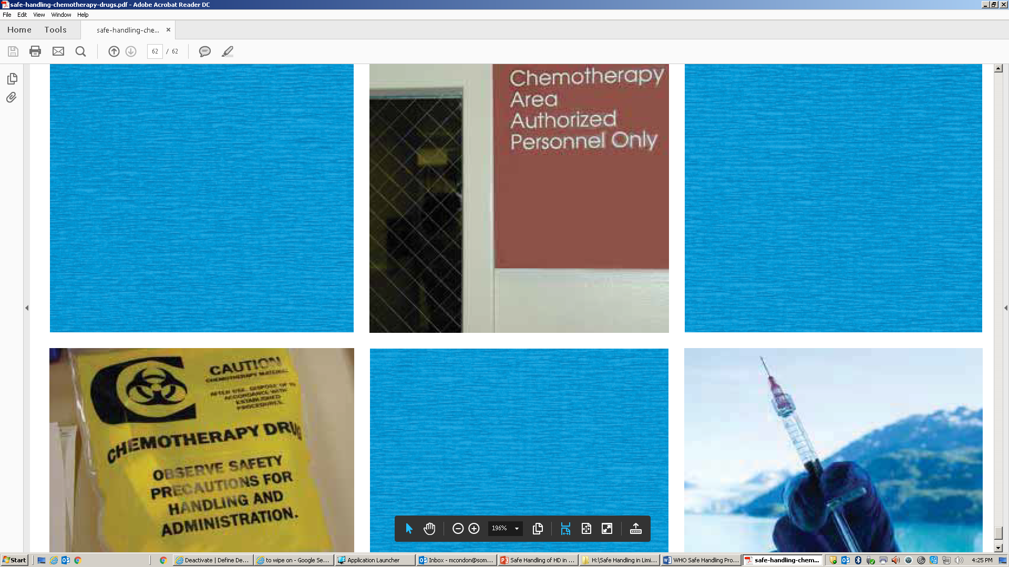
Parte 2: Administración de Medicamentos antineoplásicos

Slide 37

Administración de DPs
La mayoría de las precauciones para el manejo de DPs son similares sin importar la vía de administración
Cierto tipo de precauciones son válidas en todas las situaciones y requieren que le personal de enfermería adhiera a las practicas de seguridad específicas establecidas en los centros oncológicos

Slide 38


Precauciones de seguridad para personal de enfermería al administrar DPs
Lavarse las manos previo a la administración de DPs
Tener disponibilidad del kit de derrames
Debe utilizar EPP previo a la manipulación de las DPs que provienen del lugar de preparación
Revise el contenedor en el que le entregan los preparados en caso de derrames previo a la administración
Utilice doble par de guantes certificados para la manipulación de DPs
Utilice una bata para administración de medicamentos antineoplásicos
Utilice mascara protectora de rostro en caso de que pudiera generarse salpicaduras

Slide 39
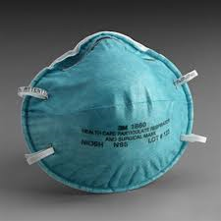
Precauciones de seguridad para personal de enfermería al administrar DPs
Use respirador si aerosol de DPs puedan generarse
Utilice Sistemas tipo Luer-Lok™ para asegurar la correcta conexión de las vías, jeringas y agujas
No cebe los preparados en gazas/pads, lavamanos o contenedores de basura
Ejecute los procedimientos bajo el nivel de los ojos
Desechar los implementas de administración IV y jeringas intactas para evitar generar contaminación durante la desconexión

Slide 40
Precauciones de seguridad para personal de enfermería al administrar DPs
Depositar todo equipamiento utilizado en la adminstración de DPs en contenedores apropiados
Remover los EEP para prevenir contaminación de manos y ropa
Deseche los EPP correctamente
NO colgar batas y reutilizarlas
Lavar las manos con abundante agua y jabón inmediatamente luego de sacarse los EPP
Notes:
Resources for training nurses administering HD
Appendix F. Hazardous Drug Administration Practicum for Nurses
Appendix G. Checklist for Safe Handling of Hazardous Drugs during Administration

Slide 41
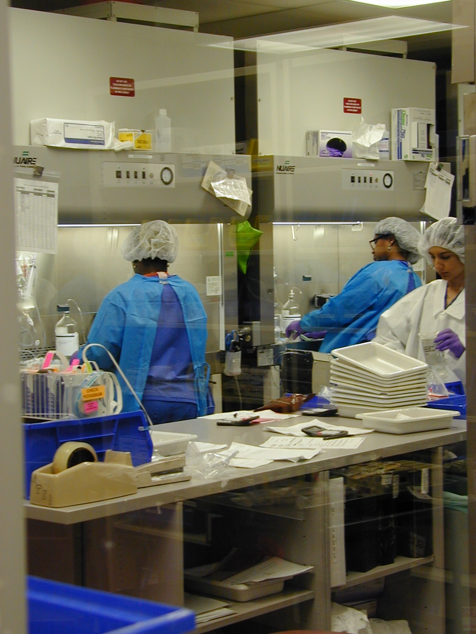
Parte 3: Técnicas para la preparación estéril de dosis de DPs

Slide 42
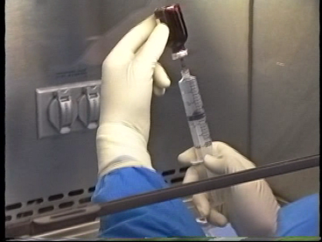
Técnica para la preparación estéril de DPs
Preparación de DPs requiere de:
  Esterilidad del preparado
  Protección del trabajador que prepara
Notes:
Compounding hazardous drugs (HD) requires precautions to maintain drug sterility
No drug residue as aerosol or spill is allowed out of the drug vial
Ampoules must be handled carefully to avoid either form of contamination and to prevent cuts or scrapes resulting from the sharp edges of the open ampoule.

Slide 43
Instrucciones generales para la preparación estéril de DPs (uso de EPP)
Lávese las manos antes de utilizar los EPP
Utilice EPP apropiados
Protección adecuada debe incluir: traje o bata impermeable a las DPs, doble par de guantes certificados, protección ocular, respirador N-95. En caso de preparar el producto en una zona abierta (sin cabina de seguridad biológica), utilice un cubre rostro de plástico
Limpie regularmente los guantes con una gaza estéril saturada con alcohol
Notes:
Wash hands before donning personal protective equipment (PPE)
Wear appropriate PPE
Full PPE includes a coated gown, double HD-tested gloves, eye protection, and an N-95 respirator plus face shield should be worn for compounding in the open
Clean gloves routinely by wiping with a sterile cloth saturated with alcohol.
Do not spray alcohol on contaminated gloves as that will transfer contamination to the environment and other surfaces.

Slide 44
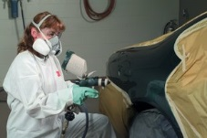
Instrucciones generales para la preparación estéril de DPs (uso de EPP)
Trabajador utilizando Elementos de Protección Personal
Protección ocular
Respirador
Bata
Guantes

Slide 45

Instrucciones generales para la preparación estéril de DPs (uso de EPP)
Video: Técnica con doble par de guantes y limpieza durante la preparación
Notes:
Two pairs of gloves should be worn, one under the cuff of the gown and one over the gown cuff

Slide 46
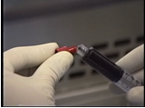
Instrucciones generales para la preparación estéril de DPs (uso de EPP)
Limpie los viales y ampollas con un paño húmedo desechable para remover la contaminación externa
Utilice jeringas que no deben ser llenadas con la DP más de tres cuartos de su capacidad
Seleccione agujas adecuadas para inserter en el vial y en la bolsa de suero
Utilice un Sistema de “locking cap”
cuando la jeringa es el contenedor
de la DP
Locking cap
Notes:
Wipe off all vials or ampoules of HD with a moist wiper to remove HD residue. Discard wiper in containment bag for appropriate disposal.
Select syringes that will be no more than three-quarters full when containing the partial or full drug dose.
Select needles of appropriate gauge and length for the vial and final container.
If the syringe is the final delivery device, select a locking cap for the syringe.

Slide 47
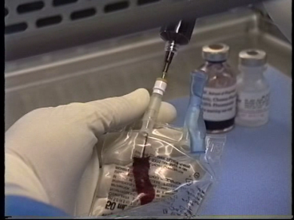
Instrucciones generales para la preparación estéril de DPs
Si la DP se depositará en bolsa de suero o botella, primero se debe instalar el set IV
Cebar el set IV con solución de la bolsa de suero o botella antes de adicionar la DP
Limpie el Puerto de inyección con un paño estéril empapado en alcohol. Deje secar
Notes:
If the dose is to be placed into an IV bag or bottle, select and prepare the container for injection of the HD dose by removing any outer wrap and spiking the bag/bottle with the appropriate IV set.
Prime the IV set with IV solution from the bag/bottle before adding HD to the final container.
Swab the injection port with a sterile alcohol wipe and allow the alcohol to dry.

Slide 48
Presión negativa
Video: Demostración del uso de la técnica de presión negativa para retitar el diluyente
Notes:
Only stringent aseptic technique maintaining negative pressure in the vial should be used

Slide 49
Presión negativa…
Ingrese aire dentro de la jeringa
Puncione el vial con la jeringa en un ángulo de 45 grados, invierta el vial
Mantenga la presión negativa para retirar el líquido diluyente
Permita que el flujo de aire se desplace desde la jeringa hacia el vial para compensar la presión negativa. No presione el émbolo de la jeringa
Si debe presionar el émbolo, hágalo cuidadosamente

Slide 50
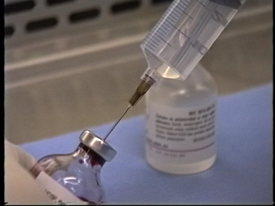
Reconstitución de DPs
Video: Adicionando diluyente al vial y homogenización
Notes:
Video demonstrates adding diluent to drug vial and mixing

Slide 51
Reconstitución de DPs
Adicione la cantidad exacta de diluyente en la jeringa
Posicione la jeringa con la aguja adecuadamente y alejada de usted
Inserte la aguja en 45 grados respecto del vial
Sitúe la jeringa perpendicular al vial y asegúrese de que la aguja está completamente inserta en el vial
Desplace el émbolo de la jeringa hacia atrás y aspire aire desde el vial, creando presión negativa en el vial
Permita que el diluyente se displace hacia el vial desde la jeringa (compensación de la presión negativa) sin presionar el émbolo
Si debe empujar el émbolo de la jeringa, hágalo lentamente

Slide 52
Remoción de la dosis desde el vial antes de remover la aguja
Video: Remoción segura de una dosis recosntituida a partir de un vial de dosis única
Notes:
If the entire vial is to be used immediately, and if the entire dose will fit into the one syringe, keep the needle fully in the vial.
Maintain negative pressure while removing drug.

Slide 53
Remoción de la dosis desde el vial antes de remover la aguja
Si el vial será utilizado completamente, mantenga la aguja totalmente inserta en el vial
Invierta el vial y retire el contenido tirando el émbolo dela jeringa para aspirar la solución con la DP mediante presión negativa en el vial
Esto causará que el aire de la jeringa fluya dentro del vial sin generar presión

Slide 54
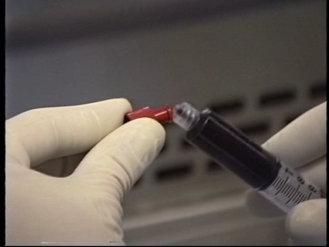
Si la dosis será administrada directamente al paciente desde la jeringa
Cubra la aguja con el dispositivo cubreaguja
Prepare el dispositivo para cubrir la jeringa
Sostenga la jeringa recta hacia arriba, remueva la aguja cuidadosamente y reemplácela por el dispositivo cubrejeringa
Locking syringe cap

Slide 55
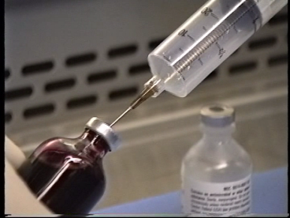
Remueva la aguja y la jeringa del vial sin remover la DP
Mueva la aguja hacia el cuello del vial (espacio con aire)
Tire del émbolo de la jeringa removiendo aire del vial (1-2 mL), esto creará una leve presión negativa en el vial
Esto permite que no queden restos de líquido en la aguja
Desplace la jeringa
hacia el espacio de aire

Slide 56
Remueva la aguja y la jeringa del vial sin remover la DP
Sujete la jeringa y el émbolo con una mano, y el vial con la otra. Cuidadosamente separe la jeringa con la aguja del vial. Esto genera una leve presión negativa en el vial
Elimine la jeringa y aguja en un contenedor adecuado para elementos cortopunzante

Slide 57
Adicionando la dosis de DP en la bolsa de suero o botella
Video: Técnica para adicionar la dosis de DP en la bolsa de suero o botella
Notes:
While these videos talk about “dye” that is because they were originally intended as training videos. The “dye” represents hazardous drugs.

Slide 58
Adicionando la dosis de DP en la bolsa de suero o botella
Limpie el sitio de inyección de la bolsa de suero. Adicione la DP en la bolsa.
Si la bolsa de suero tiene presión positiva, tire del émbolo de la jeringa una vez introducida en la bolsa. Luego empuje el émbolo para vaciar la jeringa
Elimine los residuos de la DP de la aguja succionando aire desde la bolsa de suero antes de retirar la jeringa con la aguja

Slide 59
Adicionando la dosis de DP en la bolsa de suero o botella
Una vez finalizado el proceso anterior;
  Limpie y selle el sitio de inyección de la bolsa de suero
  Quítese los guantes y reemplácelos por unos nuevos
  Limpie la bolsa de suero para remover los residuos de la DP

Slide 60
Tomando una dosis desde el vial reconstituido
Video: Técnica para tomar la dosis desde un vial reconstituido
Notes:
It is important to locate previous puncture and NOT use same puncture site

Slide 61
Tomando una dosis desde el vial reconstituido
Seleccione la jeringa, la cual no debería llenarse más de tres cuartos de su capacidad
Succione aire dentro de la jeringa (se necesita la misma cantidad de aire que de volumen de solución que será tomada del vial
Identifique la zona de punción previa en el vial
Inserte la aguja en 45 grados en una nueva zona de punción del vial
Repita los pasos descritos en la sección en al cual se utiliza presión negativa
Mantenga presión negativa mientras retira la aguja y jeringa desde el vial

Slide 62
Uso de un vial que contiene la DP líquida o en solución
Un vial que no ha sido utilizado puede contener presión neutral, positive o negativa. No se sabe hasta que se abre
Por lo tanto, succione aire en menor cantidad que el volumen de DP que se tomará
Se debe crear y mantener presión negativa en vial

Slide 63
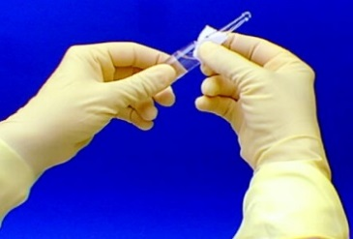
Trabajando con ampollas…
Ampollas son difícil de manejar, una vez abiertas no hay barrera para el líquido estéril
Evite la contaminación microbiana y el escape de DP al ambiente
Utilice respirador N95 y elemento cubre rostro cuando se manipula fuera de un cabina de seguridad biológica

Slide 64
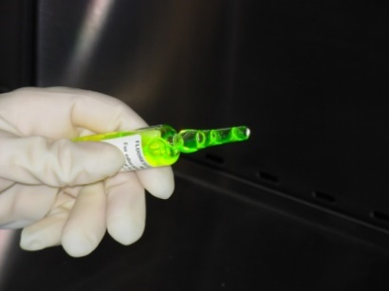
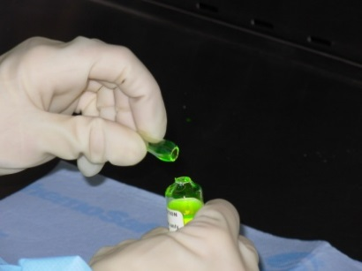
Trabajando con ampollas…
Video: Técnica para tomar la DP desde ampollas

Slide 65
Técnica para tomar la DP de una ampolla
Seleccione el filtro de aguja para usar con la ampolla. Utilícelo para tomar la DP desde la ampolla. Luego remueva y use una nueva aguja para inyectar la DP en el contenedor final
Ubique la ampolla en la superficie de trabajo. Limpie todo líquido del cuello de la ampolla con una gaza estéril y empapada en alcohol. Deje secar
Sostenga la ampolla levemente inclinada, sujete el extreme superior y quiebre la ampolla
Notes:
The use of the alcohol swab to wipe ampoule neck is to conserve drug sterility, not to decontaminate HD on outside of ampoule

Slide 66
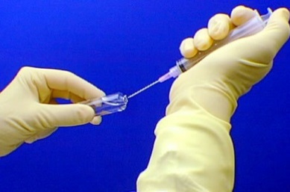
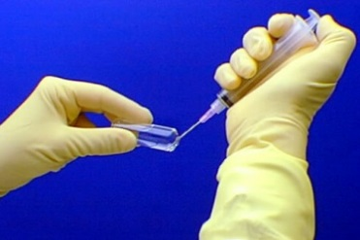
Trabajando con ampollas…
Video: Técnica para tomar la DP desde la ampolla utilizando filtro de aguja

Slide 67
Técnica para tomar al DP desde la ampolla utilizando filtro de aguja
Incline la ampolla e inserte la guja
Agujas cortas probablemente no llegan hasta el fondo de la ampolla. Incline la ampolla
Tire del émbolo de la jeringa para tomar el volumen deseado
Cubra la aguja con el dispositivo cubre aguja y luego retire la aguja
Inserte una nueva aguja en la jeringa si el contenido será depositado en un contenedor secundario
Remueva la aguja con filtro y tape la jeringa con el dispositivo cubre jeringa si la dosis será administrada directamente desde la jeringa
Deposite la ampolla en n contenedor sellado y deséchela en el contenedor de desechos peligrosos
Notes:
Recapping is not ideal, do so carefully

Slide 68
Conclusiones
La toxicidad de las DPs es bien conocida
El beneficio de utilizar quimioterapia es más importante que los efectos adversos para un paciente diagnosticado con cáncer
Trabajadores de la salud sólo se expone a los efectos adversos de las DPs
Existen guías acerca de promover el beneficio de la quimioterapia para los pacientes y asegurar la protección a laos trabajadores que manipulan DPs
Mientras el riesgo persista, y la vigilancia es aún necesaria, métodos más seguros han demostrado limitar el riesgo de exposición ocupacional a las DPs
Notes:
The toxicity of hazardous drugs has been well known since their initial clinical use
It has often been the toxic side effects of these drugs that have limited their therapeutic value
The risk-benefit equation for a cancer patient points to the appropriateness of their use for pts
These drugs present the same potential toxicities to exposed health care workers, that risk-benefit ratio is altered.
Guidance exists on how to balance the continued use of these drugs to benefit patients while ensuring the health of personnel administering them
It is important to recognize that while the risk remains, and our vigilance is still required, safer methods have been shown to limit exposure risk to workers handling these drugs

