Slide 1
An Overview of Occupational Hazards Found in Offices and the Impact of COVID-19
October 2020
Joanna Gaitens, PhD, MSN/MPH, RN
Marc Oliver, MBA, MPH, RN
Melissa McDiarmid, MD, MPH

Slide 2
About Us
Division of Occupational and Environmental Medicine, School of Medicine
PAHO/WHO Collaborating Center for Occupational Health since 2008
Primarily focused on protection of health workers
One term of reference is to support PAHO in the development of the workers’ health, safety, and well-being program

Slide 3
Interactive Exercises
To participate send the following message to 37607:
JOANNAGAITEN207
OR go to…..
PollEv.com/joannagaiten207
*Answers are anonymous!
**There will be more than one poll, so don’t delete text message or close your browser until the end of the presentation.

Slide 5
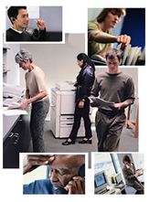
Objectives
Provide an overview of occupational hazards
Discuss how the current pandemic has ‘changed the office environment’ with emphasis on:
Ergonomic issues related to telework
Mental health stressors (work stress, work-life imbalance, social isolation, etc.)
Highlight specific tools to assess occupational hazards
Identify strategies to mitigate specific hazards, especially those enhanced by the current pandemic

Slide 6
Definition of a Hazard
An occupational hazard is any condition of a job that can harm a worker- physically or mentally.
Health is not merely the absence of disease or infirmity but a positive state of complete physical, mental and social well-being.
-WHO, 1986

Slide 7
Categories of Hazards
Physical
Involving forms of energy or having a mechanical or gravitational basis. (e.g., heat)
Psychosocial
Related to stress, the emotional reaction to the environment, or interpersonal relations.
Chemical
Biological
Produced through the action or reactions of chemical substances. (e.g., industrial cleaners)
Caused by living organisms or their products. (e.g., tuberculosis)

Slide 8
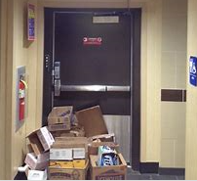
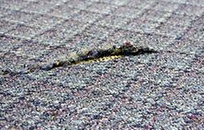
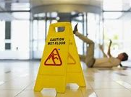
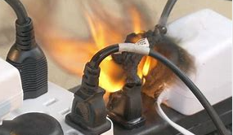
Physical Hazards in the Office
Examples of Physical Hazards
Trip hazards
Lack of emergency exit plan
Related Health and Safety Concerns
Injuries related to slips, trips, falls
Musculoskeletal disorders
Poorly designed workstations
Specific job tasks- repetitive motion
Headaches
Eyestrain
Burns
Electrical hazards
Office machines
Noise

Slide 9
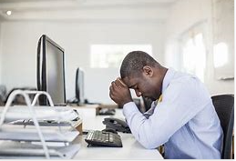
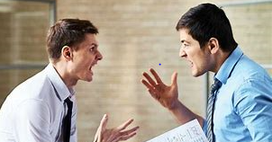
Psychosocial Hazards in the Office
Examples of Psychosocial Hazards
Excessive workload
Related Health and Safety Concerns
Stress leading to:
Anxiety, Depression
Headaches, Difficulty concentrating
Cardiovascular problems
Alcohol or drug abuse
Altered immune function
Burnout
Lack of control
Poor interpersonal relationships
Social isolation
Lack of career development
Home-work conflicts
Role ambiguity or conflict

Slide 10
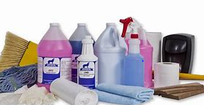
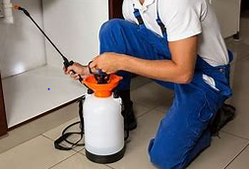
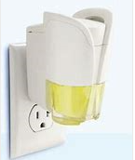
Chemical Hazards in the Office
Examples of Chemical Hazards
Cleaning products
Related Health and Safety Concerns
Irritation of skin, eyes, mucous membranes
Sensitization
Contact dermatitis
Respiratory symptoms
Perfumes, scents
Photocopier toner
Pesticides

Slide 11
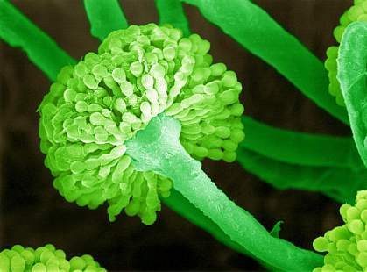
Biological Hazards in the Office
Examples of Biological Hazards
Infectious agents (TB, COVID-19)
Related Health and Safety Concerns
Respiratory illness and disease
Blood-borne diseases
Bacteria (Legionella), molds, fungi
Bedbugs
Eye, nose, throat irritation
Skin reactions
Common cold virus
Death

Slide 12
Indoor Air Pollutants

Slide 13
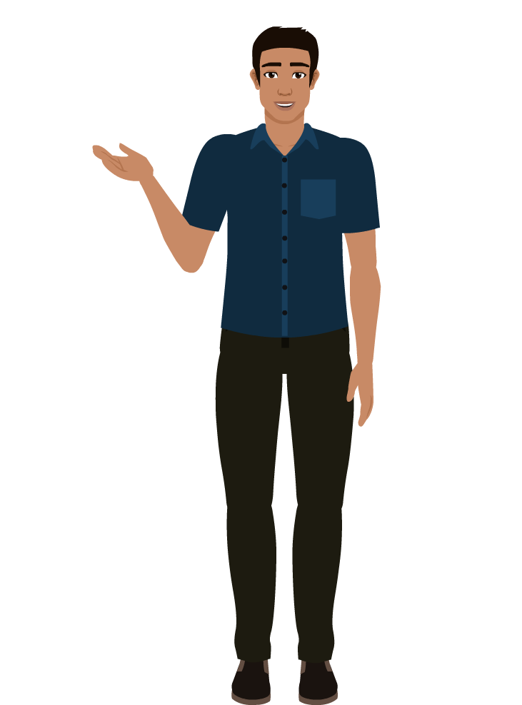
Methods for Identifying Hazards
Engage workers – listen to concerns, conduct survey
Review existing information:
Illness and injury reports
Product descriptions and Safety Data Sheets (SDS)
Conduct “Walk-through” or site survey
Understand the worker’s role and job tasks.
Notes:
A critical element of any effective safety and health program is a proactive, ongoing process to identify and assess hazards. Hazard identification is the foundation for a safe and healthy workplace, because you can’t implement effective strategies to mitigate the risk until you know what the hazards are.
There are number of different methods that can be used to identify hazards. One method involves communicating with the workers. Listen to their concerns, conduct a survey – I know PAHO did this several years to help identify concerns within the workplace.
Review available data – this includes reviewing illnesses and injury reports to gather details on potential workplace hazards as well as reviewing product safety data sheets. A safety data sheet, for those of you are aren’t familiar with them, includes information such as the properties of each chemical; the physical, health, and environmental health hazards; protective measures; and safety precautions for handling, storing, and transporting the chemical. It provides guidance for each specific chemical on things such as: Personal Protective Equipment (PPE), First aid procedures, and Spill clean-up procedures.
One of the most useful things is to do a periodic walkthroughs or sites surveys. It is most useful to use a checklist when doing this to help focus your attention and identify potential hazards. Throughout all of this, the most important thing is to understand the worker’s role and job task.

Slide 16
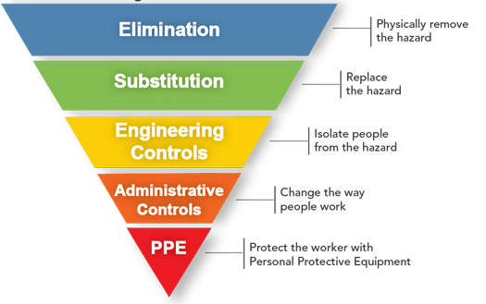
Hierarchy of Controls
Source: CDC

Slide 17
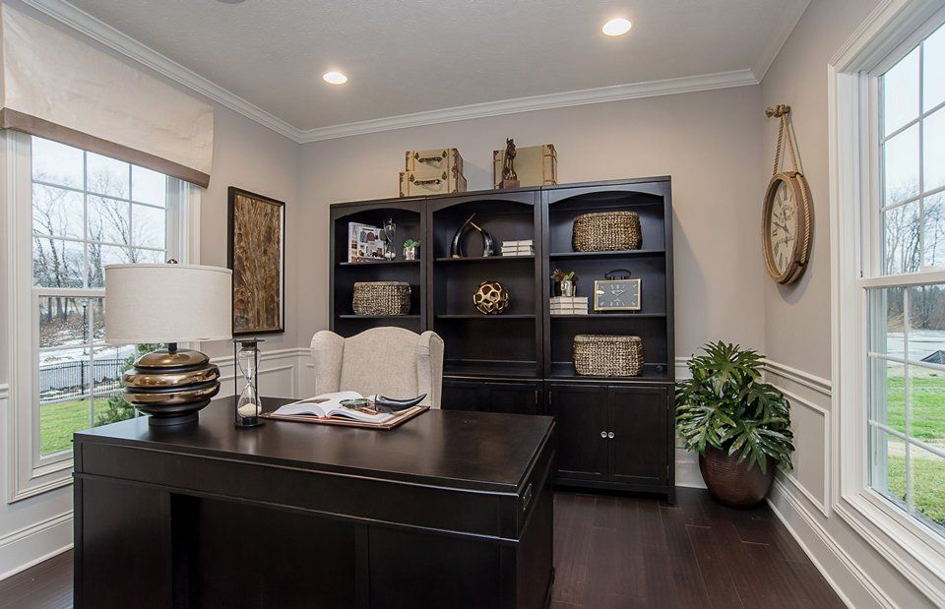
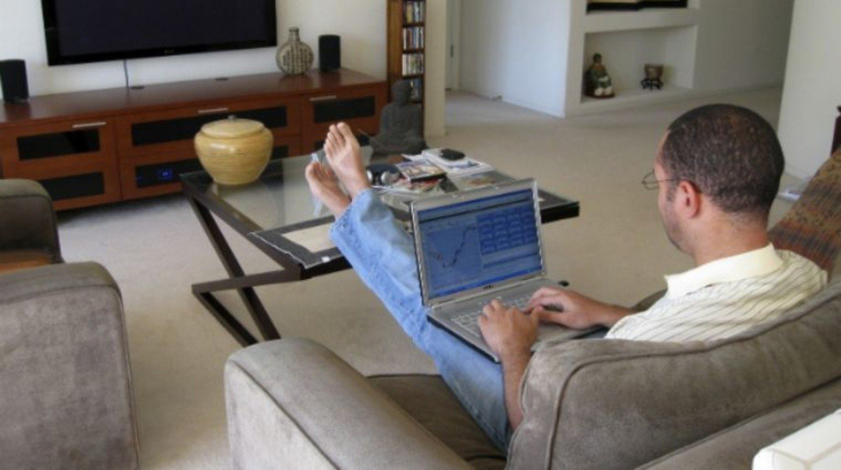
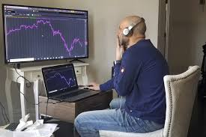
The ‘Office’ Now?
habitacional.com
laverdadnoticias.com
hbr.com
seattletimes.com

Slide 18
Ergonomics
The science of fitting the job to the worker.
Designs workstations, tools and work tasks for safety, efficiency and comfort.
Seeks to decrease fatigue and injuries, along with increasing comfort, productivity, job satisfaction and safety.

Slide 19
Musculoskeletal Disorders (MSDs)
Affect the muscles, nerves, blood vessels, ligaments and tendons
Common Work-related MSDs
Carpal Tunnel Syndrome
Herniated Discs
Bursitis
Tendinitis
Neck strain
Sciatica
Back strain
Source: NIH

Slide 20
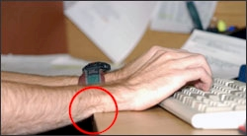
Risk Factors for Developing MSDs
Awkward or prolonged postures
Repetitive activities
Heavy lifting
Push or pull
Carrying
Gripping
Overhead work
Force
Vibration

Slide 21
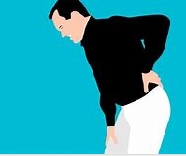
Signs that your workstation may not be working for you…
Upper back and neck comfort
Eyestrain, burning eyes, headache
Wrist and hand discomfort
Shoulder or elbow discomfort
Lower back discomfort
Muscle cramps, aches, or numbness in legs
Source: publicdomainpictures.net

Slide 22
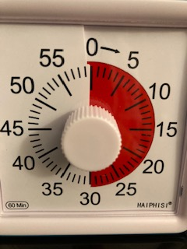
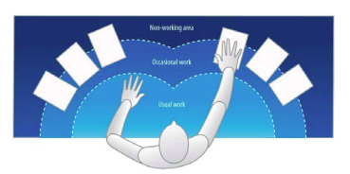
Controlling Ergonomic Hazards
Take breaks (every 30 minutes)
Pay attention to lighting!
Light perpendicular to workstation
Natural light when possible
Avoid glare
Make sure frequently used items are easy to reach

Slide 23
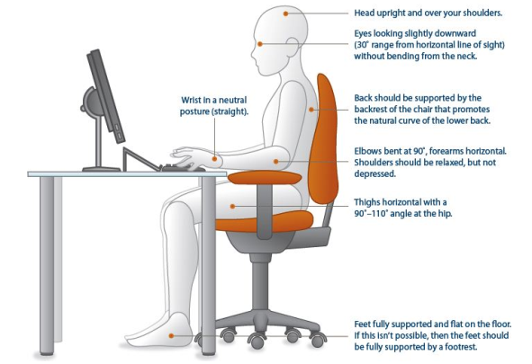
Source: NIH. Computer Workstation Ergonomics Self Assessment Checklist
Key factors:
Relaxed shoulders
Straight wrists
Supported lower back
Level head
Supported feet

Slide 24
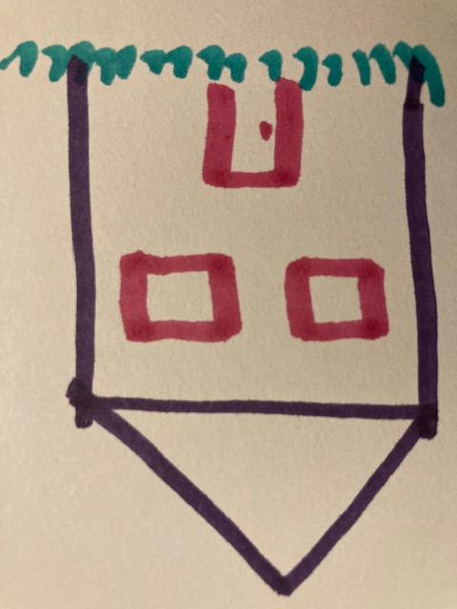
Creating a Workstation at Home
If possible, have a dedicated work area
Ensure proper lighting
Be creative with your workspace:
Work surface: hard, flat, sturdy, matte surface, with room underneath for legs
Ironing board?

Slide 25
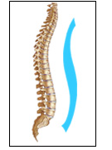
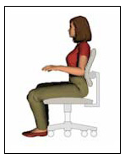
Creating a Workstation at Home – Selecting a Chair
How do you achieve this……………………….When all you have is this?
Possible solutions:
Use rolled up towels or pillows to support lower back
Add a cushion or pillow to raise the height
Use books or boxes as foot support if needed

Slide 26
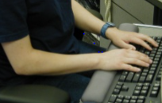
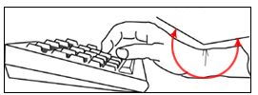
Maintaining Neutral Wrist Position at Home
How do can you achieve this ………….. When you have this?
Possible solution:
Use a rolled-up washcloths or small towel for a palm rest

Slide 27
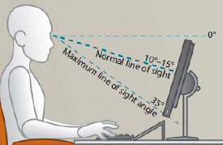
Maintaining a level head
How do can you achieve this ………….. When you have this?
Possible solutions:
Use external keyboard or external monitor
Use books to raise height of monitor
Notes:
Ideally the top of your computer monitor should be close to eye level so that your eyes are looking slightly downward when looking at the screen, but your neck is straight – you are not bending it. The problem is this hard to do when working when from a laptop. Unfortunately the solution often requires purchasing of additional equipment. Either an external keyboard or an external monitor so that the monitor can be raised to the proper height.

Slide 28
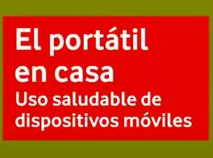
Resource-1
Simple video on ‘laptop office ergonomics- basic tips’ at home
https://youtu.be/ZLwIP8cBaWA

Slide 29
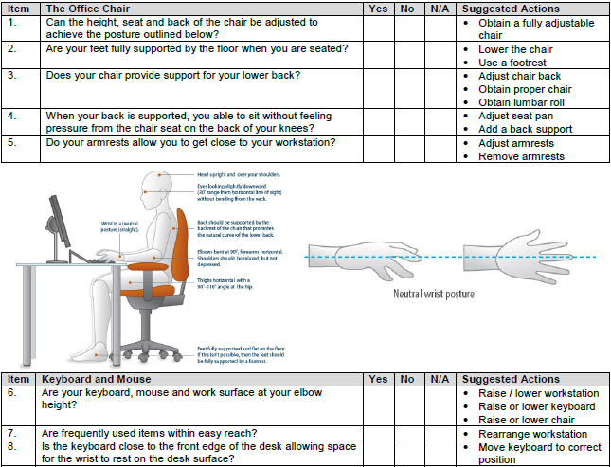
Resource-2
National Institutes of Health
Computer Workstation Ergonomics:
Self-Assessment Checklist
https://www.ors.od.nih.gov/sr/dohs/Documents/Computer%20Workstation%20Ergonomics%20Self%20Assessment%20Checklist.pdf

Slide 30
Resource -3
OSHA’s Computer Workstation Checklist
https://www.osha.gov/SLTC/etools/computerworkstations/checklist_evaluation.html

Slide 31
Time for a Stretch Break
https://www.cdc.gov/workplacehealthpromotion/initiatives/resource-center/pdf/Workplace-Physical-Activity-Break-Guide-508.pdf

Slide 32
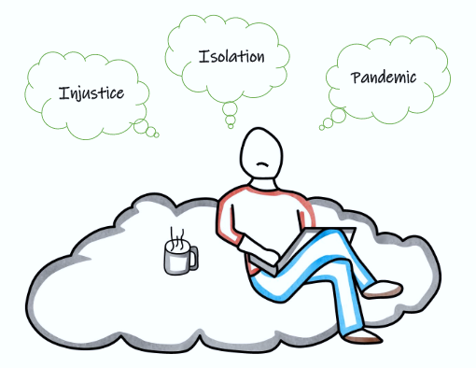
Creating a healthy workplace in the time of COVID-19
That discomfort you’re feeling is grief

Slide 33
Establishing a Healthy Workplace

Slide 34
Principles
WHO/PAHO Resources & NIOSH Total Worker Health Resource
Emphasizing Management Commitment and Worker Participation
Developing COVID-19 specific interventions NOT recycling old generic tools and approaches
Seeing Healthy Work climate as key to achieving Organizational goals

Slide 35
Workplace health climate
Definition: Employee perceptions of active support from upper management, supervisors and coworkers for the physical and psychological wellbeing of employees. (Zweber, 2016)
This climate stems from observations about what behaviors get rewarded and supported on the job. (Schwatka et al., 2018)
Leadership plays an important role in creating a positive work environment around health. (Shore et al., 2020)

Slide 37
Stress, fear and anxiety
To develop effective approaches provide:
Array of input & feedback channels
Rapid training with access to experts, acknowledge novel challenges
Essential needs: transportation, psychological 1st aid for insomnia, anxiety
Lodging if apart from families; food, childcare, check-ins, paid time off for quarantine

Slide 38
Expert Advice for Telework
Set up an organized and quiet workplace, embrace “distractions” that cannot be avoided
Establish buy-in from everyone, focus on the benefits of virtual meetings, workshops or labs
Ensure everyone is familiar with the technology, communicate ground rules; provide fast support to solve technical issues
Schedule compact sessions, use breakout sessions, frequently check-in with colleagues, schedule breaks
Encourage video calls, socialize with colleagues and leaders to avoid a social disconnect
Support employees to maintain an appropriate work-life balance

Slide 39
Revitalize Resilience to Create a Healthy Workplace
Accentuate the positive, strengthen communal bonds to restore confidence.
Create uplifting moments- (begin by acknowledging loss).
Help people to help. Helping others is a great way to improve well-being and reduce stress.
Build community rebuild a sense of belonging based on shared values, norms, and habits.

Slide 40
Practice with Case Studies
Based on what we have presented so far, you will now apply your understanding
Evaluate the behavior and attitudes of the following examples to create a health climate that facilitates a healthy workplace
Add details that represent your experience
Using the following activity suggestions, you will break into small groups and
Brainstorm together, identify a notetaker and report on the group’s evaluation

Slide 41
Activities for breakout sessions
Review:
Communications related to COVID 19 response
Changed organizational expectations including telework , flexible schedules, etc,
Promoting a health climate which prioritizes worker emotional, physical and information needs
Access to resilience/support resources & services for issues including anxiety, insomnia, home work set-up

Slide 42
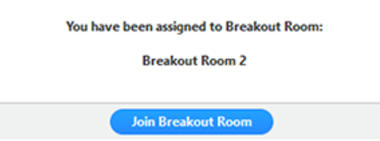
Breakout Session Logistics
There will be two groups: Manager or Employee scenario.
You are already assigned to a group.
You will receive an electronic prompt on your screen asking you to join a group when it is time.
Groups will have 15 minutes to review the case scenario.
We will then reconvene as a large group to discuss each scenario.
Be sure to leave the BREAKOUT room, NOT the meeting!

Slide 43
Breakout Session 1-Mid-level manager in an International Organization
He checks in on employees 3-4 times a day
He imposes schedules which conflict with individual time constraints without consulting affected employees
When a worker expresses concerns about insomnia, he implies that personal issues shouldn’t interfere with work
When asked for adjustment in schedules or deadlines, he replies we must focus on getting the job done even though organizational policy mandates flexibility
During staff daily Zoom meetings, he thanks staff for their efforts during a difficult time

Slide 44
Breakout Session 2 – Unit Worker in an International Organization
She is having difficulty working at home: interruptions/time management problems due to online education of children, taking care of cohabiting relatives, insomnia
She feels uncomfortable talking about problems with manager, he only seems concerned with getting the work done and emails late at night
She is concerned about when and how she will be expected to start working in the office and potential exposure to coworkers and taking the infection home

Slide 45
Conclusion
Is anything in these scenarios familiar?
Do you see some first steps the Health, Safety and Wellbeing Committee taking as a result of your reflections?
We are available to help as you move forward in creating a Healthy Work Climate based on Management Commitment and Worker Participation

Slide 46
References
Ergonomics
YouTube video: https://youtu.be/ZLwIP8cBaWA
NIH Workstation Checklist: https://www.ors.od.nih.gov/sr/dohs/Documents/Computer%20Workstation%20Ergonomics%20Self%20Assessment%20Checklist.pdf
OSHA Workstation Evaluation Checklist: https://www.osha.gov/SLTC/etools/computerworkstations/checklist_evaluation.html
Physical Activity Work Breaks
https://www.cdc.gov/workplacehealthpromotion/initiatives/resource-center/pdf/Workplace-Physical-Activity-Break-Guide-508.pdf

Slide 47
Psychosocial Resources
Burke MJ, & Signal SM (2010). Workplace safety: A multilevel, interdisciplinary perspective In Liao H, Martocchio J, & Joshi A (Eds.), Research in Personnel and Human Resources Management (Vol. 29, pp. 1–47): Emerald Group Publishing Limited.
Deloitte. Remote Collaboration - Facing the challenges of COVID-19. 2020. https://www2.deloitte.com/content/dam/Deloitte/de/Documents/human-capital/Remote-Collaboration-COVID-19.pdf
Great Place to Work. COVID-19: The Right Way To Survey Employees During A Crisis 2020. https://www.greatplacetowork.com/resources/blog/how-to-survey-employees-during-a-crisis
Gonzalez A, Cervoni C, Lochner M, Marangio J, Stanley C, Marriott S. Supporting health care workers during the COVID-19 pandemic: Mental health support initiatives and lessons learned from an academic medical center. Psychol Trauma. 2020;12(S1):S168-S170. doi:10.1037/tra0000893
Mendy A, Stewart ML, VanAkin K. A leader’s guide: Communicating with teams, stakeholders, and communities during COVID-19. McKinsey and Company: Organizational Practice. 2020. https://www.mckinsey.com/business-functions/organization/our-insights/a-leaders-guide-communicating-with-teams-stakeholders-and-communities-during-covid-19
Rangachari P, L Woods J. Preserving Organizational Resilience, Patient Safety, and Staff Retention during COVID-19 Requires a Holistic Consideration of the Psychological Safety of Healthcare Workers. Int J Environ Res Public Health. 2020;17(12):4267. Published 2020 Jun 15. doi:10.3390/ijerph17124267
Schwatka NV, Tenney L, Dally MJ, et al. Small business Total Worker Health: A conceptual and methodological approach to facilitating organizational change. Occup Health Sci. 2018;2(1):25-41. doi:10.1007/s41542-018-0013-9
Schwatka NV, Dally M, Tenney L, Shore E, Brown CE, Newman LS. Total Worker Health Leadership and Business Strategies Are Related to Safety and Health Climates in Small Business. Int J Environ Res Public Health. 2020;17(6):2142. Published 2020 Mar 24. doi:10.3390/ijerph17062142
Shanafelt T, Ripp J, Trockel M. Understanding and addressing sources of anxiety among health care professionals during the COVID-19 pandemic. JAMA 2020.
Shore E, Schwatka N, Dally M, Brown CE, Tenney L, Newman LS. Small Business Employees' Perceptions of Leadership Are Associated With Safety and Health Climates and Their Own Behaviors. J Occup Environ Med. 2020;62(2):156-162. doi:10.1097/JOM.0000000000001789

