Slide 1
Tracking Employee Exposures to COVID-19
Marianne Cloeren, MD, MPH
Division of Occupational & Environmental Medicine
mcloeren@som.umaryland.edu

Slide 2
Acknowledgement
We acknowledge the support of the University of Maryland, Baltimore, Institute for Clinical & Translational Research (ICTR) and the National Center for Advancing Translational Sciences (NCATS) Clinical Translational Science Award (CTSA) grant number 1UL1TR003098.

Slide 3
Secure web application for online surveys and databases
Developed by Vanderbilt University and shared with the world
Designed to support online or offline data capture for research studies and operations
The REDCap Consortium - a vast support network of collaborators
Academic institutions and non-profit organizations share management

Slide 4
The UMB COVID-19 Employee Tracking System in REDCap
Employee COVID-19 Exposure Tracking in REDCap
No Symptoms --> Exposure Report
Symptom Monitoring
Quarantine Decision Based on Risk
Symptoms --> Illness Report
COVID-19 Test Negative
COVID-19 Test Postive
Contact Tracing
Symptom Monitoring & Return to Work Planning
Daily Symptom Monitoring
If Symptoms --> Illness Report
Isolate & Test (If Not Yet Tested)
If Symptoms --> Illness Report
Return to Work Planning

Slide 5
The UMB COVID-19 Employee Tracking System in REDCap
Employee COVID-19 Exposure Tracking in REDCap
No Symptoms --> Exposure Report
Symptom Monitoring
Quarantine Decision Based on Risk
Symptoms --> Illness Report
COVID-19 Test Negative
COVID-19 Test Postive
Contact Tracing
Symptom Monitoring & Return to Work Planning
Daily Symptom Monitoring
If Symptoms --> Illness Report
Isolate & Test (If Not Yet Tested)
If Symptoms --> Illness Report
Return to Work Planning
Employee enters information about exposure event – colleague at work, home/ community, patient encounter
Employee health reviews information, interviews if necessary, determines risk, triggers written notification with symptom monitoring plan and decision about quarantine or return to work
Push notifications twice a day to employee to complete symptom report
If symptoms reported, flag to employee health
Employee is directed to complete illness report and moves to illness path and decisions

Slide 6
The UMB COVID-19 Employee Tracking System in REDCap
Employee COVID-19 Exposure Tracking in REDCap
No Symptoms --> Exposure Report
Symptom Monitoring
Quarantine Decision Based on Risk
Symptoms --> Illness Report
COVID-19 Test Negative
COVID-19 Test Postive
Contact Tracing
Symptom Monitoring & Return to Work Planning
Daily Symptom Monitoring
If Symptoms --> Illness Report
Isolate & Test (If Not Yet Tested)
If Symptoms --> Illness Report
Symptom Monitoring & Return to Work Planning
If employee is already having symptoms, completes information about symptoms, onset, testing completed and results, last time at work
Employee health reviews and decides on isolation plan, facilitates access to testing if not already done
Pathway branches depending on results of COVID-19 testing
System pushes reminders to employee to monitor and report symptoms twice a day
Return to work plan is based on symptom improvement and COVID-19 status

Slide 7
The UMB COVID-19 Employee Tracking System in REDCap
Employee COVID-19 Exposure Tracking in REDCap
No Symptoms --> Exposure Report
Symptom Monitoring
Quarantine Decision Based on Risk
Symptoms --> Illness Report
COVID-19 Test Negative
COVID-19 Test Postive
Contact Tracing
Symptom Monitoring & Return to Work Planning
Daily Symptom Monitoring
If Symptoms --> Illness Report
Isolate & Test (If Not Yet Tested)
If Symptoms --> Illness Report
Symptom Monitoring & Return to Work Planning
If COVID-19 positive, we can trigger a self-report on contacts to support contact tracing
Isolation period is longer, and related to days since last fever

Slide 8
The UMB COVID-19 Employee Tracking System in REDCap
Employee COVID-19 Exposure Tracking in REDCap
No Symptoms --> Exposure Report
Symptom Monitoring
Quarantine Decision Based on Risk
Symptoms --> Illness Report
COVID-19 Test Negative
COVID-19 Test Postive
Contact Tracing
Symptom Monitoring & Return to Work Planning
Daily Symptom Monitoring
If Symptoms --> Illness Report
Isolate & Test (If Not Yet Tested)
If Symptoms --> Illness Report
Return to Work Planning
Future feature in build
Tracking daily symptoms of frontline employees reporting to work

Slide 9
Exposure report
Option 1

Slide 10
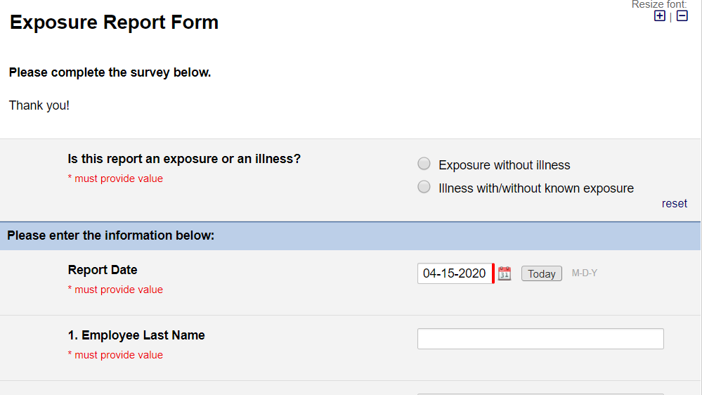
Cloeren
And additional contact info…

Slide 11
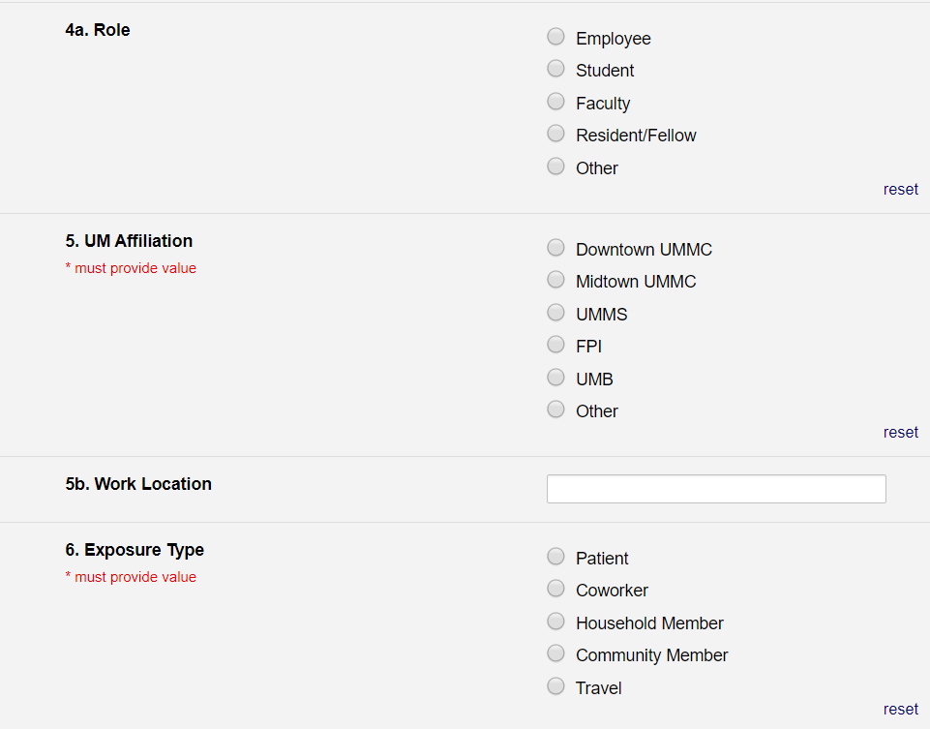
Family Medicine

Slide 12
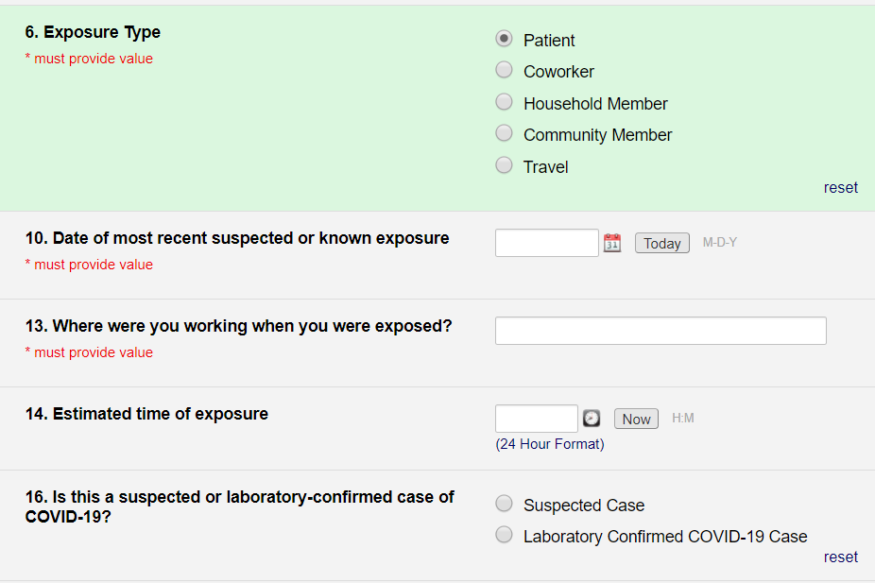
04/15/2020
Exam room B
11:00

Slide 13
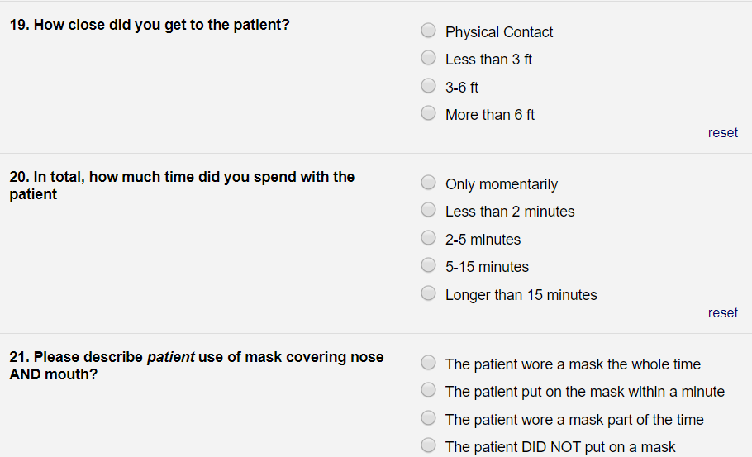

Slide 14
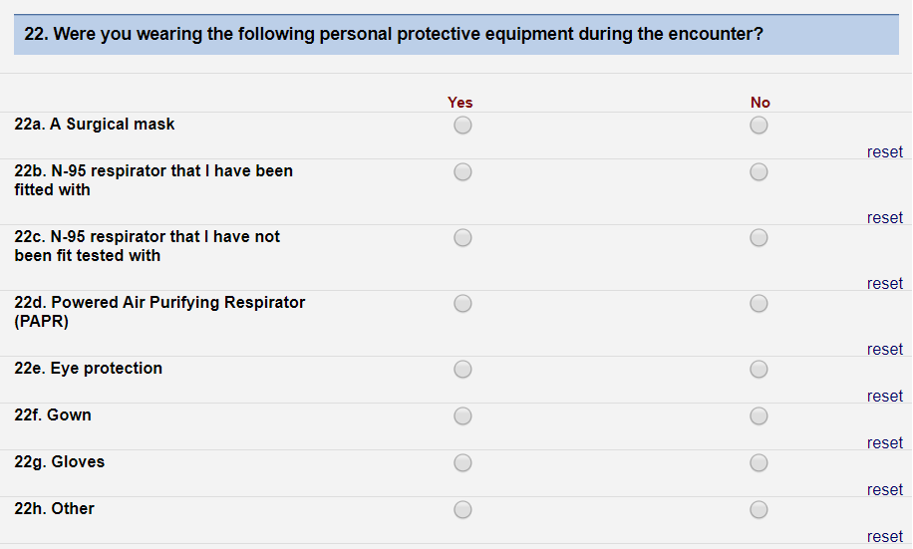

Slide 15
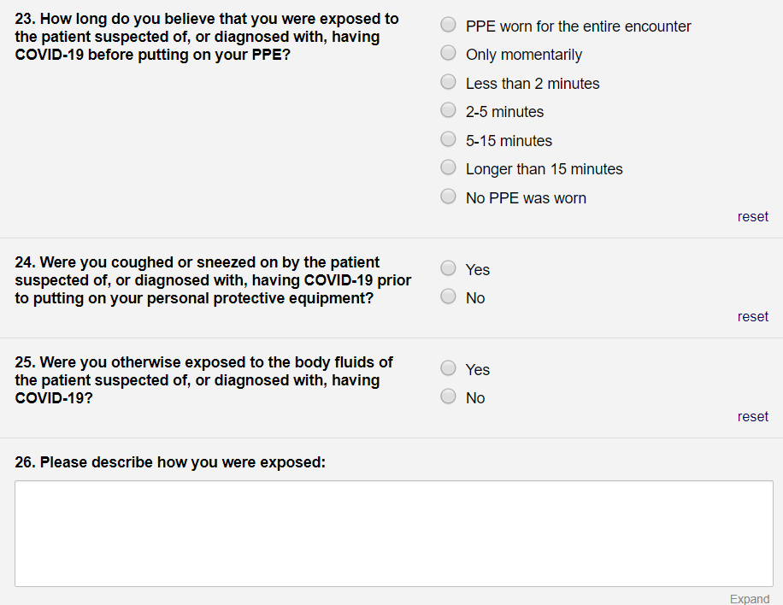
Evaluating a patient for possible COVID-19. Coughed on me while getting specimen.

Slide 16
Assessment of Risk and Plan
Employee health reviews, interviews employee if needed
Determines risk
Establishes plan for
Symptom monitoring
Return to work vs. quarantine (work at home)
Timelines
Sends communication via REDCap with recommendations

Slide 17
Symptom monitoring
Follow-up

Slide 18
Symptom Monitoring
Automated prompts to measure temperature and document symptoms twice a day
Email notification
Can be sent via phone
Logs responses
Tracks missed responses
Flags abnormal responses for employee health attention

Slide 19
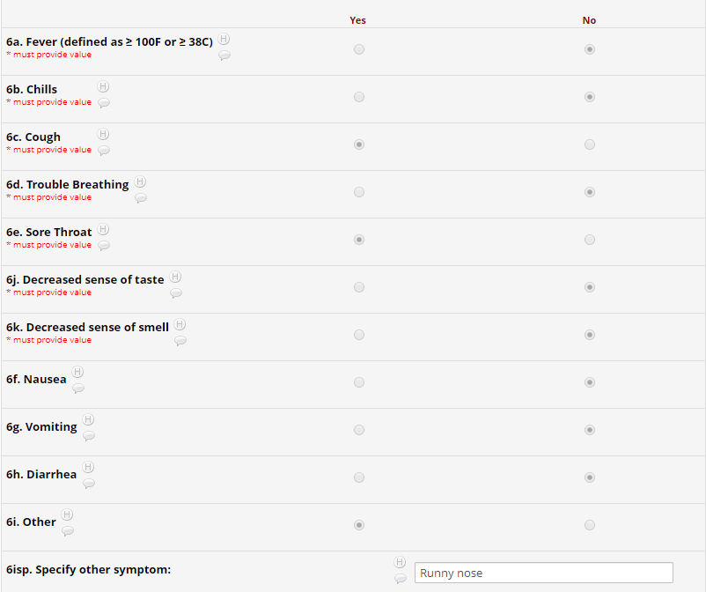
Symptom Monitoring Form Completed by Exposed Employee Twice a Day
Employee Health notified by e-mail (“flag”) if any fever or positive symptom during post-exposure monitoring
Illness developing during post-exposure symptom monitoring triggers prompt to report illness

Slide 20
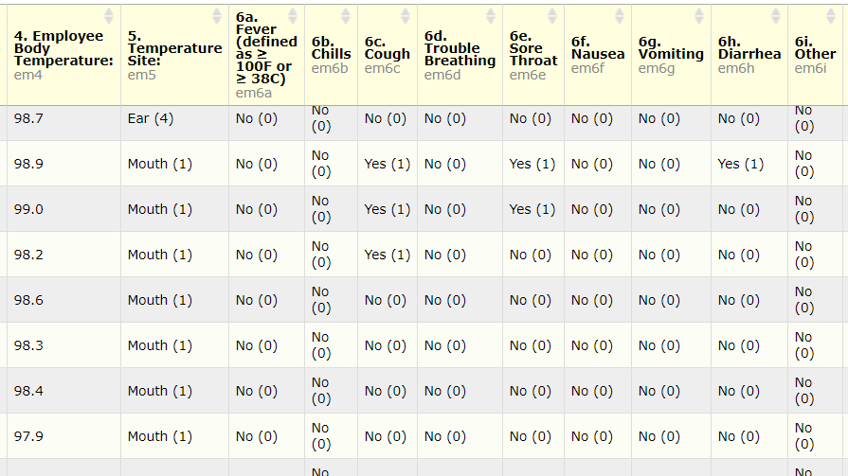
Dashboard views to review aggregate employee data
Flexible report options - customizable

Slide 21
Illness report
Option 2

Slide 22
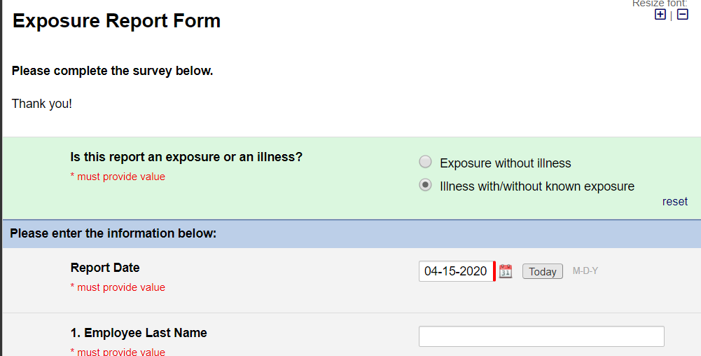
Additional contact info…
Cloeren

Slide 23
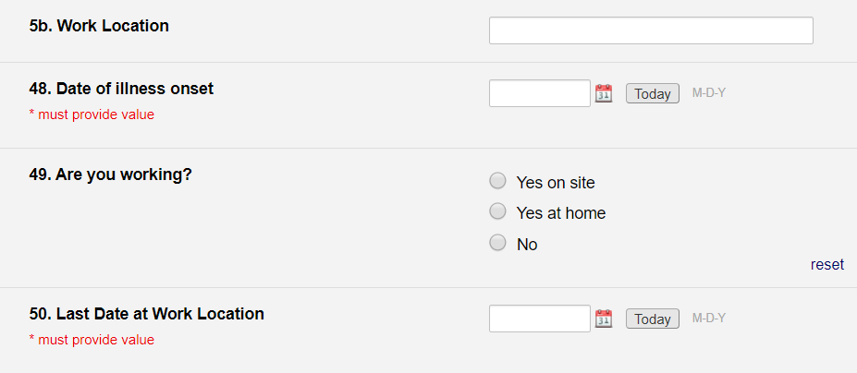
Working While Sick?
Family Medicine
04/06/2020
04/09/2020

Slide 24
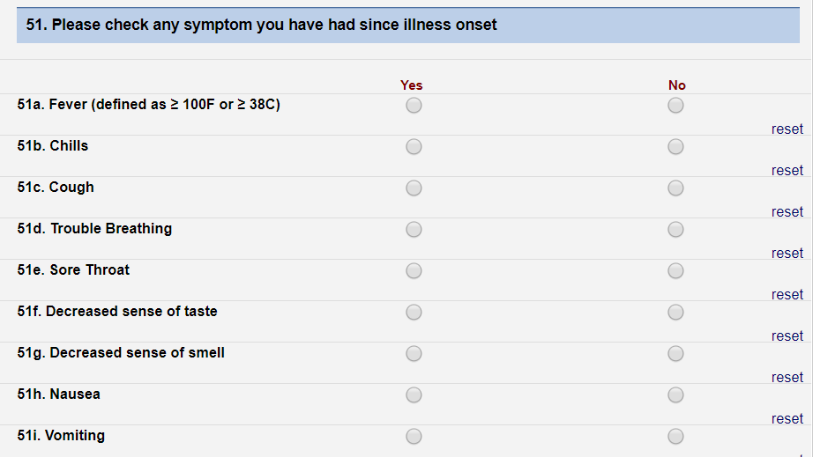
…

Slide 25
Fever History and Known Exposures
102.3
04/12/2020

Slide 26
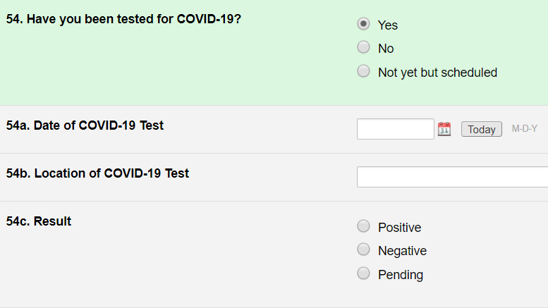
04/09/2020
UMB Urgent Care

Slide 27
Assessment & Plan
Healthcare worker who worked for 3 days while sick
Tested positive
Common story
Plan:
Isolate until 10 days fever free
Contact tracing

Slide 28
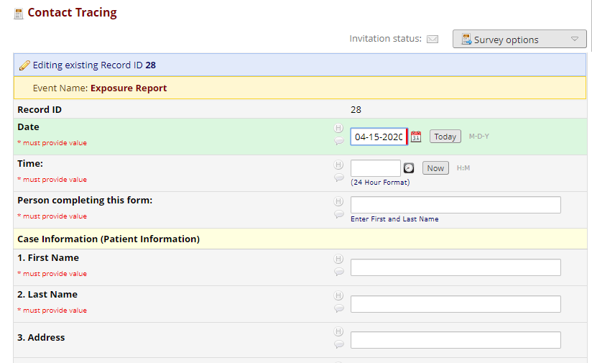
13:00
Marianne Cloeren
Marianne
Cloeren

Slide 29
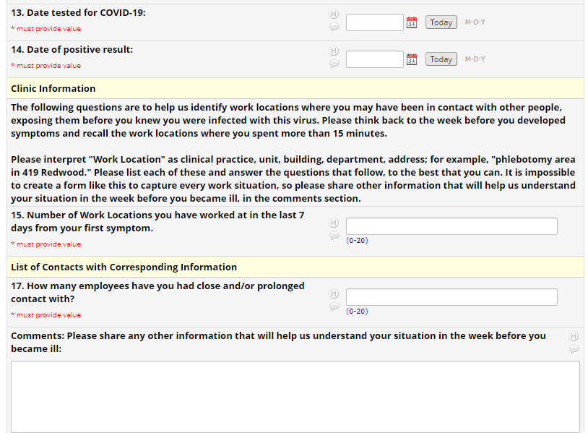
04/09/2020
04/11/2020
1
2
Working closely with occupational health nurses to don and doff PPE for training videos

Slide 30
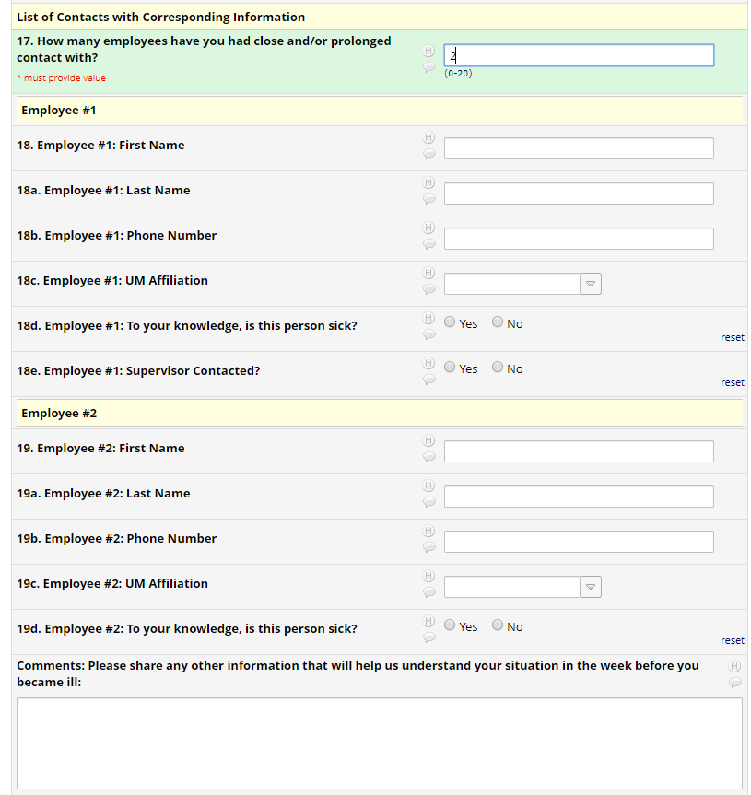

Slide 31
The UMB COVID-19 Employee Tracking System in REDCap Used to track COVID-19 employs exposures and illnesses on campus Current features and potential uses
REDCap Exposure Report
Triggers 14-day post-exposure symptom monitoring
REDCap COVID-19 Illness or Diagnosis Report
Employee completes to document COVID-19 consistent illness, test results
14-day recovery symptom monitoring for planning return to work
REDCap Daily Symptom Monitoring (in build)
Push notifications, positive symptom flags, missed report options
Templated guidance on other resources next steps if symptoms
Surveillance for front-line clinicians and employees returning to campus
Push notifications, positive symptom flags and missed reports; templated guidance
Link sent to employees reporting exposures or identified via contact tracing
Push notifications and missed reports; templated guidance on self-isolation
Contact tracing report to document last time at work and employee contacts
Opportunities for collaboration?

