Slide 1
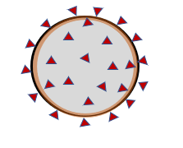
Resources for Employees Coping with COVID-19
A product of the UMMC Employee Wellness Committee and the UMSOM Division of Occupational and Environmental Medicine
11/04/2021

Slide 2







Support
Mindfulness & Meditation
Wellness Resources for Employees Coping with COVID-19
Virtual Arts Experiences
Podcasts & Courses
Exercise at Home
Articles on Coping
Readings

Slide 3




Other Mental Health Resources
Support Services
7 Cups
Free Emotional Support 24/7
Employee Assistance Program (EAP)
667-214-1555

Slide 4
Mental Health Resources
SAMHSA’s Disaster Distress Helpline – 1-800-985-5990 or text TalkWithUs to 66746 to connect with a trained crisis counselor. Provides 24/7, 365 days a year crisis counseling and support to people experiencing emotional distress
Suicide Prevention Resource Center – There are a lot of wonderful resources here! It’s more than suicide prevention. http://www.sprc.org/news/resources-support-mental-health-coping-coronavirus-covid-19
Anxiety and Depression Association of America - https://adaa.org/finding-help/coronavirus-anxiety-helpful-resources
NAMI CoVID Support blog - https://www.nami.org/Blogs/NAMI-Blog/March-2020/Coronavirus-Mental-Health-Coping-Strategies
Addiction-Specific Support Resources
Baltimore Intergroup Council of AA - Links to phone/video conferenced AA meetings in the area:
https://mailchi.mp/eaaefa9190f1/covid19announcement3162020-2591525.
More info is also available on their main website, https://baltimoreaa.org/.
Maryland Coalition of Families - AA, NA, and GA (Gamblers Anonymous) resources on their site:
http://www.mdcoalition.org/blog/resources-for-recovery-supports.

Slide 5


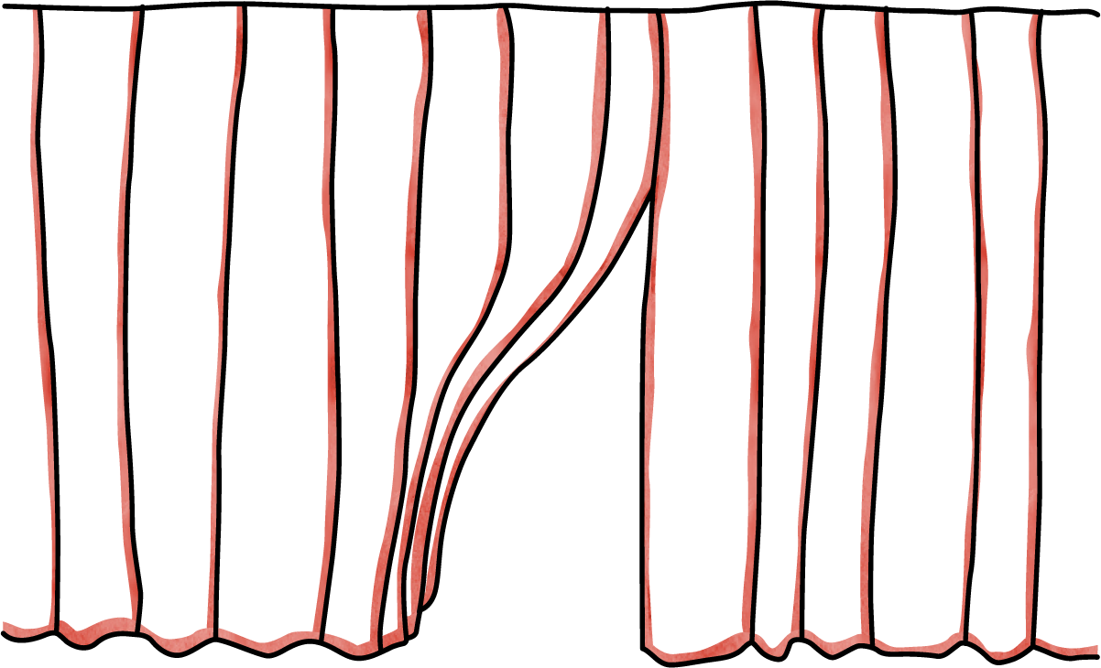

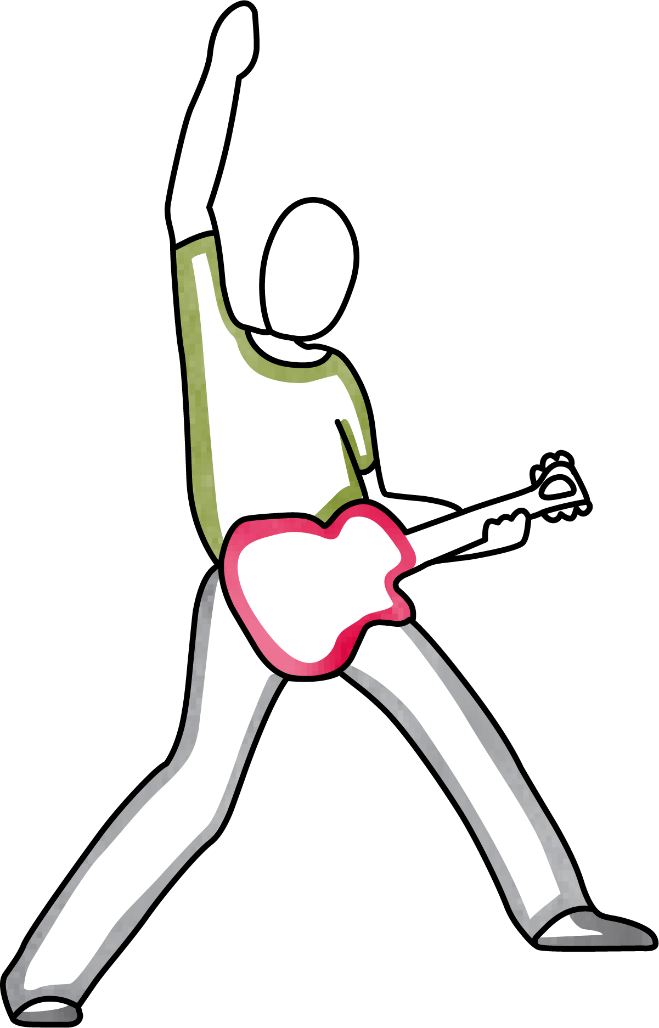

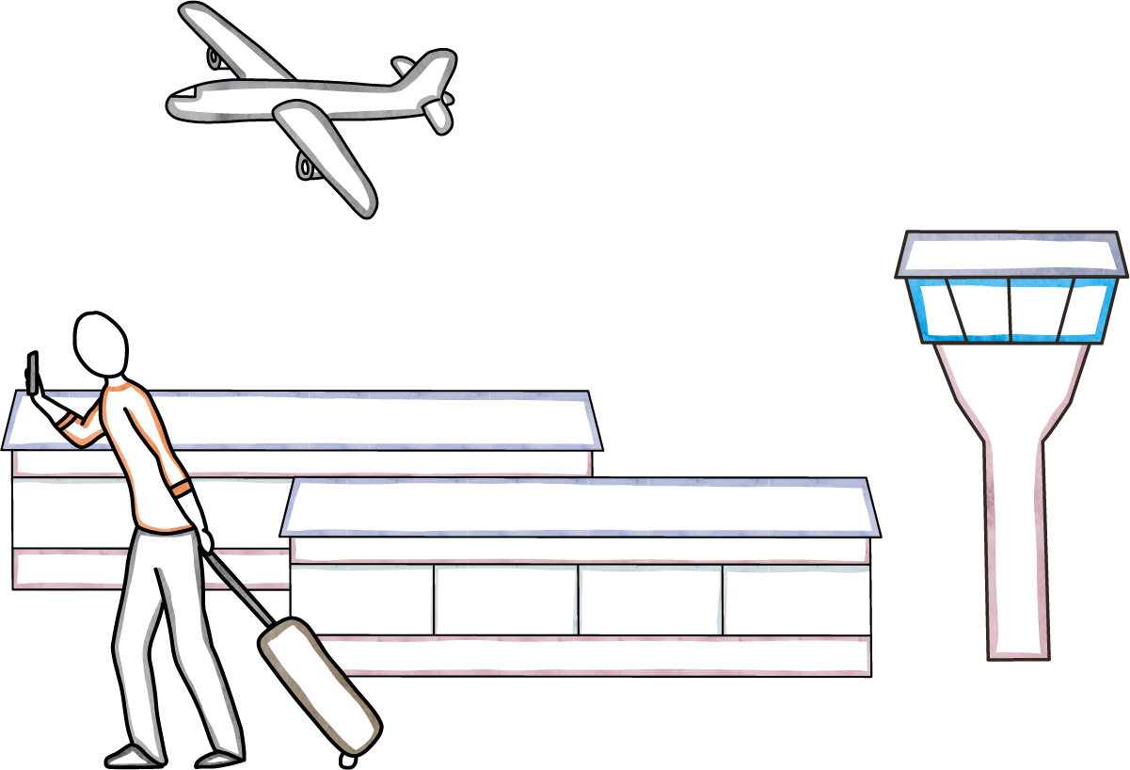

Virtual Arts Experiences
Met Free Opera
NPR Tiny Desk Concerts
Virtual Travel
Virtual Museum Tours

Slide 6

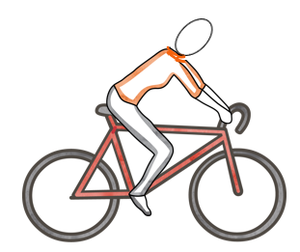
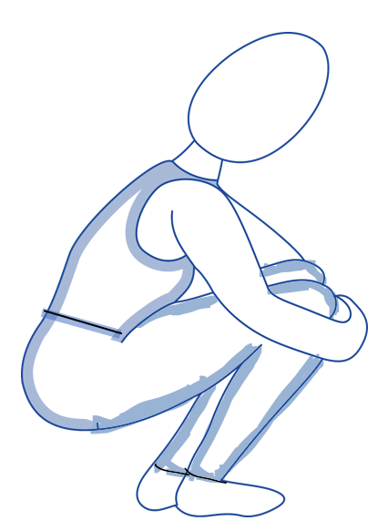


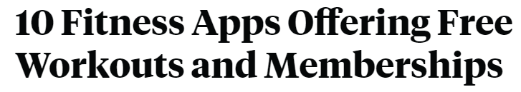
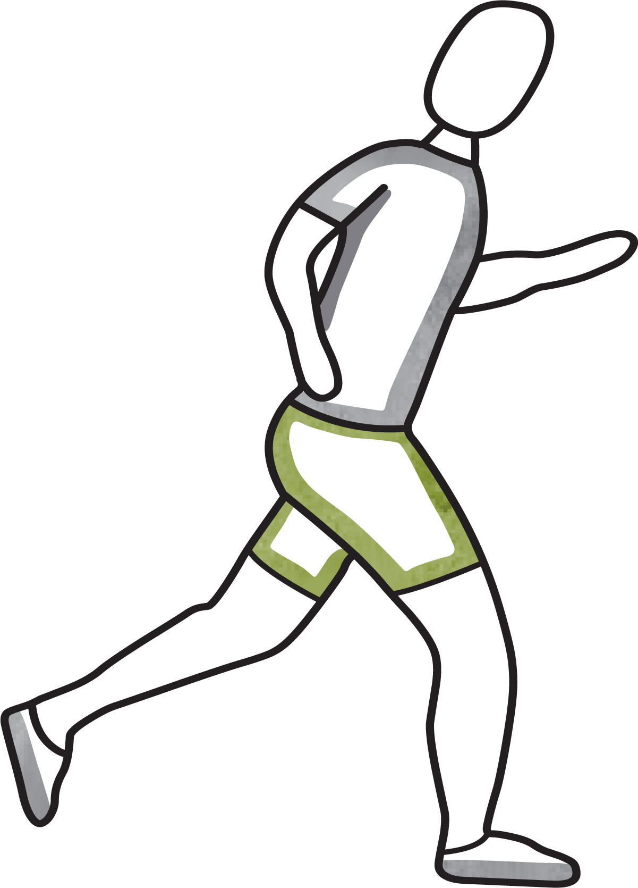
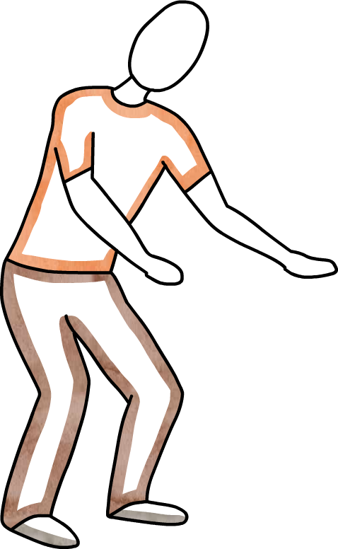


Exercise at Home
Online Fitness Classes
Free Fitness Apps
Peloton app
Obé Fitness Live and On Demand (Subscription)
Les Mills on Demand

Slide 7



Mindfulness and Meditation
Now free for healthcare providers
Live guided meditation practice
Pre-shift yoga flow video
Free coronavirus sanity guide

Slide 8




Podcasts and Courses
The Happiness Lab Podcast
How to make stress your friend
Yale Course
The Science of Well-Being

Slide 9

Thoughtful Articles about Coping with COVID-19
That Discomfort You’re Feeling Is Grief
Supporting Clinicians during the COVID-19 Pandemic
Pre-Traumatic Stress Disorder

