Slide 1
Fostering your Enterprise
Rajshree Agarwal
Rudolph Lamone Chair & Professor of Strategy & Entrepreneurship
Director, Ed Snider Center for Enterprise and Markets
Maryland Smith School of Business

Slide 2
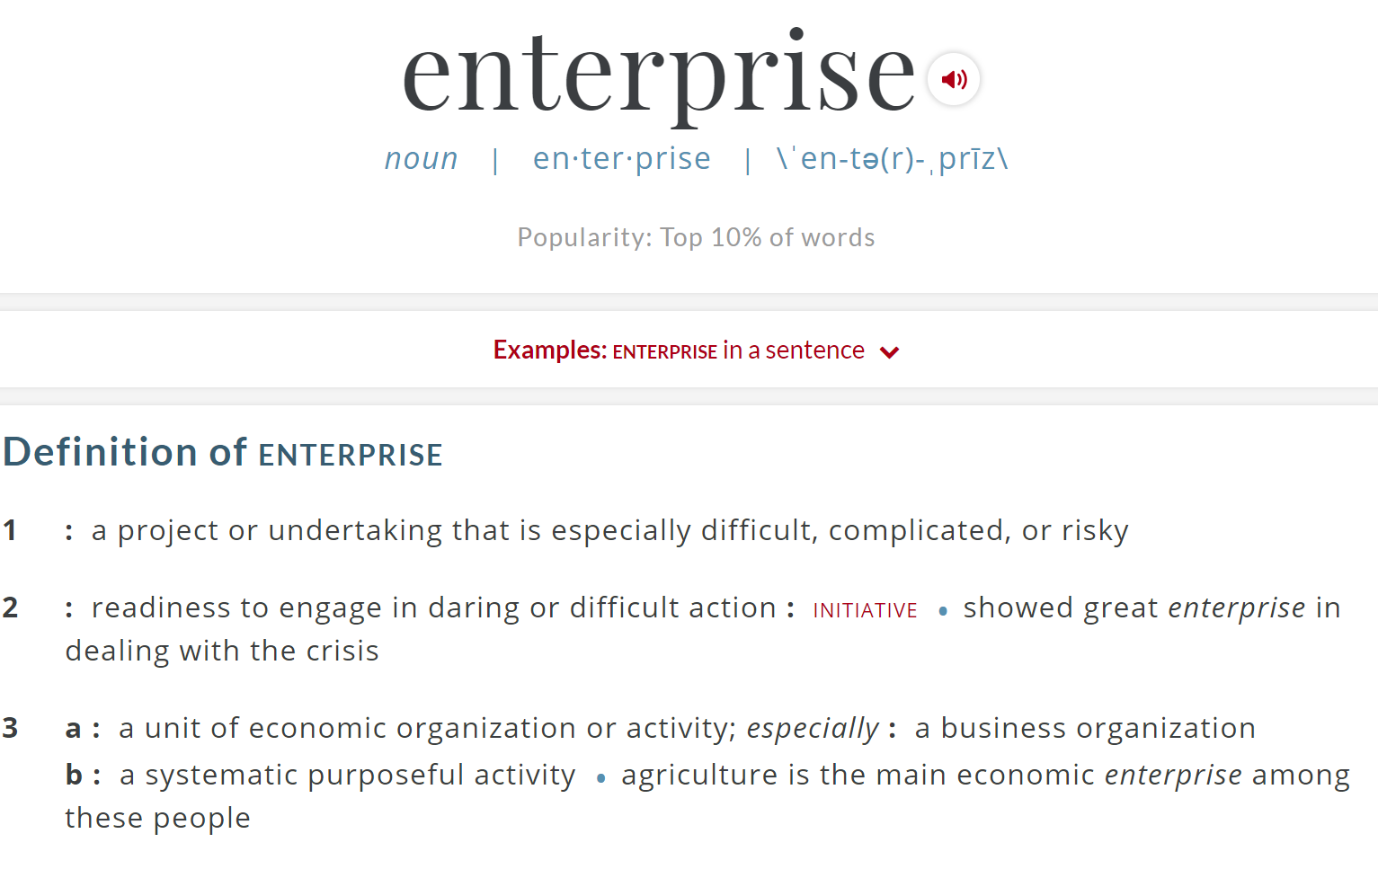
Notes:
Here, the script needs to show that the dictionary defines enterprise in two ways, and so should we. You need to think in terms of being a CEO of “Me. Inc”, and also being enterprising.

Slide 3
Me, Inc.
I am the CEO

Slide 4
Are you thinking like a CEO?
What is my purpose or mission statement?
What does success look like for me?
What is my value proposition?
With whom should I trade?

Slide 5
What is MY purpose or mission statement?

Slide 6
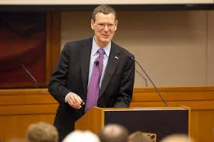
Solving problems deeply meaningful to you…
Making the world a better place to live…
…by doing something important for yourself!
John Allison
Notes:
What is my purpose/mission? : To further the vision that social progress is born of free and creative individuals who, driven by self motivation, passion and a positive approach to trading value for value, make the world a better place.

Slide 7
What does success look like to ME?
(in say five years)

Slide 8
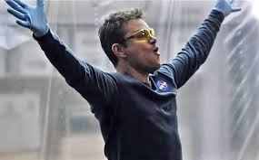
Success...
I love what I do, and I am very good at it!
“Mark Whatney” in the Martian
Notes:
Success for me: To create new knowledge and develop educational programs that empower lifelong learners, from high school through professional contexts.

Slide 9
Ability and Aspiration
A hobby
A “Calling!!”
Aspiration
(what you love)
Misery?
Just another job
Ability (what you are good at)

Slide 10
What is MY value proposition?
(in say five years)

Slide 11
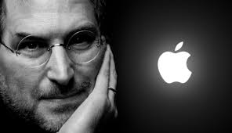
Value…
I don’t think its good that we’re perceived as different.
I think its important we’re perceived as much better.
If being different is essential to [being better], then we have to do that.
Steve Jobs

Slide 12
The “feature-benefit” matrix
Cogs in a wheel, easily replaceable
Indispensable!
How does it benefit the “consumer”
Undistinguished and Unemployed
You are the Belle/Prince of the Ball, but no-one is coming to your party!
What is unique about your abilities
Notes:
What is my feature-benefit matrix: Integrate research, teaching and engagement to create unique programs that cater to the needs of the innovative and entrepreneurial spirit, and which provide the skills, savvy and moral ground for the producer and value creator.

Slide 13
With whom should I trade?

Slide 14
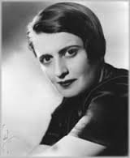
The trader principle
A trader…does not treat men as masters or slaves, but as independent equals. He deals with men by means of a free, voluntary, exchange—an exchange which benefits both parties by their own independent judgment.
Ayn Rand

Slide 15
Voluntary relationships
LOSE-WIN
WIN-WIN
Benefit to the other
(making the world a better place)
LOSE-LOSE
WIN-LOSE
Benefit to you ( what you love or is important to you)
Notes:
With whom do I trade?: I trade with like-minded people, who are drawn to the positive vision that free and creative individuals are driven to excel, and in trading value for value, make the world a better place. I trade with people who create the virtuous spiral between ability and aspiration, in themselves and in others.

Slide 16
Enterprising Ability and Aspiration
Making the world a better place, by doing something important for yourself
Loving what you do, and being very good at it
Creating unique features in yourself that provide value in trade
Seeking win-win relationships: collaboration, not competition is the hallmark of trade

Slide 17
You and the organization you choose to associate with…
Organizations are made of individuals with
  Different goals
  Different skills
  Different beliefs
These differences are unified by a common purpose, which is achieved through
  Specialization
  Coordination
  Governance

Slide 18
A Trader’s Sudoku: Bringing it all together
Me
You
Aspiration (Motives)
What am I pursuing?
How does it fit in my values/mission?
Aspiration (Motives)
What are you pursuing?
How does it fit into your values/mission?
Common Objective
What are we trying to accomplish together?
CapAbility
What do I bring to the table?
CapAbility
What do you bring to the table?
Action
What am I going to do?
Action
What are you going to do?
Adapted from Kendall Justiniano, STRIVE, 2015

Slide 19
Key Takeaways
We can foster our entrepreneurial spirit by
  Creating a virtuous spiral between our aspirations and ability, optimizing on our feature-benefits, and ensuring win-win outcomes through trade
Seek to align purpose with people you trade with, both within the organizations you associate with, and in society at large
  Seek win-win relationships, else you will end up in a lose-lose!

Slide 20
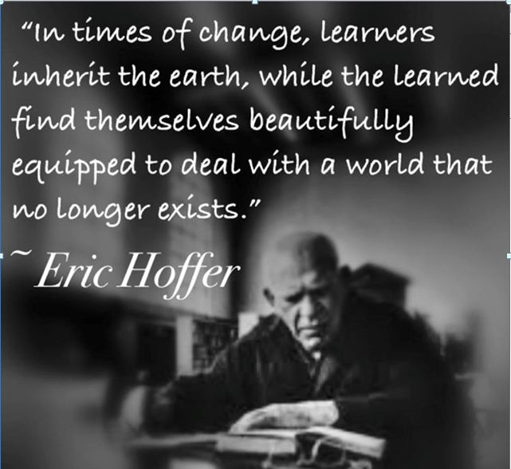
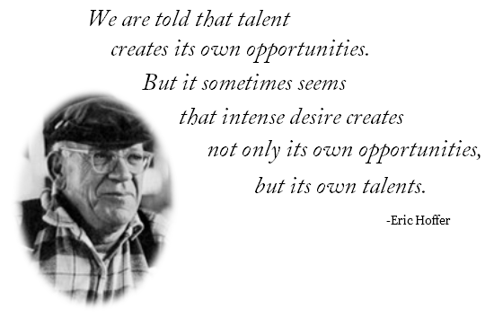
Aspiration
Ability

Slide 21
Books you may enjoy reading and learning from…
Allison, John. The Leadership Crisis and the Free Market Cure
Clear, James. Atomic Habits
Newport, Cal. Deep Work
Koch, Charles. Good Profit

